Slide 1
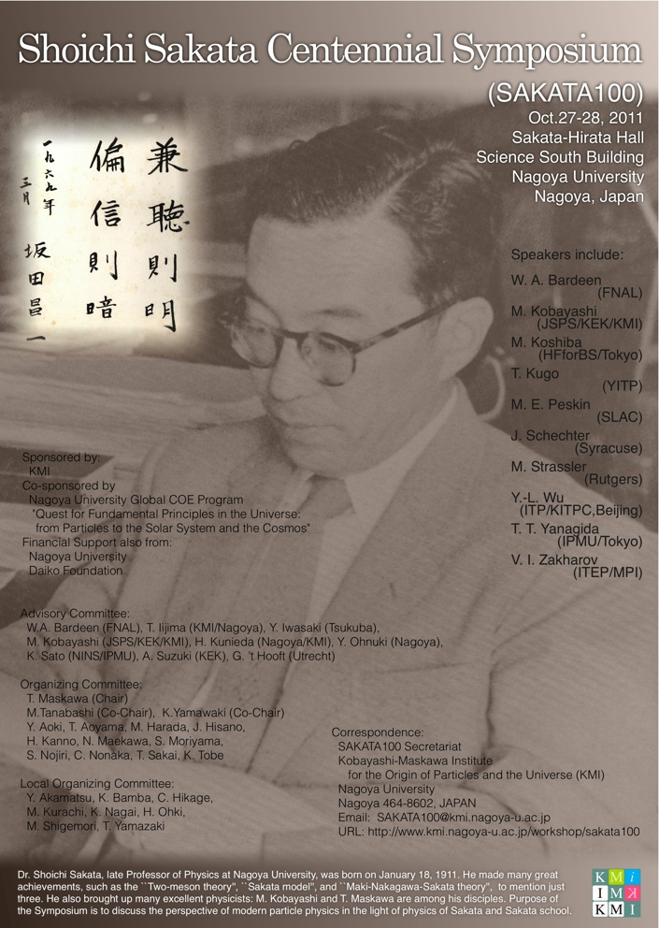

Slide 2
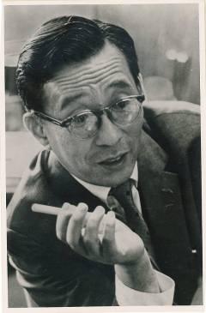
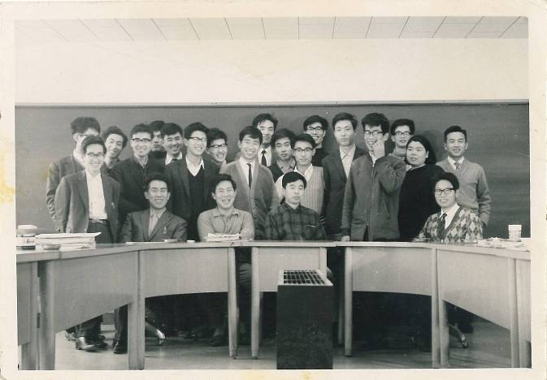
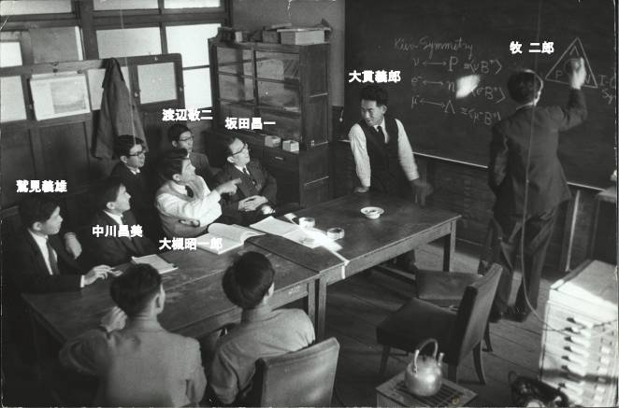
Purpose of this symposium
To discuss the perspective of modern particle physics in the light of physics of Sakata and Sakata school.

Slide 3
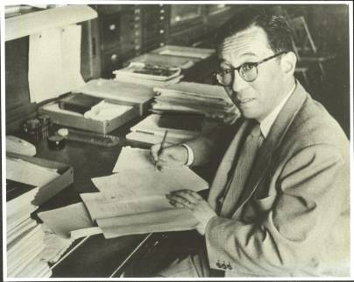
Shoichi Sakata: His Life and Physics Collections of Sakata Memorial Archival Library (SMAL)
Masaharu Tanabashi
Department of Physics, Nagoya University
and
Kobayashi-Maskawa Institute, Nagoya University

Slide 4
What is SMAL (Sakata Memorial Archival Library)?
I plan to introduce Sakata’s achievements by using SMAL archived documents
Department of Physics decided to preserve Sakata’s former office (Building-B, 4th Floor) in 1973, after the death of Sakata in 1970.
The SMAL committee was established in 1986 to put into order and to preserve various materials relating to Sakata’s achievements, as well as historical materials of Department of Physics.
The SMAL was operated under the supervision of the SMAL committee chaired by S.Ogawa, Y.Ohnuki, M.Yasuno, and then M. Aramaki (1986—2000).
It became difficult to maintain the committee system and the SMAL committee was dissolved around 2000.
Persons in charge after 2000 include A.I. Sanda, K. Yamashita, S. Sato, K. Yamawaki, and M. Tanabashi (2008~)

Slide 5
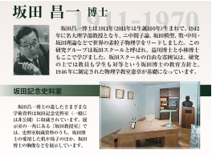
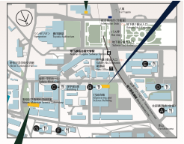
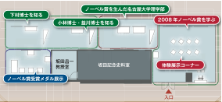
Now, SMAL is located at
2008 Nobel Prize Exhibition Gallery
SMAL was forced to move out from
Building-B due to its anti-quake
reinforcement. It is now located at a
corner of 2008 Nobel Prize Exhibition
Gallery (2nd Floor, ES-building, Nagoya U.).
Several research materials of Sakata
are exhibited in the Gallery.
SMAL

Slide 6
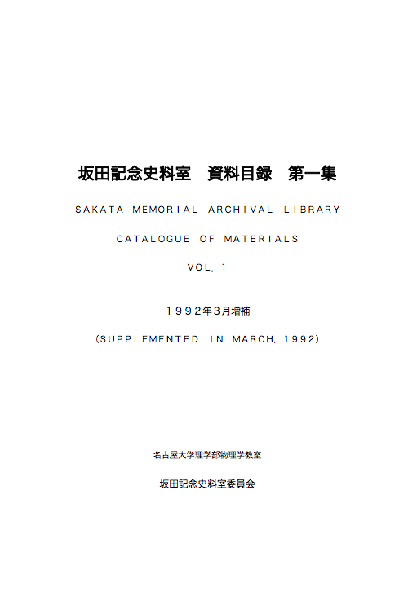
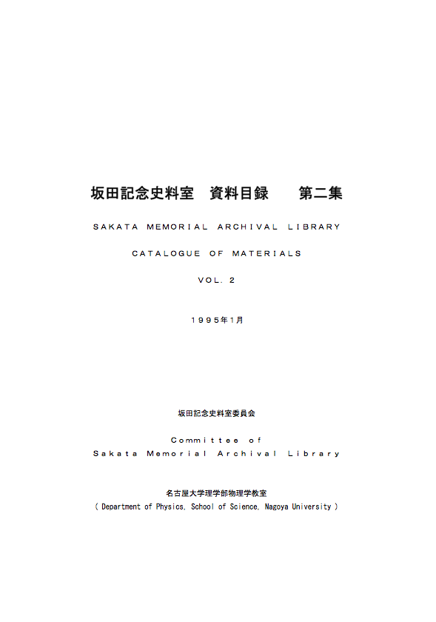
SMAL Catalogues (digitized by T.Nishitani in PDF)
CD-R in your conference bag

Slide 7
Brief Chronological Record of Shoichi Sakata’s Career
1911: Born on Jan. 18, 1911. The name “Shoichi” was given by Taro Katsura (Prime Minister, Japan), for whom Shoichi’s father Mikita served as a secretary.
1930: Entered physics course, Kyoto Imperial University
1933: Wrote a graduation thesis on theoretical study of nucleus, under the suggestion by H.Yukawa.
1933: Research associate at Nishina Lab. In collaboration with Y. Nishina and S. Tomonaga, Sakata studied the electron pair creation by gamma ray.
1934: Assistant professor of Yukawa’s group at Osaka Imperial University.
1937: In collaboration with H. Yukawa, Sakata wrote a paper of meson theory (the second paper of a series of Yukawa’s meson theory papers). He also advocated the necessity of neutral Yukawa’s meson (pi0).
1939: Moved to Kyoto Imperial University with H. Yukawa.
1940: Sakata and Tanikawa made prediction of pi0 -> gamma, gamma
1942: Sakata and Inoue advocated “two-meson theory”
1942: Appointed Professor of Nagoya Imperial University.
1946: Developed the C-meson theory with O. Hara.
1946: Took initiative in reconstructing the Physics Department according to democracy principle.

Slide 8
Brief Chronological Record of Shoichi Sakata’s Career
1949: Member of the Science Council of Japan at its start
1951: Applicability of the renormalization theory (Sakata, Umezawa and Kamefuchi).
1954: Stayed at Bohr Institute in Copenhagen half a year.
1955: The Sakata Model
1956: Attended the meeting of World Peace Council held at Stockholm.
1957: Chairman of the Committee of Atomic Energy Problem and also of the Special Committee of Nuclear Physics in Science Council of Japan
1958: Attended the 3rd Pugwash Conference
1961: Proposed “Nagoya Model” with Z.Maki, M.Nakagawa and Y.Ohnuki
1962: “New Nagoya Model” paper with Z.Maki and M. Nakagawa, in which the possibility of neutrino mixing (MNS mixing) was described.
1964: Attended Peking Symposium of Science as the head of Japanese delegation
1966: Dean of Faculty of Science, Nagoya University
1967: Attended Solvey Conference at Brussel
1968: Got ill and hospitalized for the first time.
1970: Passed away on October 16.

Slide 9
Sakata’s Achievements in Physics

Slide 10
Developments in Yukawa’s meson theory
Sakata was the most important collaborator of H.Yukawa
in his developments of meson theory explaining nuclear force

Slide 11
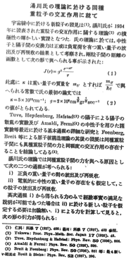
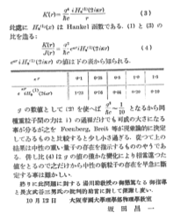
Necessity of
1937: In collaboration with H. Yukawa, Sakata wrote a paper of meson theory (the second paper of a series of Yukawa’s meson theory papers). He also advocated the necessity of neutral meson (now known as ).
“On the Interaction of Elementary Particles II”, H.Yukawa and S.Sakata,
Proc.Phys.-Math. Soc. Japan, 19 (1937).
“On the Interaction between Identical Heavy Particles in Yukawa’s theory”,
(in Japanese), Kagaku, Nov. 1937 p533
(SMAL archive)

Slide 12
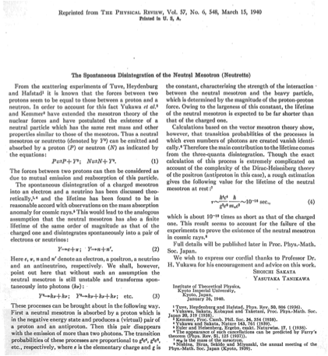
photons
1940: Sakata and Tanikawa made prediction of the decay process PR 37(1940) 548
photons
In the paper, they also estimated the life time
which remarkably agrees with the correct value we know now.
c.f.
W.A.Bardeen’s talk at pnL50, PTP suppl. 167 (2007) 44.

Slide 13
2nd generation leptons

Slide 14
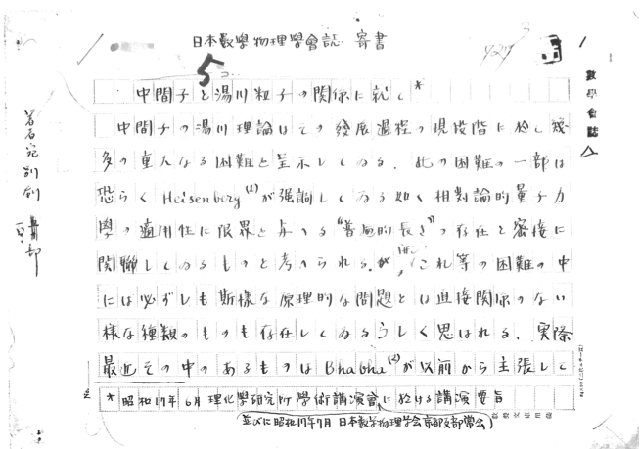
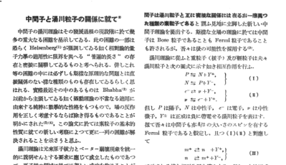
Necessity of and
1942: Sakata and Inoue advocated “two-meson theory”, in which they argued the decay of Yukawa meson:
At that time, a charged particle was discovered in the hard component of cosmic rays, which was misidentified as the Yukawa’s meson (nuclear force career particle). The cross section of this particle with atomospheric nuclei was much smaller than the predicted value in the Yukawa’s meson theory, however. Sakata’s two-meson theory resolved this confusion.
42 01 WP 01 (SMAL archive)
Bulletin of Phys.-Math. Soc. Japan 16 (1942) p.232

Slide 15
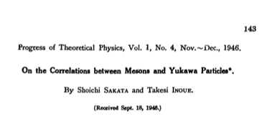
Remarks on “two-meson theory”
Unfortunately, due to the war circumstances, the English printing of two-meson theory paper was delayed until 1946.
In 1947, Powell and his collaborators confirmed Sakata-Inoue’s version of “two-meson theory”, finding the Yukawa meson decaying into a muon and a neutrino. (Nobel Prize in Physics, 1950).

Slide 16
Remarks on “two-meson theory”
Sakata and Inoue predicted the existence of and (newly introduced charged- and neutral- fermions). They also pointed out the possibility that may be regarded as a species of neutrinos.
PTP 1 (1946) 143
An alternative scenario was discussed by Y. Tanikawa.

Slide 17
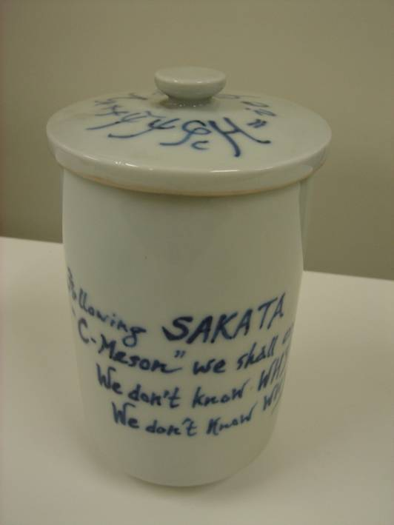
Renormalization of QFT
C-meson theory / non-renormalizable field theory

Slide 18
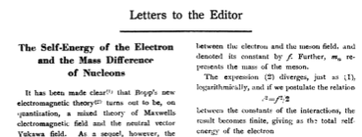
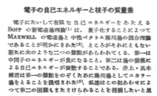
C-meson theory (Cohesive field)
1947: Sakata and Hara proposed the C-meson (Cohesive field) theory, in which they tried to resolve the UV-divergence of electron self energy by introducing a new meson (C-meson).
Sakata and Hara
Kagaku, February 1947
46 02 RE 02 (SMAL)
Sakata and Hara
PTP 2 (1947) 30

Slide 19
Idea of C-meson
photon contrib. to electron self-energy
C-meson contrib. to electron self-energy

Slide 20
Idea of C-meson
If we assume a relation among the coupling constants
the electron self-energy divergence problem can be avoided
at one-loop level.

Slide 21
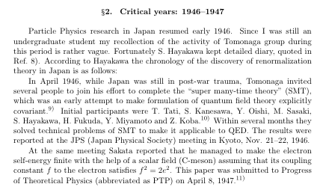
Although the idea of C-meson eventually failed….
Sakata’s C-meson idea inspired Tomonaga’s development of renormalization theory. (Kinoshita’s recollections stated at pnL50 symposium: PTP suppl. 167 (2007) 62)

Slide 22
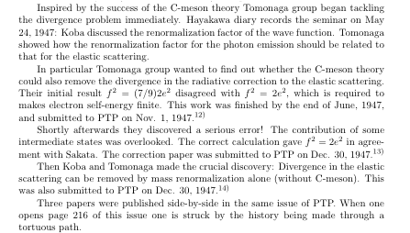

Slide 23
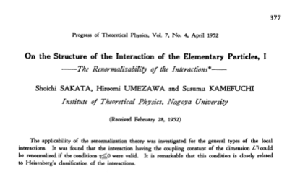
Non-renormalizable theories
1952: Sakata, Umezawa and Kamefuchi noted that the non-renormalizable theories are those whose coupling constants have negative dimensionality.
typed manuscript: 52 01 WP 01 (SMAL)
published in PTP 7(1952)377

Slide 24
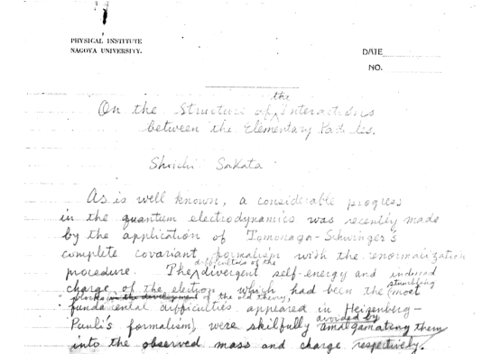
Non-renormalizable theories
In their 1952 paper, Sakata, Umezawa and Kamefuchi tried to understand the deep “structure” behind the renormalizable field theory.
51 01 WP 01 (SMAL)

Slide 25
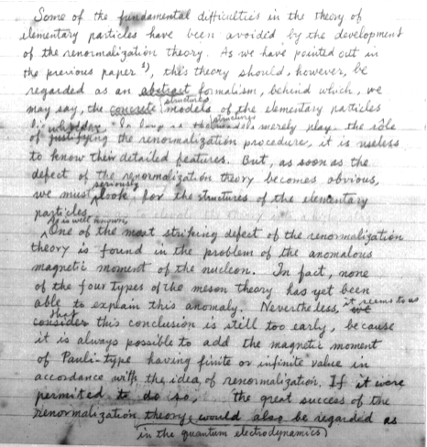
“On the closeness of the renormalization theory and the Structure of elementary particles”
51 01 WP 01 (SMAL)

Slide 26
Sakata-Umezawa-Kamefuchi emphasized the importance of “non-renormalizable” field theory,
because it may clarify the applicability of the “renormalizable” field theories.
In the light of modern quantum field theory, their work can be understood as an early attempt to think about the effective field theories.

Slide 27
Sakata Model -A precursor to the quark model-
Sakata Model
Quark Model

Slide 28
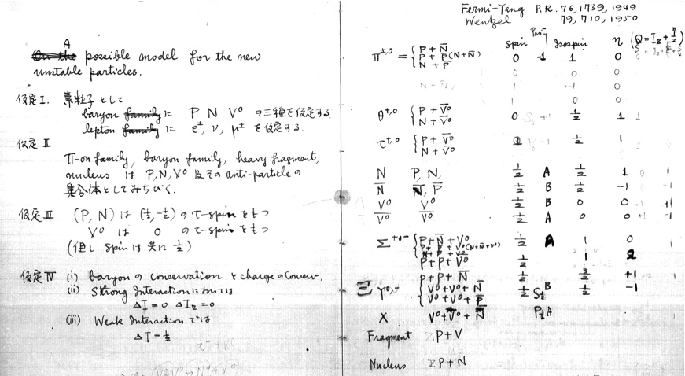
Birth of Sakata Model
Composite model of hadrons: as elementary particles
55 01 NB 02 (SMAL) Sakata’s handwritten notebook

Slide 29
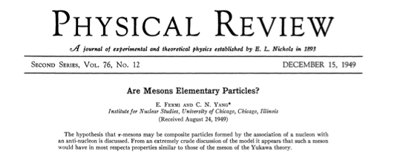
Fermi-Yang theory
The hypothesis that -meson may be composite particles by the association of a nucleon with an anti-nucleon is discussed. From an extremely crude discussion of the model it appear such a meson would have in most respects properties similar to those of meson of the Yukawa theory.

Slide 30
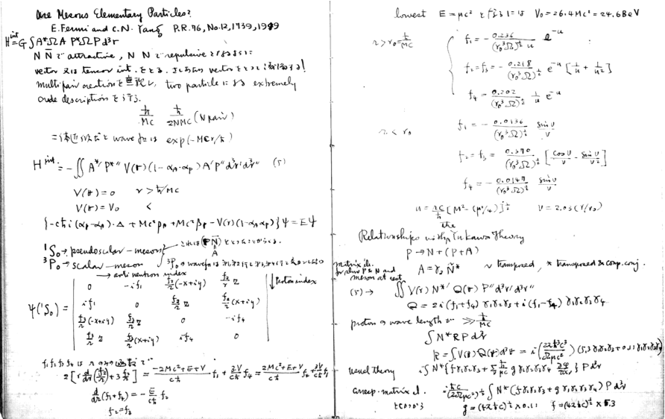
Fermi-Yang theory
55 01 NB 02 (SMAL) Sakata’s handwritten notebook

Slide 31
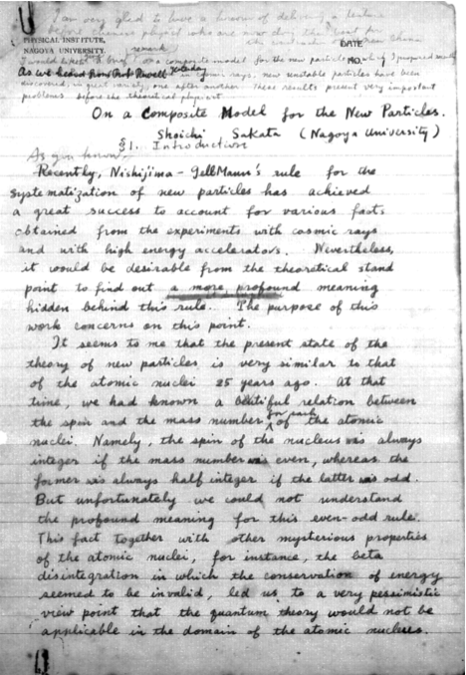
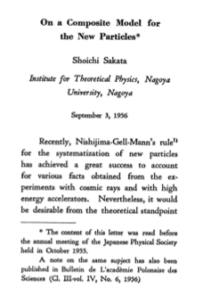
PTP 16 (1956) 686
06 01 WP 02 (SMAL)

Slide 32
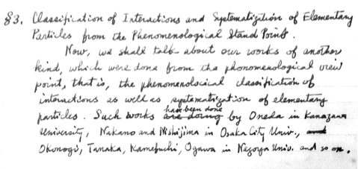
Nakano-Nishijima-Gell-Mann
Sakata’s talk at Bohr Inst. Copenhagen, 1954, titled “Some recent research
work in Japan” (54 01 WP 01) SMAL

Slide 33
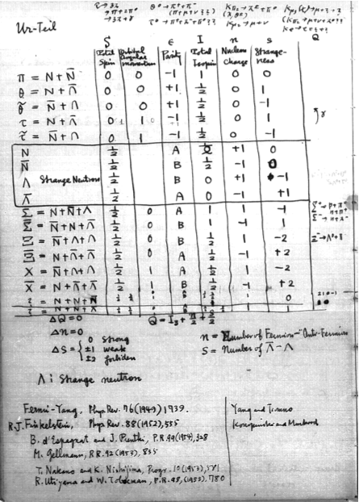
55 01 NB 02 (SMAL) Sakata’s handwritten notebook

Slide 34
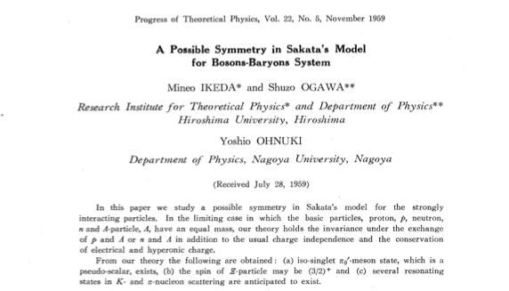
Discovery of U(3) symmetry
Quark Model

Slide 35
Neutrino Mixings
Maki-Nakagawa-Sakata theory of neutrino mixings

Slide 36
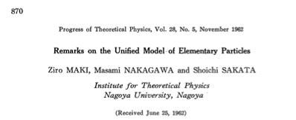
PTP 28 (1962) 870
A particle mixture theory of neutrino is proposed assuming the existence of two kinds of neutrinos. Based on the neutrino-mixture theory, a possible unified model of elementary particles is constructed by generalizing the Sakata-Nagoya model.

Slide 37
Remarks

Slide 38
Deep consideration
The original motivation of MNS paper comes from their composite model unifying both baryons and leptons
“Nagoya Model”
“New Nagoya Model”
Even though the original model eventually turned out to fail, their deep consideration leads to a correct idea of neutrino mixing.

Slide 39
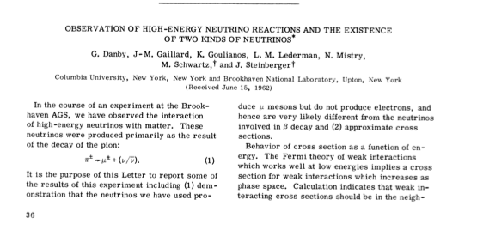
Received Dates
Lederman’s paper on “the existence of two kinds of neutrinos”: June 15, 1962.
Maki-Nakagawa-Sakata paper: June 25, 1962.

Slide 40
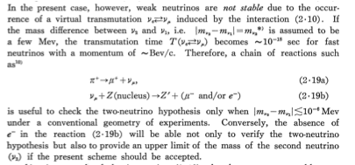
Maki, Nakagawa, and Sakata wrote their paper prior to knowing
the result of Lederman’s experiment!

Slide 41
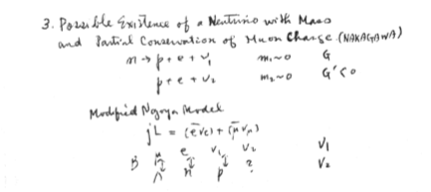
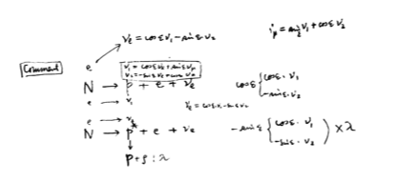
Deep consideration discussion about of lepton flavor
62 01 FL 01 p.81 (SMAL) Sakata’s handwritten notebook
See also, Nakagawa, Okonogi, Sakata, and Toyoda, PTP 30 (1963) 727

Slide 42
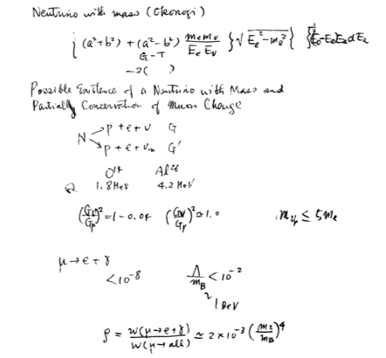
62 01 FL 01 p.84 (SMAL) Sakata’s handwritten notebook

Slide 43
Turning points

Slide 44
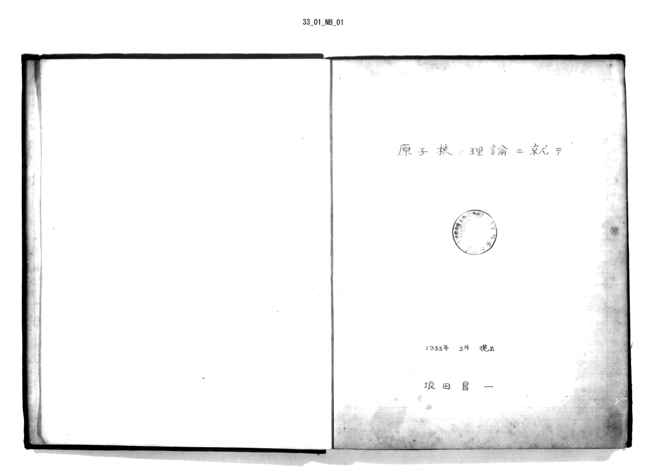
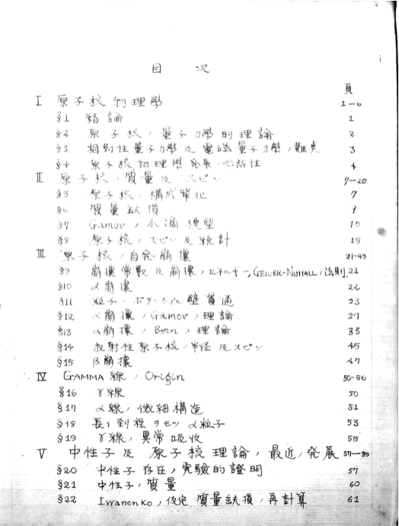
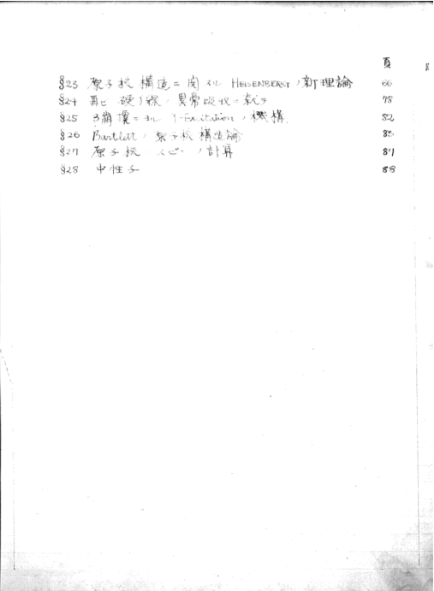
Graduation Thesis
1933: Wrote a graduation thesis on theoretical study of nucleus, under the suggestion by H.Yukawa. The moment was the discovery of neutron by J.Chadwick and the introduction of neutrino by W.Pauli. Sakata seems to be deeply impressed by this.
Primary importance to disclose the “structure” of the object.

Slide 45
Stay at Bohr Institute in Copenhagen
1954: Sakata stayed at Bohr Institute in Copenhagen half a year.
Sakata’s Diary during this stay is published recently as you find it in your conference bag. (Publication Committee for Sakata’s Copenhagen Diary.)
In the essay of Professor Kamefuchi contained in this book, he vividly describes Sakata’s “metamorphosis”:
“Formalist -> Realist”

Slide 46
Sakata’s leadership in E-ken
– 最良の組織と最高の哲学 –
The best organization and
the highest philosophy

Slide 47
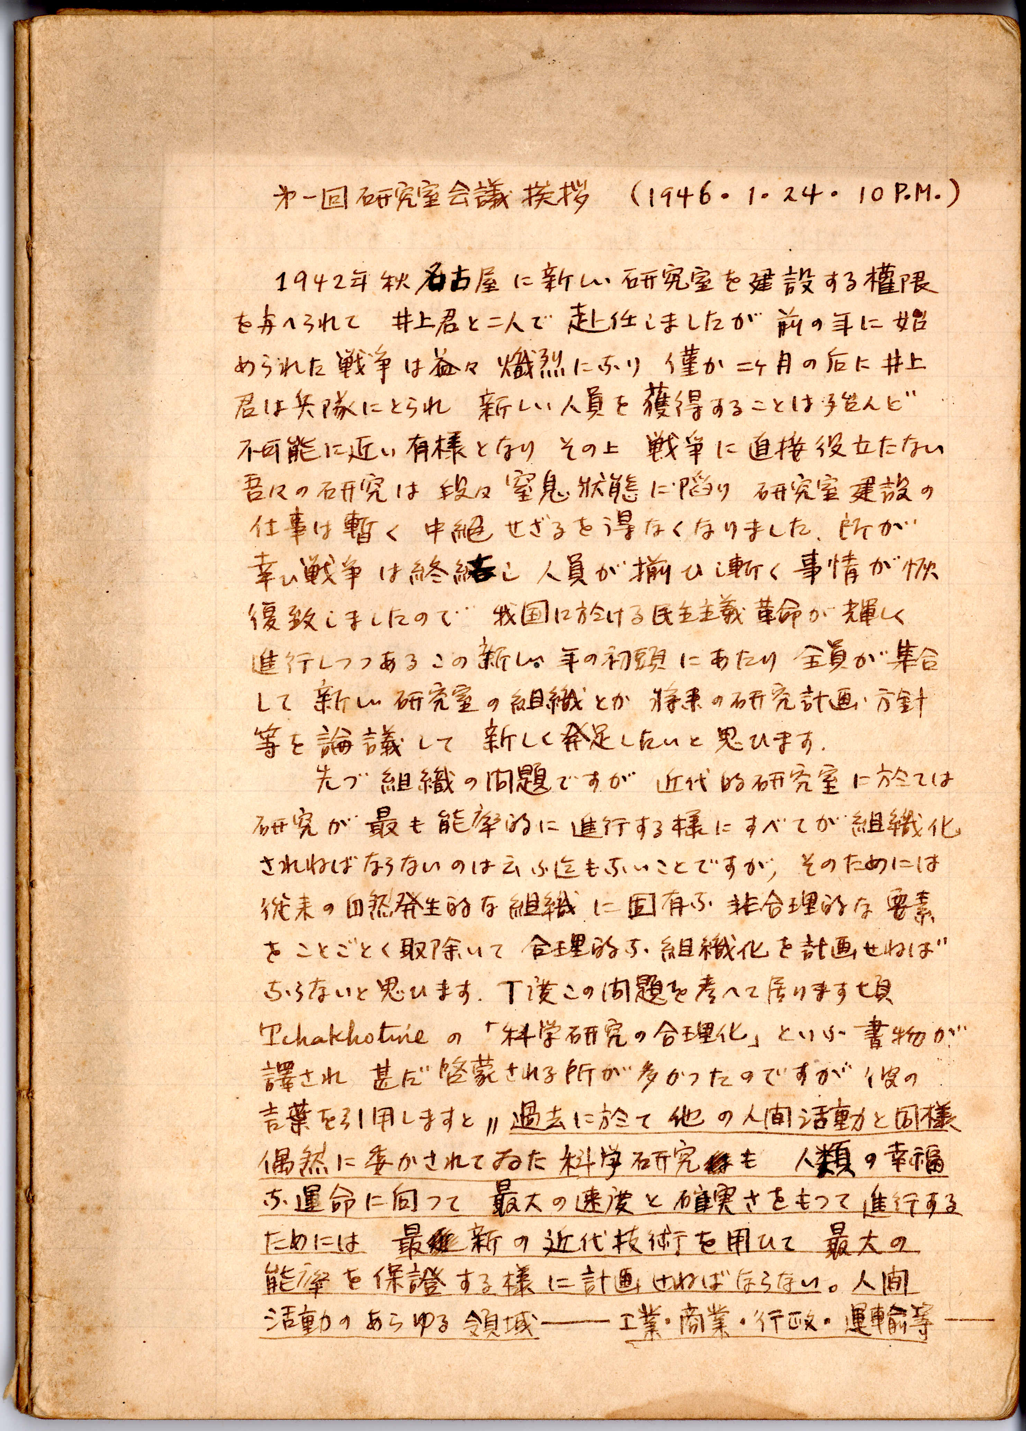
Sakata took the leadership in setting up new democratic administration system in E-ken(particle theory lab)
Address at the Inaguaral Meeting of “Laboratory Council”
Jan 24, 1946 10pm
... At this moment of democratic revolution in Japan, we
want to set up “Laboratory Council” in which we discuss
the organization of our Lab and the future plan of our
research....
... There are two important principles for the organization
of our Lab: 1) perfect freedom in the research of each
member of our Lab. 2) the output of our Lab should be more than the simple sum of activities of individual members.
...
I believe that the “Laboratory Democracy” is the
best system to solve the problem...
46 01 NB 01

Slide 48
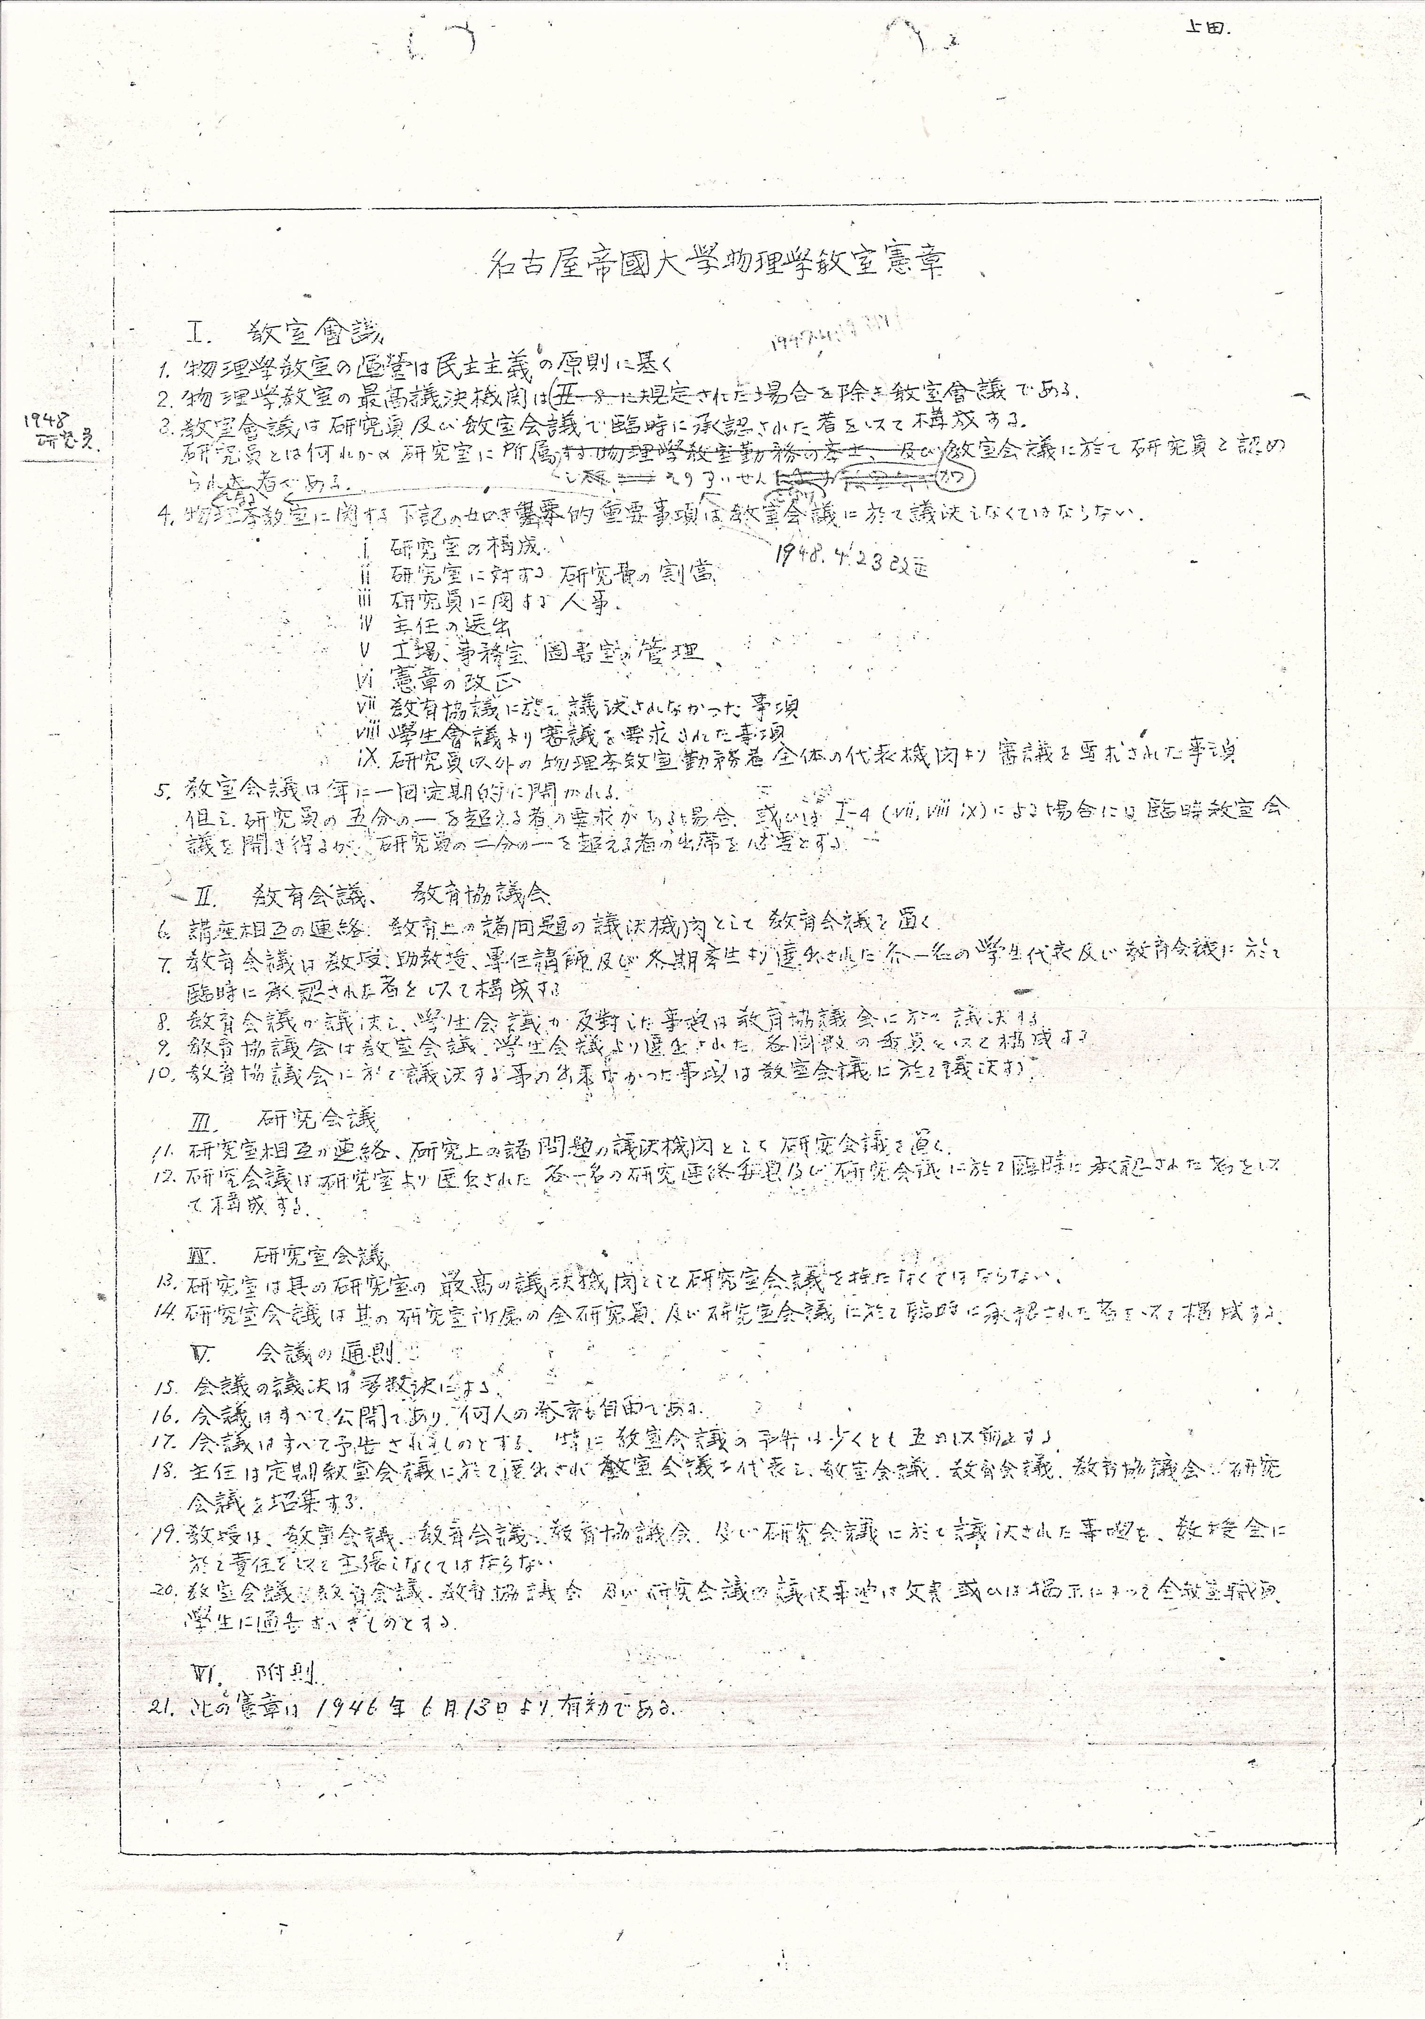
Charter of Physics Department
Sakata setup similar system in the administration of entire Physics Department, as described in the Charter of physics department (established June 13, 1946).
Perfect democracy among faculty members and students are stated in the Charter. Many glorious students of Sakata attained their high scientific skills in this democratic atmosphere.
Every year, on June 13, we celebrate “the Charter Day” in the Physics Department.

Slide 49
Sakata’s Political Activities

Slide 50
Member of Science Council of Japan (1949-1970)
Chair the Committee for Atomic Energy Problems
Chair the Special Committee for Nuclear Research
With Tomonaga and Yukawa, Sakata proposed a Japanese version of the Pugwash Conference. The first was in May 1962 Kyoto Conference of Scientists (科学者京都会議）.
Sorry, but I’m not so familiar with these activities. We have huge amount of
documents related with Sakata’s political activities in SMAL, though.

Slide 51
Modern Particle Physics in the Light of Sakata

Slide 52
Mysteries in the particle physics
Higgs? Extra-D? SUSY? GUT?
WIMPs? SuperWIMPs? Inflaton? Axion?
Baryogenesis? Leptogenesis?
Cosmological Constant? Quintessence?
We need new degree of freedom (“structure”)
as emphasized by Sakata!!

Slide 53
To hear all and any makes you enlighted, to hear one and only makes you benighted
March 1969, Shoichi Sakata
I hope this symposium can provide us such an opportunity

Slide 54
Summary
Sakata made a lot of great achievements in the developments of the modern particle theory.
Two-meson theory introduced the 2nd generation first.
C-meson theory made impacts on Tomonaga’s invention of the renormalization theory.
Sakata-Umezawa-Kamefuchi clarified the applicability of the renormalization theory.
The flavor SU(3) symmetry was first discovered in the context of the Sakata model.
Sakata pointed out the MNS mixing of neutrinos in the context of Sakata’s New Nagoya Model.

