Slide 1
Can Multiquanta Bags, Sphalerons and the CP Violation inside the Standard Model explain Baryogenesis?
Nagoya, Oct.2011
Yes, in cold electroweak
cosmological scenario
E.Shuryak
Stony Brook University (New York)

Slide 2
Papers and collaborators
The W-Z-Top Bags. Marcos Crichigno, Victor Flambaum, Michael Kuchiev, ES arXiv:1006.0645
Quantum Corrections to Multi-Quanta Higgs-Bags in the Standard Model. Marcos P. Crichigno, ES arXiv:0909.5629 ,PRD
Possible Role of the WZ-Top-Quark Bags in Baryogenesis. Victor V. Flambaum, ES, arXiv:1006.0249,PRD
The Standard Model CP Violation near the W -bags and Baryogenesis, Yannis Burnier +ES, arXive:1107.4060, PRD in press

Slide 3
outline
Can Higgs-mediated attraction lead to multiquanta bound states? – recent history
W-Z bags: 3 polarizations, E-L mix, L repelled, M simple
Adding the top/antitops: “no-Higgs” vs “inverted” bags
Baryogenesis and hybrid cosmological scenario
Hot spots = W bags, COS (finite size) sphalerons
Adding the tops: their recycling by sphalerons
Estimates for the standard model (CKM) CP violation

Slide 4
Can Higgs-mediated forces lead to many-quanta bound states?
Scalar is like gravity (spins 0 and 2): no screening, universal attraction proportional to mass, so for large enough particle number it becomes strong. Gravity is very weak yet it makes planets, stars and black holes!
``strong interaction Higgs” is the sigma meson. It may even gets massless at QCD critical point (if reachable)
(reminder: nuclear physics has a separate scale, distinct from hadronic physics, because sigma attraction is nearly exactly canceled by omega repulsion)
existing ``theories” (e.g. technicolor) predict vectors much heavier then Higgs ( 1-2 TeV vs .1 TeV) thus we do not expect such cancellations (LHC will soon tell)

Slide 5
History, starting with the 12,
C. D. Froggatt and H. B. Nielsen, Surveys High Energ. Phys. 18, 55 (2003) suggested 6 t+6 anti-t are deeply bound by
Higgs mediated attraction
M. Y. Kuchiev, V. V. Flambaum and E. Shuryak, Phys. Rev. D 78, 077502 (2008) [arXiv:0808.3632]: no, weakly bound for massless or light Higgs, but not bound at all for “real” mass (> 116 GeV)
J. M. Richard, Few Body Syst. 45, 65 (2009) [arXiv:0811.2711] confirmed our conclusions and improved binding a bit by a more sophisticated trial function, no binding for M_{H}>50 GeV

Slide 6
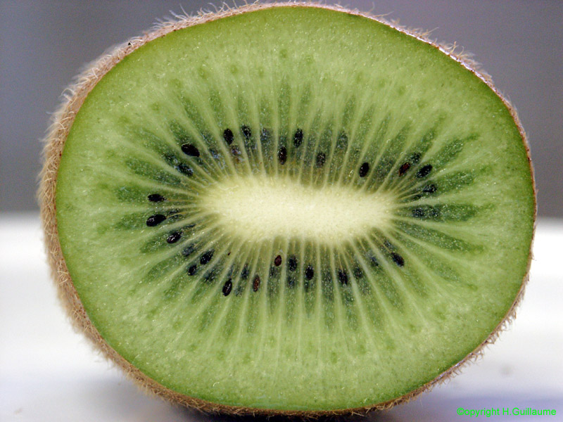
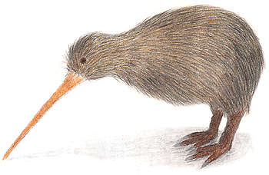

Slide 7
The main questions:
Which modes are the lowest, M, E or L?
What are the smallest number which can be bound, how does it depend on M_{H}? (O(1000) if M_{H}>100 GeV)
How those levels are related with those of the tops in the bag?
2 kinds of bags:
“No-Higgs” (phi=0 inside)
“inverted” (phi changes sign on the boundary) (inverted)

Slide 8
Magnetic, electric and longitudinal
M has eqn as a scalar except j=1,2…
E-L mixing
New term for L which is singular
at zeros of Higgs! Indeed, where W is
massless, there should not be any L modes…

Slide 9
Bags without zero
M_{t}=1.73
η <1
m_{W}=0.8
j=0 L is already higher than j=1 M
J=1 M is very close to the lowest
levels of the tops, in spite of large mass difference
L
M

Slide 10
1d kinks, an approximation for very large inverted spherical bags with zero of phi
Qualitative argument: fermions have zero mode for topological reasons
Scalars,M and E have osc.potential
And thus an oscillator level >0
But where are the L modes? Very high. The zero of phi is an inpenetrable barrier

Slide 11
If Higgs goes
through zero,
there is a quasi-
Zero mode for
large bags and
analytic solution

Slide 12
Magic numbers and levels
At a realistic higgs mass, there are no stable pure top bags at any N
But if be lighter (say 50 GeV) there would be “another nuclear physics”

Slide 13
Comparing M mode of W to tops
In general, due to existence of the zero mode,
the lowest top levels are below the W modes for large bags
So, up to 12+24=36 tops on those 2 levels cannot decay into W+b, and
have much longer lifetime than W,Z themselves
W

Slide 14
Baryogenesis in the hydbrid model

Slide 15
Baryogenesis
Sakharov (1967) had formulated 3 conditions => B-violation, CP-violation, non-equilibrium
All 3 are there in the Standard Model (SM)
And yet we do not know how n_{B}/n_{γ} =6∗10⁻¹⁰ has been obtained… as way too small numbers are obtained
beyond the SM? (very popular) or beyond the standard cosmology instead?

Slide 16
Hybrid (cold) scenario combines establisment of the EW broken phase with the end of inflation J. Garcia-Bellido, D.Y. Grigoriev, A. Kusenko and M.E. Shaposhnikov, Phys. Rev. D 60 (1999) 123504 [hep-ph/9902449]. L.M. Krauss and M. Trodden, PRL 83 (1999) 1502 [hep-ph/9902420].
Real-time lattice simulations
Only bosons: 2 scalars (Higgs and inflaton) and the gauge fields (photons, W,Z)
Mostly focused on generation of primordial magnetic field (not to be discussed in this talk)
diffusion in the Chern-Simons number => the rate of the B violation

Slide 17
Hybrid (cold) scenario (cont)
Subsequent time snapshots of the Higgs VEV modulus shows appearance of the ``hot spots”
(red) which have near-zero Higgs VEV
They remain till time
t m about 20
(m is the mass scale, in this simulation it is 240 GeV)

Slide 18
Hybrid (cold) scenario (cont)
Topological charge Q = GG_{dual} is also localized
The topological transitions happen only inside (some of) the “hot spots”
Hot spots take volume fraction of few percents, sphalerons in them also have P of few percents
=>Γ/T⁴ about 10^{-4,}
Integrated in time 10⁻³
| φ|
T m=19
The same
Time and
place
Q(x)

Slide 19
Hybrid (cold) scenario (cont)
Topological charge
explodes after a peak
Then spherical explosion with an empty shell

Slide 20
Hybrid (cold) scenario (cont)
Further details:
Magnetic field B first
Then electric E
Note that topology has sign inversion, before it comes back

Slide 21
Explaining numerical results, for (bosonic) hybrid cosmology

Slide 22
Hot spots as thermal W bags (mechanically but not thermally equilibrated)
T_{in} = 174 GeV > Tc >> T_{bulk} = 50 GeV

Slide 23
COS sphalerons (Carter,Ostrovsky,Shuryak, Phys.Rev. D 66, 036004 (2002)

Slide 24
COS sphaleron explosion

Slide 25
COS sphalerons in QCD

Slide 26
Can numerically observed topological fluctuations be described by COS sphalerons?
The shape and the size => the barrier height

Slide 27
Can numerically observed topological fluctuations be described by COS sphalerons?
Now let us evaluate the optimal size from the rate
Which is about 4/m, numerically
observed.
The rate also crudely works!

Slide 28
Adding (top) quarks to the hybrid cosmology

Slide 29
Production of the tops and their collection into the “spots”
in equilibrium broken phase bulk density is small, n_{bulk} =n_{in}/300, compared to their thermal density inside the hot spots.
99% should either be annihilated or
collected into the spots!

Slide 30
sphalerons badly need the tops! (top recycling)

Slide 31
The CP violation

Slide 32
CP violation in the SM
No summation
Jarlskog factor J appears (for 4 Ws) which gives the area of unitary triangles of CKM
If any two masses of upper or lower quarks coinside, no CP => ?
CKM part
Not true in general, only if the scale is above all masses, in denominators
Not so for K and B decays!
Loops at intermediate scales have other way to vanish => e.g. log(m_i/m_j)=0
for equal masses as well, no need to have a difference as a factor…
If so, forget the SM
Baryogenesis!

Slide 33
unitarity cut
Consider a process, 4-th order in weak interaction, describing interferences between various paths by which t quark (or anti-top) leaves the W bag.
CP violation =>
top-antitop population difference in the bag

Slide 34
The flavor trace part of the CP Violation
Flavor-independent part of S cancels out,
small flavor-dependent phases remain
Everything cancels till the 5th order in phases,
the remaining expression has definite sign which is correct! More t leave, more bar-t in the bag

Slide 35
use E as small as possible <= plasma mass g_{w}T or m_{b} scale of few GeV
All r_{ij} are as large as possible <= limited by phases not larger than 1,
One point in the bag, one as far possible consistent with exponential fall of with W mass
If so, the CP difference in t and anti-t is
No numbers tuned, just
As in numerical works

Slide 36
Summary:
Numerical studies of hybrid cosmology can be explained by COS sphalerons inside the “hot spots”: size, rates…
Tops have stronger coupling than Ws and produced more copiously: they will be collected into spots and help to stabilize them
Lifetime and top recycling increase the sphaleron rate by about O(10), from 10⁻³ to 10⁻²
CP violation: seem to be doable in the SM, after all! The sign and magnitude can be explained
(subject to Higgs discovery (!) and further scrutiny of many details…)

Slide 37
Deriving EOM
Singular near zero of Higgs

Slide 38
B-violation in SM/SC
Electroweak instantons
Electroweak sphalerons by Klinkhammer-Manton, the barrier’s height in the broken vacuum E_{KM}=14 TeV >> Tc (about .1 TeV): too high to climb!
corrected to T<Tc gives rates
In the symmetric phase T>Tc rate is too large and can erase any prior asymmetry => bubbles at Tc then?
No bubbles, as for M_{higgs}>80 GeV electroweak transition is NOT the 1st order (lattice)
(Experimentally Higgs mass is likely to be in the window around 120 GeV or M_{higgs}>160 GeV )

Slide 39
Recent development in CP
J
The authors claim that this dim-6 next-to-leading order effective action
1) has J from 4 Ws as expected, and κ_{CP}(all m’s) vanishes for equal masses
2) But converges at the low scale of only the 2nd generations =>
M²=m_{c}² and it has no other small factors (?!?)
The second paper then finds (in real time simulation for the hybrid scenario)
the overall baryon asymmetry 10⁻⁶
(or 4 orders larger than needed!)
V
V
V
V

Slide 40
CP violation in hybrid scenario: (my comments)
W⁴Z operator, dim 6. The field is much larger inside the sphalerons than anywhere else => should be happening in sphalerons?
No, it was not derived for a strong scale field!
<=at strong field there is Jarlskog suppression
<=The (LL) fermion mass at T=50 GeV is
about (5 GeV)² or at m_{b} scale
outside the ``spots” when gauge field is of mb scale, one can generate CP
of the right magnitude 10^(-7) or so (also Tranberg, private communication)

Slide 41
1d kinks, an approximation for very large spherical bags with zero

Slide 42
The lifetime of the top bags: weak decays
m_{t}
t=> b W in vacuum is possible,
(m_{t}=172 GeV > m_{W}=80 GeV)
But is it so in the bag?
Not always!
The reason is fermions
prefer to have surface bags
And they have zero mode
While the Ws do not!
m_{W}
From Flambaum,ES,
“Ws in the top bags”
The levels vs the bag size.
Large boxes – W levels,
small circles – the t levels

Slide 43
The lifetime of the top bags: strong annihilation
Calculate assuming thermal bag
Regulate angular logs
The time is about 10 times the lifetime of W hot spots in simulations

Slide 44
Do tops change the sphalerons? (the exponent)
Kappa is a parameter,
the ratio of trapped t
in units of trapped W,
In “hot spots”

