Slide 1

Problems with the MSSM :
mu & proton decay
Stuart Raby
KMI
Nagoya University
October 24, 2011

Slide 2
Outline
Review the problems & proposed solutions in the literature
Discrete non-R symmetries & μ
Discrete R symmetries
Unique
Singlet extensions of the MSSM
Conclusions

Slide 3
Outline
Review the problems & proposed solutions in the literature
Discrete non-R symmetries & μ
Discrete R symmetries
Unique
Singlet extensions of the MSSM
Conclusions

Slide 4
General SU(3)_{C} x SU(2)_{L} x U(1)_{Y} invariant
superpotential up to operators of Dimension 5

Slide 5
MSSM
term: Need
term: Weinberg operator for
neutrino mass

Slide 6
R parity violating operators
But

Slide 7
Dim 5 B & L violating operators

Slide 8
Outline
Review the problems & proposed solutions in the literature
Discrete non-R symmetries
Discrete R symmetries
Unique
Singlet extensions of the MSSM
Conclusions

Slide 9
R/Matter parity - Fayet & Farrar, Weinberg /
Dimopoulos & Georgi
Dimopoulos, Raby & Wilczek
Baryon triality - Ibanez & Ross
Proton hexality - Dreiner, Luhn & Thormeier

Slide 10
Matter parity -
Baryon triality –
Proton hexality -
Anomaly free
Baryon triality & Proton hexality
Not consistent with Grand Unification !!

Slide 12
Summary
What would we like to do ?
Forbid the μ term perturbatively
Forbid dimension 3, 4 & 5 baryon and lepton
number violating operators
And do this with a discrete symmetry
which is consistent with GUTs !

Slide 13
Anomaly coefficients

Slide 14
Consider Non – R symmetry
Anomaly cancellation :
μ term allowed :

Slide 15
Summary
M₂ : eliminates Dim 3 & 4, B & L violating operators; LSP stable
B₃ : eliminates Dim. 4, B
and Dim. 5, B & L violating operators;
LSP unstable
P₆ : eliminates Dim. 3, 4 & 5,
B & L violating operators; LSP stable
MSSM consistent with GUTs
BUT B₃ & P₆ are NOT !
μ term allowed by ALL

Slide 16
Outline
Review the problems & proposed solutions in the literature
Discrete non-R symmetries
Discrete R symmetries
Unique
Singlet extensions of the MSSM
Conclusions

Slide 17
Lee, Raby, Ratz, Ross, Schieren,
Schmidt-Hoberg & Vaudrevange
Phys. Lett. B694, 491 (2011)
Nucl. Phys. B850, 1 (2011)
Kappl, Peterson, Raby, Ratz, Schieren
& Vaudrevange
Nucl. Phys. B847, 325 (2011)
Babu, Gogoladze & Wang
Nucl. Phys. B660, 322 (2003)

Slide 19
μ term forbidden !

Slide 20
Dimension 5 operators also forbidden !

Slide 21
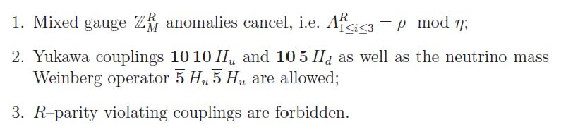
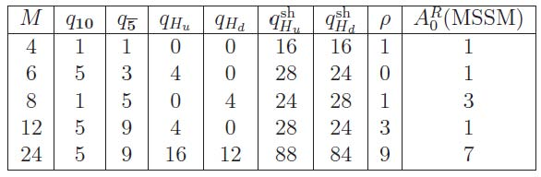
Search for Discrete R symmetry, such that
0. μ term is forbidden

Slide 22
Outline
Review the problems & proposed solutions in the literature
Discrete non-R symmetries
Discrete R symmetries
Unique
Singlet extensions of the MSSM
Conclusions

Slide 23
Unique discrete R symmetry consistent
with SO(10)

Slide 26
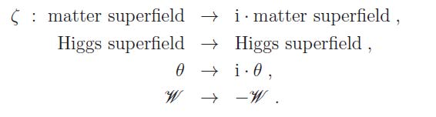
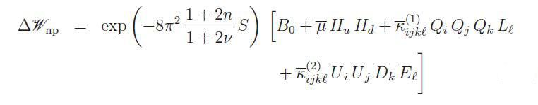
Non-perturbative effects

Slide 28
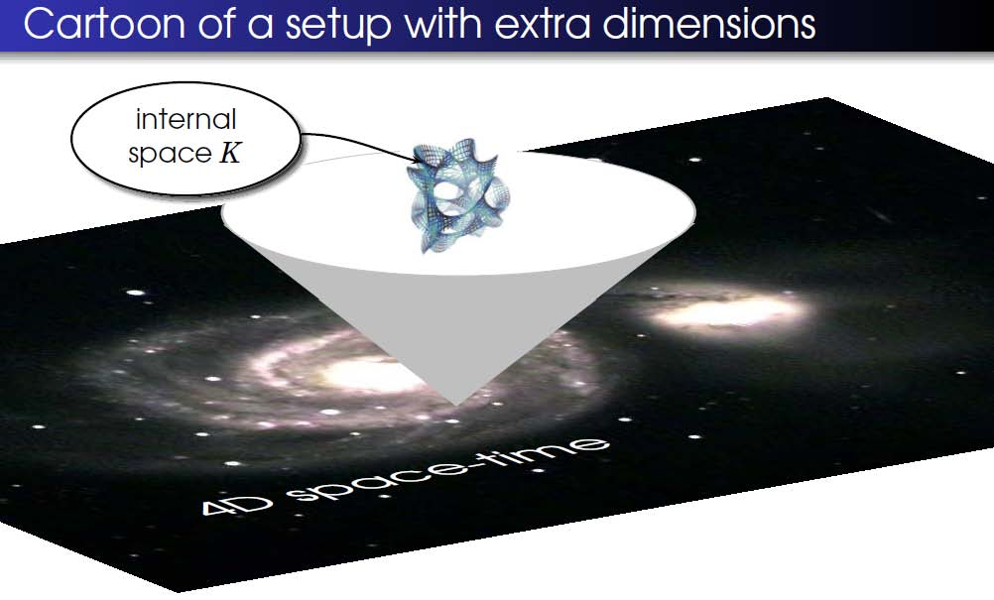
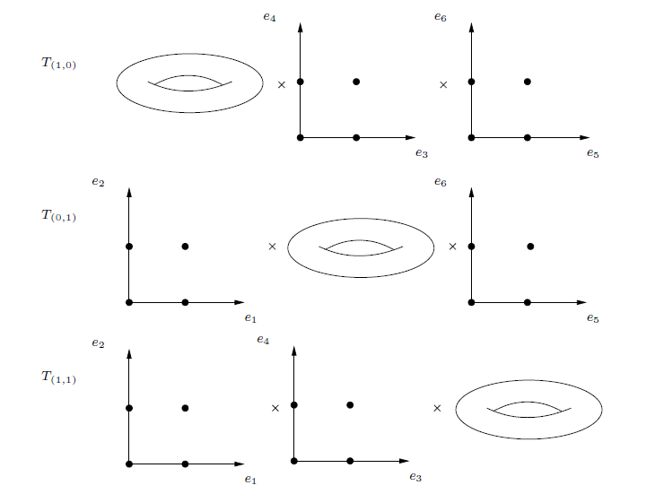
String Theory - fluctuating strings in
10 space-time dimensions
E(8)xE(8) heterotic string compactified
on (T²)³ /(Z₂ x Z₂ ) orbifold w/
Kappl, Peterson, Raby, Ratz, Schieren & Vaudrevange
NPB 847, 325 (2011)

Slide 29
String Theory - fluctuating strings in
10 space-time dimensions
E(8)xE(8) heterotic string compactified
on (T²)³ /(Z₂ x Z₂ ) orbifold
exact MSSM spectrum
F = D = 0 verified / stabilizes almost all moduli
symmetry eliminates dangerous
baryon and lepton number violating operators
μ = 0 perturbatively / μ ~ m_{3/2} non-pert.

Slide 30
String Theory - fluctuating strings in
10 space-time dimensions
comes partially from the Lorentz
symmetry of the internal dimensions
local SO(10) gauge symmetry
D(4) family symmetry / family hierarchy
Ko, Kobayashi, Park & Raby, PRD 76, 035005 (2007)
gauge – top Yukawa unification
non-trivial Yukawa matrices

Slide 31
String Theory - fluctuating strings in
10 space-time dimensions
Higgs comes from chiral adjoint of
effective 6D SU(6) orbifold GUT
Brummer, Kappl, Ratz & Schmidt-Hoberg
arXiv:1003.0084

Slide 32
Outline
Review the problems & proposed solutions in the literature
Discrete non-R symmetries
Discrete R symmetries
Unique
Singlet extensions of the MSSM
Conclusions

Slide 33
Additional MSSM singlet
Eg. 1 : GNMSSM
Ross & Schmidt-Hoberg 1108.1284 [hep-ph]

Slide 34
Eg. 2
: allows axion solution to strong CP
Second term generates

Slide 35
Outline
Review the problems & proposed solutions in the literature
Discrete non-R symmetries
Discrete R symmetries
Unique
Singlet extensions
Conclusions

Slide 36
Found unique symmetry
forbids Dim 3, 4 & 5 ops. to all orders
in perturbation theory
μ term generated non-perturbatively
Found heterotic orbifold realization !
consistent with SU(5)
: GNMSSM
: allows axion solution to
strong CP problem

