Slide 1
X-ray observations of
Dark Particle Accelerators
Hiro Matsumoto
(KMI, Nagoya University)

Slide 2
Contents
What is Dark Particle Accelerators?
  = TeV gamma-ray unID objects
Suzaku X-ray observation
  Gamma-ray brightest: HESS J1614-518
Discussion

Slide 3
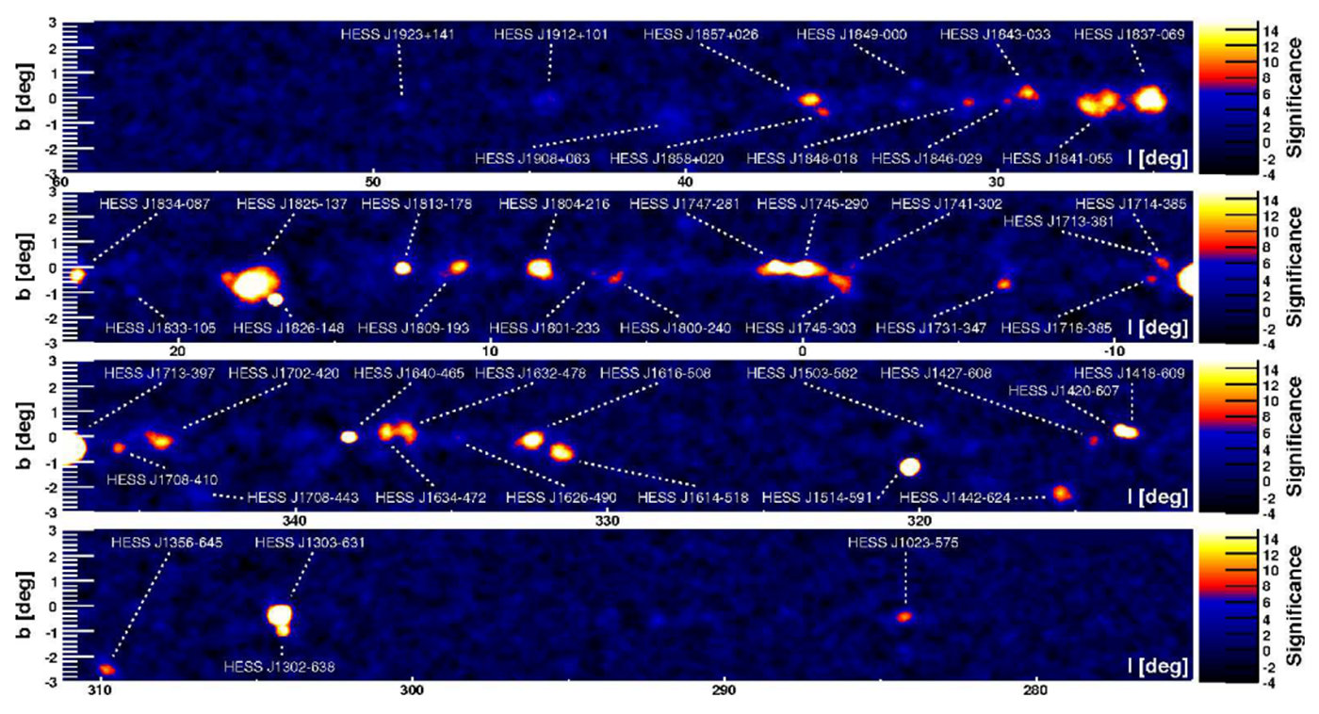
TeV gamma-ray view of Milky way
2400 Lyr
Galactic Center

Slide 4
What are they?
From TeVCat
(http://tevcat.uchicago.edu/)
Pulsar , Pulsar Wind Nebula (33)
Supernova Remnant (22)
Others (4) (binaries etc.)
Unidentified (28)
TeV unID objects
= dark particle accelerators

Slide 5
Many of them are unidentified.
Observe them in other wavelengths.
But, in the Galactic plane region.
  interstellar medium
  → Heavy extinction.
Let’s observe in the X-ray band!

Slide 6
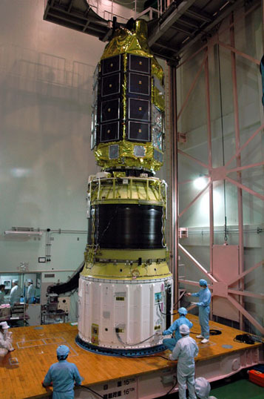
X-ray observatory: Suzaku
X-ray telescope (developed by Nagoya Univ.) + X-ray CCD
High sensitivity in the high-energy band (E>2keV)
  Little extinction.
Ideal for obs. of dark particle accelerators

Slide 7
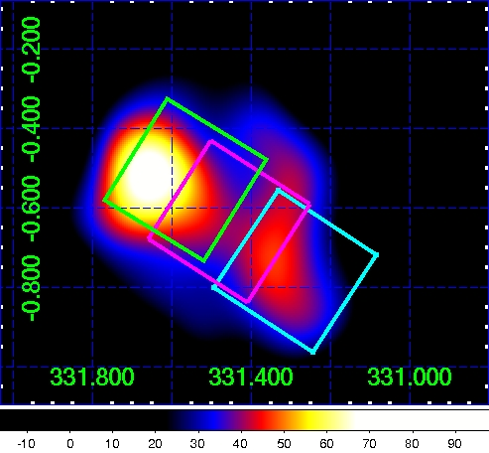
Gamma-ray brightest dark particle accelerator: HESS J1614-518
TeV gamma-ray image
～100Lyr
Squares
=Suzaku field of view

Slide 8
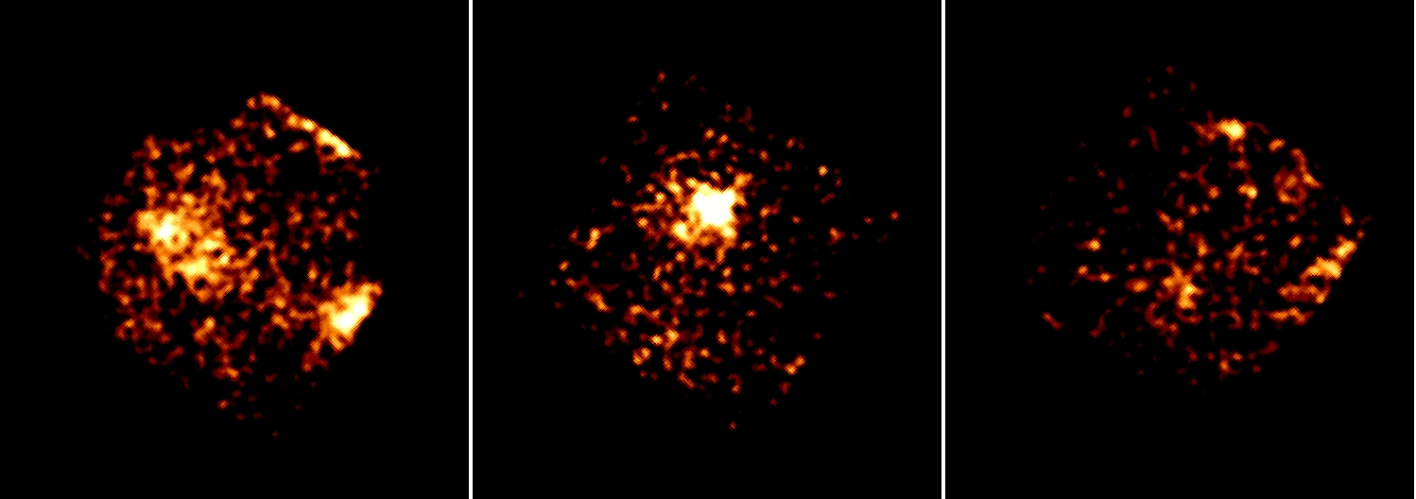
Suzaku X-ray image (3-10keV band)
X-ray counterpart
X-ray object at γ-ray valley
No X-ray object

Slide 9

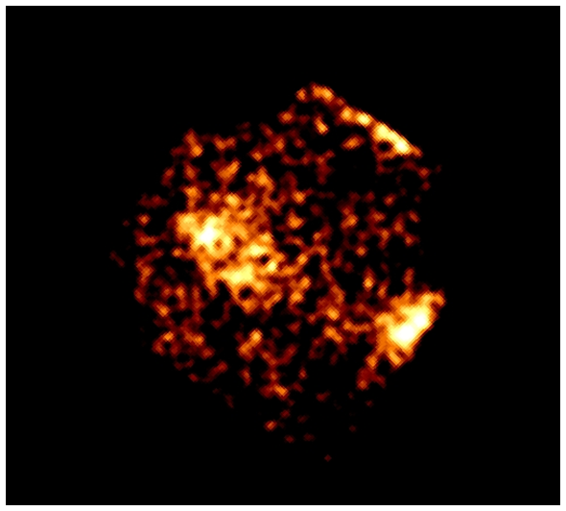
1st gamma-ray peak
TeV gamma-ray image
Suzaku X-ray image (3-10keV)
Discover X-ray counterpart

Slide 10
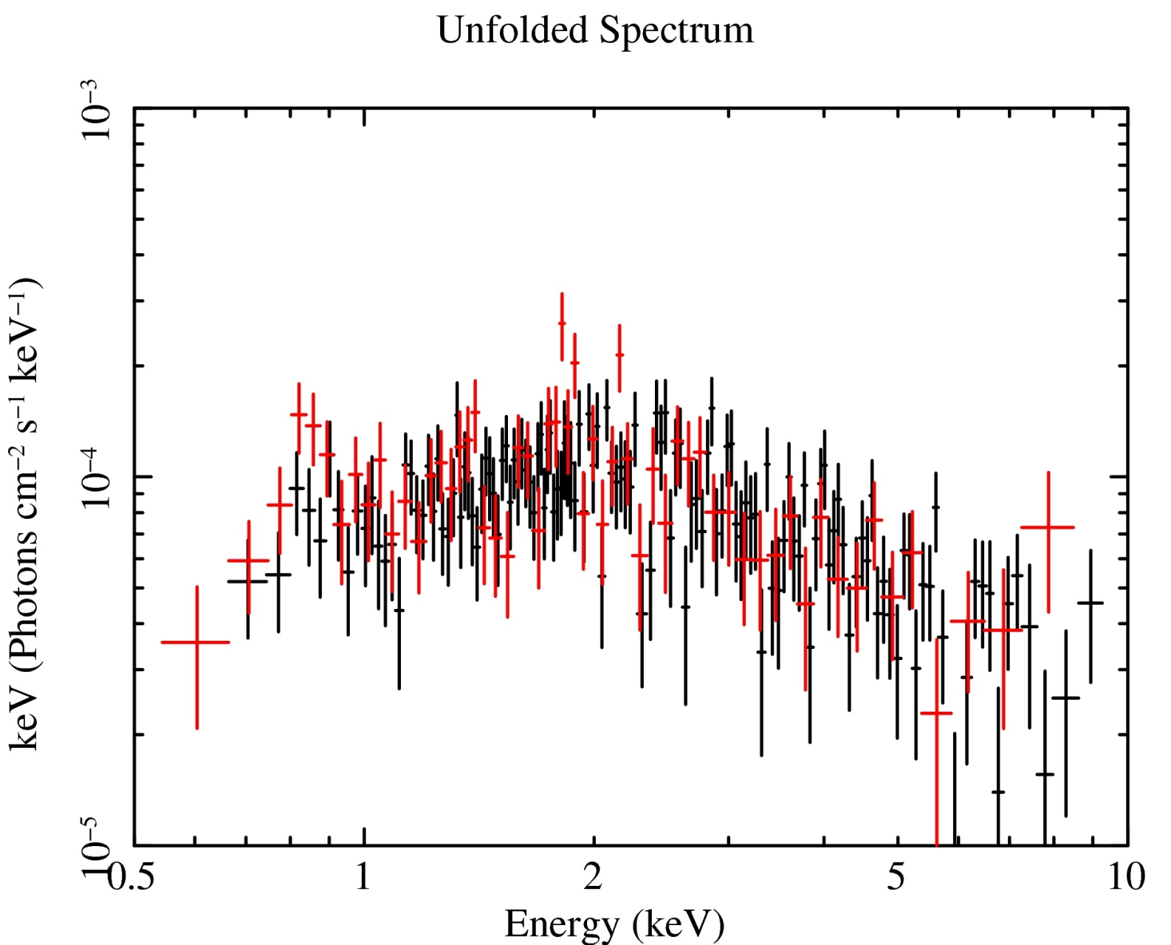
X-ray spectrum of the counterpart
What can we know?

Slide 11
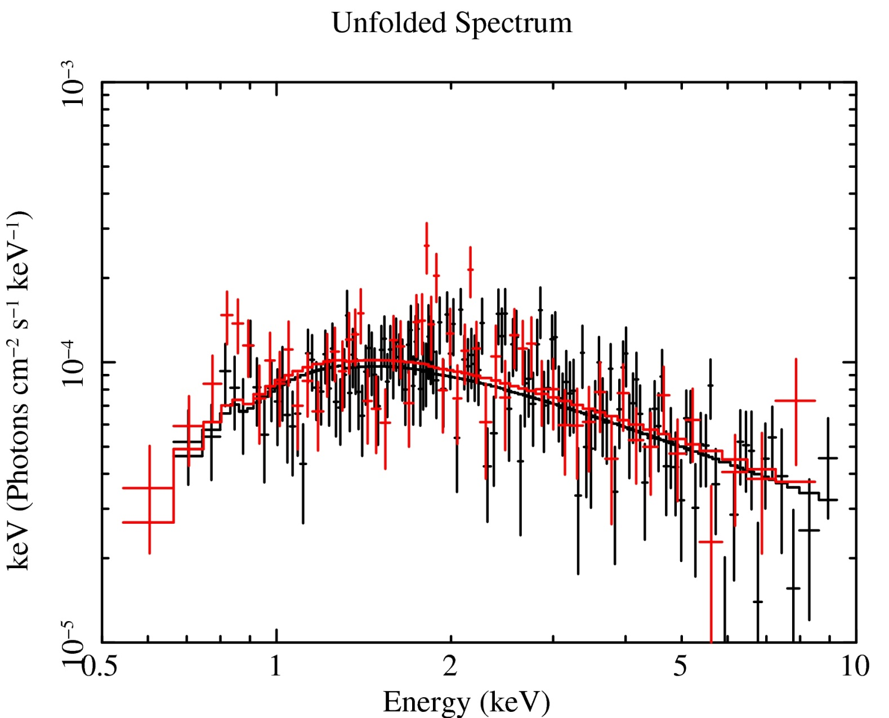
Power-law emission
Flux ∝ E^-Γ
Γ=1.7 +/- 0.1
Particle distribution is not Maxwellian.
→ Non-thermal X-ray emission.

Slide 12

Interstellar extinction
Interstellar extinction
Column density N_H = (1.2+/-0.4)e22 cm^-2
F ∝ E^-1.7

Slide 13
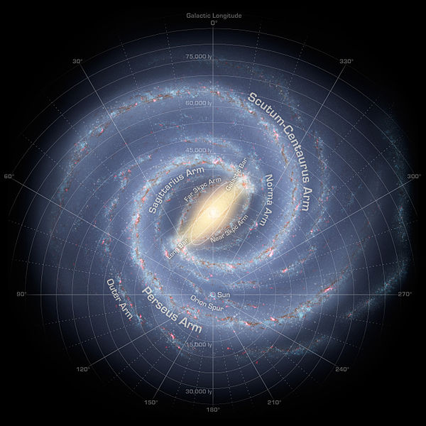

Distance to HESSJ1614
Column density
NH~2.2e22 cm^-2
Milky way galaxy
HESSJ1614
NH~1.2e22 cm^-2
D ~ 30,000 Lyr

Slide 14

X-ray Flux
Flux(2-10keV) = 5.3e-13 erg/s/cm^2

Slide 15

Very Dim in X-ray
Flux(1-10TeV)
=1.8e-11 erg/s/cm^2
Flux(2-10keV)
=5.3e-13 erg/s/cm^2
F(TeV)/F(X-ray)=34
What does this mean?

Slide 16

Two scenarios of TeV gamma-ray
High-E Proton
High–E Electron
Magnetic
field
3K CMB
protons
π0
π0
TeV γ-ray
TeV γ-ray
electrons
Synchrotron
X-ray
Interstellar matter

Slide 17
If electron origin…
High–E Electron
X-ray … B + e-
TeV … CMB + e-
Magnetic
field
3K CMB
F(TeV)/F(X-ray)
= U(CMB)/U(B)
< 1 (B > a few μGauss)
TeV γ-ray
electrons
Synchrotron
X-ray
HESSJ1614
F(TeV)/F(X-ray)=34

Slide 18
Support proton origin of TeV gamma-ray
High-E Proton
HESSJ1614
F(TeV)/F(X-ray)=34
protons
π0
π0
Dark Particle Accelerators are a possible origin of cosmic-rays.
TeV γ-ray
Interstellar matter

Slide 19
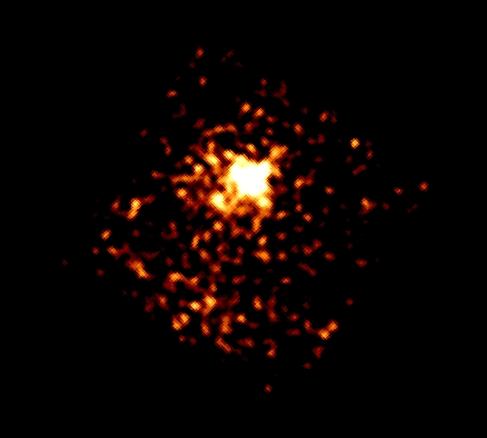
What is HESSJ1614-518?
Hint: X-ray object at the gamma-ray valley
TeV gamma-ray image
Suzaku X-ray image

Slide 20
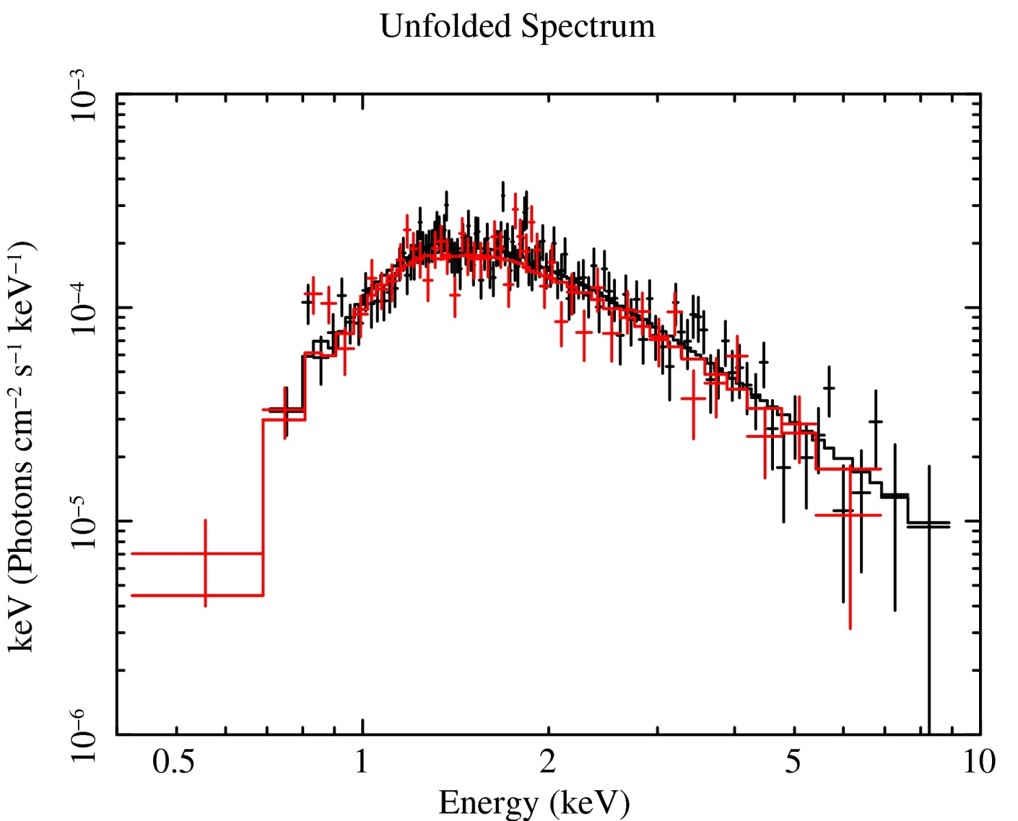
X-ray Spectrum
F∝E^-Γ
Γ=3.6+/-0.2
NH=(1.2+/-0.1)e22cm^-2
See Sakai’s poster (#31) for detailed analysis.

Slide 21
Distance to the valley object
X-ray counterpart
NH~1.2e21cm^-2
Valley object
NH~1.2e21cm^-2
Same distance
D~30,000 Lyr

Slide 22
Photon index Γ~3.6: very large
Candidate: Anomalous X-ray Pulsar (AXP)
Kind of a pulsar (neutron star)
X-ray bright
Slow spin (P=2~12s)
Slow spin down (dP/dt=1e-13~1e-10)
Energy source
Cannot be spin.
May be extremely strong B (>10^15 G)
AXPs may be “magneters”.

Slide 23
What is HESSJ1614-518?
Maybe a remnant of peculiar supernova producing an AXP.
Similar results
CTB37B (Nakamura et al. 2009)
HESSJ1427-608 (Fujinaga et al. 2011).
Some of Dark particle accelerators = Peculiar supernova remnants?

Slide 24
Summary
X-ray counterpart of HESSJ1614-518 was discovered.
F(TeV)/F(X-ray) =34
  Origin of TeV gamma-ray is protons.
  May be origin of cosmic-rays.
Some of Dark particle accelerators may be remnants of peculiar supernovae producing AXPs.

Slide 26

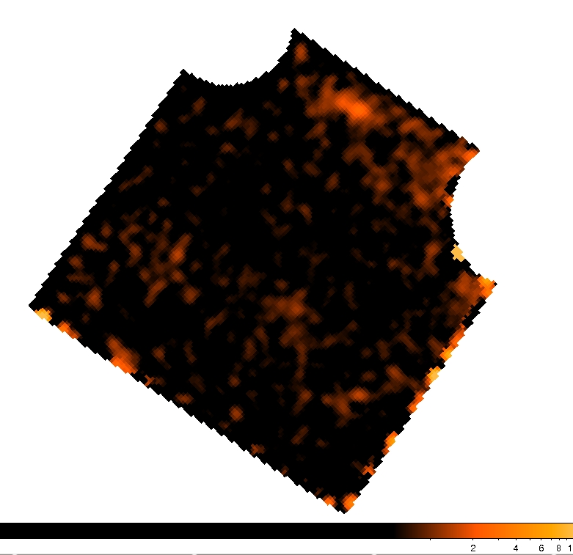
2nd gamma-ray peak
TeV gamma-ray image
Suzaku X-ray image (3-10keV)
No X-ray emission

Slide 27
What emits TeV gamma-ray?
TeV gamma-ray → E_particle = 10^12 eV
Electron?
Proton?

