Slide 1
Non-perturbative beta functions and
Conformality lost in gauge theories
SCGT12Mini @KMI, Nagoya
March. 20, 2012
H. Terao. (Nara Women’s Univ.)
Contents:
1. Introduction
2. Non-perturbative beta function
3. RG flow equations for the SU(N) gauge theories
4. Aspects of the RG flows
5. “Non-perturbative” gauge beta functions
6. Anomalous dimensions of the SU(3) gauge theories
7. SU(2) gauge theories
8. Hyper scaling in the mass deformed theories
9. Summary and discussions
Based on Y.Kusafuka, H.T., PRD 84 125006 (2011)
Y.Kusafuka, E.Ueno, H.T., in preparation

Slide 2

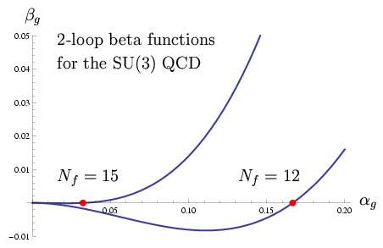



Introduction
No fixed point
Conformal window of the many flavor QCD
  IR fixed point by the perturbative beta function Caswell, Jones, Belavin, Migdal
    The IR fixed point moves towards T.Banks, A.Zaks, NP B 196 (1982)
    strong coupling region as the flavor number Nf decreases.
  Spontaneous breaking of the chiral symmetry
    Schwinger-Dyson eqn in the ladder approximation
  V.A.Miransky, K.Yamawaki, MPL A4 (1989); PRD 55 (1997)
  T.Appelquist et.al. PRL 77 (1996); PRD 58 (1998)
    ⇒ Chiral symmetry is spontaneously broken for .
    Scale invariance is lost there.
    ⇒ Fixed point cannot exist !
    Chiral dynamics determines the
    boundary of the conformal window:

Slide 3
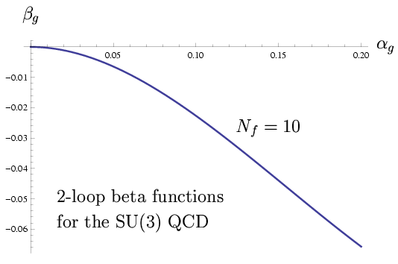
Introduction
Quest on the beta function
  How can the beta function transform to
  the confining one smoothly?
  ⇒ Need non-perturbative analysis of the beta
  function in the conformal window.
Wilson (exact) renormalization group
    Scale invariance:
    The Wilson RG is suitable for the analyses of
    scale invariant theories (or phase transition).
    Non-perturbative analysis:
    In the Wilson RG, renormalized theories can be defined by the
    renormalized trajectories (RTs) without perturbative expansion.
    The non-perturbative beta functions can be given by scale
    transformation on the RTs. J.Polchinski, N.P. B231 (1984)
    ⇒ So the ERG is a quite suitable framework!
?

Slide 4
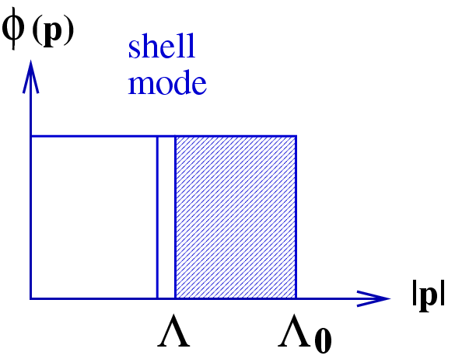
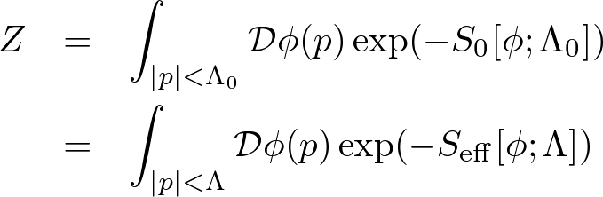
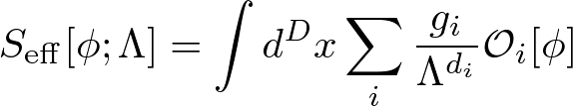

Non-perturbative beta function
Wilson RG
  Wilsonian effective action K.G.Wilson, I.G.Kogut (1974)
    Integrating out higher momentum modes
    : Wilsonian effective action contains infinitely many operators
  Exact RG
    Scale transformation of is given by the shell mode integration.
    The functional RG equation is given without perturbative expansion.

Slide 5

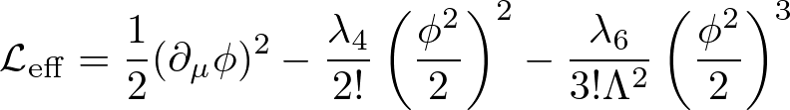
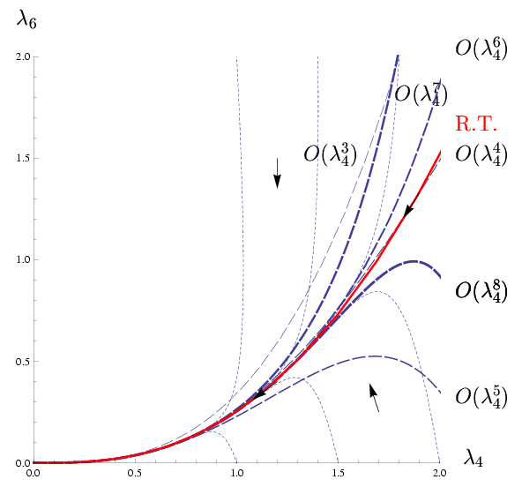
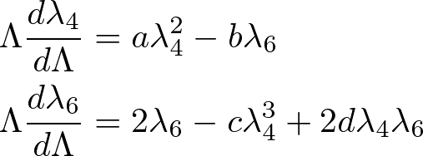
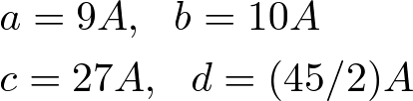

Non-perturbative beta function
Scalar field theory as a toy model
  RG flows in space (massless theory) J.Polchinski, N.P. B231 (1984)
    Operator truncation
    RG flow eqn (sharp cutoff limit)
    Renormalized trajectory (RG flow in
    the continuum limit) ⇔ renormalized theory (or phi-4 theory)

Slide 6
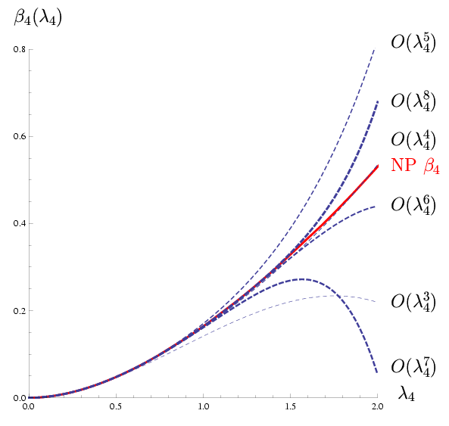

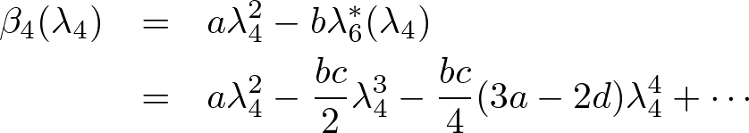
Non-perturbative beta function
  Renormalized trajectory
    Perturbative analysis
  Non-perturbative beta function
    Renormalized trajectory
    We can find the RT numerically
    without perturbative expansion.
    “Non-perturbative” beta function
    The beta function of a renormalized
    parameter is given by the scale
    transformation on the RT.
Perturbative
Beta function
“Non-perturbative”
Beta function

Slide 7



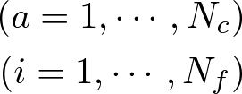

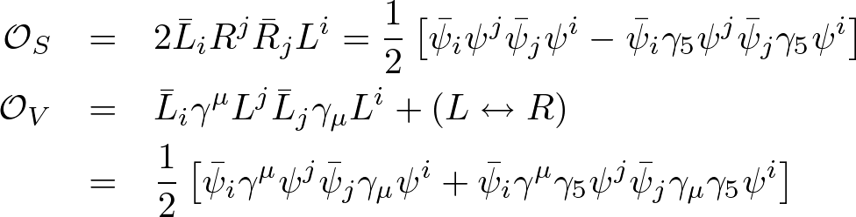
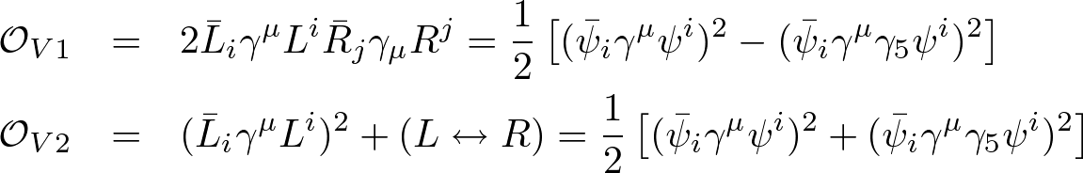
RG flow equations for SU(N) gauge theories
Wilsonian effective action
  Four-fermi operators
    Important to describe the chiral symmetry breaking
    Symmetries
      Gauge symmetry :
      Chiral flavor symmetry :
      Parity
    4 invariant four-fermi operators

Slide 8


RG flow equations for SU(N) gauge theories
  Spontaneous breaking of the chiral symmetry
      K.-I.Aoki, K.Morikawa, W.Souma, J.-I.Sumi, H.T.,M.Tomoyose,
      PTP97 (1997), PTP102 (1999), PRD61 (2000)
    ⇒ Chiral symmetry breaking
  Approximation scheme
    Operator truncation
    We discard all gauge non-invariant corrections.
    Note: Cutoff breaks gauge invariance. Gauge non-invariant
    corrections may be controlled by the modified WT identities.

Slide 9
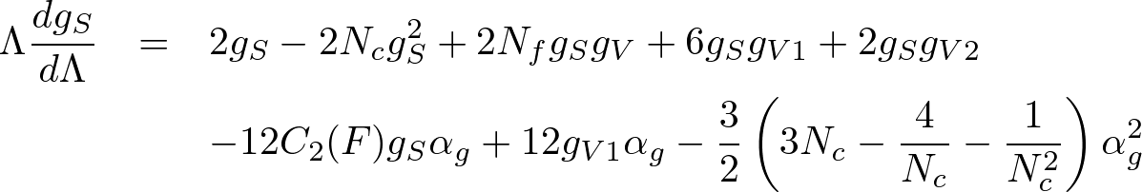
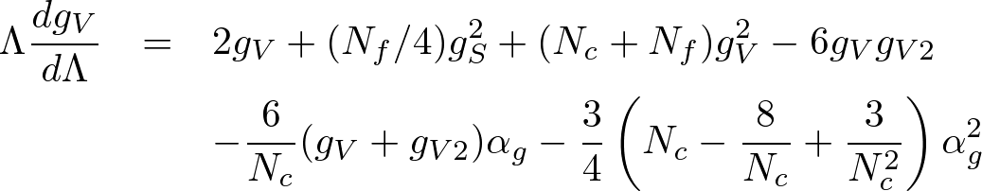
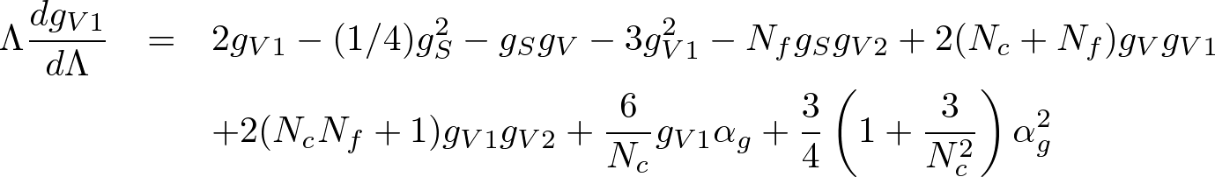
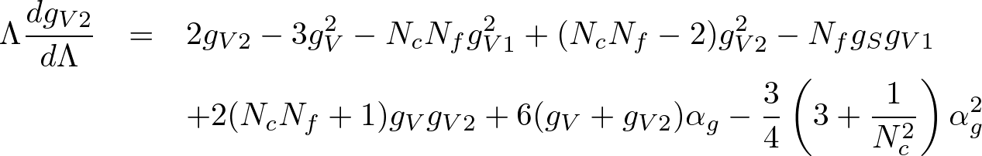
RG flow equations for SU(N) gauge theories
RG flow equations （sharp cutoff limit）
  Four-fermi couplings
H.Gies, J.Jackel, C.Wetterich, PRD 69 (2004)
    H.Gies, J.Jackel, EPJC 46 (2006)

Slide 10


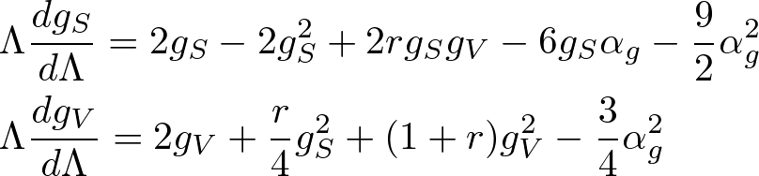
RG flow equations for SU(N) gauge theories
  Loop corrections for the four-fermi operators
  Large Nc, Nf limit
    rescale as
    Note: The four-fermi couplings gV1, gV2 do not involve in the large Nc
    and Nf limit.
    Note: The large Nc corrections contain only the ladder diagrams.
    But the non-ladder ones come through the large Nf part.

Slide 11
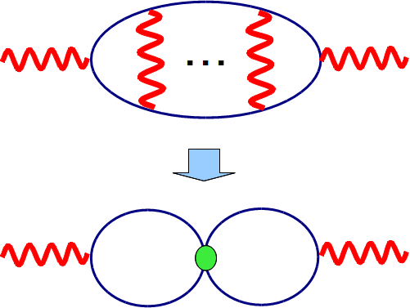


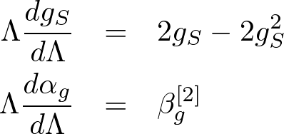
RG flow equations for SU(N) gauge theories
  Gauge coupling
    We use the perturbative beta functions in the large Nc, Nf limit
    and add a part of higher order corrections via the four-fermi
    effective couplings.
    The higher order corrections via four-fermi
    effective operators should be incorporated
    into the vacuum polarization.
  Note: The improved ladder approximation is found to be equivalent to

Slide 12
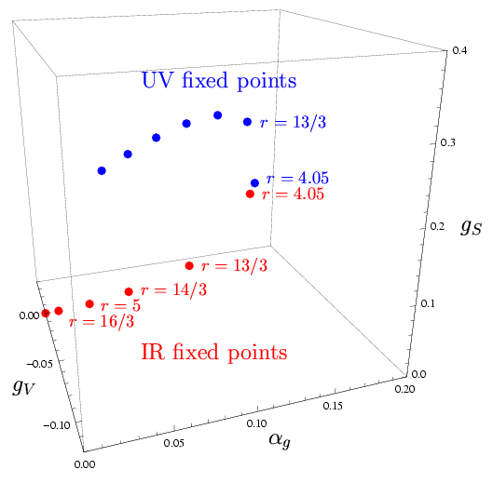

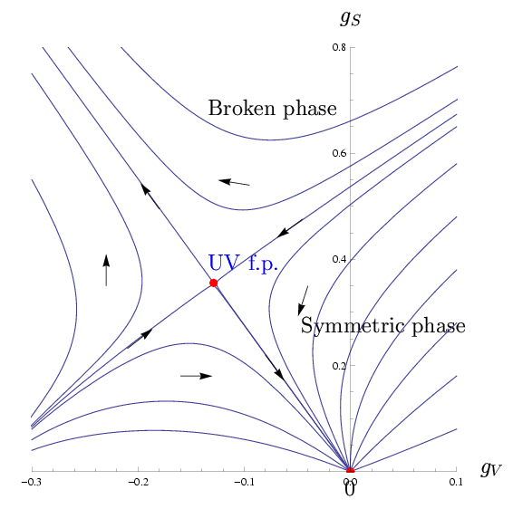
Aspect of RG flows
Numerical analysis of the flow equations
  RG flows in large Nc and Nf
    RG flows are given in 3 dimensional
    coupling space of .
  Fixed points in the conformal window
    A UV fixed point exists as well as the IR
    fixed point.
    The UV fixed point and the IR fixed point
    merge with each other at r = 4.05.
  RG flows in (gS, gV) space
  = generalized NJL model
    One linear combination of gS and gV gives
    the relevant operator, which induces the
    chiral phase transition.

Slide 13
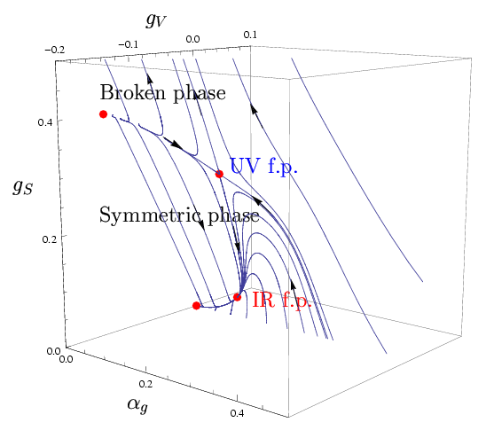
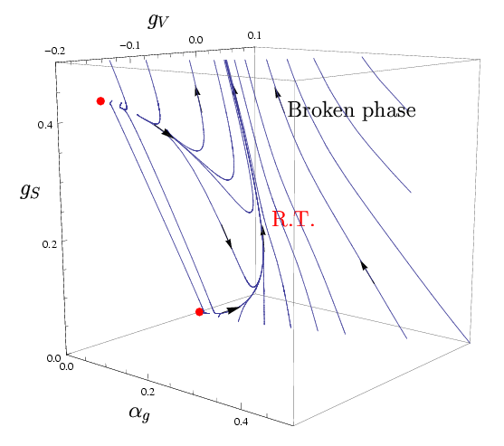


Aspect of RG flows
  RG flows in the 3D space
    There is the phase boundary of chiral symmetry and the UV fixed
    point lies on the boundary.
    Flows in the unbroken phase approach towards the IR fixed point.
    The phase boundary disappears for r < 4.05 and the entire region
    becomes the broken phase.

Slide 14
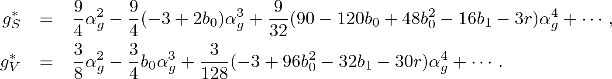
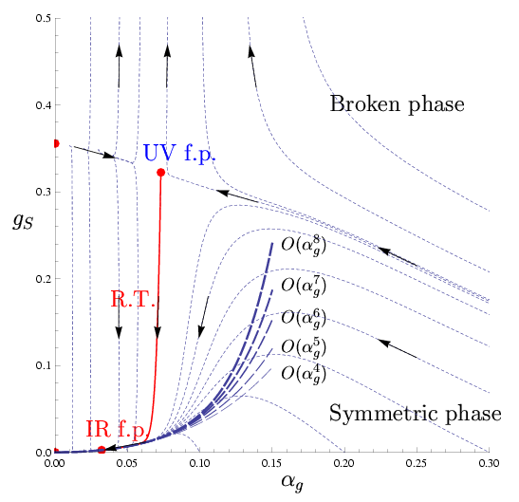

“Non-perturbative” gauge beta functions
RT in the conformal window
  Perturbative RT
    We may extract the RT by solving the truncated RG flow equations with
    perturbative expansion, and find good convergence up to the IR f.p.
    Note: These equations give continuum
    limit of the truncated ERG equations,
    not the full QCD.
    This “RT” does not seem to give a
    continuum limit beyond the IR f.p..
    However this “RT” seems to survive
    for Nf > (11/2)Nc.
    Note: Related with absence of the
    continuum limit of QED?

Slide 15
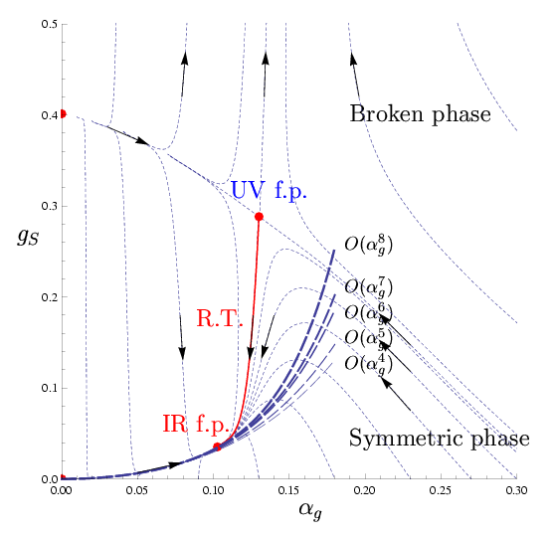
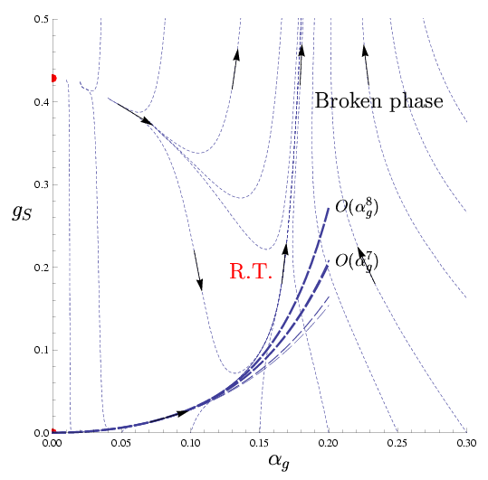
“Non-perturbative” gauge beta functions
  RTs near boundary of the conformal window
    The perturbative continuum limit lines approach towards the
    non-perturbative RT as the flavor number is lowered.
    Out of the window, the fixed points disappear. However the non-
    perturbative RT survives as the RT of the asymptotically free QCD.
    The perturbative continuum limit seems to converge towards the
    RT.

Slide 16
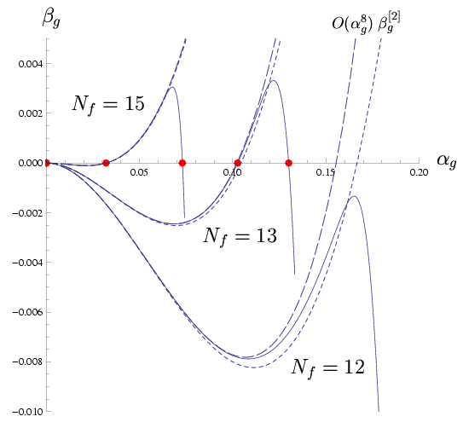
“Non-perturbative” gauge beta functions
Perturbative
beta function
Non-perturbative
Beta function
Non-perturbative gauge beta functions
    We define the non-perturbative gauge beta function by scale
    transformation of the gauge coupling on the RTs.
    A UV fixed point appears in the gauge beta function due to non-
    perturbative corrections induced through the four-fermi operators.
    The UV fixed point gives the phase
    boundary of chiral symmetry.
    The UV fixed point appears below
    the critical gauge coupling.
  Note : Fermion decoupling ?
    The bending behavior of the beta
    function in the symmetric phase
    is not due to fermion decoupling.
    It is also so out of the conformal
    window.

Slide 17



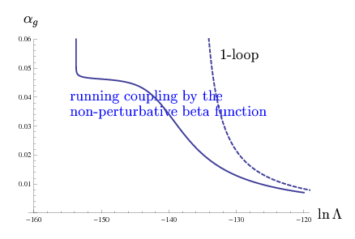
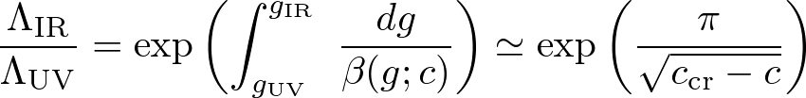

“Non-perturbative” gauge beta functions
Conformality lost and the Miransky scaling
V.A.Miransky, K.Yamawaki MPL A4 (1989); PRD 55 (1997)
  Conformality lost D.B.Kaplan, J-W.Lee, D.T.Son, M.A.Stephanov, PRD 80 (2009)
    The IR fixed point merges with the UV fixed point
    at the edge of conformal window.
    Suppose the parabolic beta function given by
    Then the fixed point couplings are .
    BKT type phase transition for
    Dynamical mass scale
    : Miransky scaling
    Note: Running effect is sizeable !

Slide 18
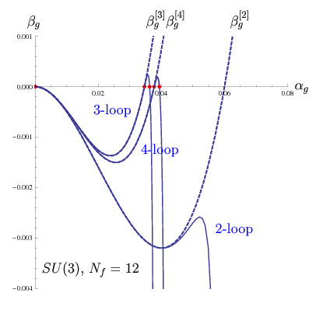



Anomalous dimensions in many flavor QCD
Critical flavor number
  Quantitative analysis for the many flavor
  SU(3) QCD for comparison with the lattice.
    Solve the RG equations with a finite Nf,.
    Use 2-, 3,- and 4-loop perturbative
    beta functions in the flow equation.
  Critical flavor numbers
    Note: Some lattice analyses indicate that QCD with 12 flavors has
    the IR fixed point.

Slide 19

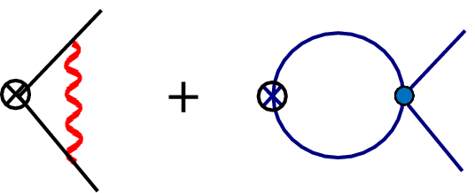

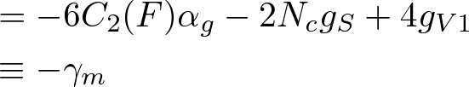
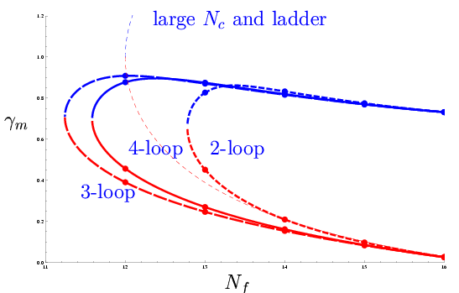
Anomalous dimensions in many flavor QCD
Anomalous dimensions of fermion mass
  Anomalous dimension of in the ERG approach
    RG scheme and gauge independent at the fixed points
  Results by the RG equations
    Note: the anomalous dimension
    is fairly suppressed compared
    with the conventional value in
    the large N and ladder approx.
  Lattice MC results
    e.g. T.Appelquist et.al. (2011)
    The 3- and 4-loop results are close to the lattice MC estimations.

Slide 20
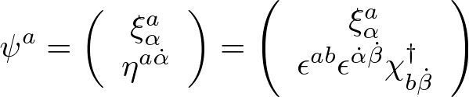
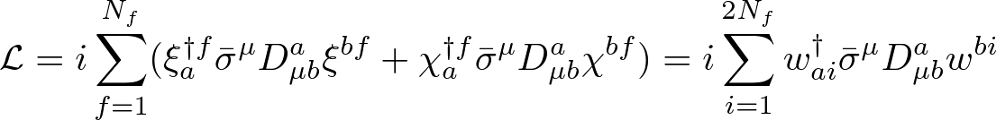

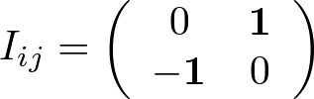
SU(2) gauge theories
: SU(2Nf) invariant
Fundamental quarks
  SU(2Nf) chiral symmetry
    Speciality of SU(2)
    Use of 2-component spinors:
    Chiral symmetry breaking:
    mass term :
  Invariant four-fermi operators
    2 independent operators

Slide 21
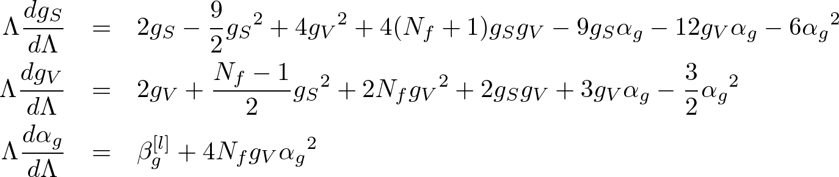
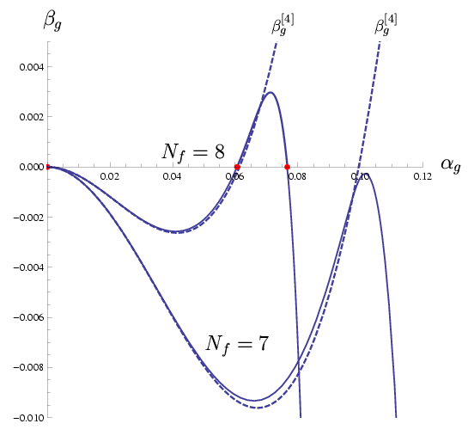
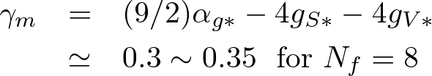
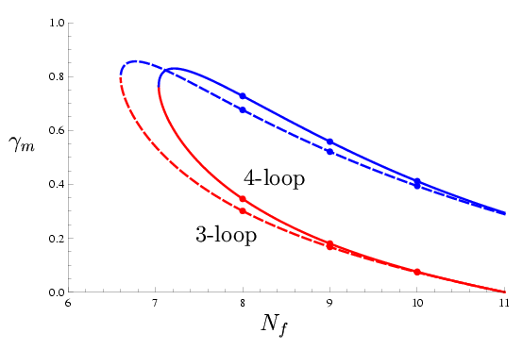
SU(2) gauge theories
  RG flow equations
  Anomalous dimension

Slide 22

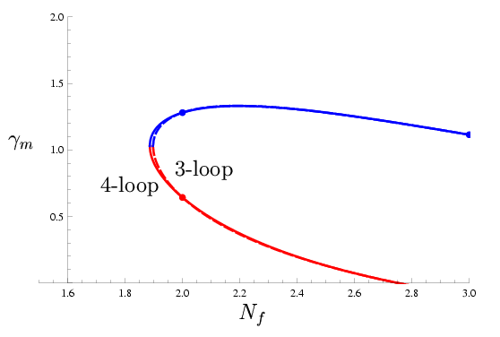
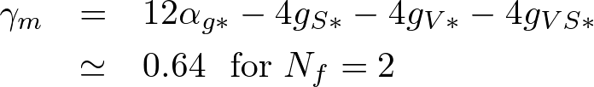
SU(2) gauge theories
Adjoint quarks
  SU(2Nf) chiral symmetry
    Chiral symmetry breaking:
    mass term:
  Invariant four-fermi operators
    3 independent operators
  Anomalous dimension
    MC simulation
    e.g. DeGrand et.al. PRD 83 074507 (2011)

Slide 23

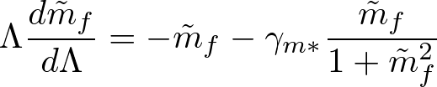

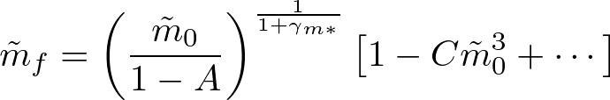

Hyper scaling in the mass deformed theories
Scaling of the explicit fermion mass
  Recent lattice analyses
    MC simulations of mass deformed QCD (adding a bare fermion mass)
      L.Del Debbio, R.Zwicky, PRD82 014502 (2010); arXiv:1009.2894
      Z.Foder et. al. arXiv:1104.3124
      T.Applequist et.al. arXiv:1106.2148
  Scaling law on the fixed point
    We consider the dimensionless mass parameter
    The RG eqn for a fermion mass and IR enhancement
    Quark mass at the decoupling scale:

Slide 24
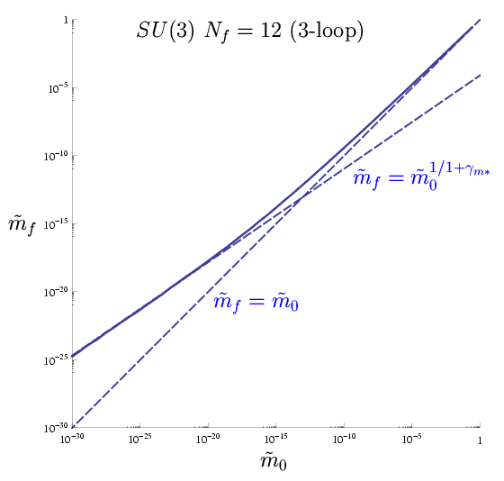
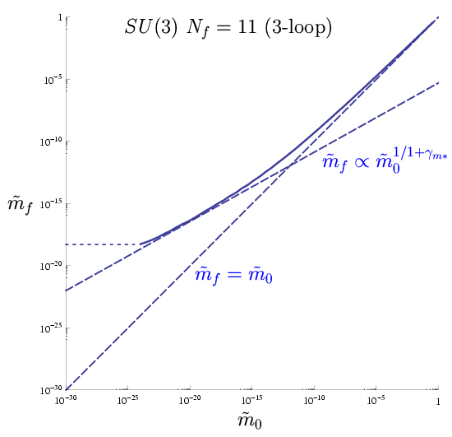
Hyper scaling in the mass deformed theories
  Scaling laws in the vicinity the conformal window
    We may solve the RG equations for the effective couplings including
    the fermion mass m on the RT numerically.
    It seems to be difficult to distinguish whether the theory is conformal
    or chirally broken.
    It is necessary to see dynamical mass generation to future work .

Slide 25
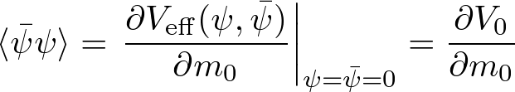





Hyper scaling in the mass deformed theories
Hyper scaling of the chiral condensate
    We may evaluate the chiral condensate from the Wilsonian effective
    potential as;
    Evaluation by the ERG equations
    by evaluating V0 at the decoupling scale , we obtain
    The linear term (contact term) is dominant for .
    ⇒ Therefore, it seems to be difficult to see the hyperscaling relation.

Slide 26
Summary and discussions
  Summary
    We extended the RG flow equation for the gauge coupling so as to
    include the “non-perturbative” corrections through the effective
    four-fermi operators.
    We gave the non-perturbative gauge beta functions by scale
    transformation on the RT, which shows merge of the UV and the
    IR fixed points. ⇒ manifestation of the “conformality lost” picture.
    The anomalous dimension of the fermion mass and the critical flavor
    number were estimated for SU(3) and SU(2) gauge theories.
    The hyper scaling of the fermion mass and the chiral condensate in the
    mass deformed QCD were also discussed in the RG framework.
  Issues remained for future studies
    Confirmation of the phase boundary in the conformal window.
    Improvement of the approximation scheme.
    Evaluation of the chiral order parameters near the conformal boundary.
    ・・・・・

Slide 27
END
Thank you!

Slide 28





Non-perturbative beta function
Exact RG equations K.G.Wilson, I.G.Kogut (1974)
    IR cutoff generating function C.Wetterich (1993)
    IR cutoff propagator
    Cutoff effective action
    Legendre flow equation (Wetterich eq.)

Slide 29
Non-perturbative beta function
Convergence of the operator truncation
  3d scalar theory
    There is an IR fixed point.
    The beta function for the 4 coupling rapidly converges as improving
    the operator truncation in the ERG.
    This is sharp contrast with the perturbative series.
Non-perturbative beta functions
Perturbative beta functions

Slide 30



RG flow equations for SU(N) gauge theories
Invariant four-fermi operators
  Apparent invariants

Slide 31






RG flow equations for SU(N) gauge theories
  Fiertz identities
  Current-current interactions

Slide 32


RG flow equations for SU(N) gauge theories
Note
  Higher order correction to the vacuum polarization
    Here we consider to take in the abelian gauge
    type corrections, which are partly given as
    corrections via effective four-fermi operators.
    In the large Nc limit, the four-fermi operator
    OV is generated.
    For the 3-loop correction, the induced coupling is given by
    In large Nc, the induced effective operator is represented as
    Therefore it may be regarded as a 2-loop
    correction with the effective coupling.

Slide 33

RG flow equations for SU(N) gauge theories
  Gauge coupling
    We use the perturbative beta functions in the large Nc, Nf limit
    and add a part of higher order corrections via the four-fermi
    effective couplings.
    Vertex correction : H.Gies, J.Jackel, C.Wetterich, PRD 69 (2004)
    We discard all vertex corrections with the four-fermi couplings,
    since the gauge symmetry should forbid them.
    Vacuum polarization :
    The higher order corrections via four-fermi
    effective operators should be incorporated
    into the vacuum polarization.

Slide 34

RG flow equations for SU(N) gauge theories
  Modification of the 2-loop beta function
    We may evaluate divergence in the effectively 2-loop vacuum
    polarization as
    Eventually we may incorporate the higher order corrections via the
    four-fermi operator in the 2-loop gauge beta function as

Slide 35








Scaling laws in nearly conformal theories
  Approximation by a parabolic function
    We may approximate the RT as a parabolic function as follows;
    Expand the RG flow equations around the critical fixed point.
    : effective couplings near a fixed point
    Note: An exactly marginal operator appears at fixed point merger.
    The RT passes along the exactly marginal direction
    .
    Extract the beta function along
    the exactly marginal direction.
    3. Find the (imaginary) fixed points
    for a off-critical flavor number Nf.

Slide 36



Scaling laws in nearly conformal theories
  Dynamical scale of the chiral symmetry breaking
    Running effect must be taken into account in the broken phase.
    J.Braun,C.S.Fischer,H.Gies arXiv: 10124279
    The four-fermi coupling diverges at the dynamical scale .
    Note: Breakdown of the description in terms of the local fermi fields
    indicates the spontaneous chiral symmetry breaking.
      K-I.Aoki et al.PTP 97 (1997); PTP 102 (1999); PRD 61(2000)
    Take difference with obtained by the 1-loop beta function.
  Approximation for the scaling law
    Large deviation from the Miransky
    scaling.
    Fit with perturbative beta functions
    + the parabolic function is good.

Slide 37




RG flow diagrams for SU(2) gauge theories
  Fundamental quarks
    Nf = 8 and 7
  Adjoint quarks
    Nf = 2 and 1.8

