Slide 1
Solving non-perturbative renormalization group equation without field operator expansion and its application to the dynamical chiral symmetry breaking
Daisuke Sato
(Kanazawa U.)
with Ken-Ichi Aoki
(Kanazawa U.)
@ SCGT12Mini

Slide 2
Non-Perturbative Renormalization Group (NPRG)
Analyze Dynamical Chiral Symmetry Breaking (D$χ$SB) , which is the origin of mass in QCD and Technicolor, by NPRG.
NPRG Eq.:
Wegner-Houghton (WH) eq.
(Non-linear functional differential equation )
Field-operator expansion has been generally used in order to sovle NPRG eq.
Convergence with respect to order of field-operator expansion is a subtle issue.
We solve this equation directly as a partial differential equation.
Notes:
Today, I’d like to talk to you about the analysis of the dynamical chiral symmetry breaking by non-perturbative renormalization group.
This phenomena is the origin of mass in QCD and Technicolor.
The NPRG eq. describes the dependence of this effective action on the renormalization scale \Lambda.in terms of differential equation.
We use this Wegner-Houghton eq. among several types of NPRG equations.
This equation is given by form of nonlinear partial differential equation, so we usually use field operator expansion in order to solve this equation.
Therefore there is a problem about the convergence of the expansion.
So today we solve NPRG eq. directly as partial differential equation.
Next slide, breafly, I explain the physical meanign of the right hand side of WH eq, called beta function.

Slide 3
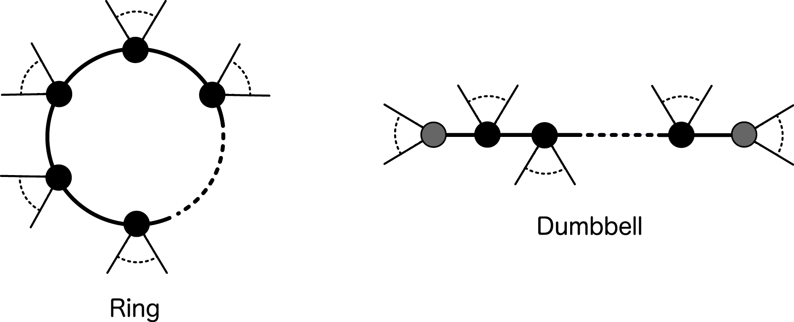
Wilsonian effective action:
: Renormalization scale （momentum cutoff）
Change of effective action
Shell mode integration
1-loop exact!!
Notes:
The central object in NPRG is the wilsonian effective action, which is defined by integrating field with higher momentum than the scale \Lambda in the partition function.
We can evaluate the infinitesimal differnce with repsect to the renoamlization scale.
The difference have the two terms including something like inverse propagator whose momentum is the shell mode.
And they have the infinite number of field operator.
So we can represent the two terms by Ring-type diagrams and Dumbbell-type diagrams, respectively.
( The internal lines represent shell mode propagators and the external lines represent the fields

Slide 4
Local potential approximation ( LPA )
Set the external momentum to be zero when we evaluate the diagrams.
Fix the kinetic term.
Equivalent to using space-time independent fields.
zero mode operator
Momentum space
renormalization group equation for coupling constants
Field operator expansion
Notes:
Unfortunately we can not solve the WH eq. exactly.
Hence we use Local potential approximation.
Here we set the external momentum to be zero when we evaluate the diagrams .
And we fix the kinetic term.
This manipulation is equivalent to using space-time independent fields.
As this result, Dumbbell-type diagrams vanish
(because the size of the momentum of the internal propagators can not became the renormalization scale.)
So we evaluate only the ring-type diagrams.
Using the field operator expansion, we can obtain the renormalization group equation for the coupling constants.

Slide 5
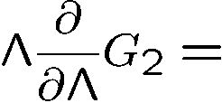
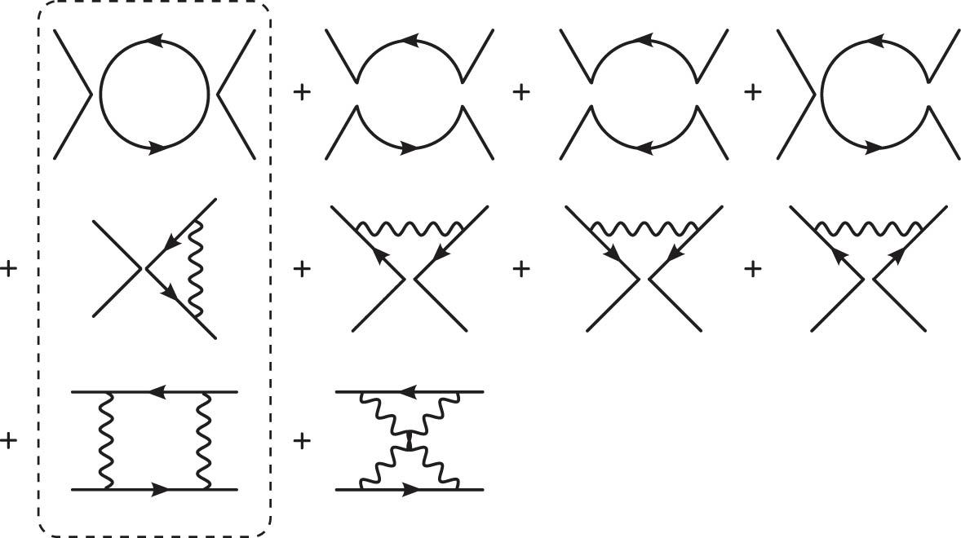
NPRG and Dynamical Chiral Symmetry Breaking (D$χ$SB) in QCD
Wilsonian effective action of QCD in LPA
: effective potential of fermion, which is central operators in this analysis
field operator expansion
NPRG Eq.:
the gauge interactions generate the 4-fermi operator, which brings about the D$χ$SB at low energy scale, just as the Nambu-Jona-Lasinio model does.
Notes:
From this slide, I’d like to explain about the analysis of dynamical chiral symmetry breaking in QCD.
We analyze the effective action of QCD given by bare QCD and …
We expand this effective potential by ifinite number of the field operators like 4-fermi, 8-fermi interaction, and more.
These running coupling constant is given by this NPRG eq.
Especially, we can obtain the beta function for 4-fermi coupling constant from these diagrams,
(which tell us how chiral symmetry breaks as follows.)
Lowering the renomalization scale from initial scale, the 4-fermi operators are generated by the gauge interactions, described by these diagrams.
The quantum correction by

Slide 6
How to deal with D$χ$SB
Introduce the bare mass $m_{0}$ , which breaks the chiral symmetry explicitly, as a source term for chiral condensates $\left\langle \overline{ψ}ψ\right\rangle$.
Add the running mass term $m\overline{ψ}ψ$ to the effective action.
Lowering the renormalization scale $Λ,$the running mass $m(m_{0};Λ)$ grows by the 4-fermi interactions and the gauge interaction.
Taking the zero mass limit: $m_{0}→0$ after all calculation, we can get the dynamical mass,
K-I. Aoki and K. Miyashita, Prog. Theor. Phys.121 (2009)
Notes:
We introduce the bare mass m_0 as the external source breaking chiral symmetry explicitly for derivation of chiral condensate.
We add the mass term to the effecitve action in order to deal with spontaneous chiral symmetry breaking.
m_0 is the running mass at the initial scale.

Slide 7
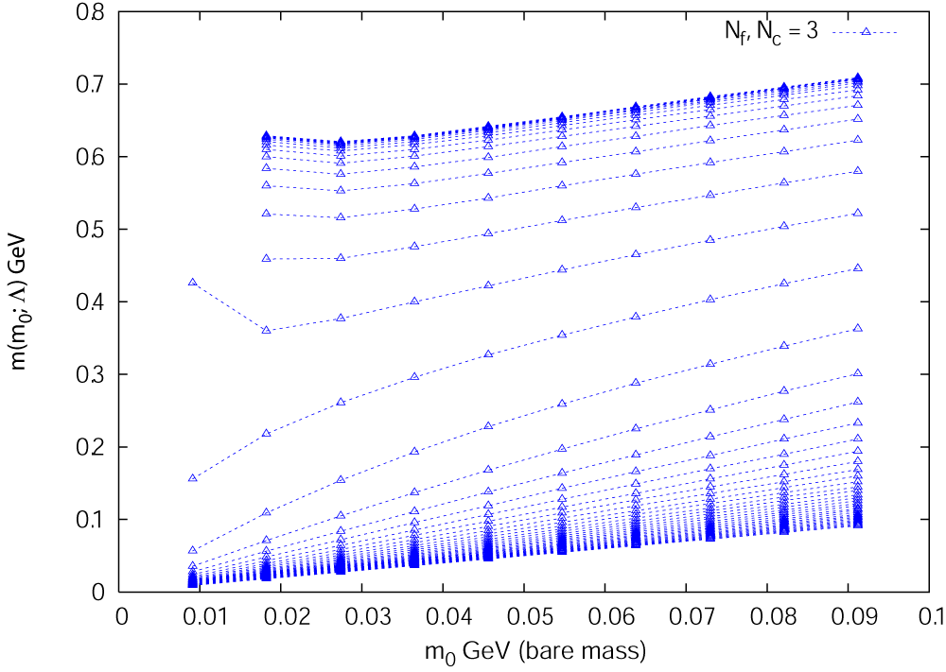
Renormalization group flows of the running mass and 4-fermi coupling constants
: 1-loop running gauge
coupling constant
Running mass plotted for each bare mass $m_{0}$
Chiral symmetry breaks dynamically.
Notes:
Next slide, we confirm that this method work well.
The left graph show running mass plotted for each bare mass and dashed line connect the same renormalization scale point.
At the high energy scale, running mass vanishes when bare mass goes toward zero. But at the low energy limit we get the nonzero dynamical mass.
So we can confirm that chiral symmetry breaks dynamically.
However, we consider only RG eq.s for mass operator and 4-fermi operator in this analysis.

Slide 8
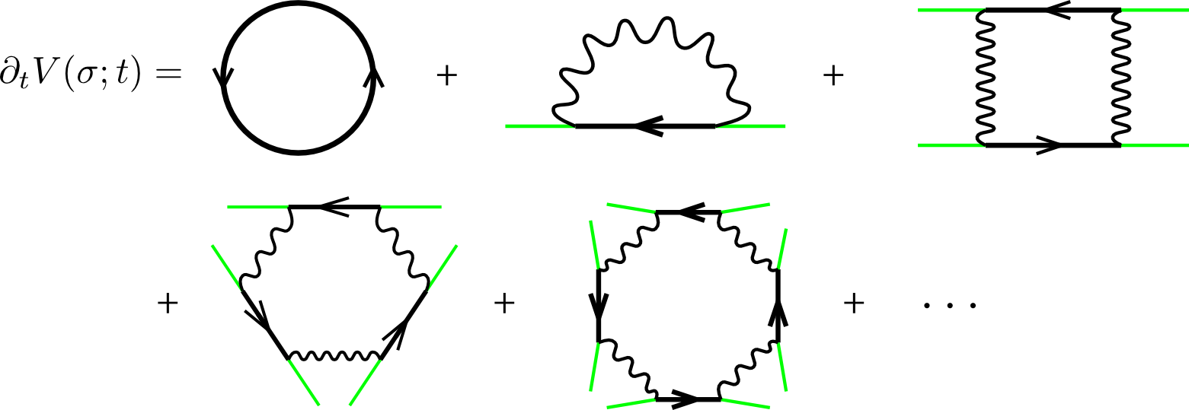
Ladder Approximation
Limit the NPRG $β$ function to the ladder-type diagrams for simplicity.
Extract the scalar-type operators ${\left(\overline{ψ}ψ\right)}^{n}$, which are central operators for D$χ$SB.
Massive quark propagator including scalar-type operators
Notes:
So next we take into account of higher dimensional operator such as 6-fermi, 8-fermi and more.
For simplicity, we limit the NPRG eq. to ladder diagrams

Slide 9
Ladder-Approximated NPRG Eq.
Ladder LPA NPRG Eq. :
Non-linear partial differential equation with respect to $Λ$ and $σ$
(Landau gauge)
This NPRG eq. gives results equivalent to improved Ladder Schwinger-Dyson equation.
Aoki, Morikawa, Sumi, Terao, Tomoyose (2000)
Expand this RG eq. with respect to the field operator $σ$ and truncate the expansion at $N$-th order.
: order of truncation
Coupled ordinary differential eq. (RG eq.) with respect to $G_{n}(Λ)$
Running mass:
Convergence with respect to order of truncation?
Notes:
We do resumation with respect to \sigma, so that we can obtain Laddder-Approximated NPRG eq. in terms of non-linear partial differential equation with respect to t and \sigma.
When we solve the equation like this, we usually expand this equation with respect to the field operator \sigma and truncate the expansion at N-th order.
And we can get the coupled ordinary differential equation with respect ot G_n, which is coefficient of the expansion of the potential.
Of course, Running mass is G_1, which is first derivative of the potential with respect to \sigma at \sigma = 0.
But there are problem of the convergence with repspect to order of truncation. And if we don’t …

Slide 10
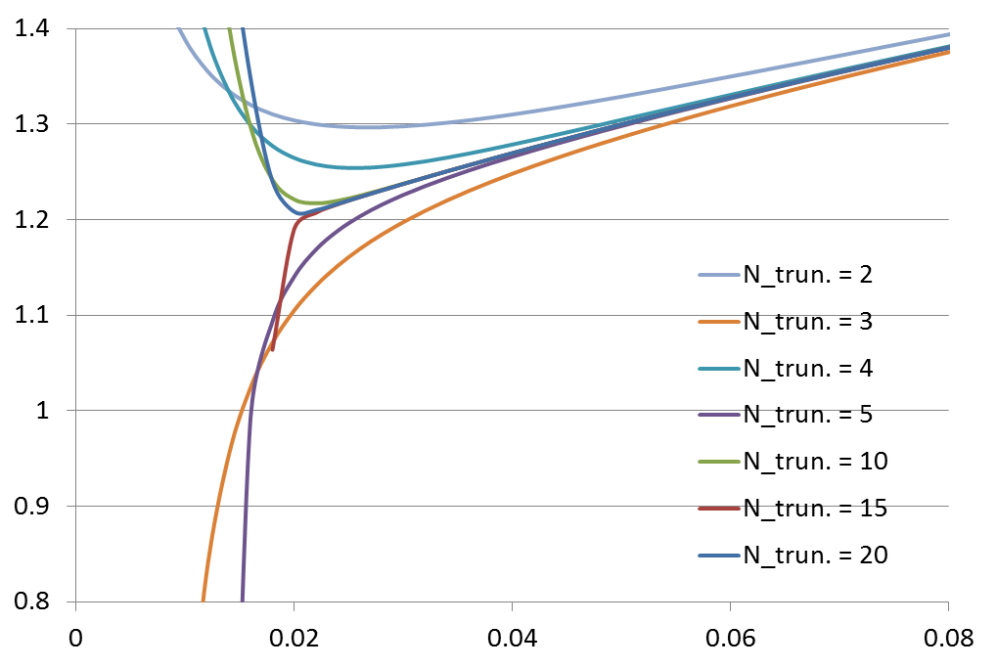
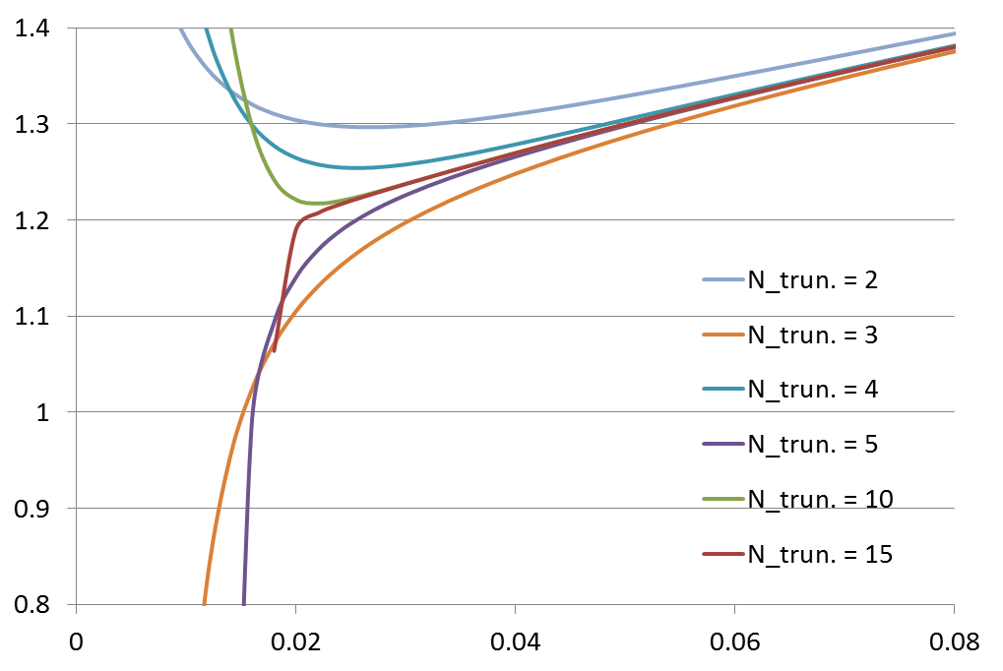
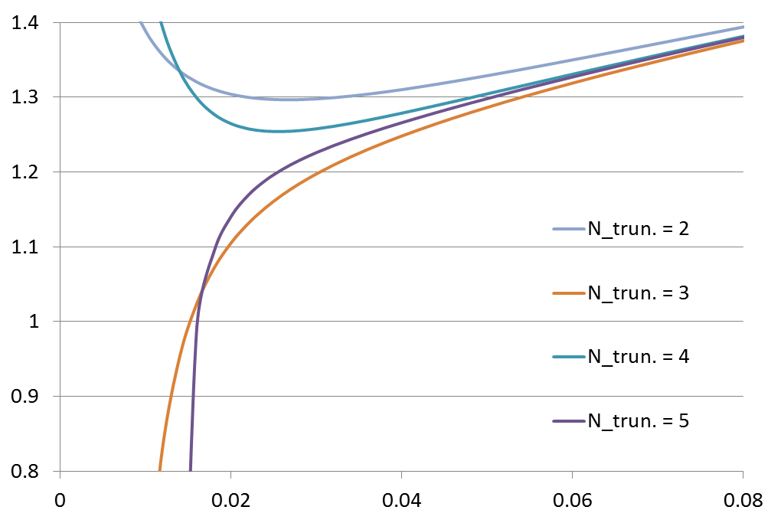
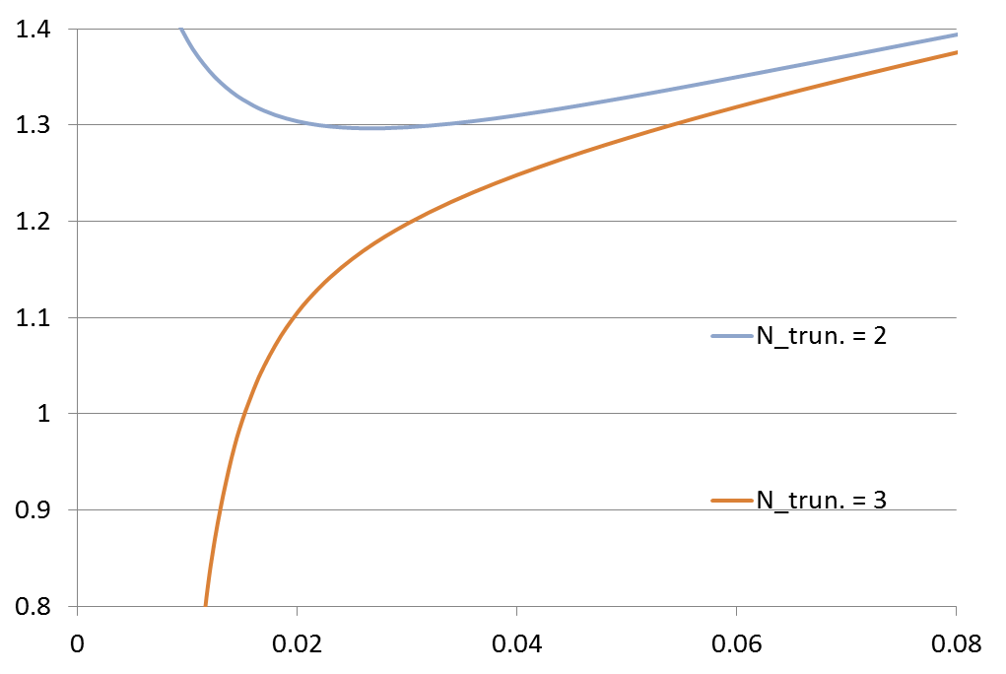
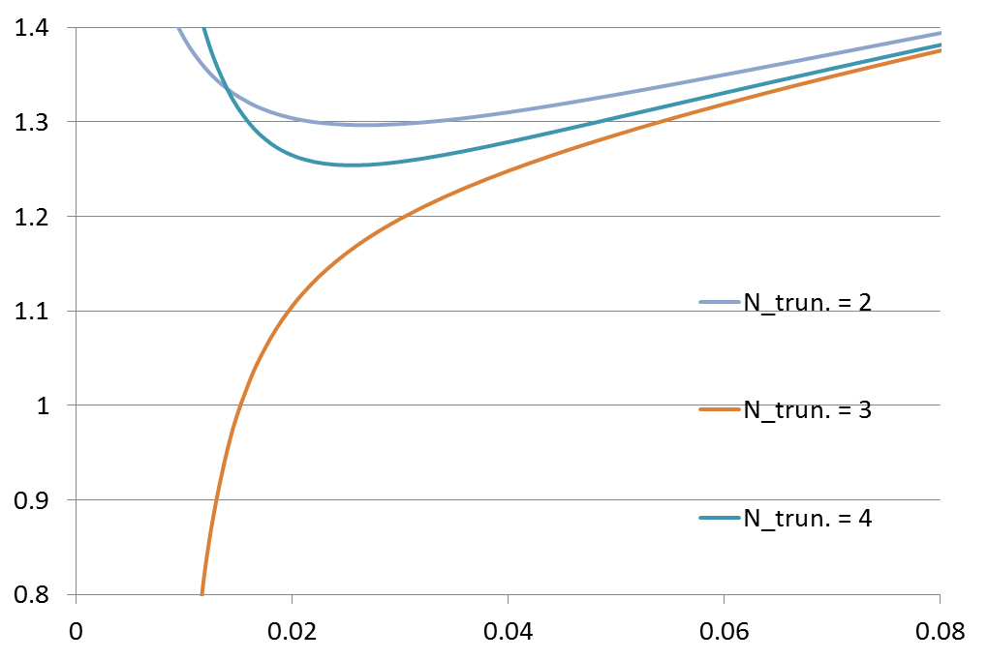
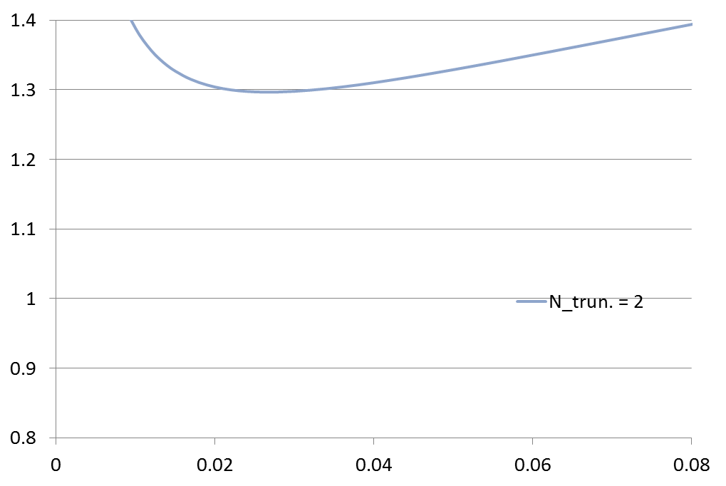
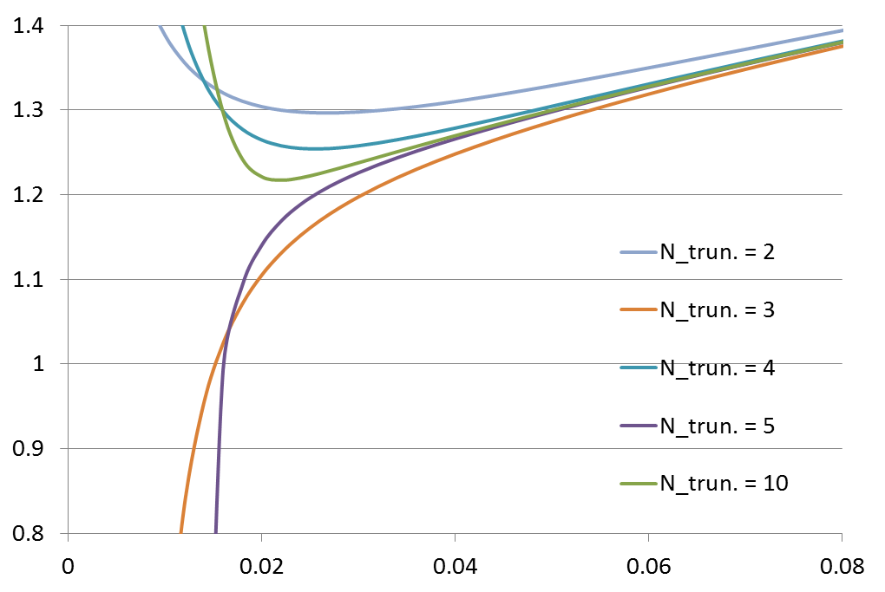
Convergence with respect to order of truncation?

Slide 11
Without field operator expansion
Solve NPRG eq. directly as a partial differential eq.
(Landau gauge)
Mass function
Running mass:
We numerically solve the partial differential eq. of the mass function by finite difference method.
Notes:
In order to avoid this difficulty, we solve NPRG eq. directly as partial differetial eq. without field operator expansion.
Here we parameterize the renormalization scale by t.
We want to know the dynamical mass, which is the first derivative of potential at origin.
So we numerially solve the partial differential eq. of this mass function by finite difference.
Here we use 1-loopg running gauge coupling constant, whose initial condition decide the breaking scale.
And the finite difference is done as the next slide.

Slide 12
Finite difference
Discretization :
Forward difference
Coupled ordinary differential equation of the discretized mass function $m_{k}\left(t\right).$
Notes:
We discretize the direction of \sigma, and replace the first derivative of mass function with respect to sigma by forward difference.
Therefore we get the coupled ordinary differential equation of the disretized mass function m_k.

Slide 13
Boundary condition
Initial condition:
: bare mass of quark (current quark mass)
source term for the chiral condensate $\left\langle \overline{ψ}ψ\right\rangle$
Boundary condition with respect to $σ$
Forward difference
We need only the forward boundary condition .
at
We set the boundary point $σ_{\text{end}}$ to be far enough from the origin ($σ=0$) so that $m(σ;t)$ at the origin is not affected on this boundary condition.

Slide 14
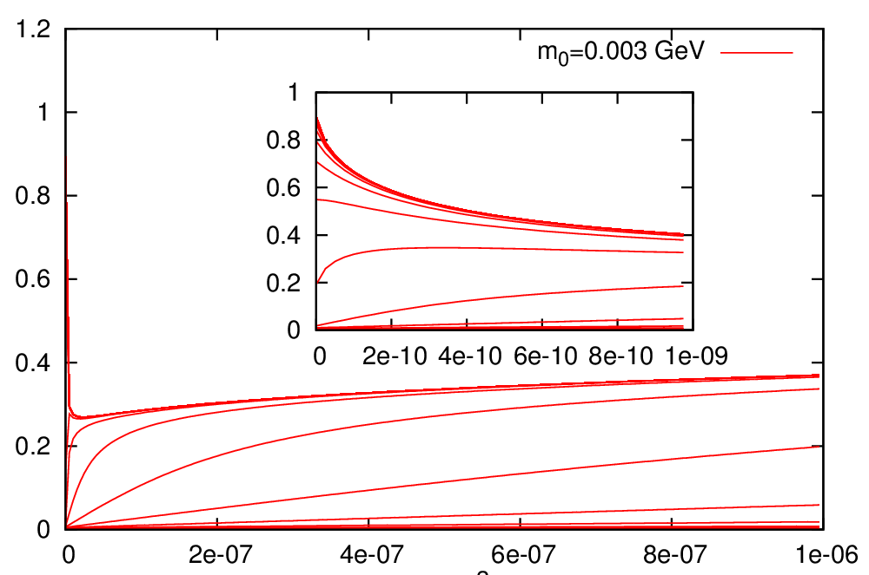
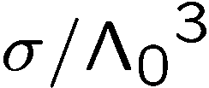
RG flow of the mass function
Notes:
(Explanation of the axes)
When we lower the renormalization scale, the mass function grows, and at infrared limit mass function at origin is much larger than bare mass

Slide 15
Infrared-limit running mass
Dynamical mass
Notes:
extrapolate the mass at origin from these 3 point by quadratic curve
Agree well with …

Slide 16
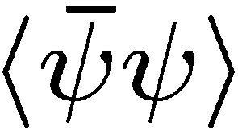
Chiral condensates
:source term for chiral condensate $\left\langle \overline{ψ}ψ\right\rangle$
free energy :
NPRG eq. for the free energy giving the chiral condensates
Chiral condensates are given by

Slide 17
Free energy
Chiral condensates
Notes:
From the sloap of the extrapolated curve at origin, we get
We extrapolate the chiral condensates

Slide 18
Gauge dependence
: gauge-fixing parameter
The ladder approximation has strong dependence on the gauge fixing parameter.

Slide 19
Improvement of LPA
Take into account of the anomalous dimension $η(Λ)$ of the quark field obtained by the perturbation theory as a first step of approximation beyond LPA
$η(Λ)$ plays an important role in the cancelation of the gauge dependence of the $β$ function for the running mass in the perturbation theory.
Notes:
In addition to the non-ladder extended approximation, we take into account the effects of the anomalous dimension of the quark filed obtained by the perturbative theory for the simplicity.
The anomalous dimension plays important role in the cancelation of the gauge dependence of the \beta function for the running mass in the perturbative thoery.

Slide 20
Ladder approximation with A. D.
The chiral condensates of the ladder approximation still has strong dependence on the gauge fixing parameter.
Notes:
The results are improved better than ladder approximation

Slide 21
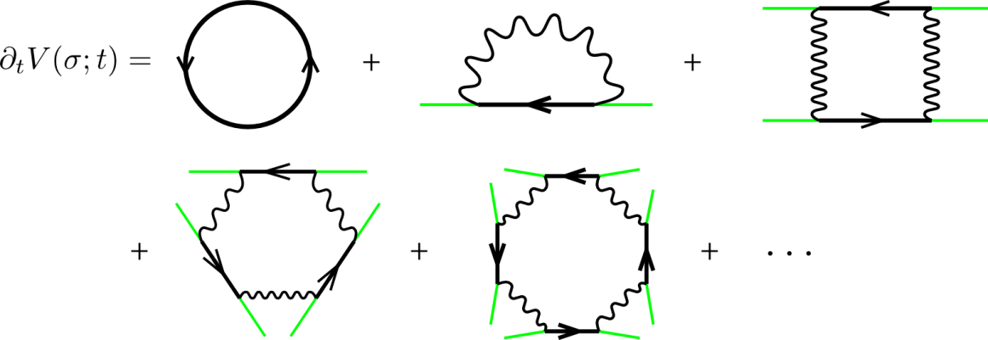
Approximation beyond “the Ladder”
Ladder
Crossed ladder
Crossed ladder diagrams play important role in cancelation of gauge dependence.
Take into account of this type of non-ladder effects for all order terms in $σ$.
Notes:
From here, we attempt to improve this gauge dependence.
In ladder app., we consider only the diagrams surrounded by black dashed line.
But this cross-ladder diagram plays important role in cancelation of gauge-fixing parameter.
So we take into account of this type of non-ladder effect with respect to infinite number of diagrams in order to improve the gauge dependence.

Slide 22
Approximation beyond “the Ladder”
Introduce the following corrected vertex to take into account of the non-ladder effects.
Ignore the commutator term.
K.-I. Aoki, K. Takagi, H. Terao and M. Tomoyose (2000)
Notes:
For this purpose, we introduce the following corrected vertex.
For simplicity, we ignore the commutator term and consider only abelian part .
( We believe that the effect of commutator is vanished by effective operators including gluon fields, which is omitted in our analysis.
And this abelian part is important in cancelation of gauge-fixing parameter. )

Slide 23
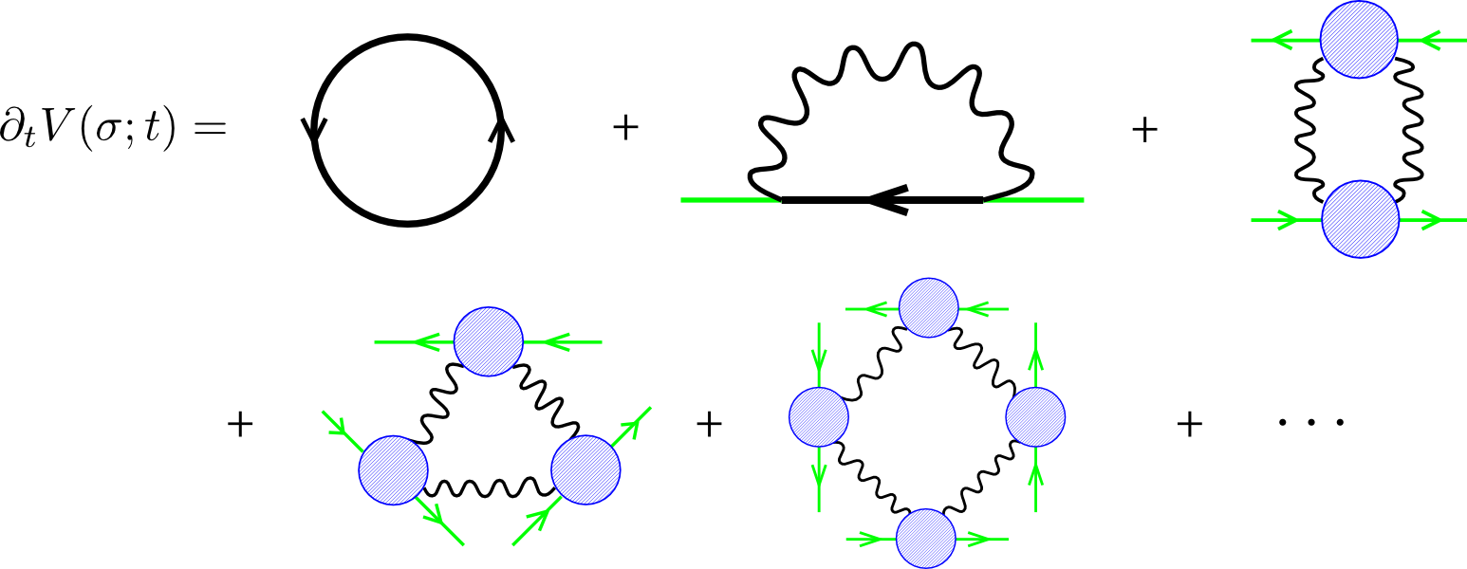
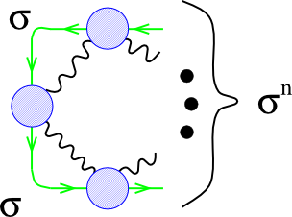
NPRG Eq. Beyond Ladder Approximation
NPRG eq. described by the infinite number of ladder-form diagrams using the corrected vertex.
Notes:
Then we can describe the NPRG eq. by the infinite number of ladder-form diagrams using corrected vertex.
And we can obtain the formulas of the diagrams with respect to any order of sigma, like this.
And we can resum the infinite number of the diagrams with respect to \sigma

Slide 24
Partial differential Eq. equivalent to this beyond the ladder approximation
Non-ladder extended NPRG eq.
Ladder-approximated NPRG eq.
Notes:
Eventually, we can obtain the following partial differential equation equivalent to this beyond the ladder approximation.
We can compare the dependence on the gauge-fixing parameter \xi between NPRG eq. including non-ladder effect and Ladder-approximated one.
Non-ladder extended NPRG eq. seems to be improved better for gauge dependence than ladder-approximated one.
Finally, let’s see the numerical result.

Slide 25
Non-ladder with A. D.
The chiral condensates agree well between
two approximations in the Landau gauge, $ξ=0$.
The non-ladder extended approximation is better.
$\left\langle \overline{ψ}ψ\right\rangle$ is an observable.
Notes:
Ladder result
On the other hand

Slide 26
Summary and prospects
We have solved the ladder approximated NPRG eq. and a non-ladder extended one directly as partial differential equations without field operator expansion.
Gauge dependence of the chiral condensates is greatly improved by the non-ladder extended NPRG equation.
In the Landau gauge, however, the gauge dependent ladder result of the chiral condensates agrees with the (almost) gauge independent non-ladder extended one, occasionally(?).
Prospects
Evaluate the anomalous dimension of quark fields by NPRG.
Include the effects of the running gauge coupling constant given by NPRG.
Notes:
Answers for the question and convenient phrases

Slide 27
Backup slides

Slide 28
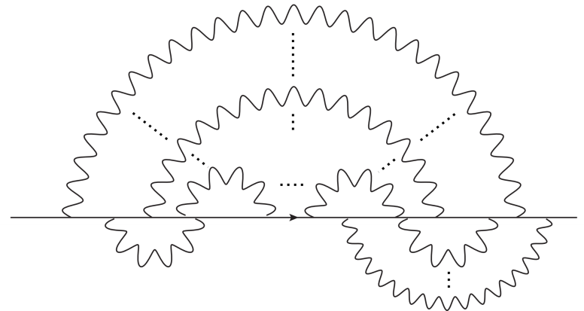
Beyond the ladder approximation
The Dyson-Schwinger Eq. approach is limited to the ladder approximation.
Ladder diagram
Non-ladder diagram
We can approximately solve the Non-perturbative renormalization group equation with the non-ladder effects.

Slide 29
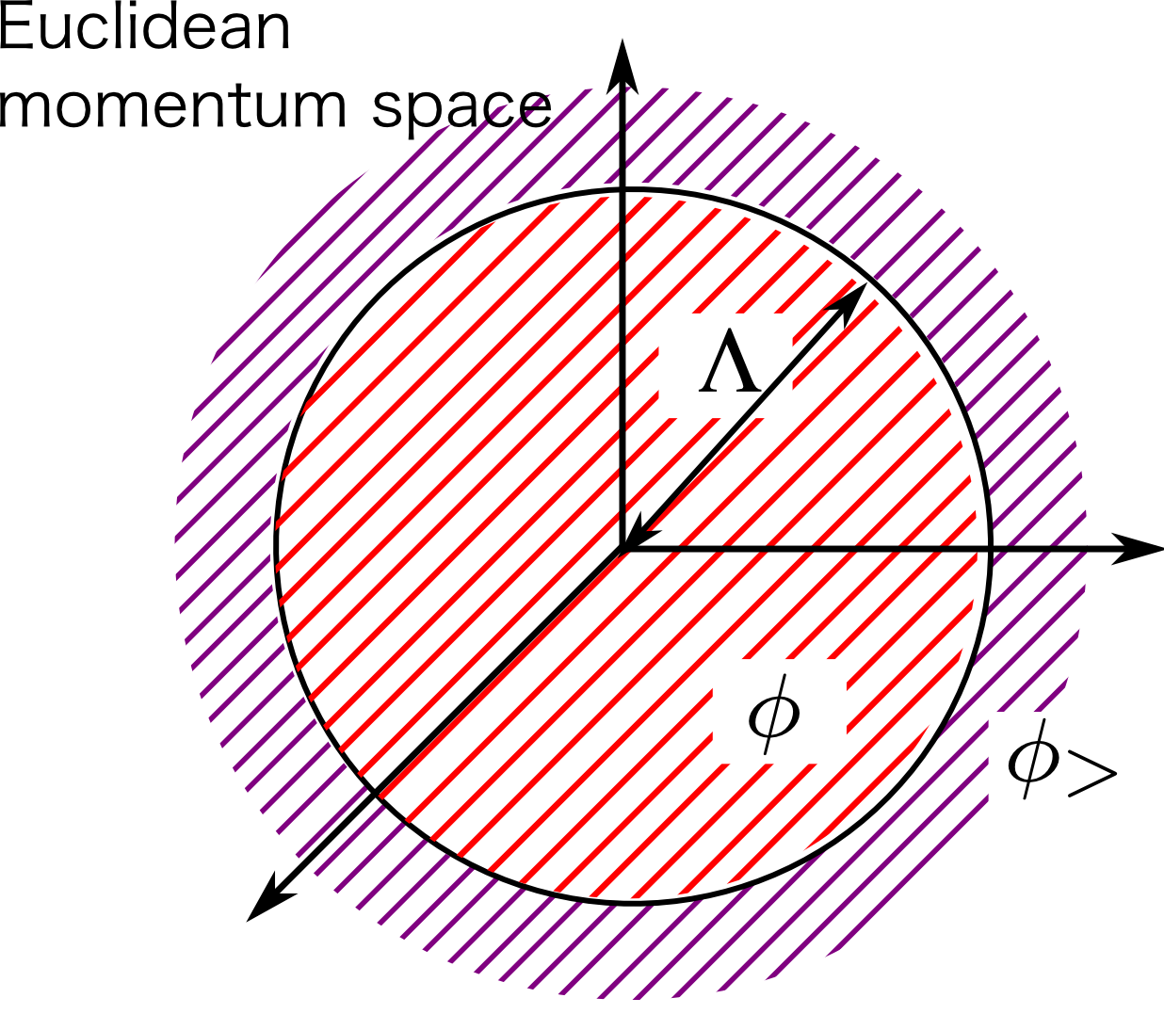
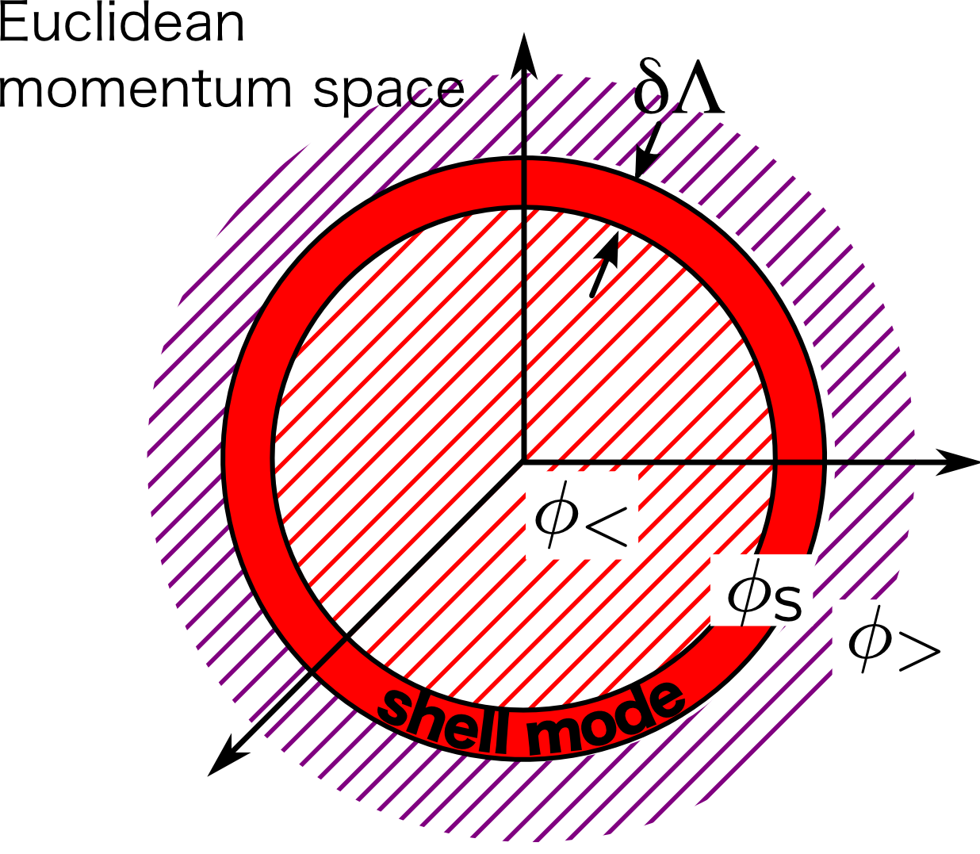
Shell mode integral
micro
macro
Shell mode integral:
Gauss integral

Slide 30
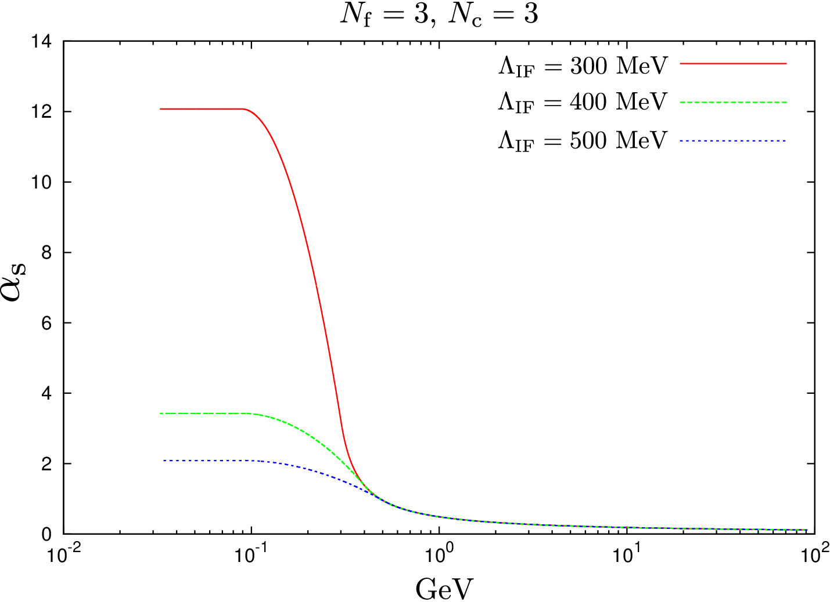
Running of gauge coupling constant
1-loop perturbative RGE
To take account of the quark confinement , we set a infrared cut-off for the gauge coupling constant.
1-loop perturbative RGE + Infrared cut-off
Notes:
stable to the Infrared cut-off

Slide 31
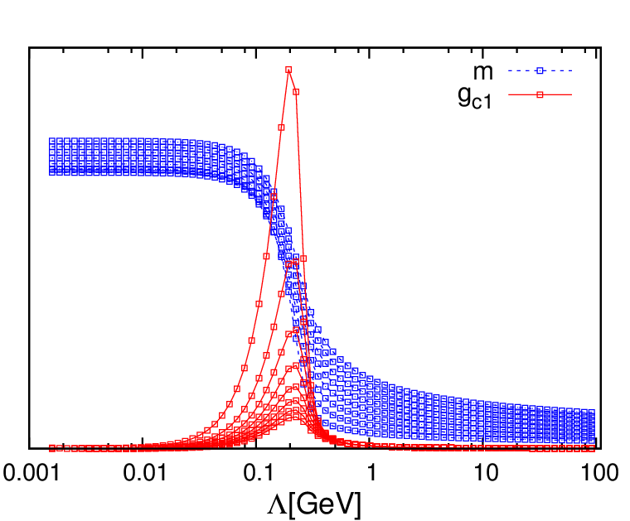
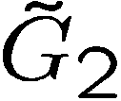
Renormalization group flows of the running mass and 4-fermi coupling constants
: 1-loop running gauge
coupling constant
Running mass $m$ grows up rapidly when the 4-fermi coupling constant $G_{2}$ is large.
Running mass plotted for each bare mass $m_{0}$
Chiral symmetry breaks dynamically.
Notes:
Next slide, we confirm that this method work well.
The left graph show running mass plotted for each bare mass and dashed line connect the same renormalization scale point.
At the high energy scale, running mass vanishes when bare mass goes toward zero. But at the low energy limit we get the nonzero dynamical mass.
So we can confirm that chiral symmetry breaks dynamically.
However, we consider only RG eq.s for mass operator and 4-fermi operator in this analysis.

Slide 32
Result of non-ladder extended app.
The chiral condensates agree well between
two approximations in the Landau gauge, $ξ=0$.
Notes:
Blue point is ladder-approximated result and magenta point is non-ladder extended result
There are not drastic improvement for gauge dependence.
But we can find a little improvement
And we can find that the chiral condensate of non-ladder result agree with ladder result.
So we guess that landau gauge seems to be good gauge.

