Slide 1
Phases of Gauge Theories
SCGT 12 Mini
Nagoya, March 19, 2012
Thomas Ryttov

Slide 2
Outline
  Phase Diagram
    Ladder approximation.
    Supersymmetric conformal window.
    Conjecture all-orders beta function.
    Four loop beta function and four loop anomalous dimension. SUSY and non-SUSY.

Slide 3
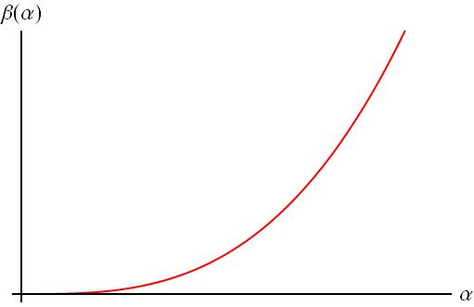
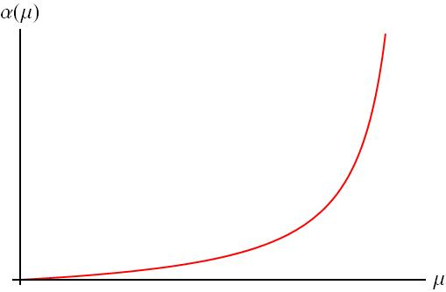
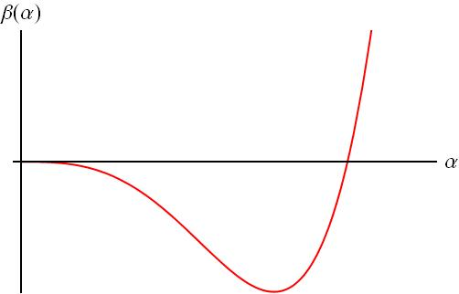
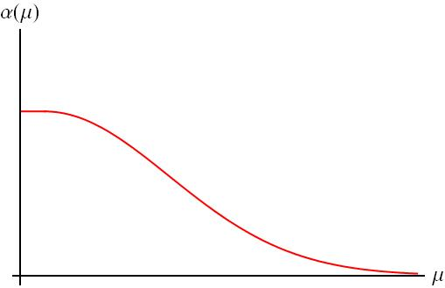
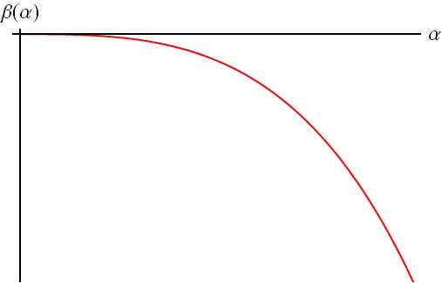
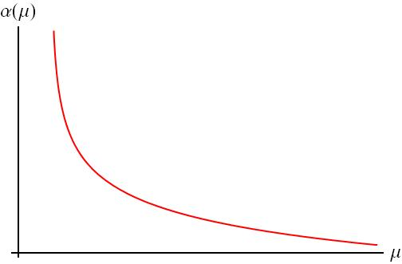
Two loop beta function
Non-Asymptotic freedom:
      Large N_{f} - β₀<0
IR fixed point:
      Intermediate N_{f} - β₀>0 and β₁<0
QCD-like:
      Small N_{f} - β ₀>0 and β₁>0

Slide 4
Scheme (in)dependence
Transformation between two schemes: S and S’
The first two coefficients of the beta function and the first coefficient of the anomalous dimension are scheme independent.
The existence of a zero of the beta function is scheme independent.
The value of the anomalous dimension at a fixed point is scheme independent.

Slide 5
Methods and Techniques
Ladder approximation
All orders beta function
Lattice
Three/four loop beta function and anomalous dimension
Many more..

Slide 6
Methods and Techniques
Ladder approximation
All orders beta function
Lattice
Three/four loop beta function and anomalous dimension
Many more..
How well do they work??

Slide 7
Ladder Approximation
Two loop fixed-point coupling
becomes large as
Perturbation theory is inadequite.
Chiral symmetry breaking could be triggered before is reached.
The gap equation has a solution for the dynamically generated mass when the coupling reaches the value

Slide 8
Ladder Approximation
If we have chiral symmetry breaking.
If we have IR conformal dynamics.
Critical number of flavors

Slide 9
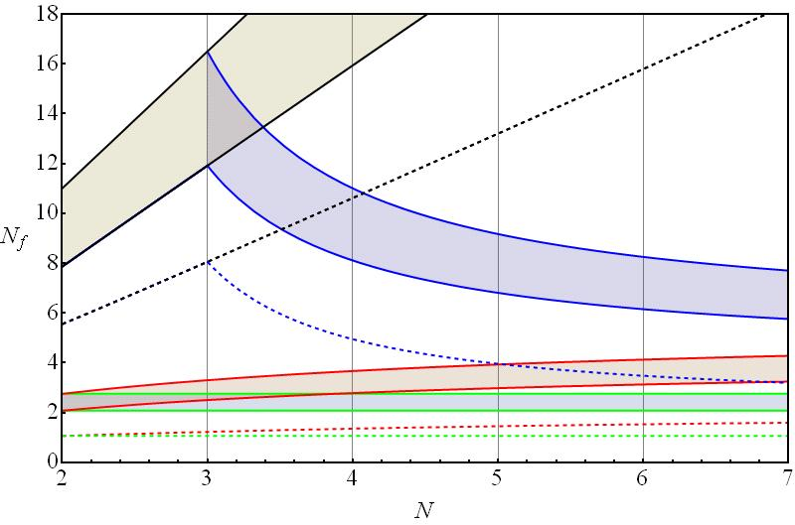
Phase Diagram (ladder approximation)
Appelquist, Lane, Mahanta, Wijewardhana, Terning
Cohen, Georgi, Yamawaki, Shrock
Dietrich, Sannino, Tuominen
Ladder approximation: Chiral symmetry breaking is triggered at

Slide 10
Supersymmetric QCD
Coulomb
Free Electric
Higgs
Confining
Free Magnetic

Slide 11
Lessons from SUSY
Exact NSVZ beta function
Novikov, Shifman, Vainshtein, Zakharov
Note: relation between beta funtion and anomalous dimension.
Anomalous dimension
First beta function coefficient

Slide 12
At zero of beta funtion
Conformality requires Mack
Critical number of flavors
Conformal window
Asymptotic freedom

Slide 13
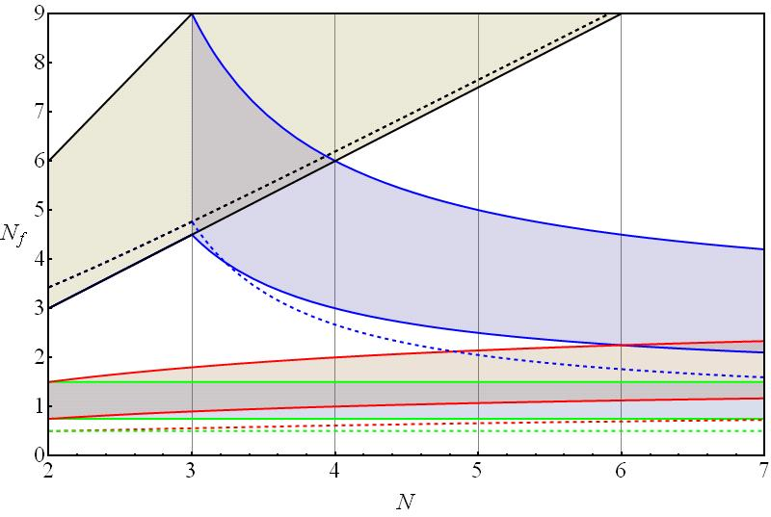
SUSY conformal window

Slide 14
All-orders Beta Function
Pica, TR, Sannino
Matching to two loop beta function
Has same form as NSVZ.
Anomalous dimension

Slide 15
All-orders Beta Function
Assume b and c do not depend on the number of flavors
With being the critical number of flavors for which asymptotic freedom is lost
With these coefficents the anomalous dimension appearing in at a Banks-Zaks fixed point coincides with the perturbative value.

Slide 16
Bounds on Conformal Window
Analysis similar to SUSY case:
  At zero of beta function
  Conformality requires
  Ladder approximation
  Critical number of flavors

Slide 17
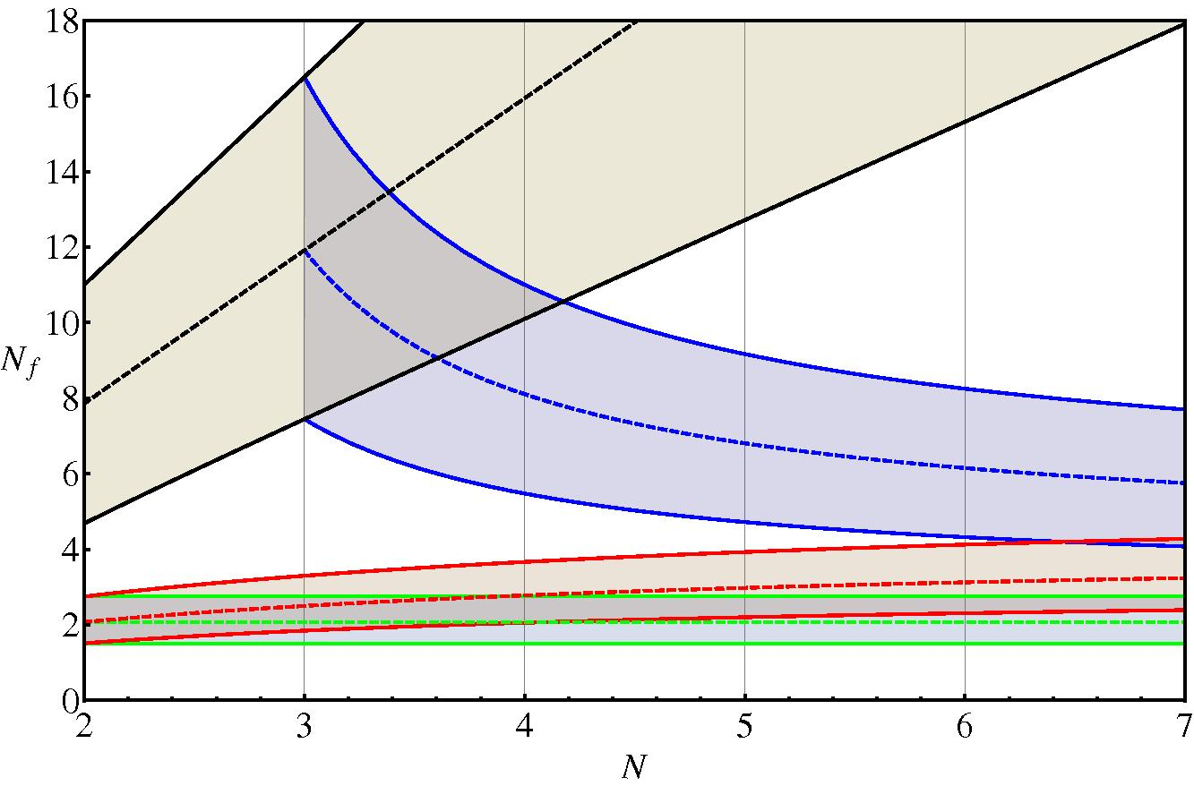
Phase Diagram

Slide 18
Four loop beta function and anomalous dimension
Four loop beta function and anomalous dimension TR, Shrock, Pica, Sannino
Ritbergen, Vermaseren, Larin have calculated the beta function and anomalous dimension in the MSbar scheme to four loop order.
New group invariants enter at the four loop level.
Search for an infrared fixed point of the beta function.
Evaluate the anomalous dimension at the infrared zero of the beta function

Slide 19
Four loop beta function
Fundamental representation
N | Nf
2 | 8 | 1.26 | 0.688 | 0.760
2 | 9 | 0.595 | 0.418 | 0.444
2 | 10 | 0.231 | 0.196 | 0.200
N | Nf
3 | 10 | 2.21 | 0.764 | 0.815
3 | 11 | 1.23 | 0.578 | 0.626
3 | 12 | 0.754 | 0.435 | 0.470
3 | 13 | 0.468 | 0.317 | 0.337

Slide 20
Four loop beta function
Adjoint representation
2-indexed symmetric representation
N | Nf
2 | 2 | 0.628 | 0.459 | 0.493
3 | 2 | 0.419 | 0.306 | 0.323
4 | 2 | 0.314 | 0.2295 | 0.241
N | Nf
3 | 2 | 0.842 | 0.500 | 0.522
3 | 3 | 0.085 | 0.079 | 0.080

Slide 21
Four loop anomalous dimension
Fundamental representation
N | Nf
2 | 8 | 0.752 | 0.272 | 0.204
2 | 9 | 0.275 | 0.161 | 0.157
2 | 10 | 0.0910 | 0.0738 | 0.0748
N | Nf
3 | 11 | 1.61 | 0.439 | 0.250
3 | 12 | 0.773 | 0.312 | 0.253
3 | 13 | 0.404 | 0.220 | 0.210

Slide 22
Four loop anomalous dimension
Adjoint representation
2-indexed symmetric representation
N | Nf
2 | 2 | 0.820 | 0.543 | 0.500
3 | 2 | 0.820 | 0.543 | 0.523
4 | 2 | 0.820 | 0.543 | 0.532
N | Nf
3 | 2 | 2.44 | 1.28 | 1.12
3 | 3 | 0.144 | 0.133 | 0.133

Slide 23
Anomalous dimension vs. number of flavors

Slide 24
Lattice
N=3 and the fundamental representation
      Nf =8 breaks chiral symmetry
      Nf =12 ??
N=2 and the adjoint representation
      Nf =2 is conformal
N=3 and the 2-indexed symmetric representation
      Nf =2 seems to break chiral symmetry

Slide 25
SUSY three loop beta function and anomalous dimension
Three loop beta function and anomalous dimension are known in DRbar scheme TR, Shrock
Search for an infrared fixed point of the beta function.
Evaluate the anomalous dimension at the infrared zero of the beta function
Same tendency as in the non-supersymmetric case.

Slide 26
Three loop beta function
Fundamental representation
N | Nf
2 | 4 | 6.28 | 2.65
2 | 5 | 1.14 | 0.898
N | Nf
3 | 5 | 18.85 | 3.05
3 | 6 | 2.69 | 1.40
3 | 7 | 0.992 | 0.734
3 | 8 | 0.343 | 0.308

Slide 27
Three loop anomalous dimension
Fundamental representation
N | Nf
2 | 4 | 1.875 | -1.68
2 | 5 | 0.260 | 0.0802
N | Nf
3 | 6 | 1.22 | -0.730
3 | 7 | 0.399 | 0.0584
3 | 8 | 0.139 | 0.104

Slide 28
SUSY anomalous dimension vs. number of flavors

Slide 29
Multiple Representations
Why study multiple representations?
Construct walking technicolor models with multiple representations: Smallest possible naive S parameter + smallest number of additional fermions.
Eichten, Lane, TR, Sannino
Other famous examples:
1) SU(5) grand unified theory: Georgi, Glashow
2) MSSM: Adj +F

Slide 30
Beta Function – Multiple Representations
TR, Sannino
Consider the zero of the beta function. Bound the conformal house by bounding the values of the anomalous dimensions (CFT and Mack, Ladder, etc).
Anomalous dimensions

Slide 31
Ladder Approximation – Multiple Representations
There is a critical coupling associated to the triggering of each of the condensates TR, Shrock
Assume: Conformal House:

Slide 32
The End

