Slide 1


Strategic HEP Program
in Japan
Atsuto Suzuki (KEK)

Slide 2
Outline
Strategy of JHEP Program
Large Projects (1) : ILC & LHC-upgrade
Large Projects (2) : Large Neutrino Detector
Medium/Small Projects :
Accelerator/Non-accelerator
Summary

Slide 3

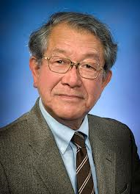
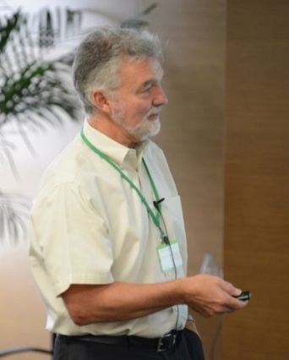
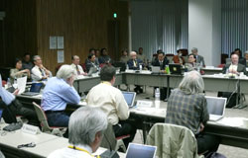
Strategy of JHEP Program
2008 - 2012
Roadmap
Dr. H. Weerts
(ANL)
Dr. S. Ozaki
(BNL)
March 2008
2013 – 2017
Roadmap
Committee put a high value on the KEK roadmap (2008)
KEK is a world leading accelerator research center today and, in the future, could become the home of the strongest all-around accelerator research center in the world. (2013)

Slide 4
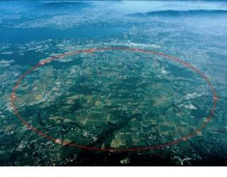
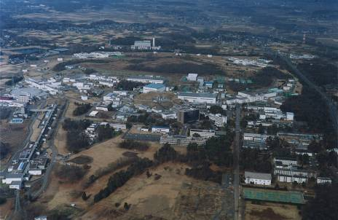
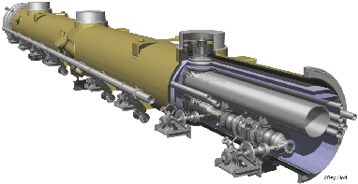
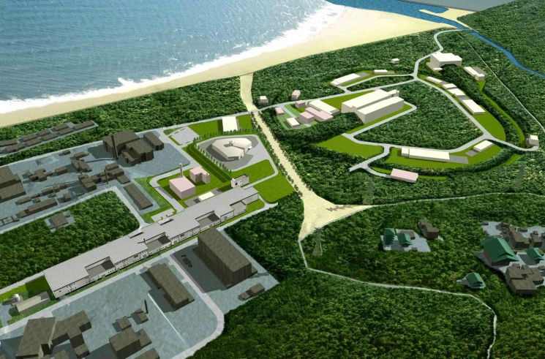
High Energy Physics in the Next Decade (2008)
LHC
Energy frontier experiments
LHC, ILC, …
Higgs, SUSY, Dark matter,
New understanding of space-time…
KEKB upgrade
New particles
and new interactions
ILC
Three approaches
to
New Physics
ν exp., μ LFV, τ LFV,
g_{μ}-2, …
Lepton flavor
physics
Quark flavor
physics
Super-B Factory,
K exp., etc.
Neutrino mixing/masses,
Lepton number non-conservation…
CP asymmetry, Baryogenesis,
Left-right symmetry, New sources
of flavor mixing…
J-PARC

Slide 5
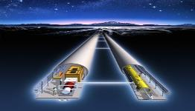
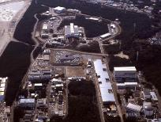
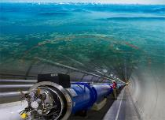
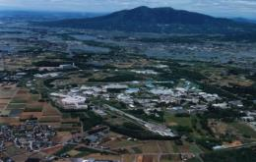
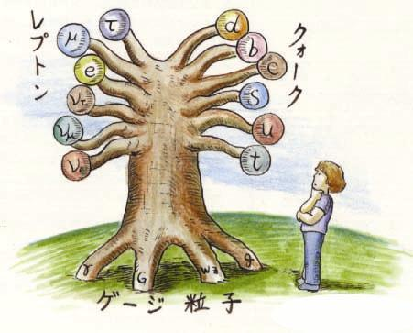
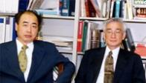

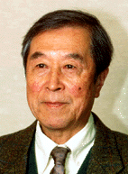
Prioritization of Accelerator Project
International Linear Collider（ILC）
Scientific Activities
Technology Innovations
Talented Human Resources
Lepton CP Asymmetry
Beyond Standard Physics
Power-Upgrade
SuperKEKB
J-PARC
KEK-B
Quark CP Asymmetry
LHC
Lepton
Quark
ν_{τ}
[Origin of Matter]
ν_{μ}
Quest for Neutrinos
ν_{e}
Quest for 6 Quarks
[Origin of Force]
Higgs Particle [Origin of Mass]

Slide 6
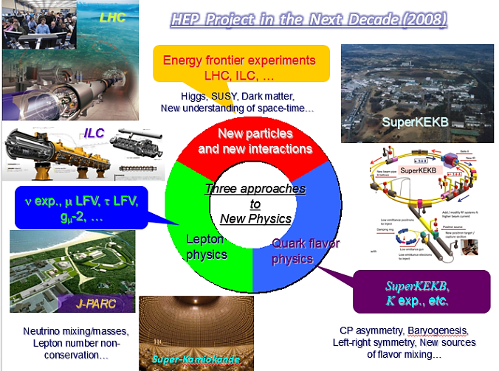
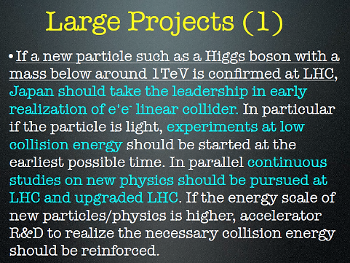
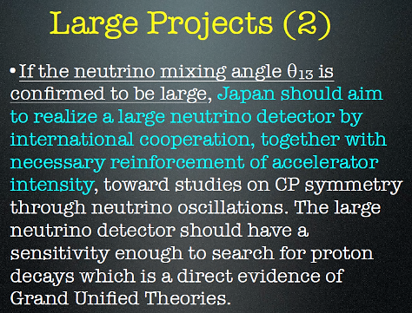
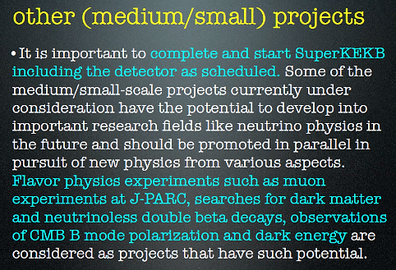
High Energy Physics Committee in Japan (2012)

Slide 7
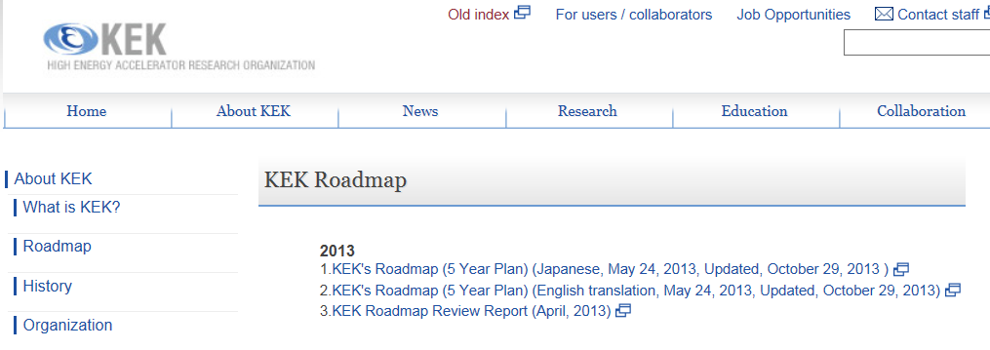
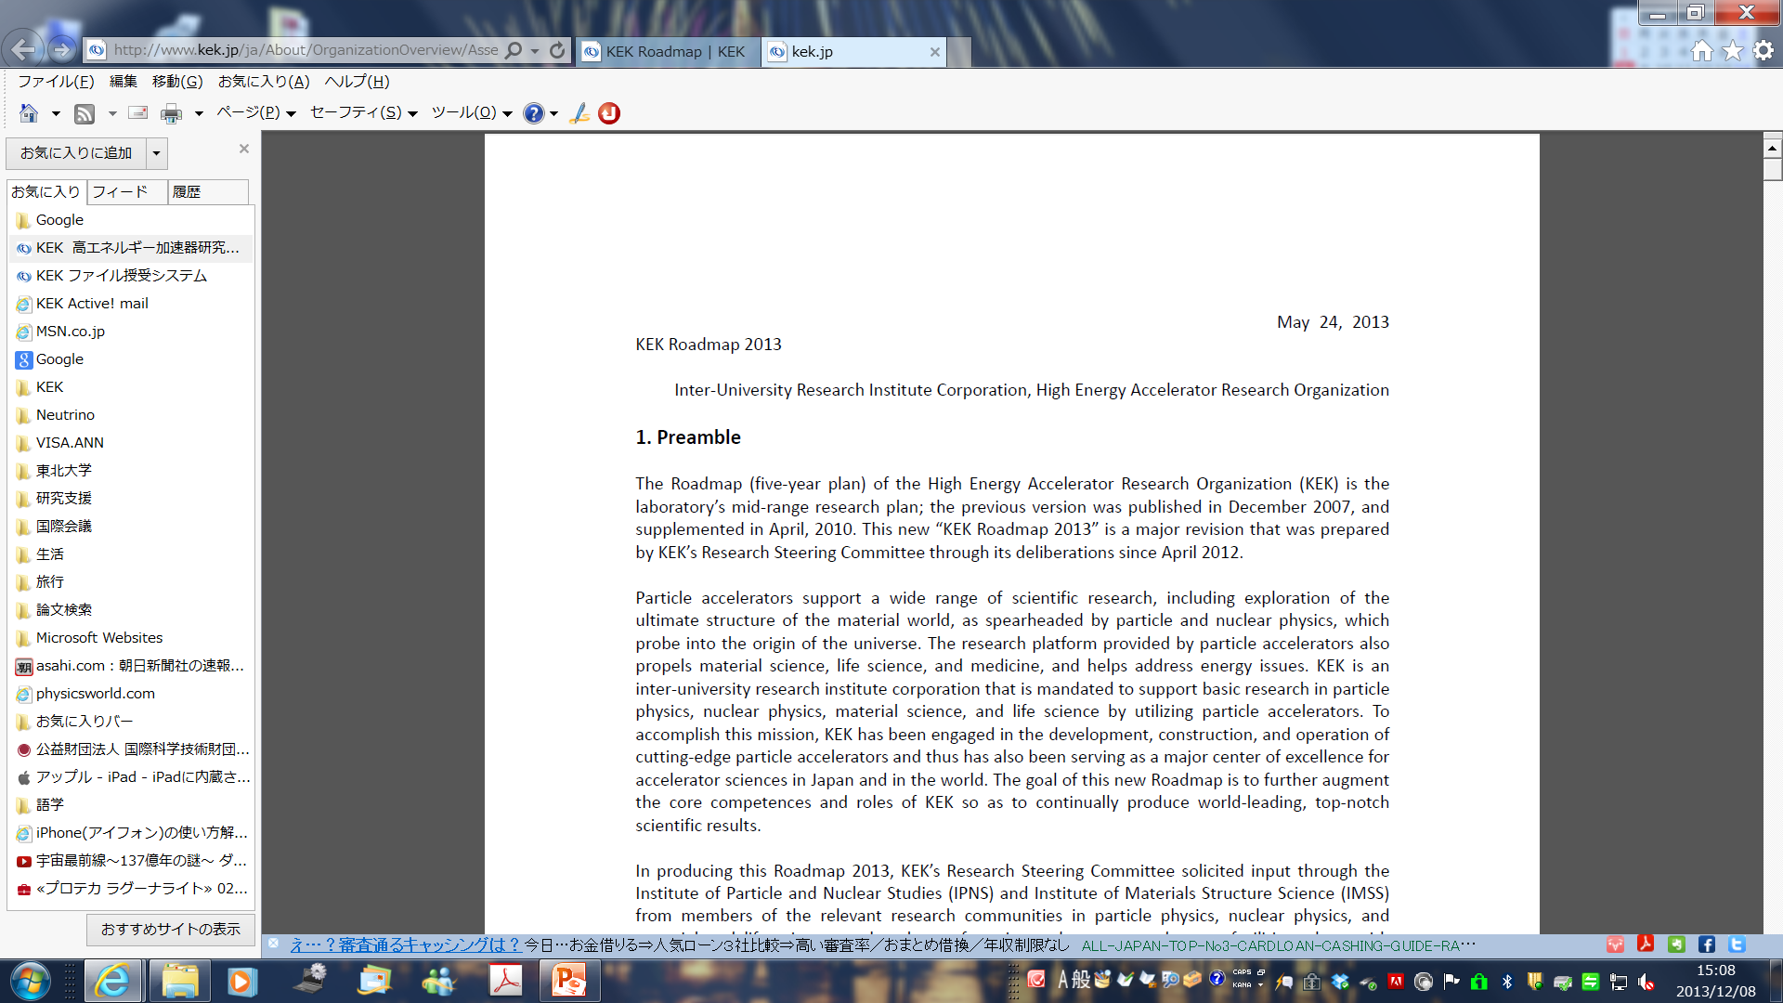
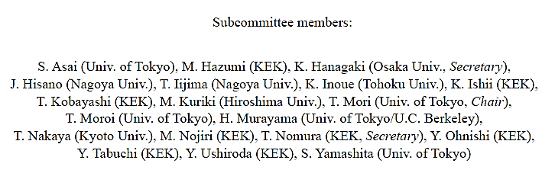

Slide 8
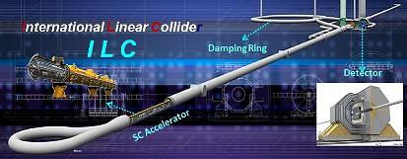
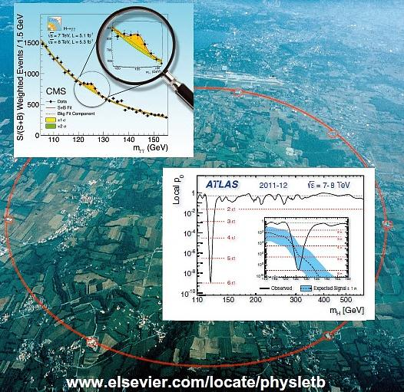
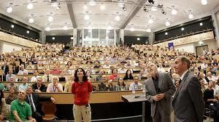
Large Projects (1)
:
ILC & LHC Upgrade

Slide 9
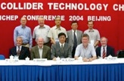
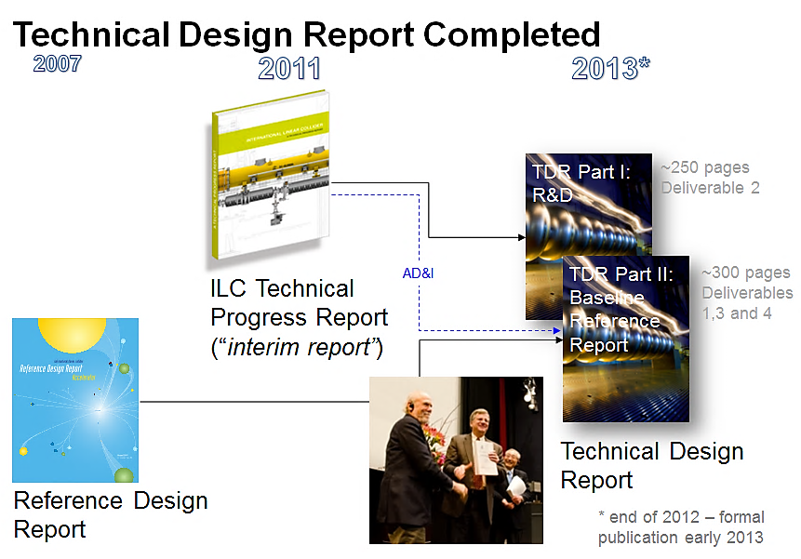
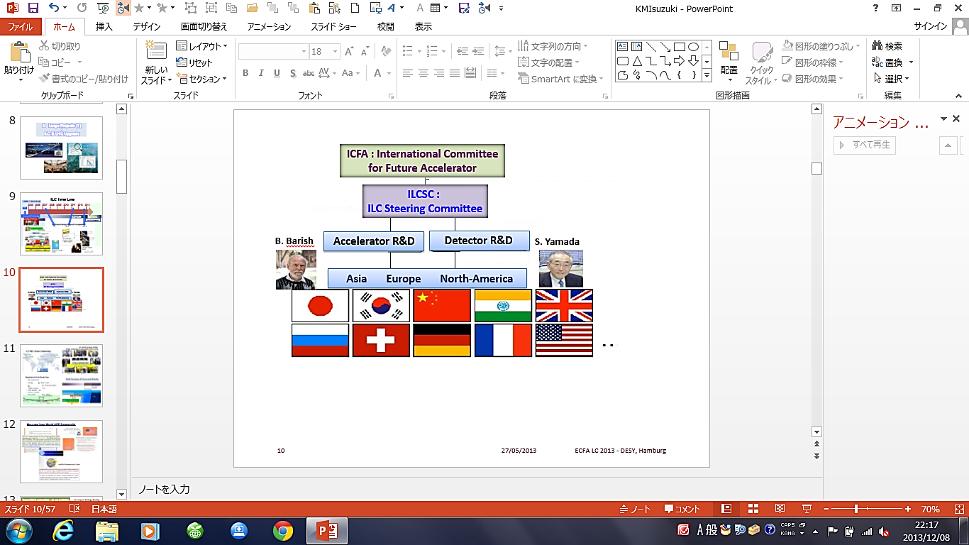
Footprint of ILC Project
1980’ ~ Basic Study
2005
2006
2007
2008
2009
2010
2011
2012
2013
2004
Selection of SC Technology
TDR completion

Slide 10
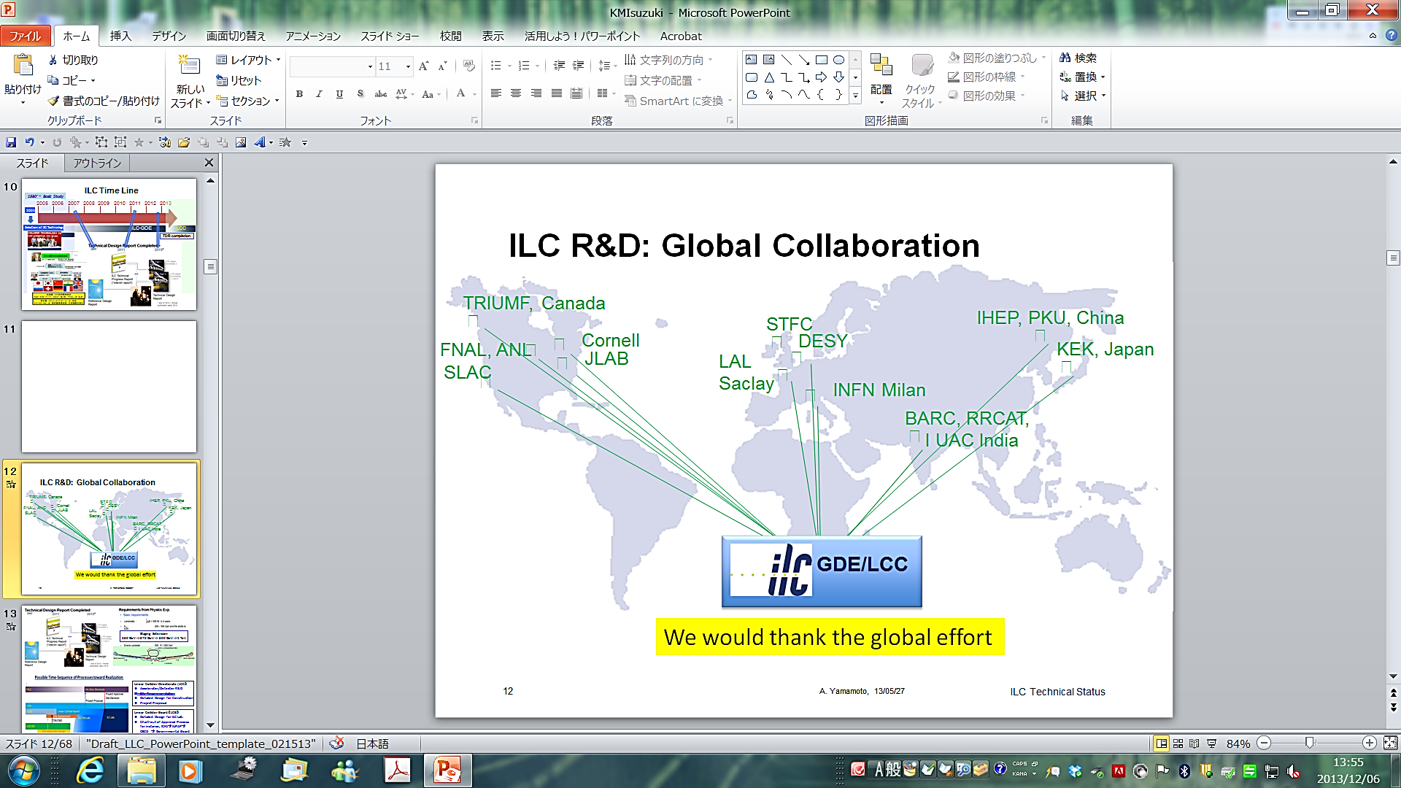
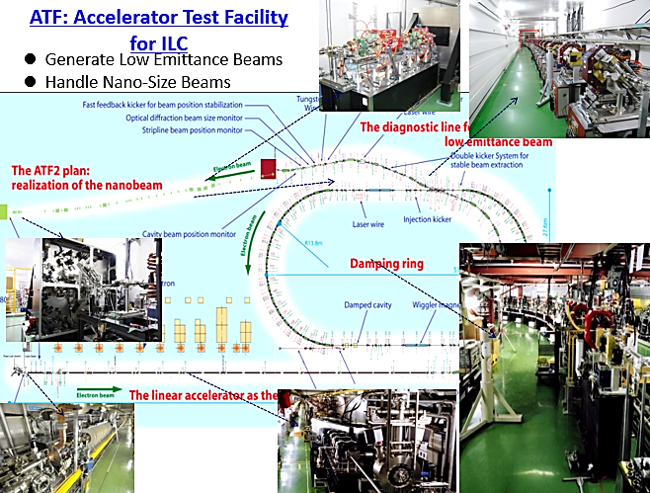
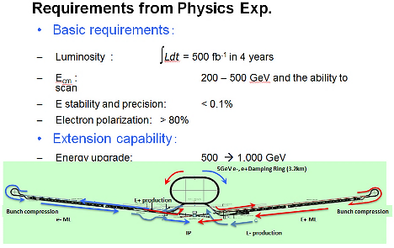
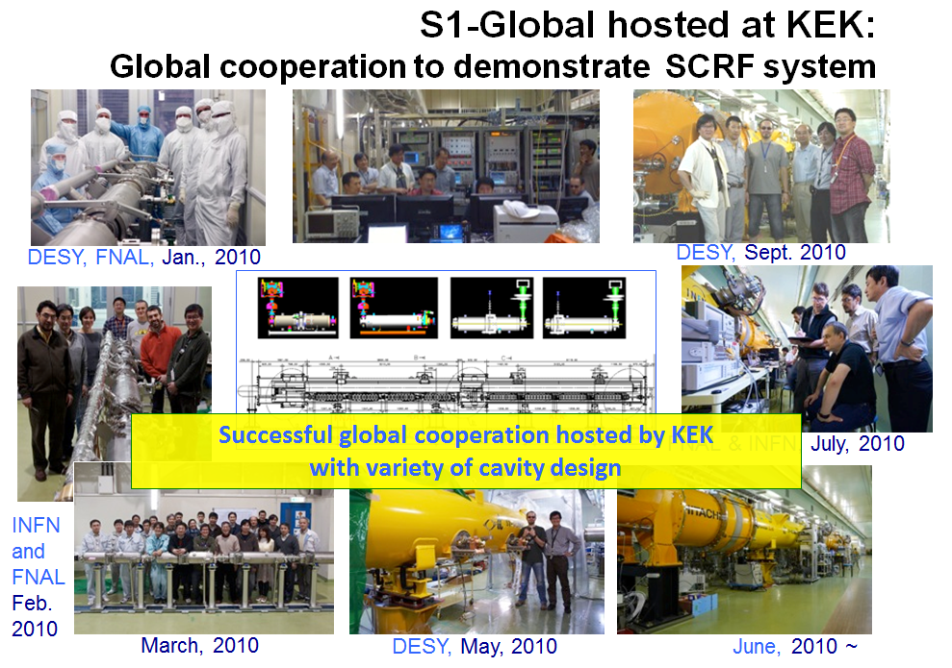
Staging Extension
250 GeV -> 370 GeV -> 500 GeV -> 1 TeV

Slide 11
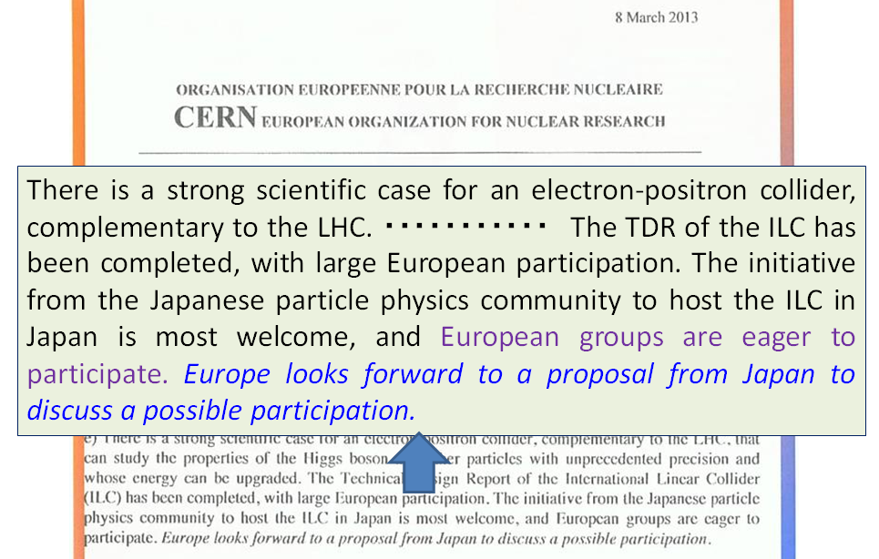
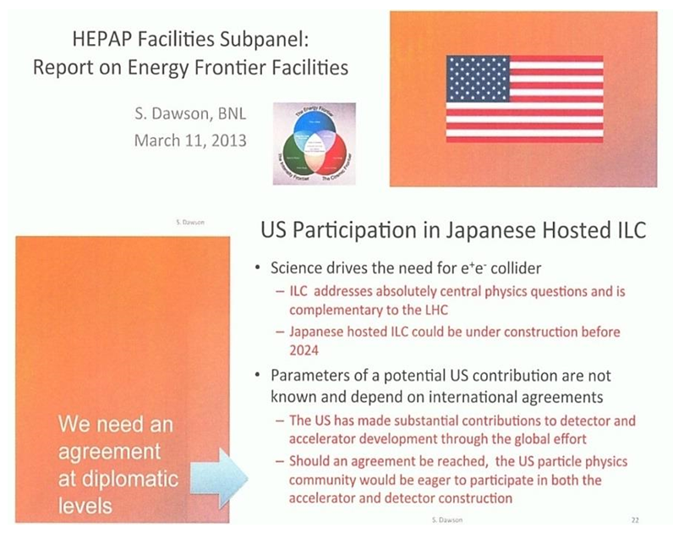
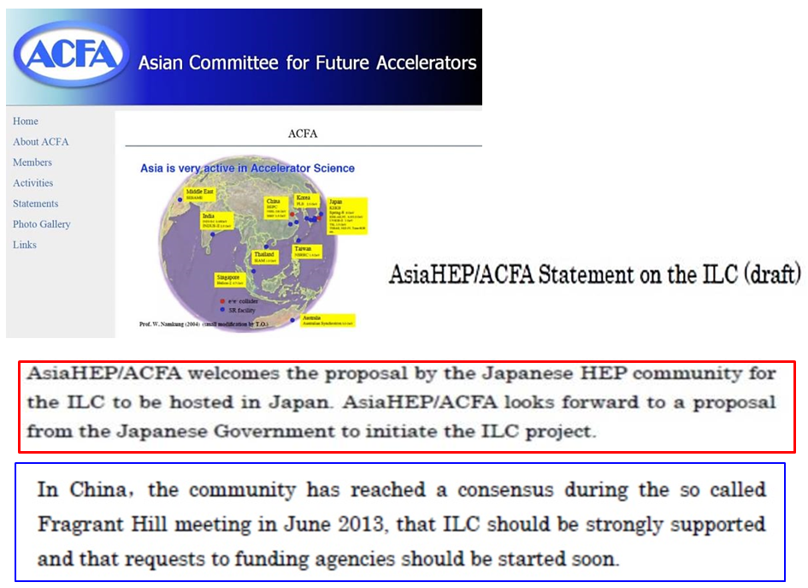
Messages from World HEP Communities

Slide 12
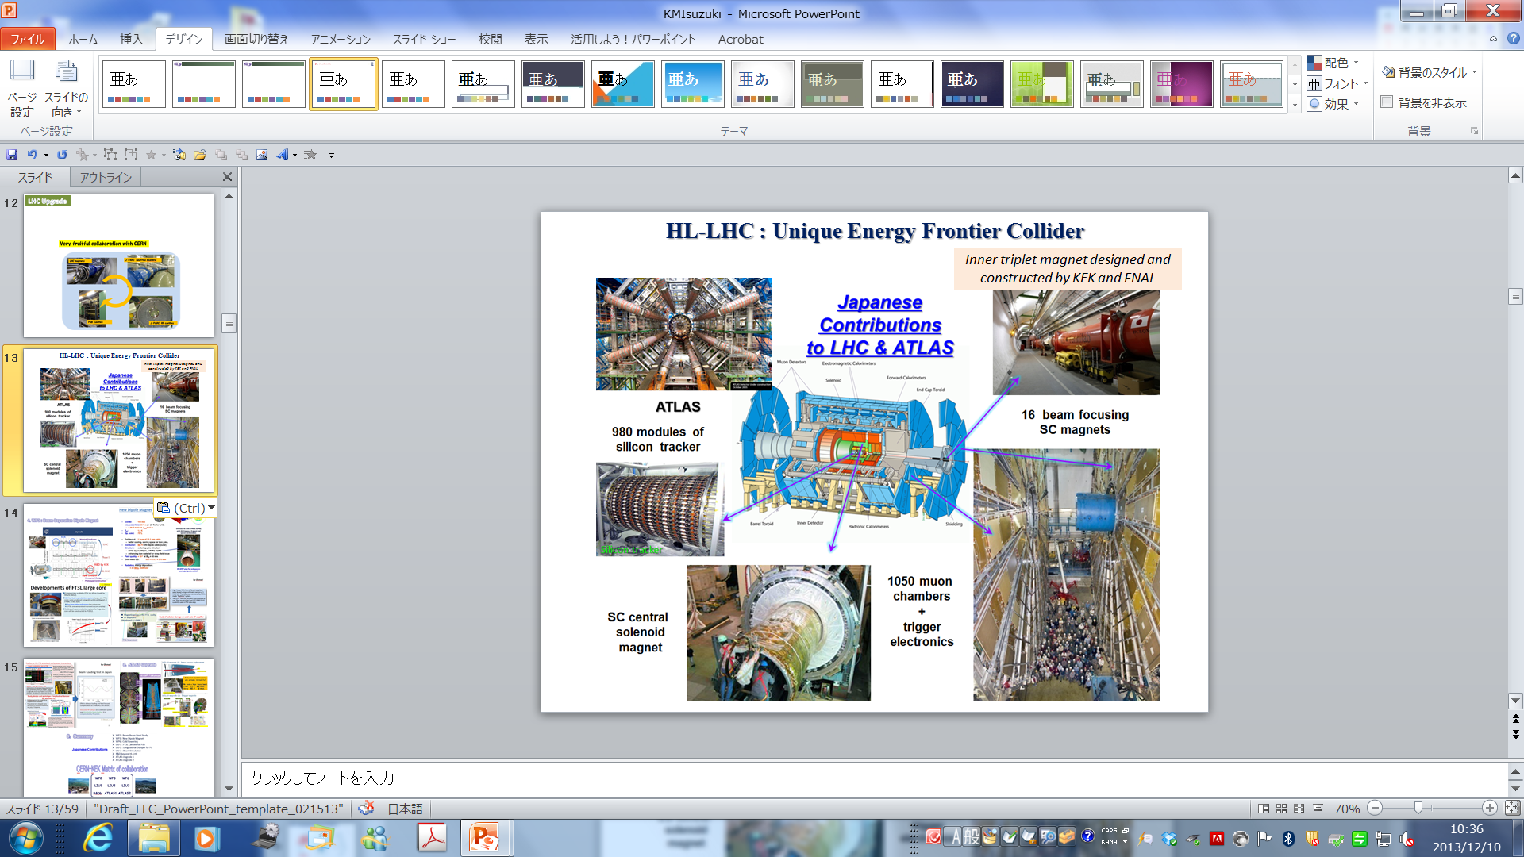
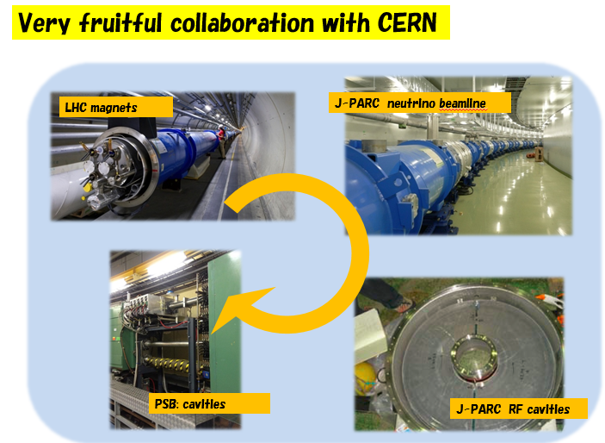
LHC Upgrade

Slide 13
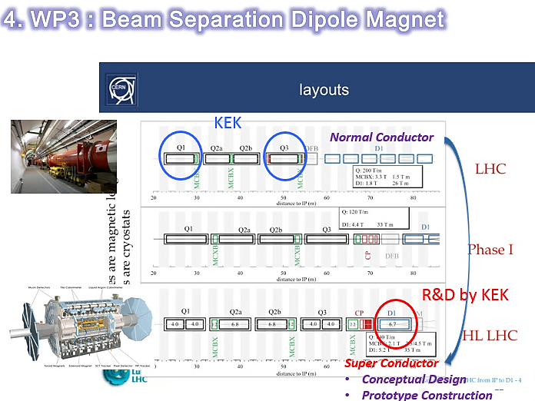
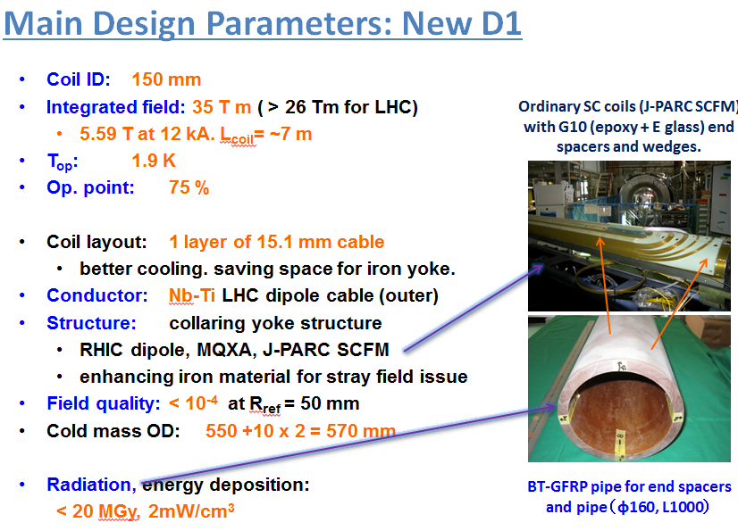
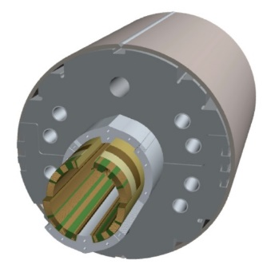
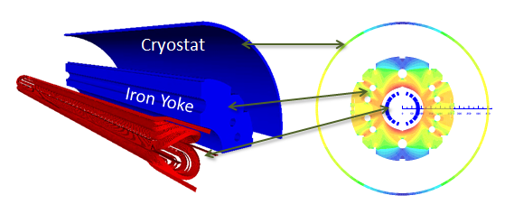
Large aperture (ID: 150 mm)
High Magnetic Field (6 Tesla)
Well Management : Stress, High Saturation, Stray Field, Flux Return Cryostat
Radiation resistance, cooling capability

Slide 14
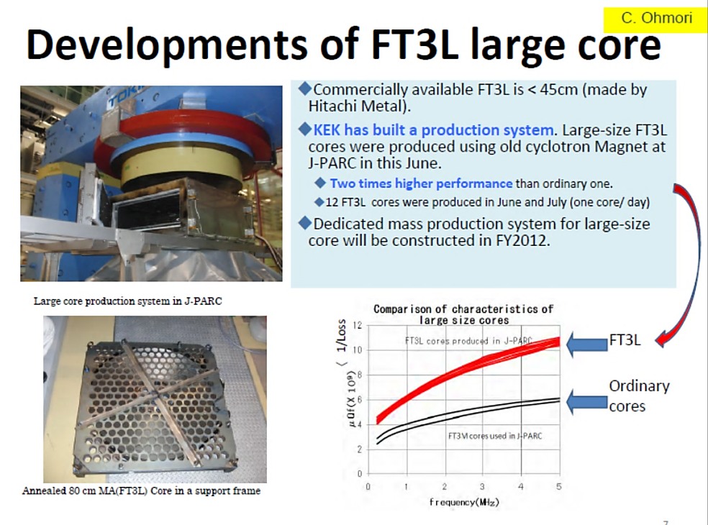
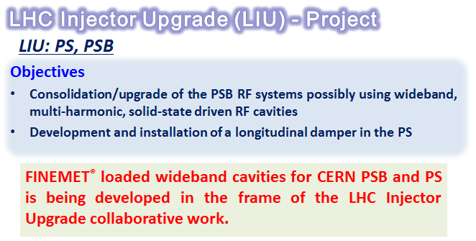
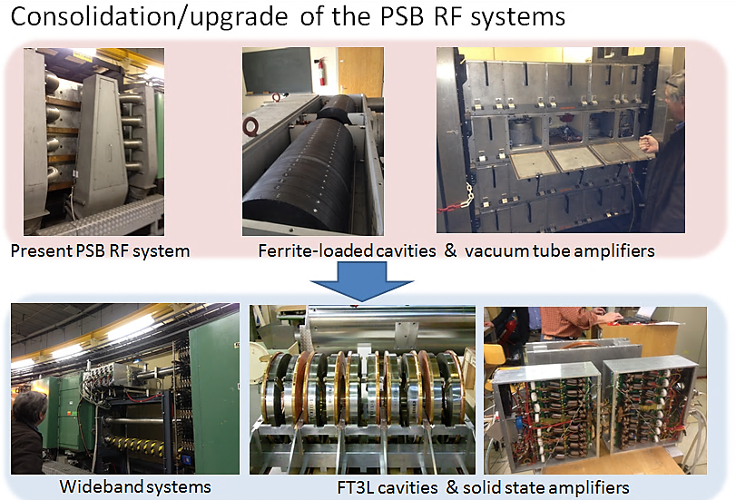
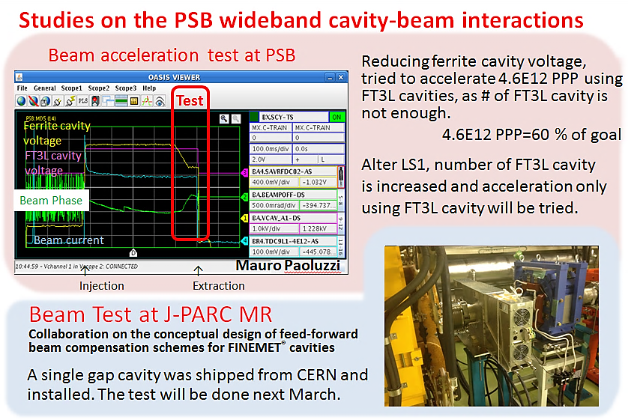
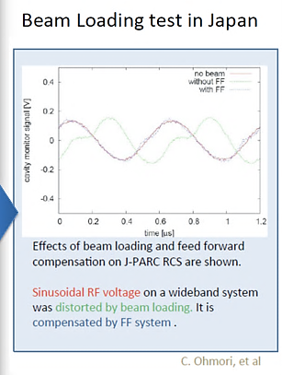

Slide 15
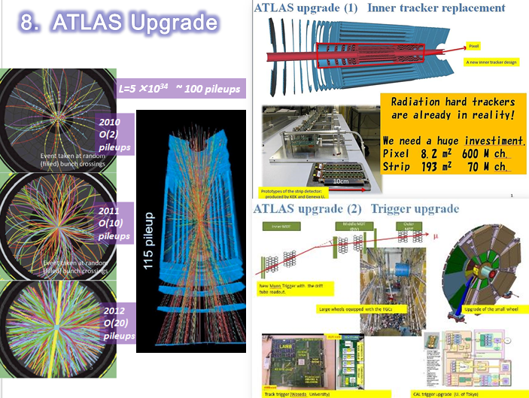
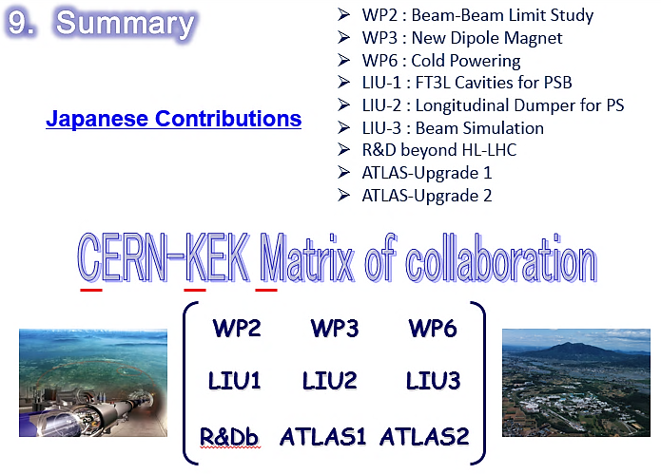

Slide 16
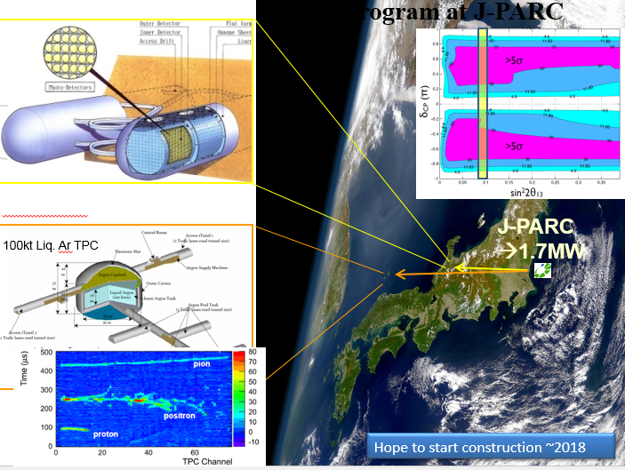
3. Large Projects (2)
:
Large Neutrino Detector

Slide 17
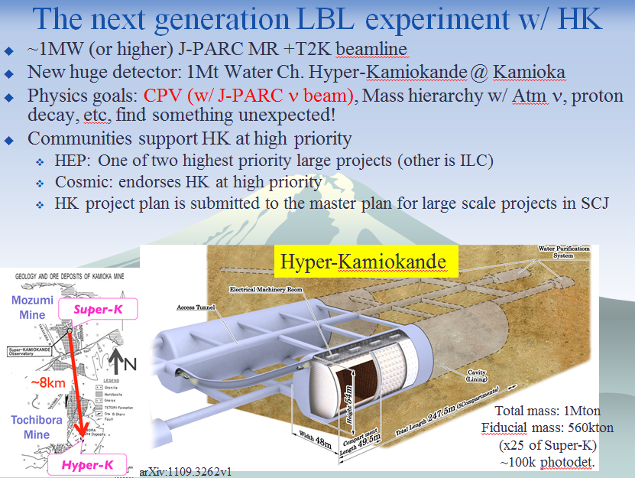
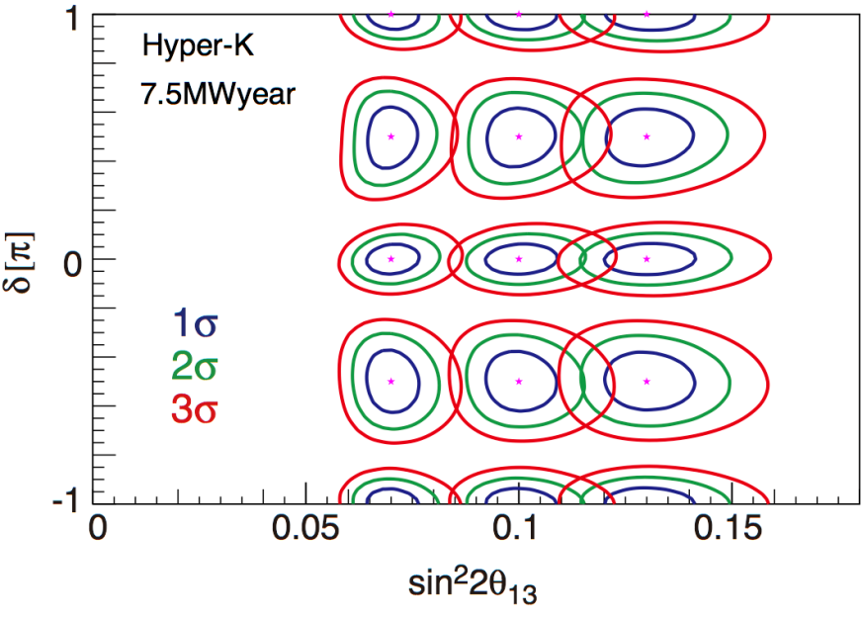

Slide 18



May 2012 | 2014 | 2018
190kW | 300kW 500kW | 750kW
> 1MW
Assuming
beam and anti-ν beam = 1:1 for both experiment
Expected number of events distributed by unknown CP δ (-π<δ<π) and θ₂₃ (0.4<sin²θ₂₃<0.6)

Slide 19
4. Medium/Small Projects

Slide 20







Inconsistency in unitarity triangle?
50 (ab)⁻¹
B -> φK_{s}

Slide 21



2015

Slide 22






J-PARC
Linac
15 mA → 24.5 mA
181 MeV → 400 MeV
RCS (3 GeV)
Neutrino beams to SK
MLF (Material and Life science experimental Facility): n, μ
ＭＲ (30 GeV)
Hadron experimental hall : K

Slide 23









J-PARC Hadron Facility
COMET: μ → e Conversion
Signal : μ- + (A,Z) → e- + (A,Z)
  131 members
  from 12 countries
2016-2017
2021

Slide 24









Slide 25

Kamioka Underground Laboratory

Slide 26







XMASS
KamLAND-Zen
Zero Neutrino double beta decay search
Phase-1: 100kg liq. Xe for dark matter search → now running
XMASS1.5 : upgrade to 5t for better sensitivity σ_{SI}< 10⁻⁴⁶ cm² (at m_{χ}∼100 GeV)
  To be launched in 2015
Final Goal: 10t fiducial mass
  Dark Matter (sensitivity σ_{SI}< 10⁻⁴⁷ cm² ),
  Double Beta decay and pp-⁷Be solar neutrinos
Results from 89.5kg-yr data
PRL 110:
062502 (2013)
XMASS1.5
〈mββ〉
<0.12~0.25 eV
@90% C.L.

Slide 27







r : size of CMB fluctuation
Berkeley, LBNL, Colorado, LAC, San Diego, Imperial C., KEK, McGill, Cardiff
SuMIRe
Subaru
Measurement of
Images and
Redshifts
Images of redshifts of galaxies and 3D map of dark matter

Slide 28



5. Summary
Time line of particle physics program in Japan

Slide 29

Recovery
SuperKEKB
T2K, KOTO, μ: g-2
MEG
PF, PF-AR,
ERL
ILC,
upgrade LHC
CLIC
KEK
KEK Penguin Diagram

Slide 30

Toward ILC Construction : Japan Activities
at European Strategy Meeting
Dec. 11, 2012
2012
2013
2014
2015~6
Positive Reference
from New Prime Minister
ILC Project Office
ILC Strategy Council
Establish ILC Pre-
J-Lab.
Establish ILC Pre-
J-Lab.
ILC Pre-Lab.
Establish ILC -Lab.
Set-up JLCB and JLCB
ILC -Lab.
HEP
Researchers
Cite Decision
Design ILC Lab.
Cite/Host
Establish
～2013.9
Project Proposal to Science Council of Japan
Formal Message
on Hosting ILC in Japan
ILC Host Recommendation to Government
Formal message
on starting governmental negotiation toward hosting ILC in Japan
Detailed Design of International Country
Japan Policy Council
Sept. 28

Slide 31


