Slide 1


Quest for Dark Matter by direct detection experiments with noble liquids
Hiroyuki Sekiya
ICRR & Kavli-IPMU, University of Tokyo
from XMASS collaboration
Dec. 12 2013
KMI International Symposium 2013(KMI2013)

Slide 2
Contents
Principle of direct detection
  Direction insensitive searches
Detection technologies with liquid noble gas = noble liquid
  Review of 2 phase detectors
  Review of single phase detectors
    XMASS
    Liquid Xe TPC
Future noble liquid detectors
Total 40 pages

Slide 3
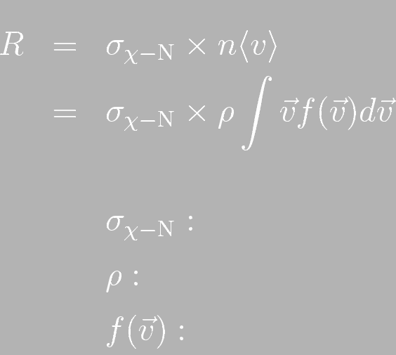
Principle of WIMP Direct Detection
Particle physics × Astrophysics
(cross section) (flux)
WIMP-nucleus cross section
WIMP density
WIMP velocity distribution
Both cross section and flux must be studied, but…

Slide 4
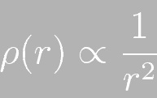
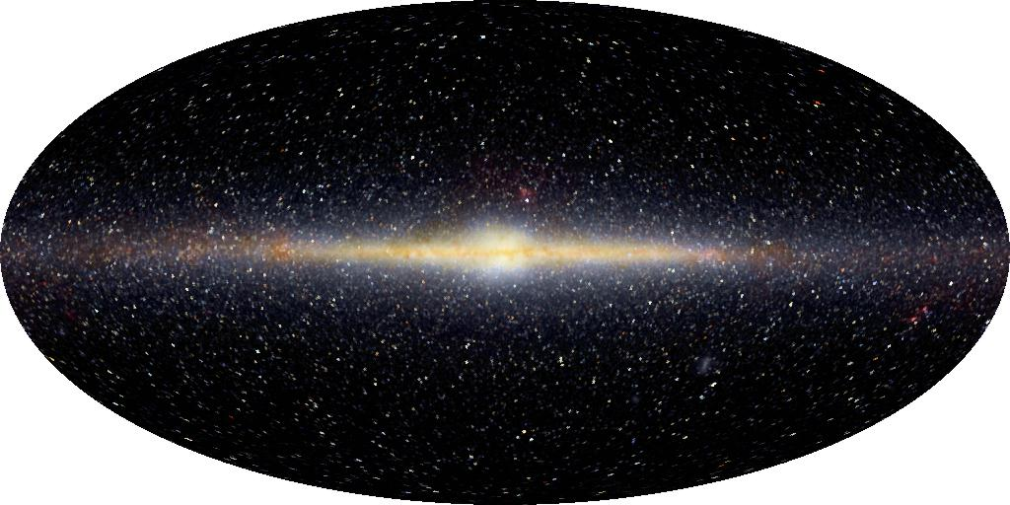
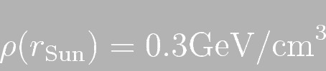
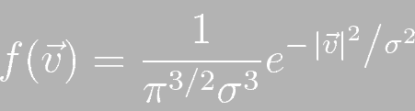
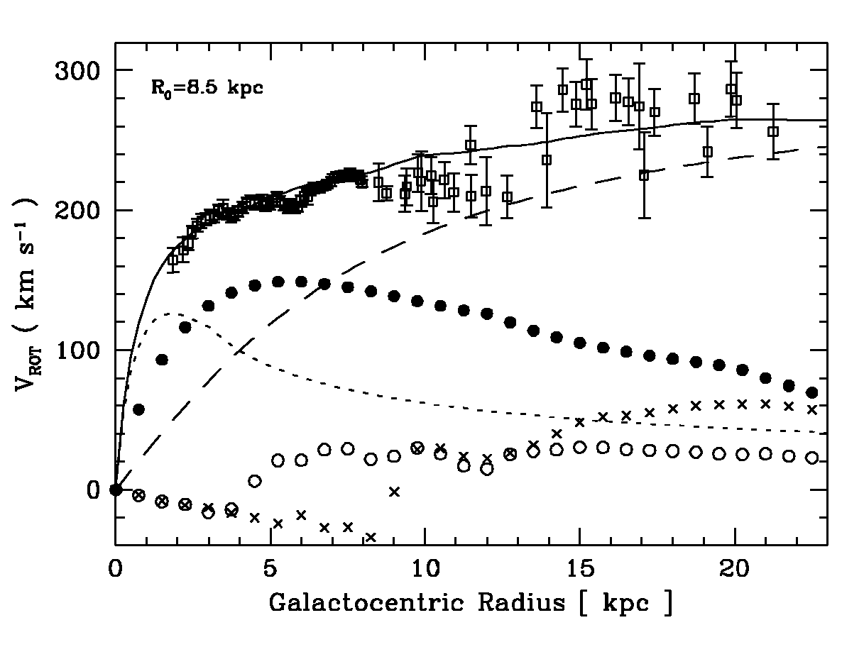
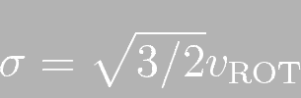

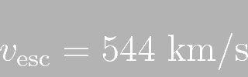
Astrophysics -The model-
Dark Halo
NASA/COBE Project
Collision-less Boltzmann equation
Sun
Maxwell distribution
MNRAS 211(2000) 361
Bulge
Disc
“Standard halo model”

Slide 5
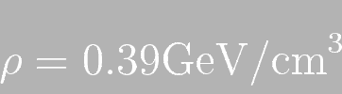
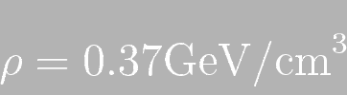
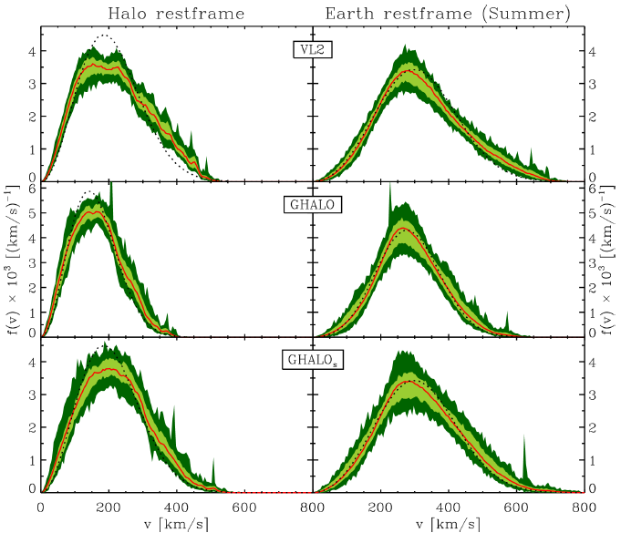
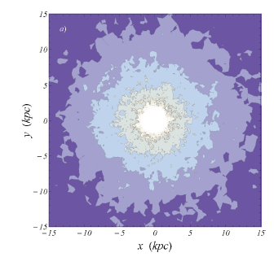
Astrophysics -Recent N-body simulations-
Density
Velocity distribution
Suggestion of deviations from the Maxwell
distribution, particularly at high velocities.
arXive;0907.0018
→Impact on Light WIMPs
Direction sensitive search
JCAP 02(2010) 030
JCAP 02(2010) 012
3GeV/cm³
1GeV/cm³
0.3GeV/cm³
8.5kpc
0.1GeV/cm³
Maxwellian
simulation
1σ
Density profile of the halo
in the galactic plane

Slide 6

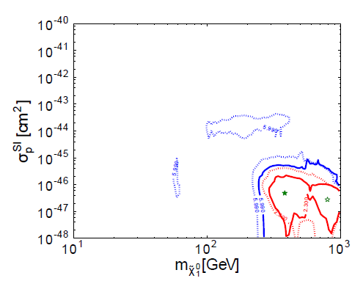
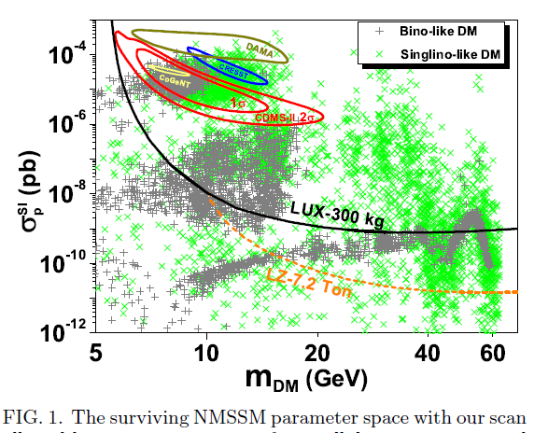

Particle physics after LHC
SUSY is still attractive, but it goes far…
  Scattering cross sections on nucleons σ_{χ-n} is now down to ~ 10⁻⁴⁸ cm²
Eur. Phys. J. C72(2012) 2243
arXive:1311.0678
cMSSM
NMSSM

Slide 7
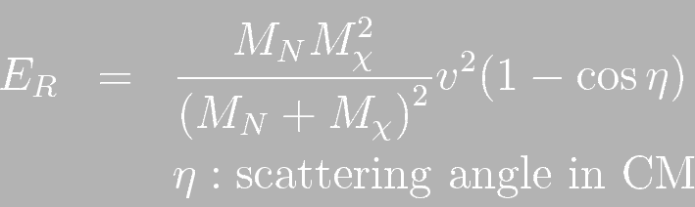
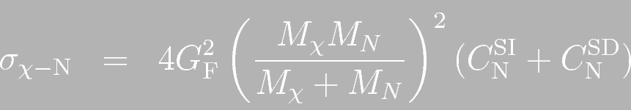


WIMP-Nucleus elastic scattering
Recoil energy
Cross section
σ_{χ-n}
In this talk
only SI is focused.
I love Fluorine!

Slide 8
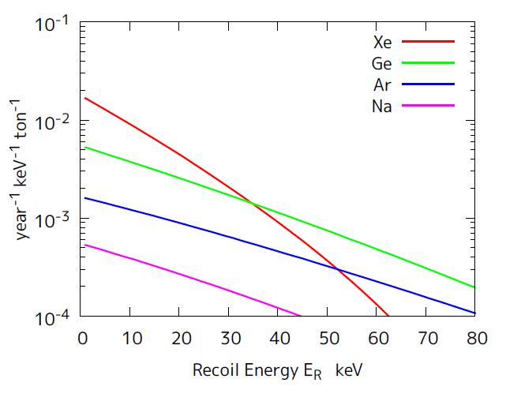
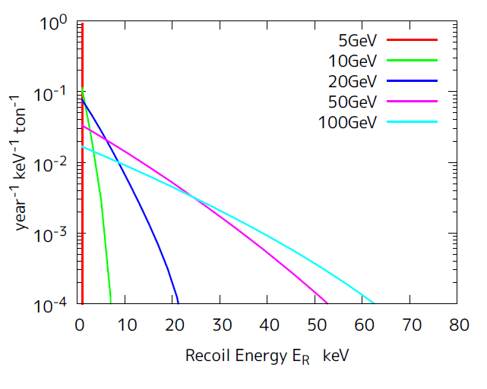
Expected detection rate
Integration over the velocity distribution (SI)
For different Nuclei
For different WIMP mass
Light WIMP
Heavy nuclei
σ_{χ-n}=10⁻⁴⁸cm²
Target:Xe
σ_{χ-n}=10⁻⁴⁸cm²
Mχ=100GeV
Heavy WIMP
Light nuclei
Ton scale is necessary. Heavy nuclei/Light WIMPs are easier for us.

Slide 9
Direct Search Experimental Challenge
As we already see
WIMP nuclear recoil signal is:
  Low rate (<1 events/ton/year)
  Small energy (<10keV, actual observed is less)
  Similar observed exponential spectrum to many background signals
Detection technique must be:
  Extremely low background
  Low threshold
  Large mass
It’s better to be
  Position sensitive for fiducalizaition
  Discriminating between WIMPs/n and γ/β
  Directional

Slide 10
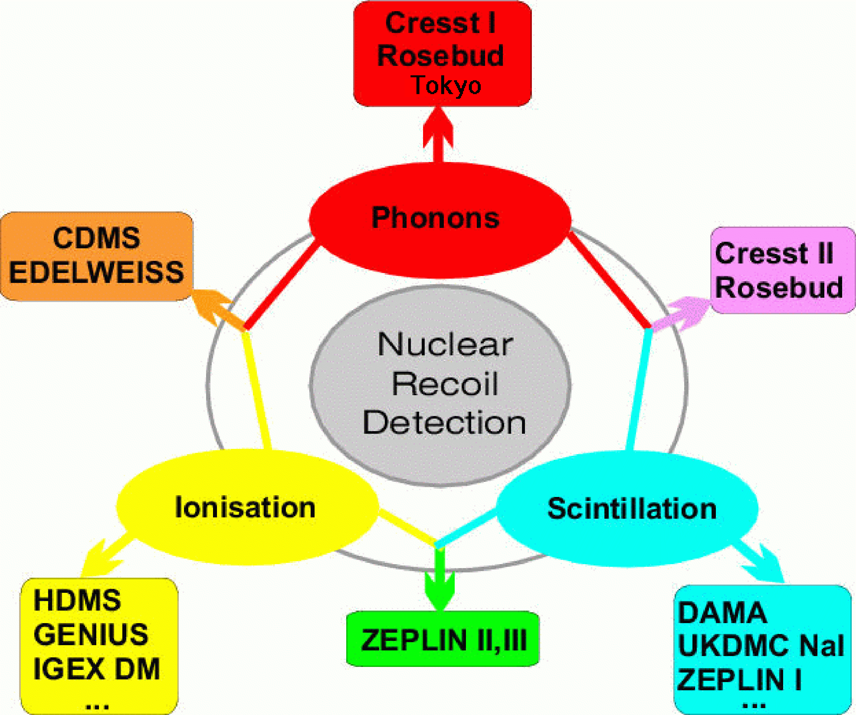
Technologies in 2003
Y.Ramachers
Nucl. Phys. B (proc. Suppl.) 118(2003)373
Notes:
2000年との比較をしてしまえ！ そしてphonon に×つける。 ＭＡＳＳの問題 resolutionが有利と思われたがいらない！

Slide 11
Technologies in 2013
CRESST-I
CUORE
Tokyo
Tracking
DRIFT
NEWAGE
DMTPC
MIMAC
emulsion
CDMS, EDELWEISS, SuperCDMS, EURECA
CRESST
CUORE
ROSEBUD
Superheated liquid
COUPP
PICASSO
SIMPLE
IGEX
GENIUS
CoGENT
CDEX
DAMIC
TEXONO
DAMA,LIBRA
NAIAD
XMASS
DEAP,CLEAN
DM-ICE
ZEPLIN
XENON
LUX
DarkSide,
WARP, ArDM,

Slide 12
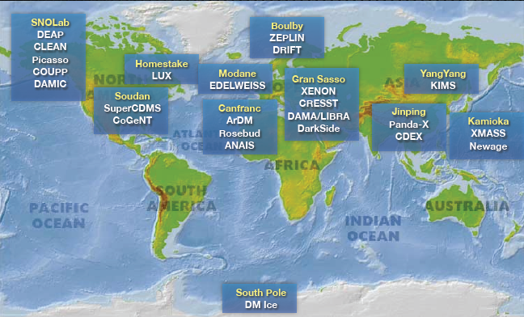
Direct searches @ Earth
Baudis SUSY2013

Slide 13
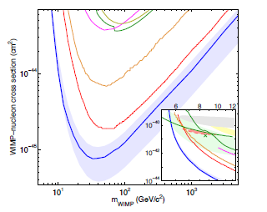
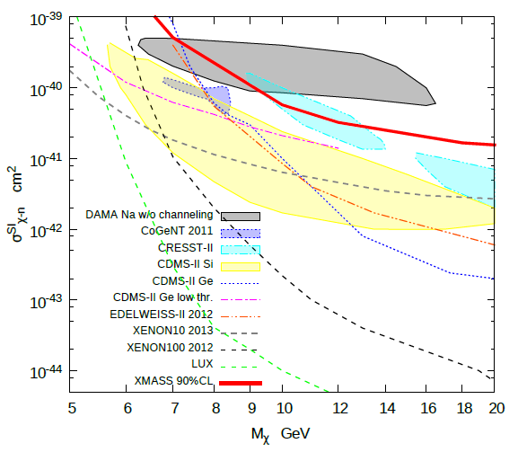
Current Status
SI WIMP-nucleon cross section limit as of Nov 2013
  The best is LUX, reaches 10⁻⁴⁶cm².
  Top 3 are all two phase Xe detectors
arXiv:1310.8214
Phys. Lett. B 719 (2013) 78
CDMS-II
ZEPLIN-III
XMASS
XENON100
XENON10
XENON100
EDELWEISS
CDMS Ge
XENON100
LUX
LUX

Slide 14
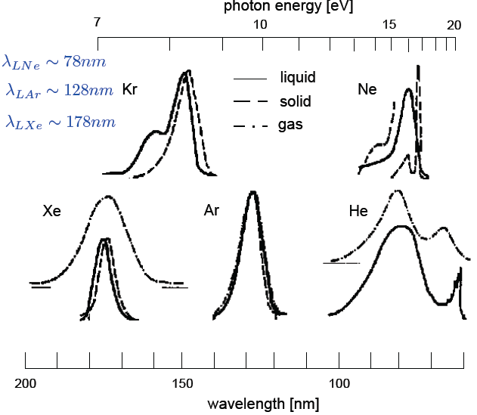
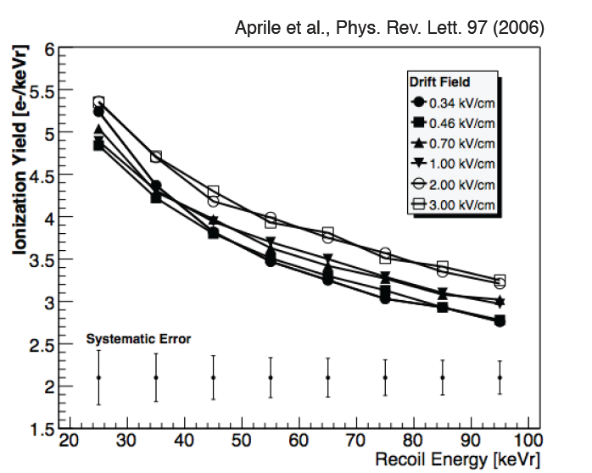
Noble liquid detector
scintillation detector / ionization detector
Baudis SUSY2013
Aprile Phys. Rev. Lett 97(2006)
LXe
Transparent to their own light

Slide 15
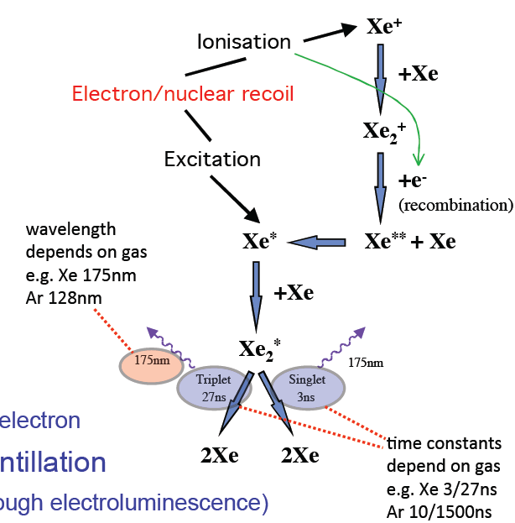
Why is noble liquid strong for WIMP?
Large mass/scalability especially Ar ←cost
Large mass number especially Xe
→Passive BG rejection: self shielding by fiducalization
Large light yields→low threshold
Purification→low BG
Noble gas interaction process
Both scintillation and ionization are detectable.
Excitation/ionization ratio provides the electron/nuclear recoil separation
→Active BG rejection
NJT Smith ICRC2013T

Slide 16
How to use noble liquids; 3 concepts
Single (liquid) phase
  Just as scintillators
    Through the recombination process, in a sense, it is also sensitive to Ionization.
    Singlet/triplet ratio difference between nuclear/electron recoil event ←possibility of PSD
  TPC to measure ionization directly
    By applying electric field, electrons produced by ionization are collected. These can be observed via charge amplification or proportional scintillation by high electric field.
Two phase (liquid+gas)
  TPC same as single phase,
    If electrons are extracted from liquid phase to gas phase, it becomes easier to get the charge amplification /proportional scintillation by high electric field.

Slide 17
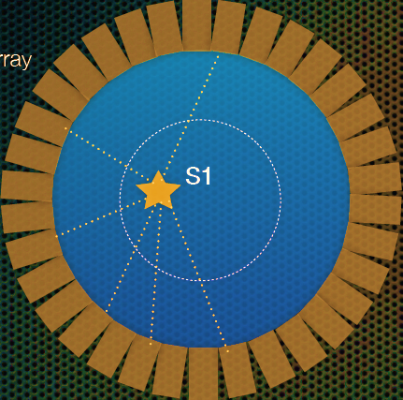
Single phase scintillator
This concept has realized recently.
PMT array
S1
Time
S1
PSD?

Slide 18
Single phase TPC
The original concept, but has not realized yet.
+HV
Charge
+HV
S2
S2
E
E
S1
e⁻
e⁻
e⁻
e⁻
e⁻
e⁻
S1
-HV
S2
Time
S1

Slide 19
Two phase TPC
Realized earliest and well-established with success
+HV
S2
E
S1
e⁻
e⁻
e⁻
-HV
S2
Time
S1

Slide 20
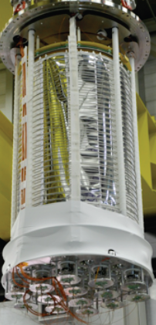
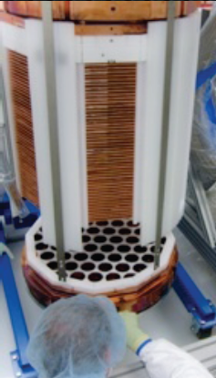
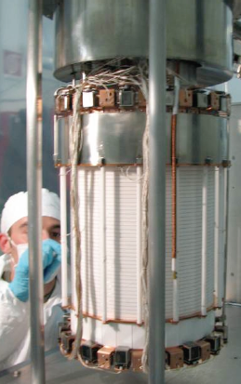
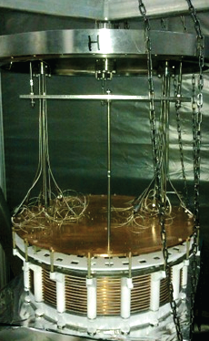
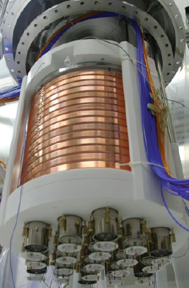
Liquid Xe/Ar TPCs
Based on
N.J.T. Smith ICRC2013
L. Baudis SUSY2013
LUX@SURF
XENON100@LNGS
PANDA-X
@CJPL
ArDM
@Canfranc
Darkside
@LNGS
350kg total
118kg FV
122 2’’ PMTs
Continues
data taking
till 2015
161kg total
50kg FV
242 1’’ PMTs
Continues
data taking
125kg total
25kg FV
143 1’’ PMTs
37 3’’ PMTs
Started
data taking
850kg total
100kg FV
28 3’’ PMTs
In commissioning
Will start
data taking in 2014
50kg total
33kg FV
³⁹Ar depleted
38 3’’ PMTs
Started
data taking

Slide 21
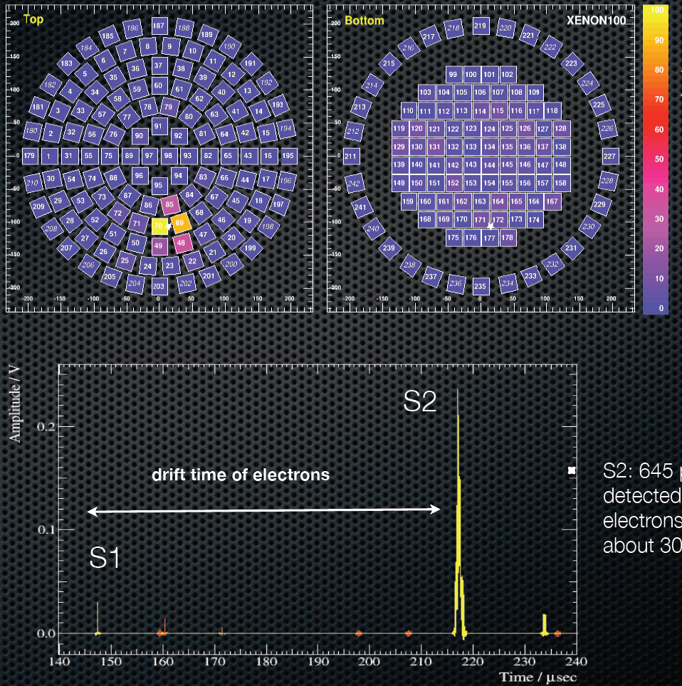
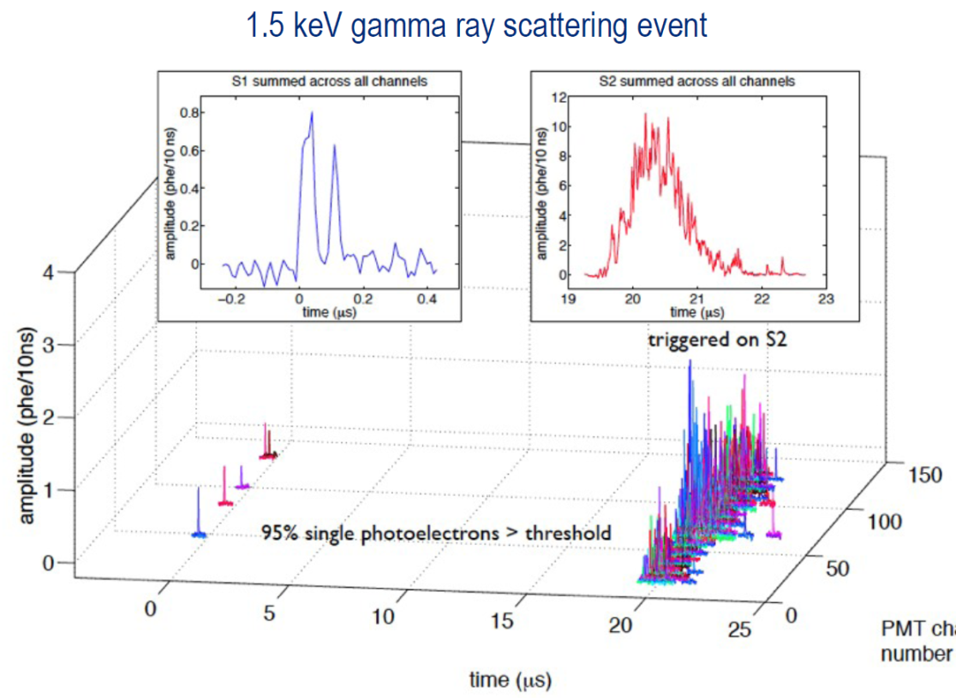
Event examples in two phase detectors
1.5keV gamma in LUX
9keV recoil in XENON100
Top PMT
Bottom PMT
S1
S2
645 p.e.
←32 e⁻
PMT channel
Drift time (μs)
4p.e..
D. McKinsey, R. Gaitskell Oct30 2013
L. Baudis SUSY 2013

Slide 22
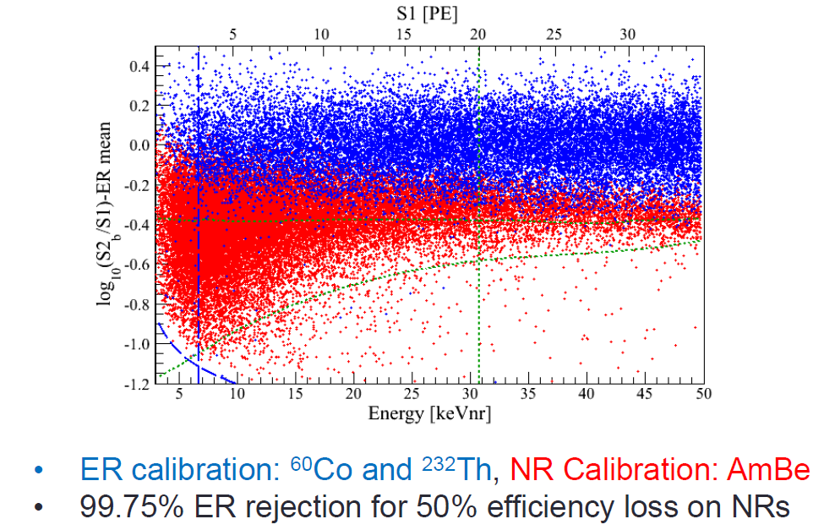
Electron/nuclear recoil separation power
XENON100 case
N. Priel SUSY2013

Slide 23
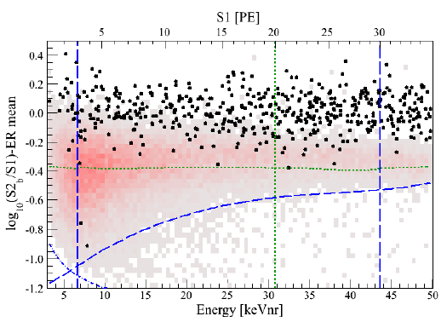
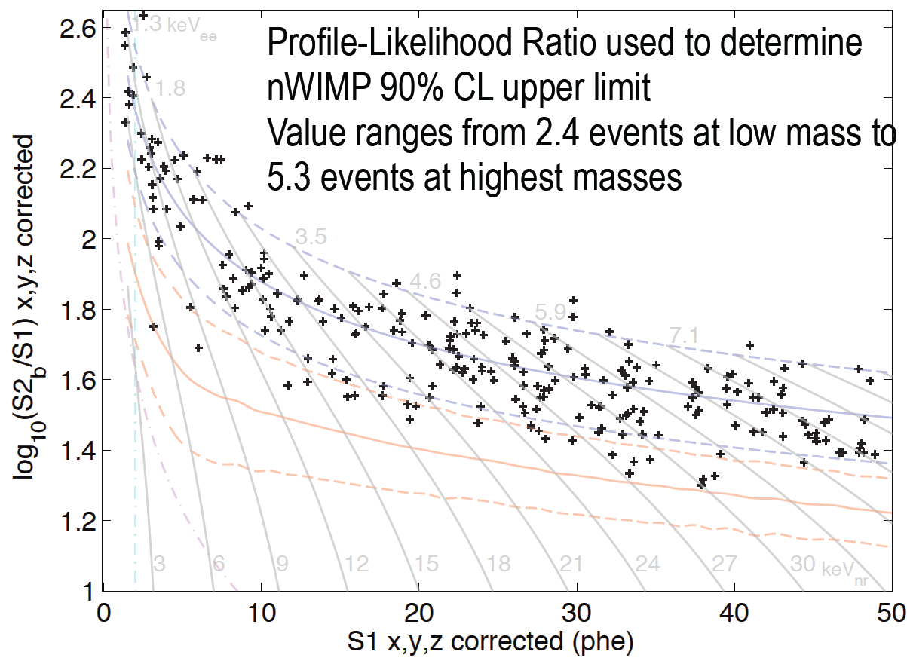

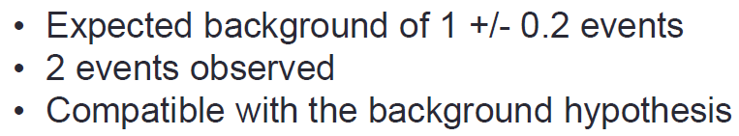
DM search results
LUX 85 days
XENON100 225 days
D. McKinsey, R. Gaitskell Oct30 2013
N. Priel SUSY2013

Slide 24
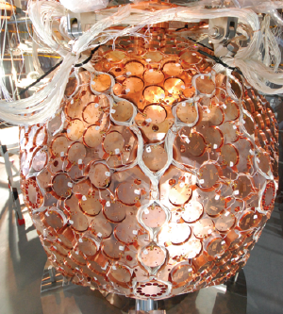
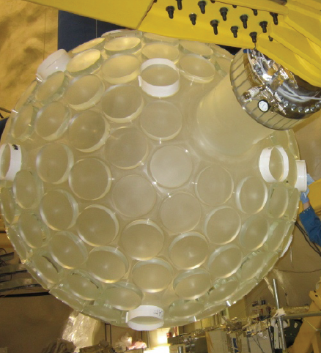
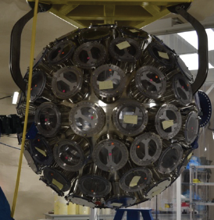
Liquid Xe/Ar scintillators
XMASS-1@Kamioka
miniCLEAN@SNOLab
DEAP3600@SNOLab
835kg total
100kg FV
642 2’’ PMTs
Refurbished
Started new data taking
500kg total
180kg FV
LNe for solar neutrino
Under construction
Will start data taking in 2014
3.6 ton total
1 ton FV
255 8’’ PMTs
Under construction
Will start data taking in 2014

Slide 25
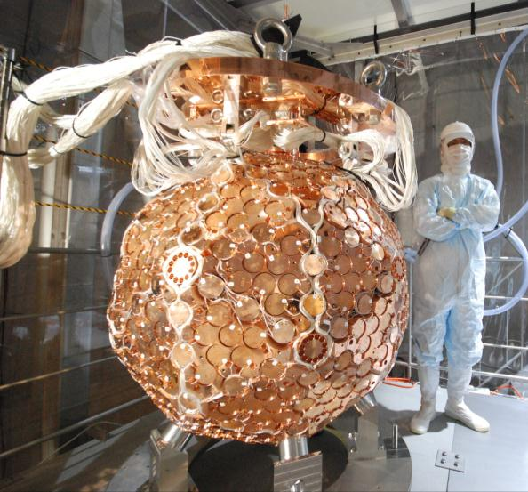

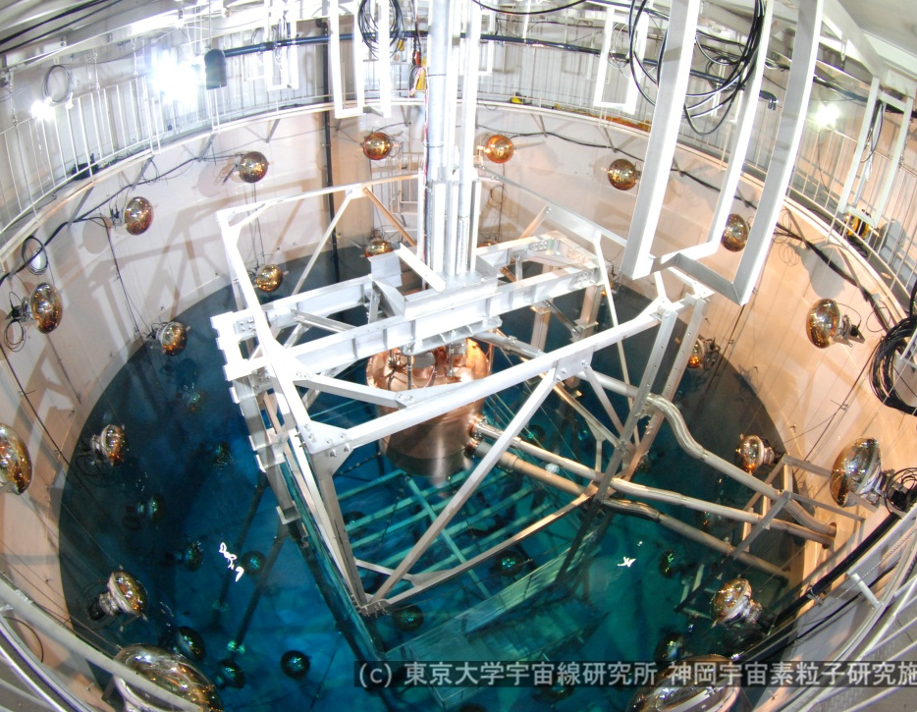
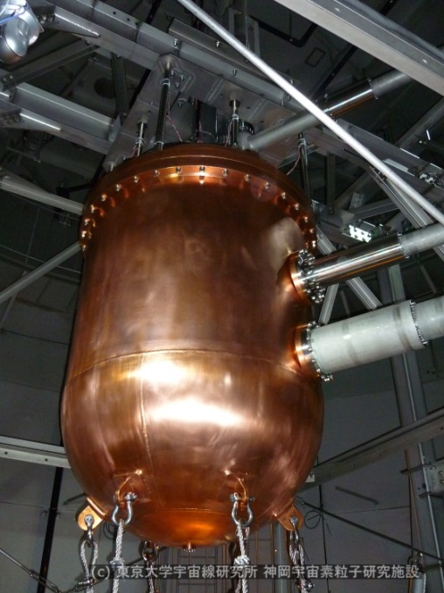
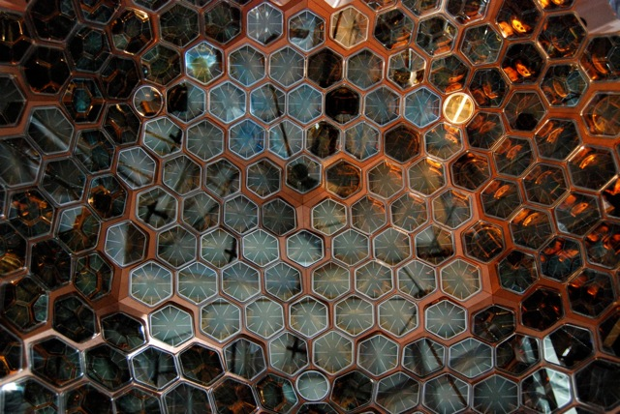
XMASS must be extremely clean
10m x φ10m water shield for external BG
Made of pure materials
    Development of low BG PMTs
Xe purification technologies
    Distillation system
Photo coverage 62.4%

Slide 26
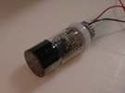
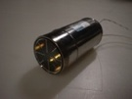
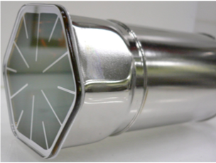

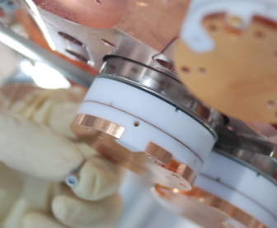
Clean
PMT
XMASS PMT HISTORY
→LUX
YEAR | 2000 | 2002 | 2009
Model | Prototype | R8778 | R10789
Material:Body | glass | Kovar | Kovar
QE | 25% | 25% | 27-39%
RI: |  |  | w/ PMT base
U [mBq/PMT] | 50 | 18±2 | 0.70±0.28
Th [mBq/PMT] | 13 | 6.9±1.3 | 1.51±0.31
⁴⁰K [mBq/PMT] | 610 | 140±20 | 9.10±2.15
⁶⁰Co [mBq/PMT] | <1.8 | 5.5±0.9 | 2.92±1.61
Clean PMT Base has also been developed.
Notes:
R10789 achieved 1/10 reduction of radioactivity level of R8778

Slide 27
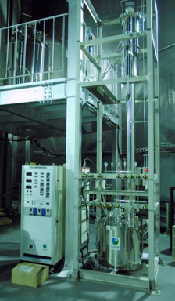
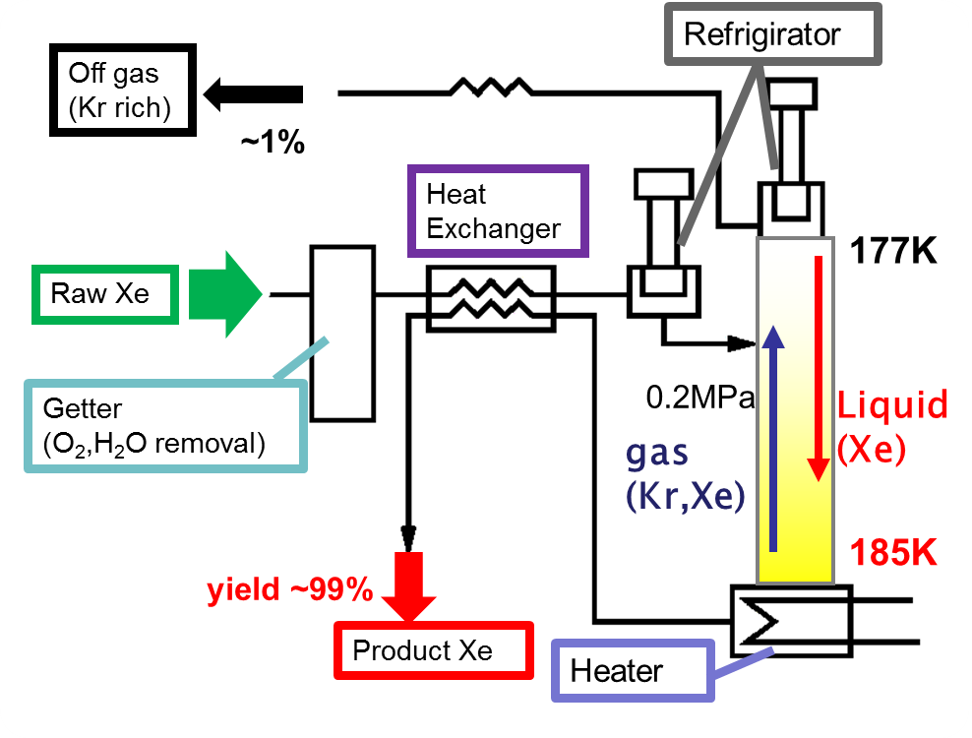
Xe Distillation System
Astoparticle Physics 31, (2009) 290
Commercial “pure Xe” contains ~0.1ppm Kr
  ⁸⁵K / K = 1.2×10⁻¹¹ τ =10.8 year, Q_{β} = 687keV
  5 order reduction was indispensable.
 | Boiling point (@0.2MPa)
Xe | 178K
Kr | 140K~150K
4m
We established
Xe purifiaction
by distillation
1 ton LXe = 170 m³ gas Xe Process speed: 4.7kg/hr → 10 days
Confirmed Kr < 2.7ppt by API-MS
→XENON
Notes:
For internal BG reduction

Slide 28



Detector Response
NIM A 716 (2013) 78
Top PMT
manipulator
Reconstructed vertex
real data simulation
real data
simulation
122keV
⁵⁷Co
~4% rms
Calibration spectrum
59.3keV of W
136keV
total photoelectrons
Highest LXe scintillation yields:
14.7p.e./keVee
Lowest threshold: 4hits→0.3keVee
-1.4 cm r.m.s. @ z = 0
-1.0 cm r.m.s. @ z = ±20 cm
Notes:
Thanks to the High QE, coverage, Xe purity, Highest! LY.

Slide 29



Unexpected BG
BG is 2 order higher than that had been expected.
Data
BG simulation
counts/day/p.e.
²³⁸U & ²¹⁰Pb of PMT Al seal
expected BG (PMT & components)
~1MeV(⁶⁰Co peak)
total photoelectrons
Major origin of BG was considered to be γ from PMTs, but the observed data seemed to have additional surface contamination.
  Aluminum sealing parts for the PMT (btw metal body and quartz glass) contains ²³⁸U and ²¹⁰Pb (>5keV)
  GORE-TEX between PMT and holder is suspicious below 5keV.
GORE-TEX?
~5keV

Slide 30

XMASS Full Volume: Low BG w/o PID
Although extra BG sources were found, XMASS BG level is still competitive w/o rejecting electron recoil events.
  XMASS has a competitive sensitivity to Light WIMPs
Evens/kg/day/keV
XMASS full volume 5591.4kg days
E. Aprile, 2010
Princeton

Slide 31

Light WIMPs
Set an upper limit on the WIMP-nucleon cross section for WIMPs with masses below 20GeV w/o PID and excludes part of the parameter space allowed by DAMA
  Phys. Lett. B719 (2013) 78
5
DAMA 5σ
σ_{WIMP-n} cm²
10⁻⁴⁰
/kg/keVee/day
4
XMASS
data
10⁻⁴¹
XENON10
3
10⁻⁴²
EDELWEISS
2
CDMS Ge
7GeV
10⁻⁴³
1
12GeV
18GeV
XENON100
LUX
10⁻⁴⁴
0
0.5
1
1.5
2
[keVee]
WIMP mass [GeV/c²]

Slide 32



XMASS-1 Refurbishment for Background reduction
Countermeasures
  PMT+Cu surface cleanup
  Remove GORE-TEX
  Cover PMT Aluminum seal
    Cu ring around aluminum seal
    Electropolished Cu cover above Cu rings

Slide 33

Refurbishment
before
after
Has just resumed data taking… looks nice!

Slide 34


Single phase TPC
Before the two phase detector realization, there were
many studies about the charge amplification and the proportional scintillation in single phase LXe.
Derenzo , Phys. Rev. A 9 (1974) 2582
Charge gain ~400
LXe
LXe
Miyajima NIM 134 (1976) 403
Charge gain ~100

Slide 35




S2 in LXe
LXe
Benetti NIMA 327 (1993) 203
Masuda NIM 160 (1979) 247
¹⁰⁹Cd 22keV was observed
Charge gain &
proportional scintillation
LXe
LXe

Slide 36




Single phase TPC
Masuda,Itow and HS
ParisTPC conf (2012)
Spherical LXe TPC
  High electric field in XMASS
  20kV at the center
Gas spherical TPC
Giomataris JINST 3:P09007(2008)
(GND)
+HV
Charge
HV
Will be tested with single
wire in this chamber
S2
E
e⁻
e⁻
e⁻
S1
Field

Slide 37





Single phase TPC
Breskin
ParisTPC conf (2012)
Thick GEM in LXe
Thickness 0.4mm
S₁
Detects S1&S2
RD51 Aug 2013
S1
S2
Detects S1
THGEM 70 kV/cm
E_{top} = 0, E_{drift} = 1 kV/cm

Slide 38

Near Future Projects
How much noble liquids do we need?
To reach ～10⁻⁴⁸ cm²
arXiv:1306.3244

Slide 39







Future Projects (all in water)
Time
XMASS1.5
LZ = LUX+ZEPLIN
7t total
500 3’’ PMTs
XENON1t
5t total
New 3’’
PMTs
XMASS 2
XENON nt
DarkSide G2
5t total
DARWIN
24t total
3.5t total
248 3’’ PMTs
In 2015?
x n?
20t LAr
10t LXe
LZ

Slide 40

Evolution of Direct Dark Matter Search
Can we realize?
L.Baudis Phys Dark Univ.1(2012) 94
1 events/kg/yr
1 events/ton/yr

Slide 41
Conclusion
Direct detection experiments have reached the sensitivity of cross section down to 10⁻⁴⁶cm² region with noble liquid technologies.
Next 5 year’s detectors which aim at <10⁻⁴⁷cm² are all using noble liquids.
  Can noble liquids catch Dark Matter?
  Beyond noble liquids, completely new technology will be required?
  SUSY? After LHC upgrade, we may have to go further…

Slide 42
Extra slides

Slide 43


The effects of the deviation from Maxwellian
“Standard” vs VL2

Slide 44


Uncertainties on the relative scintillation yeild
Relative scintillation yield measures quenching of scintillation in nuclear recoils compared to electron recoils

Slide 46


Slide 47




What makes the WIMP signal?
Earth’s motion in the galaxy
revolution 30km/s
Cygnus
Sun
232 km/s
DARK HALO
(Maxwell 分布)
Ｖ_{０}＝220km/s
Change of
Cygnus direction
232 km/s
revolution
30 km/s
Change of Ｒ

Slide 48



XMASS Projects…
Multipurpose low BG experiment with single phase (liquid) Xe
  Xenon MASSive detector for Solar neutrino (pp/⁷Be)
  Xenon neutrino MASS detector (double beta decay)
  Xenon detector for Weakly Interacting MASSive Particles(DM)
neutrinos,
axions
¹³⁶Xe
dark matters, neutrinos
24t
(10t fiducial)
Ø 2.5m
The ultimate XMASS
Y. Suzuki, hep-ph/0008296

Slide 49



Solar Axions
JETP Lett., 95, 379 (2012)
arXiv:1206.4142
A. V. Derbin et al.,
XMASS has also sensitivity to solar axions that would be produced by Bremsstrahlung and Compton effects (g_{aee} ) in the Sun through the axio-electric effect in Xe
  N.B. Not g_{aγγ} through Primakoff effect
Expected flux g_{aee}=10⁻¹⁰ .

Slide 50



Solar Axions
  Phys. Lett. B724 (2013) 46
Same data set as Light WIMP search
No indication of signals. Bound in gaee vs. mass.
Better than any other constraint in 10-40keV.
Better than any other experimental constraint
Data
Signal MC
Notes:
EDELWEISS-II arXiv:1307.1488

Slide 51
Next step: XMASS-1.5
Inner Ø: 1.5 m
  contains 5 tons of LXe
  fiducial mass 1 ton
Lessons from XMASS-1 New PMT
Still Dark matter detector
Flat photocathode
cannot catch
Plano-concave photocathode
can catch

Slide 52





XMASS-1.5
Actively being developed w/ Hamamatsu
Effectiveness is verified by MC

Slide 53





Pure components
More than 250 components
RIs of all the components were measured with HPGe and low RI materials were selected.
PMT(R10789)
3 HPGe detectors
in Kamioka
C1020(OFHC)
 | Sum of other components
RI: | Compared w/ 642 PMTs
U | <35%
Th | <35%
⁴⁰K | <20%
⁶⁰Co | <20%
RI: | /one PMT
U | 0.70±0.28 mBq
Th | 1.51±0.31 mBq
⁴⁰K | 9.10±2.15 mBq
⁶⁰Co | 2.92±1.61 mBq
SUS304 screws
LEDs

Slide 54

Quenching Factor/Leff uncertainty

Slide 55

Xe circulation system
4 x 180W refrigerator
PTR developed by KEK
Gas circulation 30L/min
gas pump
emergency gas pump
100L/min
Cable line
filters
Calibration line
Water tank
evaporator
10 m³
x 2
gas storage
Condenser
360W
filters
800kg
1050kg
Outer vacuum
liquid pump
700L
Liq. Storage
Liquid circulation 5L/min
Notes:
We are planing to putfilters to remove Rn, here…

Slide 56



Water shields for external BG
Active for μ, passive for γ,n
Ex.) Fast n flux @Kamioka mine:
(1.15+0.12) x10⁻⁵ /cm²/sec
10m
Assuming all neutron’s energies are
10 MeV very conservatively
10⁷ n generated
10m
y [cm]
water
Liq. Xe
< 10⁻⁴
count/day/kg
Water purification system
keeps Rn < 1mBq/m³
with 70 PMTs (20 inch) to detect Cerenkov light
X [cm]
5m tank is enough large to shield n and γ
Notes:
THIS PAGE CAN BE SKIPPED
200cm is enough, but it is designed for future large detector.

Slide 57


U chain Th chain

Slide 58

Calibration System
Calibration source rod
Source list
adopter (SUS304)
source＋holder
(Exchangeble)
OFHC (C1020) rod
Isotopes | Energy [keV] | intensity [Hz] | diameter [mm]
(1) Fe-55 | 5.9 | 350 | 1.42
(2) Cd-109 | 22, 25, 88 | 800 | 1.42
(3) Am-241 | 59.5 | 485 | 0.15
(4) Co-57 | 122 | 100 | 0.21

