Slide 1

Recent status of LHCf to improve the cosmic-ray air shower modeling
Takashi SAKO (KMI/STEL, Nagoya University)
for the LHCf Collaboration

Slide 2
Outline
Standard Scenario of the Cosmic-Ray Spectrum
LHCf
  Experiment Overview
  Results
  Future
Summary

Slide 3
Standard Scenario of the Cosmic-Ray Spectrum
proton
Acceleration limit of SNR
approx. 4x10¹⁵ V
Flux
Helium
Light ions
Heavy ions
Rigidity (pc/Z)
Cosmic-ray accelerators = PeVatrons have finite size and B field => Acceleration limit same in rigidity for different nuclei

Slide 4
Standard Scenario of the Cosmic-Ray Spectrum
proton
Flux
Helium
Light ions
Heavy ions
Energy
In term of ‘Energy,’ heavier particles have Z times higher energy than protons

Slide 5
Standard Scenario of the Cosmic-Ray Spectrum
Flux
Scale-up for Extra-Galactic sources
Galactic CRs
Energy
Over GCR max energy, Extra-galactic CRs appear

Slide 6
Standard Scenario of the Cosmic-Ray Spectrum
knee
Flux
ankle
(GZK) cutoff
Energy
10¹⁵ eV
10¹⁸ eV
10²⁰ eV
Questions
  End of GCR
  Turn over from GCR to EGCR
  Cutoff (acc. Limit, proton GZK, ion GZK)

Slide 7
Standard Scenario of the Cosmic-Ray Spectrum
knee
Flux
heavy
?
ankle
mass
(GZK) cutoff
light (=proton)
Energy
10¹⁵ eV
10¹⁸ eV
10²⁰ eV
Mass vs. Energy
  Light below knee
  Light to heavy over knee
  Heavy to light around ankle
  Light or light to heavy around cutoff

Slide 8
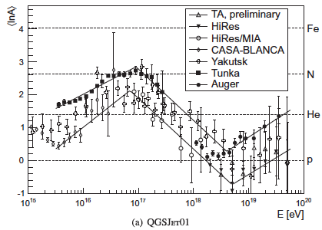
knee
Flux
heavy
?
ankle
mass
(GZK) cutoff
light (=proton)
Energy
10¹⁵ eV
10¹⁸ eV
10²⁰ eV
Mass vs. Energy
  Light < knee
  Light to heavy over knee
  Heavy to light around ankle
  Light or light to heavy around cutoff

Slide 9
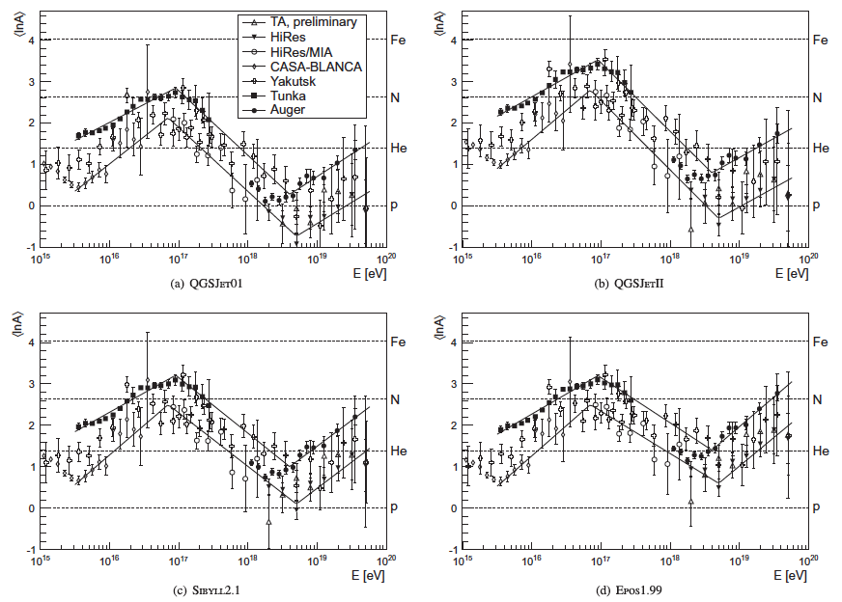
QGSJET1
QGSJETII
letter-to-PAC_20131206
letter-to-PHENIX_2013120
SIBYLL
EPOS
(Kampert and Unger, Astropart. Phys., 2012)
Interpretation depends on the hadronic interaction model

Slide 10
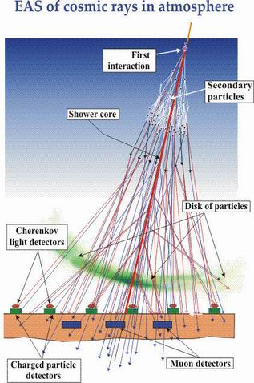
① Inelastic cross section
If large σ
rapid development
If small σ
deep penetrating
④ 2ndary interactions
nucleon, π
② Forward energy spectrum
Soft interaction (non-perturbative QCD) dominates
Various phenomenological models are proposed
(keywords: Regge theory, multi-Pomeron interaction, Glauber theory)
Experimental inputs are important
LHC gives the best opportunity
If softer
shallow development
If harder
deep penetrating
③ Inelasticity k= 1-p_{lead}/p_{beam}
If large k
(π⁰s carry more energy)
rapid development
If small k
( baryons carry more energy)
deep penetrating

Slide 11
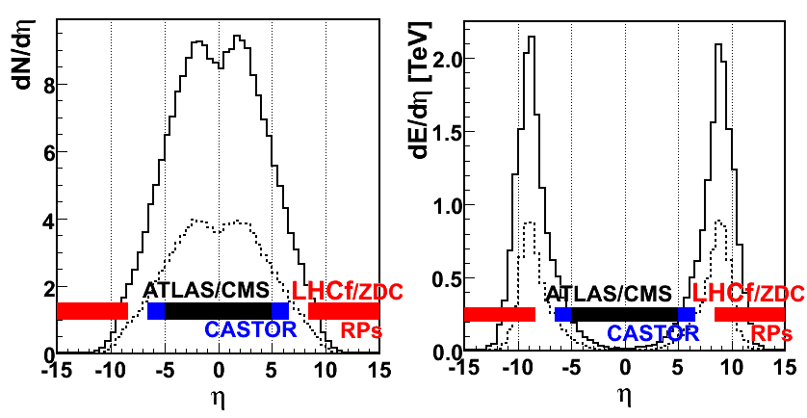
2^{ry} particle flow at colliders multiplicity and energy flux at LHC 14TeV collisions
Multiplicity
Energy Flux
All particles
neutral
Most of the energy flows into very forward
√s=14 TeV pp collision corresponds to E_{lab}=10¹⁷eV

Slide 12
Large Hadron Collider forward
(LHCf)

Slide 13






The LHCf experiment (Oct. 2013-)
*Y.Itow, K.Kawade, Y.Makino, K.Masuda, Y.Matsubara, E.Matsubayashi, Y.Muraki, *T.Sako, *N.Sakurai, Y.Sugiura, Q.D.Zhou
Solar-Terrestrial Environment Laboratory, Nagoya University, Japan
*Kobayashi-Maskawa Institute, Nagoya University, Japan
H.Menjo Graduate School of Science, Nagoya University, Japan
K.Yoshida Shibaura Institute of Technology, Japan
K.Kasahara, Y.Shimizu, T.Suzuki, S.Torii
Waseda University, Japan
T.Tamura Kanagawa University, Japan
M.Haguenauer Ecole Polytechnique, France
W.C.Turner LBNL, Berkeley, USA
O.Adriani, L.Bonechi, M.Bongi, R.D’Alessandro, M.Delprete, M.Grandi, G.Mitsuka, P.Papini, S.Ricciarini, G.Castellini
INFN, Univ. di Firenze, Italy
A.Tricomi INFN, Univ. di Catania, Italy
J.Velasco, A.Faus IFIC, Centro Mixto CSIC-UVEG, Spain
A-L.Perrot CERN, Switzerland
（-Mar2013）

Slide 14
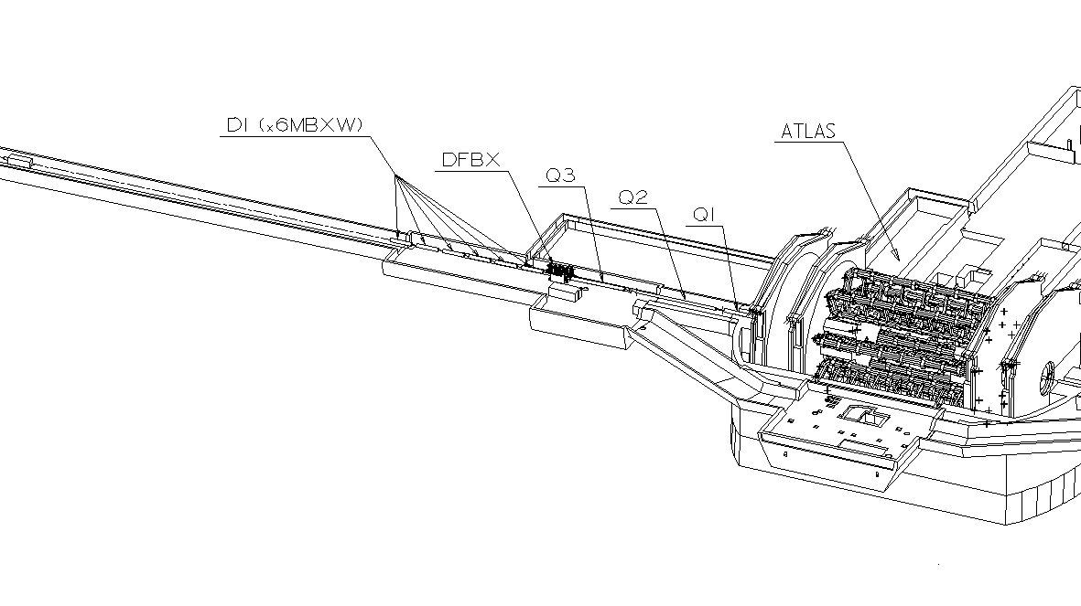
The LHC forward experiment
LHCf Arm#1
ATLAS
140m
Two independent detectors at either side of IP1 (Arm#1, Arm#2 )
Beam
Beam pipe
Charged particles (+)
LHCf Arm#2
Neutral
particles
96mm
Charged particles (-)
All charged particles are swept by dipole magnet
Neutral particles (photons and neutrons) arrive at LHCf
0 degree is covered

Slide 15
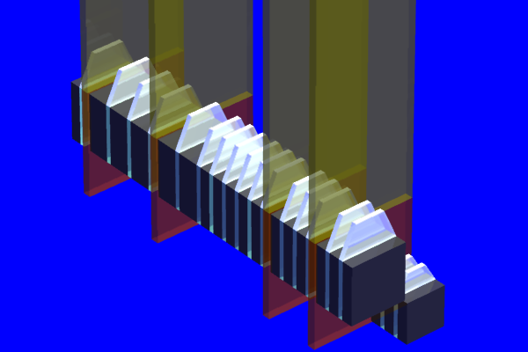
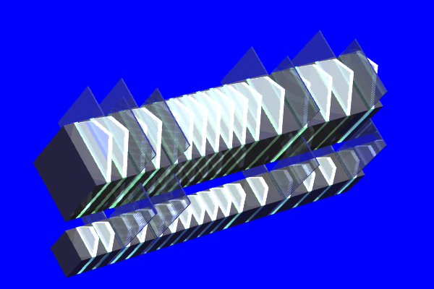
LHCf Detectors
Imaging sampling shower calorimeters
Two calorimeter towers in each of Arm1 and Arm2
Each tower has 44 r.l. of Tungsten,16 sampling scintillator and 4 position sensitive layers
Arm#1 Detector
20mmx20mm+40mmx40mm
4 XY SciFi+MAPMT
Arm#2 Detector
25mmx25mm+32mmx32mm
4 XY Silicon strip detectors

Slide 16
LHCf Status
Done
  0.9, 2.76, 7 TeV pp collision, 5 TeV pPb collision data taking
  Photon spectra at 0.9 and 7TeV published
  π⁰ spectra at 7 TeV published
  Performance at 0.9 and 7TeV published
On going
  Neutron spectra at 7TeV
  π⁰ and UPC spectra at 5TeV pPb
  Rad-hard detector upgrade for 13 TeV pp
Plan
  13TeV pp collision in 2015 (operation plan in discussion)
  0.5TeV pp at RHIC (LOI submitted)
  Discussions for light ion collision at RHIC and LHC

Slide 17
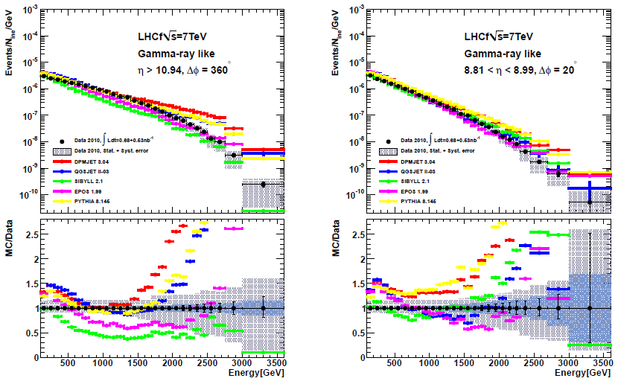
Photon spectra @ 7TeV (Data vs. Models)
Adriani et al., PLB, 703 (2011) 128-134
Around 0 degree (On axis)
Off axis
DPMJET 3.04 QGSJET II-03 SIBYLL 2.1 EPOS 1.99 PYTHIA 8.145

Slide 18
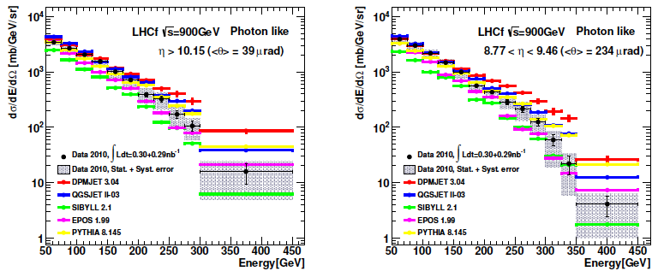
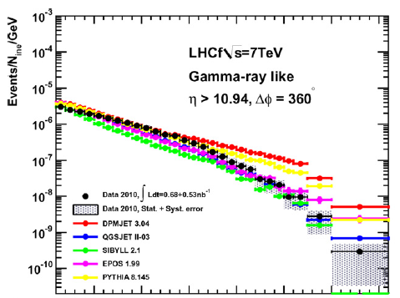
Photon spectra @ 900GeV
Adriani et al., PLB, 715 (2012) 298-303

Slide 19
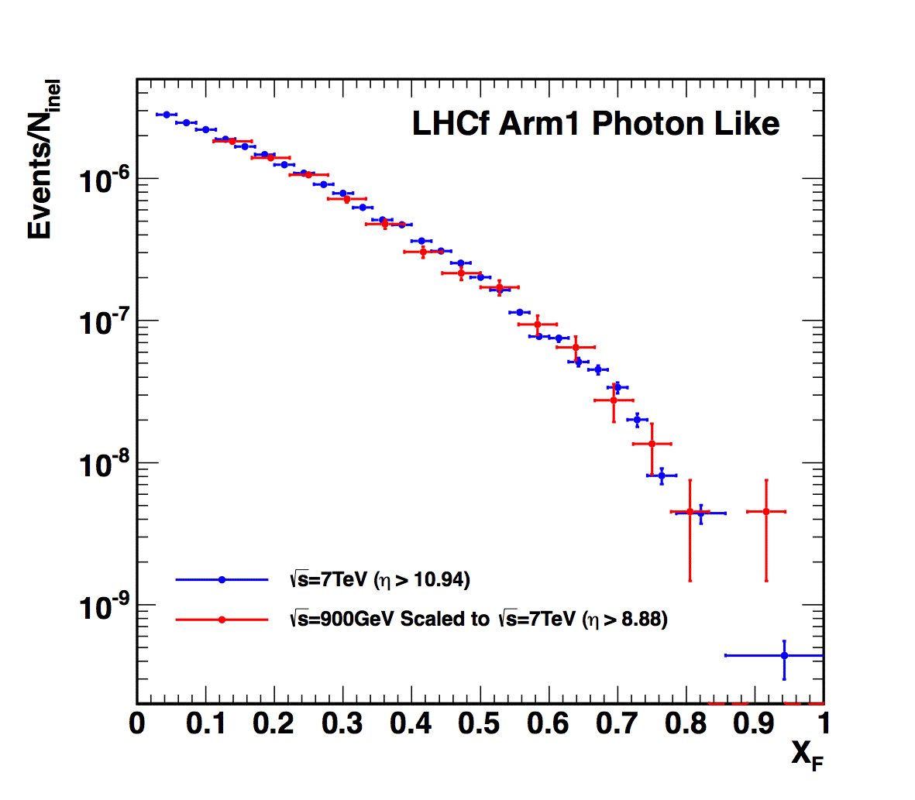
900GeV vs. 7TeV
XF spectra : 900GeV data vs. 7TeV data
Preliminary
Data 2010 at √s=900GeV
(Normalized by the number
of entries in X_{F} > 0.1)
Data 2010 at √s=7TeV (η>10.94)
Comparison in the same p_{T} range (pT<0.13x_{F} GeV/c)
Normalized by # of events X_{F} > 0.1
Statistical error only

Slide 20
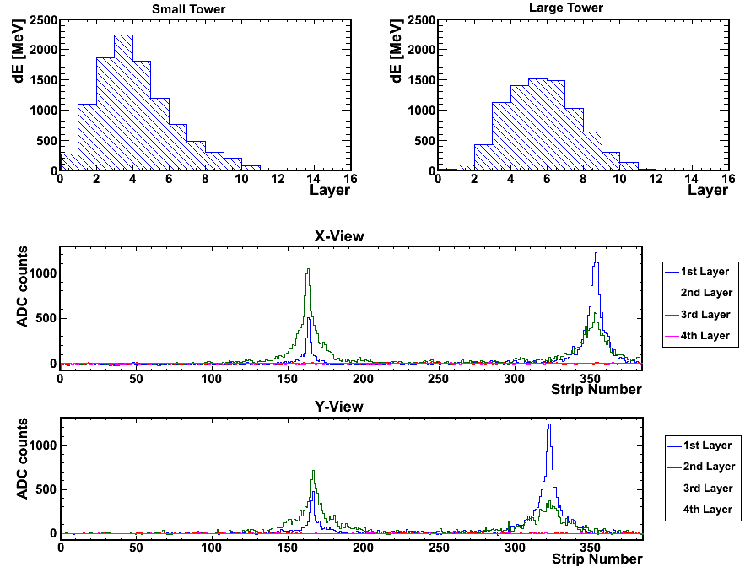
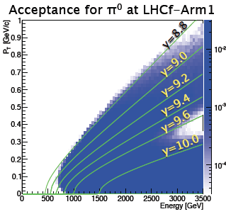
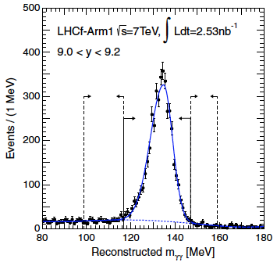
π⁰ analysis
Longitudinal development
π⁰ candidate
599GeV & 419GeV photons in 25mm and 32mm tower, respectively
M = θ√(E₁xE₂)
Small
Cal.
Large
Cal.
Lateral development
γ₁(E₁)
Silicon X
R
140m
θ
Silicon Y
γ₂(E₂)
I.P.1

Slide 21
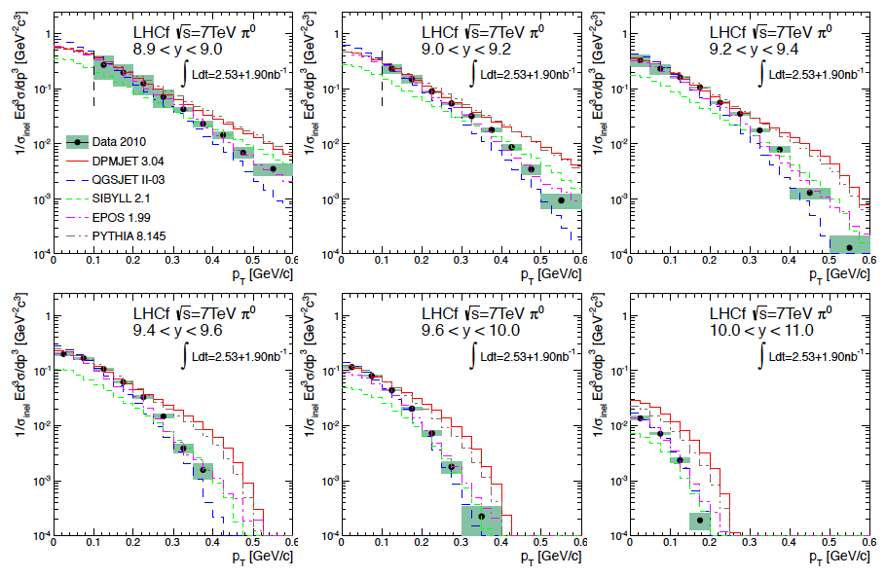
π⁰ p_{T} distribution in different rapidity (y) ranges
Adriani et al., PRD, 86, 092001 (2012)

Slide 22
Confirmation of x_{F} scaling
Events selected from very narrow phase space to compare with 900GeV result
Preliminary
Phase space of LHC 900GeV data
Phase space of LHC 7TeV data
LHCf@RHIC=RHICf
RHICf 500GeV
p_{T} (GeV/c)
p_{T} (GeV/c)
p_{T} (GeV/c)
2
1
Color map: photon production rate
Red triangle: LHCf acceptance
E (GeV)
0
100
200
E (GeV)
E (GeV)

Slide 23
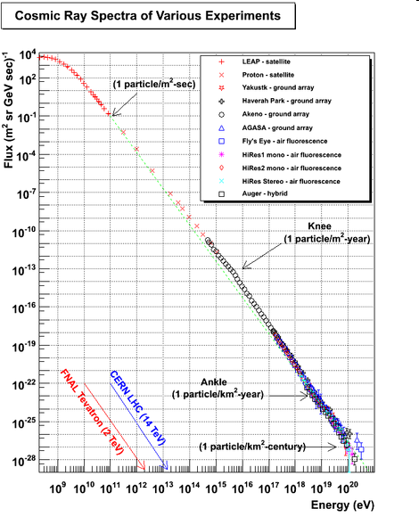
Cosmic-ray spectrum & Colliders
Knee: end of galactic proton CR
End of galactic CR and
transition to extra-gal CR
Ankle
(GZK) cutoff:
end of CR spectrum
10¹⁰
10²⁰ eV
ISR
SppS
RHIC
Tevatron
LHC 13TeV
LHC 0.9TeV
LHC 7 TeV

Slide 24
Next Step of LHCf
SLIDE in 2011
at KMIIN
Analysis
  Impact on air shower calculation / CR physics
  Photon spectra at √s = 0.9 TeV in analysis
  π⁰ spectra in analysis
  P_{T} spectra
  Hadron spectra (photon/hadron ratio)
  Test for LPM effect
  Correlation with central production (joint analysis with ATLAS)
Measurements
  LHC √s = 14 TeV pp
  LHC p-Pb in study
  Possibility in the other colliders
  Dream : N-p, N-N, N-Fe (N; Nitrogen) in future
In progress/assured
In consideration

Slide 25
Next Step of LHCf
In progress/assured
In consideration
Analysis
  Impact on air shower calculation / CR physics
  Photon spectra at √s = 0.9 TeV in analysis
  π⁰ spectra in analysis
  P_{T} spectra
  Hadron spectra (photon/hadron ratio)
  Test for LPM effect
  Correlation with central production (joint analysis with ATLAS)
Measurements
  LHC √s = 14 TeV pp
  LHC p-Pb in study
  Possibility in the other colliders
  Dream : N-p, N-N, N-Fe (N; Nitrogen) in future
Dr. Sakurai joined
Done!
Done!
Baryon
Complete soon
PRIME TARGET
Preparation on going
Operation done! Analysis on going
LOI to RHIC
Discussion at RHIC and LHC

Slide 26

43 participants
13 from abroad
LHCf
TOTEM
ALICE
CMS
PHENIX
Cosmic Ray
Diffraction
CGC
UPC
Interaction Model

Slide 27
Summary
Determination of the CR mass (chemical) composition is important to understand the CR origin
LHCf is motivated to constrain the hadronic interaction models used to interpret the cosmic-ray air shower data
Successful operations at LHC p-p and p-Pb collisions
Three physics publications and some ongoing analysis
No surprise so far but set strong constraints to the models
Preparation for the highest energy operation in progress
Discussions for future plan started
  RHIC; validation of Feynman scaling
  RHIC; first light ion collision
  LHC; highest energy light ion collision

Slide 28
Backup

Slide 29


Slide 30
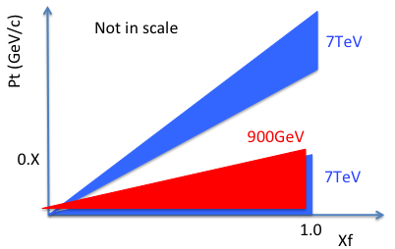
900GeV vs. 7TeV
LHCf coverage in X_{F}-p_{T} plane
(X_{F} = E/E_{beam})
XF spectra : 900GeV data vs. 7TeV data
Preliminary
900GeV vs. 7TeV
with the same PT region
Data 2010 at √s=900GeV
(Normalized by the number
of entries in X_{F} > 0.1)
Data 2010 at √s=7TeV (η>10.94)
small-η = Large tower
0.1
900 GeV
Small+large
tower
big-η =Small tower
Normalized by # of evnetsX_{F} > 0.1
Statistical error only
Good agreement of X_{F} spectrum shape between 900 GeV and 7 TeV.

Slide 31
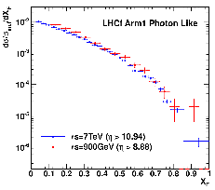
x_{F} scaling : a key for extrapolation
LHC single gamma data
(900GeV pp / 7TeV pp)
Expected from models
(5TeV, 14TeV and 50TeV)
Data
Preliminary
0.9TeV (η>8.68)
7TeV scaled (η>10.94)
But this comparison done in very limited phase space..

