Slide 1
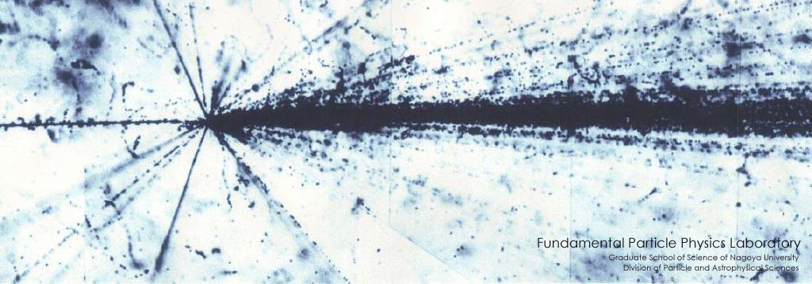
Nuclear Emulsion Technology and
Directional Dark Matter Study
Tatsuhiro NAKA
KMI / IAR, Nagoya University
KMI2013 @ Nagoya University, Dec. 12th (11-13), 2013

Slide 2
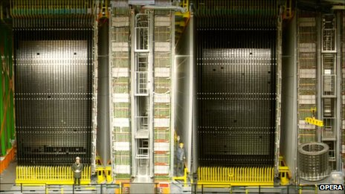
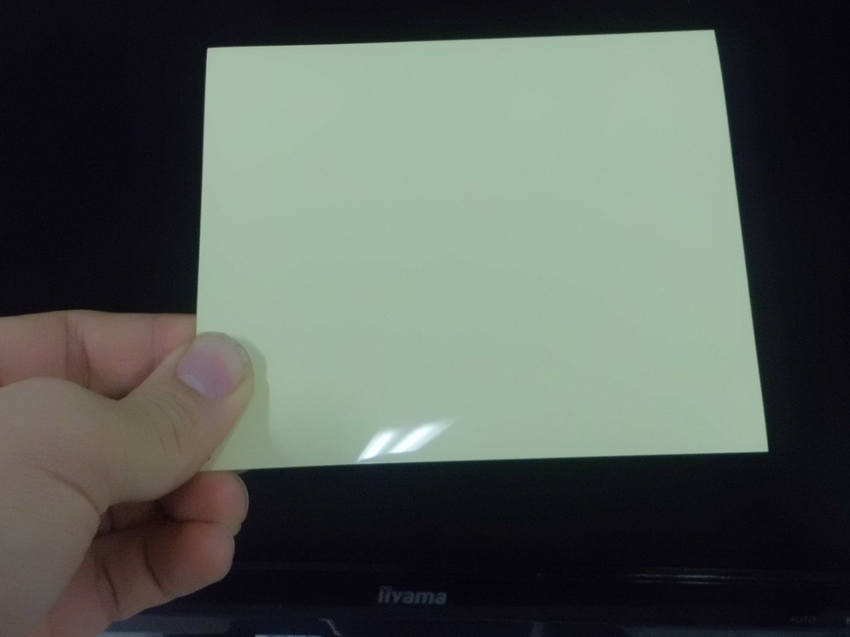
OPERA detector
Emulsion mass ~ 30 ton
Why is it capable of detection of tau neutrino ?
It has extremely high spatial resolution .
( tau decay length ~ 100 µm)
Why does it have such high spatial resolution?

Slide 3
Nuclear Emulsion Detector
Ag⁺ + e⁻ → Ag₁・・・Ag_{n}
Polymer (C, (N,O))
Charged Particle
Silver halide crystal
(AgBr)
e -
e -
e -
e -
e -
e -
e -
e -
Ionized electrons concentrated on the electron trap to form the latent image specks in a crystal
Development treatment
Silver grains
(size : several 10 nm ~ 1 µm)

Slide 4
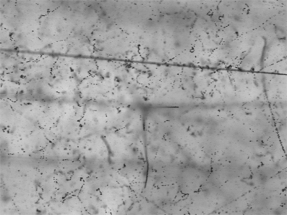
Nuclear Emulsion Detector
Polymer (C, (N,O))
Nuclear spallation reaction by heavy ion
Charged Particle
Silver halide crystal
(AgBr)
Development treatment
100 µm
Spatial resolution
- silver halide crystal size
- number density of silver halide crystal
Sensitivity
- Chemical treatment
- Crystal defect and doping etc.
Silver grains
(size : several 10 nm ~ 1 µm)

Slide 5
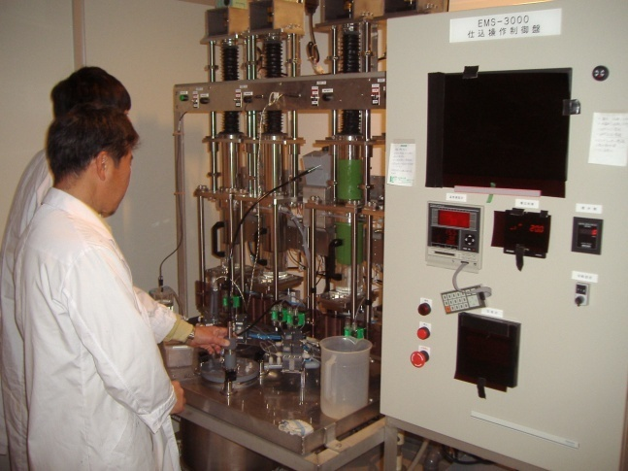
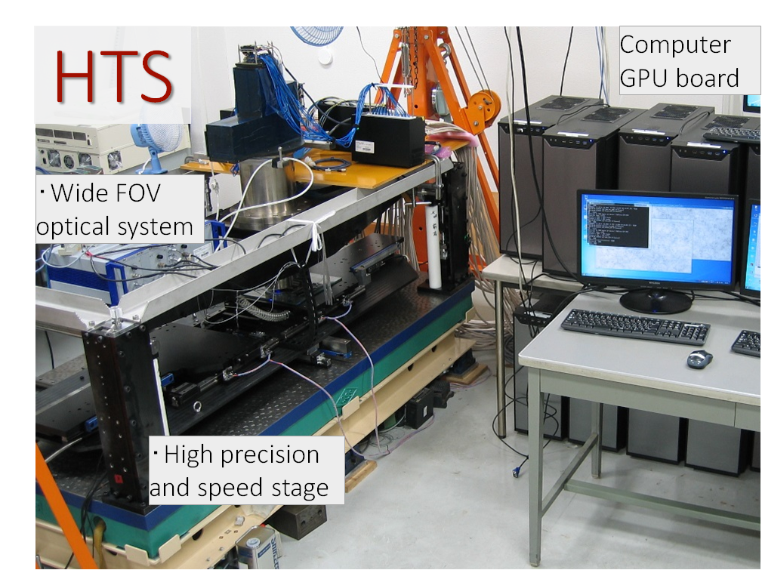
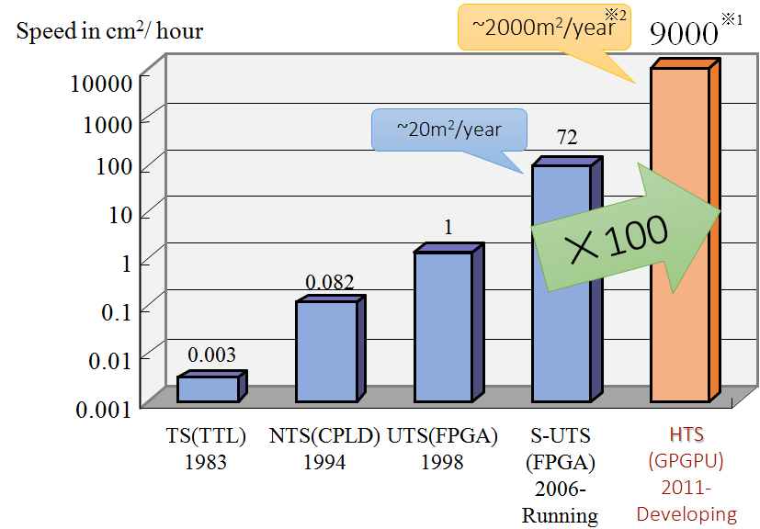
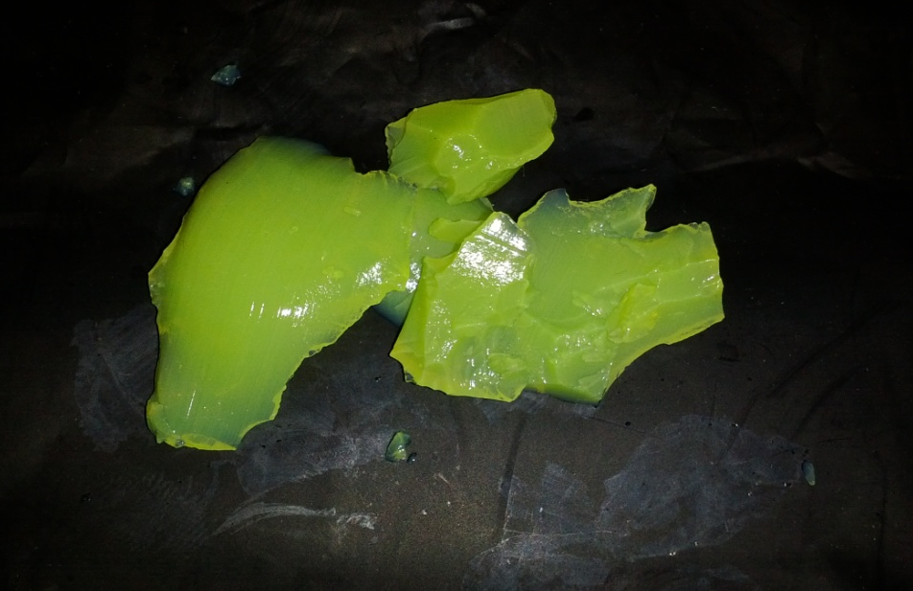
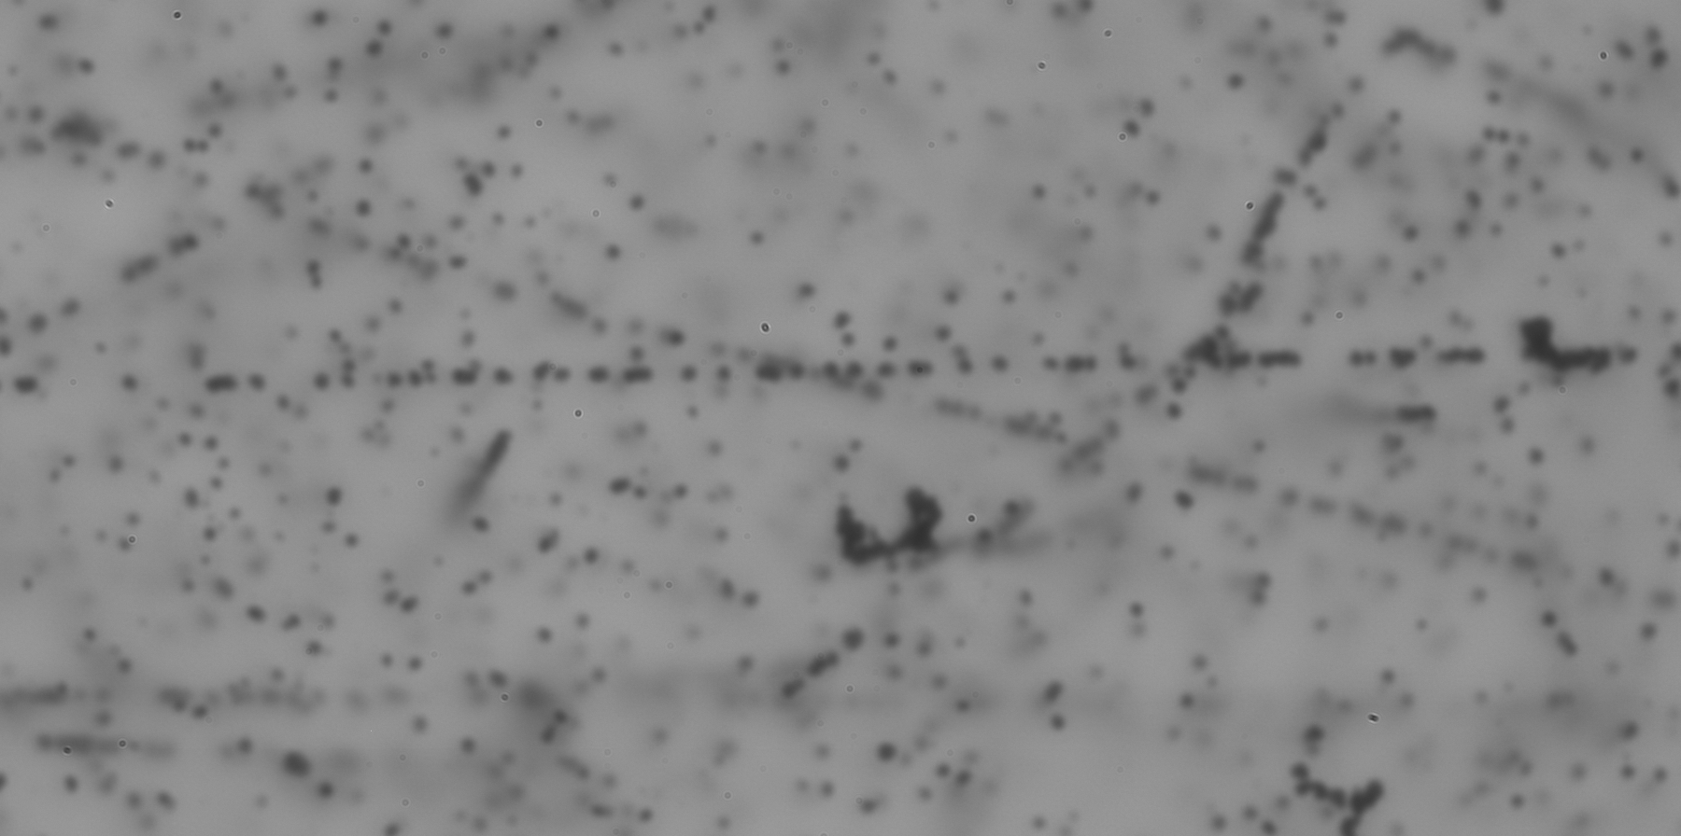
Key technology
Devise self-production
Readout system
Emulsion production facility @ Nagoya U.
Track of MIP
100μm
~ 100 kg order /year
Notes:
Scanning speed have been improved year by year

Slide 6
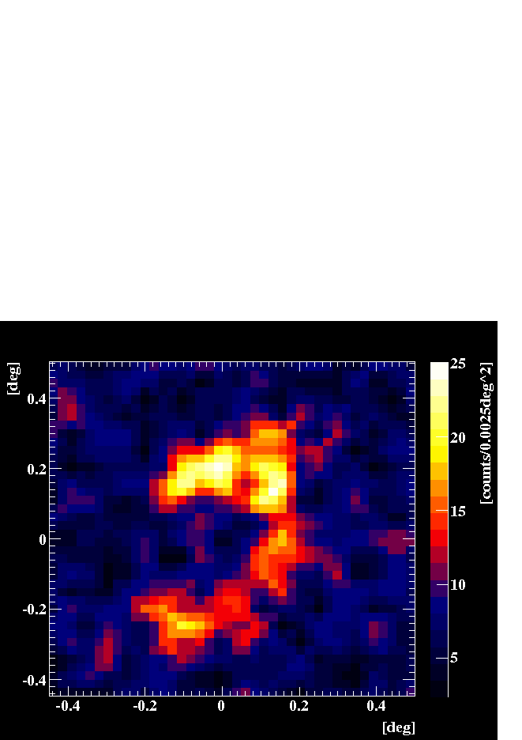
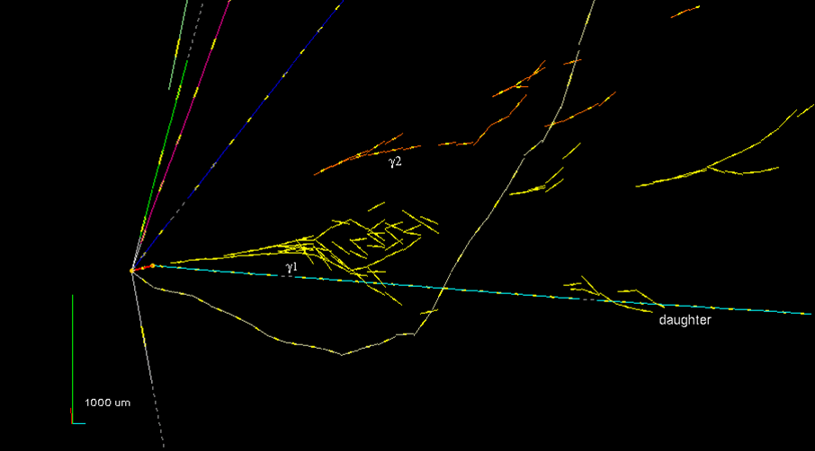
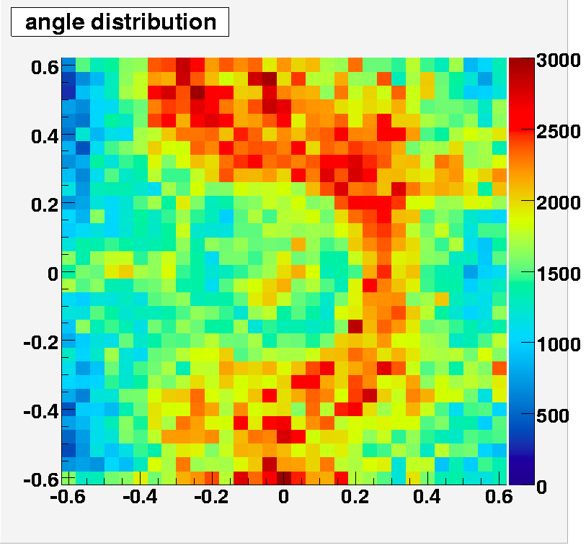
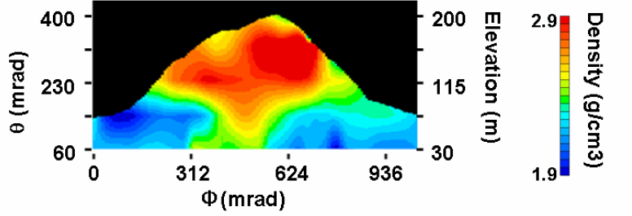
simulation
γ₂
γ₁
τ
π
Gamma-ray telescope
e.g. Grain project [poster : No 15]
Dark Matter Search
e.g. This talk [poster : No12]
Neutrino Experiment
e.g. OPERA experiment
Double Hyper Nuclei
Experiment s using nuclear emulsion technology
Gravitation effect between H and anti-H
e.g. AEgiS project@ CERN
Radiation monitor
e.g. neutron monitor, medical
Muon radiography
e.g. volcano, nuclear plant etc.

Slide 7
Dark Matter Search

Slide 8
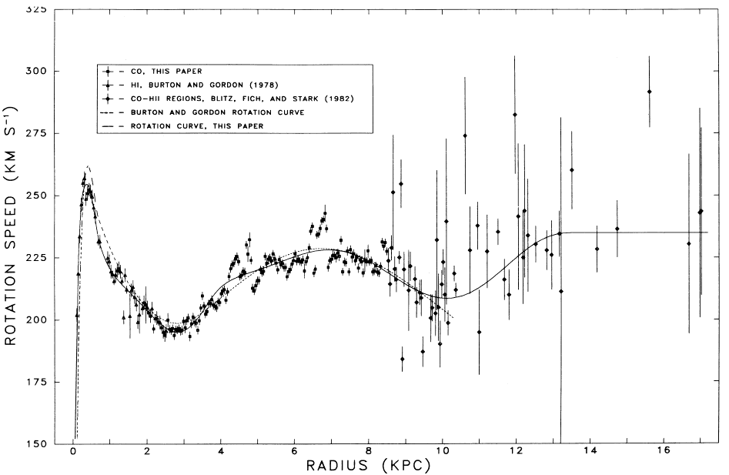
Dark Matter Problem
Component of our universe
Rotation Velocity Curve of Milky way Galaxy
Dark Energy
(68%)
Dark Matter
(27%)
solar system
Ordinary matter
(5%)
missing mass
only visible
Planck 2013 results
Astrophys. J. 295: 422-436, 1985
Dark Matter density around solar system
0.3 – 0.5 GeV/cm³
( flux of 10000 /cm²/sec of 100GeV/c² at earth )

Slide 9
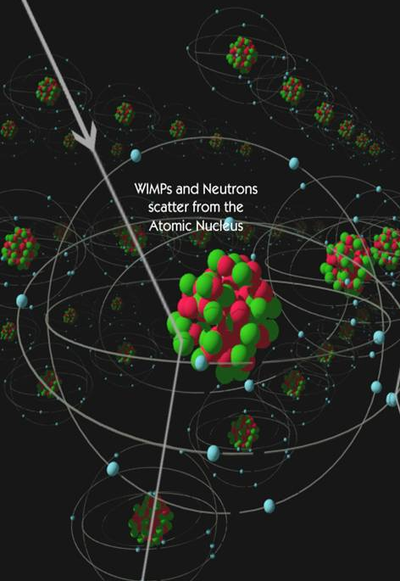
Direct Dark Matter Search
Dark matter
Dark Matter velocity ~ 100 km/sec order
( limited by escape velocity of Milkyway galaxy)
de Broglie wavelength scale
λ =h/p ~ 10 fm
Nucleus scale!
We should detect the nuclear recoil induced by dark matter
Recoil energy scale < ~ 100 keV order

Slide 10
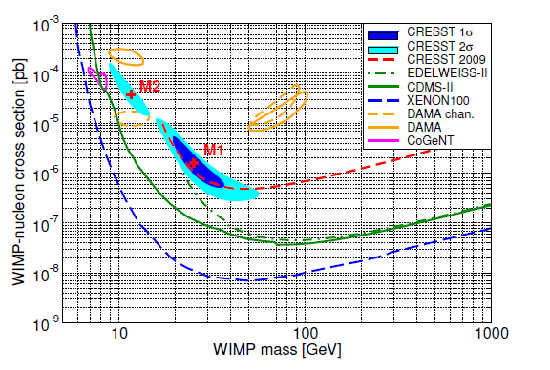
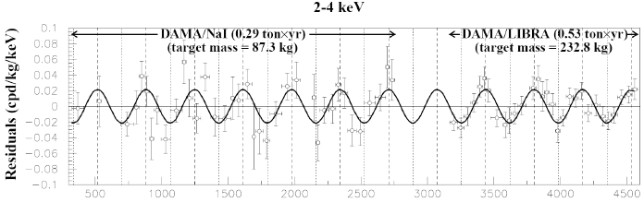
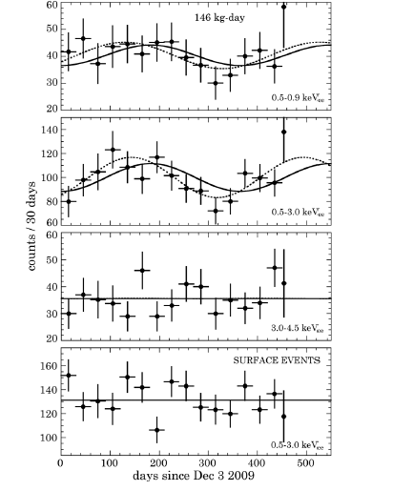
Current Method of dark matter identification
30 km/sec
earth@summer
DAMA/LIBRA [ NaI, 8.9σ annual modulation]
DM
Direction of solar system
(230km/sec)
CoGent [Ge, 2.86σ Ann. Mod.]
30 km/sec
earth@winter

Slide 11
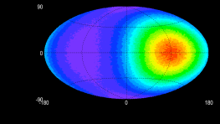
Directional Dark Matter Search
earth@summer
Target nuclei
DM
Direction of solar system
(230km/sec)
DM
Dark matter
wind
Direction sensitive Detector
earth@winter
Detection of recoiled nuclei as tracks
Direction sensitive detector
Emulsion detector

Slide 12
Current Collaboration
Nagoya University
T. Naka, T. Asada, T. Katsuragwa, M. Yoshimoto, K. Hakamata, M. Ishikawa, A. Umemoto, S. Furuya, S. Machii, Y. Tawara, M. Nakamura, O. Sato, T. Nakano
Chiba University
K. Kuge
University of Napoli
G. de Lellis , A. Di Crescenzo, A. Sheshukov , A. Aleksandrov, V. Tioukov
University of Padova
C. Sirignano
Laboratori Nasionale de Grann Sasso (LNGS)
N. D’Ambrossio, N. Di Marco, F. Pupilli
Technical Support
- SPring-8
- DarkSIDE group at LNGS
- retired FUJI FILM engineer etc.

Slide 13
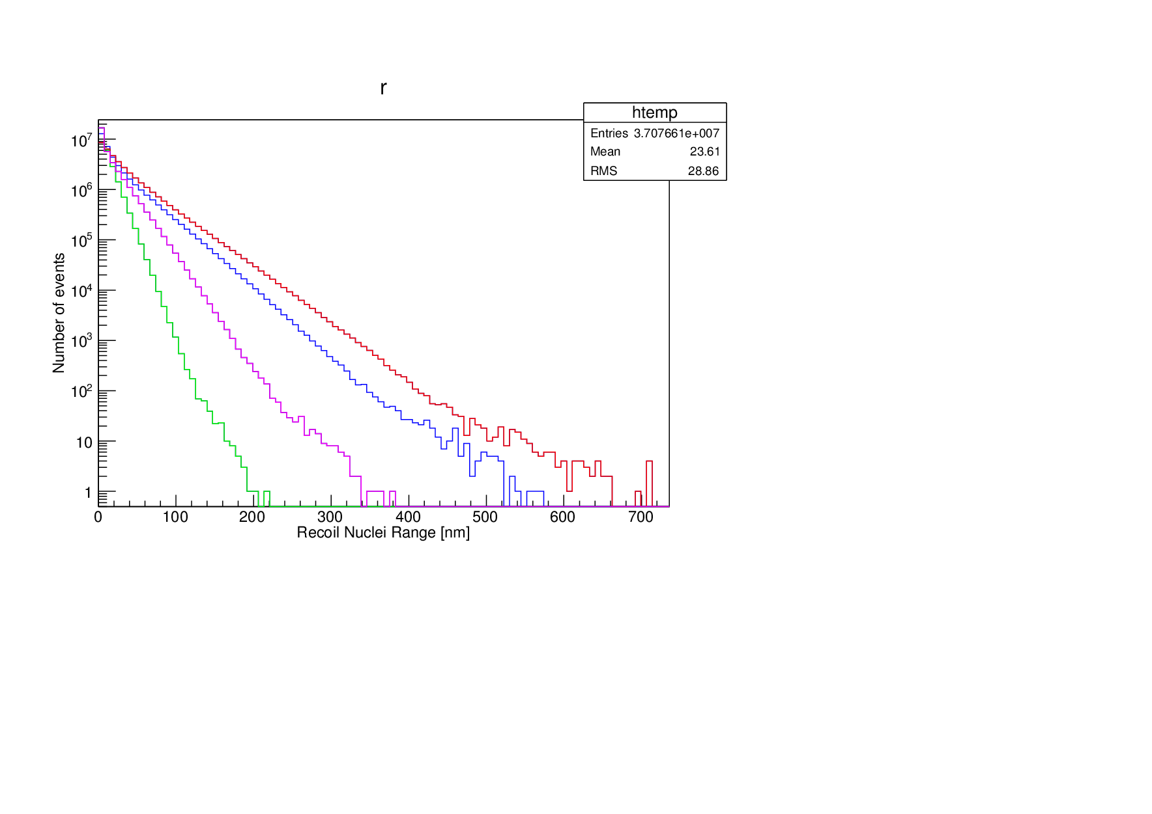
Directional Dark Matter Search with very high resolution nuclear emulsion
Target nuclei
DM
Detection of recoiled nuclei as tracks
DM
Target Nuclei :
C (N,O) and Ag, Br
⇒ Sensitivity of C (N,O) recoil is dominant for tracking because tracking
Energy threshold and form factor value.
Dark matter
wind
Direction sensitive Detector
― : 100 GeV/c²
― : 50 GeV/c²
― : 20 GeV/c²
― : 10 GeV/c²
Emulsion detector will mount the equatorial telescope to keep the direction because it has no time resolution.
Track length of submicron
10 GeV/c²
20 GeV/c²
50 GeV/c²
100 GeV/c²
Track length [nm]

Slide 14
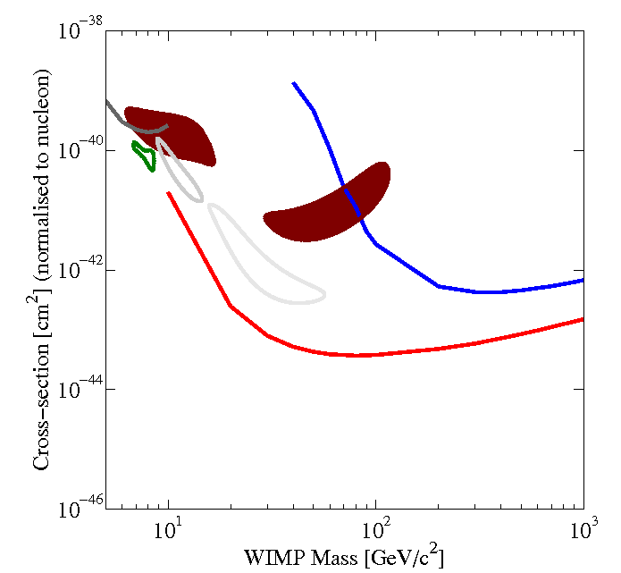

Ideal Sensitivity for SI interaction with emulsion detector
Emulsion 25kg・y, 90% C.L., Track length > 100nm
Spin-Independent
Preliminary
Only Ag, Br recoil
Including C,N,O recoil
Directionality is not taken into account!

Slide 15
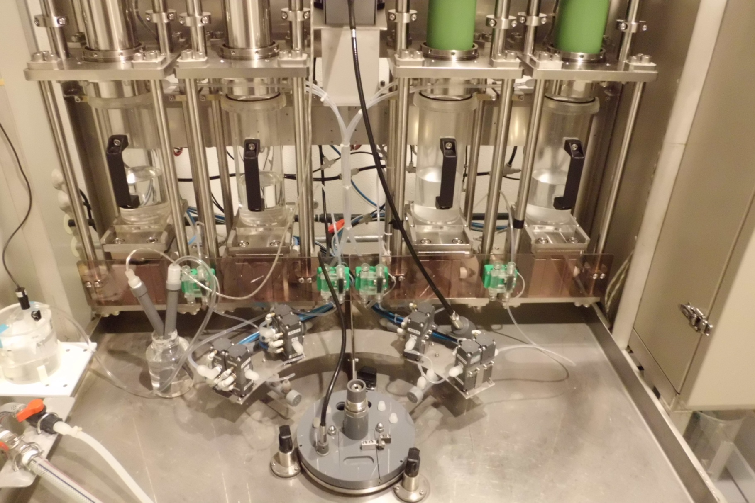
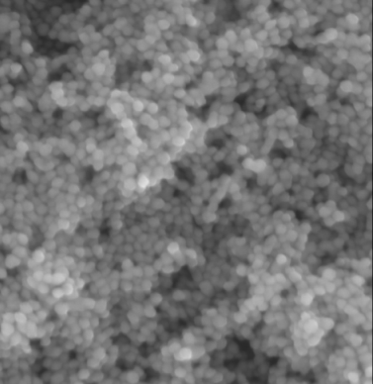
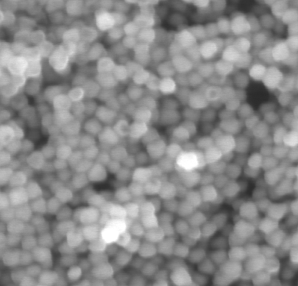
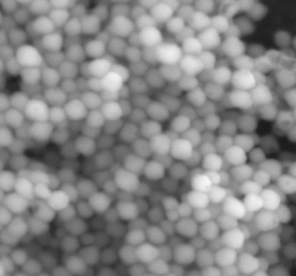
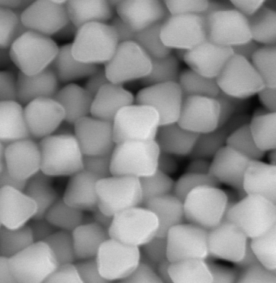
Emulsion Self-Production at Nagoya University
AgNO3
AgNO3
KBr/NaBr
KBr/NaBr
AgBr crystals
[AgNO3 + KBr → AgBr + NO³⁻ + K⁺ ]
Production scale ~ 1 kg detector/week
35nm crystal
70nm crystal
100nm crystal
200nm crystal
For DM search
500nm

Slide 16
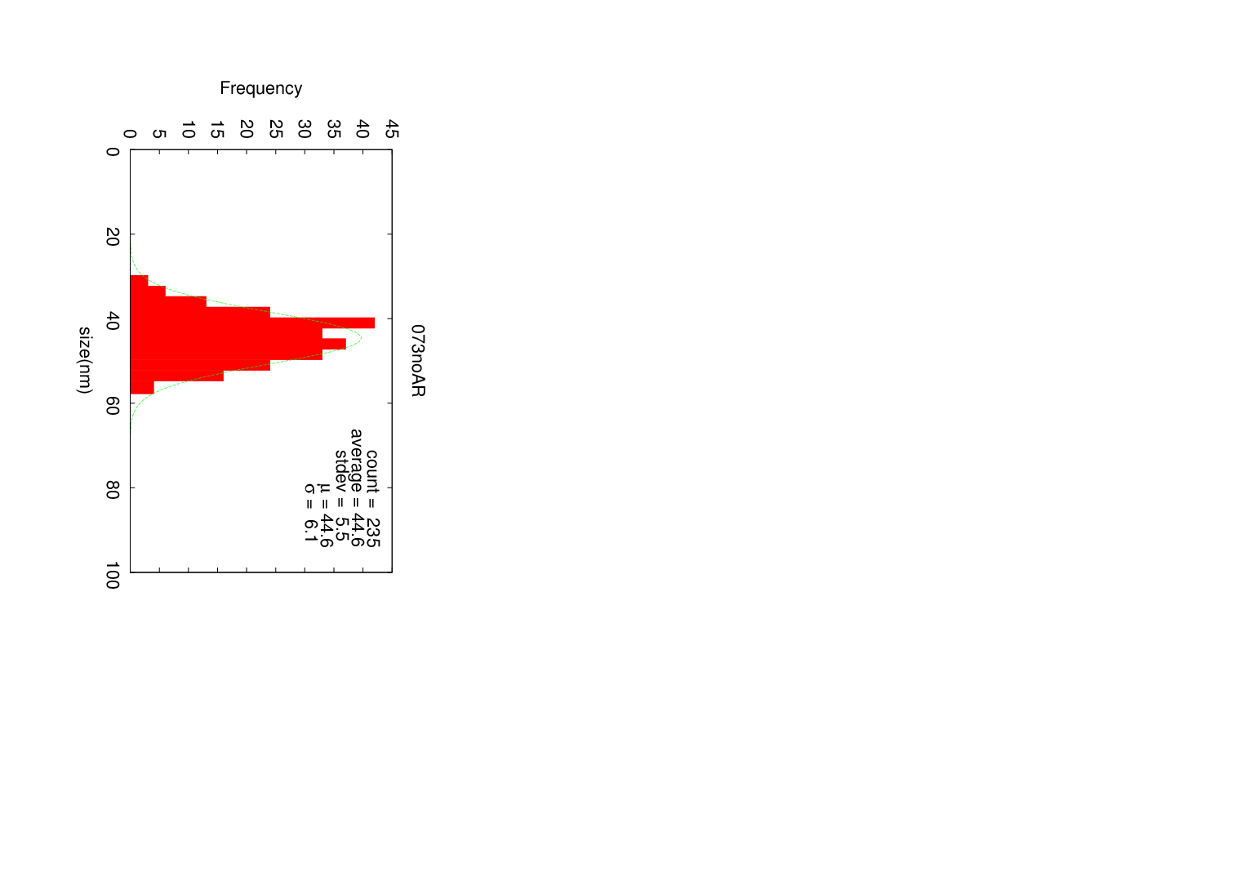
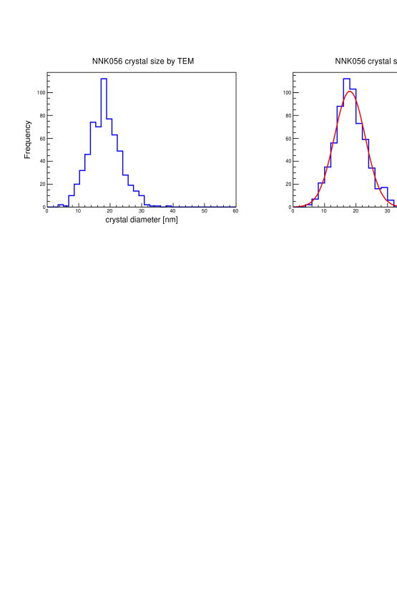
Nano Imaging Tracker
NIT
U-NIT
Current R&D emulsion
Finest grain emulsion
Mean : 44.6 +- 0.4 [nm]
Sigma : 6.1 +- 0. 3 [nm]
Mean : 18.0 +- 0.2 [nm]
sigma: 4.9 +- 0.2 [nm]
Crystal diameter [nm]
Crystal diameter [nm]
Current R&D emulsion
Further detector for physics run
 | NIT | U-NIT
AgBr density | 12 AgBr/µm | 29 AgBr/µm
Detectable range | > 200 nm | > 100 nm
Tracking E threshold | > 80 keV@C | > 35-40 keV@C
One crystal sensitivity | > 90 % @ C of 35keV | Not yet

Slide 17
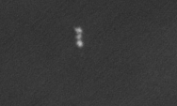
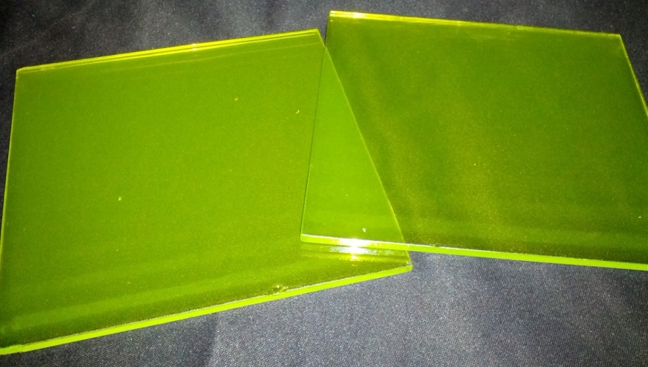
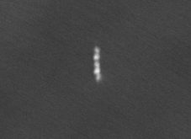
Submicron tracking of NIT
Emulsion detector for dark matter search
Kr 200keV
[Current Detector density : 3.2 g/cm³]
200nm
Scanning Electron Microscope
Kr 400keV
500nm
Detector cost : 1 kg ~ 100k Yen (~ 1k ＄, €)
How can we readout such very short length tracks ?

Slide 18
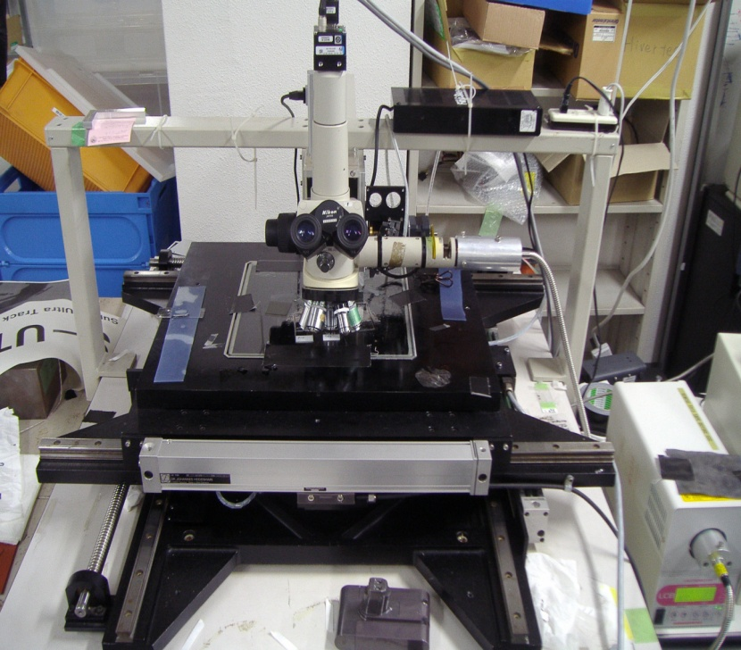
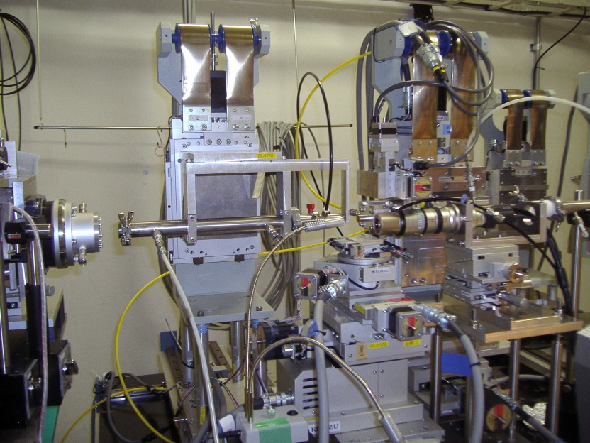
Concept for the readout system
Optical microscopy Readout
High readout speed
Poor spatial resolution
(⊿x ~ 200 nm)
Automatic selection of candidate signals by optical microscopy.
Combined analysis between both systems
X-ray microscopy Readout
High spatial resolution (⊿x ~ 65 nm)
Low readout speed
Pin-point check of candidate signals selected by optical readout.

Slide 19
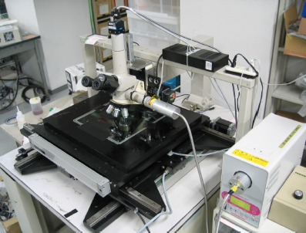
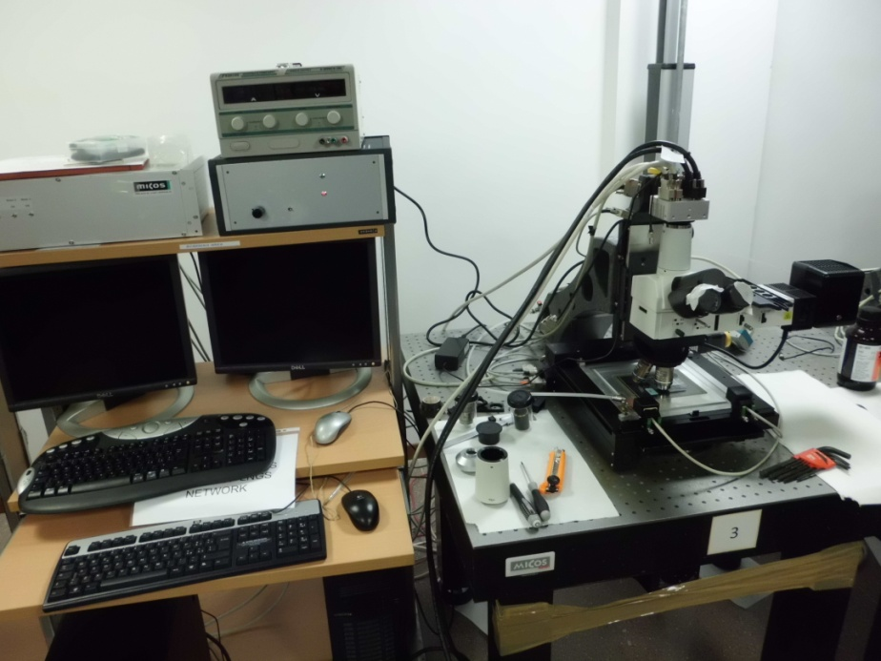
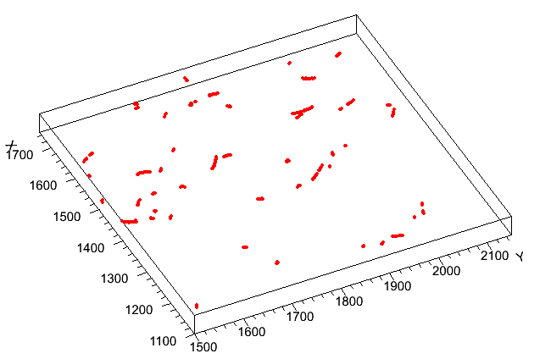
Submicron tracking
Epi-illuminated optics
⇒ high contrast for finer grains
⇒ plasmon analysis (new idea)
Automatic driving stage and image taking
Image processing
⇒ 3D information
⇒ brightness
⇒ shape
⇒ trackness etc.
Nagoya University (Japan)
Neutron
University of Napoli (Italy)
LNGS (Italy)

Slide 20
Neutron (14 MeV) recoil track under optical microscopy
632 nm
337 nm
308 nm
217 nm
592 nm
392 nm
Almost Br recoil (170 - 600keV) because of low sensitivity tuning.

Slide 21
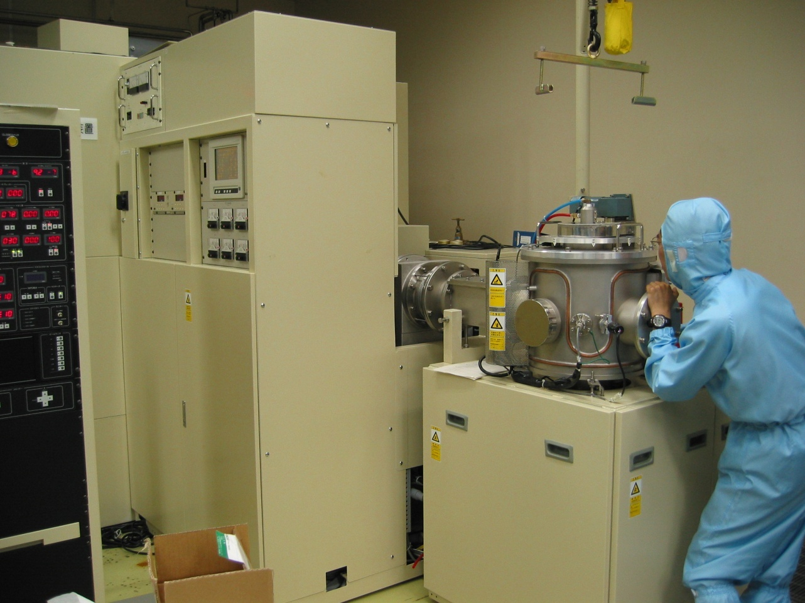
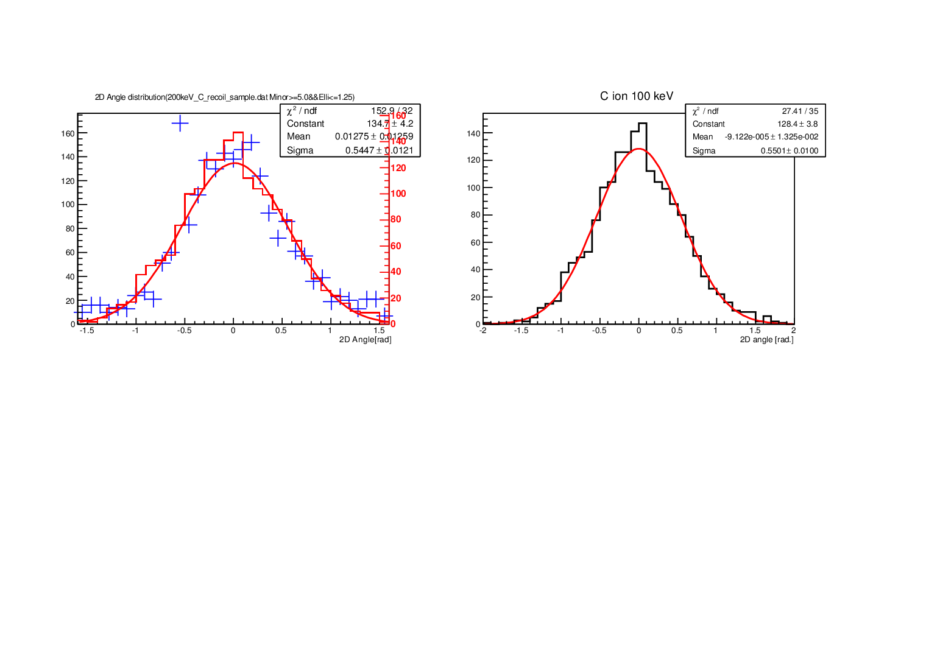
Direction Sensitivity
Ion implant system
⇒ 80, 100, 125, 150, 200 keV C ion (realistic C ion demonstration)
※ ⊿E/E < ~ 1 %
Angular distribution of 100 keV C ion
― : data
― : MC simulation
[Crystal size : 44.6 +- 0.4 nm]
2D angle [rad.]

Slide 22

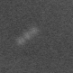
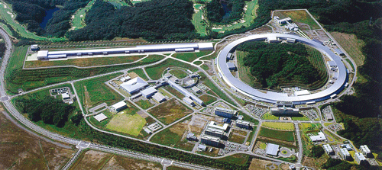
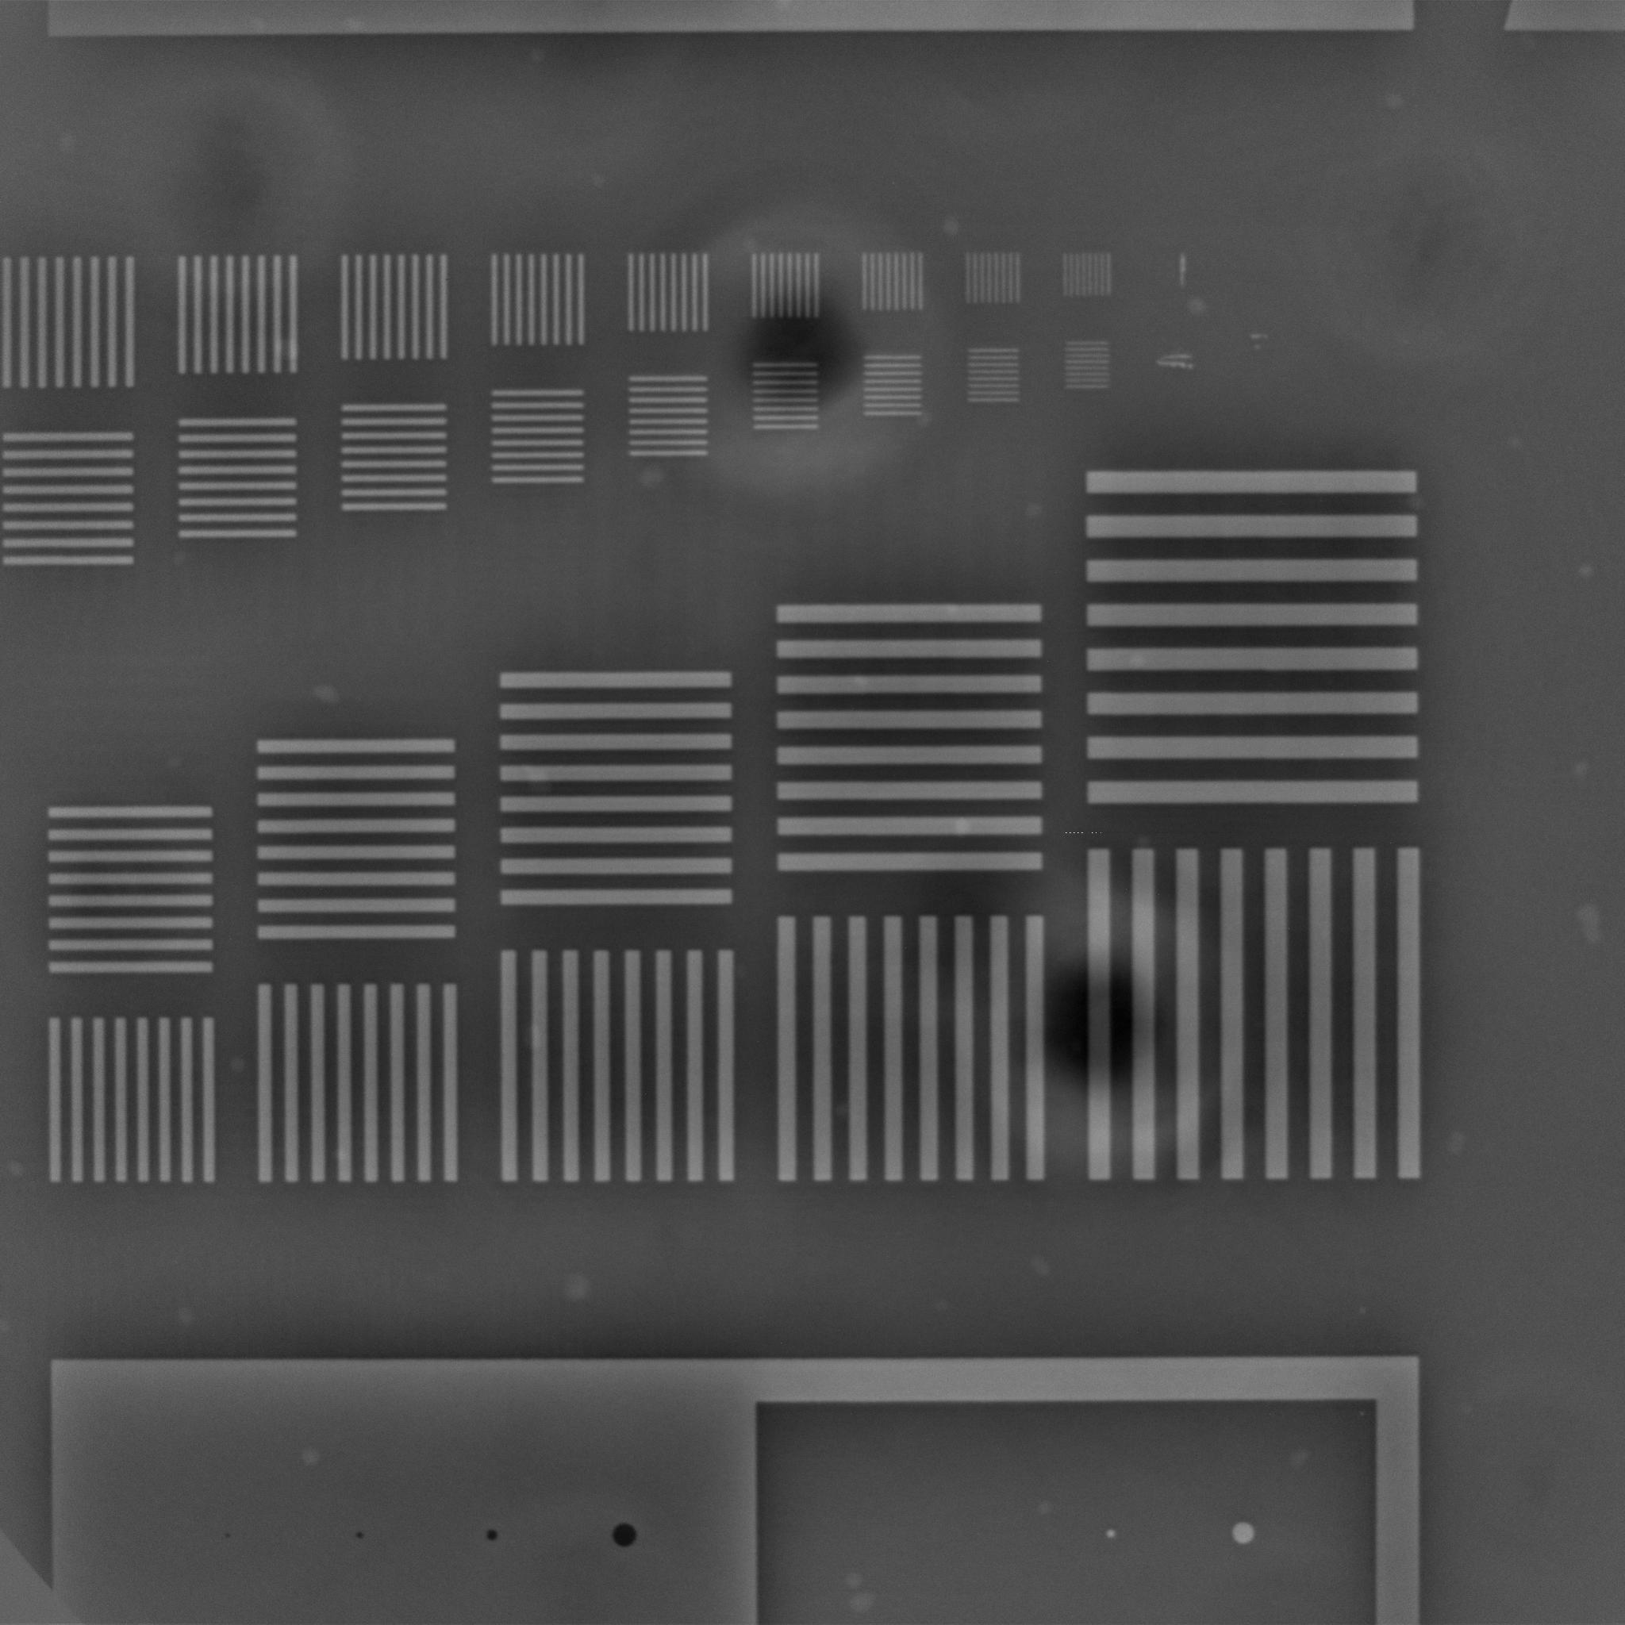

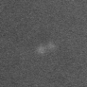

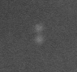
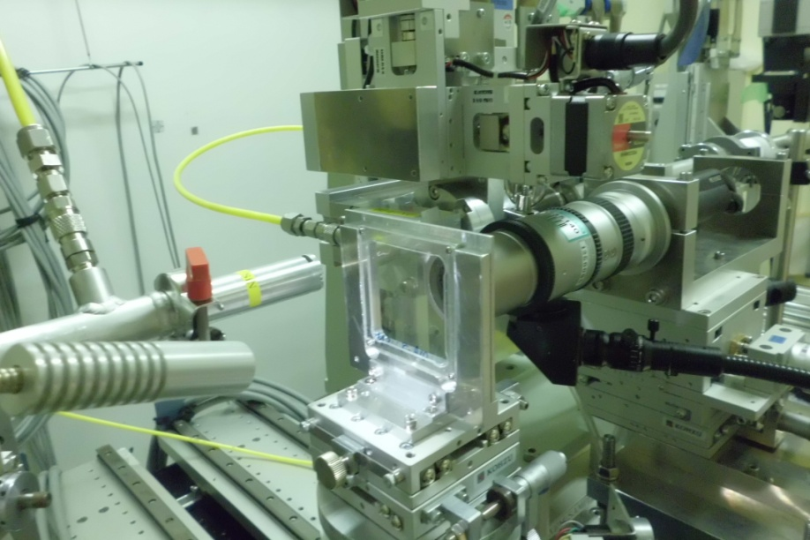
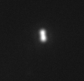
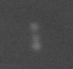
Confirmation of candidate signal by hard X-ray microscope
SPring-8 @ Japan
Optical microscope
⊿x of X-ray microscope : < 70 nm
486nm
X-ray microscope
70 nm line/70 nm space
236nm
100 nm thick. Ta on Si
330nm
Current Condition
- 6 or 8 keV X-ray and phase contrast
- Matching Efficiency : > 99 %
- Matching accuracy < 10 µm
- Analysis speed : ~1000 events/day
600nm
X-ray microscope system is going well!

Slide 23
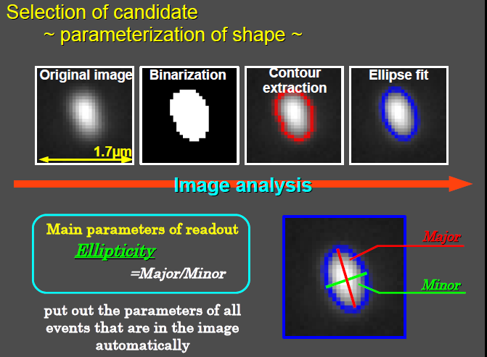
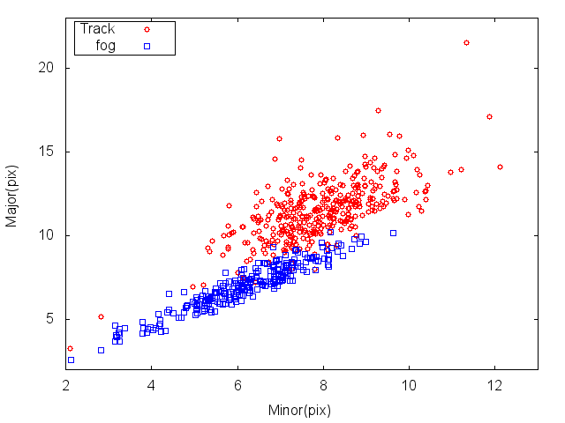
Combined analysis between Optical and X-ray microscope
Calibration of signal selection parameter for optical microscope system
Optical microscope selection
confirmed nuclear recoil tracks
Signal region
Major length [pix]
minor length
Confirmed random noise or electrons
Major length
minor length [pix]

Slide 24
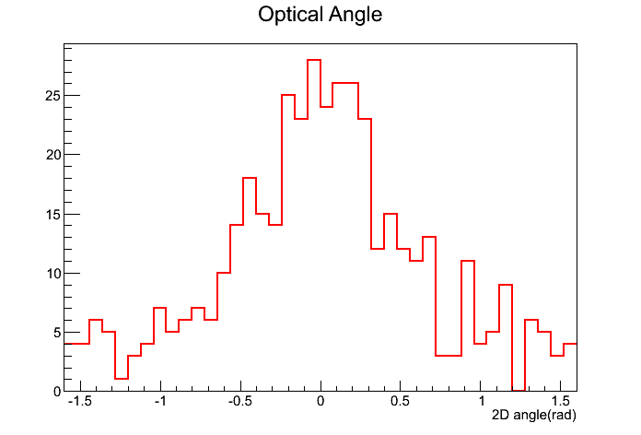
Angular distribution
confirmed nuclear recoil tracks
Major length [pix]
Confirmed random noise or electrons
minor length [pix]
Consistent with incoming direction
of neutrons and simulation

Slide 25
Understand of backgrounds
We don’t understand the detector response yet.
Now, those studies are under way.
Understand of BG
- intrinsic backgrounds (radio activity in the detector)
- neutron background from inside and outside
- another noise backgrounds
We are studying in Gran Sasso, Italy

Slide 26
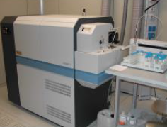



Intrinsic background measurement and estimation
1. Mass spectroscopy
e.g. U, Th, Pb , K
We already started the measurement of materials for the emulsion detector .
AgBr・I sample
Gelatin sample
ICP-MS (Inductively Coupled Plasma mass spectrometer)
2. Gamma-rays spectroscopy due to very-low
radio activity
e.g., U-238, Th-228, Th-232, K-40, Ra-226, 214-Pb
3. Intrinsic Neutron activity simulaiton
⇒ simulation of (α, n ) reaction background
High purity Ge spectroscopy
Supported by DarkSIDE groups

Slide 27
Understand of detector
We don’t understand the detector response yet.
Now, those studies are under way.
Understand of BG
- intrinsic backgrounds (radio activity in the detector)
- neutron background from inside and outside
- another noise backgrounds
Low-background detector R&D
- developing of threshold type detector
- color and brightness analysis for low dE/dx backgrounds rejection
using Plasmon effect
- PVA (poly-vinyl alchole) emulsion detector

Slide 28
Near Future plan
2013
2014
2015
2016
2017
1~10 g scale commissioning
100g scale Run
Detector R&D for low backgrounds
Evaluation of background rejection
power and detection efficiency
Intrinsic background estimation
@ LNGS
aim to DAMA 100 GeV/c² region
background study
R&D phase
~ g scale commissioning
Physics run
Proposal to LNGS
Underground neutron measurement
underground neutron flux > 1 MeV

Slide 29
Summary
Current upgraded emulsion technology
⇒ self-production system
⇒ Hyper Track Selector
Current experiments
e.g. neutrino, gamma-rays telescope, dark matter, muon radiography atc.
Development of very high resolution emulsion detector for
Directional dark matter search
Submicron track detection and readout by optical and X-ray microscope
Background and low-background detector study are under way.
we aim the experiment of 100kg scale to search 10^(-41-42) cm2 region (SI interaction).

