Slide 1


Physics of SuperKEKB/Belle II
Toru Iijima
2013.12.11
KMI2013 International Symposium

Slide 2
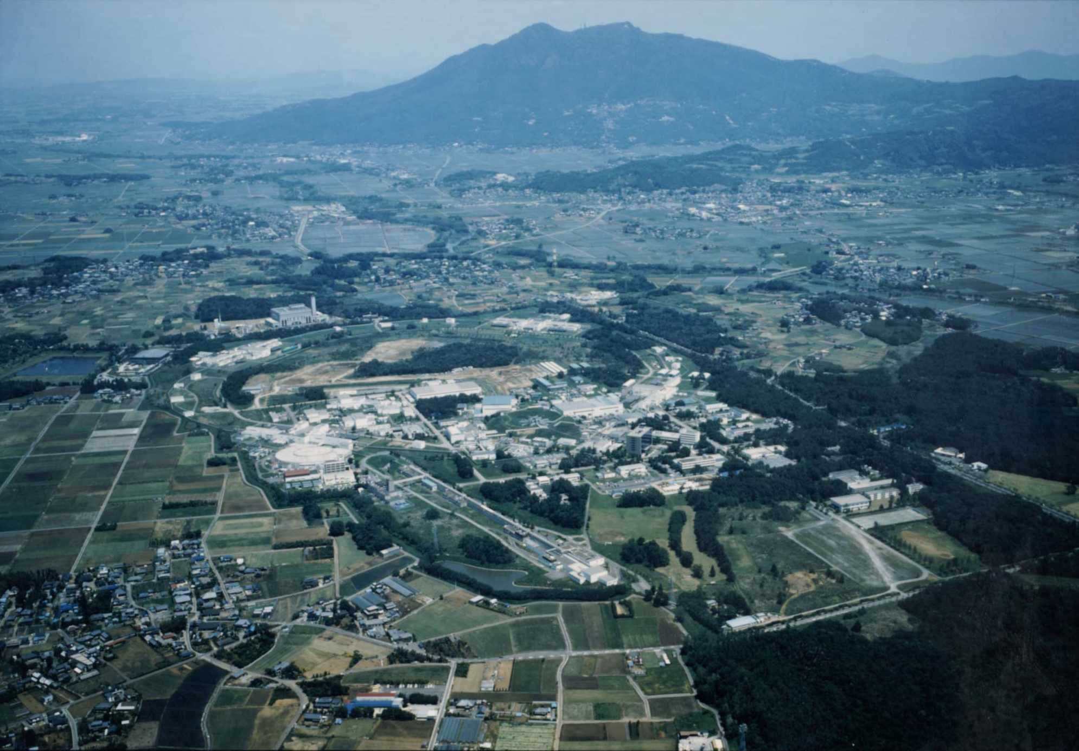
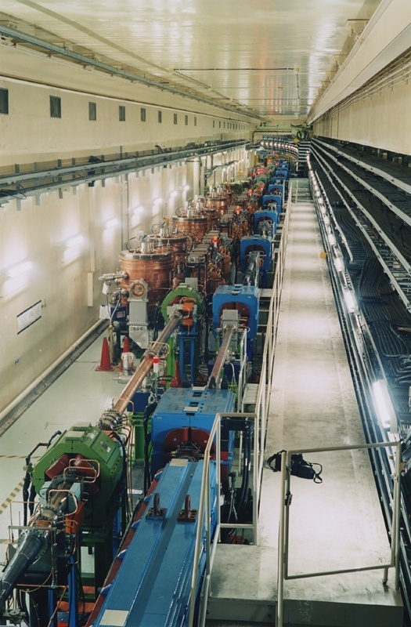
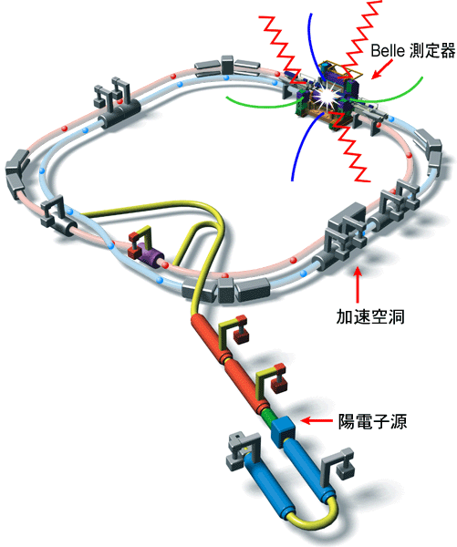
The KEKB Collider
e⁻ (8.0GeV) × e⁺ (3.5GeV)
  ⇒Υ(4S) →BB
  ⇒Lorentz boost:
  βγ = 0.425
Finite crossing angle
  - 11mrad ×2
Operated 1999-2010
SCC RF(HER)
Belle detector
ARES(LER)
Ares RF cavity
Peak luminosity
2.1 x 10³⁴ cm⁻²s⁻¹ !
e⁺ source
The World Highest Luminosity
Notes:
Such success was brought by the high luminosity accelerator.

Slide 3
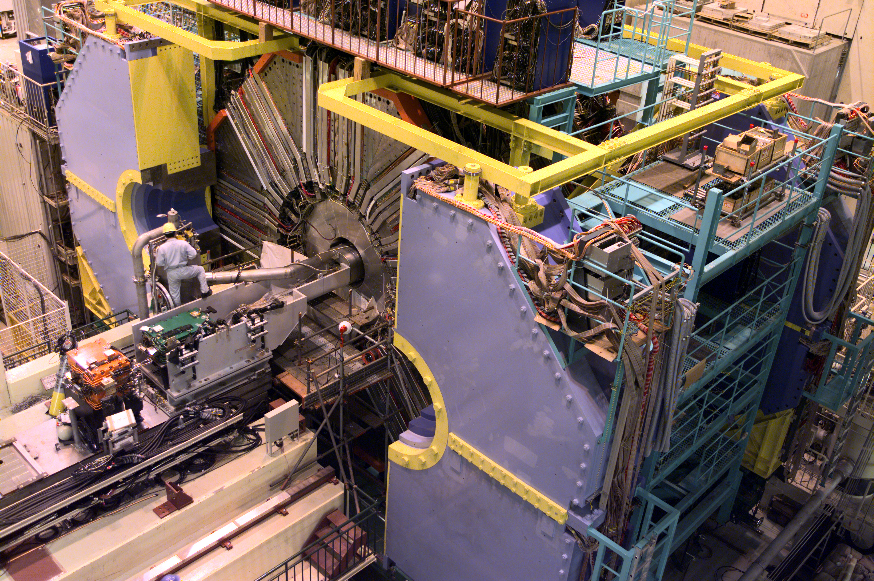
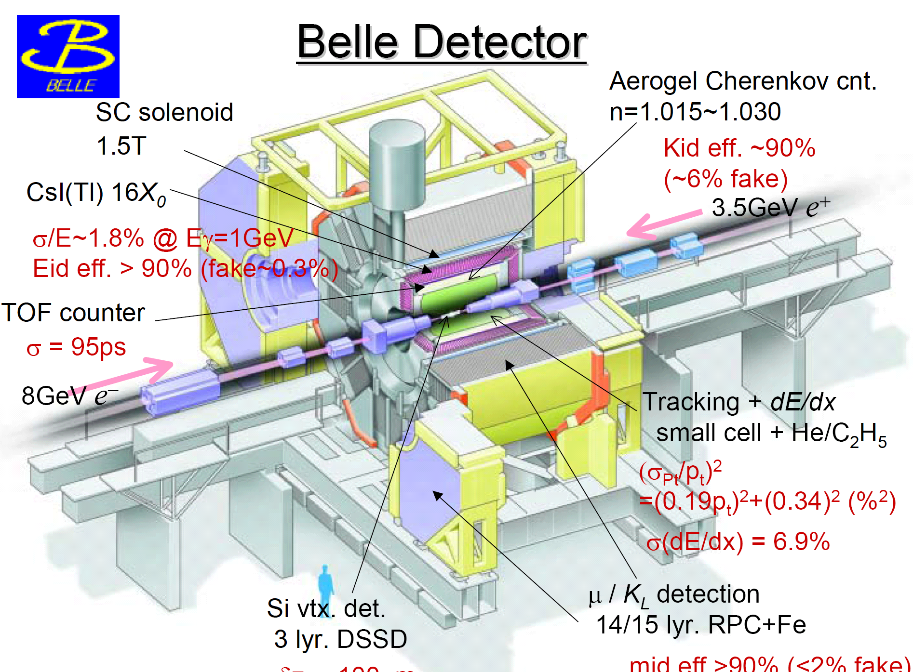
Belle Detector

Slide 4
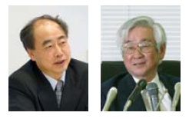
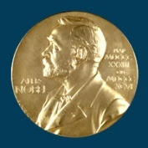
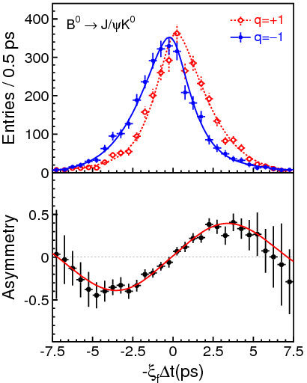
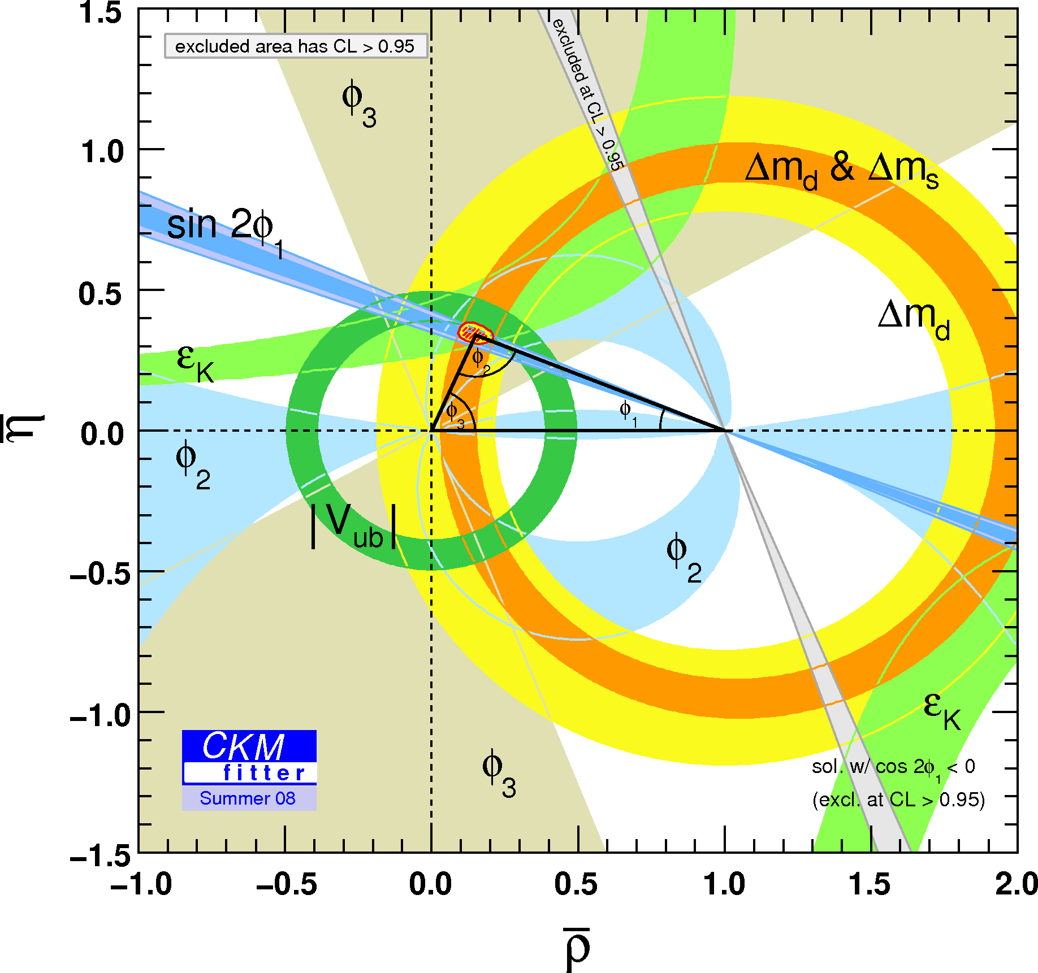
Confirmation of Kobayashi-Maskawa
B⁰ tag
_
B⁰ tag

Slide 5
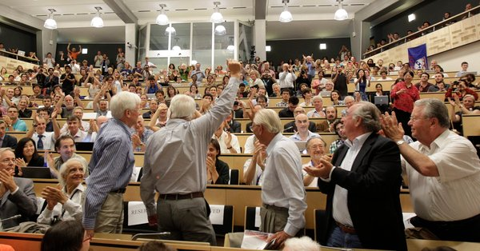
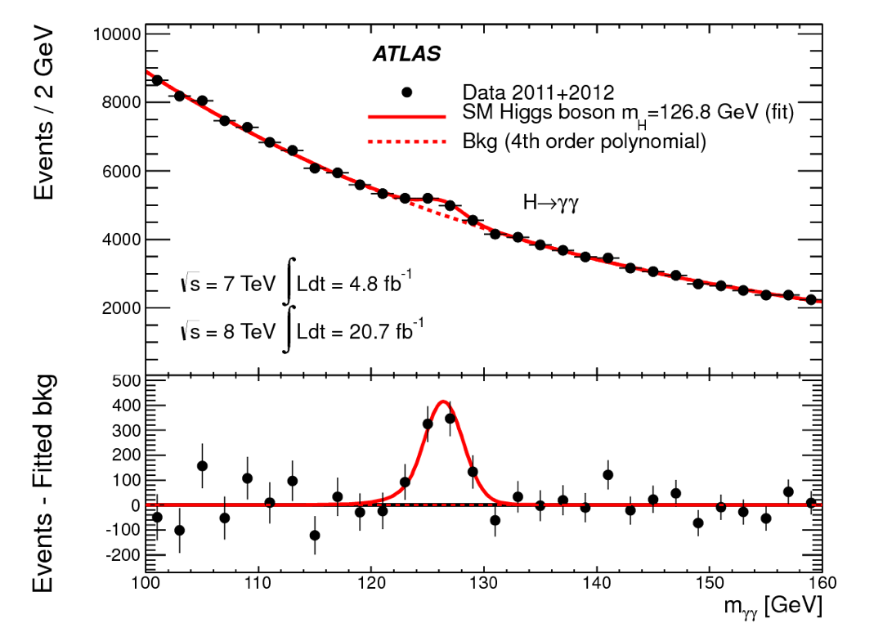
Discovery of Higgs
ATLAS, PLB726, 88 (2013)

Slide 6
The Next Challenge
New Physics (NP)
Beyond the SM (BSM)
Solution/Hints to “Dark Universe”
(Dark Matter, Dark Energy, Inflation,…)

Slide 7
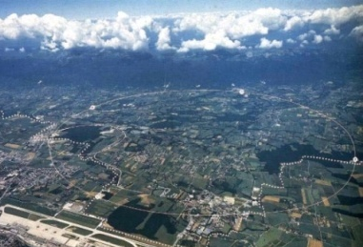
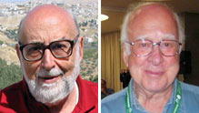


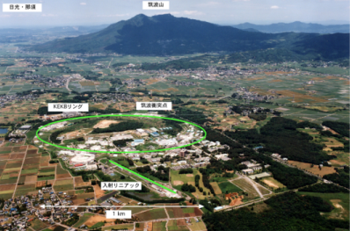


Two Approaches to NP
2005
2010
2015
2020
2025
Confirmation of SM
( KM + Higgs )
BSM: Physics beyond the SM
(SUSU, e-DIM, …)
High Energy Frontier
“Revolution of particle physics”
7-8 TeV
13-14 TeV
LHC
Direct search
Nobel prize for experimentalists !
p
p
~
g
~
~
~
_
q
χ
ν
High Intensity Frontier
q
q
l⁻
KEKB
Super KEKB
8×10³⁵cm⁻²s⁻¹
2.1 ×10³⁴cm⁻²s⁻¹
Indirect search (loop)
~
q
ｂ-quark
ｓ-quark
~
g
photon（γ）

Slide 8
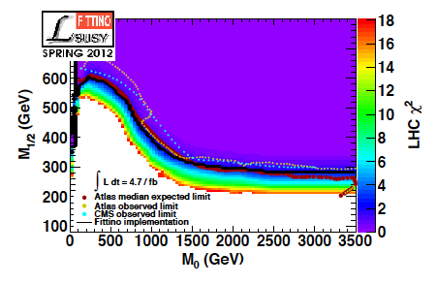
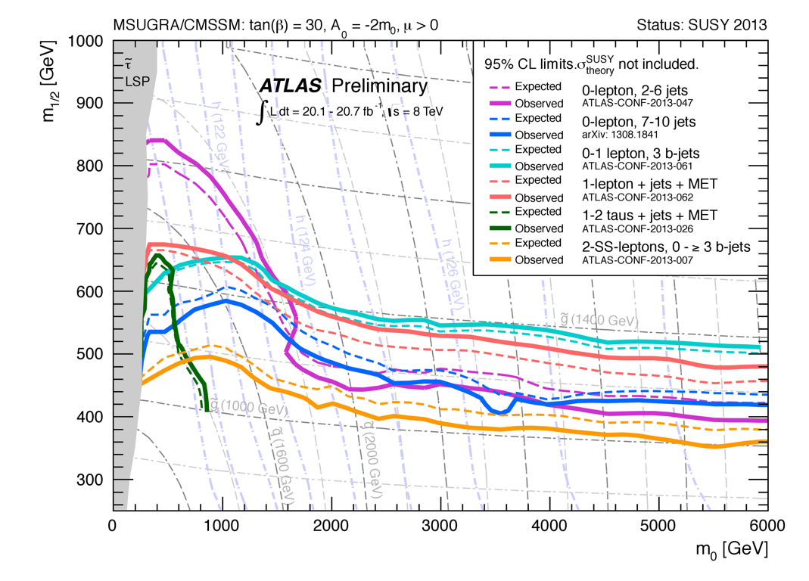
SUSY at LHC
No evidence of BSM (so far).
Energy upgrade (8 → 13-14 TeV) gives higher sensitivity
based on 4.7fb⁻¹, CMSSM
P. Bechtle et al. (Fittino), arXiv.1204.4199
CMSSM
(constrained supersymmetric model)
5 parameters
M_{1/2}: gauguno mass
M₀: unified scalar mass

Slide 9
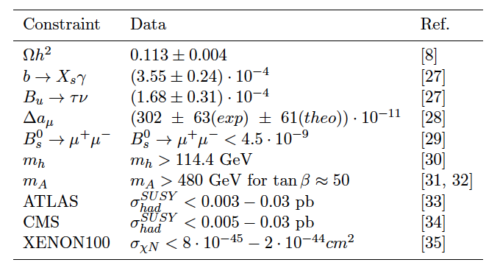
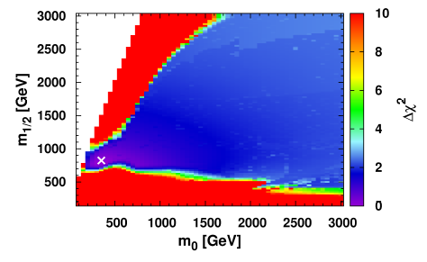


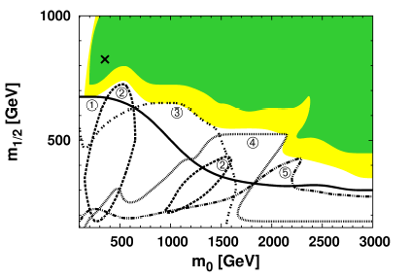
Interplay: LHC + Flavor + DM
Example: CMSSM constraint by LHC+LHCb+XENON100
C. Beskidt, W. de Boer, D. I. Kazakov, F. Ratnikov,1207.3185
Constraints used in the fit
① LHC direct search
② B physics (Bs→μμ）
③ SM Higgs
④ Pseudo-scalar Higgs
⑤ Direct DM searches
(XENON100)

Slide 10
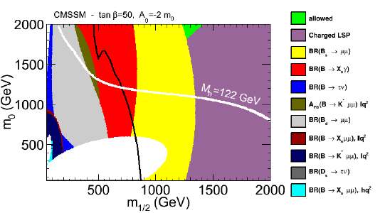

Role of B physics
Test of SM → Search for BSM
Complementarity to LHC
Flavour constraints in CMSSM in (m1/2, m0) plane
F. Mahmoudi, 1310.2556v1
B→Kμμ
B_{s}→μμ
B_{d}→μμ
B→Xsγ
B→τν
Many ways to play a role in this game.
ATLAS SUSY direct search limit w/ 20.3fb⁻¹
Higgs mass can reach 122 GeV

Slide 11
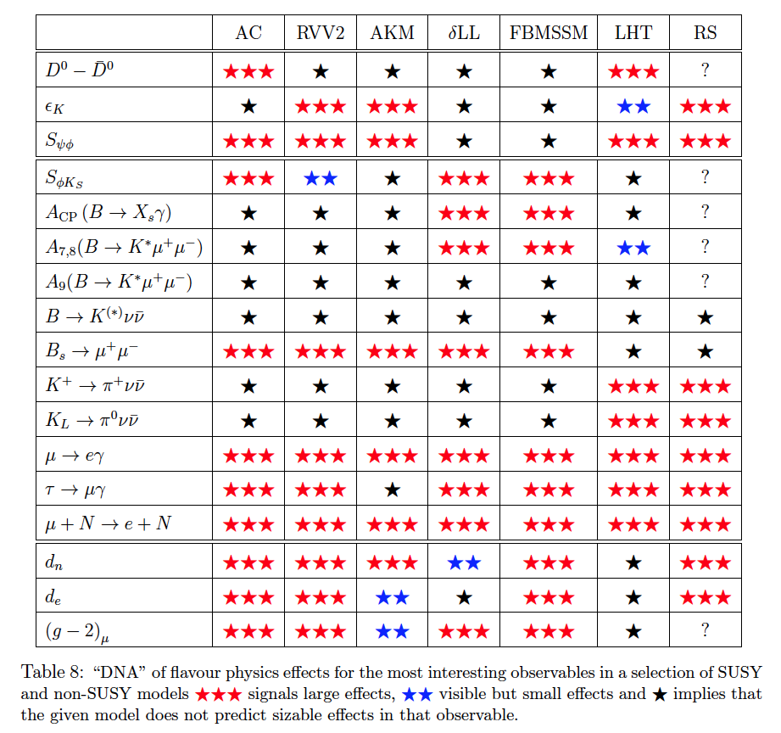
Role of Flavor Physics
Variety of observables w/ different sensitivity to NP models.
Clarify if NP exists in the TeV scale.
Elucidation of new physics.
W. Altmannshofer, A. J. Buras, S. Gori, P. Paradisi, D. M. Straub, Nucl. Phys. B830, 17-94, 2010.

Slide 12
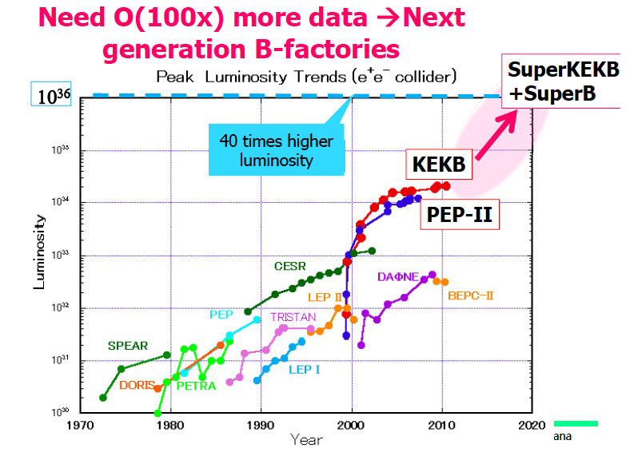
Super KEKB
Target luminosity: L_{peak} = 8 x 10³⁵cm⁻²s⁻¹
L_{int} >50 ab⁻¹ by early 2020’s.
Production rate: ~10¹⁰ BB, τ⁺τ⁺ and charms per year.
L_{peak} (KEKB) =
2.1x10³⁴cm⁻²s⁻¹
Notes:
So now I switch to the Super B Factories. The next generation B factories aims having the peak luminosity close to 10^36cm-2s-1,, which is about 40-50 higher than the present record by KEKB (2.1x1034), and integrated luminosity of 50-75ab-1 by early 2020’s.

Slide 13

Japanese institutes (129) : Chiba(6), Kavli-IPMU(3), KEK(52), Nagoya/KMI(15), Nara-W(8), Niigata(6), Osaka-city(4), Toho(4), Tohoku(18), TMU(6), Tokyo(6), Yamagata(1)

Slide 14

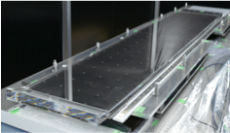
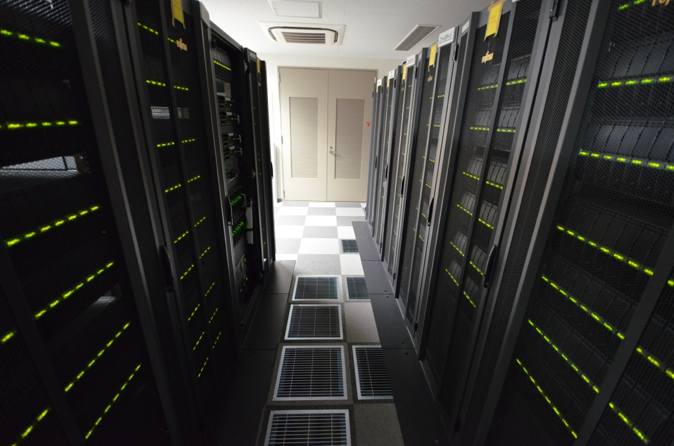
Belle and Belle II at Nagoya/KMI
Physics
B, τ, hadron
T. Iijima
New Detector (TOP)
Computing (GRID)
K. Inami
K. Hayasaka

Slide 15
Importance of Tau Lepton
As a source of new BSM phenomena
  Ex:τ→μγ, μμμ etc.
  LFV (Lepton flavor violation)
τ→lγ
τ→3l,lη
As a probe to NP in heavy flavor decays
Ex:τ→μγ, μμμ etc.
  Charged Higgs search
ν
B
H⁺/W⁺
τ ⁺

Slide 16
LFV Search at Belle
LFV τ decay search w/ world highest sensitivity !
by K.Hayasaka, K. Inami et al.

Slide 17
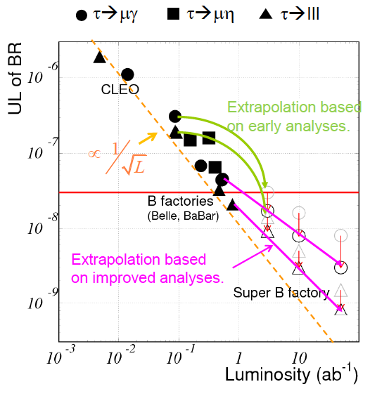

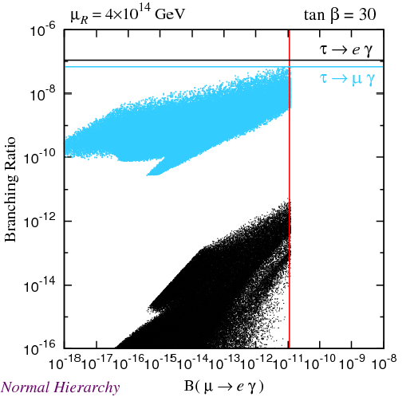
LFV in τ Decays
model Br(τ→μγ) Br(τ→lll )
mSUGRA+seesaw 10⁻⁷ 10⁻⁹
SUSY+SO(10) 10⁻⁸ 10⁻¹⁰
SM+seesaw 10⁻⁹ 10⁻¹⁰
Non-Universal Z’ 10⁻⁹ 10⁻⁸
SUSY+Higgs 10⁻¹⁰ 10⁻⁷
τ→lγ
τ→3l,lη
SU(5)+ν_{R}, non-degenerate ν_{R}(I),
Normal hierarchy
Goto et al.,PRD77, 095010 (2008)
Notes:
Super B factory is also the Super tau factory and provide unique opportunity to search for tau LFV decays. Typical modes and tau -> mu or e gamma mode via SUSY loop, and tau-> 3 leptons or lepton + eta via higgs exchange. These two classes of decays have different sensitivity to different SUSY models, which is useful to test the models.
The left-hand side plot show the correlation between the mu->e gamma and tau->mu gamma in blue and tau-> e gamma in black. This demonstrates that tau->mu gamma search around 10-9 is comparable to mu->e gamma search around 10^-12->13 being carried out by MEG at PSI.
Super B factories will enable us to search for these tau LFV decays at the order of 10^-9, and even further for tau->3l, which has less background.

Slide 18

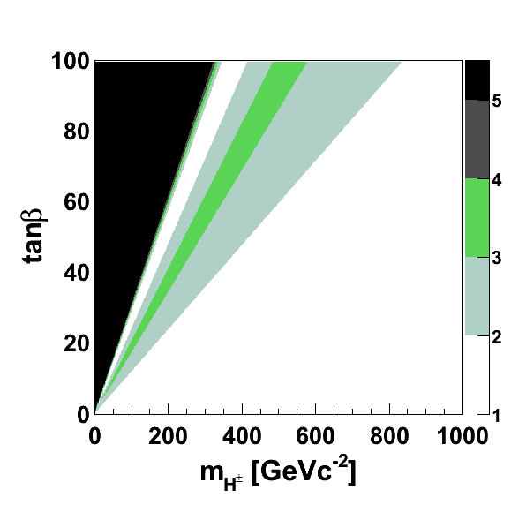
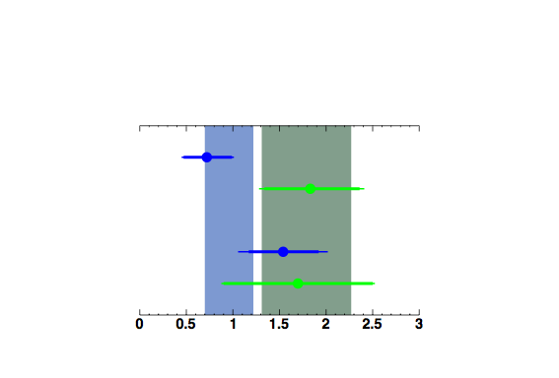

Charged Higgs search w/ B→τνat Belle
The first observation (2006)
Chaged Higgs constraint
(Type II HDM)
B⁺ g D⁰ π⁺
K⁺ π⁻ π⁺ π⁻
B⁻ g τ ⁻ ν
e⁻νν
temp
Present status (2012 summer)
Belle
Excl. at
Hadronic tag
BaBar
2σ
Belle
3σ
Semileptonic tag
BaBar
5σ
Belle combined: B=(0.96±0.26)x10⁻⁴
BaBar combined: B=(1.79±0.48)x10⁻⁴
A naive world average: B=(1.15±0.23)x10⁻⁴
By K. Hara, Y. Horii, T. Iijima et al.

Slide 19
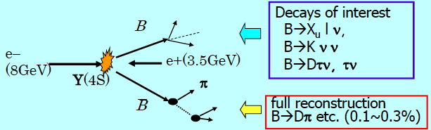
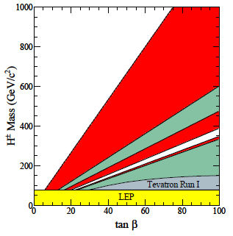
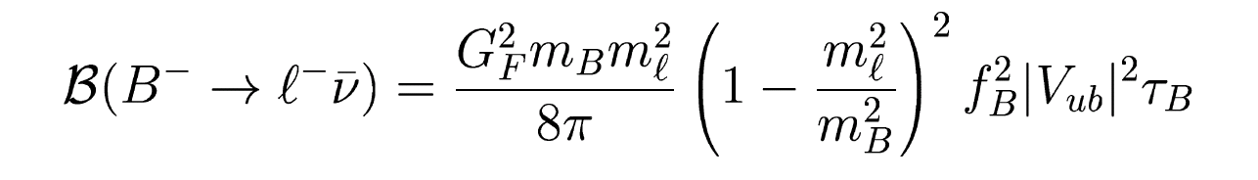
Search for charged Higgs (B→τν)
Super B factories can measure the missing energy modes by fully reconstructing one of the B mesons.
50ab⁻¹ assume
5σ discovery
ν
B
H⁺/W⁺
LHC 30fb ⁻¹
τ ⁺
LHC 100fb ⁻¹
In SM,
In Type II HDM,
B→τv/Dτν probes b-H±-u, b-H±-c couings to compare b-H±-t coupling from LHC high P_{T} programs.
Notes:
Especially, Super B factories have great advantage for measuring the missing energy modes by fully reconstructing one of the B mesons. The typical example is the B-> tau nu, which is sensitive to the charged Higgs effect. Present B fatories have already measured the decay and constrain the charged Higgs in Type II HDM like green hatched region,, and the Super B factories can further explore the region comparable to the direct search at LHC. Similar measurement can be done also for B->D tau nu, and then H+ coupling to b-u and b-c can be measured at Super B factories and compared to the b-t coupling from LHC high PT programs.

Slide 20
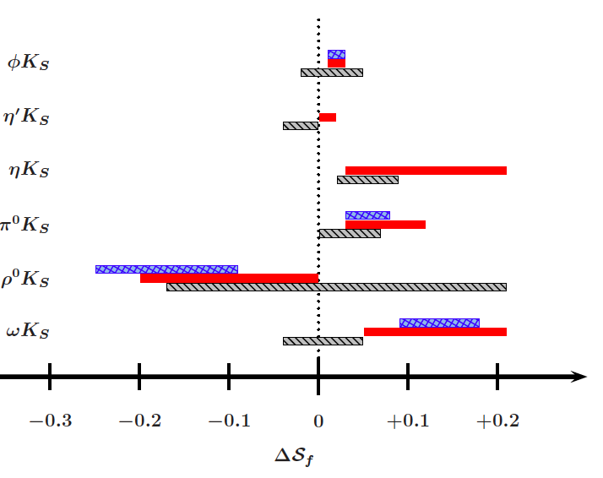
Key Measurements at Belle II
 | Belle’06 (~0.5ab⁻¹) | 5ab⁻¹ | 50ab⁻¹
ΔS(φK⁰) | 0.22 | 0.073 | 0.029
ΔS(η’K⁰) | 0.11 | 0.038 | 0.020
ΔS(K_{S}K_{S}K_{S}) | 0.33 | 0.105 | 0.037
ΔS(K_{S}π⁰γ) | 0.32 | 0.10 | 0.03
Br(X_{s}γ) | 13%
A_{CP}(X_{s}γ) | 0.058 | 0.01 | 0.005
C₉ [A_{FB}(K*ll)] | --- | 11% | 4%
C₁₀ [A_{FB}(K*ll)] | --- | 13% | 4%
Br(B⁺ → K⁺νν) | <9Br(SM) | 33ab⁻¹ for 5σ discovery
Br(B⁺ →τν) | 3.5σ | 10% | 3%
Br(B⁺ →μν) | <2.4Br(SM) | 4.3ab⁻¹ for 5σ discovery
Br(B⁺ → Dτν) | --- | 7.9% | 2.5%
Br(τ →μγ) | <45 | <30 | <8
Br(τ →μη) | <65 | <20 | <4
Br(τ → 3μ) | <209 | <10 | <1
Δsin2φ₁ | 0.026 | 0.016 | 0.012
ΔΦ₂ (ρπ) | 68°ー95° | 3° | 1°
ΔΦ₃( Dalitz) | 20° | 7° | 2.5°
ΔV_{ub} (incl.) | 7.3% | 6.6% | 6.1%
CPV in b→s modes
FCNC
b→sγ
b→sll
Tauonic decays
LFV tau decays
Precision CKM
QCD correction/error in ΔS
Ultimate measurements down to theory error !
Notes:
This is a table from the Belle II community to list the reach for key important measurements. In general, the precision for these observables in rare decay processes will improve from 10% level to a couple of %, which are comparables to theory errors, I explain a few examples.

Slide 21
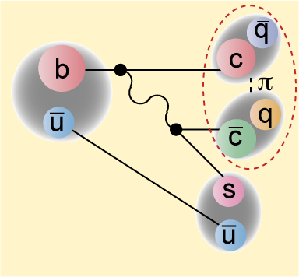
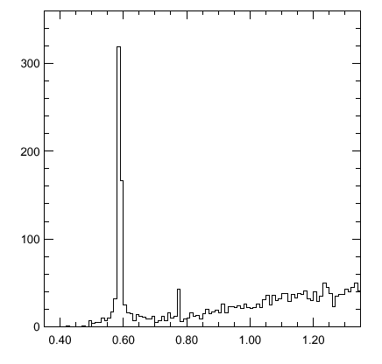
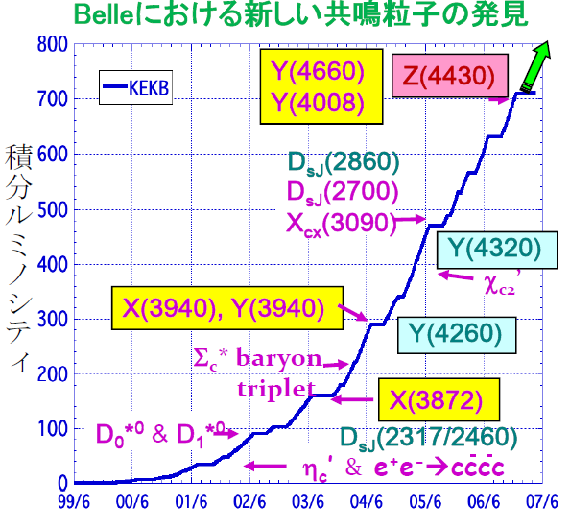
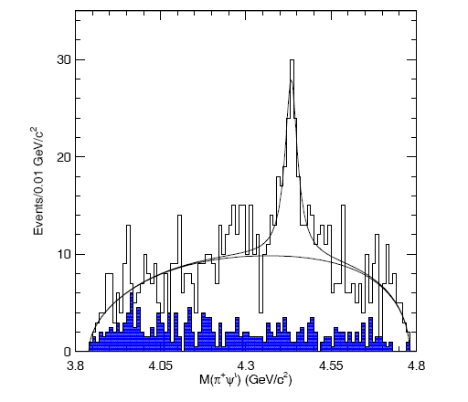
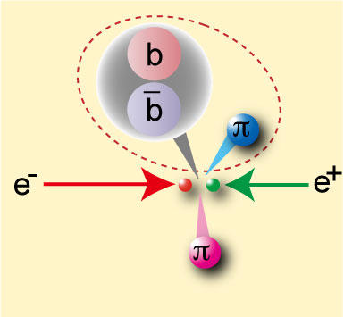
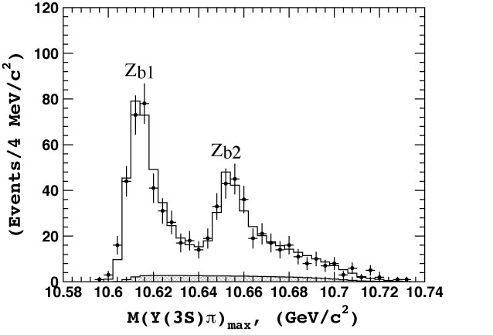
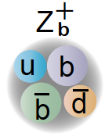
Hadron Spectroscopy
X(3872)
ψ’
B→K π⁺π⁻J/ψ
Z⁺(4430)
Belle
605fb⁻¹
X(3872)
M(π⁺π⁻J/ψ)−M(J/ψ)
Z_{b}⁺(10510) , Z_{b2}⁺(10560)
arXiv:1105.4583
Possible interpretations
c
c
Υ(3S)
c
π
u
c
u
u
c
u
c
Molecular states
Tetra-quark
Hybrid
Future heavy flavor experiments enable us to search for new states and to study their detailed properties (J^{PC}, decay modes etc. )
Notes:
Super B factories provide opportunities not only for the NP searches in EW channels, but also for improving our knowledge on QCD. As you know, high luminosity at B factories have brought dozens of discoveries of new hadrons, denoted as XYZ, such as X(3872) and Z+(4430). The recent addition from Belle is the bottommonium counter-part, observed in e-e+ -> Upsilon pi pi reactions. We found doublets in botommonium and s single pion., which has a charge and thus require at least four quarks as constituents. Future heavy flavour programs, not only the Super B factories but also the LHCb and tau-charm factories, will enable us to search for new states and to study their detailed properties (J^{PC}, decay modes etc. ) .

Slide 22
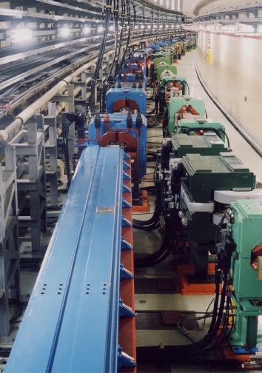
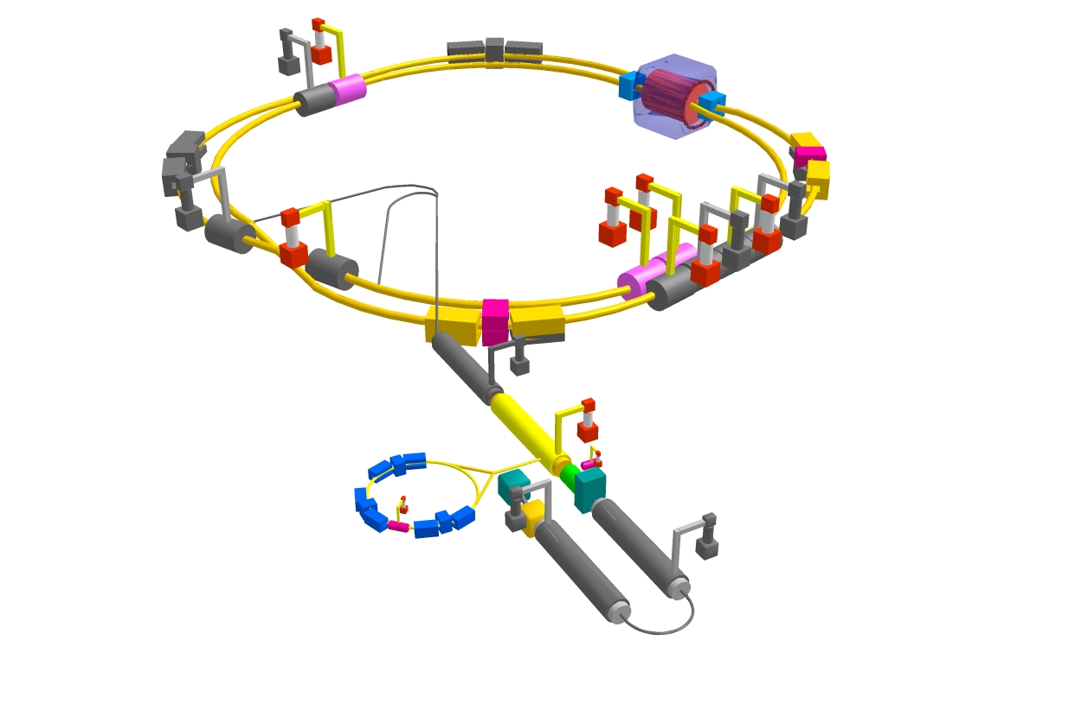


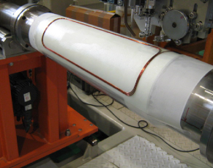
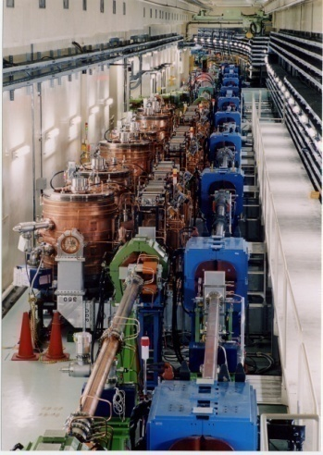


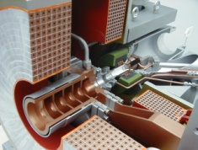
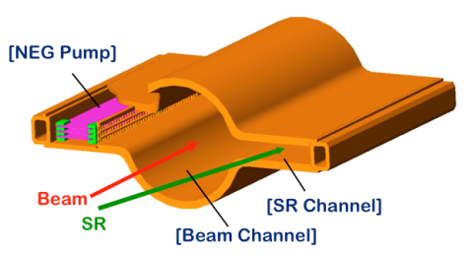
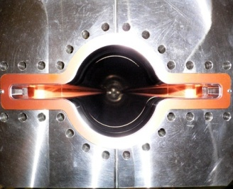

e+ 4 GeV 3.6 A
Colliding bunches
Belle II
New IR
e- 7 GeV 2.6 A
New superconducting final focusing quads near the IP
New beam pipe
& bellows
Replace short dipoles with longer ones (LER)
Add / modify RF systems for higher beam current
Low emittance positrons to inject
Redesign the lattices of both rings to reduce the emittance
Positron source
Damping ring
New positron target / capture section
TiN-coated beam pipe with antechambers in LER
Low emittance gun
Low emittance electrons to inject
x 40 Gain in Luminosity
Notes:
This is the layout of the superKEKB, which will be built in the same tunnel as the KEKB. We introduce damping ring to inject low emittance positrons, redesign the lattice of both rings to reduce the emittance. For higher beam currents we add/modify RF systems and replace the beam pipes with new ones with anti-chamber to avoid brow up of beams by electron cloud produced by SR.

Slide 23
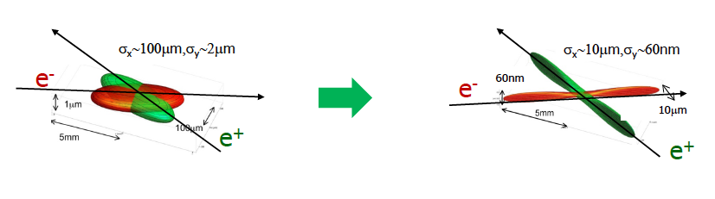
How to achieve “Super Luminosity”
Luminosity formula
KEKB
Stored current
Beam-beam parameter
Lorentz factor
Vertical β at the IP
For higher Luminosity; In case of KEKB → SuperKEKB
Vertical β function at IP (β_{y}*): 5.9 → 0.27/0.30mm (x20)
Increase beam currents: 1.7/1.4 → 3.6/2.7 A (x 2)
Increase ξ_{y} 0.09 → 0.09 (x 1)
SuperKEKB
Basic concept: “Nano-beam scheme”
Notes:
So, how do we achieve the Super luminosity ?
There are three essential ingredients in this luminosity formula.; the vertical beta function at IP, beam currents and the beam-beam parameter.
In case of the KEKB->SuperKEKB upgrade, we reduce beta_y* significantly by a factor of 20, and increase the beam current by a factor of 2.
We could also increase the beam-beam parameter, but at this moment we are conservative and assumes no improvement here.
In any case, the basic concept is the nano-beam ssheme, invented by Pantareo Raimondi for SuperB.

Slide 24
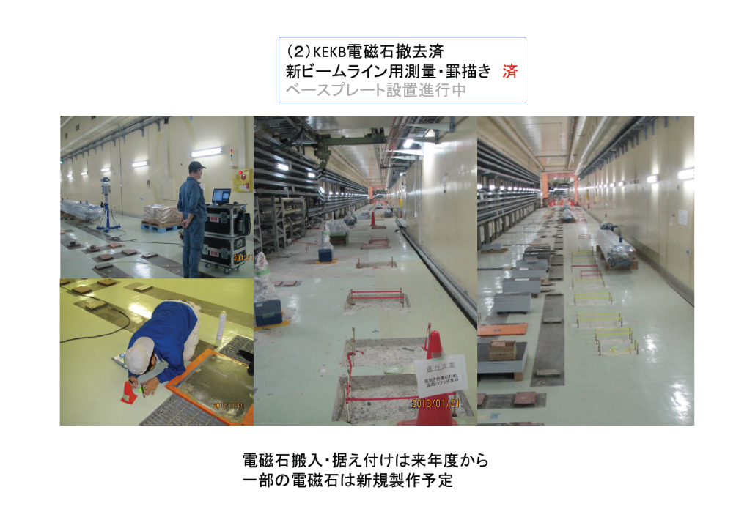
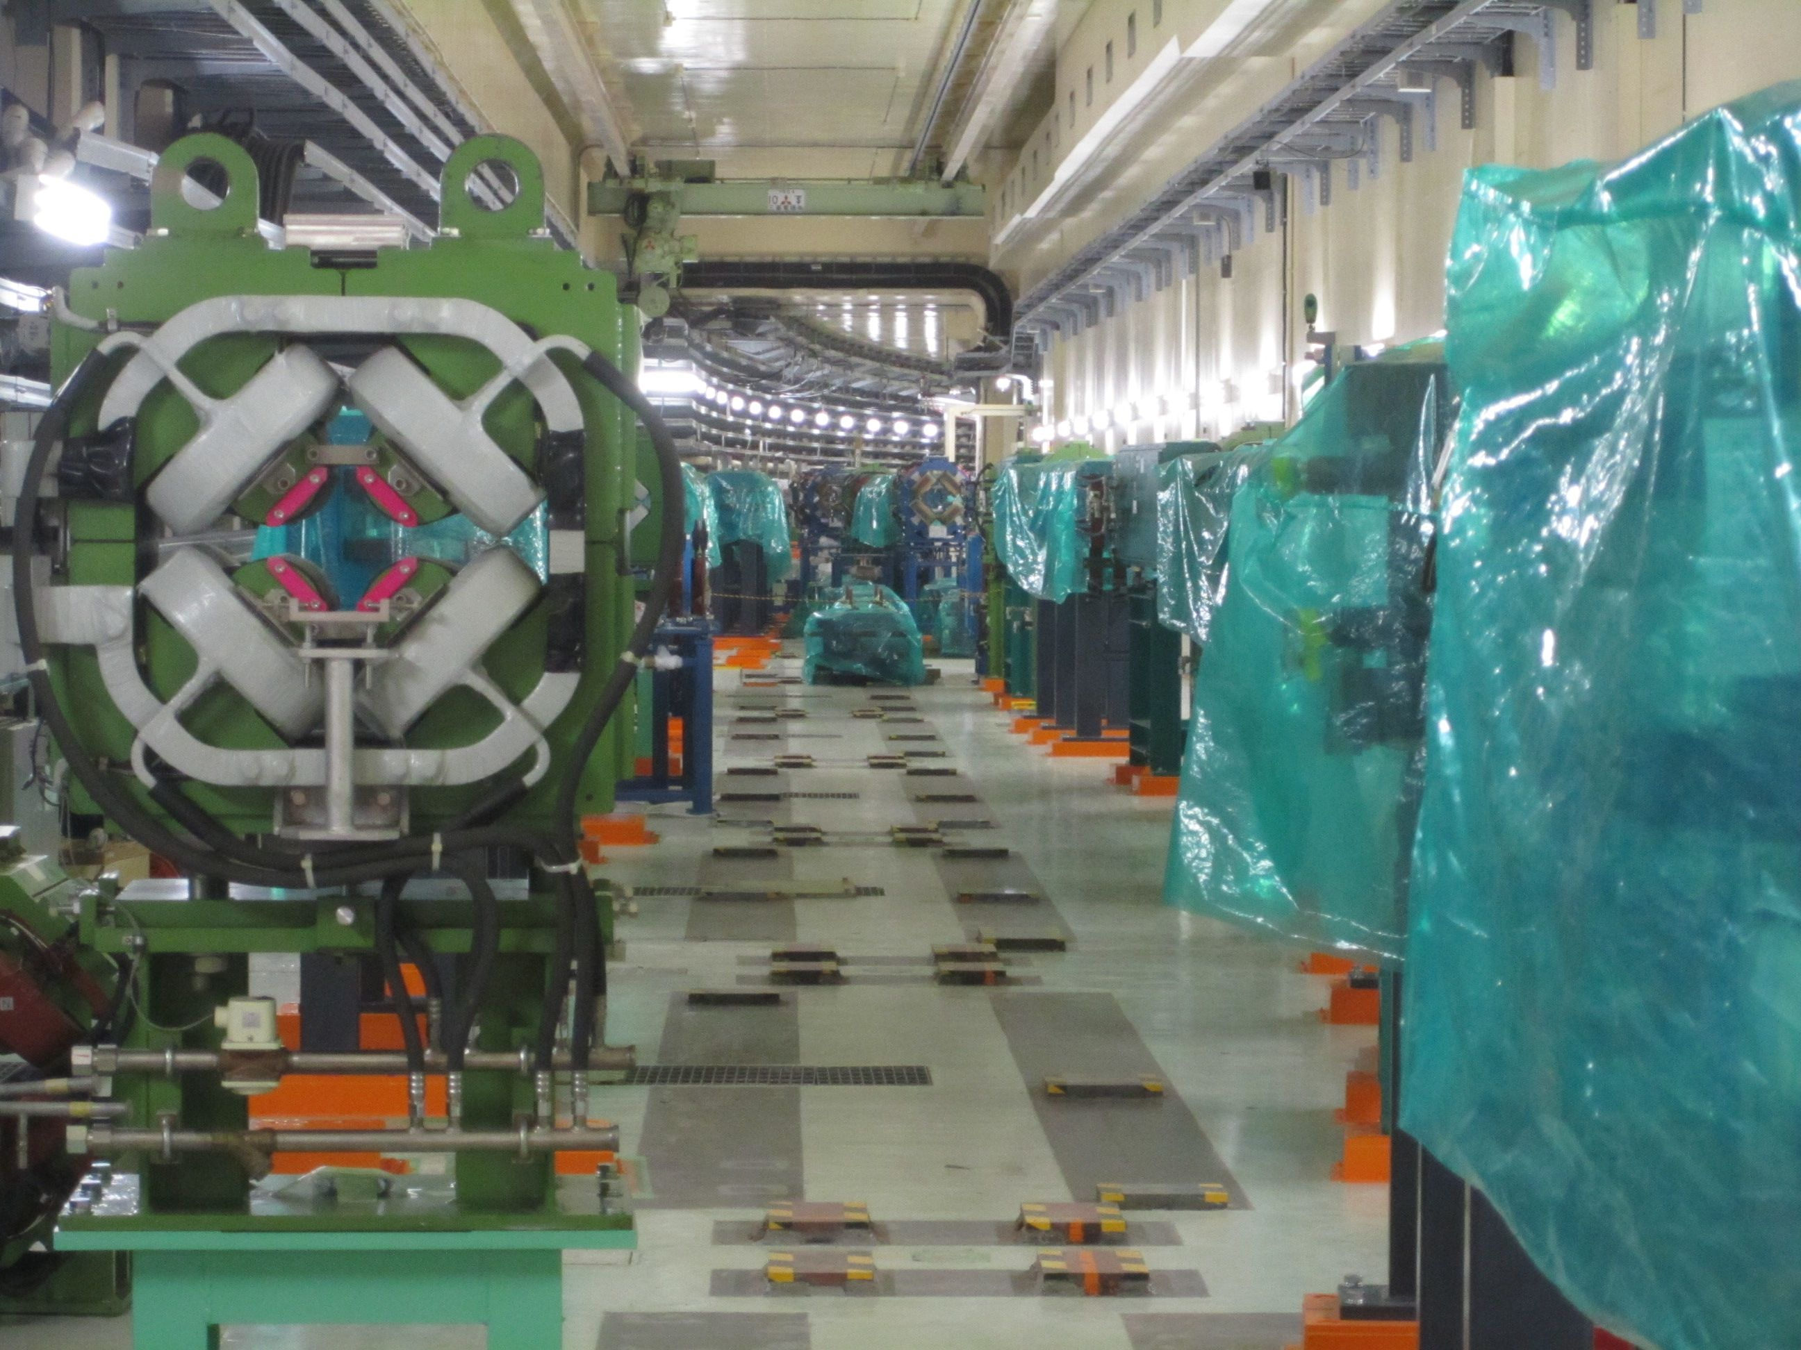
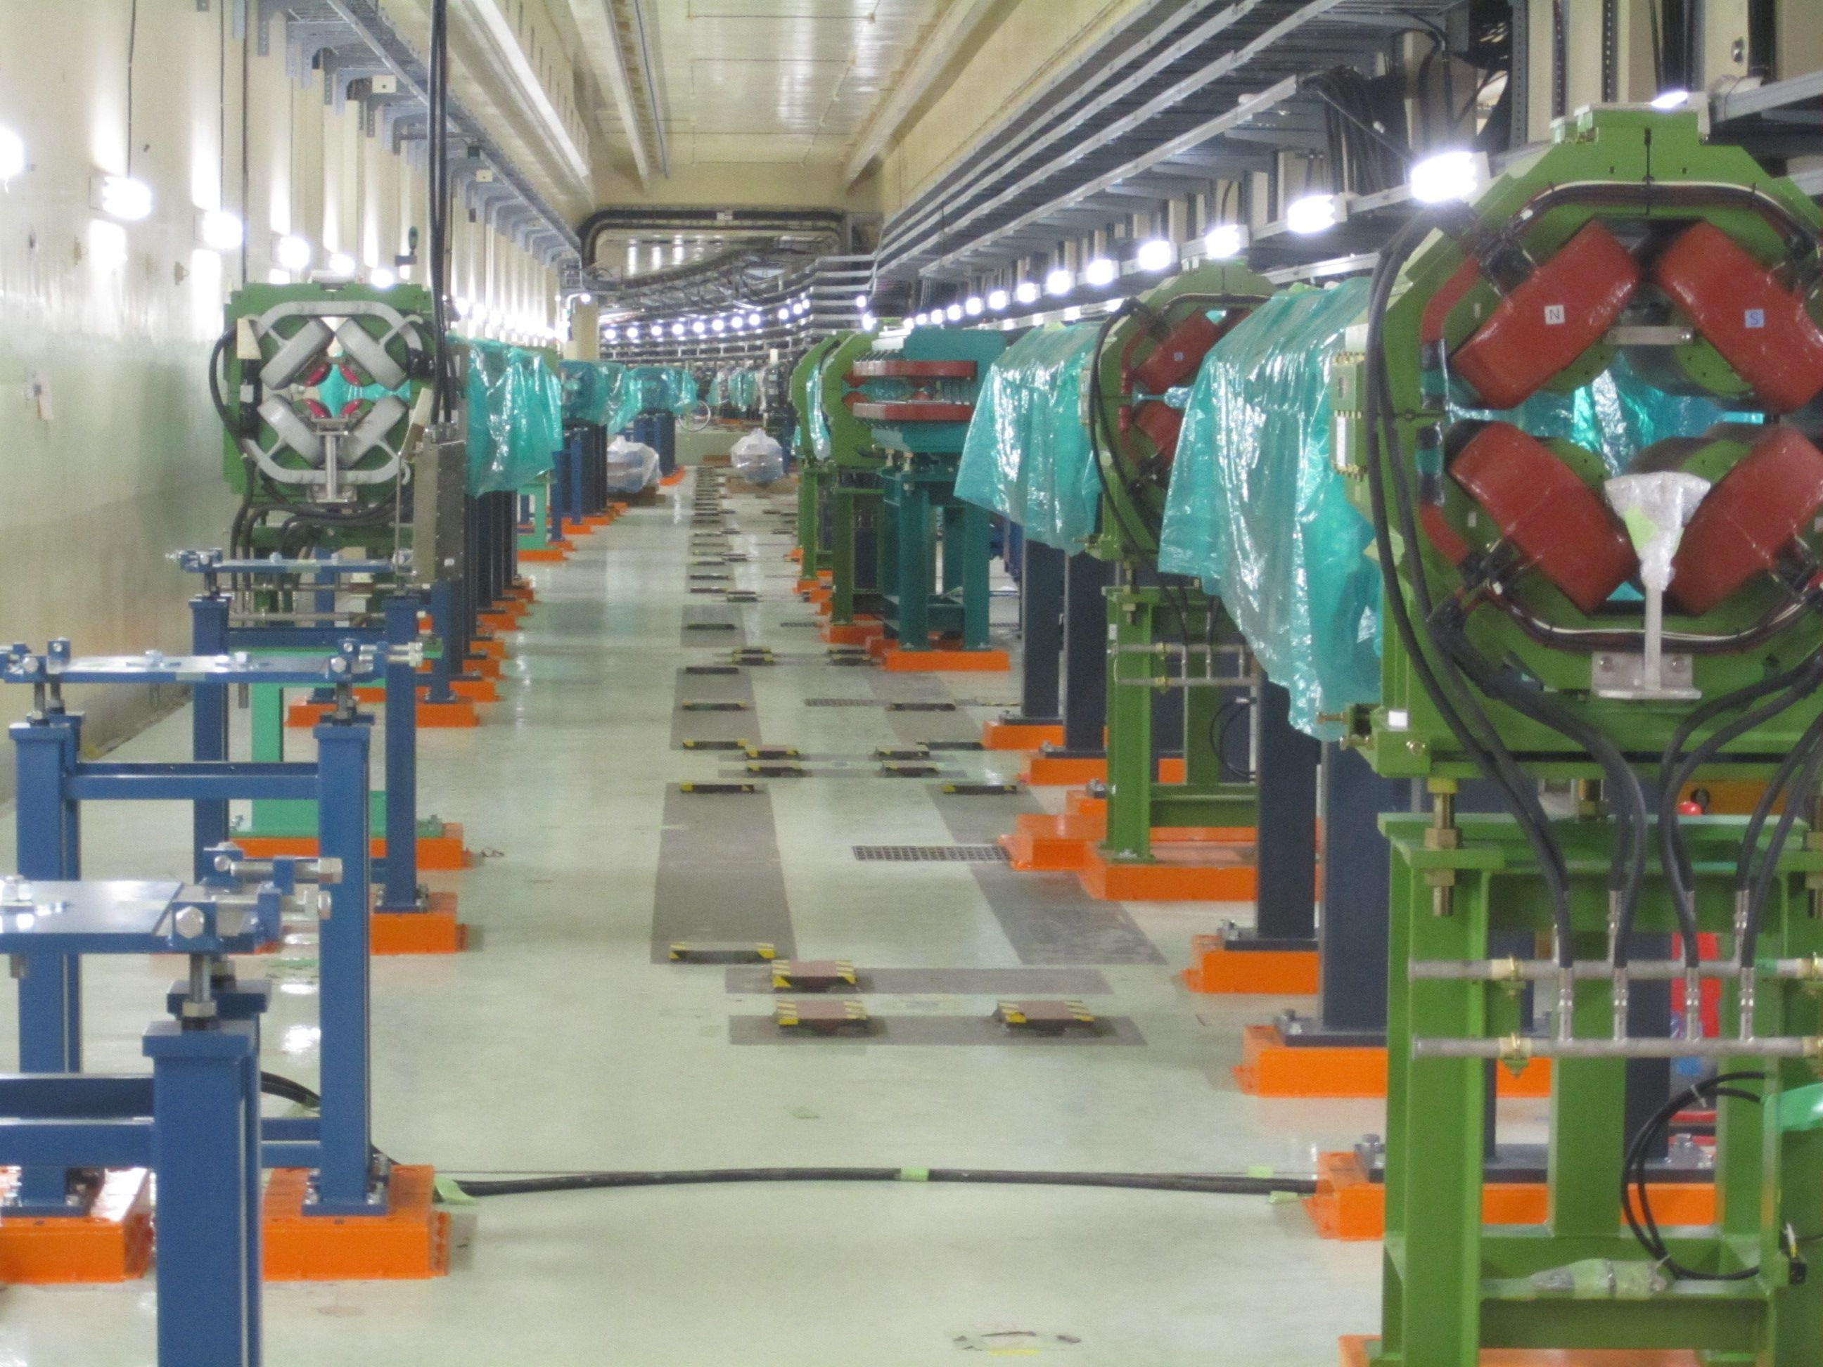
Magnets have been installed
March 2013
D2(Oho-side)
D1(Nikko-side)

Slide 25
Belle II Detector
Deal with higher background (10-20×), radiation damage, higher occupancy, higher event rates (L1 trigg. 0.5→30 kHz)
Improved performance and hermeticity
CsI(Tl) EM calorimeter: waveform sampling electronics,
Pure CsI for endcaps
RPC μ & K_{L} counter: scintillator + Si-PM
for end-caps + inner barrel
4 layers DS Si vertex detector
→ 2 layers PXD (DEPFET),
+ 4 layers DSSD
Time-of-Flight, Aerogel Cherenkov Counter → Time-of-Propagation (barrel), prox. focusing Aerogel RICH (forward)
Central Drift Chamber:
smaller cell size, long lever arm
International collaboration from: Saudi Arabia, Australia, Austria, Canada, China, Czech, Germany, India, Japan, Korea, Malaysia, Viet Nam, Poland, Russia, Slovenia, Spain, Taiwan, Thailand, Turkey, USA, Ukraine

Slide 26


TOP (Time-Of-Propagation) Counter
Simulation
2GeV/c, θ=90 deg.
pion / Kaon
Cherenkov ring imaging using timing information
Idea developed by Nagoya (Ohshima et al.)
Very compact, suitable for collider geometry.
Key technologies:
  Photodetection w/ precision timing (~50ps/photon) ←MCP-PMT
  Accurately polished quartz bar (5Å)
Difference of path length → Difference of time of propagation (TOP)
150~200ps from TOP + TOF from IP
with precise time resolution (σ~40ps) for each photon
δ-ray,
had. int.
Photodetectior
(MCP-PMT)
Incoming track
Focusing mirror
Quartz bar
~2.5m (~45cm wide, 20 mm thick)

Slide 27





TOP Status
Performance demonstration at SPring-8
        → Construction phase
Observed ring image (R : MC / L : Data)

Slide 28


Computing
Distributed experimental apparatus
  Important as part of the Belle II detector
  Interface to physics
KMI, Nagoya
Talk by Hayasaka-san

Slide 29

SuperKEKB/Belle II Schedule
Accelerator ready by FY2014, and comissiioning starts immediately.
Belle II Physics run starts in 2016.
We are here
Goals of Belle II/SuperKEKB
Integrated luminosity
(ab⁻¹)
We will reach 50 ab⁻¹
in 2021
9 months/year
20 days/month
Commissioning starts
in late 2014.
Peak luminosity
(cm⁻²s⁻¹)
Shutdown
for upgrade
Year

Slide 30
Summary
The SuperKEKB/Belle II provides us unqiue opportunities to search for NP with B, D and τdecays.
  Complementary approach to LHC
  In case no NP, ultimate tests of SM and strong constraint
Nagoya/KMI group is playing a leadng role, and has unique and large contributions to
  TOP detector
  Grid computing
  Physics focusing on the Tau-Lepton
Thank you !

Slide 31

CMSSM
L. Roszkowski, “Is the CMSSM already ruled out ?”

Slide 32



Precision CKM constraints
Success of the B Factires
(SLAC/KEK)
The "dream" scenario with 75ab⁻¹
Still room for sub-leading contribution from NP at O(0.1)
There are tree and loop diagrams involved.
LHCb and Tau-charm will also contribute here.
Notes:
This shows the present status of the CKM fit, successfully made based on the present data, mainly from the two B factories. This confirms the KM phase is the primary source of CP violation seen in K and B decays, however, there are some issues left. There is still room for sub-leading contribution from NP. Also, there are tree and loop diagrams involved here. Ideal way is to determine the apex only by tree processes, i.e., Vub and gamma, and compare it to that from loop processes. But, you see the present resolution for these two quantities are not so good,
The right-hand plot demonstrate the precision in the next generation. Especially Super B factories will be unique for determination of sides Vub and Vcb from semileptonic decays, which cannot be done at LHCb.

Slide 33

Photon polarization in b → s(d) γ
In SM, photons from b→s(d)γ processes are left handed, therefore, (almost) no CPV.
If unknown right handed current exists, CPV may arise clear NP signal !
ΔS
1
Belle measurements
Possible deviation from SM
O(1): Warped extra dim.
O(1): L-R symmetric model
O(0.1): SUSY SU(5)
B → ργ
B → K*γ
0.1
In SM,
|S(K*⁰γ)| < 0.02, S(ρ⁰γ) ~ 0
With improved Ks vertex finding efficiency
SUSY
ΔS(K*⁰γ) = 0.027 @ 50 ab⁻¹
SM(K*⁰γ)
ΔS(ρ⁰γ) = 0.075 @ 50 ab⁻¹
0.1
1
10
50
L_{int} [ab⁻¹]

Slide 34




CPV in b→s Penguins
SM
NP
Present upper
limits
ΔS(B→φK⁰)
50ab⁻¹
MC
J/ψK⁰
Deviation from SM
φK⁰
Measurements
at upgraded KEKB
（ ab⁻¹ ）
Present B factories
Upgraded KEKB
Notes:
例として、B→fK⁰などのペンギン崩壊モードにおけるCP非対称度を数％の精度で測定する。これにより現在のデータが示唆する標準理論からのズレの有無に決着をつける。

Slide 35
Machine Parameters
 |  | SuperKEKB |  | SuperB (base line)
Parameters | unit | LER | HER | LER | HER
Circumference | m | 3016.3 |  | 1258.4
Energy | GeV | 4 | 7 | 4.18 | 6.7
Half x-ing angle | mrad | 41.5 |  | 33
β_{x}* / β_{y}* at IP | mm | 32 / 0.27 | 25 / 0.31 | 32 / 0.205 | 26 / 0.253
Hor. emittance (ε_{x}) | nm | 3.2 | 5.0 | 2.46 | 2.00
σ_{x} / σ_{y} at IP | μm | 10.2/0.059 | 7.75/0.059 | 8.872 / 0.036 | 7.211 / 0.036
Beam-beam (ξ_{y}) |  | 0.0886 | 0.0830 | 0.0971 | 0.0970
N_{bunches} |  | 2500 |  | 978
Beam currents | A | 3.6 | 2.6 | 2.447 | 1.892
Luminosity | cm⁻²s⁻¹ | 0.8 x 10³⁶ |  | 1.0 x 10³⁶
Compared to KEKB/PEP II
Smaller beam size and higher currents.
Larger (half) crossing angle than (11mrad @ KEKB)
Less energy asymmetry (higher E_{LER}) for longer Touschek lifetime (LER).
Notes:
This table compares the machine parameters.
SuperKEKB has a larger circumference and store more bunches and currents. Compared to KEKB/PEP II, we introduce large crossing angle, and less energy asymmetry for longer Touschek lifetime in LER.
Please note that the Crab waist scheme is not applied to the SuperKEKB design.

