Slide 1



Exotic Hadron Spectroscopy at B-factories
Toru Iijima
Kobayashi-Maskawa Institute
Nagoya University
KMI Topics Seminar
March 11, 2015

Slide 2
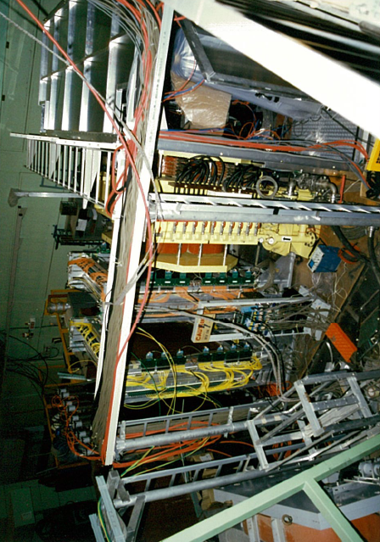
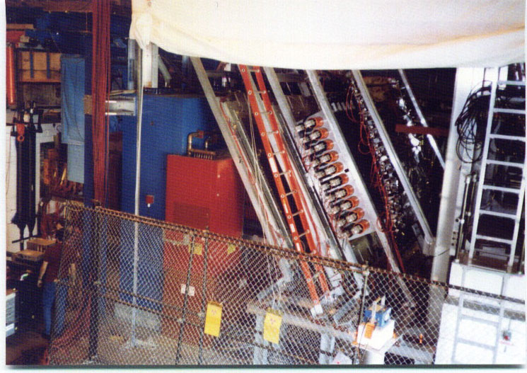
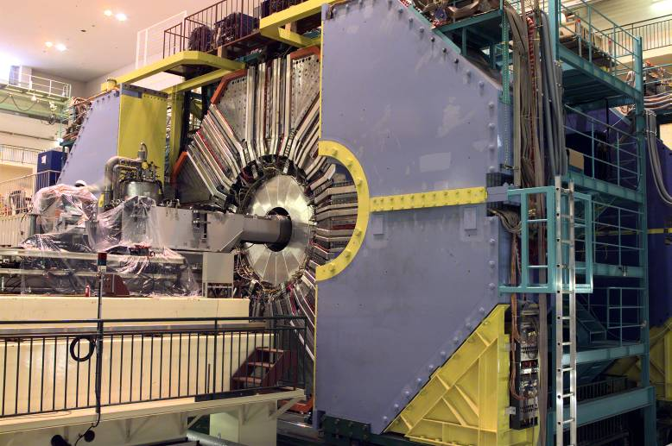
About Me
KEK-E176
KEK-E176/E224
BNL-E813/836
1987-1994: Kyoto University
H dibaryon search
  KEK-E176
  A-dependence of (K⁻,K⁺)
  BNL-E813/E836
1994-2002: KEK, 2002-now: Nagoya University
B factory → Super B factory
  Particle ID (Cherenkov detectors)
  CP violation
  Rare decays
  Hadron physics
    「新ハドロン」新学術領域（2009~）
u
u
d
d
s
s
Belle実験
c
u
d
c
Hadron spectroscopy is one of my favorite subjects

Slide 3

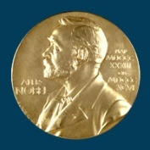
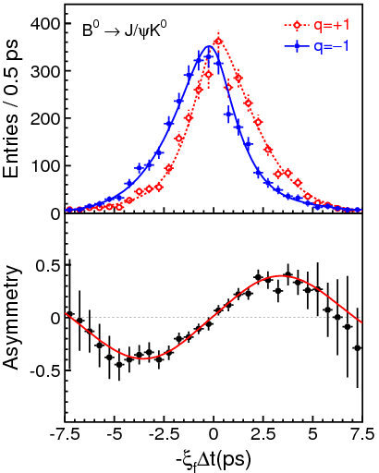

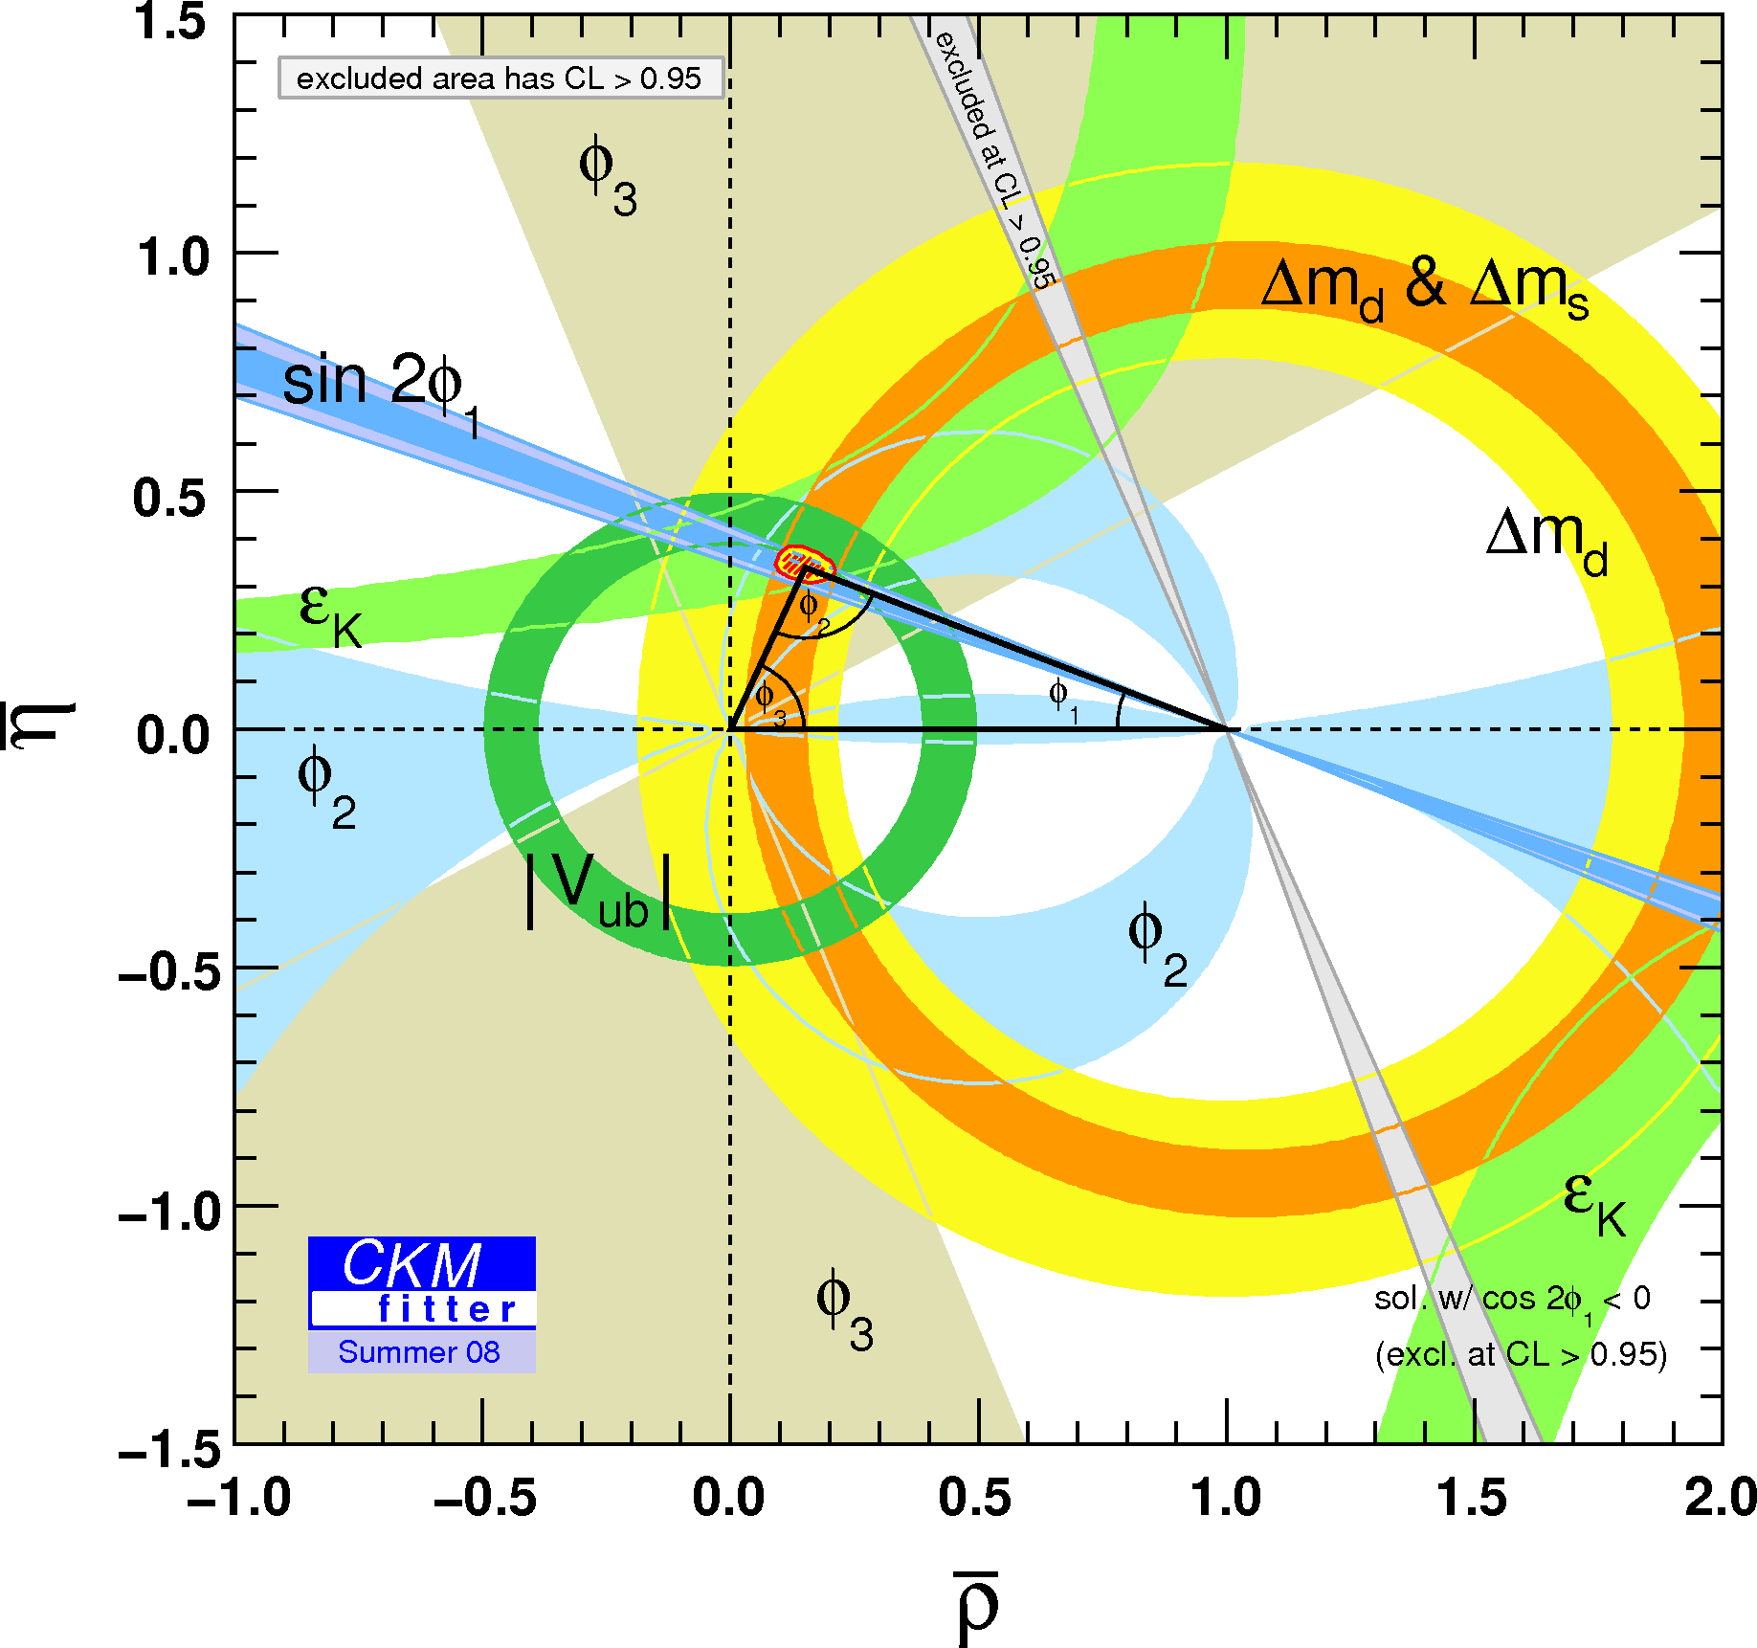
Confirmation of Kobayashi-Maskawa
B⁰ tag
_
B⁰ tag
Press release from the Academy
“As late as 2001, the two particle detectors BaBar at Stanford, USA and Belle at Tsukuba, Japan, both detected broken symmetries independently of each other. The results were exactly as Kobayashi and Maskawa had predicted almost three decades earlier. “

Slide 4

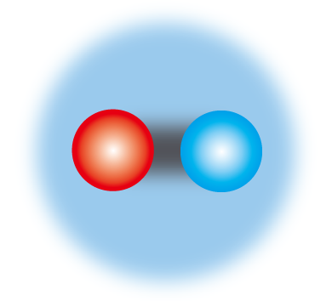
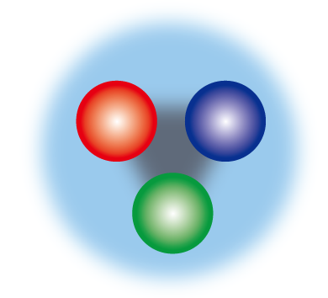



Quest in low-energy QCD
Are there exotics beyond meson(qq) /baryon (qqq) ?
Sakata Model
(p, n, Λ)
6 quark model
I
II
III
q=u, d, s, c, b, t
u
c
t
up
charm
top
flavor
Gell-Mann
(u,d,s)
s
b
d
color (R,G,B）
down
strange
bottom
Ordinal Hadrons
New Hadrons（Exotics）
meson
baryon
Tetra-quark
Penta-quark
Molecule
q
q
q
q
q
QCD just require hadrons to be colorless, and allow exotics.
Such exotic states exist ?
Notes:
One of the fundamental question in low-energy QCD is whether or not there are exotics beyond meson and baryon.
All of the well known hadrons are classified into q—bar mesons or qqq baryons, however, QCD just reuire hadrons to be colorles, and it does not exclude the existence of exotics like tetra-quark, penta-quark or molecule-like structures.

Slide 5
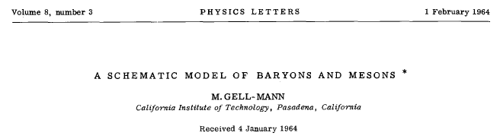
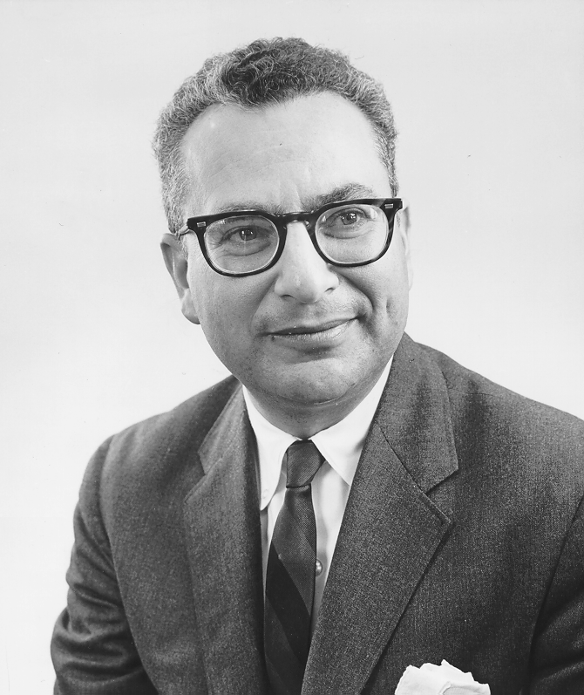

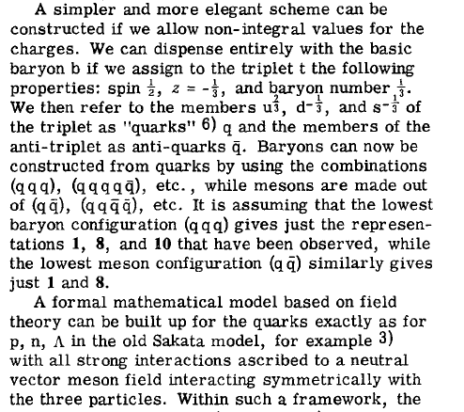

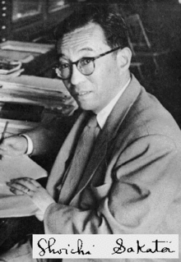
Gell-Mann 1964
Existence of such exotics have long been discussed since the birth of the quark model.

Slide 6
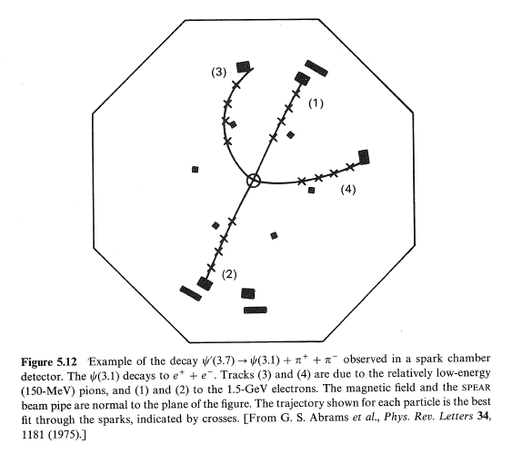
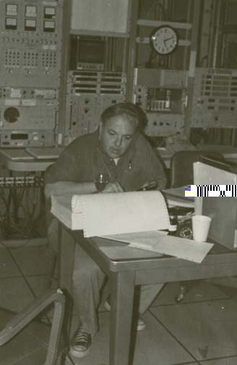
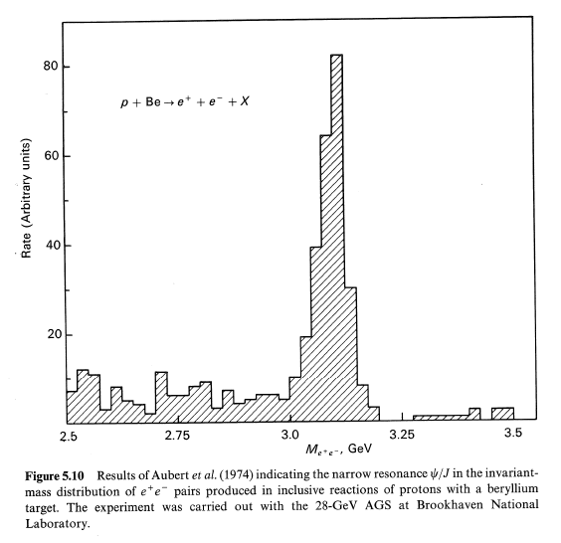
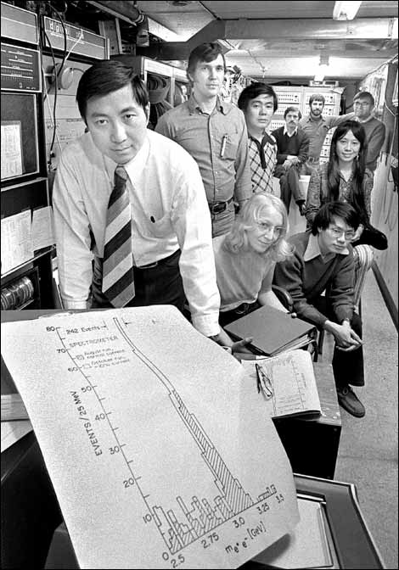
Discoveries in 1974
Discovery of J/ψ
  SLAC, Burton Richter et al.
  BNL, Samuel Ting et al.
And following qurkonium spectroscopy established physical existence of quarks and qq picture of mesons.

Slide 7
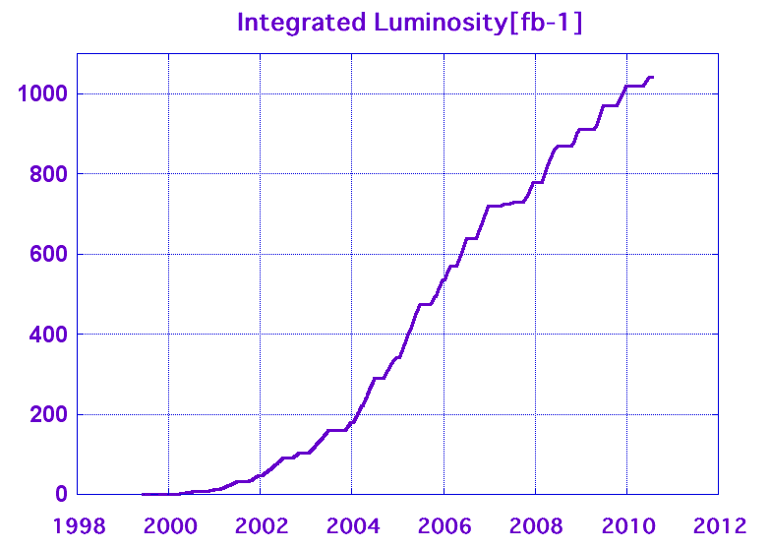

Discoveries at B-factories
New resonances discovered
at B-Factories
Zb⁰
Z(3885)
Observed >15
Exotic resonances
Zb(10610),Zb(10650)
η_{b}(2S)
temp
X(3915), Y(4350)
h_{b}
Charged
Integrated Luminosity
Yb
Z(4050),Z(4250)
Y(4660)
Y(4008)
Z(4430)
c
u
d
u
u
c
c
c
D_{sJ}(2700)
Ξ_{cx}(3090)
D_{sJ}(2860)
Tetraquark
cluster
χ_{c2}’
Neutral
X(3940), Y(3940)
Y(4320)
g
c
Σ_{c}* baryon triplet
c
c
Y(4260)
u
u
Hybrid
X(3872)
c
D_{sJ}(2317/2460)
D₀*⁰ & D₁*⁰
η_{c}’ & e⁺e⁻→cccc

Slide 8
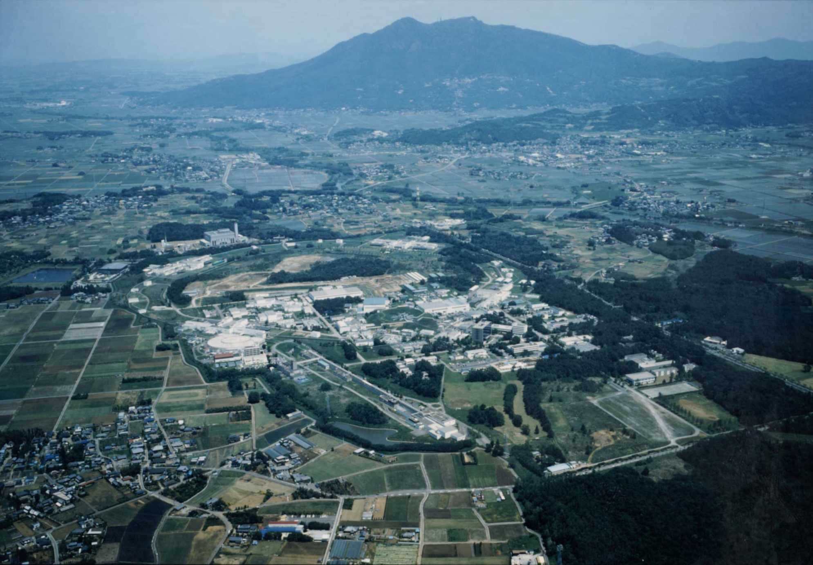
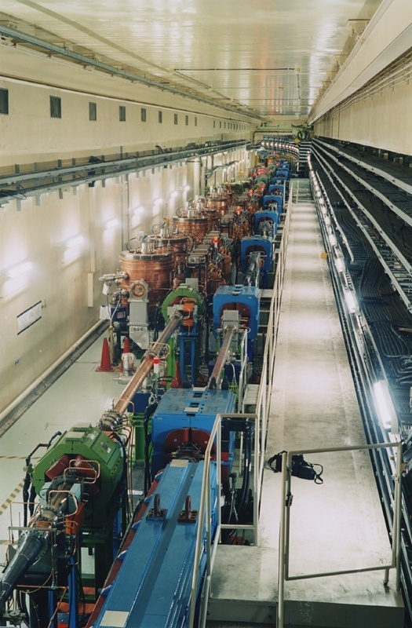
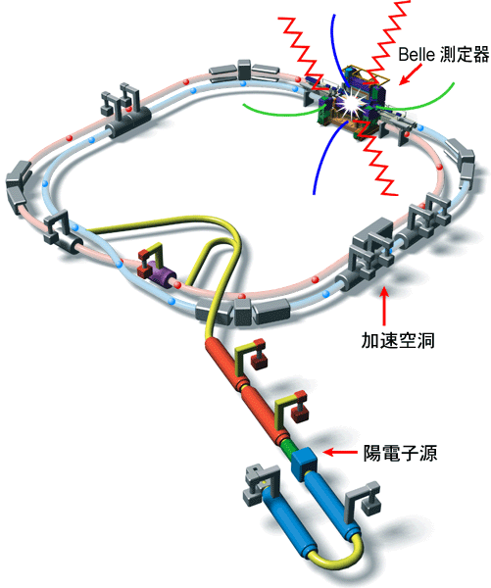
The KEKB Collider
e⁻ (8.0GeV) × e⁺ (3.5GeV)
  ⇒Υ(4S) →BB
  ⇒Lorentz boost:
  βγ = 0.425
Finite crossing angle
  - 11mrad ×2
Operated 1999-2010
SCC RF(HER)
Belle detector
ARES(LER)
Ares RF cavity
Peak luminosity
2.1 x 10³⁴ cm⁻²s⁻¹ !
e⁺ source
The World Highest Luminosity
Notes:
Such success was brought by the high luminosity accelerator.

Slide 9
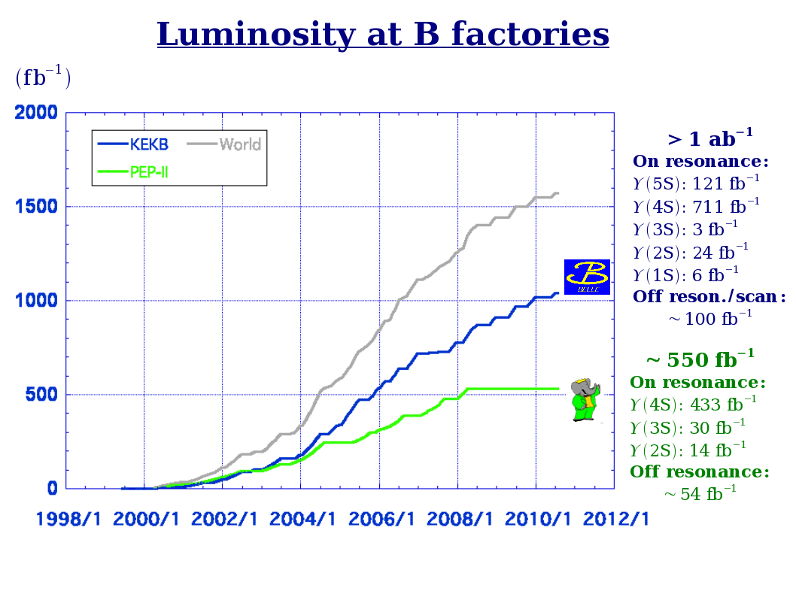
Luminosity at B Factories
@ Belle

Slide 10
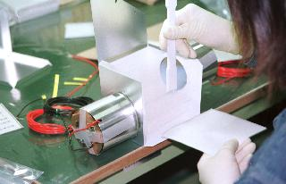
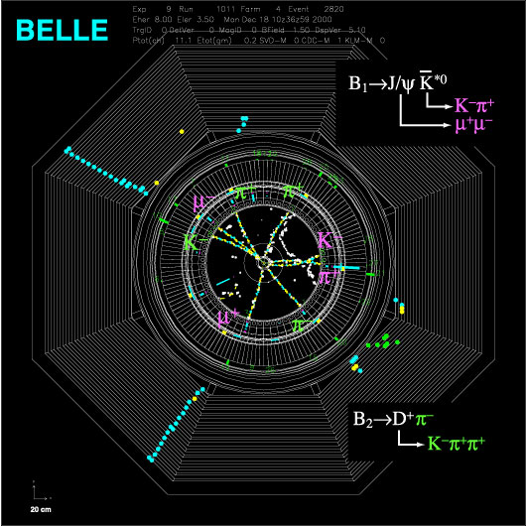
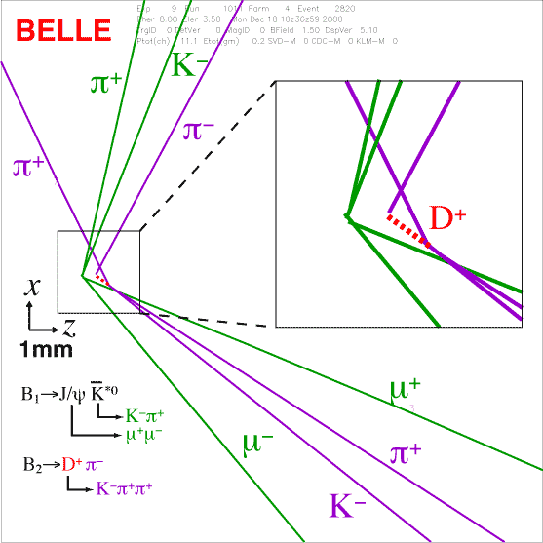
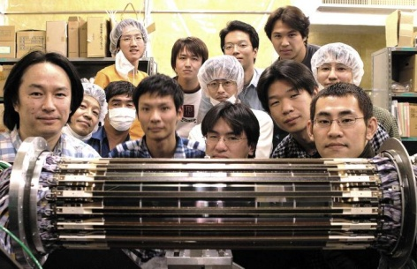
Belle Detector
Acceptance: 0.9 ×4π
Vertex resolution
s(J/ψ →ll) ~75nm
Momentum resolution
σ(Pt) = 0.19・Pt ⊕ 0.34/β %
Energy resolution
σ(Eγ)/Eγ =1.8% @ 1GeV
Particle ID
e, μ, π, K, p
Minimum bias trigger
Evis >= 1GeV & Ntrk >= 2
& Ncluster >= 4
essentially no loss for BB.
Notes:
The 2nd key is the detector., which has near 4-pi coverage, and particle identification for all particle species, and the data taking with minimum bias trigger thanks to the clean environment of e+e- collisions. We basically detect everything whatever happens in the e+e- reaction, and can excluisvely reconstruct hadrons.

Slide 11
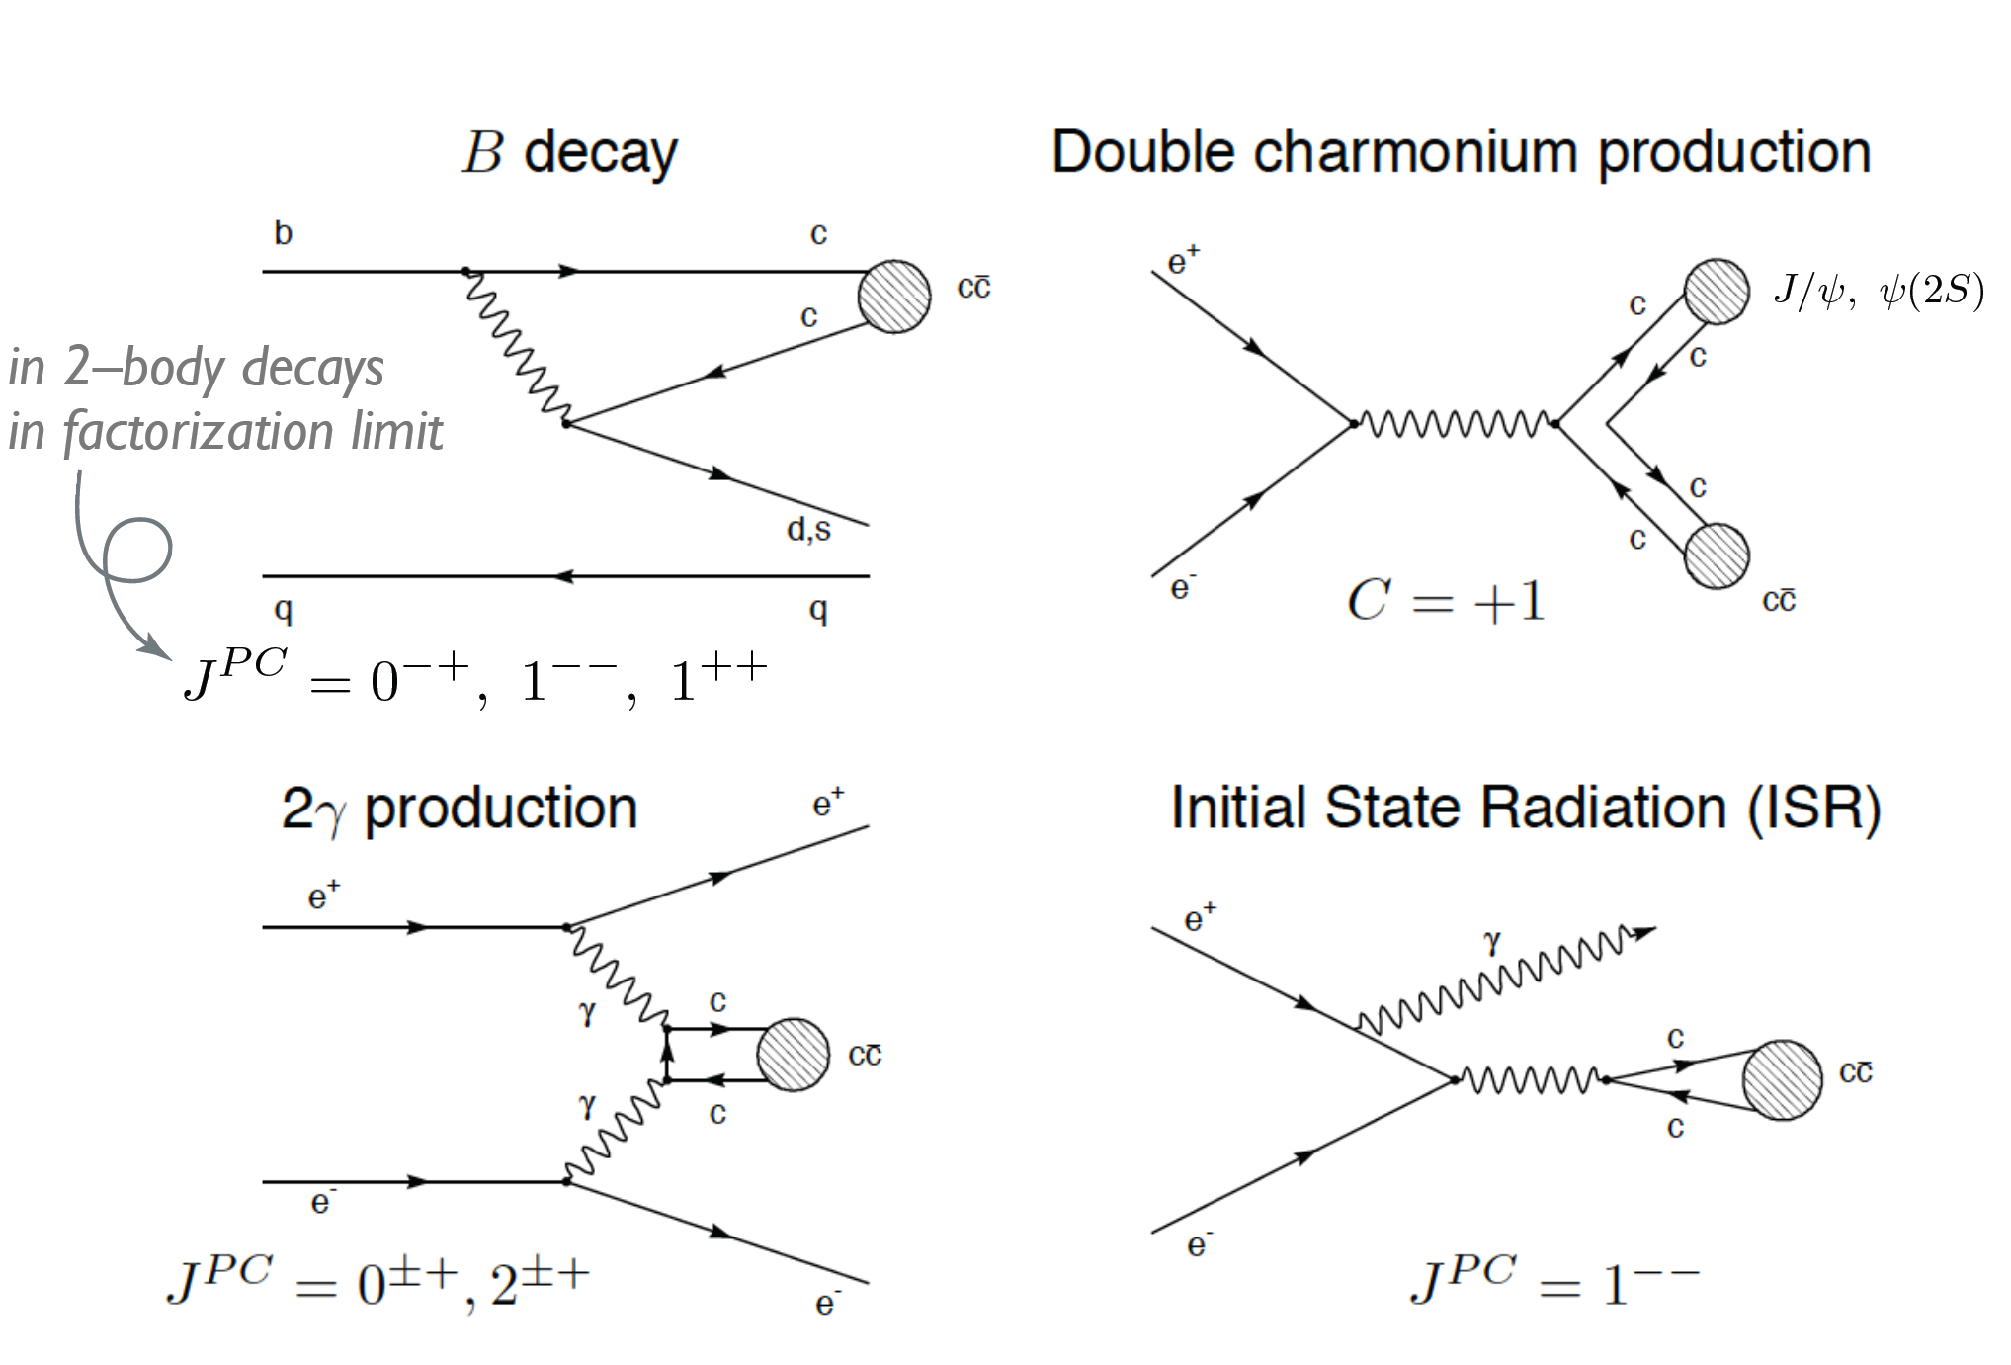
Production of cc in B Factories
B factories can produce charmonium (-like) states in four ways.
Notes:
In the e+e- collisions, there are 4 possible ways to produce the charmonium-like hadrons.

Slide 12
Chamonium-like Exotics

Slide 13
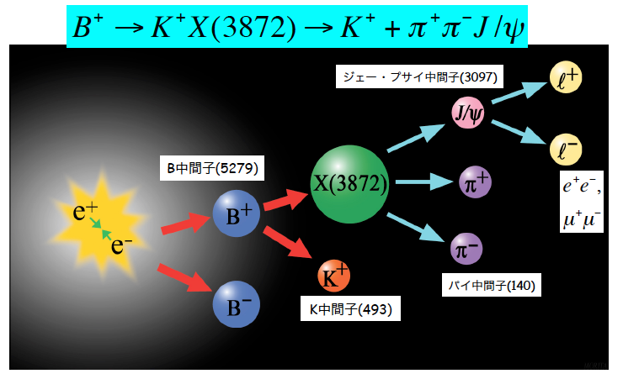
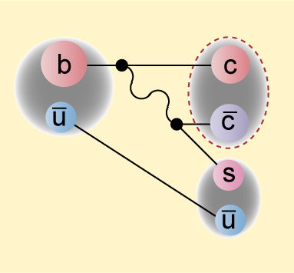
Discovery of X(3872)
2003, by Belle

Slide 14


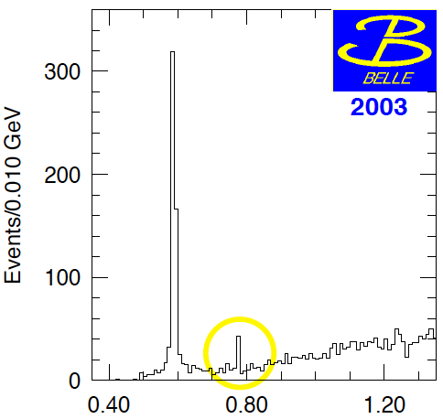
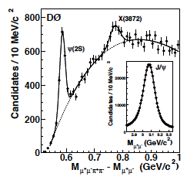
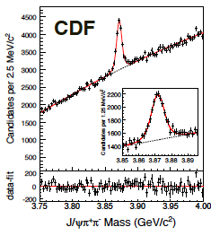
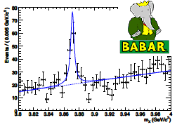


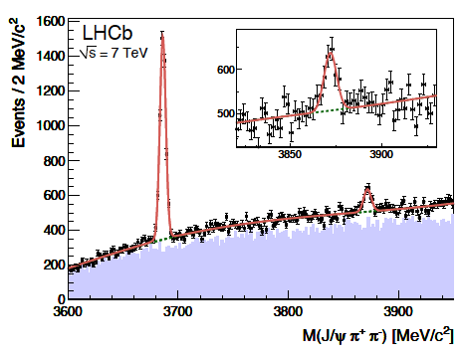
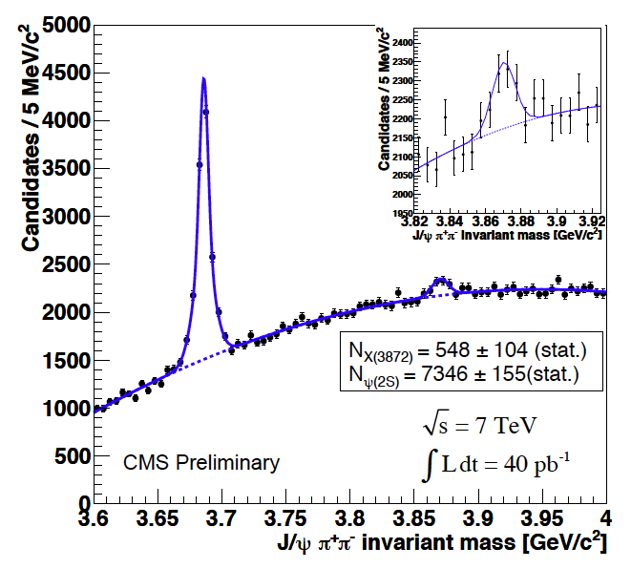
X (3872)
Discovery by Belle in 2003, followed by D0, CDF, BaBar.
ψ’
B→K J/ψππ
X(3872)
And more recently also by LHCb, CMS
PDG2012:
M=3871.68 +/- 0.17
M(D⁰)+M(D^{*0})=3871.84 +/- 0.20
Notes:
PDG2012:
X(3872) mass: 3871.68 +/- 0.17
D0 : 1864.86 +/- 0.13
D*0 : 2006.98 +/- 0.15

Slide 15
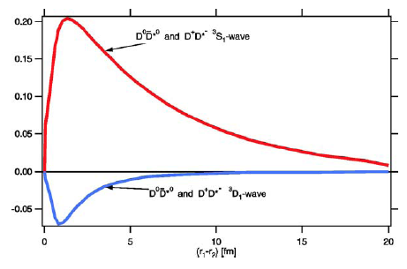
What is X(3872) ?
PDG2014
  mass M＝3871.69 ± 0.17 MeV
  Width Γ < 1.2 MeV (90%C.L.)
The observed mass is
  different from that predicted by conventional charmonium picture.
  Very close to M(D⁰) + M(D^{*0}) = 1864.84 + 2006.96 = 3871.80 MeV
The width is very narrow
N. A. Tornqvist,
PLB590.209 (2004)
Tetraquark
D^{(*)}D^{(*)} Molecule
“Di-quark”

Slide 16

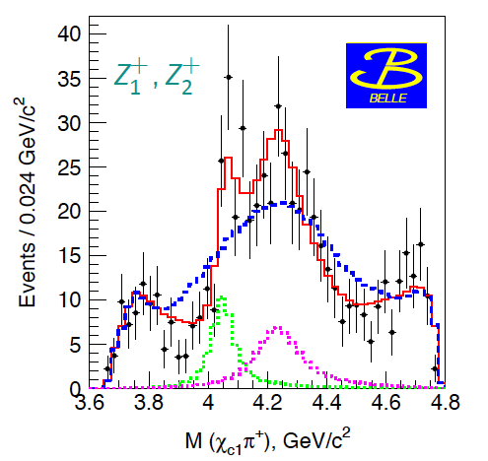
Z(4430)⁺, Z (4050)⁺, Z(4250)⁺ by Belle
Belle found Z(4430)⁺ in B→K π⁺ ψ’ decays.
  One-dimensional fit on ψ’π⁺ distribution after K*(890) /K*(1430) vetos.
  Confirmed by analysis with a full Dalitz plot.
Belle found also another two states, Z(4050)⁺ & Z(4250)⁺, in B→K π⁺ χ_{c1} decays.
PRD80, 031104(2009)
PRD80, 031104(2009)
M²(ψ’π⁺)
Their minimum quark content must be exotic:

Slide 17
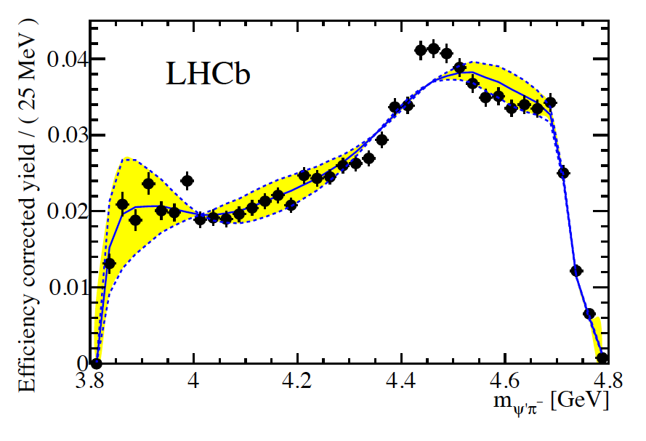
Z(4430) at LHCb
Observation of Z(4430)⁺
  Confirmed the Belle result
  J^{P}=1⁺
LHCB-PAPER-2014-014

Slide 18
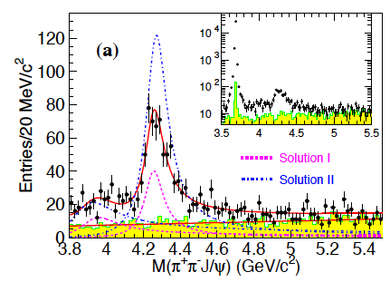
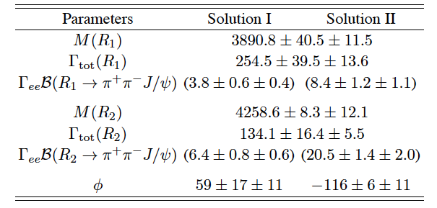
Update of Y(4260)/Y(4008)
Updated measurement for e⁺e⁻ → π⁺π⁻J/ψ w/ initial state radiation (ISR) using full Belle data sample (967fb⁻¹).
Two resonances; Y(4008) and Y(4260) are observed, consistent with the previous Belle measurement.
Resonance parameters
PRL110.252002(2013)

Slide 19
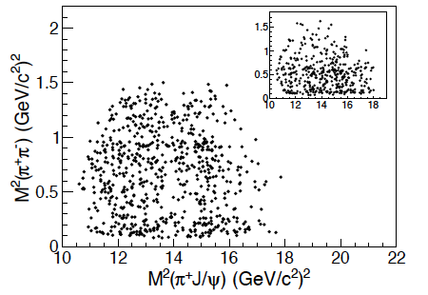
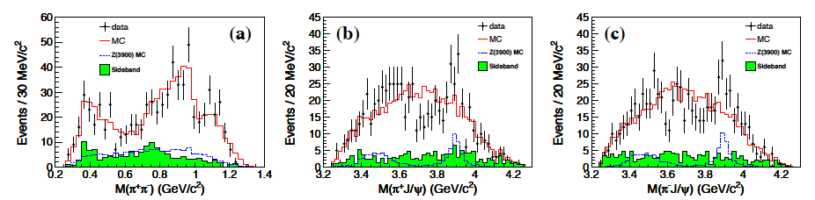
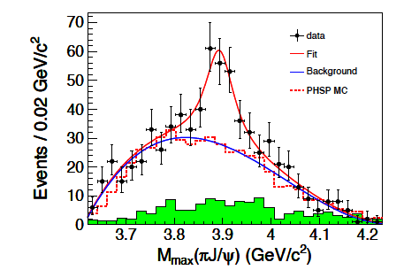
Z(3895)⁺
PRL110.252002 (2013)
Dalitz plot of M²(π⁺π⁻) and M²(πJ/ψ) for 4.15 < M(ππJ/ψ) < 4.45 GeV/c².
M(π⁺π⁻) [GeV/c²]
M(π⁺ J/ψ) [GeV/c²]
M(π⁻ J/ψ) [GeV/c²]
A structure is observed in the M(πJ/ψ) mass with 5.2 σ significance.
  Mass = 3894.5 ± 6.6 ± 4.5 MeV/c²
  Width = 63 ± 24 ± 26 MeV/c²
Similar state also seen by BES III
PRL110.252001(2013)
A new charged charmonium-like state !

Slide 20
Bottomonium-like Exotics

Slide 21
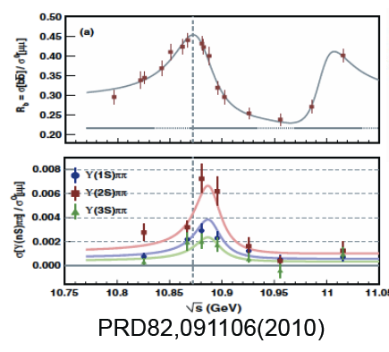
Yb: Y(4260) counter part
Hadrons
Large rate of
Y(4260) → J/ψ π⁺π⁻
Anomalously large rates
ϒ(5S) → ϒ (nS) π⁺π⁻
~100 times larger than
ϒ(1-4S) → ϒ (nS) π⁺π⁻
Peak locations are
Different ?

Slide 22
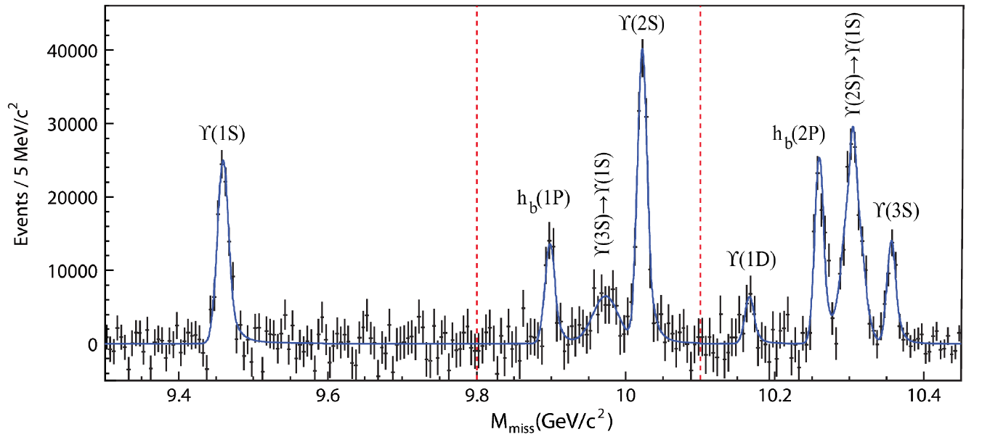

Anomalies in ϒ(5S) decay
ϒ(11020)
Γ[ϒ(5S) →ϒ(1,2,3S) π⁺π–]
>> Γ[ϒ(4,3,2S) →ϒ(1S) π⁺π–]
11.00
ϒ(10860)
10.75
260
Belle PRL100,112001(2008)
π⁺π–
h_{b} production
2M(B)
ϒ(4S)
10.50
2
330
ϒ(3S)
Mass, GeV/c²
h_{b}(2P)
h_{b}(2P)
10.25
430
h_{b}(1P)
1
190
η_{b}(2S)
ϒ(2S)
10.00
h_{b}(1P)
290
6
9.75
Belle PRL108,032001(2012)
partial Γ(keV)
ϒ(5S) → h_{b}(1,2P) π⁺π– are not suppressed
9.50
ϒ(1S)
Expect suppression ∼Λ_{QCD}/m_{b}
η_{b}(1S)
spin-flip
Heavy Quark Symmetry Violation
J^{PC} = 0
-+
--
1⁺⁻
1

Slide 23
Anomalies in ϒ(5S) decay
ϒ(11020)
11.00
ϒ(10860)
+
h_{b} production
⇒ via intermediate charged states Z_{b}
10.75
260
π–
Z_{b}
2M(B)
ϒ(4S)
10.50
2
ϒ(3S)
π⁺
Mass, GeV/c²
h_{b}(2P)
10.25
430
1
η_{b}(2S)
ϒ(2S)
10.00
h_{b}(1P)
290
6
9.75
ϒ(5S) → h_{b}(1,2P) π⁺π– are not suppressed
partial Γ(keV)
9.50
ϒ(1S)
Expect suppression ∼Λ_{QCD}/m_{b}
η_{b}(1S)
spin-flip
Heavy Quark Symmetry Violation
J^{PC} = 0
-+
--
1⁺⁻
1

Slide 24
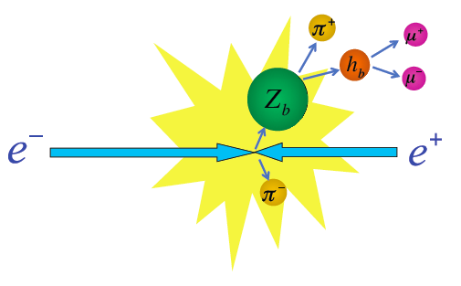
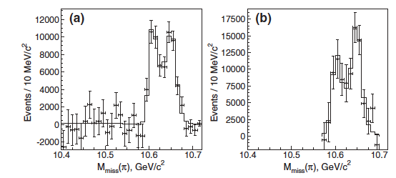
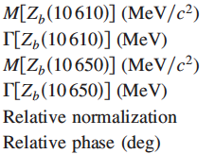
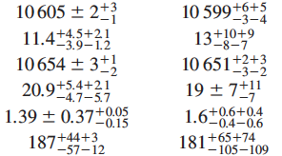
h_{b} (1P, 2P) π⁺ π⁻
h_{b}(1P) π⁺
h_{b}(2P) π⁺
to look at h_{b} π⁺
Fit with
Two peaks at the positions
same as ϒ(nS)π⁺π⁻

Slide 25
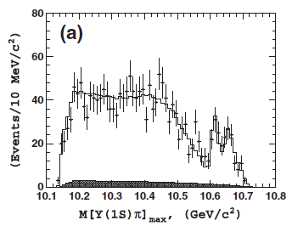
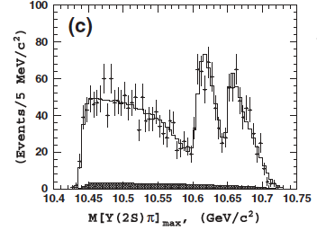



Charged Bottomonium-like Z_{b}⁺ in ϒ(nS)π⁺
Two peaks at the same positions in the 3 modes.
ϒ(1S)
ϒ(2S)
ϒ(3S)
Two resonances: Z_{b}⁺(10510), Z_{b}⁺(10560)

Slide 26


Z_{b}(10610) & Z_{b}(10650)
M=10608.4±2.0 MeV
M=10653.2±1.5 MeV
Γ=15.6±2.5 MeV
Γ=14.4±3.2 MeV

Slide 27


Molecular Explanation of Z_{b}⁺
Bondar et al, PRD84,054010(2011)
Proximity to thresholds favors molecule picture
Each of them is mixture of spin triplet and singlet bb
Z_{b}⁺(10510)
Z_{b}⁺(10560)
b
b
ū
π
ū
π
b̄
b̄
B⁻
d
B^{*-}
d
B^{*0}
B^{*0}
This model explains
Why h_{b} is unsuppressed relative to ○
Relative phase ~0 for ○ and ~180⁰ for h_{b}
Production rates of Z_{b}(10610) and Z_{b}(10650) are similar widths
If Z_{b}⁺ is B*B^{(*)} molecule, it should decay into B*B^{(*)}…

Slide 28
Final Remarks

Slide 29


Slide 30


New Resonances by Belle
Resonance Spectrum discover by Belle
Υ(４S)
2003~2009.8(15 states)
Υ(5S)
2009.8~(11 states)
Charm Flavor Region
Bottom Flavor Region
Zb⁰
X(3825)
Z(3885)⁺
Z(4200)⁺
η_{b}(2S)

Slide 31
XYZ at B Factories
State | Mass (MeV) | Width (MeV) | Decay | Production
Ys(2175) | 2175±8 | 58±26 | φf₀ | ISR
X(3872) | 3871.84±0.33 | <0.95 | J/ψππ, J/ψγ | B decay
X(3872) | 3872.8 +0.7/-0.6 | 3.9 +2.8/-1.8 | D^{*0}D⁰, J/ψω | B decay
Y(3915) | 3915±4 | 17±10 | J/ψω | γγ
Z(3940) | 3929±5 | 29±10 | DD | γγ
X(3940) | 3942±9 | 37±17 | DD* | Double-charm
Y(3940) | 3942±17 | 87±34 | J/ψω | B decay
Y(4008) | 4008 +82/-49 | 226 +97/-80 | J/ψππ | ISR
Z(4051)⁺ | 4051 +24/-43 | 82 +51/-28 | πχ_{c1} | B decay
X(4160) | 4156±29 | 139 +113/-65 | D*D* | Double-charm
Z(4248)⁺ | 4248 +185/-45 | 177 +320/-72 | πχ_{c1} | B decay
Y(4260) | 4264±12 | 83±22 | J/ψππ | ISR
X(4350) | 4350 +4.7/-5.1 | 13 +18/-14 | J/ψφ | γγ
Y(4350) | 4361±13 | 74±18 | ψ’ππ | ISR
Z(4430)⁺ | 4433±5 | 45 +35/-18 | ψ’π | B decay
Y(4660) | 4664±12 | 48±15 | ψ’ππ | ISR
Y_{b}(10890) | 10889.6±2.3 | 54.7 +8.9/-7.6 | ππΥ(nS) | e⁺e⁻ annihilation
Z_{b}(10610) | 10608.4±2.0 | 15.6±2.5 | (Υ(nS) or h_{b}) π | Υ(5S) /Y_{b} decay
Z_{b}(10650) | 10653.2±1.5 | 14.4±3.2 | (Υ(nS) or h_{b}) π | Υ(5S) /Y_{b} decay
Tetraquark
Light
quark
“Di-quark”
D^{(*)}D^{(*)} Molecule
charm
Hybrid
bottom

Slide 32









International Cooperation
LEPS2
Super-KEKB
J-PARC
GSI/FAIR
JLAB
LHC
BEPCII
RHIC
J-LAB

Slide 33

Charmonium-like Spectroscopy
Below DD threshold;
  All charmonium states have been observed.
  Spectra are in good agreement with naïve quark model
However,
Above DD threshold;
  Observed states DO NOT fit to the predicted spectrum.
Charged states cannot be
Above DD threshold
?
DD*
DD
Below DD threshold
well understood by
Conventional quark model describes only part of hadronic states.
Notes:
Heavy quarkonium is an ideal tool to study mesons, and well described by a pair of constituent quark and anti-quark bounded by the QCD confinement potential. However, data in this century, mainly come from the B factories revealed that above the DD threshold, observed states DO NOT fit to the predicted spectrum and even Charged states, which cannot be cc-bar have been found. It is not conclusive yet. But, still it demonstrates that we do not understood yet how hadrons are formed from QCD.

Slide 34

New Quark Model ?
Conventional quark model does not work for excited states.
  D.O.F. = “constituent quark”
Can we build a new (extended) quark model ?
  D.O.F. = quasi-particle ?
Q
Q
q
q
Di-quark
Colored meson
“New Nagoya Model ?”

Slide 35

Hot Region ?

Slide 36

Impact in the Universe History ?
cf. ¹²C Hoyle state（0⁺ triple-alpha)
William Alfreed Fowler
Nobel prize in physics 1983

Slide 37
Summary
Exotic hadron spectroscopy is very hot topics.
Experimentally, it has been and will be very productive.
The real value is unknown (honestly speaking), although I “believe” it is significant.
KMI is a good place to discuss
  Collaboration between exp. – theory is essential.
  Link to the universe development ???
Interpretation
Model
New data
Exp.
Theory
Verification
Prediction

Slide 38
Thank you !

Slide 39




X(3872)/Z(4430) at LHCb
B⁺ →X(3872)K⁺, with X(3872)→J/ψ(μμ)π⁺π⁻ J^{PC} = 1⁺⁺
Evidence for the decay X(3872)→y(2S) γ
PRL110, 222001 (2013)
LHCB-PAPER-2014-008
Observation of Z(4430)⁺
  Confirmed the Belle result
  J^{P}=1⁺
LHCB-PAPER-2014-014

Slide 40
Study of Z_{b}→B*B^{(*)}
For the ϒ(5S) →B*B(*) π⁺ channel:
Fully reconstruct one B meson in five exclusive decay modes.
Look at recoil mass of Bπ (for missing B) rM(Bπ)
and of the pion (for two B combination) rM(π).
_

Slide 41

Clear BB*π and B*B*π signals
_
_
Select two peaks
_
Full reconstruction of one B in 5 modes
BB*π
M_{miss}(Bπ)
_
recoil mass
BBπ
_
M(B)
B*B*π
preliminary
BF[ ϒ(5S) → B⁽*⁾B⁽*⁾π ]
significance
_
121.4 fb⁻¹
BB
BB* + BB*
B*B*
<0.60 % at 90% C.L.
(4.25 ± 0.44 ± 0.69) %
(2.12 ± 0.29 ± 0.36) %
_
_
_
_
_
9.3σ
5.7σ

Slide 42



Observation of Z_{b}→BB* and Z_{b}’→B*B*
_
_
_
M (BB*)
Z_{b}’ → BB* is suppressed w.r.t. B*B*
despite larger PHSP
Z_{b}
8σ
Z_{b}’ ?
_
phsp
Molecule ⇒ admixture of BB* in Z_{b}’ is small
preliminary
Assuming Z_{b} decays are saturated by these channels:
_
M (B*B*)
Z_{b}’
6.8σ
phsp
arXiv:1209.6450

Slide 43

Fit ϒ(2S)π⁰π⁰ structure
arXiv:1207.4345
Dalitz plot analysis
with Z_{b}s
without
Clear Z_{b}⁰ signals are seen in ϒ(2S)π⁰π⁰
Significance of Z_{b}⁰(10610) is 5.3σ (4.9σ with systematics)
Z_{b}⁰(10650) is less significant (~2σ)
Fit gives M(Z_{b}⁰(10610) ) =10609±8±6 MeV
cf: M(Z_{b}⁺)=10607.2±2.0 MeV

Slide 44






H-dibaryon Search
ϒ(1S, 2S) decays
World largest data samples
tri-diquark
Jaffe, PRL 38, 195 (1977)
hypernucleus
[PRL 110, 222002(2013)]

Slide 45
Doubly-Charmed Hadrons (C=-2) ?
Doubly charmed baryons Ξ_{cc}⁺(ccd), Ξ_{cc}⁺⁺(ccu) have not been established.
  Evidence reported by SELEX at FNAL, but not confirmed by BaBar/Belle.
T_{cc} (udcc, spin=1) predicted to be stable against strong decay (S. H. Lee, S. Yasui);
  B.E. = M(T_{cc}) – M(D) – M(D*) = -79MeV.
Θ_{cs}(uudsc), H_{c} (qqqqqc) are also interesting.
Good chance also for bottom counterpart.
Belle has seen large double charm production.
Possible decay modes:
Notes:
Double-charm production

Slide 46


Ξ_{cc} Search w/ Full Belle Data
Y. Kato, T. Iijima et al.,PRD89, 052003 (2014)

Slide 47



Charmed Strange Bayons Ξ_{c}
First observation of Ξ_{c}(3055)⁰ !
980 fb⁻¹

