Slide 1
Directional Dark Matter Search with
Very High Resolution Nuclear Emulsion
Tatsuhiro Naka
Nagoya University, Japan
Institute for Advanced Research
KMI・Center of Experimental Studies

Slide 2
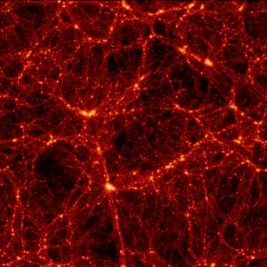
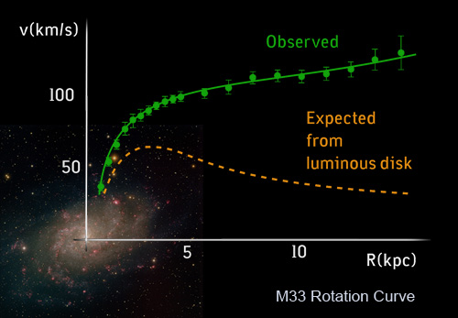
Dark Matter Problem
Dark Energy
(68%)
Dark Matter
(27%)
Ordinary matter
(5%)
Planck 2013 results
The universe needs the cold dark matter to construct the current structure.
Galaxy are constructed in Dark matter halo because dark matter has unevenness.
This unevenness reflect CMB
⇒ Dark matter density from WMAP observation
- Velocity curve of galaxy indicates the existence of dark matter in local scale.

Slide 3
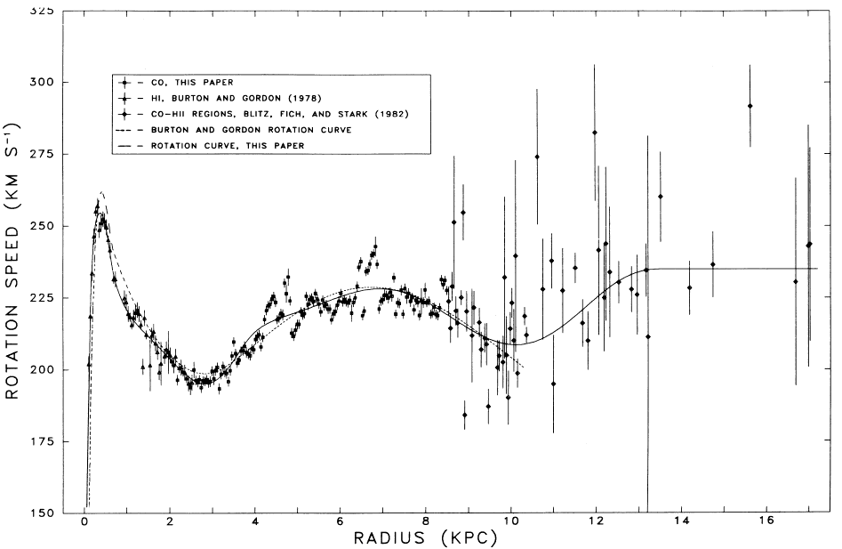
Existence of dark matter around solar system
Rotation Velocity Curve of Milky way Galaxy
Local Dark matter
- density : 0.3-0.5 GeV/cm³
10000/cm2/sec flux @ earth (DM mass ~ 100GeV/c²)
velocity distribution
⇒ Maxwellian ??
(astrophysical parameter)
solar system
only visible
Astrophys. J. 295: 422-436, 1985
High accuracy measurement by VERA (2012)
~ 240 +- 14 km/sec

Slide 4
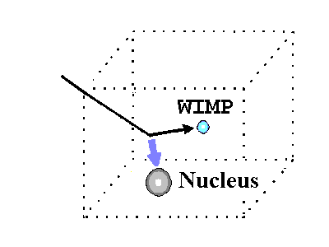
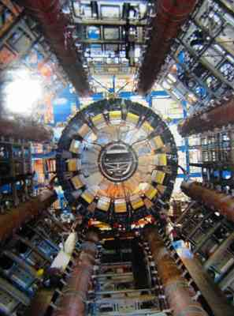
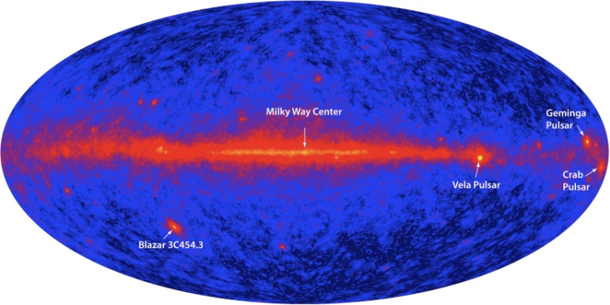
Direct Detection
χ
χ
q
q
Indirect Detection
Accelerator Detection
χ
γ, ν, lepton
χ
q
χ
γ, ν, lepton
q
χ

Slide 5
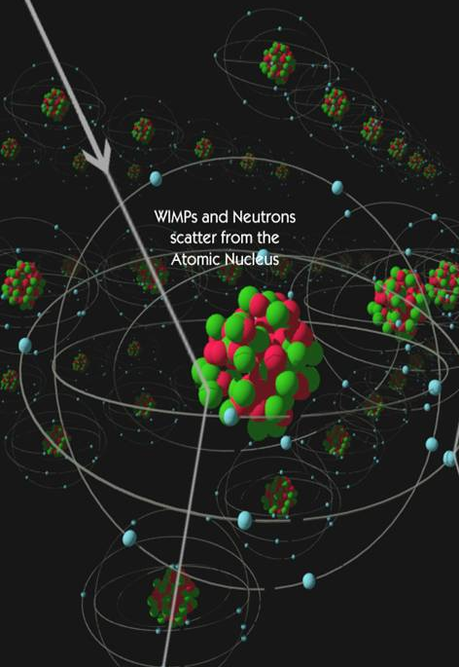
Direct Dark Matter Search
Dark Matter velocity ~ 100 km/sec order
( limited by escape velocity of Milkyway galaxy)
de Broglie wavelength scale
λ =h/p ~ 10 fm
Nucleus scale!
We should detect the nuclear recoil induced by dark matter
Recoil energy scale < ~ 100 keV order
Dark matter signals

Slide 6
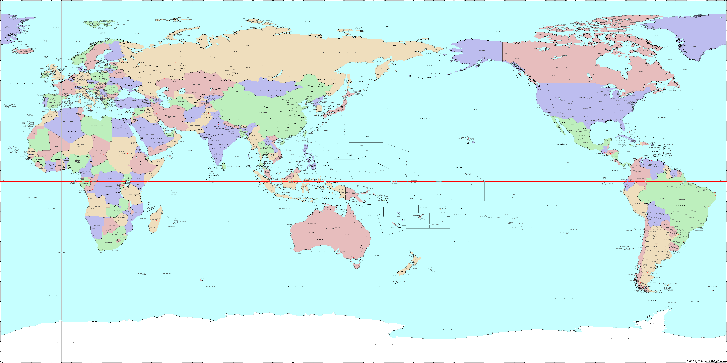
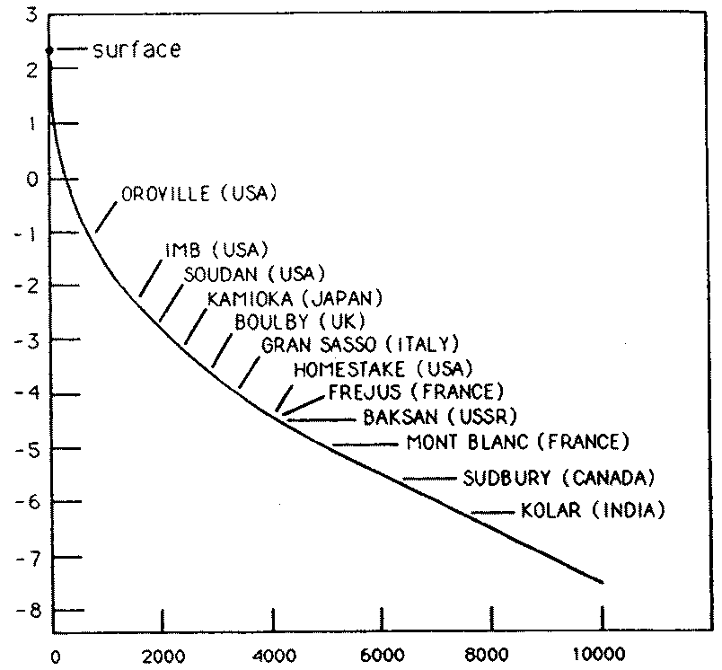
DRIFT
ZEPPLIN
EDELWEISS
MIMAC
XMASS
NEWAGE
CDMS
CoGeNT
COUPP
DM-TPC
DAMA/LIBRA
XENON
CRESST
DarkSIDE
DM-ICE
Log₁₀(muon flux) [/m²/sec]
Dark Matter Experiment s
all of the world
Depth [m. w.e.]

Slide 7
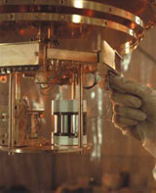
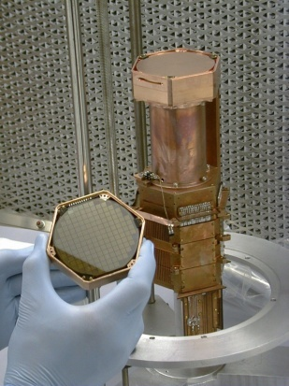
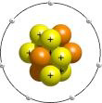
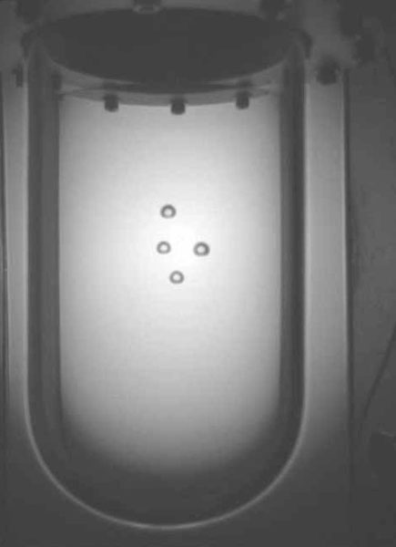
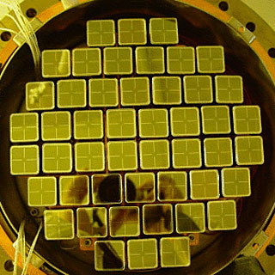
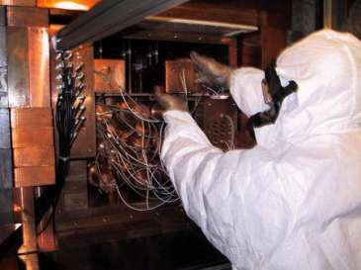
Direct Dark Matter Search
Target : Xe, Ge, Si, NaI, Ar etc
phonon
CRESST
CDMS, EDELWEISS
light
ionization
COUPP
XENON, WArP, ZEPELIN
XMASS, DAMA, KIMs

Slide 8
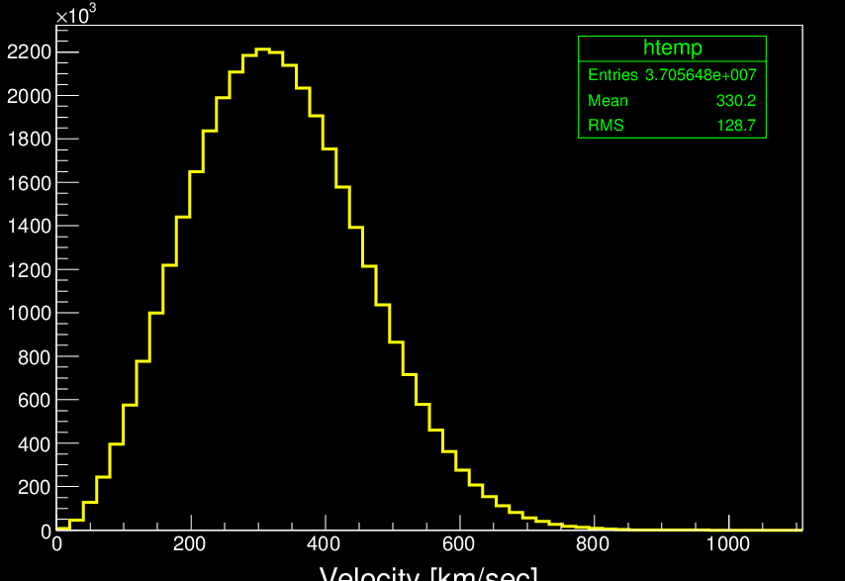
Evidence of dark matter for the status experiments
Current Method of dark matter identification
30 km/sec
earth@summer
DM
@ earth
Direction of solar system
(230km/sec)
Example)
Sun
Event rate [/kg/kev/day]
few %
30 km/sec
WIMP mass 100GeV
Maxwell velocity distribution
earth@winter
Relative velocity of earth to dark matter is variable by revolution around sun
Annual modulation
Notes:
赤道儀でやる。→方向の偏りとして見える。

Slide 9
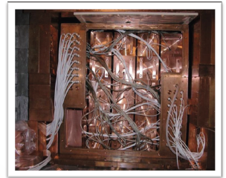
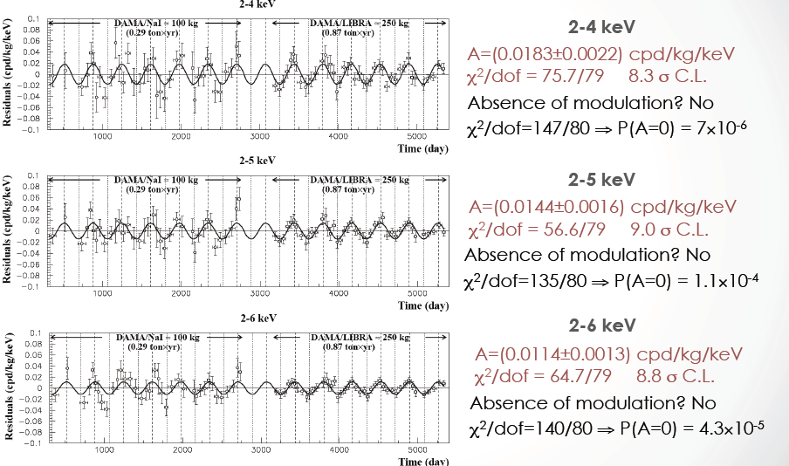
DAMA/LIBRA
250 kg pure NaI
(²³²Th, ²³⁸U and ⁴⁰K at level of 10⁻¹² g/g)
Gran Sasso @ Italy
DAMA/NaI 7 year + DAMA/LIBRA 6 years
Total exposure : 1.17 ton x years
Multiple hit (neutron events ) analysis
⇒ no annual modulation
Phase check of muon modulation (compare with LVD, Borexino and MACRO)
⇒ 5.7 σ far from LVD, BREXINO
(7.1 σ from MACRO)

Slide 10
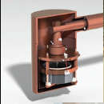
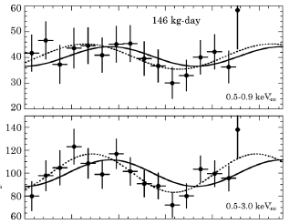
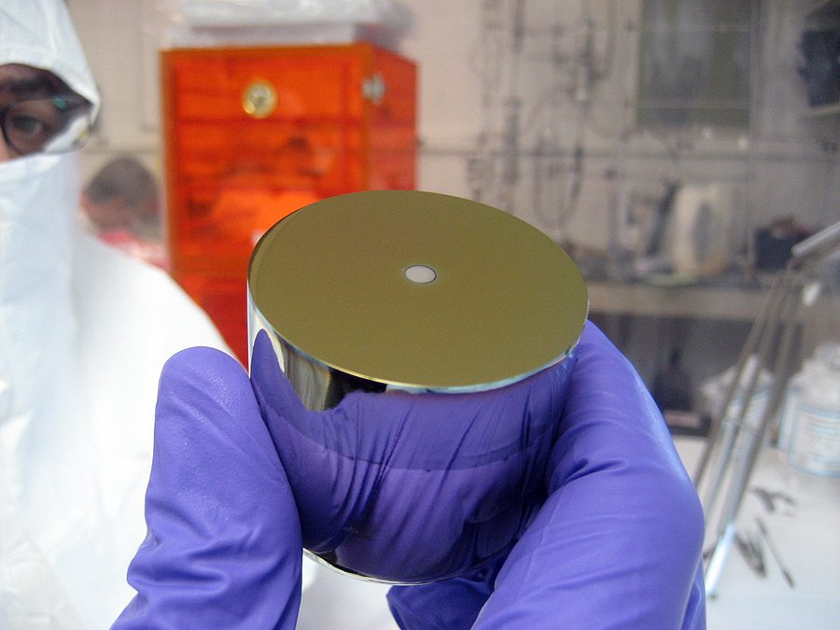
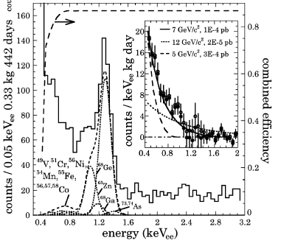
CoGeNT experiment
Phys. Rev. Lett. 107, 141301 (2011)
Counts/ 30 days
P-type point Ge detector
Dotted line : best fit
Solid line : 7 GeV/c2 WIMP + Maxwellian
Soudan mine @ USA
146 kg・days exposure
Energy threshold > 0.4 keVee (~1 keVr)
2.8 σ annual modulation
detector mass :

Slide 11
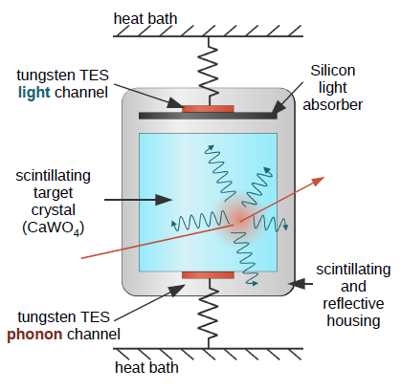
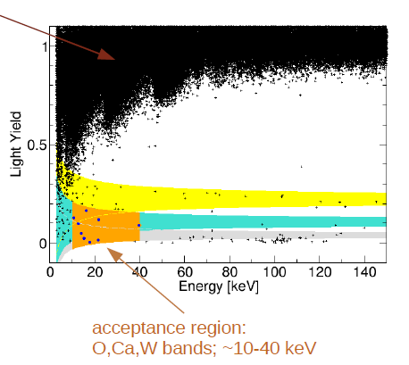
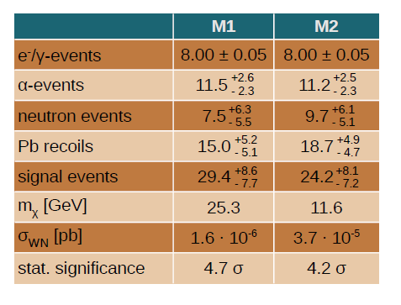
CRESST-Ⅱ
Detector : 300g CaWO4
Total maas : 10 kg
Place : Gran Sasso, Italy
Exposure : 730 kg・days
Eur. Phys. J C(2012) 72-1971; arXiv: 1109.0702

Slide 12
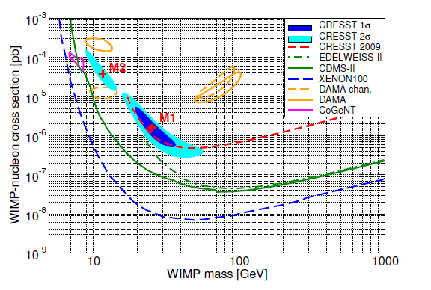
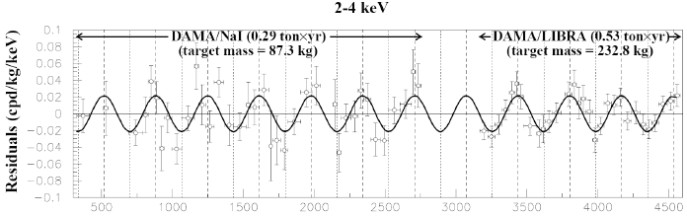
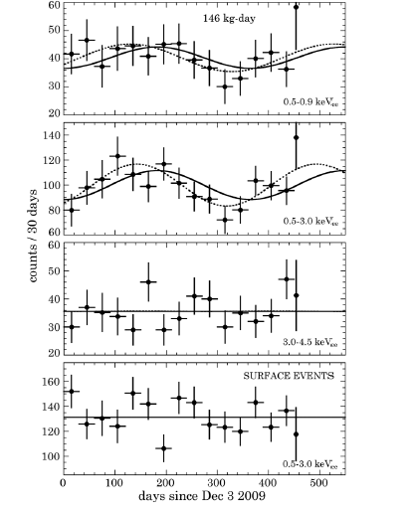
Status cross section limit
DAMA/LIBRA [ NaI, 8.9σ annual modulation]
CoGent [Ge, 2.86σ Ann. Mod.]

Slide 13
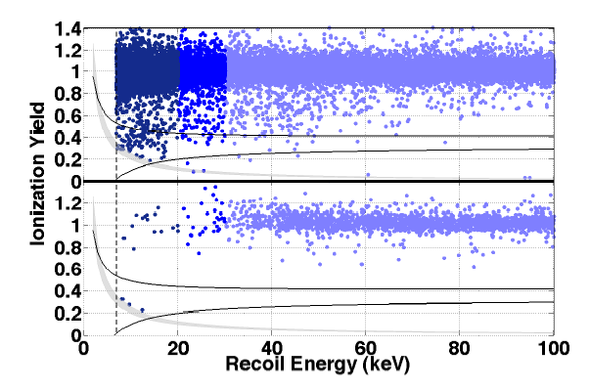
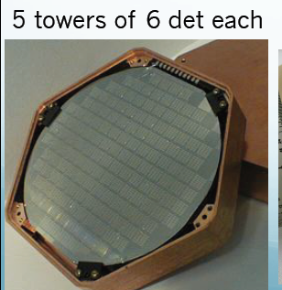
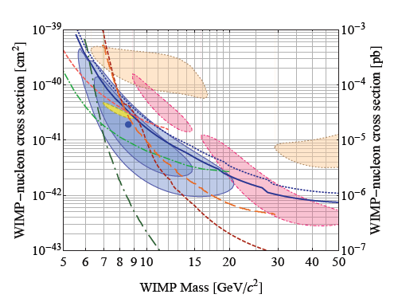
CDMS-Ⅱ
Ionization energy
Phonon energy
Si detector analysis
- 140.2 kg・days exposure
Expected total BG : 0.7
・Probablity would produce three
or more ⇒ 5.4 %
・Likelihood-Analysis ⇒ 0.19 %
arXiv:1304.4279v2 [hep-ex] 4 May 2013

Slide 14
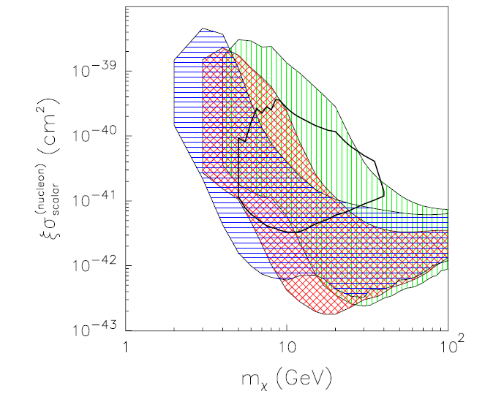
Phenomenology of positive result
DAMA and CoGenT have the consistency depending on models.
PRD 84(2011) 055014
Distribution Function
Isothermal
Jaffe distribution
Triaxial distribution
[Color region -> DAMA region ]
Green : without the channeling effect
Blue : include the channeling effect
Red : without the channeling effect + energy dependence of Na and I quenching factor.
These results have consistency if astrophysical uncertainty and uncertainty of detector response are considered.

Slide 15
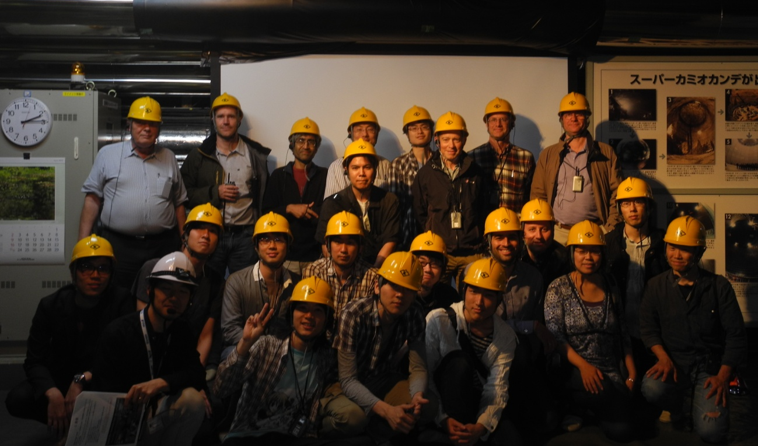

CYGNUS2013
Workshop on Directional Detection of Dark Matter
アクセス・お問い合わせ
内部専用
サイトマップ
RSS
10-12 June, 2013 @ Toyama, Japan
Directional dark matter search project
DRIFT , Newage, DM-TPC, MIMAC, Emulsion and D3
Sponsor
Notes:
Sort from the oldest groups

Slide 16
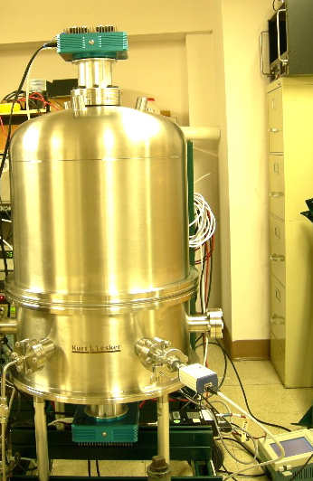
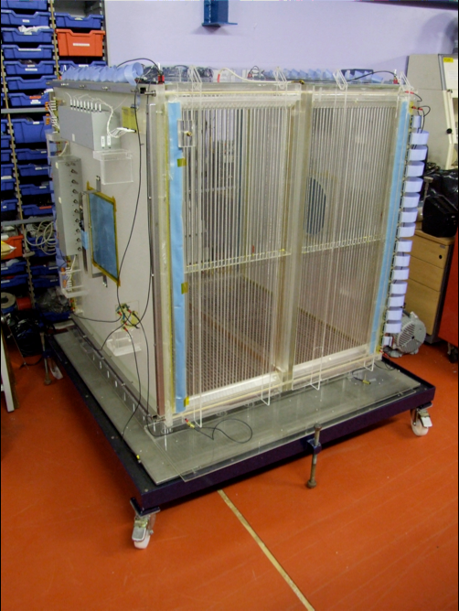
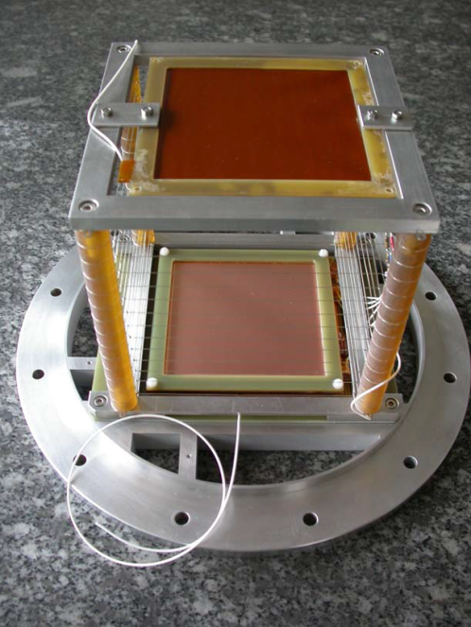
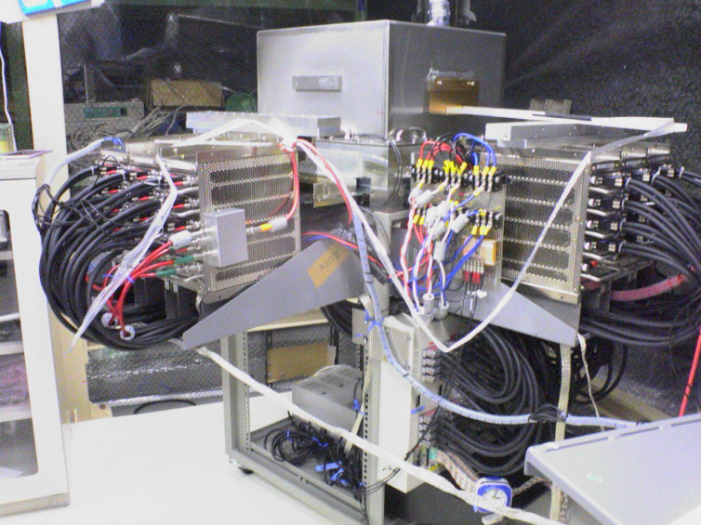


Directional Dark Matter Search
Number of group : 5 groups
(4 groups are using the gaseous detector)
Target: CF₄, CF₄+CS₂, CF₄ + CHF₃
⇒sensitive to spin-dependent interaction
DRIFT @ UK
DM-TPC@ USA
Ex. DAMA region search with F target
cm²
cm²
cm²
cm²
They need larger scale (exposure) of 2 – 3 order to search the SI interaction region.
NEWAGE@ Japan
MIMAC@ France

Slide 17
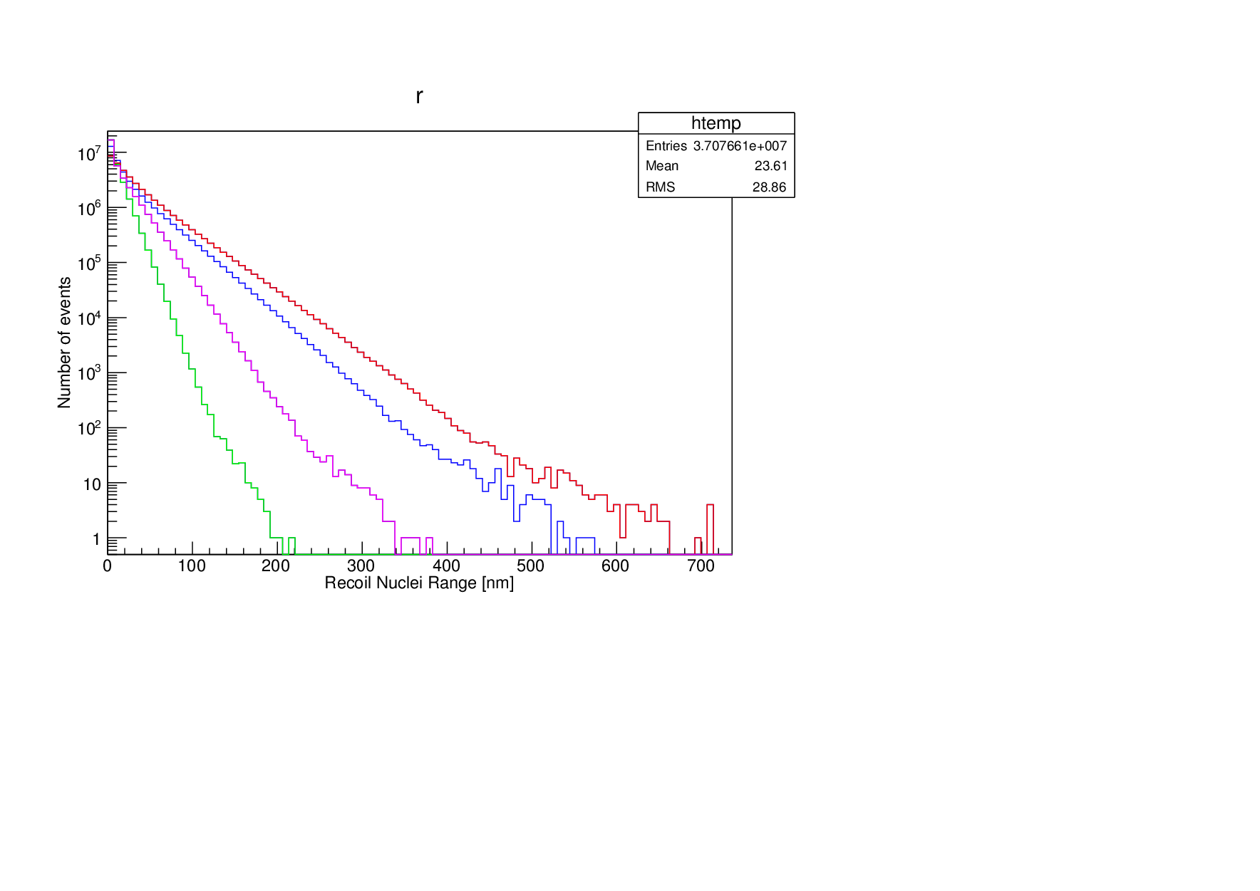
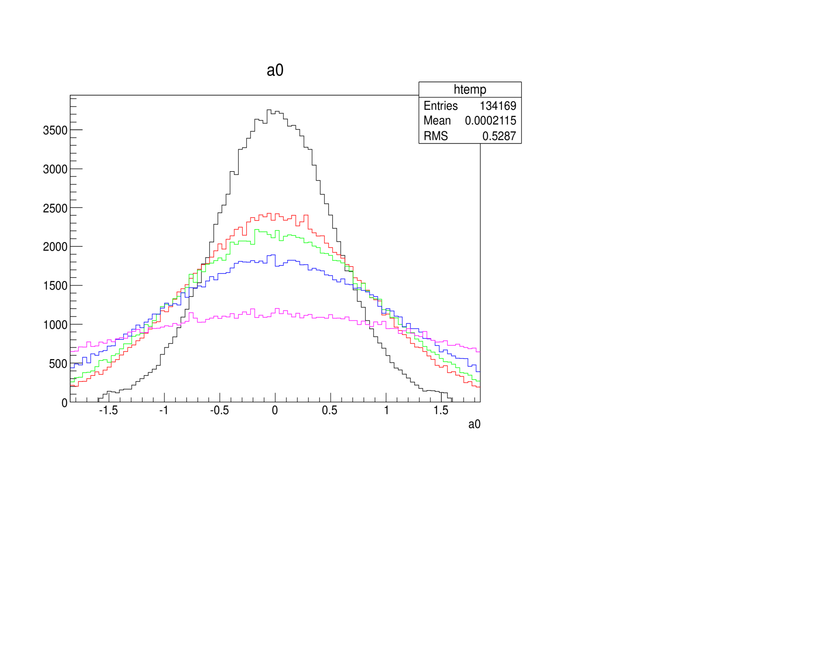
Directional Dark Matter Search with Nuclear Emulsion
earth@summer
Target nuclei
DM
Direction of solar system
(230km/sec)
Dark matter
wind
DM
Direction sensitive Detector
earth@winter
Detection of recoiled nuclei as tracks
― : 100 GeV/c²
― : 50 GeV/c²
― : 20 GeV/c²
― : 10 GeV/c²
Rth > 100 nm
(all targets )
DM mass : 20 GeV/c²
Δθ=0 °
Δθ=0 °
Δθ=20 °
Δθ=30 °
Δθ=45 °
20 GeV/c²
50 GeV/c²
100 GeV/c²
Δθ=90 °
10 GeV/c²
Track length [nm]
2D angle [rad.]
Solar system direction

Slide 18
Collaborator and Technical Supporter
Nagoya University
T. Naka (Organizer of Japan and all)
T. Asada ( R&D of fine-grained emulsion )
T. Katsuragawa ( Readout system)
M. Yoshimoto (Optical Readout Stage)
K. Hakamata (Development treatment)
M. Ishikawa (Plasmon analysis study)
K. Kuwabara (R&D of emulsion)
A. Umemoto (Plasmon analysis)
S. Furuya (detector R&D)
S. Machii (optical microscpe )
Nagoya University [ X-ray Astronomy]
Y. Tawara (X-ray microscope)
University of Napoli
G. de Lellis (Organizer of Europe)
A. Di Crescenzo (DM simulation)
A. Sheshukov (Emulsion simulation)
A. Aleksandrov (Optical stage study)
V. Tioukov (tracking algorithm)
University of Padova
C. Sirignano ( LNGS activity)
LNGS
N. D’Ambrossio
(Optical microscope study in LNGS)
N. Di Marco (simulation, background)
F. Pupilli (background measurement)
Chiba University
K. Kuge (emulsion and development study)
Fuji Film researcher
T. Tani (Emulsion and phenomenology)
K. Ozeki (Emulsion and phenomenology)
S. Takada (the emulsion sensitivity)
SPring8
Y. Suzuki, A. Takeuchi, K. Uesugi and Y. Terada

Slide 19
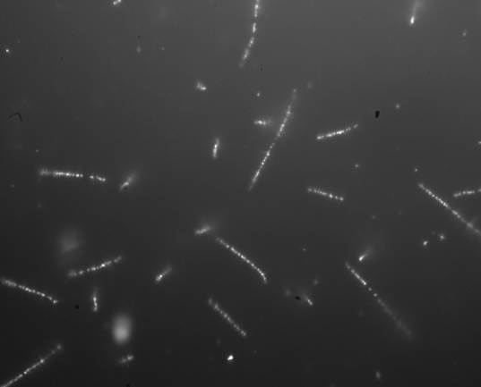
Nuclear Emulsion Detector
Polymer (C, (N,O))
Epi-illuminated dark field optics image
Charged Particle
Silver halide crystal
(AgBr)
50 µm
Development treatment
3D tracking detector
solid state detector (3-4 g/cm³)
high spatial resolution
very stable to increasing in size
Silver grains

Slide 20
Advantage of emulsions
Nuclear Emulsion
Gaseous detector
Current directional detector
(e.g. gaseous TPC, MWPC )
e-
e-
e-
e-
e-
e-
e-
e-
readout
Ionized electrons closed in the crystal
⇒ diffusion problems are nothing .
Diffusion problem
⇒ limitation of angular resolution
and energy threshold
⇒ limitation of scale
Scalability of emulsion is by far the best.

Slide 21
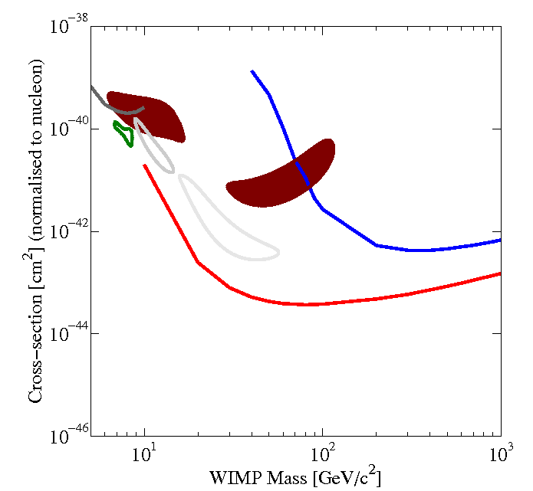

Ideal Sensitivity for SI interaction with emulsion detector
Emulsion 25kg・y, 90% C.L., Track length > 100nm
Preliminary
Only Ag, Br recoil
Including C,N,O recoil
Directionality is not taken into account!

Slide 22
Homework from referee of LNGS
[one year milestone]
A refereeing committee was appointed by INFN
Asses the intrinsic background and make sure that it is not an issue. Otherwise, optimise the production process.
Show the directionality measurement on neutrons, never done by other experiments. Important measurement in general for all experiments in LNHS.
Make tests on lowering the threshold for the track
length. Show stable results with a significant statistics.
Proposal to apply as LNGS (INFN) official group

Slide 23
R&D status

Slide 24
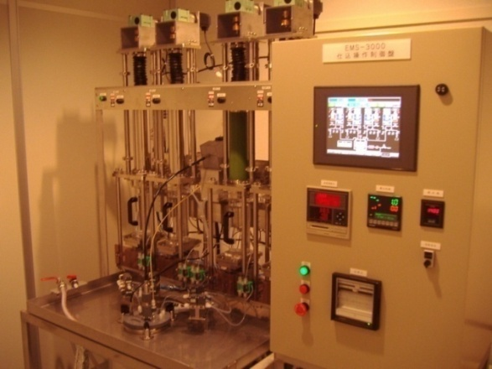
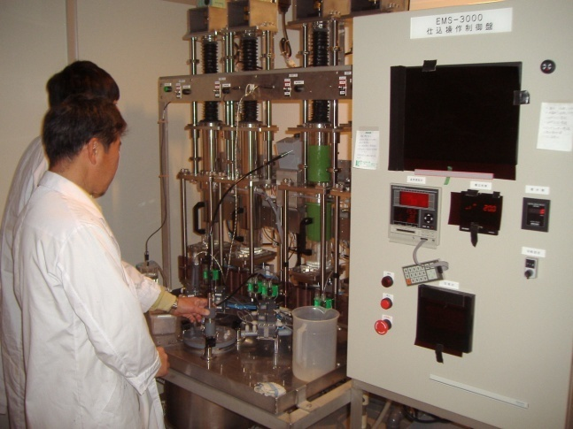
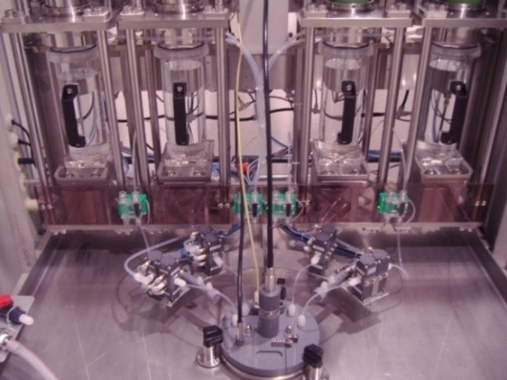
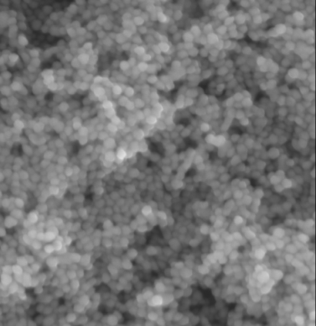
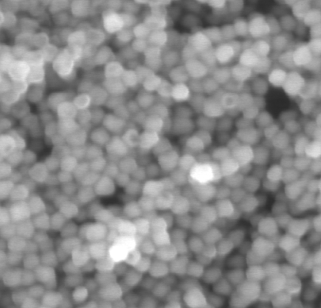
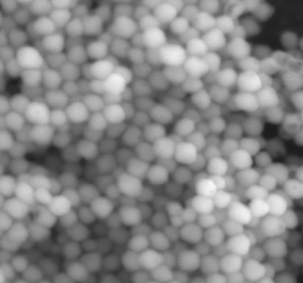
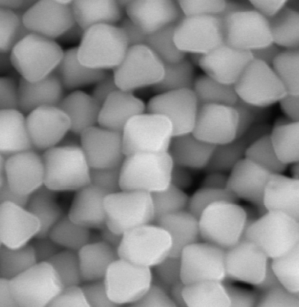
Emulsion Production Facility
Crystal size control (i.e. spatial resolution control)
Sensitivity control (i.e. tuning of S/N ratio)
35nm crystal
70nm crystal
100nm crystal
200nm crystal
500nm
size
~200g emulsion detector /days ⇒ ~1 kg emulsion detector/week
( 1 kg detector ~ 15万Yen )

Slide 25
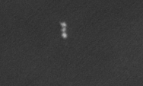
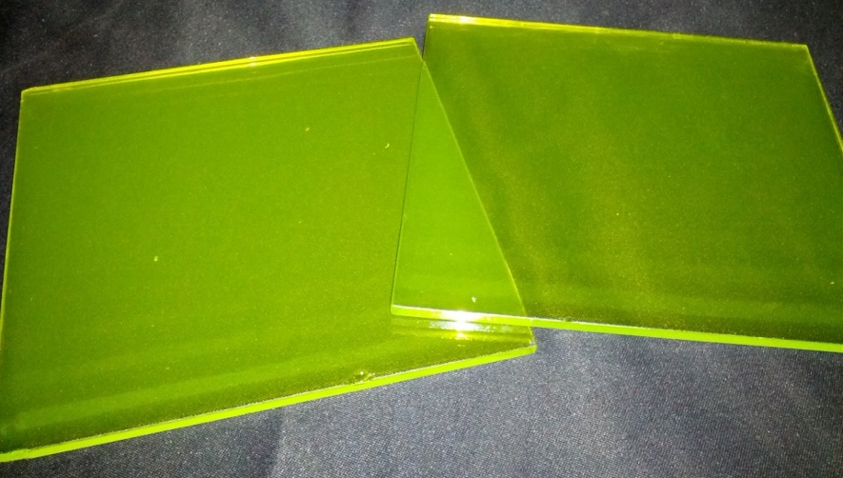


Emulsion Dark Matter Search
Kr 200keV
200nm
Emulsion detector for dark matter search
[Current Detector density : 3.2 g/cm³]
Scanning Electron Microscope
Kr 400keV
500nm
100 nm detectable
Range distribution [nm]

Slide 26


Current Fine-grain detector
NIT
U-NIT
Current R&D emulsion
Finest grain emulsion
Mean : 44.6 +- 0.4 [nm]
Sigma : 6.1 +- 0. 3 [nm]
Mean : 18.0 +- 0.2 [nm]
sigma: 4.9 +- 0.2 [nm]
Crystal diameter [nm]
Crystal diameter [nm]
Current R&D emulsion
Further detector for physics run
 | NIT | U-NIT
AgBr density | 12 AgBr/µm | 29 AgBr/µm
Detectable range | > 200 nm@ C | > 100 nm@C
Tracking E threshold | > 80 keV@C | > 35-40 keV@C

Slide 27

Background rejection concept
Target nuclei to DM : C, N, O
→ Total dE/dx > ~100 keV/µm
Carbon Total
Main background :
intrinsic radio isotope (e.g. C-14, Th・U families etc.
→ γ・β backgrounds
Carbon (NSP)
Carbon (ESP)
electron
Making the threshold for the dE/dx

Slide 28


Our goal
To make the emulsion insensitive to electrons
DM
DM
Sensitivity
Sensitivity
BG
BG
dE/dx of particle
dE/dx of particle
old type
new type
Am-241 γ-rays exposure
~ 60 µm
~ 60 µm

Slide 29
Readout Method

Slide 30
Readout concept
Optical microscope readout
Candidate selection
Spatial resolution ~ 250 nm
✓Candidate signal selection in large volume detector.
✓High speed selection.
Higher resolution microscope technology
Upgraded optical microscope
⇒ ⊿x~ 190 nm
X-rays microscope
⇒ ⊿x~ 60-70 nm
Plasmon analysis
Fluorescence
⇒ ⊿x~ 40-50 nm
⇒ confirmed principly
Confirmation
⇒ almost ready
⇒ under studying
⇒ new idea

Slide 31
Readout concept
Optical microscope readout
Candidate selection
Spatial resolution ~ 250 nm
✓Candidate signal selection in large volume detector.
✓High speed selection.
Higher resolution microscope technology
Upgraded optical microscope
⇒ ⊿x~ 190 nm
X-rays microscope
⇒ ⊿x~ 60-70 nm
Plasmon analysis
Fluorescence
⇒ ⊿x~ 40-50 nm
⇒ confirmed principly
Confirmation
⇒ almost ready
⇒ under studying
⇒ new idea

Slide 32


Prototype of readout system
Nagoya University (Japan)
University of Napoli (Italy)
LNGS (Italy)

Slide 33



PTS system
Prototype DM scanning machine for R&D
This type
Epi-illuminated optics
⇒ High contrast
Usual type
Transmission optics
⇒ Low contrast
Status Condition
Camera : DALSA 1M120
Lens NA : 1.25
Magnification : x100

Slide 34


Limitation of recognition of track with optical microscope
NA : 1.25, Wavelength : 500 nm
[ optical resolution : 244 nm]
200 nm
We can discriminate the direction until 200 nm by usual optical microscope condition.
200 nm length 2grains track
The candidate selection using shape analysis is essential method.

Slide 35


Slide 36
Event images of each focus
Mean brightness
58.6
68.5
87.0
Best Focus
30pix
1pix=57nm
101.9
116.3
109.3
Step of layer taking
0.2μm
77.7
64.7
57.0

Slide 37

3D information of signal
Neutron
Output parameter
Brghtness
3D position infromation
Major length
minor length
elipticity etc.

Slide 38


Angular resolution for optical readout
Angular resolution is better than about 25 deg. for 80 keV C recoil tracks.
Low velocity ion created by an ion-implantation system
[Crystal size : 44.6 +- 0.4 nm]
Angular distribution of 100 keV C ion
― : data
― : MC simulation
Preliminary
2D angle [rad.]

Slide 39
Readout concept
Optical microscope readout
Candidate selection
Spatial resolution ~ 250 nm
✓Candidate signal selection in large volume detector.
✓High speed selection.
Higher resolution microscope technology
Upgraded optical microscope
⇒ ⊿x~ 190 nm
X-rays microscope
⇒ ⊿x~ 60-70 nm
Plasmon analysis
Fluorescence
⇒ ⊿x~ 40-50 nm
⇒ confirmed principly
Confirmation
⇒ almost ready
⇒ under studying
⇒ new idea

Slide 40



Confirmation by X-ray microscope
SPring-8 @ Japan
-Thickness of film : 100µm
-Focal depth : 70µm
-Type of optics: phase contrast
-X-ray Energy : 8keV
8keV X-ray
It is possible to analysis of
1000 events /day .
Zone plate
Zernike phase plate
System is almost ready for realistic dark matter search.

Slide 41



Ta 100 nm thickness pertarn
on SiN membrane (2µm)
BL47XU
70 nm line/70 nm space
80 nm line/80 nm space
90 nm line/90 nm space
100 nm line/100 nm space
SPring-8 BL47XU
120 nm line/120 nm space
140 nm line/140 nm space
Phase Plate : Zernike phase plate ( π/4λ shift)
X-ray energy : 6 or 8 keV (⊿E/E = 10⁻⁴)
Spatial resolution < 70 nm
(theoretical resolution = 62 nm )
Notes:
Ta 8 keV, δ = 4.0E-5, β = 3.7E-6
[c.f. Ag 8 keV, δ = 3.0E-5, β = 2.7E-6]
Camera : CMOS (HAMAMATSU) 2048(H) x 2048(V)
6.5 µm(H) x 6.5 µm(V) cell size

Slide 42


Concept of readout tracks
Optical Readout
Automatic selection of candidate signals by optical microscopy.
Record of Position information for the events passed the signal selection filter.
Affine transformation using mask pattern
X-ray Readout
Pin-point check of candidate signals selected by optical readout.
Confirmation of signal!

Slide 43


Neutron Source
[Advanced Industrial Science And Technology, Tsukuba, Japan]
14.8MeV neutron source by nuclear fission
²D + ³T →⁴He + n
14.8MeV neutron

Slide 44
Neutron (14 MeV) recoil track under optical microscopy
632 nm
337 nm
308 nm
217 nm
592 nm
392 nm
Almost Br recoil (170 - 600keV) because of low sensitivity tuning.

Slide 45








Maching of recoiled tracks between Optical and X-ray microscope
Optical microscope
486nm
X-ray microscope
236nm
330nm
600nm
Success rate of matching
572/579=99%

Slide 46


Signal Selection
Optical readout results of events confirmed as tracks and noise by X-ray microscopy analysis.
Major
signal region
Minor
θ
Major length[pix]
θ
Major(pixel)
Red: tracks
Blue: Noise
Cos (2D angle)
minor length[pix]

Slide 47


Detectable range
Detectable range
Ellipticity
Detectable range
Visible track length [nm]
Energy of 200 nm
Ag : 450 keV
Br : 325 keV
CNO : 70 keV
Notes:
Detector resolutionを有効に検出できている。

Slide 48



Upgraded readout technology
Upgrade optical microscope
⇒ upgraded optics (objective lens and wavelength)
Ex. Elipticity cut value 1.2 → ~ 1.5 @ 200nm tracks
2. Plasmon analysis
⇒ non-linearity optical response
Selection of dE/dx from scattering light
3. Fluorescence analysis
Super resolution microscopy
⇒ expected resolution ~ 50 nm !!

Slide 49

Activity in Gran Sasso National Laboratory (LNGS)

Slide 50


1st DM collaboration meeting @ LNGS
Collaboration
Nagoya, Napoli, LNGS, Padova, (Dubuna), (Moscow)
Sensitivity simulation
Intrinsic backgrounds
neutron study
R&D of emulsion and development
Readout technology

Slide 51





R&D underground facility in Gran Sasso
Gran Sasso (LNGS), Italy
2nd Floor: Detector Production
1st Floor : Development Facility

Slide 52



Underground activity
Environment Measurement
Underground Activity
Neutron measurement in underground and surface lab.
Underground Rn measurement
Practice of emulsion pouring and development
Rn (～50 Bq/m³)

Slide 53




Intrinsic background measurement
Mass spectroscopy
e.g. U, Th, Pb , K
We already started the measurement of materials for the emulsion detector .
AgBr・I sample
Gelatin sample
ICP-MS (Inductively Coupled Plasma mass spectrometer)
Gamma-rays spectroscopy due to very-low
radio activity
U-238, Th-228, Th-232, K-40, Ra-226, 214-Pb
This is currently in progress.
High purity Ge spectroscopy
Notes:
10-100 mBq/kg or ppb- ppt level (Borexino paper)

Slide 54

Underground Neutron
Neutron flux in LNGS
Neutron Flux in underground of LNGS
< 1E-6 /cm²/sec
(the flux in outside is about 1E-3 /cm²/sec)
Neutrons won’t be background until kg scale for the emulsion detector without
neutron shield.
Dominant source of underground neutron is (α, n) reaction in the rock, rather than neutrons induced by cosmic ray muons.
8 % water content
16 % water content
Measurement
MC simulation
 | Flat spctr. | Flat + Watt | Hall A, dry | Hall A, wet | Hall C, dry
Total flux (x 10⁻⁶ /cm²/sec) | 3.78+-0.25 | 3.81+-0.11 | 3.75+-0.67 | 1.67+-0.29 | 2.26+-0.49
Flux (> 1 MeV) | 0.70+-0.14 | 0.60+-0.07 | 0.58+-0.13 | 0.33+-0.07 | 0.45+-0.13
H. Wulandari et al./ Astro. Phys. 22 (2004) 313-322
Notes:
Watt spectrum : The spectrum model of the emitted neutron due to spontaneous fission (N(E)=Cexp(-E/a)sinh(bE)^0.5
⇒ Los Alamos model
Flat : neutron energy spectrum of flat in chosen energy interval
Flat + Watt : flat in thermal and epithermal eenrgy and other range follow the Watt spectrum

Slide 55
Summery
DAMA, CoGeNT and CRESST claim the positive results.
DAMA observed clear annual modulation. However, some groups exclude their results.
Directional Dark Matter search is very important to defeat the situation.
High resolution become directional dark matter detector.
Now, nuclear emulsion can be produced in house.
By optical and X-ray microscope system, submicron length tracks are read out.
We aim the search of DAMA and other positive result region with less than 100kg detector.
We are constructing the R&D facility at LNGS. Here, we started the background study.

Slide 56
Near Future Planning
2013
2014
2015
2016
R&D in LNGS and outside
R&D in LNGS and physics run of phase.1
R&D in Lab
Detector study
R&D of sensitivity control
and development treatment
~g scale run ⇒BG run
R&D for improvement of quality
10- 100 g scale detector
Equatrial telescope study
BG rejection study
Optical readout system
Readout system upgrade
⇒resolution, speed and
new Information
⇒ neutron demonstration
~ g scale analysis
High speed system
BG rejection from optical response
10-100 g scale analysis
High speed system and high background discrimination
Background study
Understanding of Intrinsic background
and gamma sensitivity
BG run and intrinsic BG study
Understanding of BG
BG run and intrinsic BG study
Understanding of BG
Facility and Run
Construction of R&D facility at Gran Sasso
Construction of BG shield
Environment system
DAMA 100GeV region
~ g scale run
10 – 100 g scale run

Slide 57
Backup

Slide 58


Slide 59


Slide 60


Slide 61


New Beam Line:BL37XU
CMOS Imaging
~ 25 m
拡大X線光学系
High resolution
(いままでは、撮像系の分解能でリミットされていたたため)
- High Contrast
2012B 一般課題(代表 :中) でスタディ中

Slide 62


Slide 63

Emulsion Production
OPERA film has no ability to detect the DM because it has
poor spatial resolution for this motivation .
We have to produce the emulsion by ourselves.
Naka
Naganawa
Kuwabara
- We can produce the emulsion more freely and flexible.
- We can test the various idea.

Slide 64

Signal Selection by Optical microscope system
signal region
現状、楕円フィッティングをベースにしたシンプルなセレクション
Major
Major length[pix]
楕円率とサイズを飛跡認識のパラメター
Minor
Red: tracks
Blue: Noise
minor length[pix]
θ
Readout efficiency
Visible Track length [nm]
短波長解析、高分解能カメラ&レンズ、精密形状認識により、より選別能力を上げる。
Cos (2D angle)

Slide 65


Fine Crystal Emulsion production with PVA
only gelatin type crystal size
Fine crystal only with gelatin is succeeded, but the size isn’t stable.
We try new method to product with polyvinyl alcohol (PVA) , which strongly covers crystals surface and suppresses their growing.
Production with PVA solution make crystals size very stable.
We could start studying about crystal sensitivity.
solution
only Gelatin
↓
Gelatin & PVA
Silver halide crystal size [nm]
PVA mixed type crystal size
Silver halide crystal size [nm]
Notes:
We succeeded to make very fine crystal emulsion. (we report it at SYGNUS 2011)
But its crystal size isn’t stable to modify crystals.
Thanks to this PVA mixing method, we could try modify crystals themselves.

Slide 66
He and C ion dE/dx
He ion (alpha-ray)
C ion (alpha-ray)
Alpha-decay region
C recoil region

Slide 67


Prototype detector
Measured by TEM
51.9 +- 6.5 nm
It’s not minimum sizes because sensitivity is required for C(N,O) recoil detection.
(We don’t find the best sensitized treatment for 20 nm level crystals)
Density = 3.2 g/cm³
- Ion implantation check
OPERA developer [3min]
Manual check
-> select the elliptical shape events
However, we recognized the C ion signals as tracks!!
Very Preliminary!!
We can rise the sensitivity by using chemical sensitization.
Next Step : sensitivity control by chemical sensitization.

Slide 68
Predicted Backgrounds
1. Gamma, beta backgrounds
Isotope | Event rate [/kg/day] | Beta energy [keV]
C-14 | 5.5 x 10⁶ | 156
K-40 | 1.4 x 10⁶ | 1300
Th-238 | 1.8 x 10⁴ | 569, 2250
We aim 1E-9~10 rejection power
Gamma –ray flux from outside : ~ 10⁸ [/kg/day] (flux : 0.51/cm2/sec)
2. Neutron backgrounds
Neutron flux in LNGS : < 1E-6/cm2/sec
It has no contribution as backgrounds until kg scale with non-shield condition
Reference data :
F. Arneodo et al., Il Nuovo Cim. 112A (1999) 819.
P. Belli et al., Il Nuovo Cim. 101A (1989) 959.
3. Fog backgrounds (2 grains chance coincidence)
We aim 3 grains threshold → 5-6 order rejection !!

Slide 69

γ・β–rays Background rejection method
Geant4 simulation
γ 59keV
Proton 1 MeV
Alpha 5 MeV ～ C recoil
High sensitivity emulsion tend to detect the other background signal,
however energy losses are quite different.
dE/dx [keV/µm/step]
Difference of dE/dx for each particle should be reflected in signal (developed silver grains).
dE/dx [keV/µm/step]

Slide 70

Temporary test of development speed control for alpha and beta with PMT presoak
Development Study
By adsorption of PMT on the surface of crystal, development speed is controlled (suppressed).
PMT
(1-Phenyl-5-mercapto-1H-tetrazole)
 | α Grain Density [grains/μm] | γ(β) Density [grains/(10μm)³] | Fog Density [grains/(10μm)³]
Treatment without PMT | 1.79±0.03 | 30±2 | 4.3±0.3
Treatment with PMT | 1.62±0.10 | 0.2±0.1 | 0.12±0.05
γ-rays : 2 x 10⁵/(0.1x0.1)um²/10min
Induced electron : ~60 e/(10um)³
S/N ration was improved !
Electron rejection power : > 3E-2
This is the evidence that the sizes of latent image specks are different for the value of dE/dx.
Now, we are search the best condition and best chemical (e.g., benzotoriazole)

Slide 71
R&D underground facility in Gran Sasso
Gran Sasso (LNGS), Italy
2nd Floor: Detector Production
1st Floor : Development Facility
Notes:
部屋は2階と1階に分かれている

Slide 72


Slide 73


Best focus automatic selection
Red : best focus layer
Blue : de-focus layer
Mean value of brightness
Definition of best focus
Z[micron]

Slide 74

Background Reduction
Change requirement for signal from 2 grain to 3grain
Range threshold become worse,
but chance coincidence of noise was
greatly reduced.
If noise density is 0.1 and
range threshold is 200nm,
we can do 1kg mass experiments
without background.
3grain
Plasmon Effect
Range ~ 100nm
Range~200nm
Noise Density (number/(10um)³ )
Silver grains of noise have another
generating mechanism from signal’s one.
We are studying Plasmon Effect, which
show non-liner behavior of signal grains.
It is expected to distinguish noise track
from signal.
It can reduce noise amount directly.
Notes:
We consider some way of background reduction.
One is Change requirement for signal, form 2 grain to 3 grain at least.
Of course twice range is required for detection, but chance coincidence of noise was
greatly reduced.

Slide 75
Reaction of WIMPs and target nuclei
For example, in the case of Neutralino (SUSY)
χ
χ
・Majorana particles
・spin ½
・neutral charge
χ
χ
H,h,Z⁰
q
q
q
q
Spin-dependent cross section
Spin-independent (scalar) cross section
SD
SI
Neutralino-nucleon coupling

Slide 76



Optical microscope
Microscope ：Nikon E600
Objective Lens：N.A.(numerical aperture) 1.40
Nikon Plan Apo 100x oil
Illumination：epi-illumination Hg Xe lamp
Wavelength：550nm(510~560nm),
440nm(400~500nm)
Camera：STC-CMB4MCL SENTECH
Microscope ：PTS (Nikon IM-3)
Objective Lens ：N.A. 1.25 Nikon Plan 100x oil
Illumination：epi-illumination Hg Xe lamp
Wavelength：550nm(510~560nm),
440nm(400~500nm)
Camera：1M120 DALSA

Slide 77
Optical no-linearity response
Ag nano grains in emulsion (irradiated 100keV carbon ion before development)
Microscope image taken by a color camera
We can see various colored Ag grains→Plasmon resonance
possible to apply the Plasmon resonance to Dark Matter search?

Slide 78


What is Plasmon resonance?
Plasmon is electron ensemble and Plasmon resonance is non-linear optical effect
Nano metallic grain has resonance wavelength in visible , so we can see colored reflections of grains
60nm Ag grain (after image processing)
85nm Ag grain (after image processing)
Reference
C. Sönnichsen et al., Phys. Rev. Lett., vol. 88, no. 7 (2002)
W. Gotschy et al., Opt. Lett., vol. 21, no. 15 (1996)
Resonance wavelength depends on the size of grain
The bigger the grain size ,the longer the resonance wavelength

Slide 79
Fluorescence analysis
分解能50 nmレベルの解析を行う

Slide 80


A certificate of merit of Novel Prize
(2002)
Our motivation
M. Koshiba
R. Davis Jr
Current DM search

Slide 81
Optical readout upgrade
- DALSA1M120 (cell size : 7.5 x 7.5 µm²) → SENTECH CMB4MCL ( cell size : 5.0 x 5.0 µm²)
- Wavelength for readout : 550 nm (green) → 450 nm (blue)
- Numerical Apperture : 1.25 → 1.40
100 nm track
125 nm track
150 nm track
175 nm track
200 nm track
Optical simulation
→ visibleなtrack lengthで150 nmまではselection可能。
→ 1.2倍のメカニカルな引き延ばしで、10 GeV/c2までの探索は、原理的に可能。
(技術的には、2倍までの引き延ばしは経験あり)
→さらなる解析手法で、noiseとの識別能力を向上させる。

Slide 82


