Slide 1
On recent detection of a gravitational wave from double neutron stars
Atsushi Nishizawa
(西澤 篤志)
Nov. 8, 2017 KMI topics

Slide 2
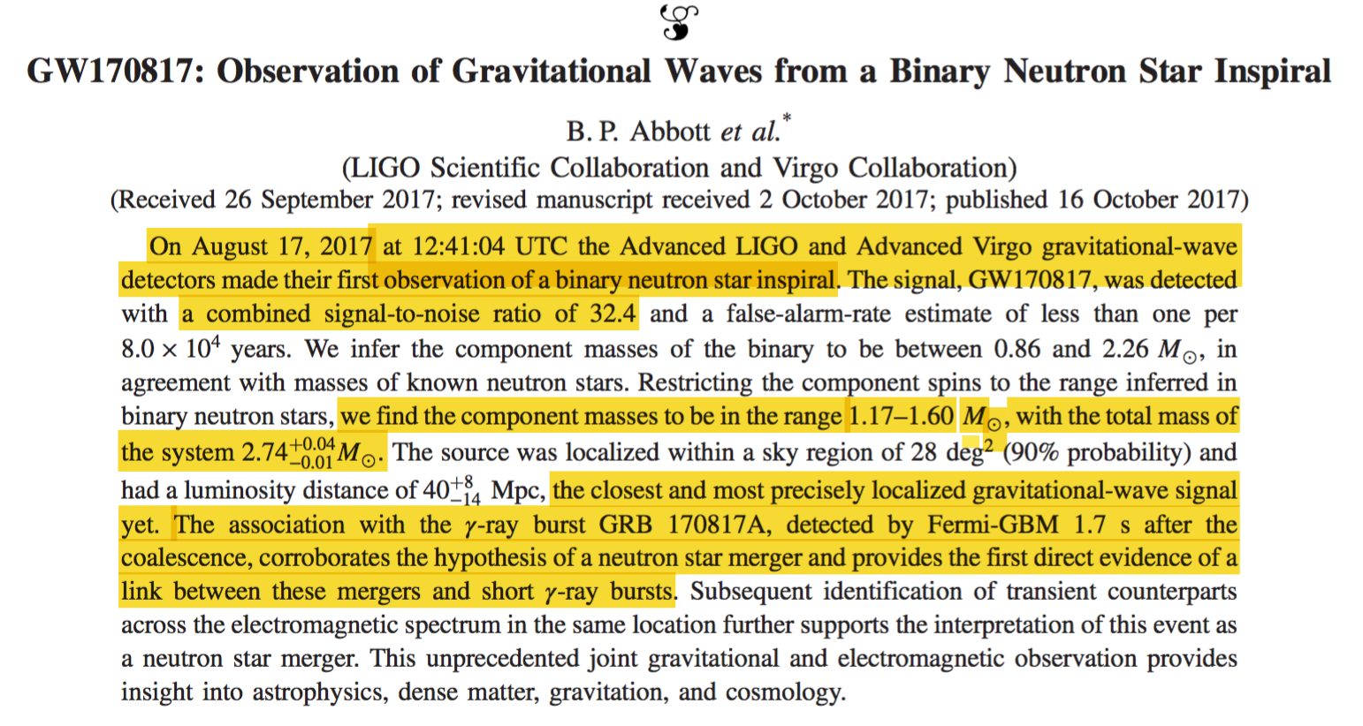
PRL 119, 161101 (2017)
Notes:
1

Slide 3

What is neutron star?
Neutron star is a very compact star supported by
degeneracy pressure of neutrons against gravity.
Radius is ~10 km for ~1.4 Msun.
Some of them emit radio pulses with
very stable period.
~15 binary neutron stars have been
found in our galaxy. But they are
far from merging (large orbital separation).
indirect evidence for the existence of GW has been
accumulated since 1975.
Notes:
2

Slide 4
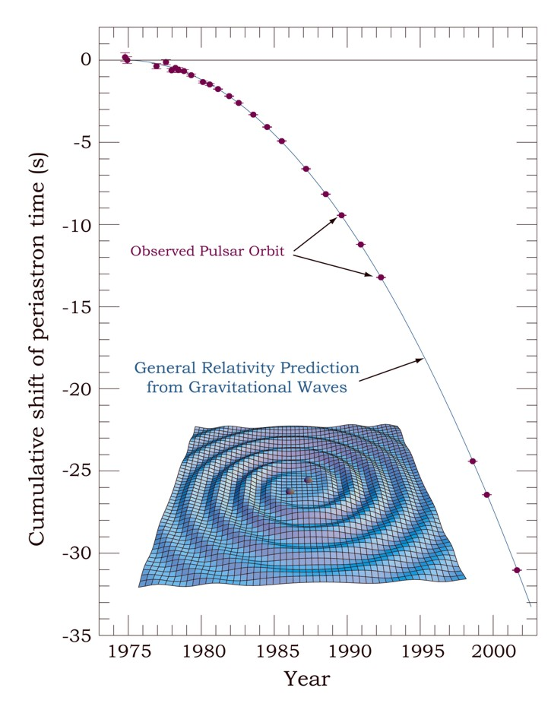
Hulse-Taylor binary pulsar
orbital period of the binary
gradually shortens.
GW should carry away energy.
existence of GW
Notes:
3

Slide 5
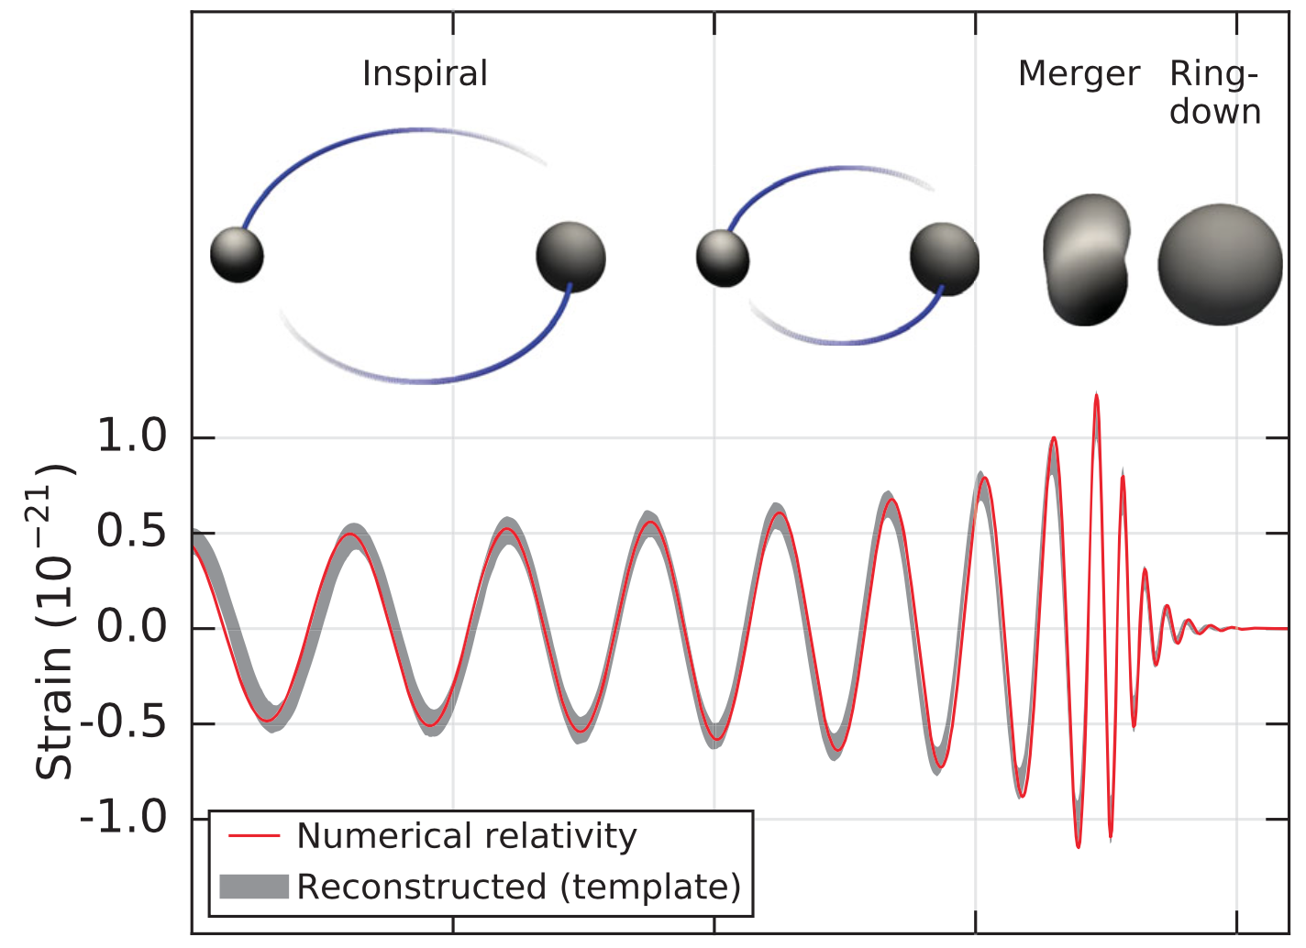
GW signal
depends on
neutron star
or black hole
In case of
neutron stars,
mass ejection
occurs.
(waveform is
not so clean)
Notes:
4

Slide 6
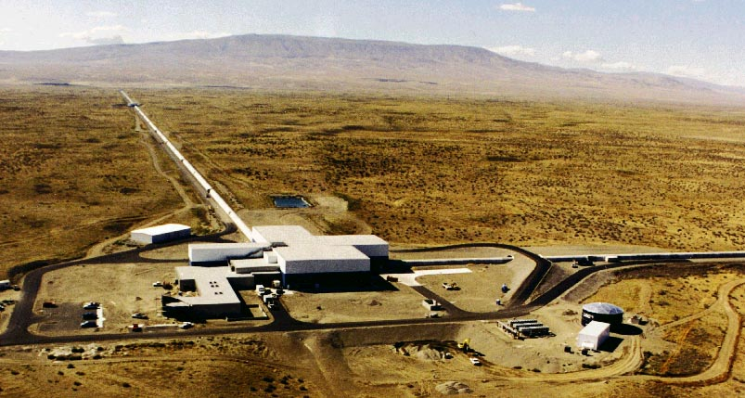
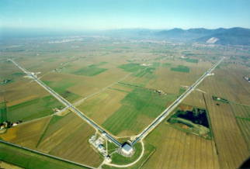
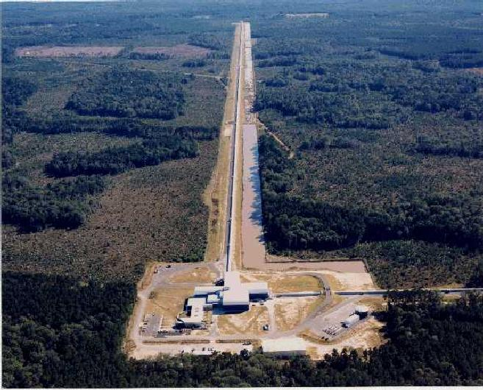
GW detectors
LIGO Hanford
4 km
Virgo Italy
3 km
2015年〜
2017年〜
LIGO Livingston 4 km
LIGO (O2)
Nov. 30, 2016 – Aug. 25, 2017
(detection distance ~80 Mpc)
2015年〜
VIRGO
Aug. 1, 2017 – Aug. 25, 2017
(detection distance ~20 Mpc)
Notes:
5

Slide 7
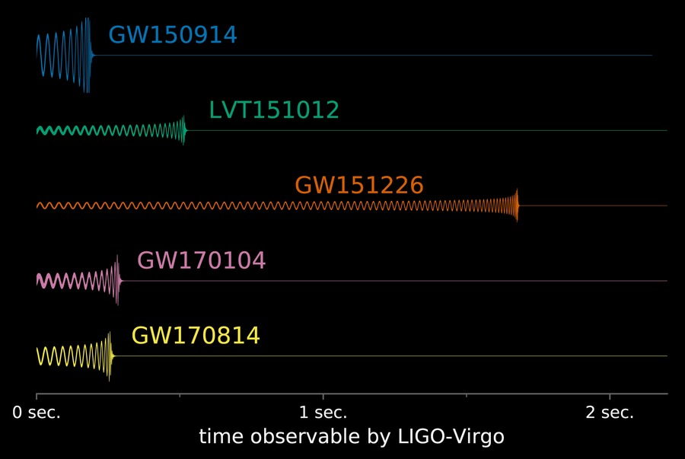
GW signals so far
All were GW from
binary BH merger
1st GW event
GW signal candidate
2nd GW event
3rd GW event
4th GW event
LIGO/Caltech/MIT/LSC
Notes:
6

Slide 8
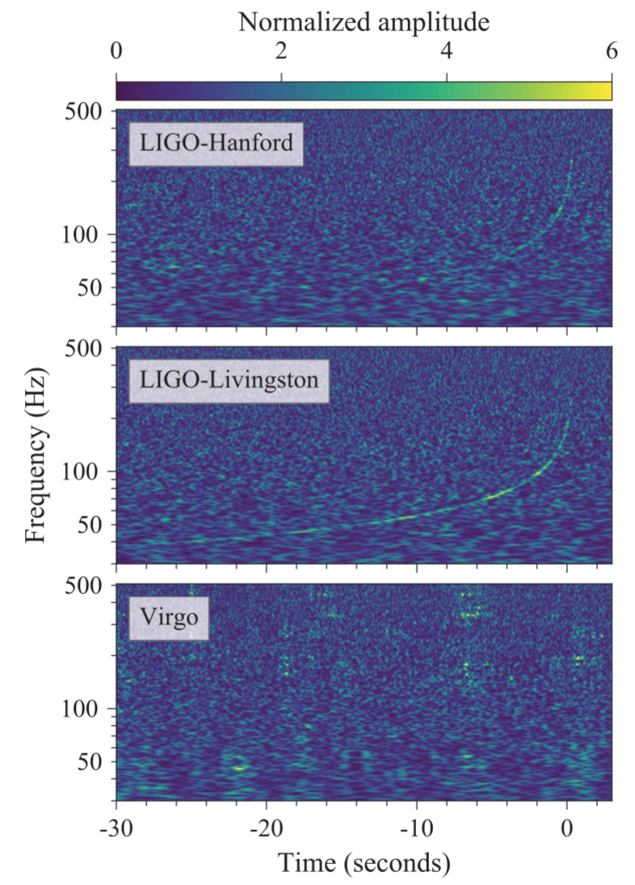
GW170817
network SNR=32.4
loudest event
signal duration ~30 sec
longest event
luminosity distance ~40 Mpc
closest event
two LIGOs detected,
but VIRGO couldn’t.
Notes:
7

Slide 9
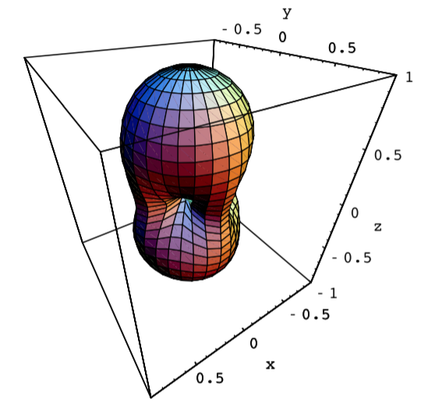
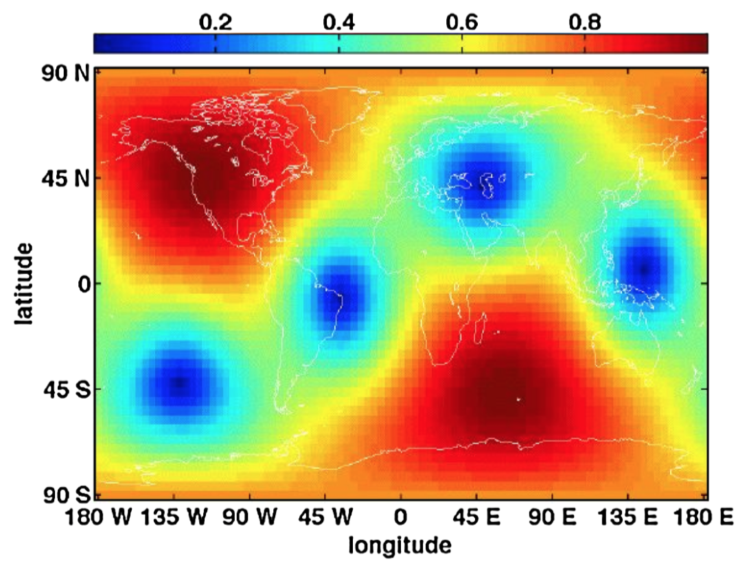
How to determine the source direction
detector antenna pattern
LIGO-H1
SNR of a single detector
(LIGO-H1, LIGO-L1, VIRGO) = (18.8, 26.4, 2.0)
consistent sky direction is searched.
Notes:
8

Slide 10
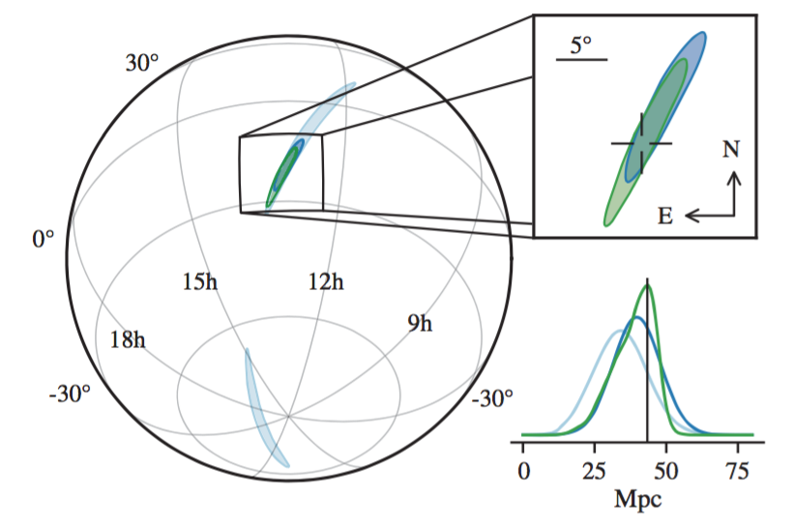
PDF for a source direction
from two LIGOs
~ 190 deg² (light blue)
+ VIRGO
~ 31 deg² (dark blue)
complete analysis
~ 28 deg² (green)
most well-localized event yet observed
because of three detectors & high SNR
Notes:
9

Slide 11
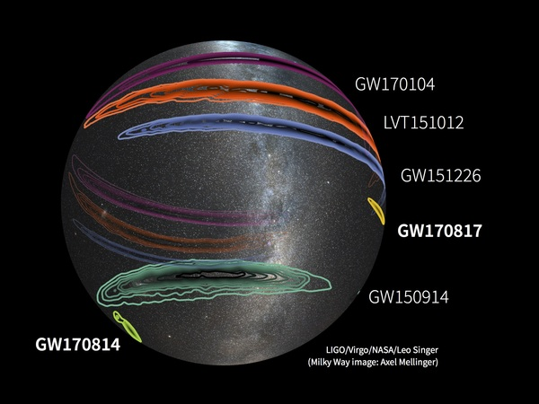
Comparison with previous events
Notes:
10

Slide 12
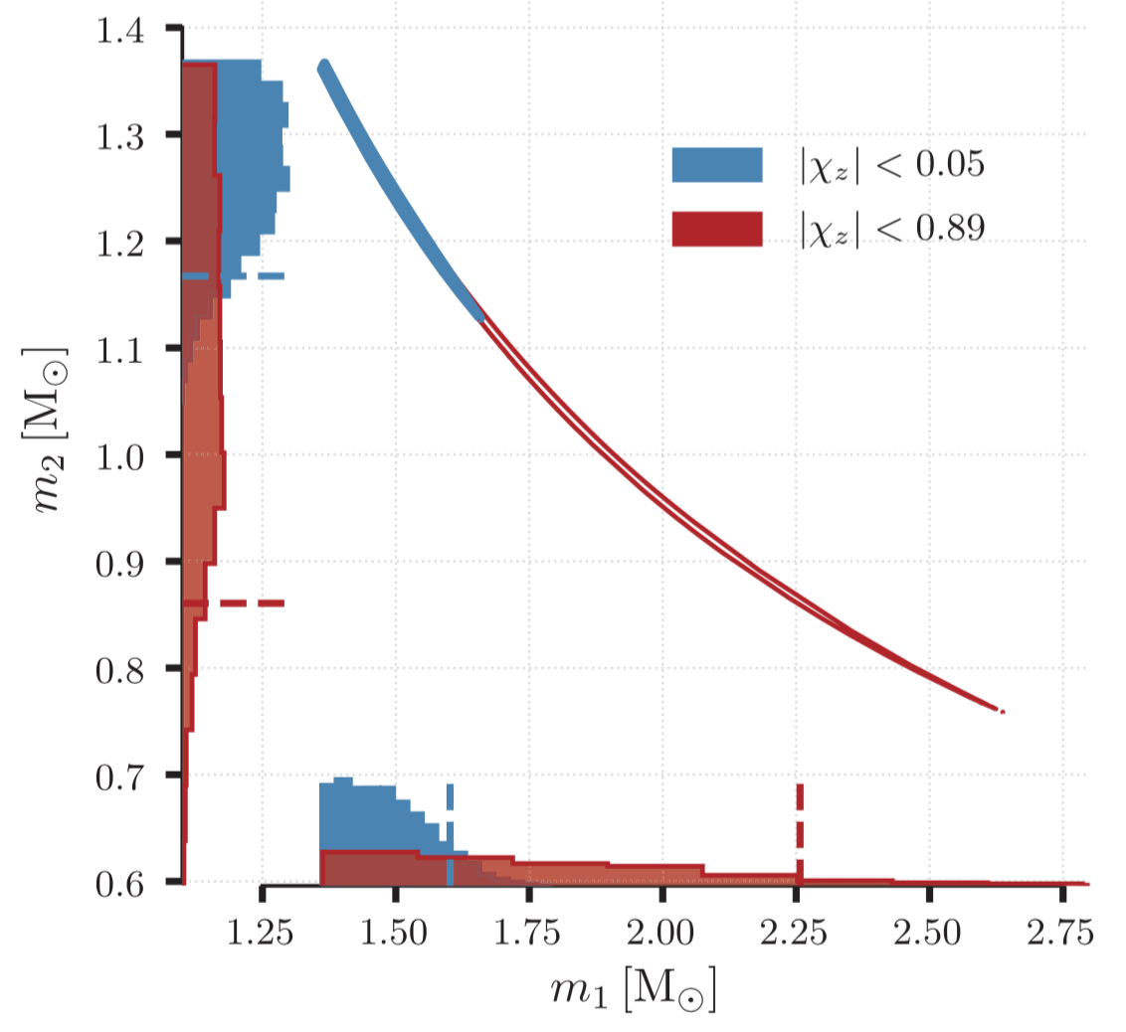
mass parameters
high spin prior
low spin prior
Notes:
11

Slide 13
mass parameters
high spin prior
cosistent with fiducial neutron star mass
~1.35 Msun
low spin prior

Slide 14
NS-NS merger rate
theoretical expection
LSC, CQG 27, 173001 (2010)
(review paper)
( realistic value )
from O1+O2 observation
Based on this rate, 5-70 event/yr is expected
with three detectors at design sensitivity (with 4 or 5 yrs).
Notes:
12

Slide 15
NS-NS merger rate
theoretical expection
LSC, CQG 27, 173001 (2010)
(review paper)
The optimistic and pessimistic merger
rates have been ruled out.
( realistic value )
from O1+O2 observation
Based on this rate, 5-70 event/yr is expected
with three detectors at design sensitivity (with 4 or 5 yrs).

Slide 16
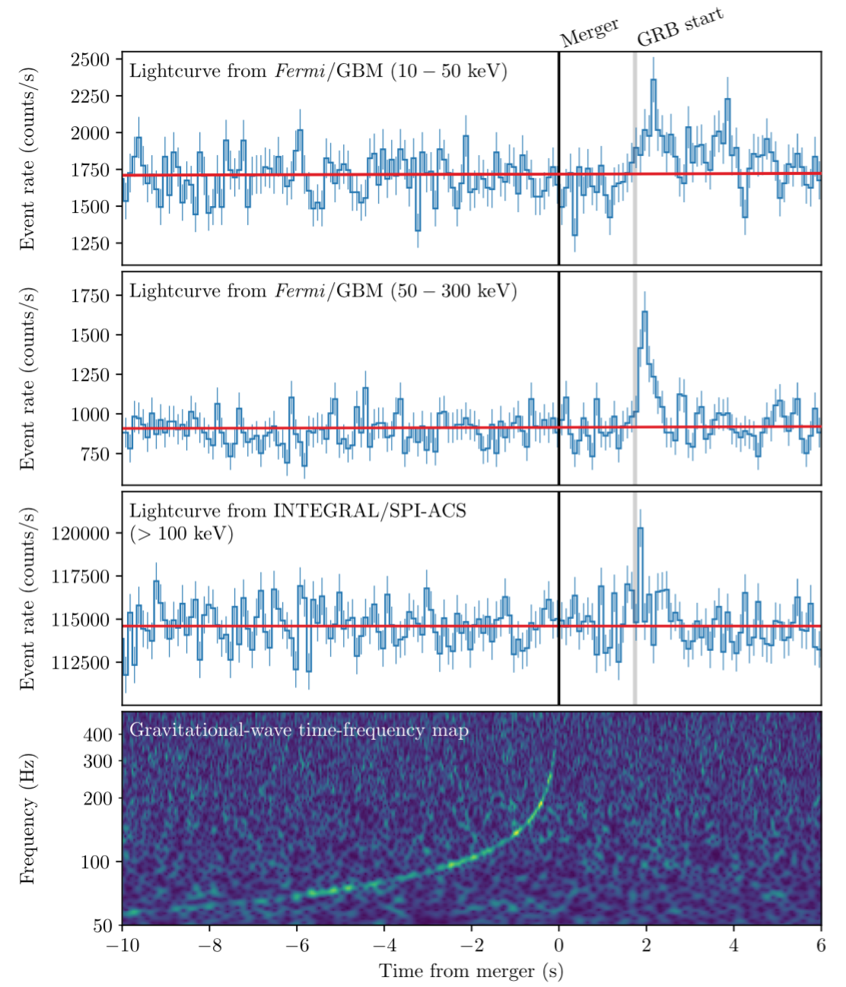
Gamma-ray observation
LSC + Fermi + INTEGRAL,
ApJL 848, L13
Fermi & INTEGRAL detected
gamma-ray burst at 1.7 sec
after GW from the merger.
The temporal coincidence
with GW was identified
immediately by referring to
the trigger alart.
The temporal and spatial
coincidences give statistical
significance 5.3 .
Notes:
13

Slide 17
Gamma-ray observation
LSC + Fermi + INTEGRAL,
ApJL 848, L13
Fermi & INTEGRAL detected
gamma-ray burst at 1.7 sec
after GW from the merger.
First direct evidence linking GW
from a binay neutron star merger
and a short gamma-ray burst
The temporal coincidence
with GW was identified
immediately by referring to
the trigger alart.
The temporal and spatial
coincidences give statistical
significance 5.3 .

Slide 18
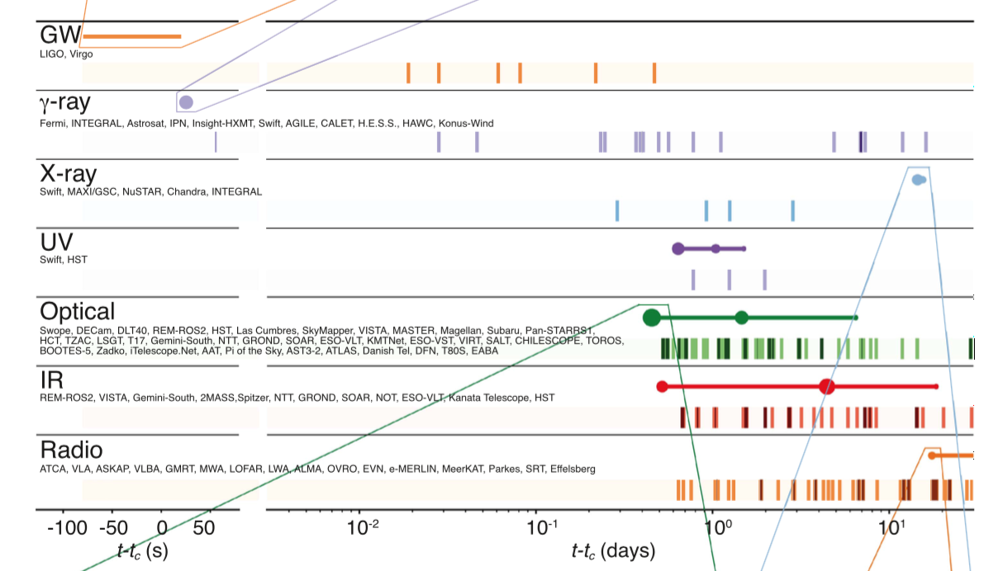
Other follow-up observations
LSC + all EM telescopes, ApJL 848, L12
No neutrino was detected. LSC + neutrino detectors, arXiv:1710.05839
Notes:
14

Slide 19
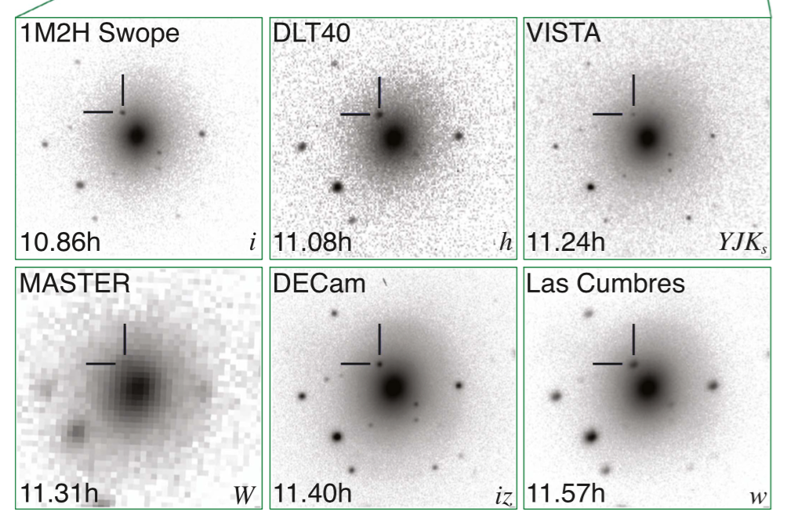
Other follow-up observations

Slide 20
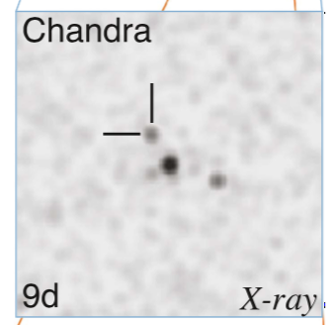
Other follow-up observations

Slide 21
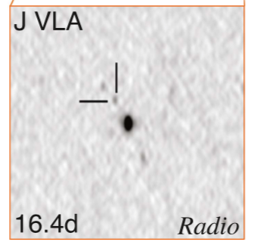
Other follow-up observations

Slide 22
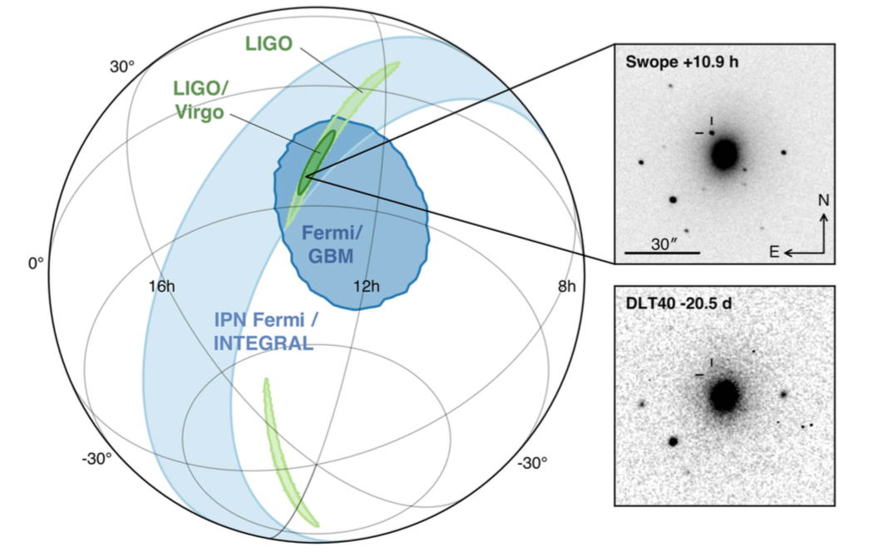
From these follow-up observations,
the host galaxy was identified.
Notes:
15

Slide 23
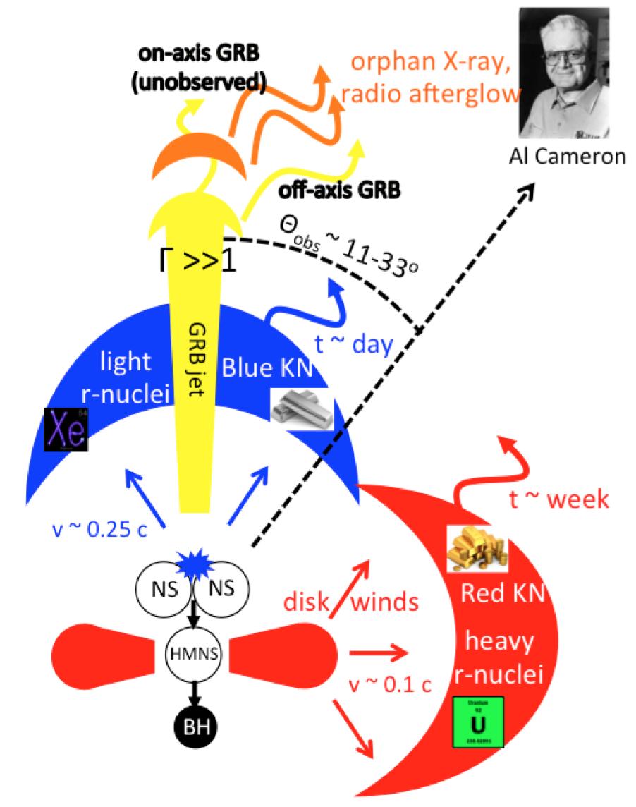
kilonova (macronova)
Metzger, arXiv:1710.05931
(review paper)
(1) NS coalescence
+ mass ejecta (polar)
(2) hypermassive NS
+ accretion disk
(3) GRB jet, < 2 sec
(4) off-axis GRB (weaker GRB)
(5) disk winds
+ mass ejecta (equatorial)
(6) blue kilonova, ~a few days
(7) red kilonova, ~a week
(8) GRB afterglow (X-ray, radio),
~two week
Notes:
16

Slide 24
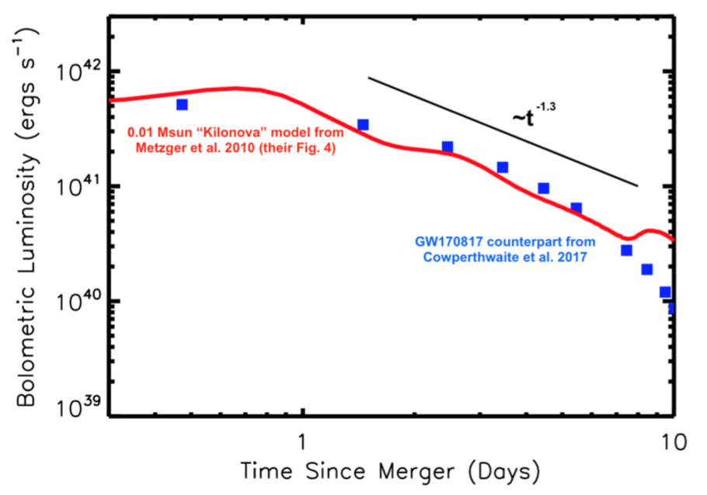
kilonova light curve
from Metzger, arXiv:1710.05931
Notes:
18

Slide 25
kilonova light curve
from Metzger, arXiv:1710.05931
Kilonova model seems to be correct.

Slide 26
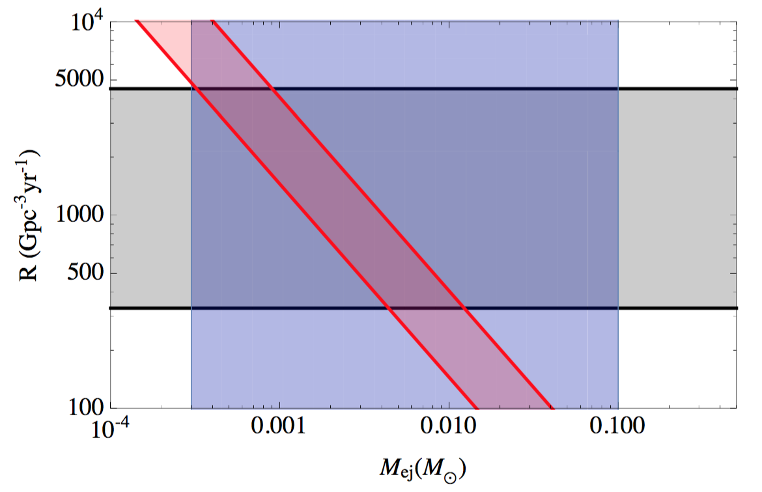
heavy element abundance
LSC, arXiv:1710.05836
from GW observation
from chemical
abundance obs.
from kilonova modeling & observations
Notes:
19

Slide 27
heavy element abundance
LSC, arXiv:1710.05836
Neutron star mergers & kilonovae would
be able to explain all amount of r-process
elements in Milky-Way-like galaxies.
from GW observation
from chemical
abundance obs.
from kilonova modeling & observations

Slide 28

GW propagation
Current constraints on GW speed.
From the observations of ultra-high energy cosmic rays (UHECR)
[ Moore & Nelson 2001 ]
If a graviton propagates with subluminal speed, it looses energy due to gravitational Cherenkov radiation.
applied only to subluminal case
at
From arrival time difference between LIGOs
[ Cornish et al. 2017 ]
GW150914
GW151226
GW170104
Notes:
20

Slide 29
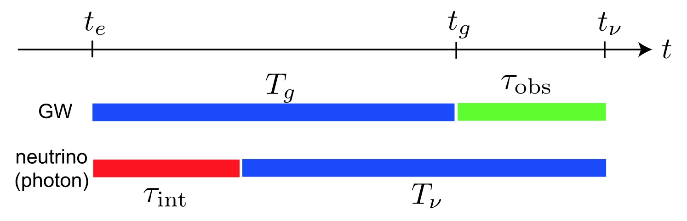
Our previous works
Nishizawa & Nakamura, PRD 90, 044048 (2014)
arrival time difference between GW and short GRB
,
Nishizawa, arxiv:1710.04825
generalized framework for testing GW propagation

Slide 30
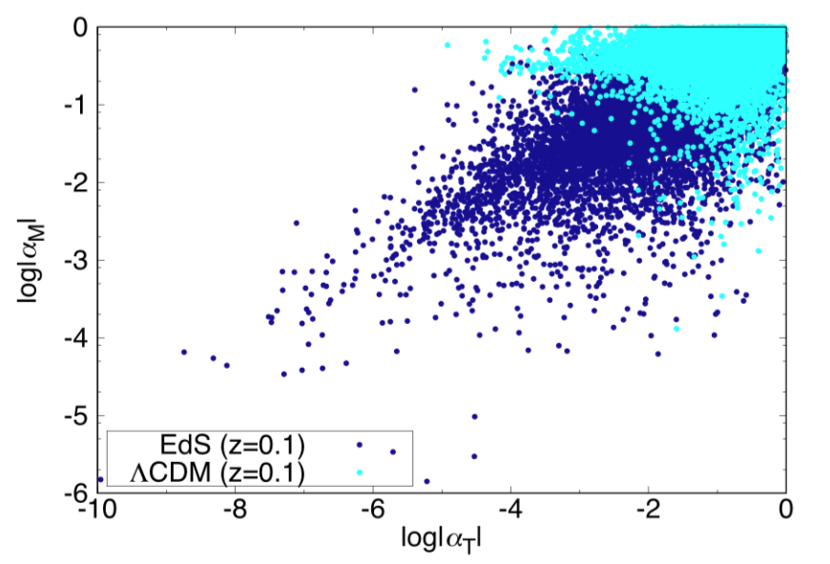
New constraint from GW170817
Constraint on GW propagation speed
(subluminal),
(superluminal),
LSC + Fermi + INTEGRAL,
ApJL 848, L13
Constraint on Horndeski theory
Arai & Nishizawa, in prep.
Only theories such as
quintessence,
nonlinear kinetic term,
f(R) gravity
can survive as a DE model.

Slide 31
New constraint from GW170817
Constraint on GW propagation speed
(subluminal),
(superluminal),
LSC + Fermi + INTEGRAL,
ApJL 848, L13
Constraint on Horndeski theory
Arai & Nishizawa, in prep.
Only theories such as
quintessence,
nonlinear kinetic term,
f(R) gravity
can survive as a DE model.
excluded

Slide 32
New constraint from GW170817
Constraint on GW propagation speed
(subluminal),
(superluminal),
LSC + Fermi + INTEGRAL,
ApJL 848, L13
Almost all gravity theories whose GW
speed different from c were killed.
Constraint on Horndeski theory
Arai & Nishizawa, in prep.
Only theories such as
quintessence,
nonlinear kinetic term,
f(R) gravity
can survive as a DE model.
excluded

Slide 33
Summary
GW170817 is the first GW from a binary-neutron-star merger.
Also it is the first direct evidence that binary neutron stars
are associated with short gamma-ray bursts.
A kilonova was observed by many telescopes around the world.
Its model works very well and explain the data.
Almost all gravity theories whose GW speed different from c
were killed.
Also the EOS of neutron star and the Hubble constant have
been measured. But only weak constraints have been obtained.

Slide 35
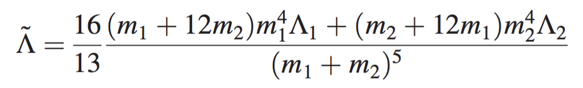
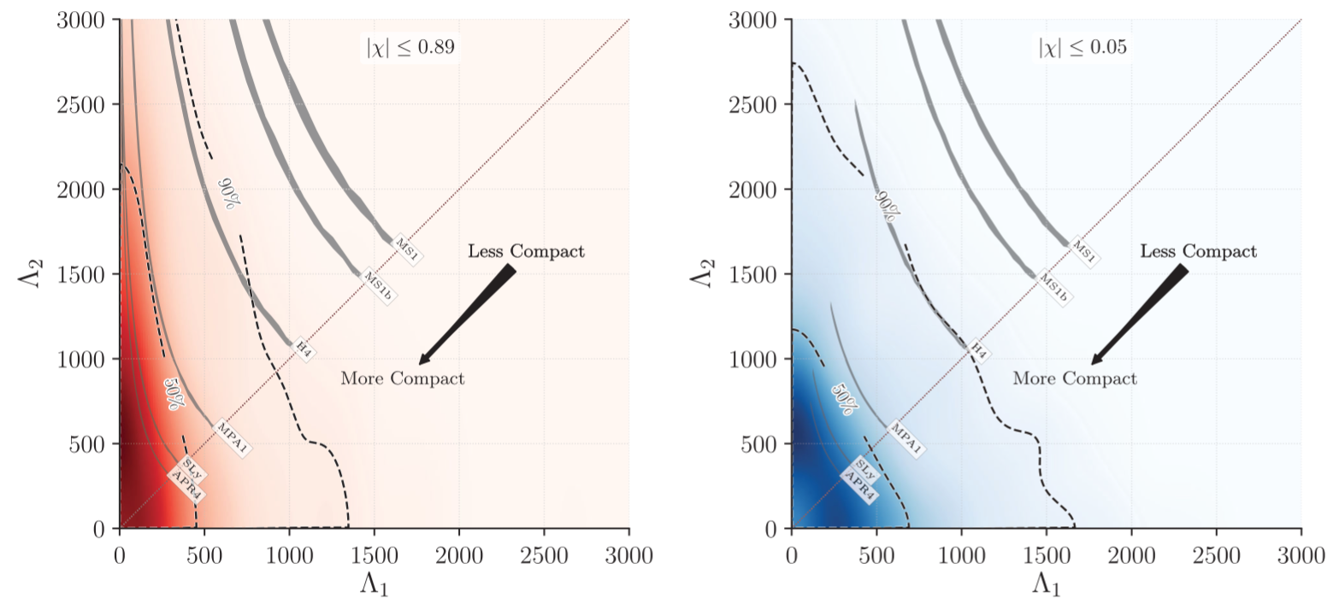
neutron star EOS
constraint on tidally induced deformation of a neutron star

Slide 36
neutron star EOS
constraint on tidally induced deformation of a neutron star
Weak constraint on NS EOS was
obtained. Some nonstandard EOS
have been rejected.

Slide 37
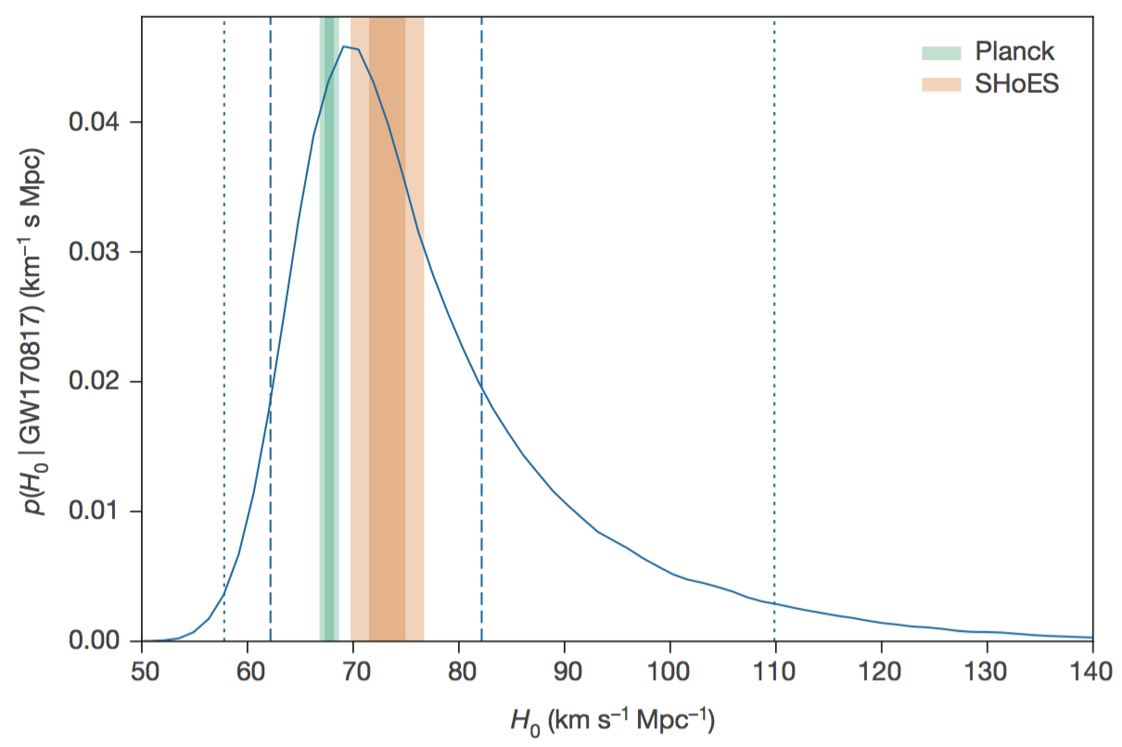
Hubble constant
LSC + optical telescopes, Nature 551, 85
at low redshift ,
from EM observation
of the host galaxy
from GW observation

Slide 38
Hubble constant
LSC + optical telescopes, Nature 551, 85
at low redshift ,
from EM observation
of the host galaxy
from GW observation
Hubble constant has been measured
for the first time, but the constraint is
still weak.

