Slide 1

Particle Candidates for Dark Matter
Introduction to dark matter
(Still) Supersymmetry
(Still) H- and Z-portal models
(Not so) Simplified Z’ models
Light dark matter models
(GW-inspired) Crazy ideas
John Ellis
Time for desperation creative thinking

Slide 2
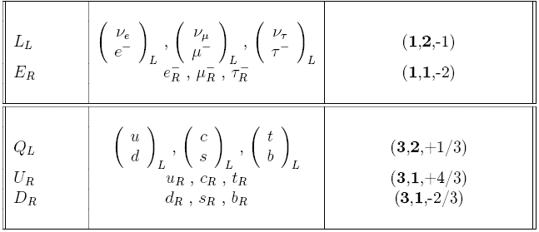
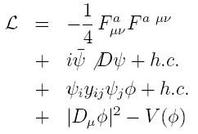
Summary of the Standard Model
Particles and SU(3) × SU(2) × U(1) quantum numbers:
Lagrangian: gauge interactions
matter fermions
Yukawa interactions
Higgs potential
Untested
before 2012

Slide 3
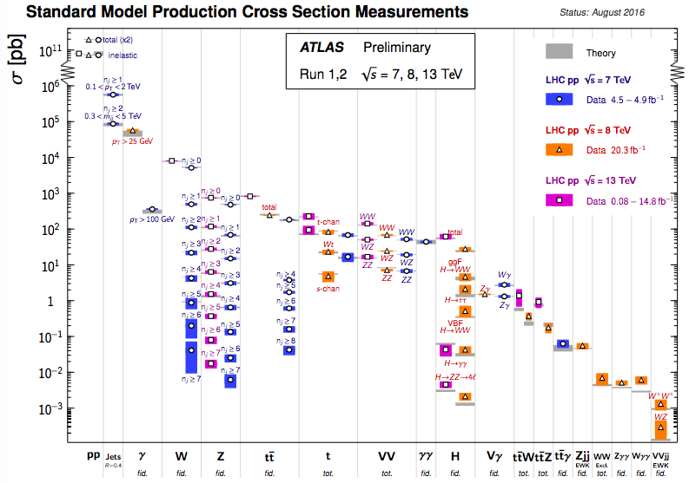
New Physics beyond the SM?
Standard Model Cross-Sections @ LHC

Slide 4

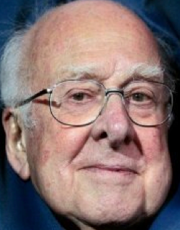

« Empty » space is unstable
Hierarchy problem
Dark matter
Origin of matter
Masses of neutrinos
Inflation
Quantum gravity
…
Run 2
SUSY
Run 2
SUSY
Run 2
SUSY
Run 2
SUSY
SUSY
SUSY
^{The} Standard Model
Notes:
4

Slide 5
Prehistory of Dark Matter
1783: John Michell proposed black holes
1844: Friedrich Bessel suggested gravitational detection
1904: Kelvin proposed ‘dark stars’ in Milky Way
1906: term ‘dark matter’ introduced by Henri Poincaré
1915: Kelvin proposal revived by Ernst Opik
1922: Kelvin proposal re-revived by Jacobus Kapteyn
1932: First kinematical analysis of stars in solar neighbourhood by Jan Oort

Slide 6
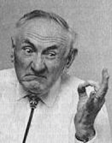
The Dark Matter Hypothesis
Proposed by Fritz Zwicky, based on observations of the Coma galaxy cluster
The galaxies move too quickly
The observations require a
stronger gravitational field
than provided by the visible matter
Dark matter?

Slide 7
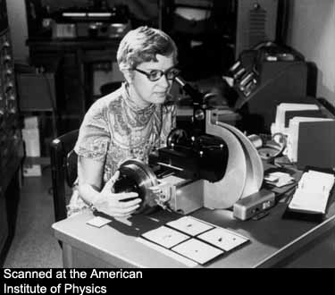
The Rotation Curves of Galaxies
Measured by Vera Rubin et al.
The stars also orbit ‘too quickly’
Her observations also required a
stronger gravitational field
than provided by the visible matter
Further strong evidence for dark matter
Also:
  Structure formation, CMB, …

Slide 8
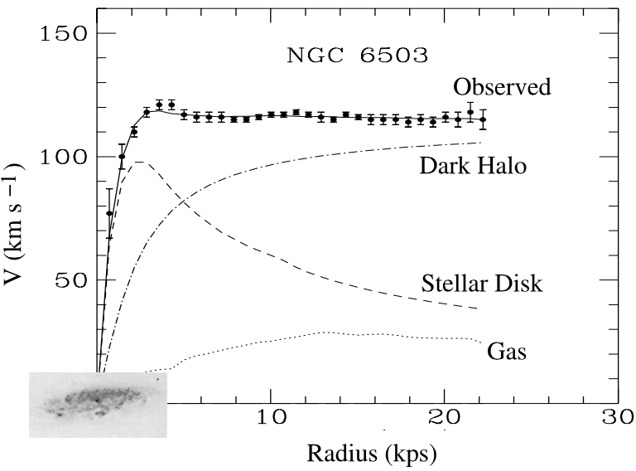
Sample Rotation Curve: NGC 6503
Much larger than visible galaxy
Tkachev, arXiv:1802.02414

Slide 9
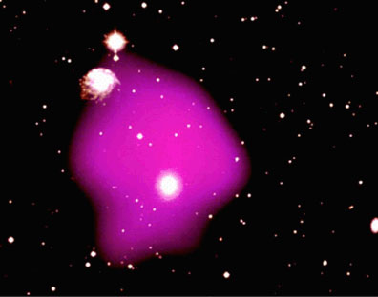
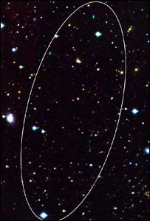
More Evidence for Dark Matter
X-ray emitting gas held
in place by extra
dark matter
Even
‘dark galaxies’
without stars

Slide 10
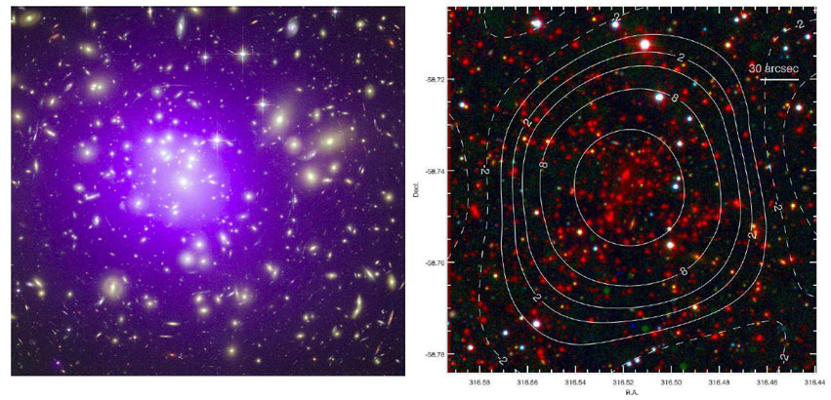
X-Rays from Galaxy Clusters
High temperature and pressure
Need extra gravity to hold them together

Slide 11
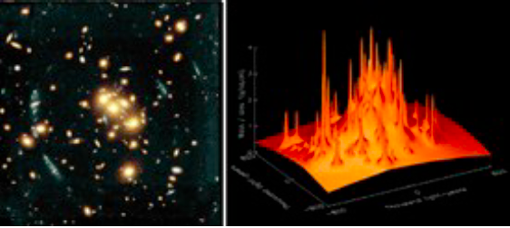
Gravitational Lensing
Reveal all the matter
Galaxies = peaks on a background of dark matter

Slide 12
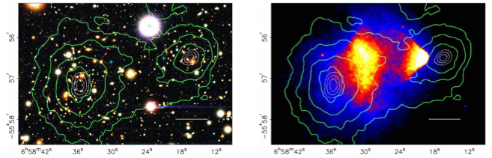
More Evidence for Dark Matter
Collision between
2 clusters of galaxies:
Dark matter passes through
Collision between
2 clusters of galaxies:
Gas interacts, heats and stops
Clowe et al, 2006

Slide 13
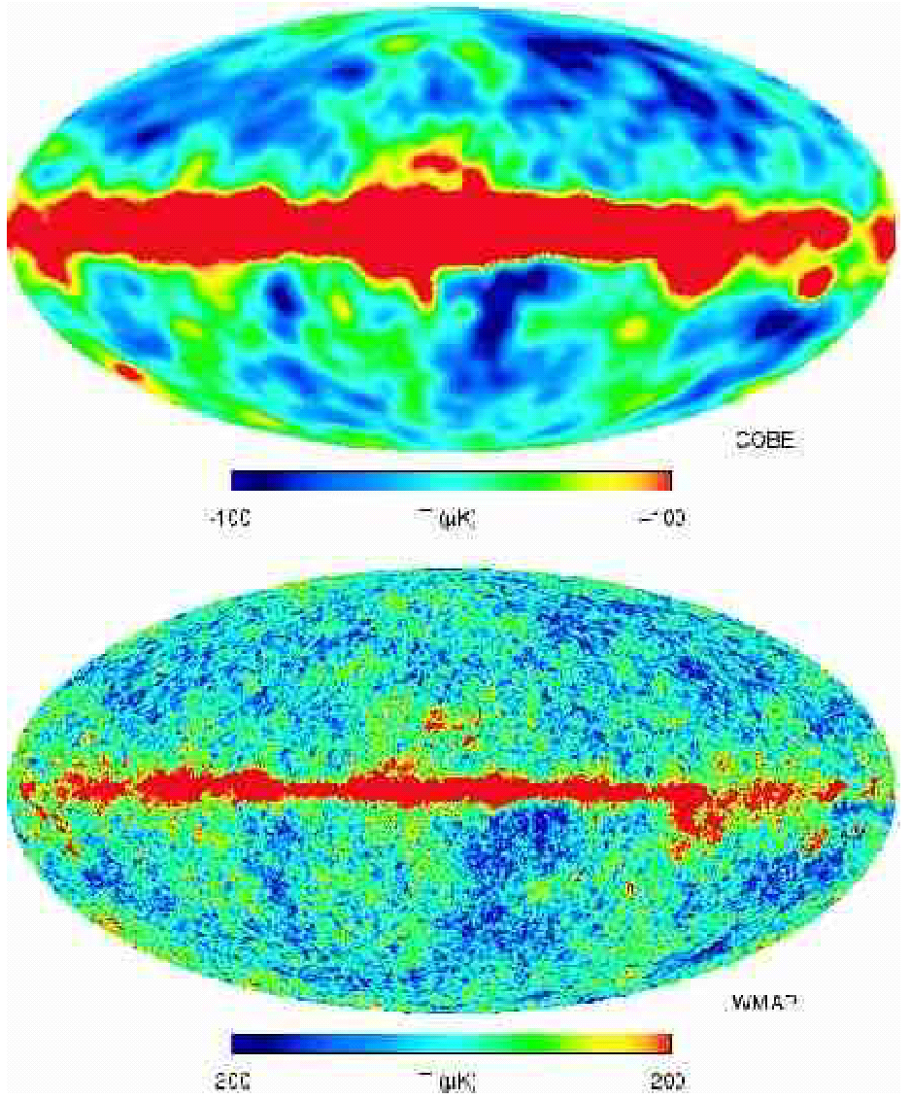

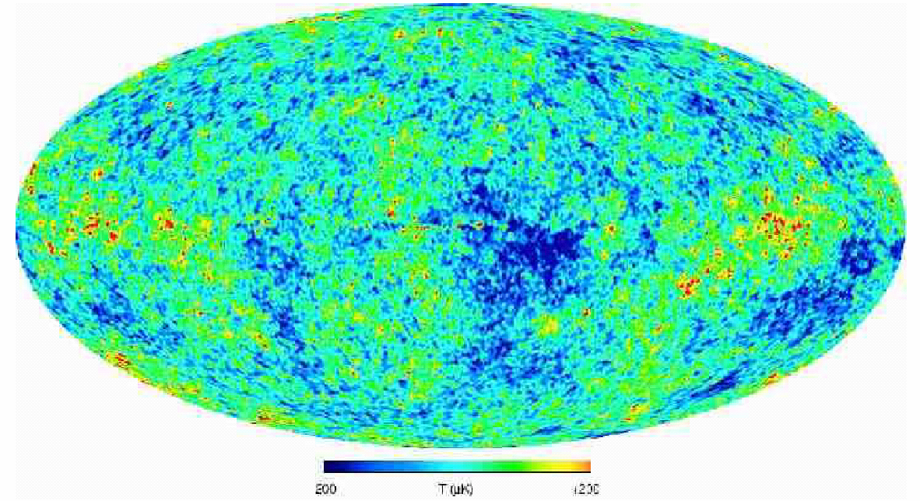
Cosmic
Microwave
Background
According to COBE satellite
Nobel Prize 2006: John Mather & George Smoot
According to WMAP
satellite

Slide 14

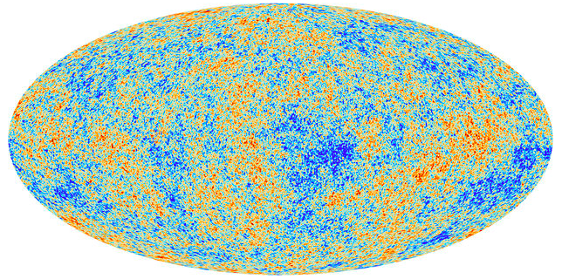
What is the Cosmic Microwave Background telling us?

Slide 15
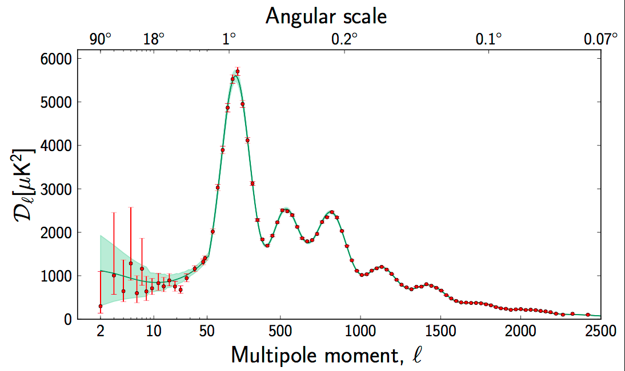
The Spectrum of Fluctuations in the Cosmic Microwave Background
The position of the first peak
→ total density
The other peaks
depend on density of
ordinary matter
& dark matter

Slide 16
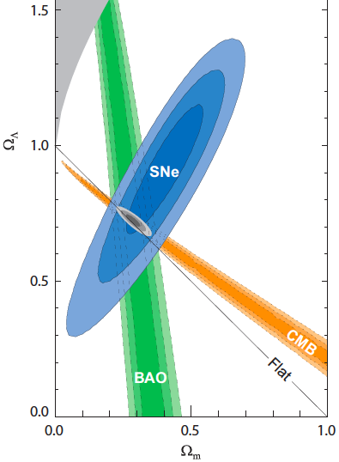
The Content of the Universe
According to
  Microwave background
  Supernovae
  Structures (galaxies, clusters, …) in the Universe
Dark energy
And dark energy
There is dark matter

Slide 17
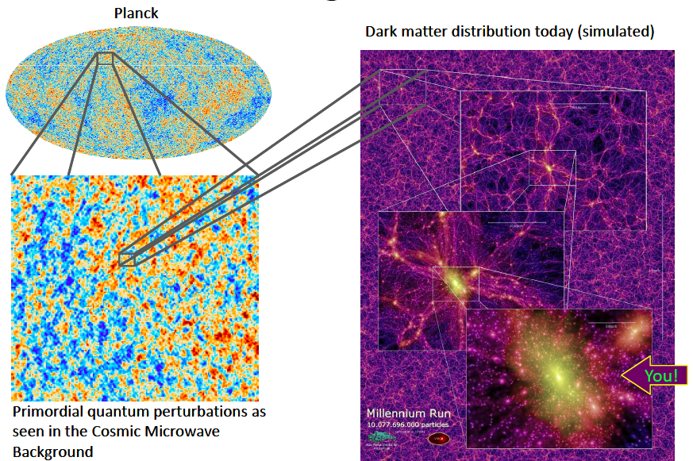
Perturbations Generate Structures

Slide 18
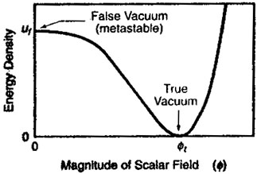
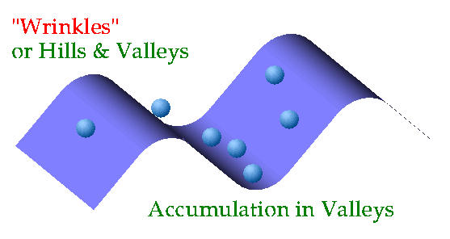
The Origin of Structures in the Universe
Small primordial
quantum fluctuations:
~ 1/10⁵
Gravitational instability:
dark matter falls into the
gravitational potential wells,
visible matter follows
Become density fluctuations
Become structures in Universe

Slide 19
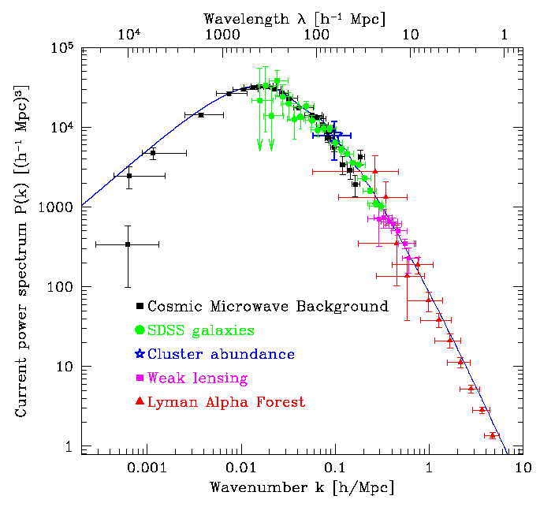
A Successful Theory of the Formation of Structures in the Universe
Dark matter:
Ω_{CDM} ~ 0.25,
Visible matter:
Ω_{b} ~ 0.05,
Dark energy:
Ω_{Λ} ~ 0.7

Slide 20
Problems for Cold Dark Matter?
Cusps vs cores of galaxies?
  Need simulation of “gastrophysics” including DM interactions with ordinary matter
  Diversity understood with strongly-interacting DM?
Number of dwarf galaxies?
  More being found
  Also need simulation of “gastrophysics”
Fuzzy DM?
Jury still out

Slide 21
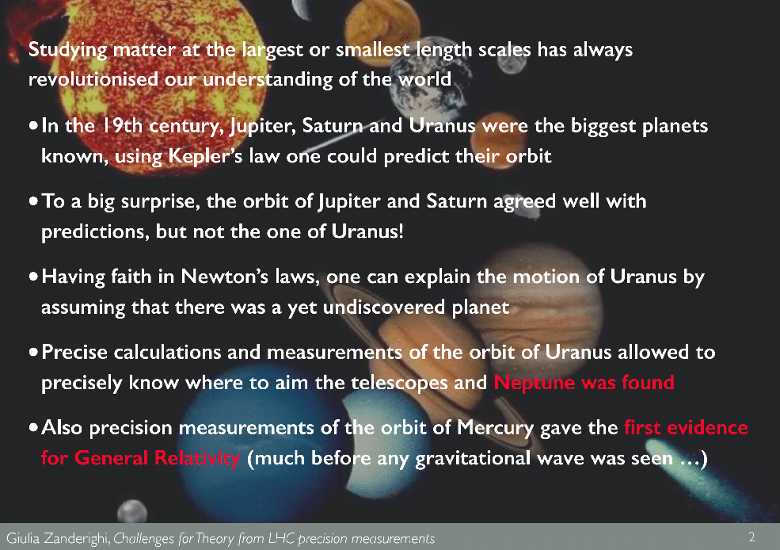
Caveat Vulcan!
But many convergent indicators for DM

Slide 22
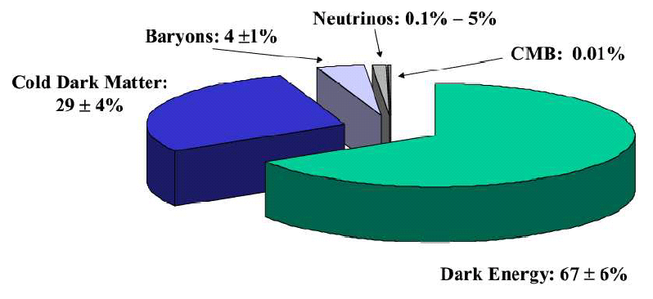
Strange Recipe for a Universe
The ‘Standard Model’ of the Universe
indicated by astrophysics and cosmology

Slide 23
Properties of Dark Matter
Should not have electric charge
  Otherwise we would have seen it
Should interact weakly with ordinary matter
  Otherwise we would have detected it, either directly or astrophysically
Should not be too light
  Needed for forming and holding together structures in the Universe: galaxies, clusters, …

Slide 24
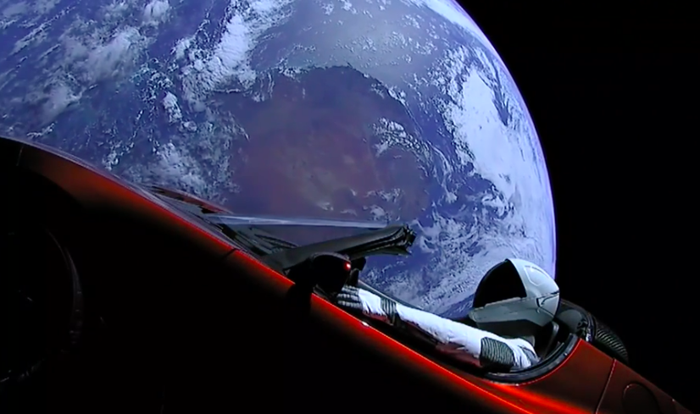
What is the Dark Matter?

Slide 25
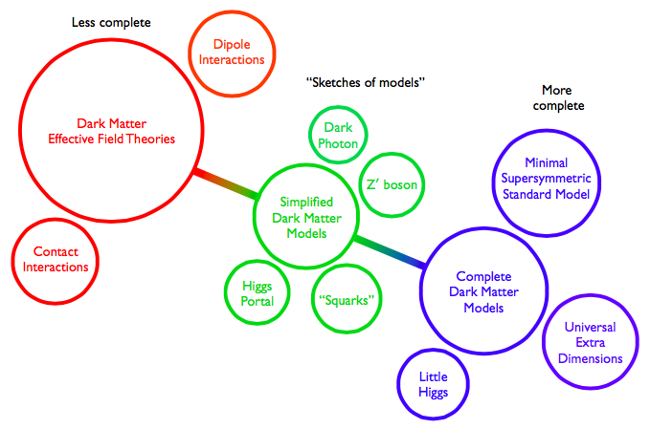
Particle Dark Matter Models
Abdallah et al, arXiv:1506.03116
Z,
Black
Holes

Slide 26
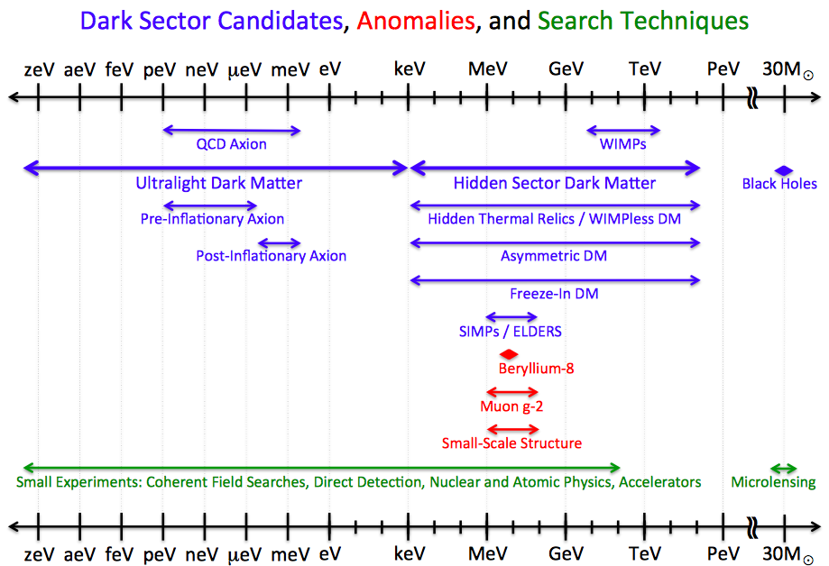
(Particle) Dark Matter Candidates

Slide 27
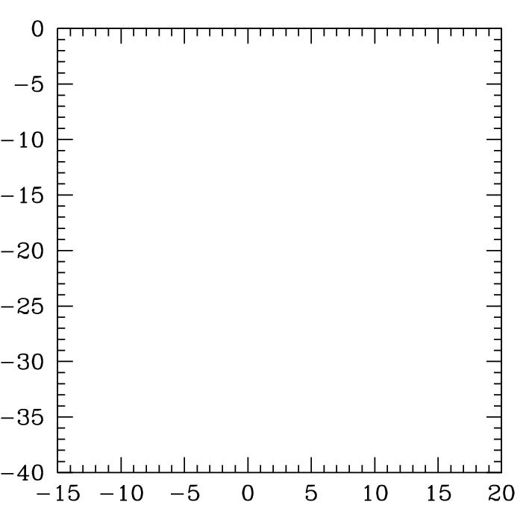
Particle Dark Matter Candidates
A
A
A
A
A
A
A
A
A
A
A
A
A
A
A
a
Weakly-interacting
Massive Particles
(supersymmetry)
Neutrinos
Superheavy ‘cryptons’
Black
Holes
→
Axions
Log₁₀(σ/picobarns)
Super-weakly
interacting
particles, e.g.,
gravitino
Log₁₀(mass/proton mass)

Slide 28
Neutrinos
They exist! ☺
They have weak interactions ☺
They have masses ☺
  As indicated by neutrino oscillations
But their masses are very small ☹
  < 1 eV (= 1/1000,000,000 of proton mass)
Not able to grow all structures in Universe ☹
  (run away from small structures)
Maybe some other neutrinos beyond the Standard Model? Sterile neutrinos?

Slide 29
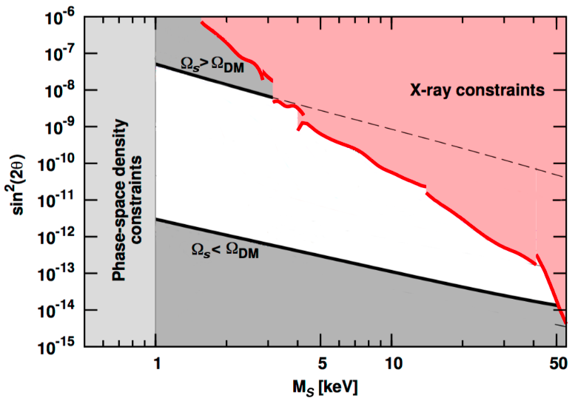

Sterile Neutrino?
Sterile = no Standard Model interactions
Expected to mix with standard left-handed ν’s
Relic density if no significant asymmetry
Could be larger if asymmetry
X-ray constraints on decays
Tkachev, arXiv:1802.02414

Slide 30
A
A
A
A
A
A
A
A
A
A
A
A
A
A
A
a
Particle Dark Matter Candidates
Weakly-interacting
Massive Particles
supersymmetry)
Neutrinos
Superheavy ‘cryptons’
Black
Holes
→
Axions
Log₁₀(σ/picobarns)
Super-weakly
interacting
particles, e.g.,
gravitino
Log₁₀(mass/proton mass)

Slide 31
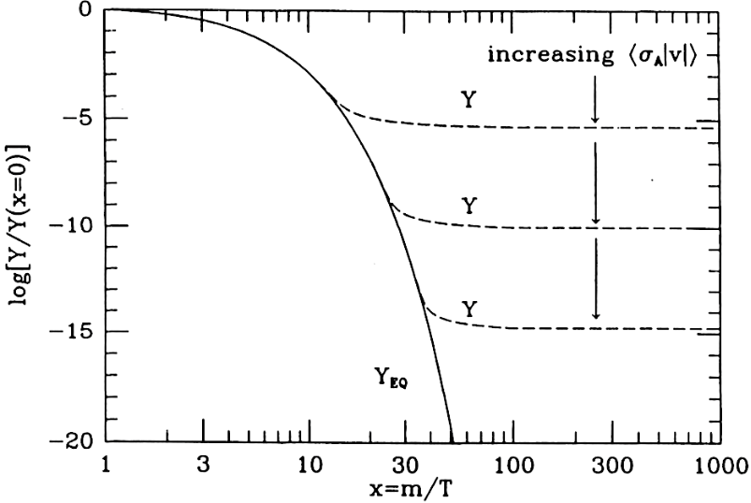
Weakly-Interacting Massive Particles (WIMPs)
Expected to have been numerous in the primordial Universe when it was a fraction of a second old, full of a primordial hot soup
Would have cooled
down as Universe
expanded
Interactions would
have weakened
WIMPs decoupled
from visible matter
“Freeze-out”
Larger σ → lower Y
Tkachev, arXiv:1802.02414

Slide 32
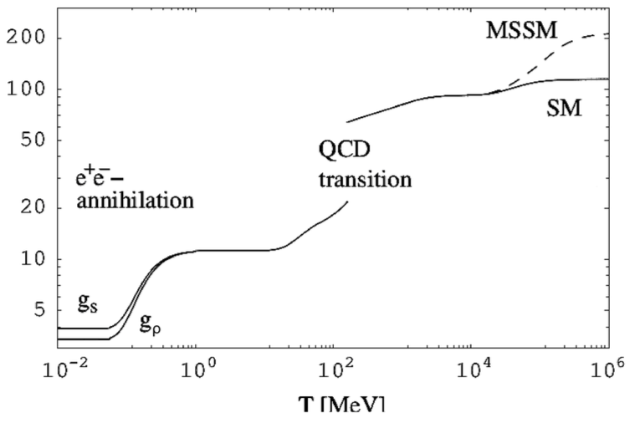
‘Standard’ Thermal History of Early Universe
WIMP, e.g., SUSY
Freeze-out at
O(10) GeV?
Tkachev, arXiv:1802.02414

Slide 33



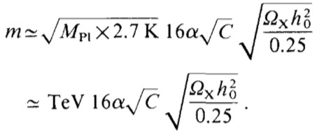

The WIMP ‘Miracle’
The TeV scale from cosmology:
Generic density from freeze-out:
Generic annihilation cross-section:
Generic relic mass:
Putting the numbers in:
Dimopoulos, PLB246, 347 (1990)

Slide 34
WIMP Candidates
Could have right density if weigh 100 to 1000 GeV (accessible to LHC experiments?)
Present in many extensions of Standard Model
Particularly in attempts to understand strength of weak interactions, mass of Higgs boson
Examples:
  Extra dimensions of space
  Supersymmetry

Slide 35
What lies beyond the Standard Model?
Supersymmetry
New motivations
From LHC Run 1
Stabilize electroweak vacuum
Successful prediction for Higgs mass
  Should be < 130 GeV in simple models
Successful predictions for couplings
  Should be within few % of SM values
Naturalness, GUTs, string, …, dark matter

Slide 36

Supersymmetry?
Would unify matter particles and force particles
Related particles spinning at different rates
0 - ½ - 1 - 3/2 - 2
Higgs - Electron - Photon - Gravitino - Graviton
(Every particle is a ‘ballet dancer’)
(pirouette at different speeds)
Would help fix particle masses
Would help unify forces
Predicted light Higgs boson
Could provide dark matter for the
astrophysicists and cosmologists

Slide 37
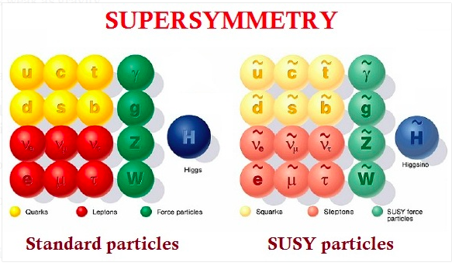
Minimal Supersymmetric Extension of the Standard Model

Slide 38
Why Supersymmetry (Susy)?
Hierarchy problem: why is m_{W} << m_{P} ?
(m_{P} ~ 10¹⁹ GeV is scale of gravity)
Alternatively, why is
G_{F} = 1/ m_{W}² >> G_{N} = 1/m_{P}² ?
Or, why is
V_{Coulomb} >> V_{Newton} ? e² >> G m² = m² / m_{P}²
Set by hand? What about loop corrections?
δm_{H,W}² = O(α/π) Λ²
Cancel boson loops ⬄ fermions
Need | m_{B}² – m_{F}²| < 1 TeV²

Slide 39
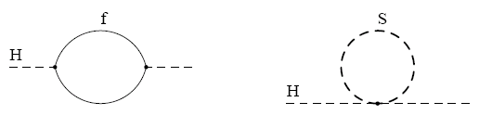



Loop Corrections to Higgs Mass²
Consider generic fermion and boson loops:
Each is quadratically divergent: ∫^{Λ}d⁴k/k²
Leading divergence cancelled if
Supersymmetry!
2
x 2

Slide 40
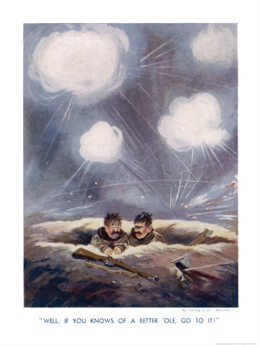
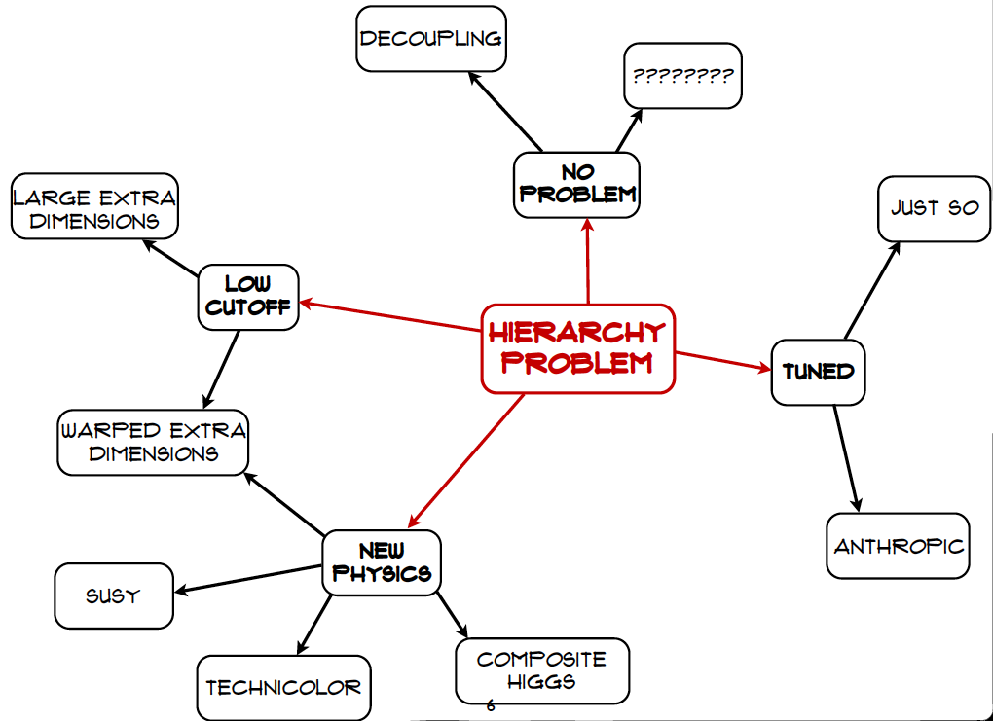
Craig@LHCP
If you know of a better hole, go to it

Slide 41


Minimal Supersymmetric Extension of Standard Model (MSSM)
Double up the known particles:
Two Higgs doublets
- 5 physical Higgs bosons:
- 3 neutral, 2 charged
Lightest neutral supersymmetric Higgs looks like the single Higgs in the Standard Model

Slide 42
Lightest Supersymmetric Particle
Stable in many models because of conservation of R parity:
R = (-1) ^{2S –L + 3B}
where S = spin, L = lepton #, B = baryon #
Particles have R = +1, sparticles R = -1:
Sparticles produced in pairs
Heavier sparticles → lighter sparticles
Lightest supersymmetric particle (LSP) stable

Slide 43
Lightest Sparticle as Dark Matter?
No strong or electromagnetic interactions
Otherwise would bind to matter
Detectable as anomalous heavy nucleus
Possible weakly-interacting scandidates
Sneutrino
(Excluded by LEP, direct searches)
Lightest neutralino χ (partner of Z, H, γ)
Gravitino
(nightmare for detection)

Slide 44
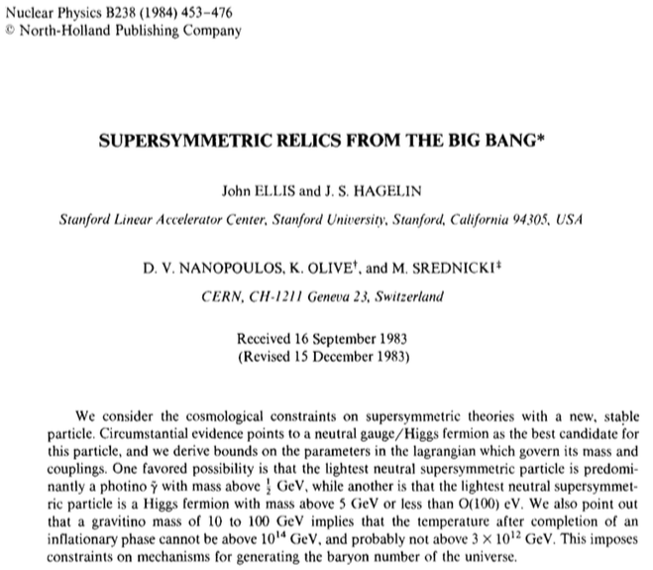
Personal Bias

Slide 45
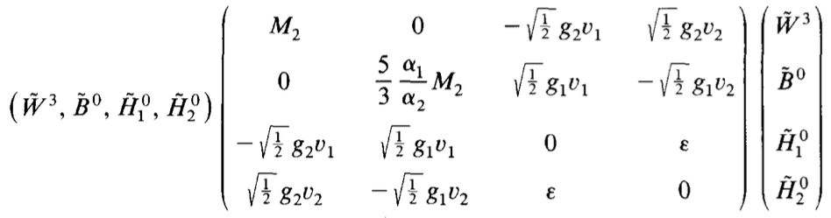
Neutralino Dark Matter?
Lightest supersymmetric particle (LSP) is a mixture of Wino, Bino and Higgsinos:
Bino dark matter if M₁ small
  Expect M₁ < M₂ (GUT relation)
Higgsino dark matter if μ small
M₁
μ
μ
JE, Hagelin, Nanopoulos, Olive & Srednicki,
NPB238, 453 (1984)

Slide 46
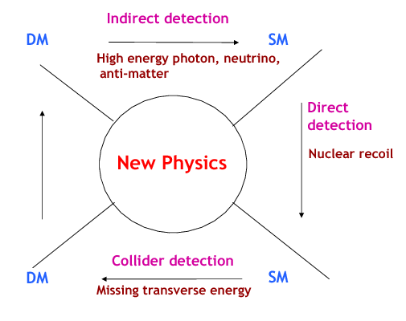
Searches for WIMP Dark Matter
Annihilation
to particles ➔
in cosmic rays
Dark Matter
Standard Model
Annihilation
in the early ➔
Universe
Production
⬅ at particle
colliders
⬆
Direct dark matter detection
Dark Matter
Standard Model

Slide 47
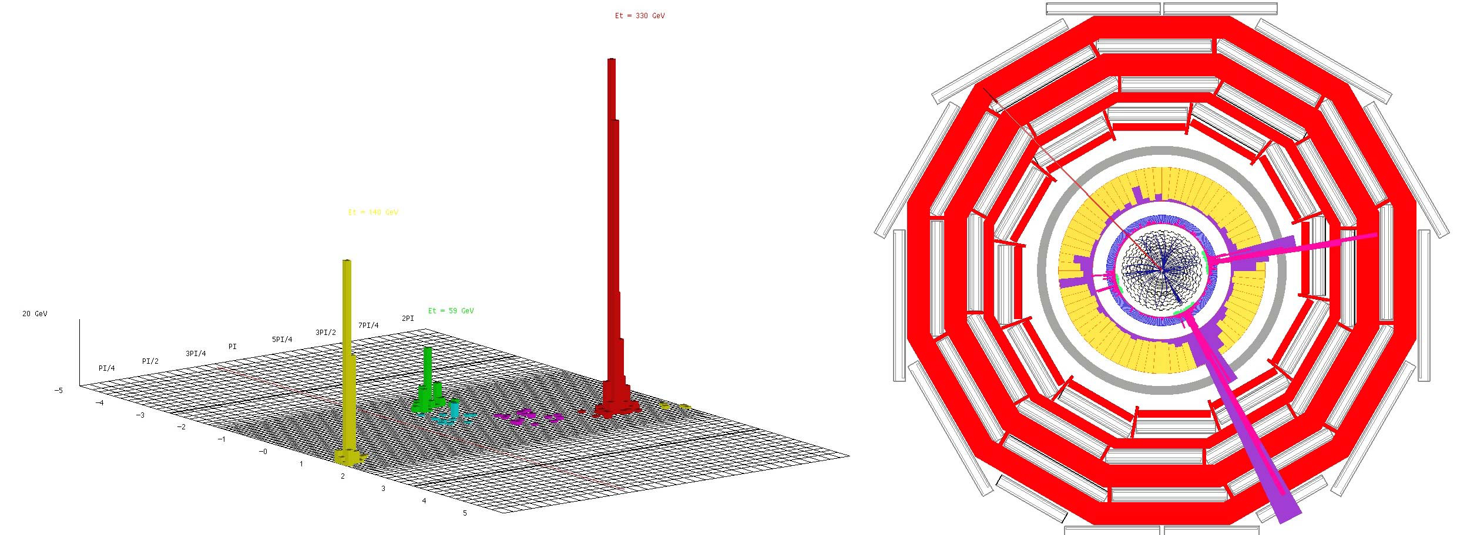
Classic LHC Dark Matter Signature
Missing transverse energy
carried away by dark matter particles

Slide 48
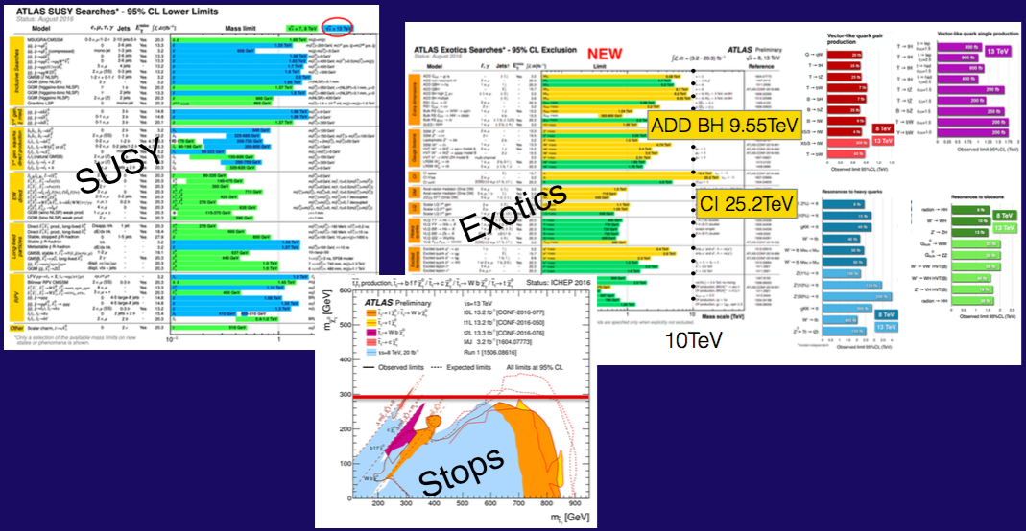
Nothing (yet) at the LHC
No supersymmetry
Nothing else, either
More of same?
Unexplored nooks?
Novel signatures?

Slide 49
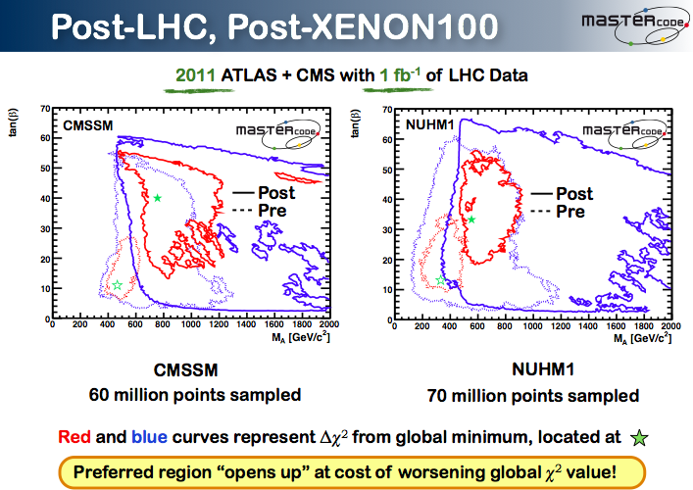

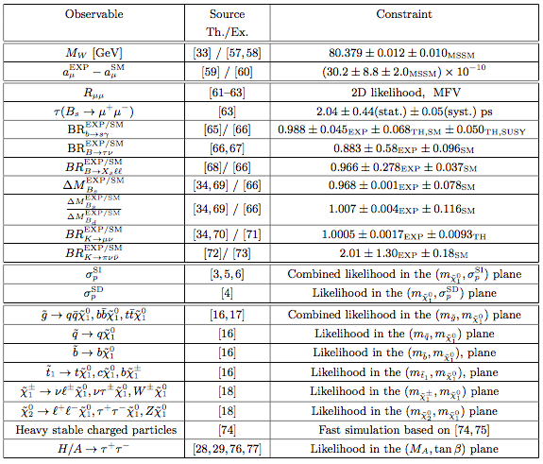
Inputs to Global Fits for New Physics
Electroweak
observables
Flavour
observables:
Interpretation
requires
lattice inputs
Dark Matter
LHC
observables

Slide 50
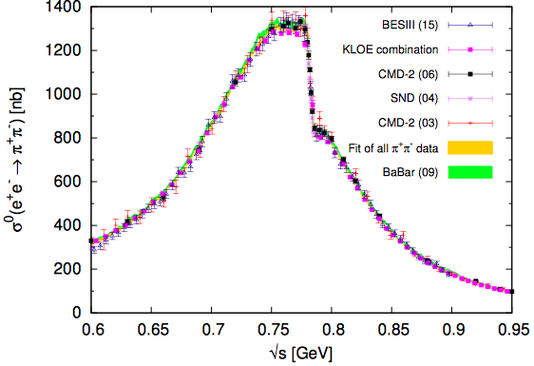
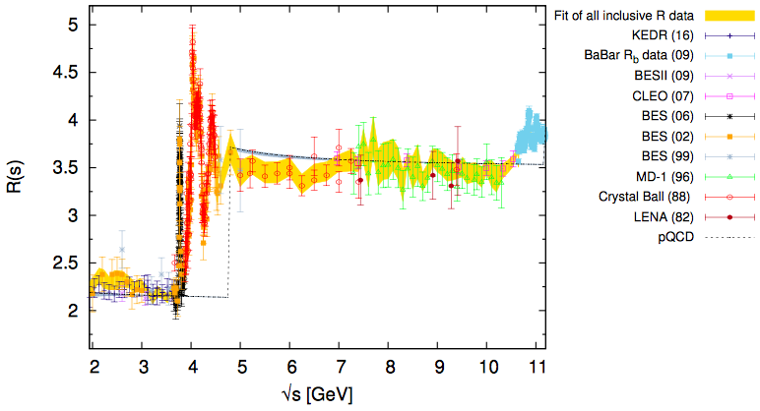
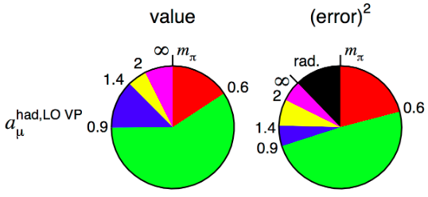
Standard Model Calculation of g_{μ} - 2
Main contribution from hadronic vacuum polarization, estimated from e⁺e⁻, τ decay (lattice)
Largest contribution and
uncertainty from low-mass region
(light-by-light scattering)
Notes:
50

Slide 51

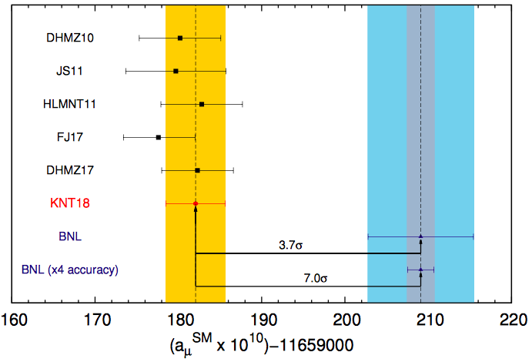
Quo Vadis g_{μ} - 2?
SUSY?
Strong discrepancy between BNL experiment and e⁺e⁻ data now ~ 3.7 σ
New experiment at FNAL (JPARC)
Notes:
51

Slide 52
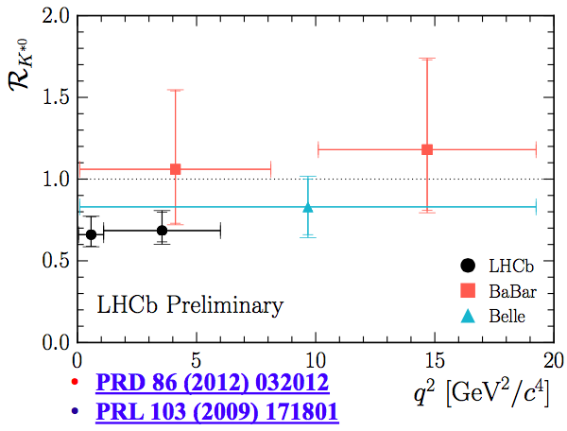
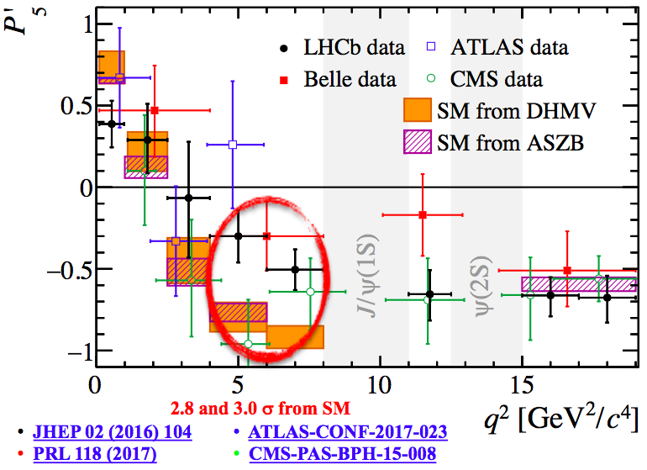
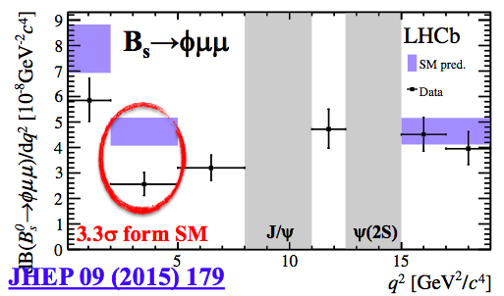
Flavour Anomalies in B➔K^{(*)}μ⁺μ⁻, B_{s}➔ϕμ⁺μ⁻
Apparent violation of μ-e universality in B➔K^{(*)}μ⁺μ⁻
Anomalous angular distribution in B➔K*μ⁺μ⁻
Anomalous q² distribution in B_{s}➔ϕμ⁺μ⁻ decay
Not SUSY?

Slide 53
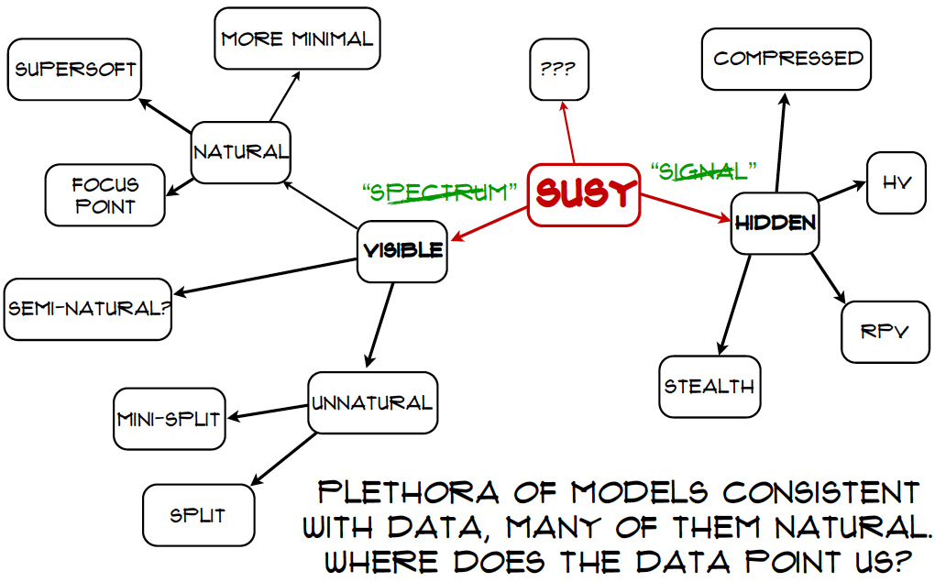

Craig@LHCP

Slide 54



SUSY Dark Matter Mechanisms
Bringing relic density into cosmological range often requires specific relation between sparticle masses, such as:
  Near-degeneracy, e.g..:
  Direct-channel resonance, e.g.:
Indicate by following shadings
“Blind spots”
Bagnaschi, Sakurai, JE et al, arXiv:1710.11091

Slide 55


Analysis of pMSSM11
Phenomenological MSSM with 11 parameters
Sample parameter space using Multinest technique
Sampling with/without g-2
Dedicated sampling of Dark Matter regions
Sample 2 × 10⁹ points
Bagnaschi, Sakurai, JE et al, arXiv:1710.11091

Slide 56

Squark & Gluino Mass Planes
Phenomenological MSSM
Fit including g_{μ}-2
Fit excluding g_{μ}-2
‘Nose’ regions where LHC sensitivity reduced
because of compressed spectrum
Bagnaschi, Sakurai, JE et al, arXiv:1710.11091

Slide 57

How Light can Squarks & Gluinos be?
Phenomenological MSSM
Squarks, gluinos could weigh ~ 1 TeV if drop g_{μ}-2
Bagnaschi, Sakurai, JE et al, arXiv:1710.11091

Slide 58

Likelihood for LSP Mass
Phenomenological
MSSM
(no assumptions
on mass parameters)
With g_{μ}-2
Without g_{μ}-2
Bagnaschi et al, arXiv:1710.11091

Slide 59

Dark Matter Composition
Phenomenological MSSM
(minimal assumptions on mass parameters)
With g_{μ}-2
Without g_{μ}-2
Bagnaschi, Sakurai, JE et al, arXiv:1710.11091

Slide 60

Best-Fit Sparticle Spectrum
Phenomenological MSSM
Fit including g_{μ}-2
Accessible to LHC?
Bagnaschi, Sakurai, JE et al, arXiv:1710.11091

Slide 61

Best-Fit Sparticle Spectrum
Phenomenological MSSM
Fit excluding g_{μ}-2
Accessible to LHC?
Bagnaschi, Sakurai, JE et al, arXiv:1710.11091

Slide 62


Decay Pattern at ‘Nose’ Point
Phenomenological MSSM
‘Nose’ point excluding g_{μ}-2
LHC sensitivity reduced because of
compressed spectrum, multiple decay modes
Bagnaschi, Sakurai, JE et al, arXiv:1710.11091

Slide 63

Dark Matter Mechanisms
Phenomenological
MSSM
(no assumptions
on mass parameters)
Smuon
Stau
With g_{μ}-2
Heavy
Higgs
Chargino
Without g_{μ}-2
Squark
Gluino
Bagnaschi et al, arXiv:1710.11091

Slide 64

Sparticle Masses in the pMSSM
& production at e+e- colliders
With g_{μ}-2
68 & 95% CL ranges
Best-fit values
Accessible in pair production at ILC500, ILC1000, CLIC
Bagnaschi, Sakurai, JE et al, arXiv:1710.11091

Slide 65

Sparticle Masses in the pMSSM
& production at e+e- colliders
Excluding g_{μ}-2
68 & 95% CL ranges
Best-fit values
Accessible in pair production at ILC500, ILC1000, CLIC
Bagnaschi, Sakurai, JE et al, arXiv:1710.11091

Slide 66

Direct Dark Matter Detection
Scattering of dark
matter particle in
deep underground
laboratory

Slide 67




WIMP Dark Matter Scattering
Effective Lagrangian:
Only α_{2,3} are velocity-independent, non-negligible
Spin-independent cross-section related to α₃:
& depends on quark contributions to nucleon mass:
Spin-dependent cross-section related to α₂, & depends on axial-current matrix elements
JE, Ferstl & Olive, hep-ph/0001005

Slide 68



Scattering Matrix Elements
Spin-independent scattering
  Related to <N|qq|N>, obtained from
  πN scattering:
  Baryon masses:
  Principal uncertainty:
  Our values:
Spin-dependent scattering
  Related to quark contributions to proton spin: Δq
  Axial-current matrix elements:
  & deep-inelastic lepton scattering
Bagnaschi, Sakurai, JE et al, arXiv:1710.11091

Slide 69




Dark Matter Scattering in SUSY
Neutralino mass
eigenstates:
Sfermion mixing:
And
for up (down) quarks
JE, Ferstl & Olive, hep-ph/0001005

Slide 70
Spin-Independent Scattering:
Sensitivities to Hadronic Matrix Elements
Sensitive to quark contributions to
nucleon mass, estimated using
octet baryon masses (σ₀)
matrix element for πN scattering (Σ_{πN})
(lattice)
Central values for different σ₀
Bands for ± 8 MeV for σ₀, Σ_{πN}
Our central
values
X
JE & Olive, in preparation

Slide 71

Direct Dark Matter Searches
Compilation of present and future sensitivities
SUSY
models
Neutrino
“floor”

Slide 72

Direct Dark Matter Searches
Phenomenological MSSM
Spin-Independent Scattering
With g_{μ}-2
Without g_{μ}-2
Bagnaschi, Sakurai, JE et al, arXiv:1710.11091

Slide 73

Direct Dark Matter Searches
Phenomenological MSSM
Spin-Dependent Scattering
sensitive to quark contributions to nucleon spin
With g_{μ}-2
Without g_{μ}-2
Bagnaschi, Sakurai, JE et al, arXiv:1710.11091

Slide 74
PICO vs Annihilations in Sun ➔ ν
⬇
Interpretation
dependent on
annihilation
channel
⬇

Slide 75
A
A
A
A
A
A
A
A
A
A
A
A
A
A
A
a
Particle Dark Matter Candidates
Weakly-interacting
Massive Particles
(supersymmetry)
Neutrinos
Superheavy ‘cryptons’
Black
Holes
→
Axions
Log₁₀(σ/picobarns)
Super-weakly
interacting
particles, e.g.,
gravitino
Log₁₀(mass/proton mass)

Slide 76
Super-WIMP Dark Matter
Only gravitation-strength interactions
  (gravitational interactions only one known)
Relic density not determined by freeze-out
  Production by high-energy/temperature interactions in very early Universe?
  Produced in decays of heavier particles
Subsequently out of thermal equilibrium
Prototype: gravitino in supersymmetry

Slide 77
Searches for Super-WIMP Dark Matter
Annihilation
to particles ➔
in cosmic rays
Dark Matter
Standard Model
Annihilation
in the early ➔
Universe
Production
⬅ at particle
colliders
Gravitational
strength
Interactions
via decays of heavier particles
⬆
Direct dark matter detection
Dark Matter
Standard Model

Slide 78


Hidden-Sector Dark Matter?
‘Generic’ string models have ‘many’ hidden sectors with different sets of gauge interactions
Also have heavy scalar ‘moduli’ fields Φ that decay into visible & hidden sectors
  reheating:
Sample study:
  Representative values (fixing dark fraction 0.1)
  Branching ratio for Φ → dark DM particle 10⁻³
Acharya, S.Ellis, Kane, Nelson & Perry, arXiv:1704.03850, 1707.04530

Slide 79


Hidden-Sector Dark Matter?
Acharya, S.Ellis, Kane, Nelson & Perry, arXiv:1704.03850, 1707.04530
Generic string models have (many) dark sector(s)
Lightest sparticle likely (?) to be in one of these
  Typical mass ≤ 100 GeV
Mixing with visible sector
→ super-weakly-interacting
Density of lightest hidden-
sector sparticle (LHSP) fixed
by annihilation
via mediator M

Slide 80


Lightest Visible-Sector Particle Long-Lived?
Mixing induces decay of lightest visible-sector sparticle (LVSP) into LHSP
Small kinetic mixing ε
between U(1)_{SM} & U(1)_{H}
(M_{ab} mass matrix of particles
with both charges, M ~ M_{GUT})
LVSP may have
detectable decay length
Acharya, S.Ellis, Kane, Nelson & Perry, arXiv:1704.03850, 1707.04530

Slide 81

Constraints on Parameter Space
Mediator
Mass
Constraints from direct detection experiments
g_{H} = hidden coupling
Acharya, S.Ellis, Kane, Nelson & Perry, arXiv:1704.03850, 1707.04530

Slide 82




Simplified Dark Matter Models
General formulation using minimal models
Different mediator particles possible
Tag with radiated gluon (photon, W, Z, H)
Mono-X
signatures
Scalar
Vector
g
γ

Slide 83

Simplified Dark Matter Models
Z’ mediator models
Present sensitivities for different Z’ mediator bosons
Complementarity between LHC and direct searches
LHC
DM search
DM search
LHC
Model dependence

Slide 84

Simplified Dark Matter Models
Involve bosonic mediator particles of spin 0 or 1
The latter are gauge bosons of some U(1)’ with vector and/or axial-vector couplings
Consistency of theory requires cancellation of anomalous triangle diagrams
Standard Model has
quark-lepton cancellation
Should be re-examined in models with extra fermions and/or gauge bosons
JE, Fairbairn & Tunney, arXiv:1704.03850

Slide 85

Anomaly Cancellation Conditions
Colour/U(1)’:
SU(2)_{W}/U(1)’:
U(1)_{Y}²/U(1)’:
U(1)_{Y}/U(1)’²:
U(1)’³:
Gravity/U(1)’::
Non-trivial set of constraints
JE, Fairbairn & Tunney, arXiv:1704.03850, 1705.03447

Slide 86


Simplified Dark Matter Models
Mass of Z’ boson > about 3 TeV if produced by 1st generation quarks and decays to leptons
Impact reduced if leptophobic
Impact of direct DM searches reduced if
  DM particle has axial Z’ coupling
  DM particle has axial nuclear coupling
  DM particle decouples from 1st/2nd generation
What anomaly-free U(1)’ models compatible with these desiderata?

Slide 87






Benchmark Anomaly-Free DM Models
Single DM particle χ, free parameters: ,
Axial coupling for DM particle χ:
Leptophobic model + SM doublet A, singlets B,C
Strong LHC, DM scattering constraints, specific pattern of couplings
Strong LHC constraints, restricted pattern of couplings, 2nd ‘dark’ fermion
Weaker LHC constraints, restricted couplings, new doublet, 2 ‘dark’ fermions
JE, Fairbairn & Tunney, arXiv:1704.03850

Slide 88

Experimental Constraints on
Anomaly-Free Dark Matter Models
g = 0.1
g = 0.01
Excluded by LHC dilepton searches
Excluded by direct dark matter searches
JE, Fairbairn & Tunney, in preparation

Slide 89
Flavour Anomalies in B➔K^{(*)}μ⁺μ⁻, B_{s}➔ϕμ⁺μ⁻
Apparent violation of μ-e universality in B➔K^{(*)}μ⁺μ⁻
Anomalous angular distribution in B➔K*μ⁺μ⁻
Anomalous q² distribution in B_{s}➔ϕμ⁺μ⁻ decay
(Also anomalies in B ➔D τν, …)

Slide 90


Flavour Anomalies in B➔K^{(*)}μ⁺μ⁻
Extra contribution to coefficient of
No evidence for extra contribution to
or operators with electrons
Difficult to explain with SUSY
B. Capdevila, A. Crivellin, S. Descotes-Genon, J. Matias and J. Virto, arXiv:1704.05340

Slide 91
Possible Z’ Interpretations
Coupling to muons, not electrons (LEP), tau?
Prefer vector-like coupling to muons
Coupling to LH charge – 1/3 quarks
Prefer universal couplings to 1st/2nd generation quarks (FCNC)
Different coupling to 3rd generation quarks to get bs flavour change
Non-zero couplings of RH charge 2/3 quarks?
Additional ‘dark’ sector or heavy vector-like lepton?
JE, Fairbairn & Tunney, arXiv:1705.03447

Slide 92
Flavourful Z’ Models are not so Simple
If only SM particles, all quark U(1)’ charges zero
Same if only one DM particle
If 2 ‘dark’ fermions, models with OK?
  No DM candidate with axial coupling
If RH quark charges and one DM fermion
  Solutions [A, B, C] with vector-like muon coupling
  [A] also axial DM fermion
  Also models [D] without 1st/2nd generation couplings
  These have Also OK?
Models with extra leptons, no DM
JE, Fairbairn & Tunney, arXiv:1705.03447

Slide 93

Comparison of Models to
Global Analysis of Flavour Anomalies
RH 2/3 quarks
Single DM fermion
Model [D]
RH 2/3 quarks
Single DM fermion
Models [A, B, C]
LH quarks only
2 dark fermions
Dot-dashed line:
Dashed line:
OK with data?
JE, Fairbairn & Tunney, arXiv:1705.03447

Slide 94
Possible Experimental Signatures
2 ‘dark’ SM-singlet fermions?
  Decays of heavier mass eigenstate
  Z’ coupling to muons not vector-like
  Strong LHC dilepton constraint
  No DM candidate with axial coupling
If RH quark charges and one DM fermion?
  Models with vector-like muon, axial Z’ DM couplings
  Models without 1st/2nd generation couplings have weaker LHC constraint,
Models with extra leptons, no DM?
  LHC constraint weakened by small branching ratio?
  May not have vector-like muon coupling
JE, Fairbairn & Tunney, arXiv:1705.03447

Slide 95
H- and Z-Portal Models are not dead yet
Dropping ideology
Consider spin-0, -1/2, -1 DM coupled to Standard Model via Higgs or Z boson
All available collider, DM search constraints
Bayesian & frequentist statistical analyses
JE, Fowlie, Marzola & Raidal, arXiv:1711.09912

Slide 96

Higgs coupled to
Spin-0 DM
Relic density
+ collider
Also indirect
DM search
Red = 1-, 2-σ regions
Grey = relic density
On- and off-shell cases both allowed
Also direct
DM search
Possible future
direct
DM search
JE, Fowlie, Marzola &
Raidal, arXiv:1711.09912

Slide 97

Higgs coupled to
Spin-½ DM
Dirac fermion
Scalar coupling
Dirac fermion
Pseudoscalar
Red = 1-, 2-σ regions
Grey = relic density
On- and off-shell cases both allowed
Majorana fermion
Scalar coupling
Majorana fermion
Pseudoscalar
JE, Fowlie, Marzola &
Raidal, arXiv:1711.09912

Slide 98

Z Boson coupled to
Spin-½ DM
Dirac fermion
Vector coupling
Dirac fermion
Axial coupling
Red = 1-, 2-σ regions
Grey = relic density
On- and off-shell cases both allowed
Majorana fermion
Axial coupling
JE, Fowlie, Marzola &
Raidal, arXiv:1711.09912

Slide 99

Summary of Results
OK
Strongly
disfavoured
OK
JE, Fowlie, Marzola & Raidal, arXiv:1711.09912

Slide 100
Invisible H or Z decays to DM
H → Dirac
fermion
H → complex
scalar
In on-shell cases
Red = 1-, 2-σ regions
Sensitivity of future e⁺e⁻ collider
Z → complex
scalar
Z → Dirac
fermion
JE, Fowlie, Marzola & Raidal, in preparation

Slide 101

The LHC in Future Years

Slide 102

Squark-Gluino Plane
Discover 12 TeV squark,
16 TeV gluino @ 5σ

Slide 103
Many other Candidate Dark Matter Particles

Slide 104

Light Dark Matter Searches
Possible search strategies
Nuclear
recoil
Electron
recoil

Slide 105

Light Dark Matter Searches
Compilation of present and future sensitivities
LHe
detectors
Solar
neutrinos
Neutrino
“floor”
Atmospheric
neutrinos

Slide 106


Constraints on Light DM + Scalar Mediator
Mediator ϕ
Dark matter χ
Nucleon
coupling
Why not?
Laboratory
constraints
Astrophysical
constraints
Knapen, Lin & Zurek, arXiv:1707.07882

Slide 107

Direct Detection of Light Scalar DM?
Nucleon
coupling
Excluded
region
Detection
sensitivity
Knapen, Lin & Zurek, arXiv:1707.07882

Slide 108

Direct Detection of Light Scalar DM?
Nucleon
X-section
Excluded
region
LHe
detectors
Knapen, Lin & Zurek, arXiv:1707.07882

Slide 109


Constraints on Leptophilic Mediator
Laboratory
constraints
Electron
coupling
Astrophysical
constraints
Knapen, Lin & Zurek, arXiv:1707.07882

Slide 110

Constraints on Leptophilic Mediator
Direct
detection
Electron
X-section
Astrophysical
& cosmological
constraints
Two representative mass scenarios
Knapen, Lin & Zurek, arXiv:1707.07882

Slide 111


Fermionic DM Coupled via Dark Photon
Electron
X-section
Direct
detection
Knapen, Lin & Zurek, arXiv:1707.07882

Slide 112

Fermionic DM Coupled via U(1)_{B-L}
Laboratory
constraints
U(1)_{B-L}
coupling
Astrophysical
constraints
Knapen, Lin & Zurek, arXiv:1707.07882

Slide 113

Fermionic DM Coupled via U(1)_{B-L}
Direct
detection
Electron
X-section
Knapen, Lin & Zurek, arXiv:1707.07882

Slide 114
Particle Dark Matter Candidates
A
A
A
A
A
A
A
A
A
A
A
A
A
A
A
a
Weakly-interacting
Massive Particles
(supersymmetry)
Neutrinos
Superheavy ‘cryptons’
Black
Holes
→
Axions
Log₁₀(σ/picobarns)
Super-weakly
interacting
particles, e.g.,
gravitino
Log₁₀(mass/proton mass)

Slide 115

Axion(-like Particle)s
Very light (<< eV) spin-zero particles
Postulated originally to explain why strong interactions conserve CP symmetry
Many present in string models
Would be present in waves throughout Universe
Density dependent on wave height
Would decay into pairs of photons
Could be emitted by stars

Slide 116



The Strong CP Problem
In presence of non-perturbative phenomena, dependence on possible P- (and CP-)violating term
Strong upper limit θ_{QCD} < 10⁻¹⁰ from electric dipole moment of neutron:
Fine-tuning problem at classical level due to CP violation in electroweak sector:
Quantum corrections are small, first logarithmic divergence appears at seven-loop level
  Not same naturalness problem as Higgs mass

Slide 117

The Axion
Peccei & Quinn, 1977
Weinberg, Wilczek, 1978
Upgrade c-number phase θ to quantum field ϕ
Non-perturbative QCD → effective potential
  (breaking of Peccei-Quinn symmetry)
Curvature of potential → mass of corresponding particle “axion”:
  f_{a} = model-dependent “horizontal” scale
Direct couplings to nucleons, electrons ~ 1/f_{a}
Axion decays to γγ via loop diagrams (like pion)
  Look for γ + B-field → a, a + B-field → γ, …

Slide 118

Survey of Axiology
Battaglieri et al., arXiv:1707.04591
Astro/cosmo
constraints

Slide 119

Searches for Axion-Like Particles
Axions
from Sun
Axions
from halo
Correct
DM density
Graham et al., arXiv:1602.00039

Slide 120

Constraints on Axion(-Like) Particle-Nucleon Scattering
Battaglieri et al., arXiv:1707.04591

Slide 121

Present & Future Helioscopes
IAXO
Battaglieri et al., arXiv:1707.04591

Slide 122

Axion Miniclusters
Possible if effective potential appears after inflation
  (breaking of PQ symmetry)
Characteristic mass scale may be similar to planets
Temperature
dependence
of axion mass
Fairbairn, Marsh, Quevillon & Rozier, arXiv:1707.03310

Slide 123

Axion Miniclusters
Evolution with redshift
Minicluster sizes now
What fraction f_{MC} of the total axion density today?
Fairbairn, Marsh, Quevillon & Rozier, arXiv:1707.03310

Slide 124


Microlensing by Axion Miniclusters
Amount of magnification sensitive to initial over-density δ, which controls profile
Fairbairn, Marsh, Quevillon & Rozier, arXiv:1707.03310

Slide 125

Expected MACHO Event Numbers
For fractional density
f_{MC} = 1
Fairbairn, Marsh, Quevillon & Rozier, arXiv:1707.03310

Slide 126

Constraints from MACHO Searches
On fractional density
of miniclusters, f_{MC}
n: temperature
dependence of m_{a}
Sensitivity of hypothetical
future 10-night HSC data
Fairbairn, Marsh, Quevillon & Rozier, arXiv:1707.03310

Slide 127

Constraint on Axions
Fairbairn, Marsh, Quevillon & Rozier, arXiv:1707.03310
No
Miniclusters
Temperature
dependence
of axion mass

Slide 128
Particle Dark Matter Candidates
A
A
A
A
A
A
A
A
A
A
A
A
A
A
A
a
Weakly-interacting
Massive Particles
(supersymmetry)
Neutrinos
Superheavy ‘cryptons’
Black
Holes
→
Axions
Log₁₀(σ/picobarns)
Super-weakly
interacting
particles, e.g.,
gravitino
Log₁₀(mass/proton mass)

Slide 129
Black Holes
They exist! ☺
They do not shine ☺
They have BIIIIIIG masses ☺
Would have had to be formed before the Universe was ~ 1 second old ☹
  (otherwise included in BBN constraint on baryons)
BUT they are subject to many astrophysical and cosmological constraints ☹

Slide 130


Gravitational Waves
A world-shaking discovery
Earth expands and contracts by the diameter of an atomic nucleus: 10⁻¹² cm

Slide 131

Discovery of Gravitational Waves
Measured by the LIGO experiment in 2 locations
State of Washington
State of Louisiana

Slide 132

Fusion of two massive black holes
Masses many solar masses
Radiated energy > solar mass

Slide 133

What was observed
Very similar signals in the 2 detectors
In agreement with gravitational-wave predictions

Slide 134

Fusion of two massive black holes
Einstein was right
A new way to study the Universe – & physics?

Slide 135


Measured Black Hole Masses
First LIGO
event
Recent
LIGO
event
70
60
50
40
30
20
10
0
Other LIGO
events
Solar masses
X-Ray Studies

Slide 136

Could Black Holes be the DM?
Carr et al., arXiv:1705.05567
Microlensing
At most 10% of total Dark Matter?
Survival of stars
in dwarf galaxy
Segue 1
BH masses
from mergers
⬇

Slide 137

Neutron Star Merger
GW170817
Longer chirp, extending to higher frequencies
Masses < 2 solar masses
Two neutron stars!
Weak signal in Virgo helps localization
Electromagnetic counterpart seen in detail
LIGO /Virgo, Oct. 2017

Slide 138

Localization of NS-NS Merger
LIGO /Virgo/70 groups of astronomers, Oct. 2017

Slide 139


Compilation of Observations
LIGO /Virgo/Fermi/INTEGRAL
LIGO /Virgo+70
Velocity of gravity ~ light
Electomagnetic follow-up

Slide 140

Compilation of Light Curves
Villar et al., arXiv:1710.11576
Agreement with models of NS-NS mergers
Evidence for heavy elements
Example of astrophysical r-process

Slide 141
Signatures of Dark Matter in NS-NS Mergers?
Crazy ideas for dark matter signatures
JE, Hektor, Hütsi, Kannike, Marzola, Raidal & Vaskonen, arXiv:1710.05540

Slide 142



What Happens before the Merger?
DM cluster in neutron star can modify effective equation of state
Change radius, tidal deformability
Models of
neutron star
equation of state
Smaller
radius
Smaller
deformability
JE, Hektor, Hütsi, Kannike, Marzola, Raidal & Vaskonen, in preparation

Slide 143


What Happens after the Merger?
Neutron star cores orbit and oscillate radially
Characteristic spectrum of frequencies in GW emissions
Frequency peaks at stationary points in oscillations
Weakens
in few ms
Takami, Rezzolla & Baiotti, arXiv:1403.56720, 1412.3240

Slide 144


Toy Mechanical Model
Neutron cores oscillate and rotate inside disc
Captures surprisingly well major features of strain fluctuations
Takami, Rezzolla & Baiotti, arXiv:1403.56720, 1412.3240

Slide 145


Including Dark Matter
DM
Two pairs of oscillating cores
Reproduce results when no DM
Weakens in few ms
2 peaks if unequal DM core masses
EHHKMRV, arXiv:1710.05540

Slide 146

Possible Strength of DM Signal
Depends on DM fraction, dynamical parameters
EHHKMRV, arXiv:1710.05540

Slide 147

Microlensing of Quasar Horizon?
Quasar RXJ1131−1231 emissions from near horizon
Fluctuations in FeKα frequency
Due to microlensing of different (small) emission regions (red/blue shifted) by planetary-mass objects?
Dai & Guerras, arXiv:1802.00049

Slide 148

Enhanced Probability of Microlensing
Dai & Guerras, arXiv:1802.00049
Probability too low with stars alone
Data fit by enhanced probability of microlensing by planetary-mass objects
Constraint on axion miniclusters?
JE, Fairbairn, Marsh & Quevillon, in preparation

Slide 149

Summary
Supersymmetry is still alive:
  Many variants
  Little change from LHC Run 1
A fortiori, other WIMP scenarios also possible
  Connected to Standard Model via H or Z
  Couple via Z’: extra signatures
Open season for crazy ideas
  Light dark matter?
  Black holes? ……..
Not dead yet

