Slide 1
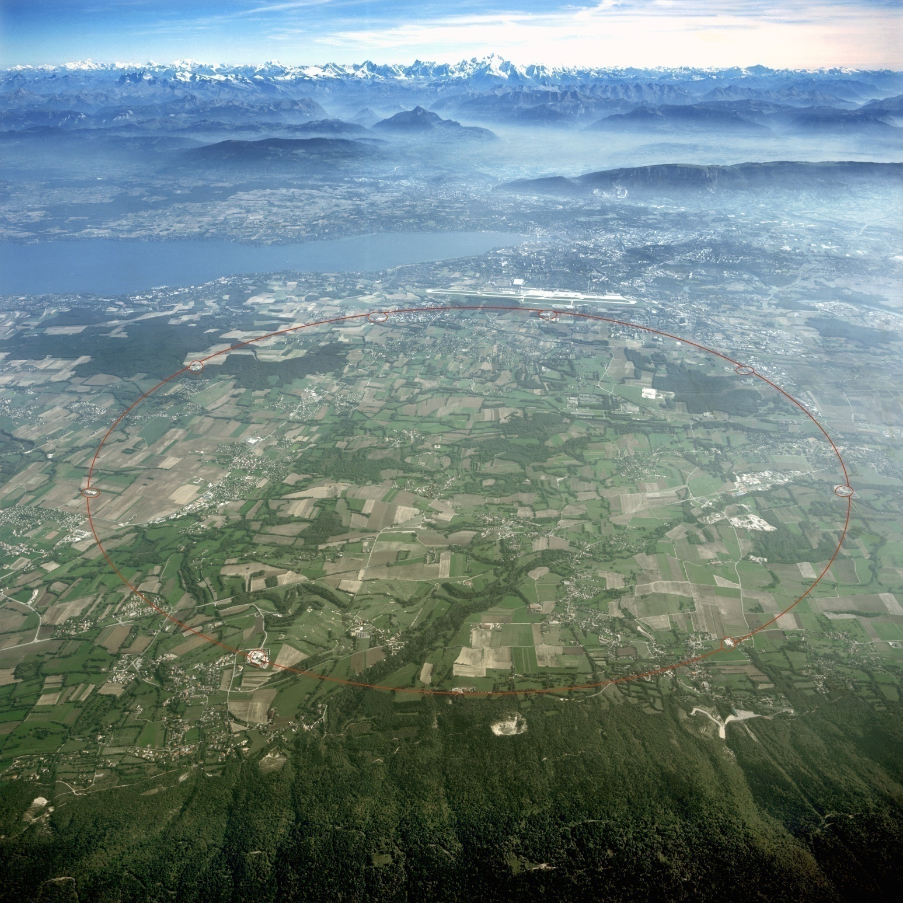
LHC now and its future prospect
LHCｂ
ATLAS
CMS
ALICE
KMI Inauguration Conference
Katsuo Tokushuku (KEK)

Slide 2
LHC now and its future prospect
Four large experiments
+
Three small ones
LHCｂ
MoEDAL
ATLAS
LHCf
CMS
TOTEM
ALICE
KMI Inauguration Conference
Katsuo Tokushuku (KEK)

Slide 3
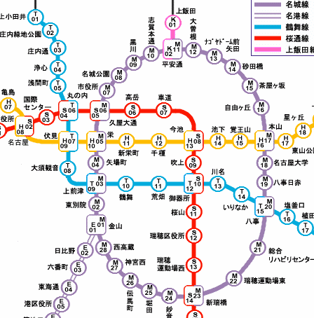
LHC: circumfernce: 26.7km
Nagoya subway: meijo-line: 26.4km
(completed in 2004)
LHCｂ
MoEDAL
ATLAS
We are here!
LHCf
Your hotel
CMS
TOTEM
ALICE

Slide 4

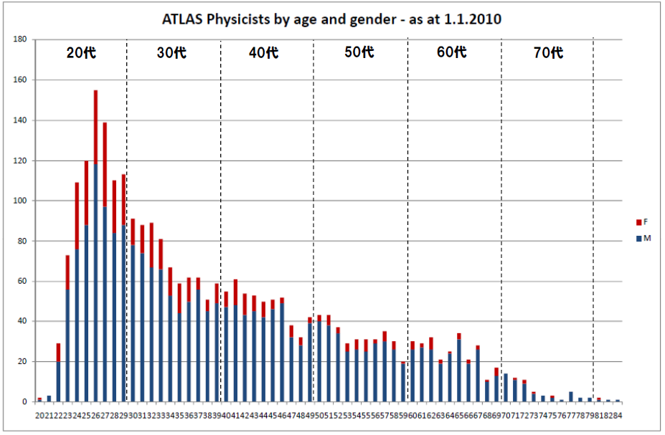

ATLAS Collaboration
38 Countries
173 Institutions
~ 2980 active scientists:
~ 1800 with a PhD → contribute to M&O share
~ 1100 students

Slide 5
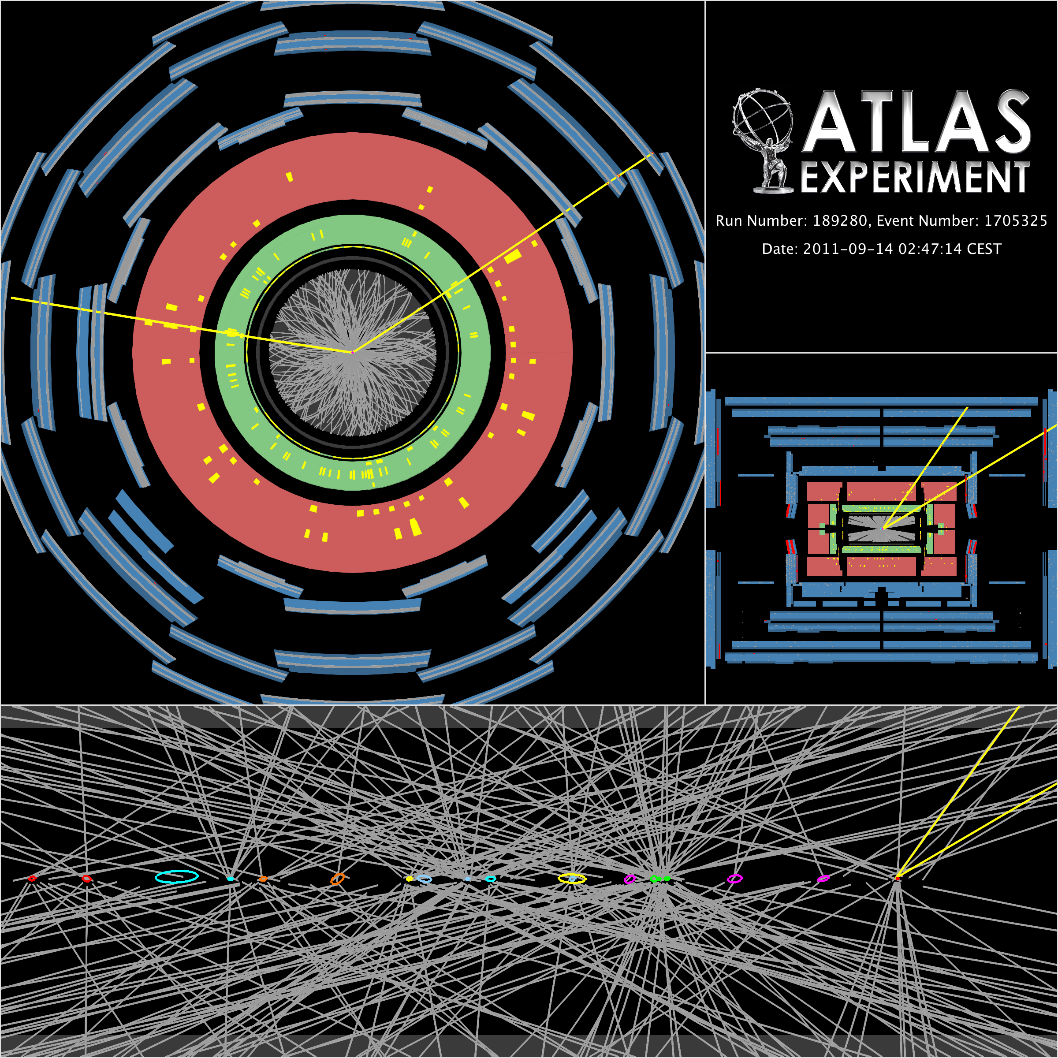
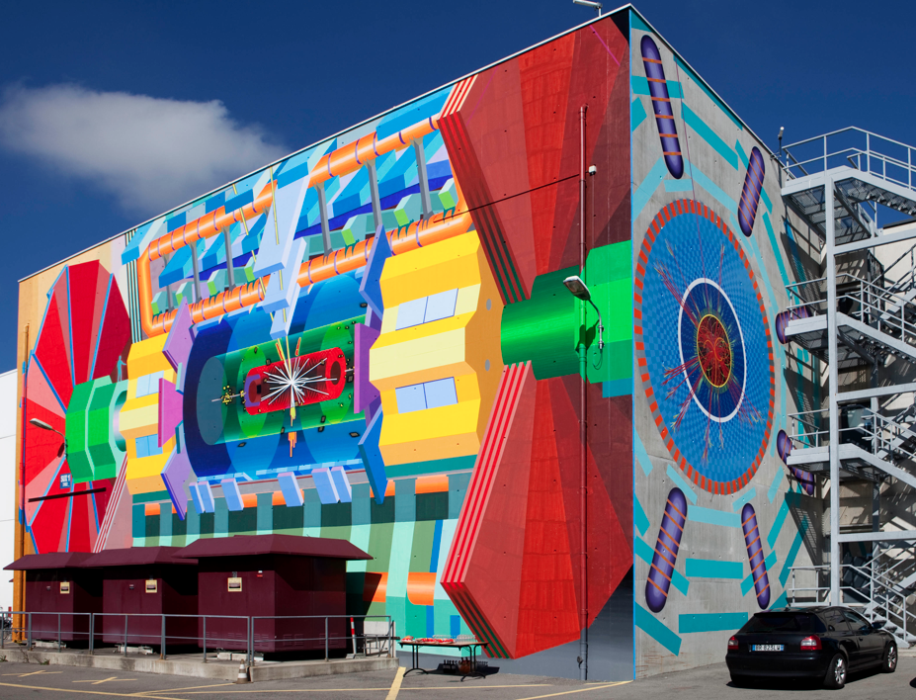
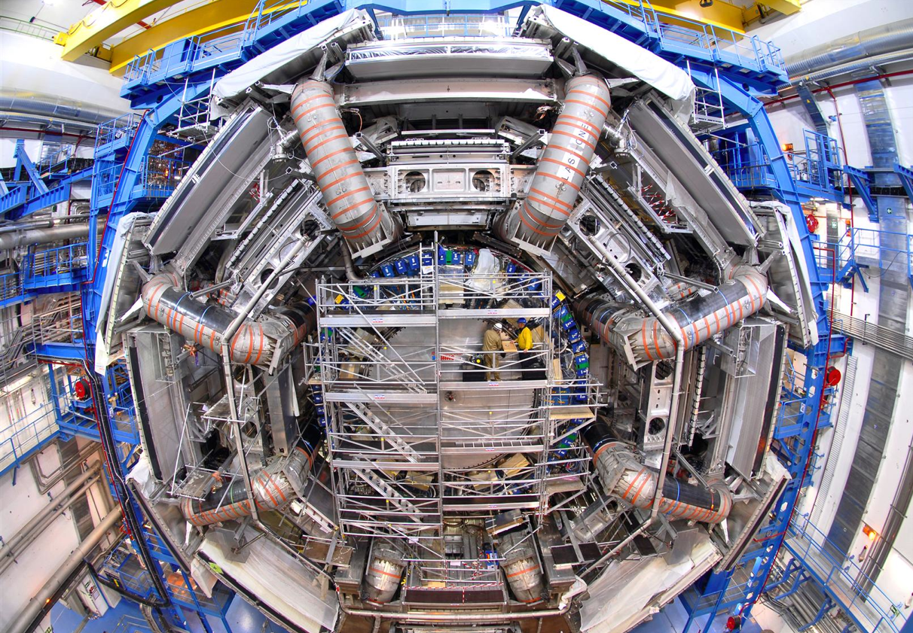
ATLAS history
2009-: Data!
1992: Letter of Intent
Z → μμ event with 20
reconstructed vertices
(ellipses have 20 σ size
for visibility reasons)
2008: The Detector is ready

Slide 6
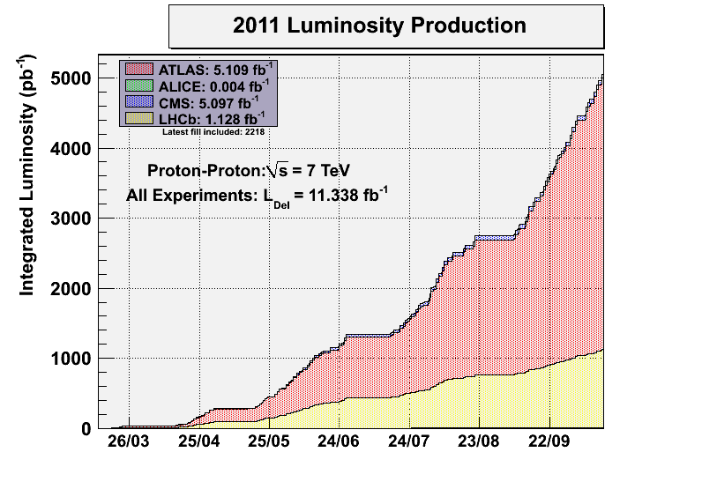
Summary of Records (17th October 2011)

Slide 7
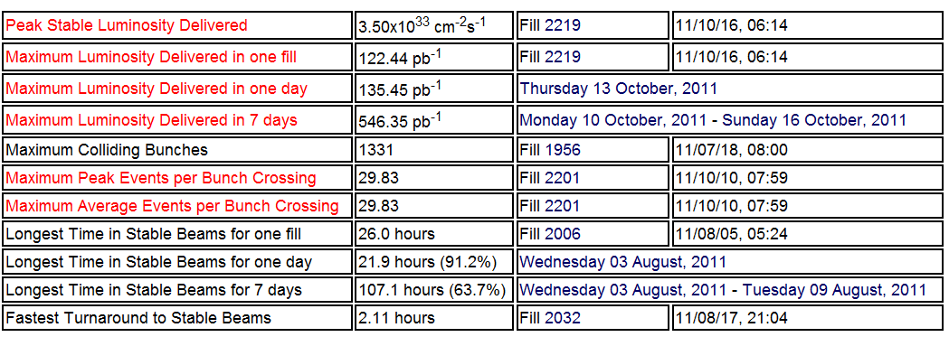
Summary of Records (17th October 2011)
The achieved luminosity per bunch is already better
than the design value. (at Ecm=7TeV)

Slide 8
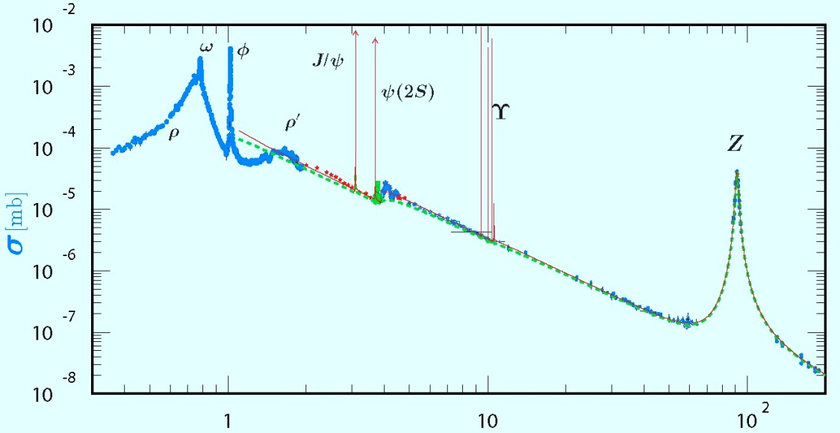
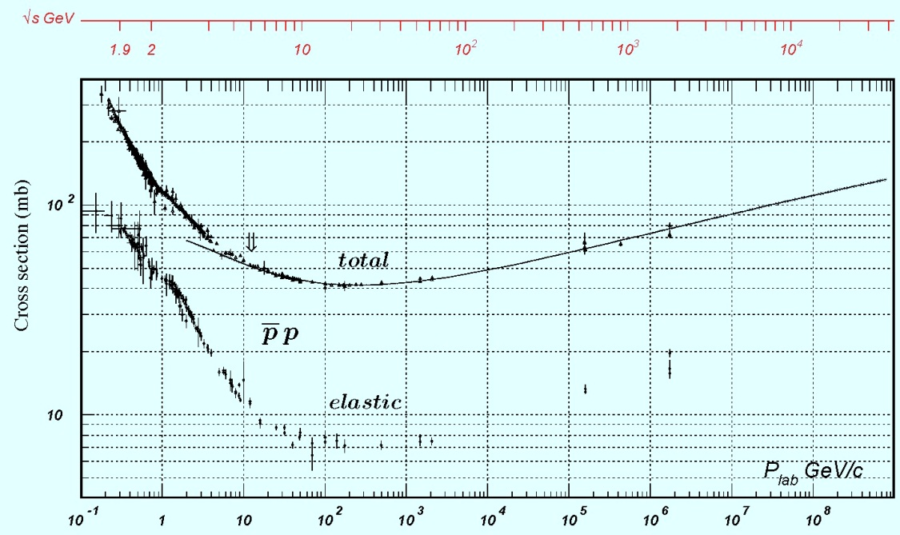
Proton-proton scattering
e⁺ + e⁻ scattering:
cross section ∝ 1/s
e⁻
Z/γ
e⁺
(－)
p p scattering:
cross section ~ s^{0.08}
d
Proton :
a composite object
d
d
s
u
s
u
u
u

Slide 9
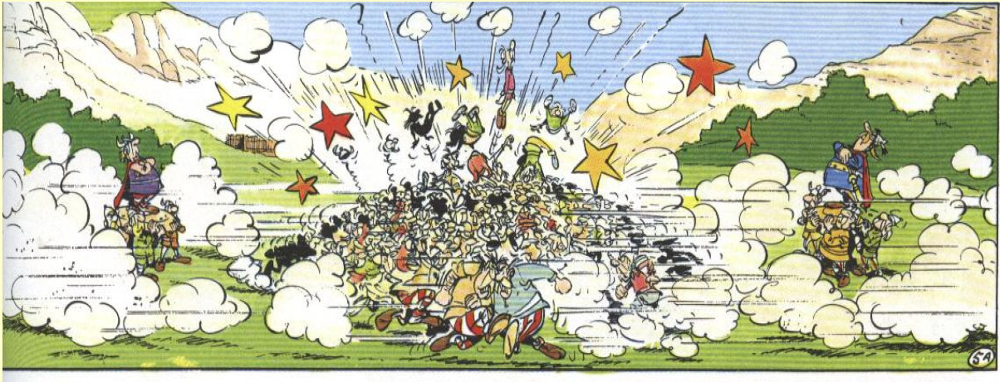
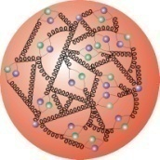
ＰＤＦ (parton distribution function)
g
g
Note the scale factor.
Gluon dominant at low-x

Slide 10
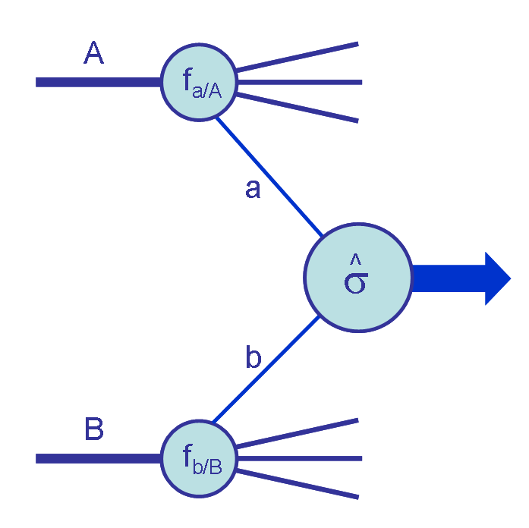
Jet
Quark
x_{a}E₀ GeV
proton
E₀GeV
proton
quark
x_{b}E₀ GeV
Jet

Slide 11
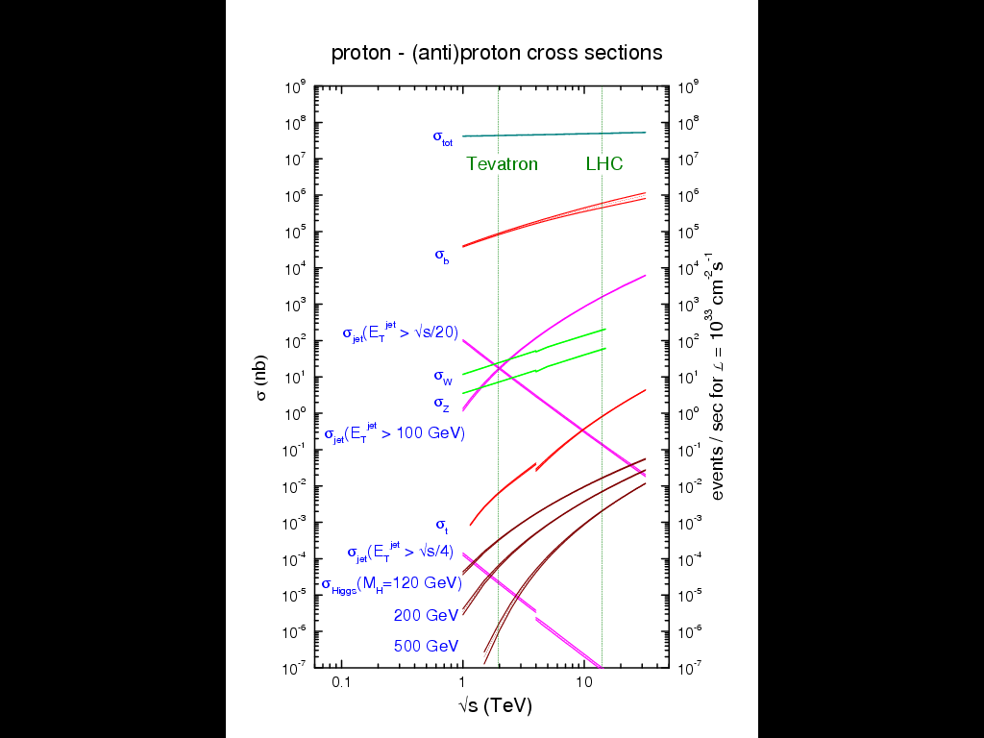
2009
~10μb⁻¹
2011 June
1fb⁻¹
Energy

Slide 12
LHC first-year achievement 1:
Proton-proton cross section become large (as expected from various models）

Slide 13
LHC first-year achievement 1:
Proton-proton cross section become large (as expected from various models）
√s=7TeV Totem : EPL, 96 (2011) 21002
σ_{inel} (CMS) = (68.0 ± 2.0^{(syst)} ± 2.4^{(lumi)} ± 4.0 ^{(extrap)}) mb
σ_{inel} (ATLAS) = (69.4 ± 2.4^{(exp)} ± 6.9 ^{(extrap)}) mb
Σ_{inel} (ALICE) = (72.7 ± 1.1^{(mod)} ± 5.1 ^{(lumi)}) mb

Slide 14
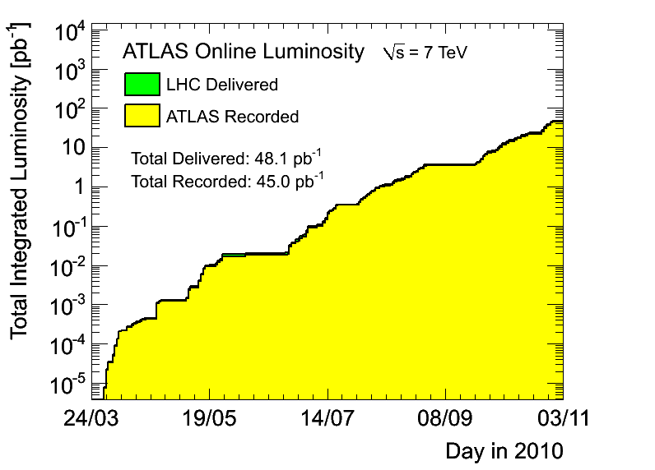
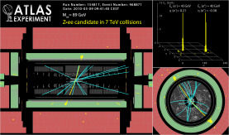
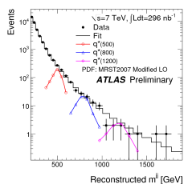
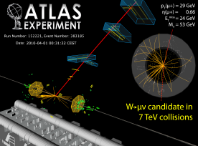
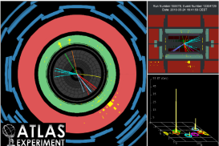
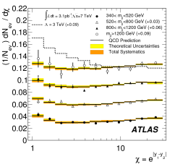
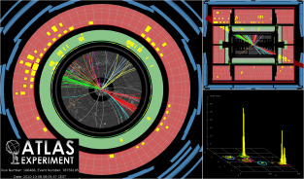
LHC first-year achievement 2:
Re-discovery of the various standard model particles.
May: 1st Z
July: first searches
beyond Tevatron
April:1st W
June: first top
candidates
August: more searches
beyond Tevatron
October: highest mass
di-jet event (4 TeV)

Slide 15
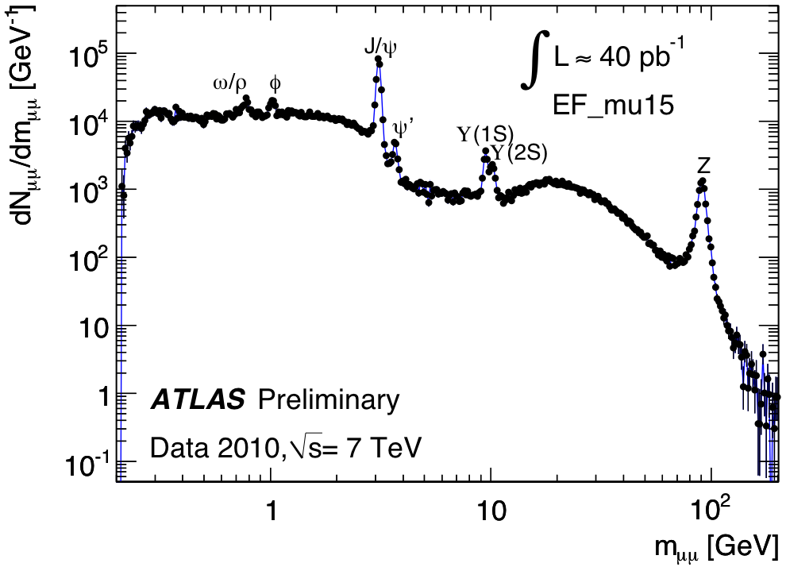
LHC first-year achievement 2:
Re-discovery of the various standard model particles.
+2/3
u
c
t
quarks
-1/3
d
s
b
0
ν_{e}
ν_{μ}
ν_{τ}
leptons
-1
e
μ
τ
Top? Higgs? ->
Tomoto-san’s talk
μ⁺μ⁻

Slide 16
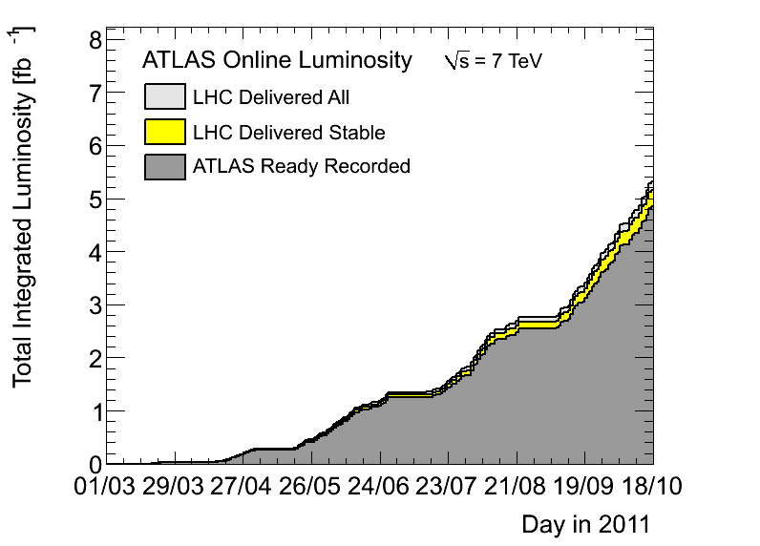
Now we have 5fb⁻¹ data !
5.1 fb⁻¹
4.8 fb⁻¹
EPS, July
~ 1.2 fb⁻¹
Lepton-Photon,
end August ~ 2.5 fb⁻¹

Slide 17
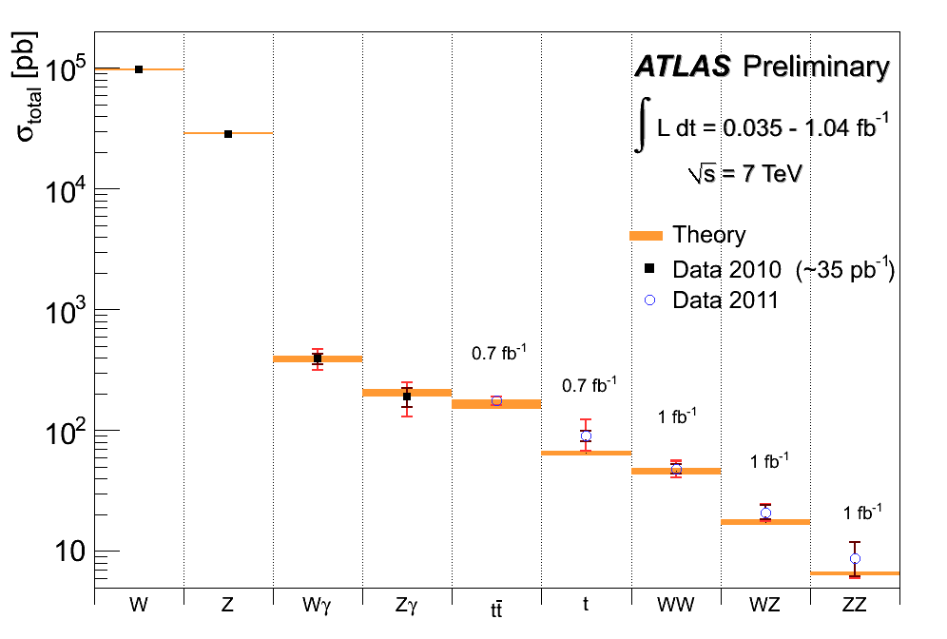
Summary of main electroweak measurements
Inner error: statistical
Outer error: total
σ (pp→ H) m_{H}=130 GeV
Good agreement with SM expectations (within present uncertainties)
Experimental precision starts to challenge theory for e.g. tt (background to most searches)

Slide 18
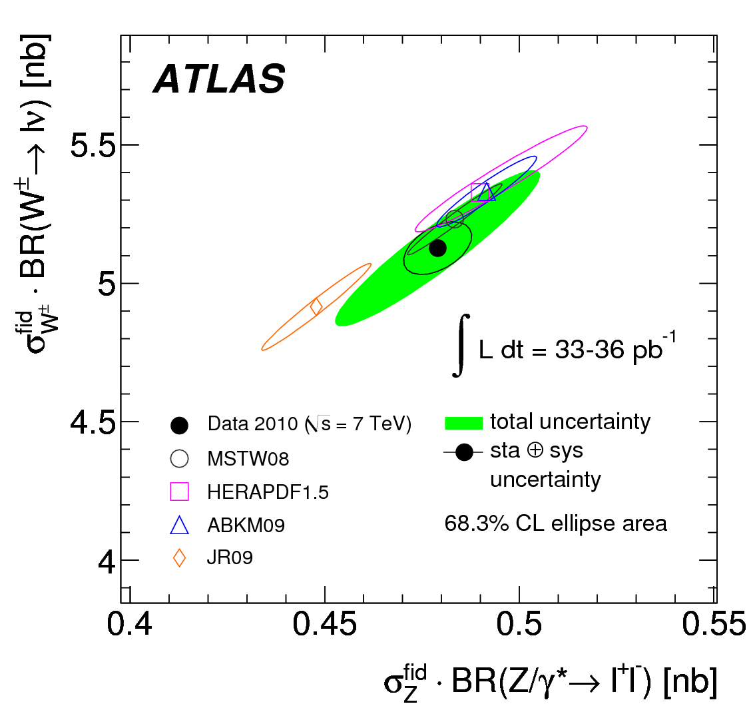
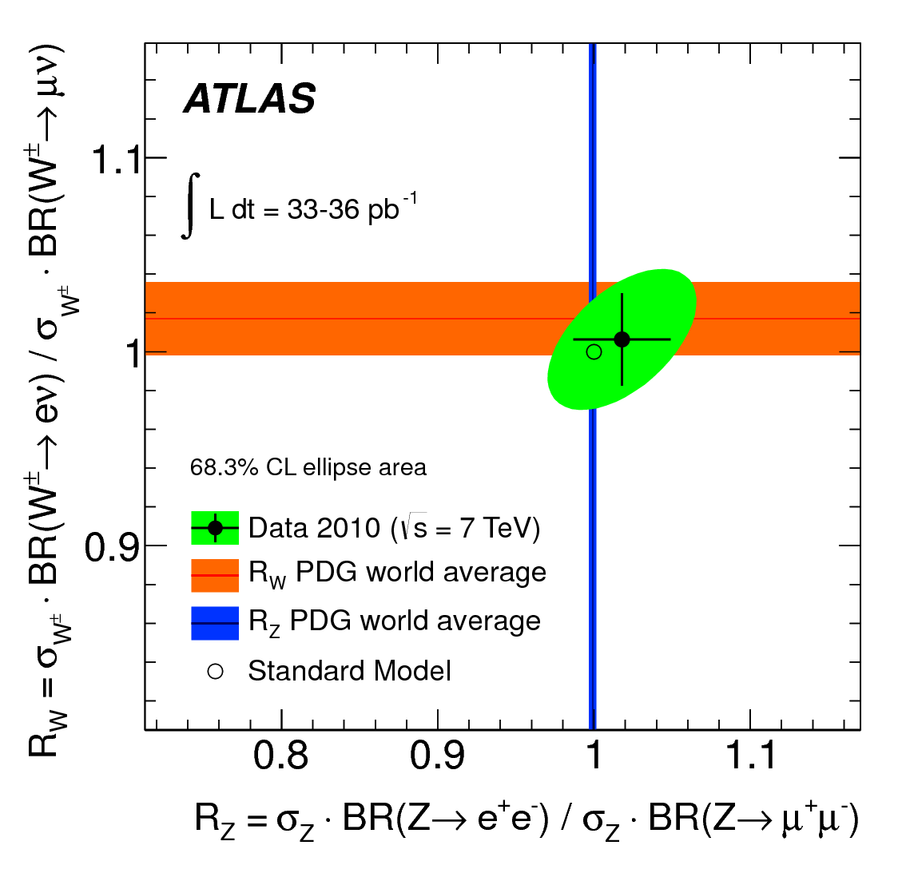
W, Z precision measurements :
Lepton universality:
The precision is already closed to the PDG average
Sensitive to constrain the pdfs

Slide 19
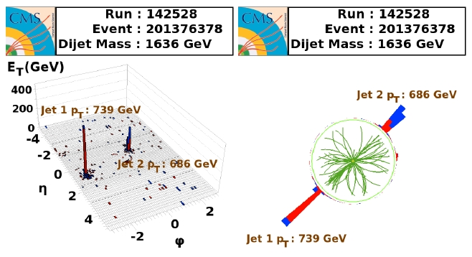
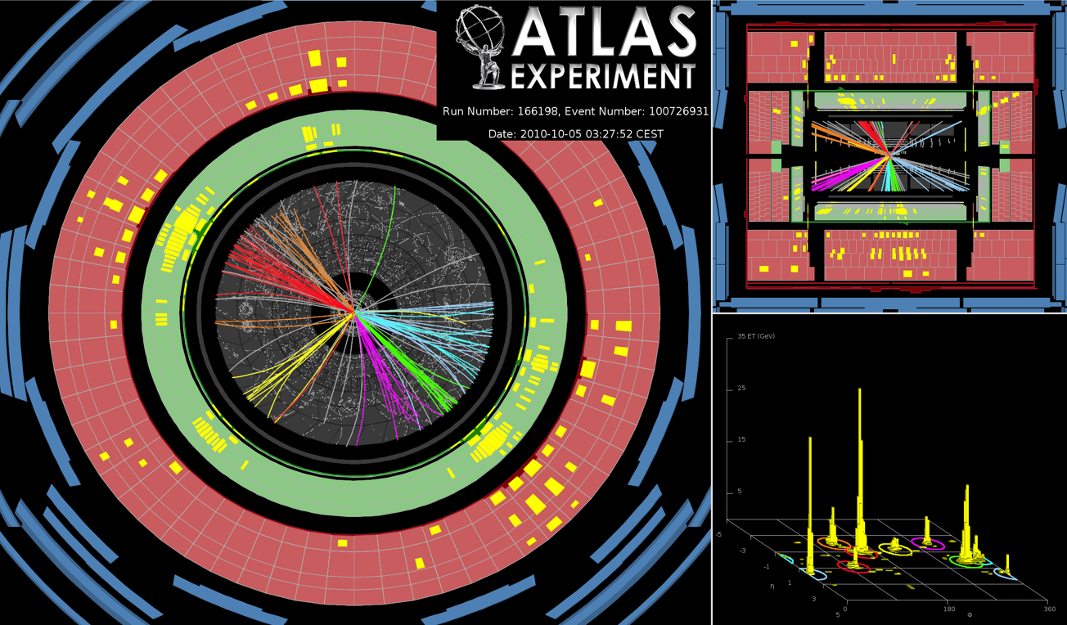
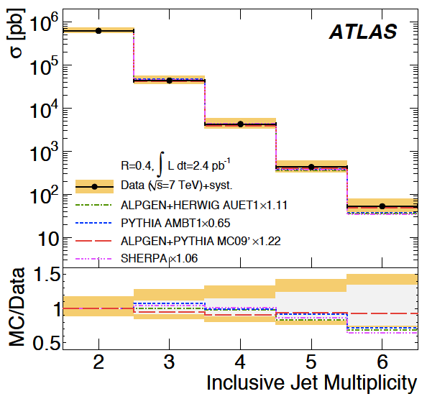
LHC first-year achievement 3:
The parton-parton scattering model works
High-pT di-jet event in CMS
JETS
8 jet event in ATLAS

Slide 20
Jet cross section:
2010 measurement
New points

Slide 21
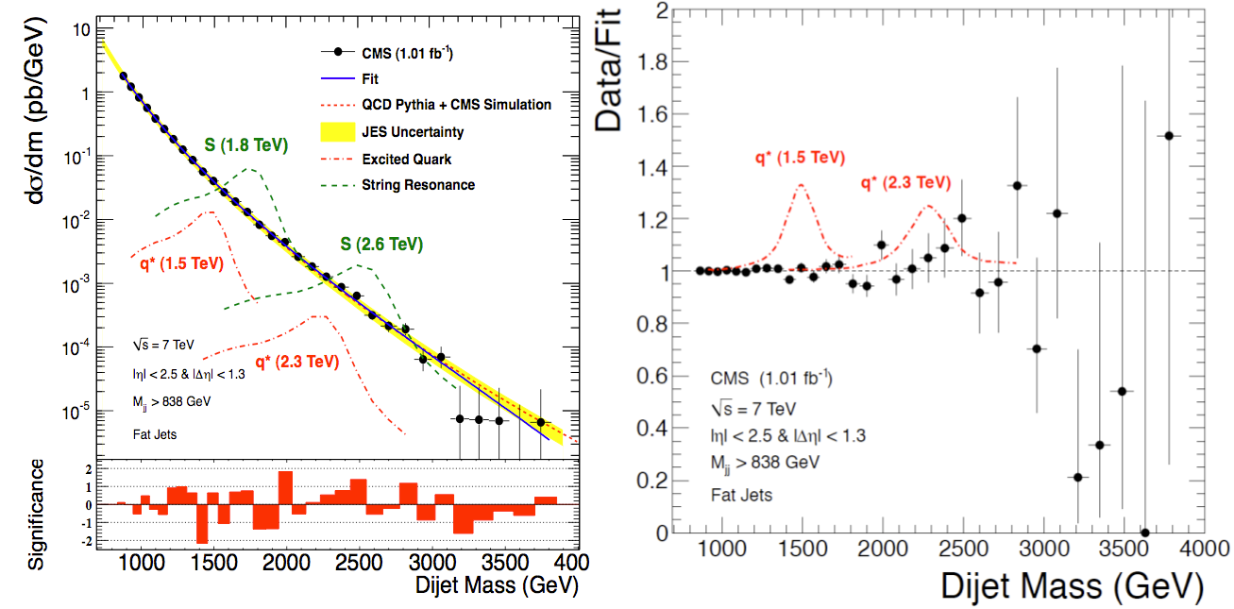
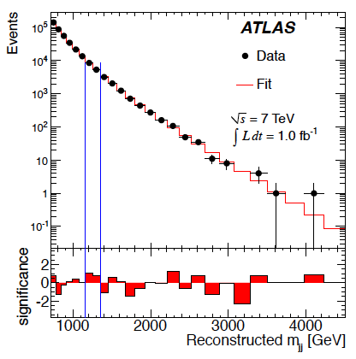
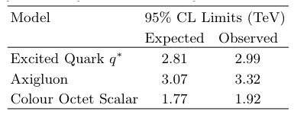
High mass dijet :
Searches for New Physics in
di-jet final states (1 fb⁻¹)

Slide 22
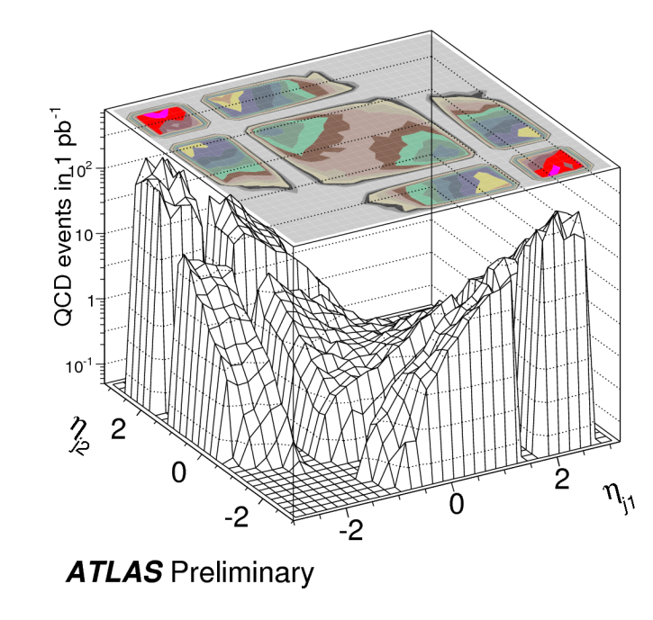
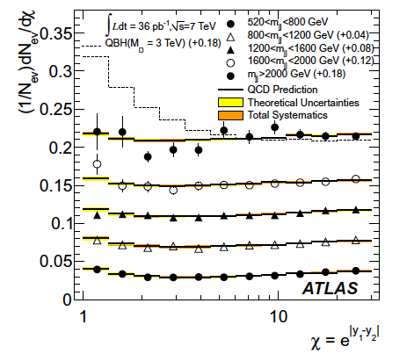
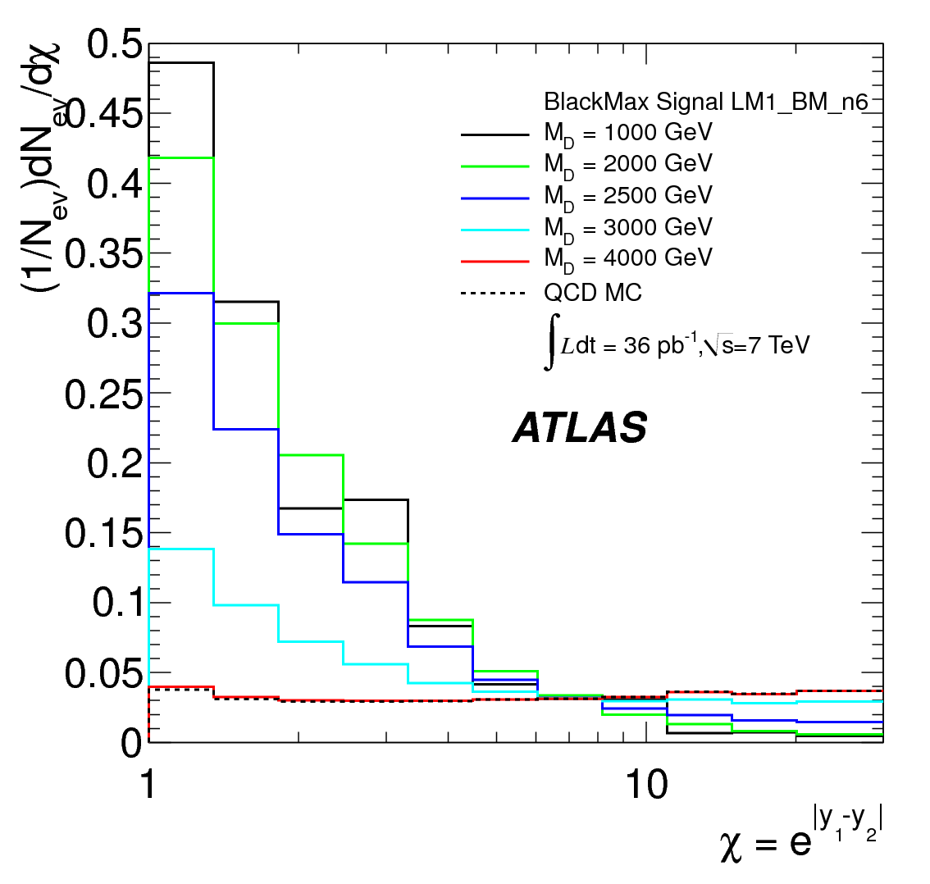
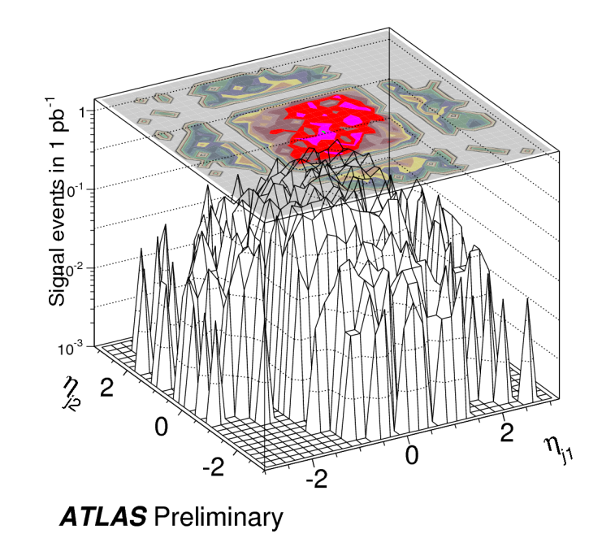
Dijet angular distribution
QCD
Θ*: angle in 2jet center-of-mass frame
New particle
NJP13(2011)053044
Well described by QCD

Slide 23
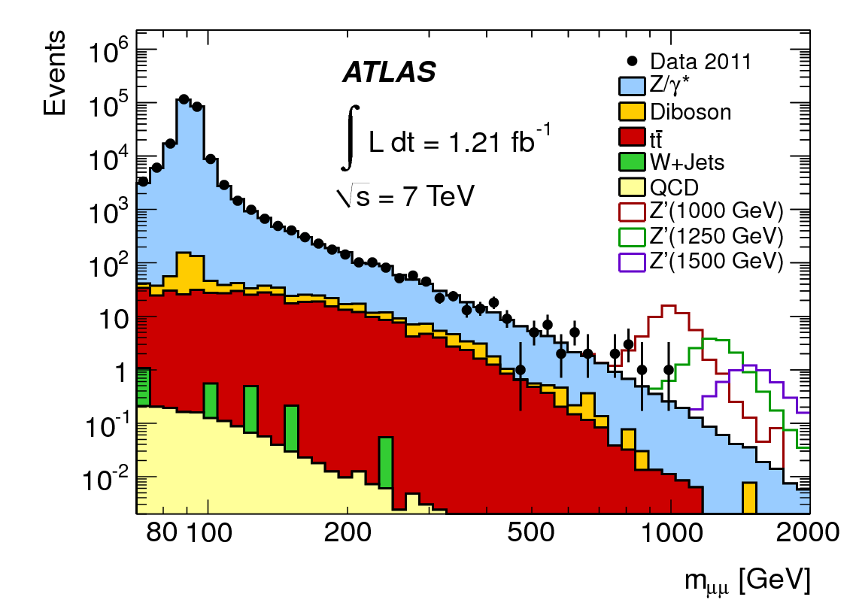
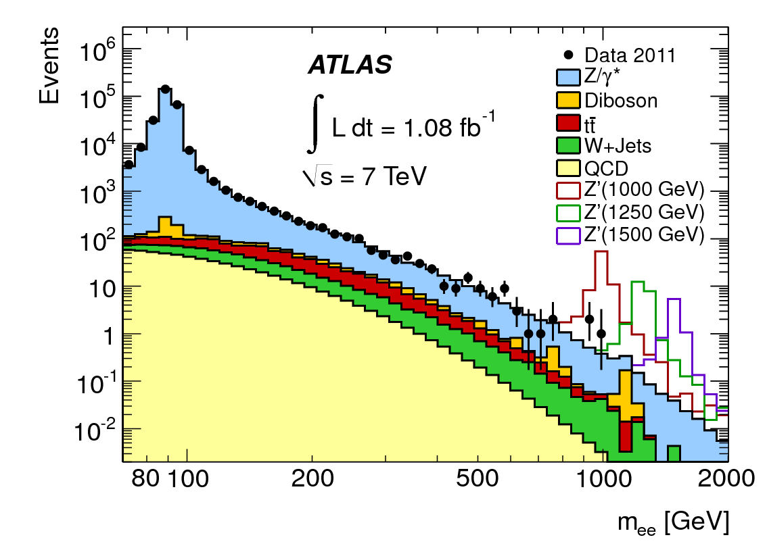

No extra di-lepton resonance (yet)
Limit on Z’, $G_{KK}$ etc. up to 1-1.5 TeV

Slide 24

But we should have something beyond the SM

Slide 25
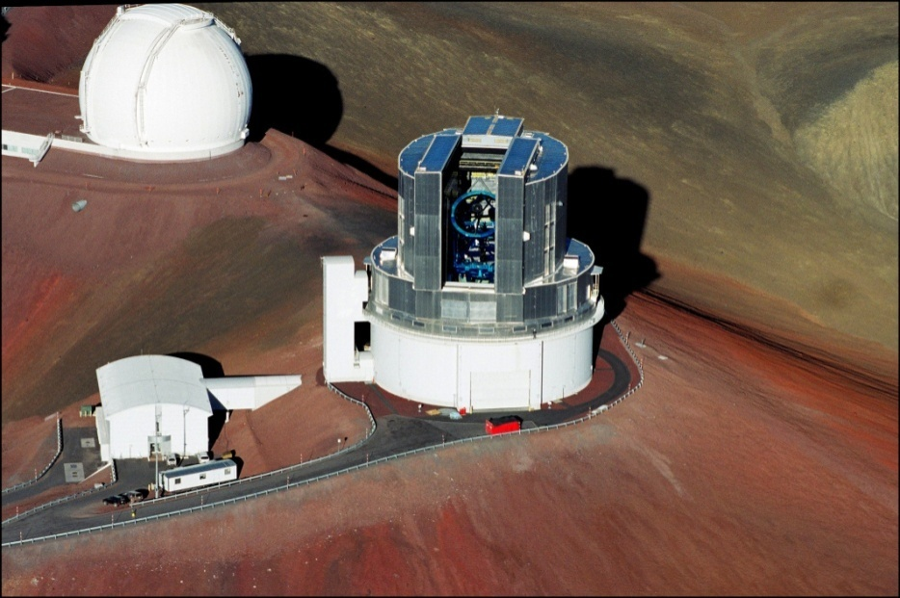
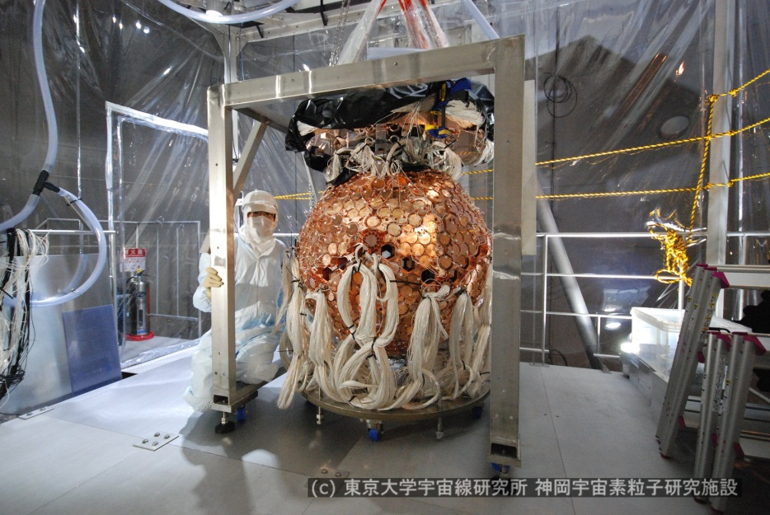
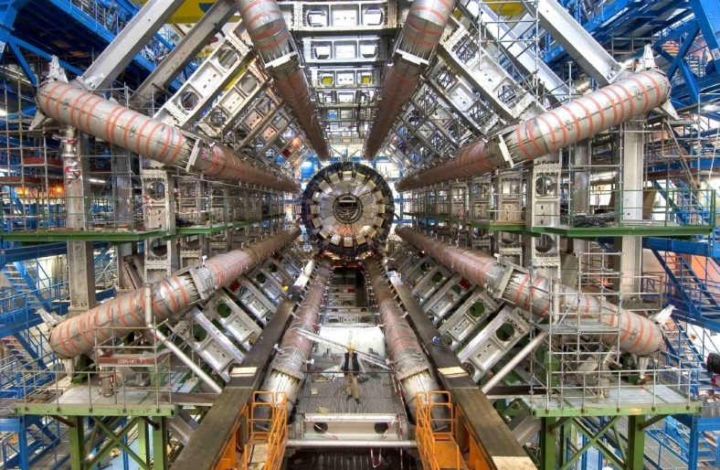
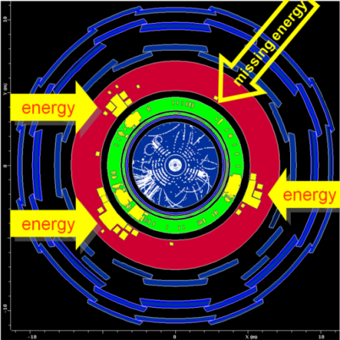
Various approaches to find DM
Create it! LHC
Watch galaxies
Catch it under ground
simulation
If all results are consistent, -> victory of science:

Slide 26
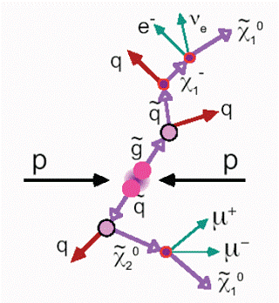
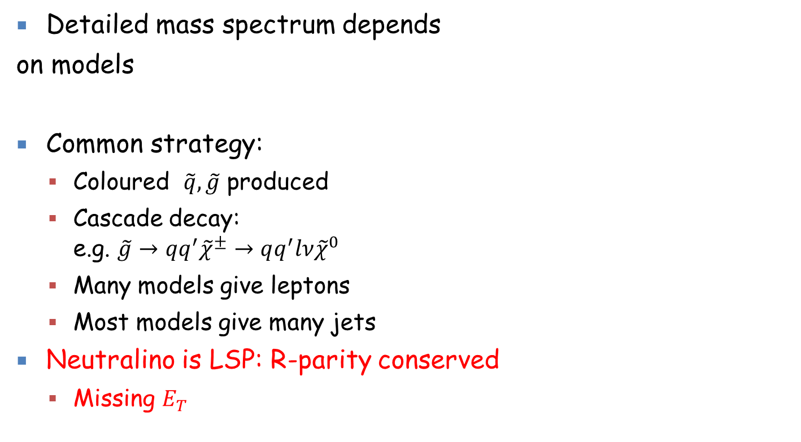
SUSY : as a model with DM
Detailed mass spectrum depends
on models
Common strategy:
  Coloured $\tilde{q}, \tilde{g}$ produced
  Cascade decay:
  e.g. $\tilde{g}→qq^{′}{\tilde{χ}}^{±}→qq^{′}lν{\tilde{χ}}^{0}$
  Many models give leptons
  Most models give many jets
Neutralino is LSP: R-parity conserved
  Missing $E_{T}$
Experimentaists try to make generic searches
Searches for events with large missing-Et + (jets + lepton + b-quark ..)

Slide 27
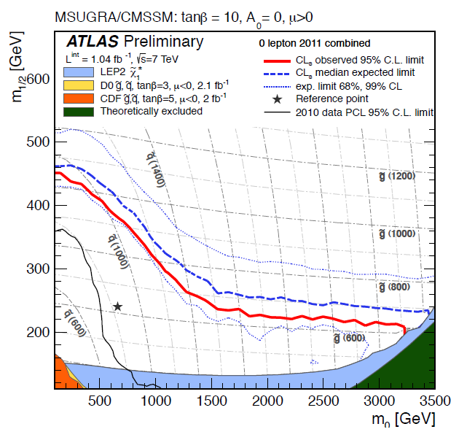
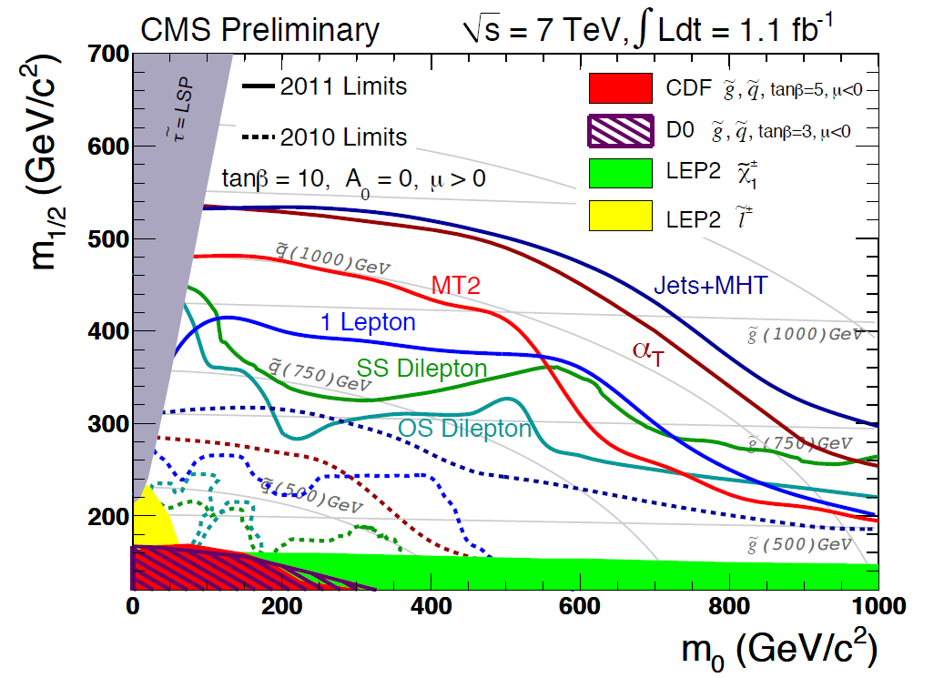
No signal (yet)
ATLAS/CMS are excluding a large parameter space in M₀/M_{1/2}.
Squark, gluino >~ 1TeV (MSUGRA/CMSSM)
But still many possibilities: :
  Etmiss requirement <- bad if LSP pt is low
  not quite sensitive to stop, yet.
=> Wider searches are going on.
=> Big improvement, if LHC runs with higher energy

Slide 28
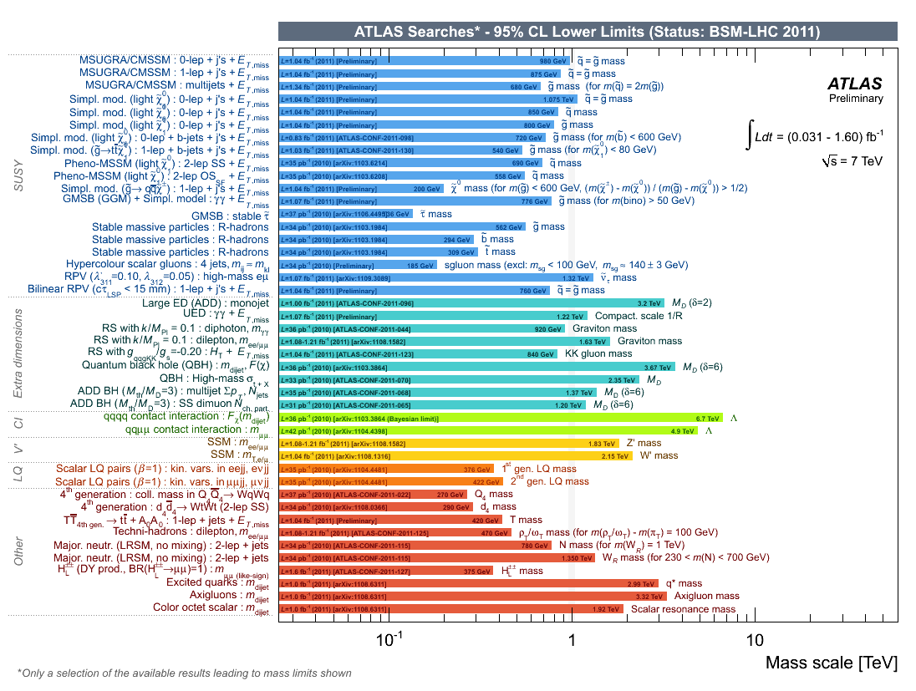
Results of main searches for New Physics
SUSY: mass limits
on in the range
0.5-1 TeV
(within constrained models)

Slide 29
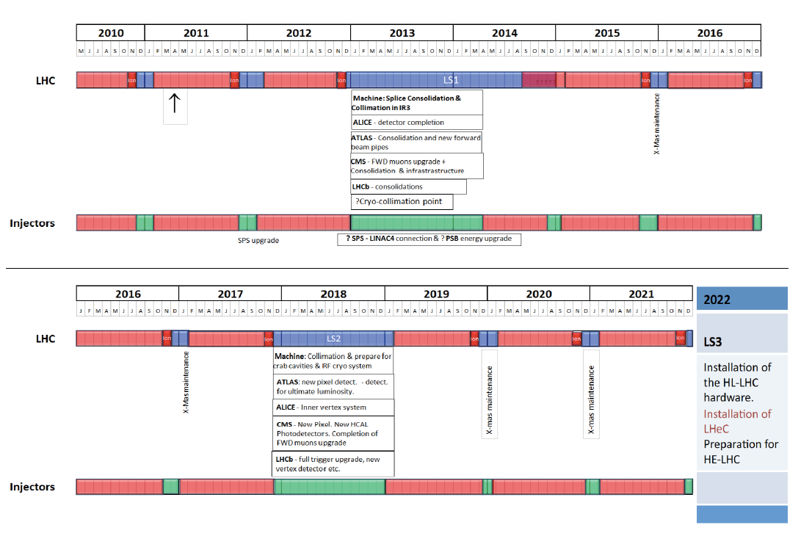
LHC Time Schedule (Not yet official)
Ecm= 7TeV
5fb⁻¹ taken
7 (or 8?)TeV
~5fb⁻¹
Ecm~14TeV
300 fb⁻¹ by 2021
Year 2022 ~
LHeC (ep collider)?
Draft CDR is ready
see http://cern.ch/lhec
Year 2022-2032
HL-LHC
Ecm~14TeV
3000 fb⁻¹
Year 2033? ~ 2043??
HE-LHC
Ecm~33TeV!
500 fb⁻¹
Middle term plan:
If Higgs is found, precision measurements will start.
If Higgs is excluded, check W_{L}W_{L} scattering at high M_{WW} energy.
Continue new partcile searches. (High lumi == access to high energy partons

Slide 30
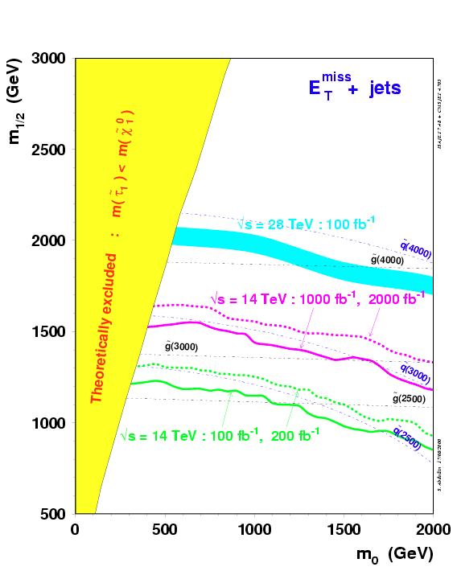
High statistics → High Energy
SUSY searches：
2.5 -> 3 TeV
g
g
30

Slide 31
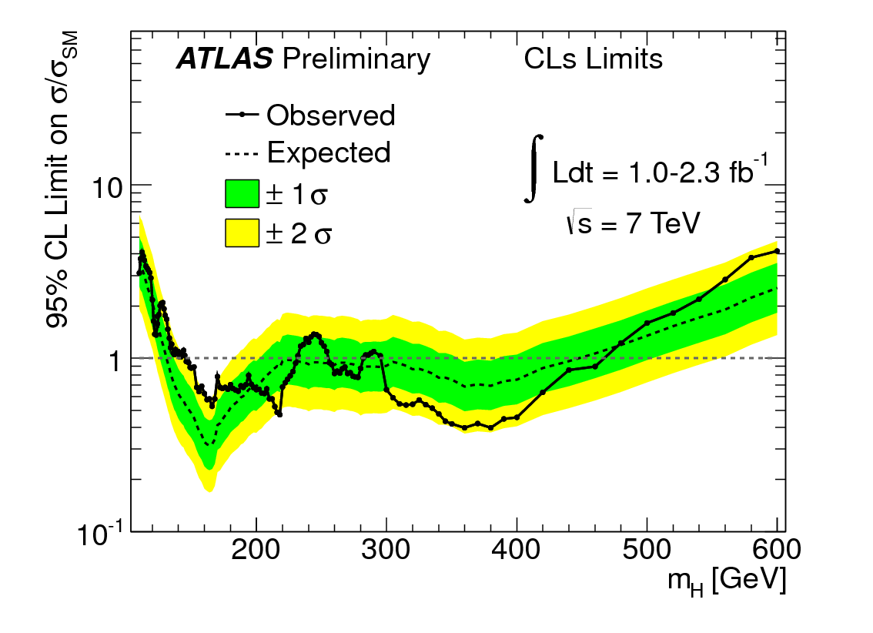

Higgs: near future
2010 data
IntL= 0.035 fb⁻¹
2011 July
IntL= 1 fb⁻¹
2011 Aug
IntL= 1-2.3 fb⁻¹
2012 Dec
IntL= 10 fb⁻¹

Slide 32

Higgs: near future
ATLAS or CMS
Table shown in summer.
More improvements are under ways.

Slide 33
Summary
LHC is running very well. ~5fb⁻¹ Int. L is delivered to ATLAS (and CMS). ~ 5 times higher than promised!
ATLAS and CMS are also working well.
  Many known particles are re-discovered.
  Now it’s time for the SM precision measurements.
  Unfortunately there is no sign of new physics yet (with IntL~1fb⁻¹ data). More data are being analyzed with improved analysis methods.
We expect ~10fb⁻¹ data by the end of 2012. The data seems to be sufficient to discover or to exclude the higgs particle.
LHC will run till ~2030, collecting 3000 fb⁻¹ data. R&D for HE-LHC (Ecm 33TeV) is started

Slide 34
Backup slides

Slide 35

Higgs: near future
Yr1999 ATLAS physics TDR

Slide 36

Higgs: near future: high mass side
Other modes such as W-> lνｊｊ can also be used.

Slide 37



H→ μμ
Br ～ 10^{－4}
600fb⁻¹ → 3.5σ
6000fb⁻¹ →9.5σ
Higgs 発見後のHiggs 精密測定：
Higgs と他の粒子との結合係数測定 →本当に質量に比例するか？
LC (黒ポイント）の精度にはかなわないが、１０～２０％の精度で探索可能
For M
h
= 140 GeV
For M
h
= 120 GeV
μ
37

Slide 38


LHC first-year achievement 1:
Proton-proton cross section become large (as expected from various models）

Slide 39


Jet reconstruction in LHC
Calorimeter Cell clustering
  3-D topological clusters
    start with seed (>4σ)
    add neighboring cells (>2σ)
    add all adjacent cells (>0)
Jet Reconstruction
  combine the clusters using anti-k_{T} algorithm (infrared & collinear safe)
  R=0.4, 0.6 (or 1.0)
  infrared safe : essential for NLO comparison
  cone shape : pileup subtraction
Calibration
  response corrections: hadronic components (compensation), inactive volume, out of cone leakage, pile-up
  EM calib → JetEnergyScale calib
  MC-based correction function in jet E, 𝜼 bins

Slide 40



Jet performance
ATLAS-CONF-2011-032
Jet Energy Scale uncertainties
(from 2010 data)
2.5% for ~100GeV central jets
Calorimeter response to the single particle is dominant component (reduced significantly from in-situ meas.)
Unfolding for detector effects
restoring effects (resolution, efficiency)
bin-by-bin correction was used
JES uncertainty
jet p_{T} [GeV]
ATLAS-CONF-2011-047
Jet kinematics : phase space reach
Kinetic range of full 2010 data (green)
With a few 10 pb⁻¹ of data, the reach in jet pT at the LHC is already twice of other experiments
Forward jet measurement cover up to |y| = 4.4
p_{T} range goes up to > 1TeV
jet p_{T} [GeV]
L=37pb⁻¹
jet rapidity |y|

