Slide 1
Direct Dark Matter (WIMPs) Searches and the XMASS Experiment
16:25-17:10 (40+5)
Y. Suzuki
Kamioka Observatory, Institute for Cosmic Ray Research (ICRR), the University of Tokyo,
and
Kamioka Satellite, Institute for the Physics and Mathematic of the Universe (IPMU), the University of Tokyo

Slide 2
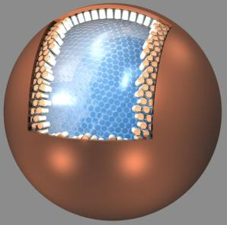
“XMASS Experiment”
Y. Suzuki, hep-ph/0008296
XMASS: Multi-purpose liq. Xenon detector
(10 ton fiducial mass(2.5mφ))
  Xenon MASSive detector for Solar neutrino
    pp-solar neutrinos: ν+e → ν+e
  Xenon neutrino MASS detector
    Double beta decay ¹³⁶Xe → ¹³⁶Ba + 2e⁻
  Xenon detector for Weakly Interacting MASSive Particles
    Dark Matter: χ+Xe → χ+Xe
➔ Phase-I: 100 kg fid. dedicated for dark matter search
Construction was completed
Under commissioning in the Kamioka Underground Observatory
Conducted by Kamioka Observatory (ICRR, Tokyo), IPMU(Tokyo) Kobe, Tokai, Gifu, STEL(Nagoya), Yokohama National,, Miyagi U. of Ed and Korean institutions (KRIS, Sejong): 10 institutes & 41 Collaborators
➔ We will discuss ’phase-I XMASS’ later in my talk.

Slide 3
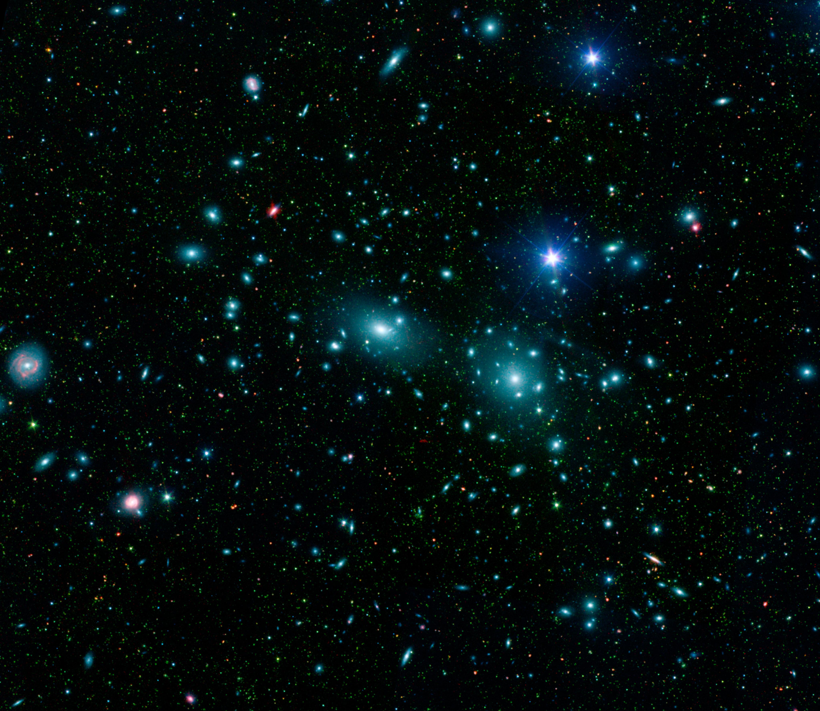
Outline
Brief Introduction
Direct Dark Matter (WIMPs) Search Experiments
Status of the XMASS experiment
Coma Cluster

Slide 4
  Why people believe in Dark Matter
Evidence at the different scale of the Universe
Rotation curve of a galaxy
Cluster of Galaxies
  luminocity vs velocity
  Gravitational lensing
CMB
and so on…..

Slide 5
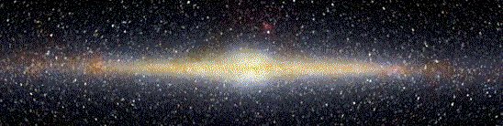
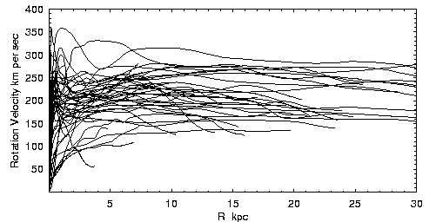
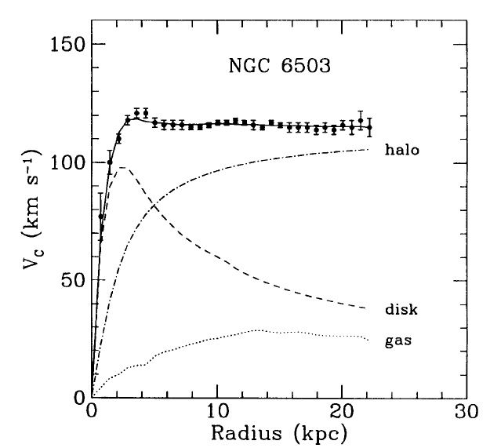
  Why people believe in Dark Matter
Evidence at the different scale of the Universe
Rotation curve of a galaxy
Cluster of Galaxies
  luminocity vs velocity
  Gravitational lensing
CMB
and so on…..
First indicated that invisible matter exist in a galaxy by Vera Rubin in 1972
Y.Sofue and V. Rubin
Astroph/0010594v2
NGC6503
Many Galaxies
Total
Dark Matter
Luminous Matter
Rotation vetocity
Notes:
Most near-by evidence

Slide 6
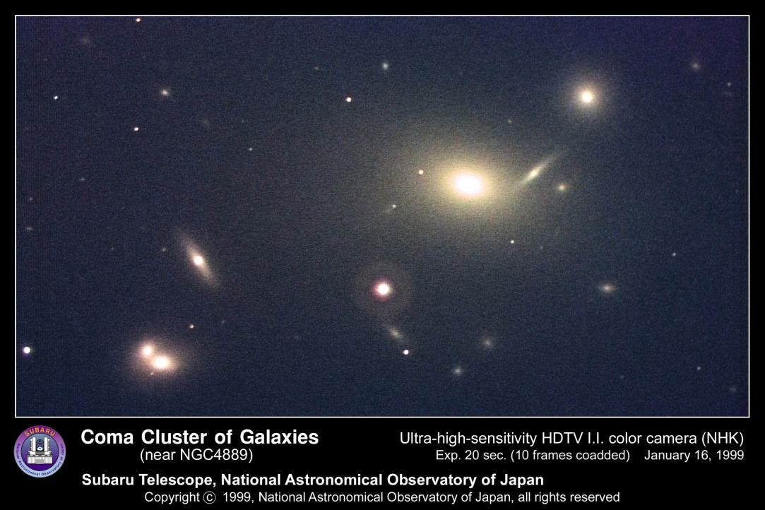
  Why people believe in Dark Matter
Evidence at the different scale of the Universe
Rotation curve of a galaxy
Cluster of Galaxies
  luminocity vs velocity
  Gravitational lensing
CMB
and so on…..
First in 1933: Fritz Zwicky
  Luminous matter
  << matter from orbital velocities ← Virial theorem

Slide 7
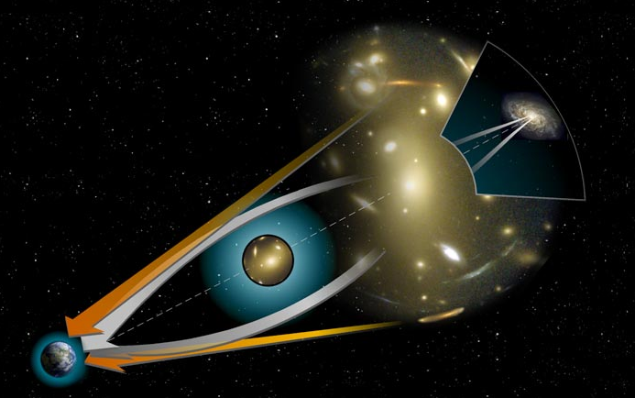
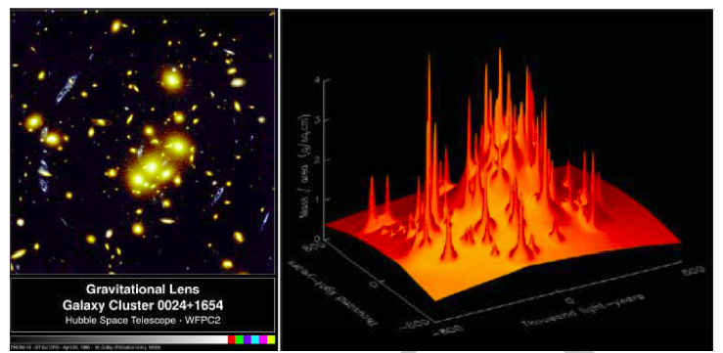
  Why people believe in Dark Matter
Evidence at the different scale of the Universe
Rotation curve of a galaxy
Cluster of Galaxies
  luminocity vs velocity
  Gravitational lensing
CMB
and so on…..
Matter distribution of the foreground (lenz) galaxies

Slide 8
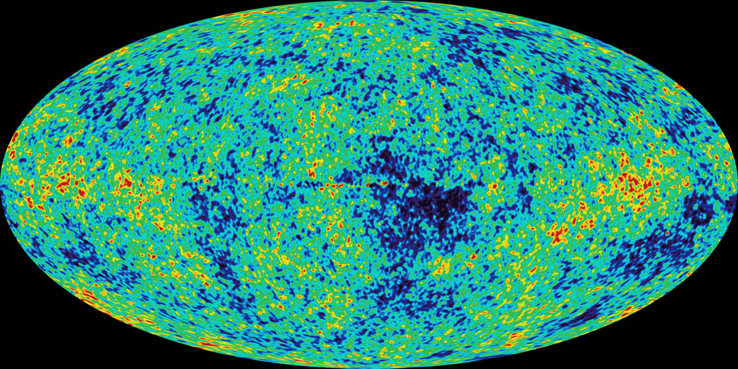
  Why people believe in Dark Matter
-0.0002 ºK
2.725 ºK
Evidence at the different scale of the Universe
Rotation curve of a galaxy
Cluster of Galaxies
  luminocity vs velocity
  Gravitational lensing
CMB
and so on…..
Ordinary Matter（４％）
Dark Matter
２３％
Dark Energy
７３％

Slide 9
Dark Matter Candidates
Gravitationally interacting
Neutral (not charged)
Stable or long lived
  ⬅ Ω_{DM} = 0.23
Cold or Warm (not hot)
  large scale structure
non-Barionic
  ⬅ CMB, BBNS
Physics beyond
The Standard Model
AXION
AXINO
Gravitino
Sterile Neutrinos
WIMP
…..

Slide 10
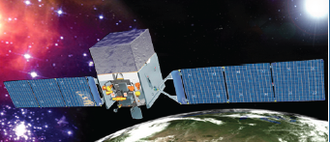
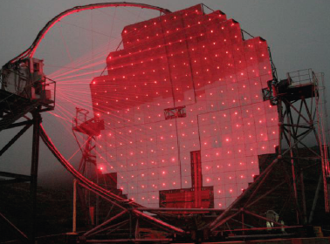
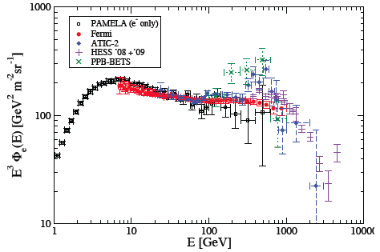
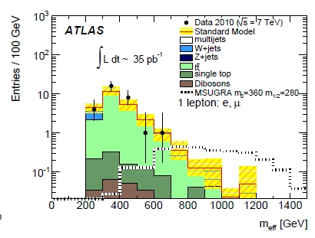
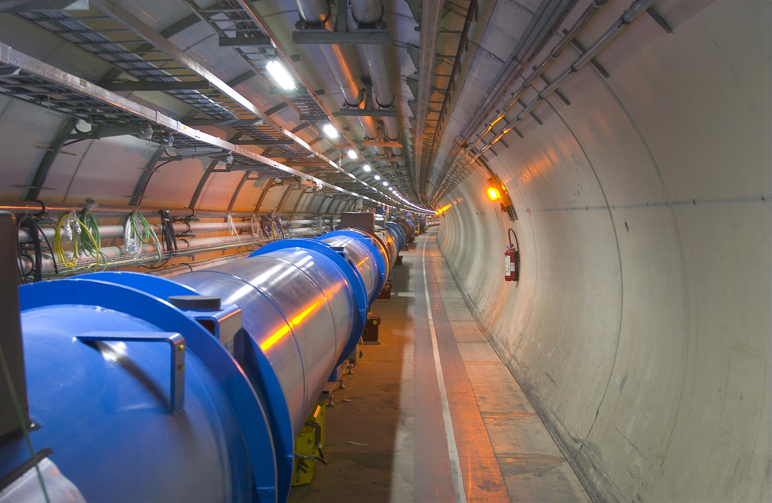
Detection of DM other than Gravitational Effect
Indirect Detection
  Annililation & decay
    Charged Particels
      PAMELA, Fermi, ATIC, HESS..
    Gammas
    Neutrinos
Direct Detection
  Scattering in the laboratory detectors
  AXION searches…
Accelerator: Creation and Measurement

Slide 11
Today, we concentrate on direct search experiments for WIMPs
Natural candidates from SUSY ??? LHC
Many experiments to look for WIMPs are conducted
  For the last couple of years, direct dark matter experiments have been very exciting.
    Indications of low mass DM (a few ∼ 10 GeV)?
    By DAMA/LIBRA, CoGeNT, CRESST-II
  Limits and exclusions?
    By CDMS-II, EDELWEISS, XENON10, XENON100
  Very strong tensions !
In my talk, I will not explain the various efforts to reconcile the conflicting experiments.
Instead, I will discuss on what experimentalists should do in order to clarify or strengthen the observed results.

Slide 12
Galactic Dark Matter
Isothermal Halo Model (Standard Halo Model)
  a single component isothermal sphere with a Maxwellian velocity distribution
  Typical Values:
  V₀ = 220km/s
  <v_{DM}²> = 270km/s
  Escape speed, v_{esc} ∼ 550km/s
  Density: ρ_{x} = 0.3 GeV/cm³
  Values and uncertainties of these astrophysical parameters have been revisited and reevaluated, and still under the discussion

Slide 13
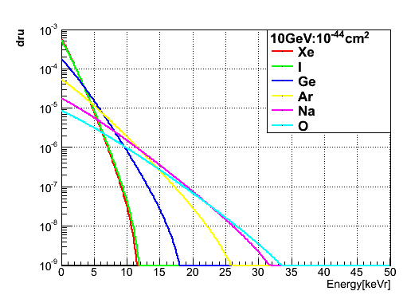
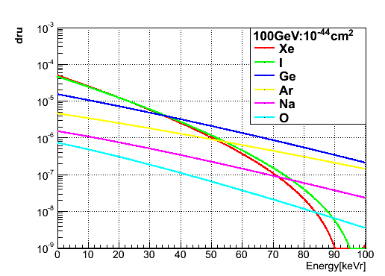
Direct Detection
Dark Matter
For 10 GeV
WIMPs
Nuclear Recoil
Event Rate
Direct searches : Observe Nuclear Recoils
  χ + N ➔ χ + N
Recoil Energy:
  Kinetic energy of DM
Xe, I
Ge
Na, O
0 10 20 30 40 50
For 100 GeV
WIMPs
Xe, I
Ge
Ar
  1∼100 keV
  For low mass DM, sp. become very soft for large target masses like Xe, Ge,,
    Loose efficiency unless lowering the threshold
Event Rate
Na
O
0 20 40 60 80 100
Recoil Energy (keV)

Slide 14
Event Rate
TYPICAL:
∼0.1 ev/day/100kg-Xenon
for m_{χ} = 50 GeV and σ_{SI}=10⁻⁴⁴ cm²
with 10keV_{NR} threshold, 30% eff
Seasonal variations of the velocity: ±30km/s ➔
< ∼ 10% modulation effects
  depend upon spectrum shape, trigger efficiency, analysis cuts and so on
WIMPs
June
Earth
∼ + 30km/s
Cygnus
SUN
60^{O}
V₀∼220km/s
∼ − 30km/s
December

Slide 15
Direct Search Experiments
Various Detection Technology
  Scintillation, Heat-Phonon and Ionization
  Usually combined technologies to reduce backgrounds
  Self-shielding may work for some materials
Bubble
PICASSO,
COUPP
CaWO₄,Al₂O₃,
BGO, LiF
Heat-Phonon
CRESST I
ULTIMA
ROSEBUD
CRESST-II, EURECA
CaWO₄,
³He
Ge, Si
CDMS
EDELWEISS, EURECA
Scintillation
NAIAD, ZEPLIN-I, DAMA/LIBRA
XMASS, DEAP/CLEAN
Ionization
IGEX, CoGeNT
Track
DRIFT, DM-TPC
Emulsion, NIMAC
NEWAGE
NaI, Xe, Ar
CF₄, CS₂
Ge, Si
ZEPLIN-II,-III, XENON
LUX, WARP, ArDM,
SIGN
Xe, Ar

Slide 16

Backgrounds
Cosmic Rays
➔ Cosmo-genic,
Spallation products
➔ Go deeper site
Key Issue of the experiments !
Many:
detector dependent
but common techniques to reduce backgrounds
Rn
Shields
Pd, Polyethylene, Water,…
Rn
External BG (γ, n)
Shields&Detector parts
External BG, γ, n, β, α
U/Th, K,…
Material screening
Purification
Rn
Internal BG:
Detector dependence
U/Th, K, …..
➔ purification
Cosmo-genic ⬅ CR
Rn

Slide 17
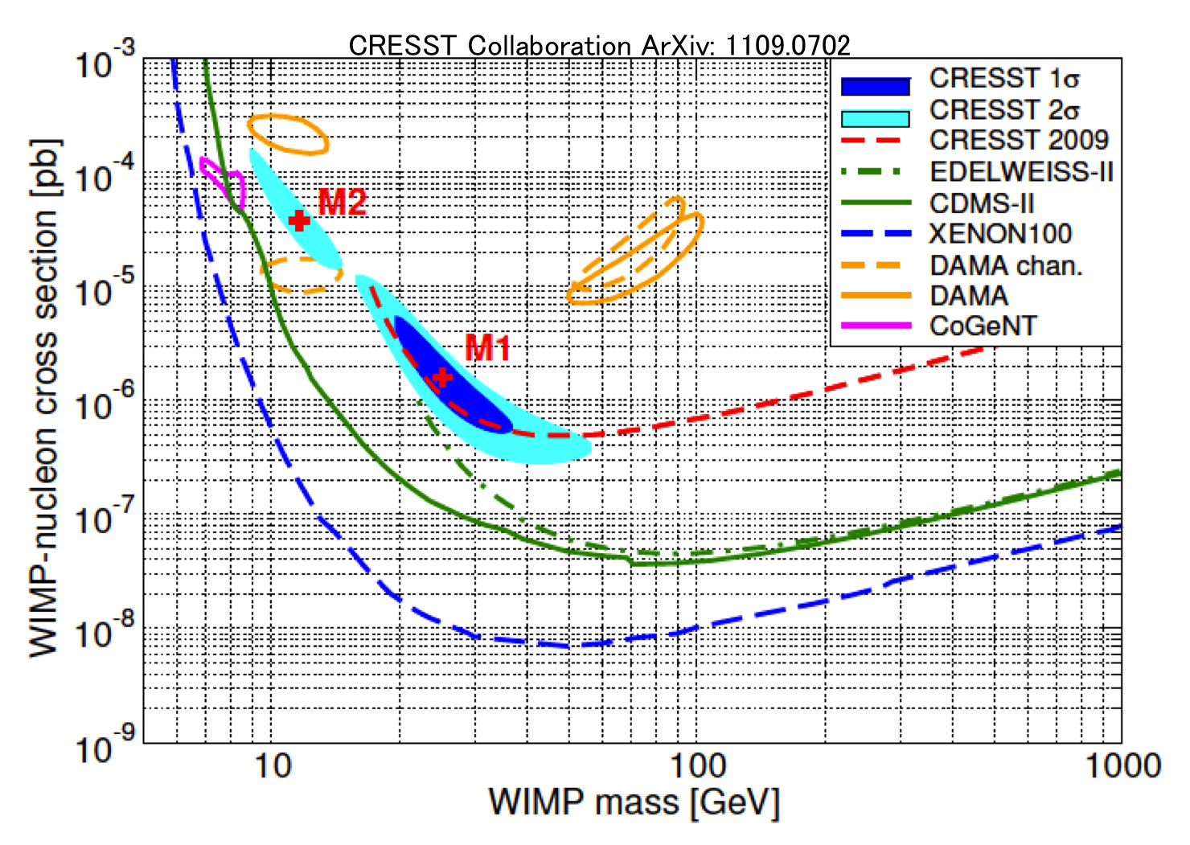
Current Experimental Situation
10⁻³⁹
CoGeNT
DAMA
CRESST
EDELWEISS-II
CDMS-II
XENON100
10⁻⁴⁵

Slide 18
Current players of the game
Positive Indication
Experiment∂ | Target | Threshold | Total Exposure | Recoil Identification | Main body of Signal ? | Modulation
DAMA/LIBRA | NaI | 2.0 keV_{ee} | 427,000 kg-days | (NR+EM) | ー | ○
CoGeNT | Ge | 0.5 keV_{ee} | 140 kg-days | (NR+EM) | ○ by fit w/BG | ○
CRESST | CaWO₄ | 10.0 keV | >700 kg-days | NR | ○ by fit w/BG | ー
Negative and set limit
Experiment∂ | Target | Threshold | Total Exposure | Recoil Identification | Main body of Signal ? | Modulation
CDMS-II | Ge/Si | 10.0 keV | 612 kg-days | NR
CDMS-II (LE) | Ge | 2.0 keV_{NR} | 241 kg-days | (NR+reducedEM)
EDELWEISS | Ge | 20.0 keV | 384 kg-days | NR
XENON100 | Xe | 8.4 keV_{NR} | 1471 kg-days | NR
XENON10 (LE) | Xe | 1.4 keV_{NR} | 15 kg-days | (NR+reducedEM)

Slide 19
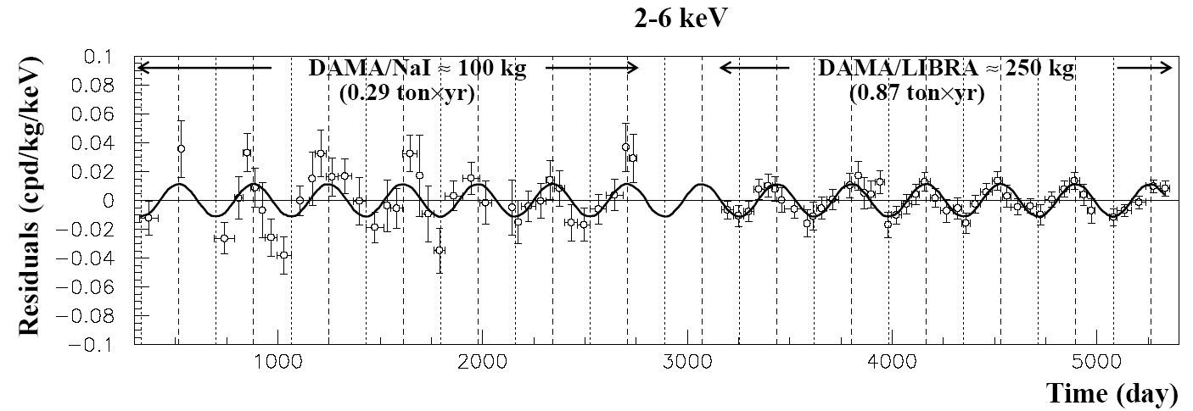
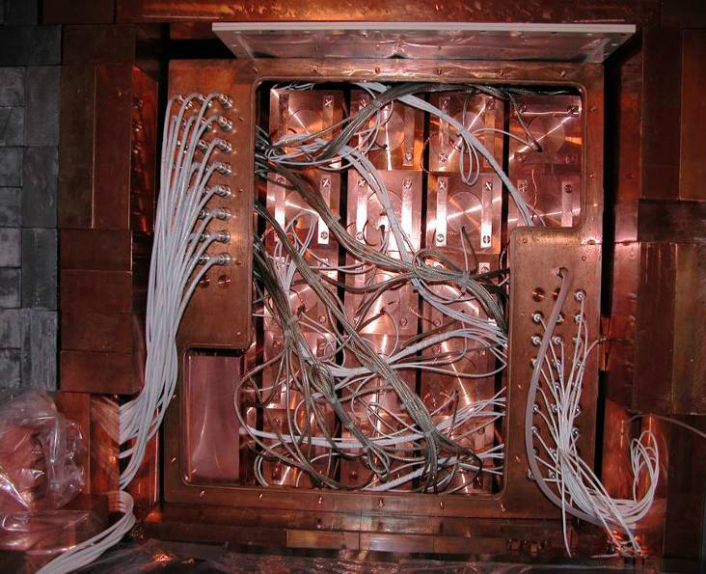
DAMA/LIBRA
Early ‘96
Residuals (cpd/kg/keV)
Sept ‘09
+ 0.02
− 0.02
2∼6 keV
1000 2000 3000 4000 5000
DAMA/LIBRA: High purity low BG NaI
  250kg NaI(Tl) for DAMA/LIBRA
Total exposure: 1.17 ton-yr (13 cycles)
  427,000 kg-days
Result ➔ Modulation (8.9σ)
  S_{k}=S₀+S_{m}cosω(t-t₀)
  Amplitude(S_{m}): for 2∼6 keV
  0.0116±0.0013 cpd /kg /keV (dru)
R.Cerulli@TIPP2011
View at the end of DAMA/LIBRA

Slide 20
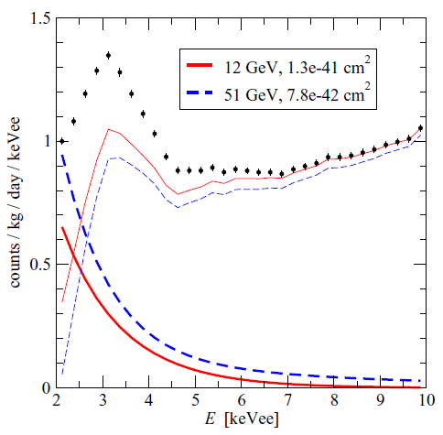
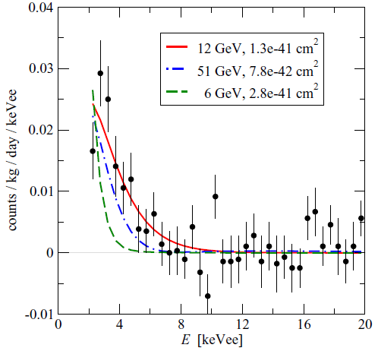
Question: Where is the un-modulated part of signal, S₀ ?
3.2keV Auger
from ⁴⁰K EC(10%)
1.46MeV γ escape
Must be in somewhere underneath of the spectrum !
In most of the elastic scattering cases, S₀(E) monotonically goes down as energy increase, then backgrounds must sharply goes down below 3∼4 keV.
This may not be natural
Simple Elastic Scattering interpretation may have a internal inconsistency?
-> Inelastic ? also strong tension
-> Other scenarios ???
Ex. M. Fairbairn and T. Schwets, arXiv:0808.0704v2[hep-ph]
1
0.5
0
Rate (dru)
Backgrounds
Spectrum
Un-modulated signal
2 4 6 8
0.04
0.03
0.02
0.01
0
-0.01
Modulated
Spectrum
dru
0 2 4 6 8
Energy (keV)
Also similar study: V. A. Kudryavtsev et al.
J. Of Phys. Conf. Ser. 203(2009)012039

Slide 21
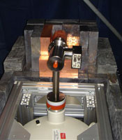
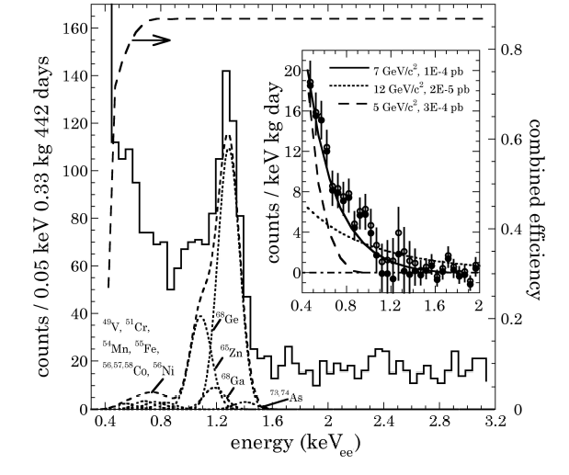
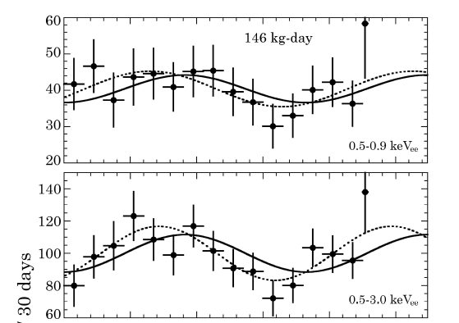
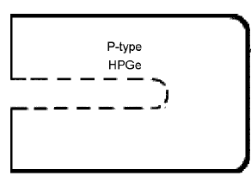
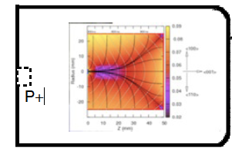
CoGeNT
Coherent Germanium Neutrino Telescope
Counts / 30 days
0 100 200 300 400 500
Days since Dec-3, 2009
P-type Point Contact (PPC) germanium detectors: 440g
  High resolution (low C)
Threshold ∼ 0.4 keVee (lowest)
But no Nuclear Recoil separation
BG: Reject surface events
irreducible excess below 3 keV
442 effective days, ssuming all the unknown excess is ‘signal’
➔ Modulation (0.5 – 3.0 keVee):
  2.8 σ
  Amplitude: 16.6±3.8%
  Minimum: Oct 16±12 d
➔ Need more data

Slide 22
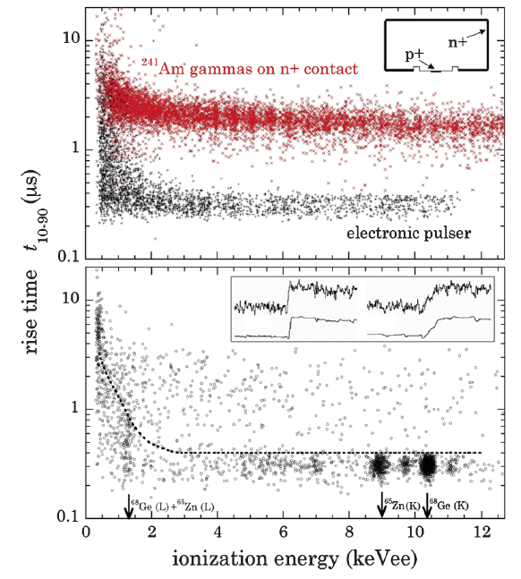
What should we watch
Backgrounds are crucial for all the DM experiments
  Surface events (CoGeNT)
    (n+) 1mm: dead, 1mm transition (∼external γ’s)
  ⬅ rise time difference to discriminates
  bulk (0.3 μs ∼ 2 μs @low energy)
  Surface (2 μs ∼ 4μs @low energy)
They said that any such contamination should be modest
Calibration was done for different detector
➔ Need clear and quantitative evaluation of the leakage from the surface event
10
1
0.1
Different detector
@Chicago
Rise Time t₁₀₋₉₀μs
10
1
0.1
90% acceptance for bulk events
0 2 4 6 8 10 12
Ionization Energy (keVee)

Slide 23
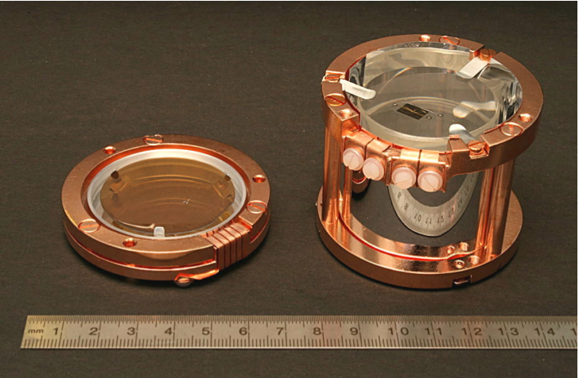
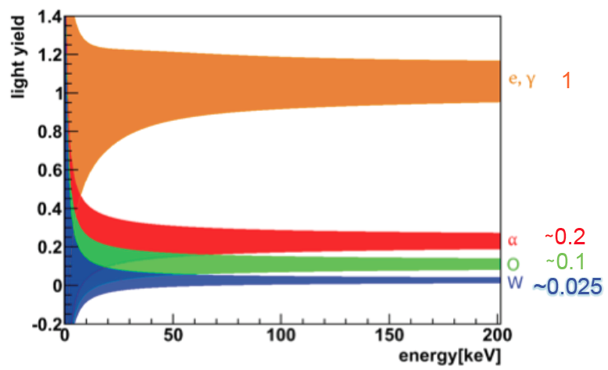
CRESST-II
  CaWO₄(Multi-material target)
  up to 10 kg, 33 crystals, (0.3kg each)
  phonon (∼10 mK)
  Scintillation
    ➔ Reduced light output for nuclear recoils
    Light output decreases with increasing mass number of recoiling nucleus
Data used (2009 – 2011)
  730kg*days
  8 detector modules
Light sensor
Crystal &
phonon sensor
e/γ
α
O
W

Slide 24
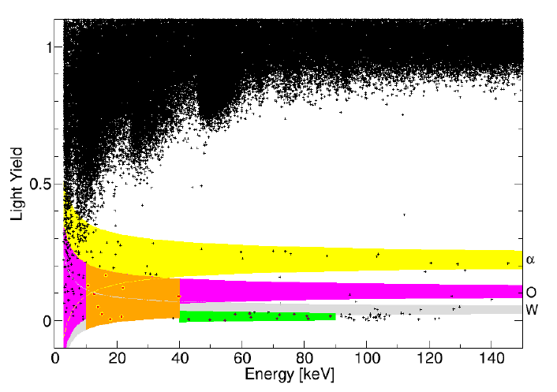
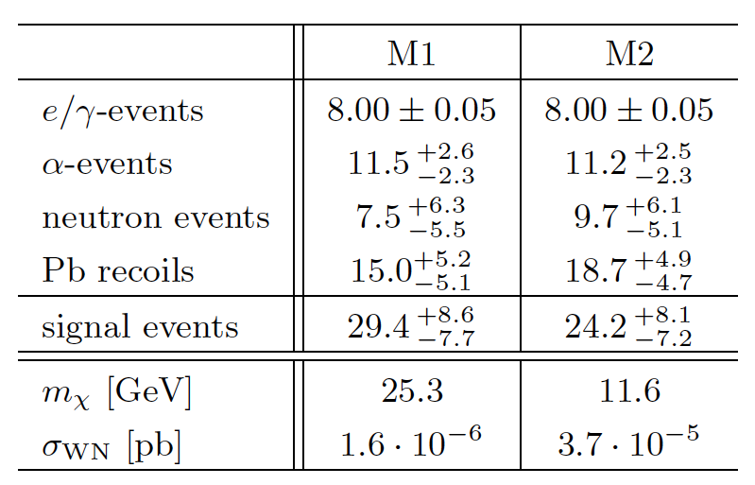
O-band events
  67 events
4 source of BG
  Leakage from e/γ band
  Leakage from α related
    Degraded α events
  Neutron events (O)
  Pb recoils:
  ²¹⁰Po→ ²⁰⁶Pb(103keV)+α(out)
“room for signal”
  36 ∼ 44 %
Degraded α
  ²¹⁰Po→ ²⁰⁶Pb(103keV)+α

Slide 25
Current Experimental Situation
10⁻³⁹
CoGeNT
DAMA
CRESST
EDELWEISS-II
CDMS-II
XENON100
10⁻⁴⁵

Slide 26
Current players of the game
Positive Indication
Experiment∂ | Target | Threshold | Total Exposure | Recoil Identification | Main body of Signal ? | Modulation
DAMA/LIBRA | NaI | 2.0 keV_{ee} | 427,000 kg-days | (NR+EM) | ー | ○
CoGeNT | Ge | 0.5 keV_{ee} | 140 kg-days | (NR+EM) | ○ by fit w/BG | ○
CRESST | CaWO₄ | 10.0 keV | >700 kg-days | NR | ○ by fit w/BG | ー
Negative and set limit
Experiment∂ | Target | Threshold | Total Exposure | Recoil Identification | Main body of Signal ? | Modulation
CDMS-II | Ge/Si | 10.0 keV | 612 kg-days | NR
CDMS-II (LE) | Ge | 2.0 keV_{NR} | 241 kg-days | (NR+reducedEM)
EDELWEISS | Ge | 20.0 keV | 384 kg-days | NR
XENON100 | Xe | 8.4 keV_{NR} | 1471 kg-days | NR
XENON10 (LE) | Xe | 1.4 keV_{NR} | 15 kg-days | (NR+reducedEM)

Slide 27
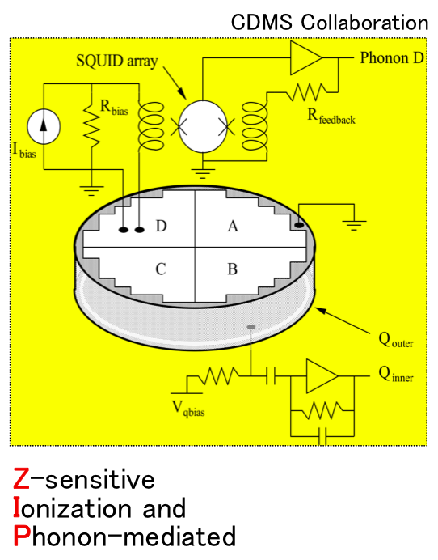
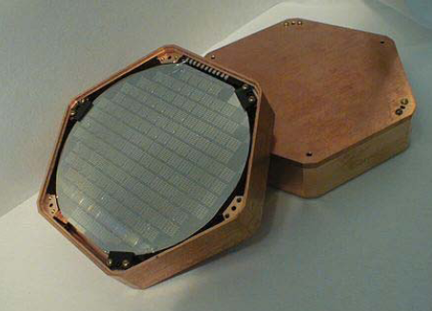
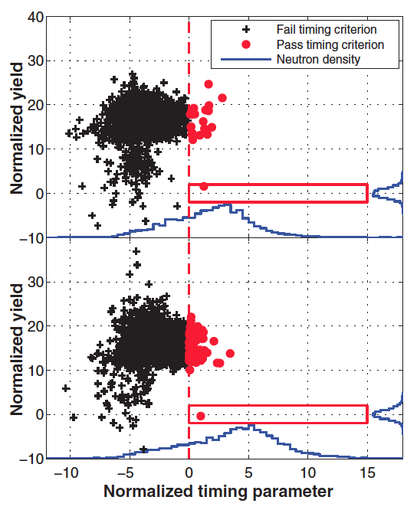
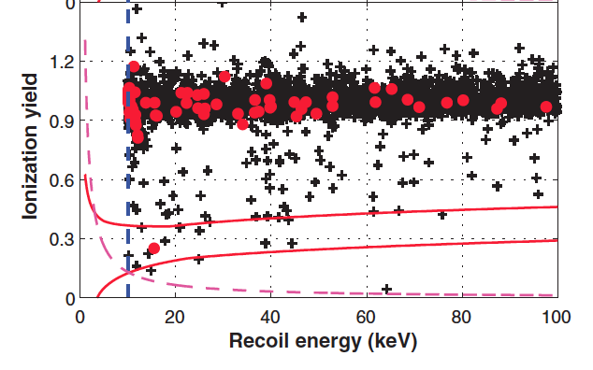
CDMS-II
Ge(&Si) detector (∼10mm thick and φ=76mm)
230g x19 ∼ 4 kg
Ionization and phonon (<50mK)
  Ionization yield ➔ 1 in 10⁴ raj. for γ’s
  Timing cut ➔ surface events (>10⁶ raj.)
10 keV threshold & < 100keV
Data: 612kg-days
2 events found
Backgrounds: 0.9±0.2
  0.8±0.1±0.2 surface events
  0.1 neutron events
Bulk
Detector: T3Z4

Slide 28
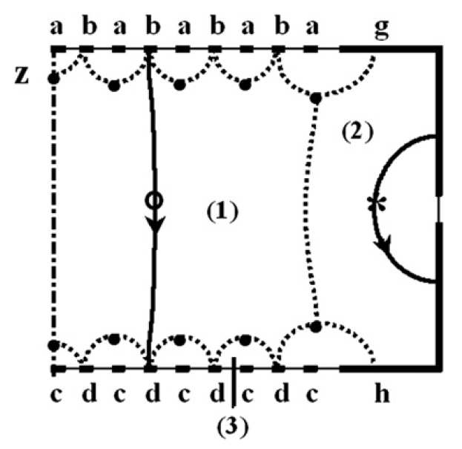
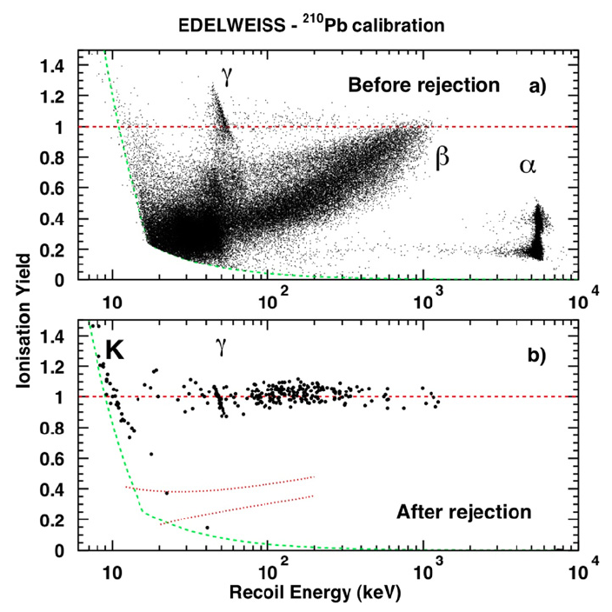
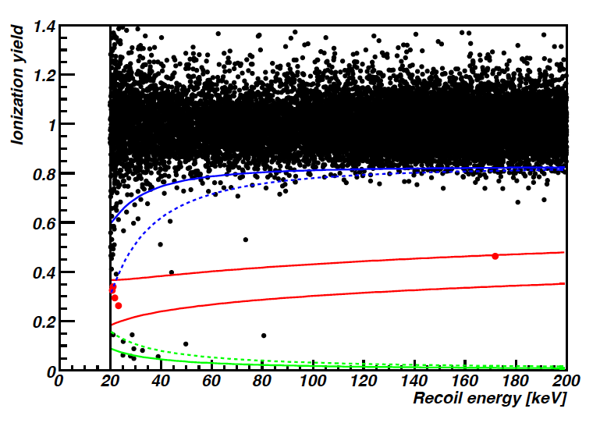
EDELEWEISS-II
‘Fiducial’
400g x 10 Ge= 4 kg (1.6kg:fid.)
Phonon+ charge collection electrodes w/ interleaved geometry (Ge-ID)
  ➔ reject of near surface events
Rej, Rate: 6x10⁻⁵
Threshold: E_{NR} < 20keV
∼14 months of running: 384kg*day
Found: 5 Nuclear Recoil events
< 3.0 BG events
  γ-BG leak (<0.9), surface (0.3), muon induced(0.4), neutron(1.4)
Combined Analysis w/ CDMS-II
Next Step:
  Next EDELWEISS-III
    26kg (40 x 800g) aiming 10⁻⁴⁵cm² (SI)
    Start installation in 2012
99.99% rejection
av. & worst
NR band @90%
Ionization thr. of 2 keVee
av. & worst
Degraded
α’s ?

Slide 29
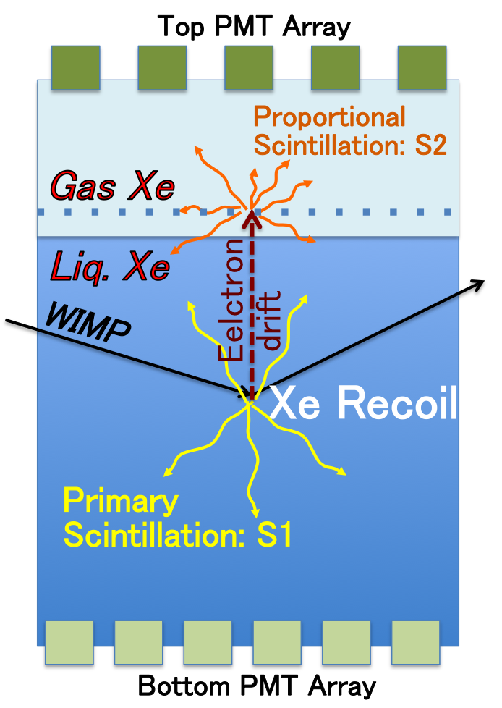
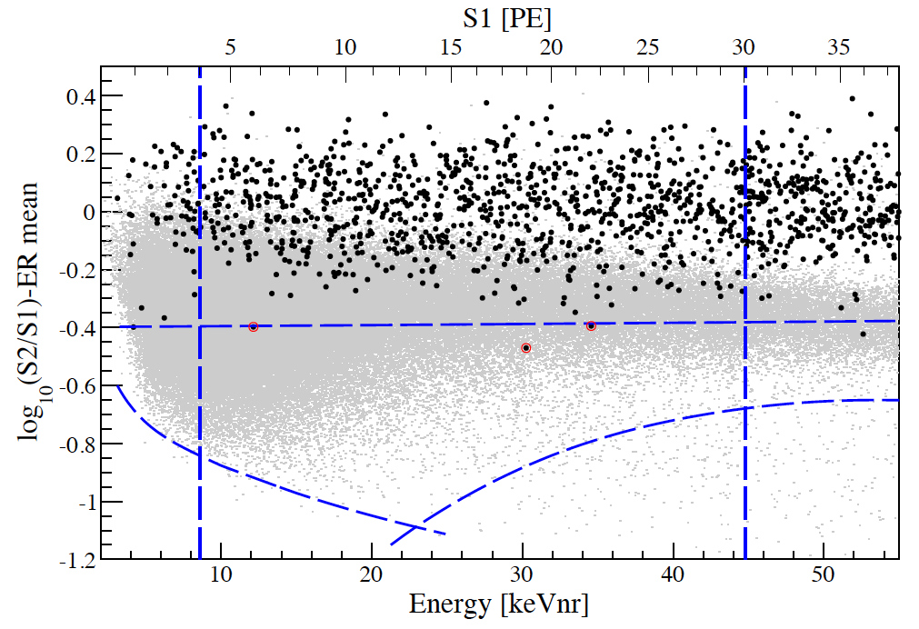
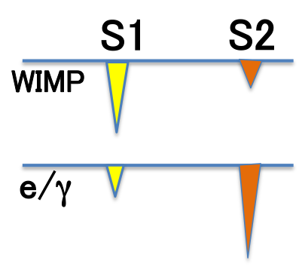
XENON-100
2 phase
liquid Xenon detector
Simultaneous detection of light (S1) and charge (as S2)
  Ionization e’s → S2 (prop. Scinti.)
S2/S1 →NR and EM discri: ∼1/1000
100.9 live days (till June in 2010) w/48 kg fiducial mass (62kg)➔ 1471kg-day
3 events remain after S2/S1 selection (99.75% EM rejection)
Expected BG: 1.8±0.6
  ⁸⁵KR: 1.14±0.48
  Others: 0.56(+0.21/-0.27)
99.75%
3σ NR accept.
8.4 keV
S2 threshold
10 20 30 40 50
(S2/S1)_{WIMP} < (S2/S1)_{γ}
Energy [keV_{NR}]

Slide 30
Current Experimental Situation
10⁻³⁹
CoGeNT
DAMA
CRESST
EDELWEISS-II
CDMS-II
XENON100
10⁻⁴⁵

Slide 31
Current and Future direct WIMP Search experiments
35 programs (not complete list : sorry for those projects I have missed)
Experiments | site | Target & mass | technology | Achieved (cm²) | Sensitivity (cm²) | Status & comments | Year to start
Xenon
ZEPLIN-III | Boulby | Xe: 8kg | two phase |  | SI: 10⁻⁴³ | Stop in 5- 2011 | results soon
XENON100 | LNGS | Xe: 48kg | two phase |  | SI: 7x10⁻⁴⁵ |  | On going
XENON1T | LNGS | Xe: 1t | two phase |  | SI: 10⁻⁴⁷ |  | 2015
XMASS | Kamioka | Xe: 100kg | single phase |  | SI: 10⁻⁴⁵ | commissioning | On going
XMASS-1.5 | Kamioka | Xe: 1ton | single phase |  | SI: 10⁻⁴⁶ |  | 2013
XMASS-II | Kamioka | Xe: 10ton | single phase |  | SI: 10⁻⁴⁷ |  | 2016
PANDA-X | Jing Ping | Xe: 25kg | two phase |  | SI: 10⁻⁴⁵ |  | > 2013
LUX | SUSEL | Xe: 100kg | two phase |  | SI: <10⁻⁴⁵ | Surface lab | 2012
LZS | SUSEL/SNO | Xe: 1ton | two phase |  | SI: 10⁻⁴⁷ |  | 2015
Ar
WARP | LNGS | Ar:140kg | two phase |  | SI: 5x10⁻⁴⁵ | commissioning
DarkSide50 | LNGS | DAr: 50kg | two phase |  | SI: 10⁻⁴⁵ | prototype
ArDM | Canfranc | Ar: 850kg | two phase |  |  | Prototype | 2011
DEEP3600 | SNOLAB | Ar: 1ton | Single phase |  | SI: 10⁻⁴⁵ |  | 2012
MiniCLEAN | SNOLAB | Ar: 150kg | Single phase |  | SI: 10⁻⁴⁴ |  | 2011
DARWIN | Europe | Ar or Xe: tons | two phase |  | SI: <10⁻⁴⁷
MAX | DUSEL | Ar and Xe |  |  | SI:<10⁻⁴⁷ | R&D

Slide 32
Experiments |  | site | Target & mass | technology | Sensitivity (cm²) | Achieve (cm²) | Status & comments | Year to start
Ge
Super-CDMS |  | SOUDAN | Ge: 15kg | char+phonon | SI: 5x10⁻⁴⁵ |  |  | 2011
Super-CDMS |  | SNOLAB | Ge: 100kg | char+phonon | SI: 3x10⁻⁴⁶ |  |  | 2015
CoGeNT-C4 |  | SOUDAN | Ge: 4kg | charge |  |  | installation | 2011
CDEX |  | Jing Ping L | PC-Ge:10 kg | charge | SI: 10⁻⁴³ |  | 1kg test
Bubble Chamber
PICASSO | SNOLAB |  | C₄F₁₀: 2.6kg | BC | SD: 2x10⁻³⁷ |  |  | On going
SIMPLE | Rustrel |  | C₂ClF₅: 26 kg | BC |  |  | Test 0.2kg | Install 2012
COUPP | SNOLAB |  | 60kg | BC |  |  | 4kg test | 2011
Scintillation (+phonon)
DAMA | LNGS, |  | NaI: 250kg | Scintillation | SI: 10⁻⁴⁰ |  |  | On going
KIMS | Yang Yang |  | CsI: 104.4kg | Scintillation | SD:10⁻³⁸ |  |  | On going
CINDMS | Jing Ping L |  | CsI(Na) | Scintillation |  |  | R&D
CRESST-II |  |  |  | Sintill+phonon |  |  |  | On going
ROSEBUD | Canfranc |  | Al₂O₃ etc. | Scintill+phonon |  |  | R&D
DM-Ice | South pole |  | NaI:>250kg | Scintillation | Test DAMA |  | Prototype: 17kg | ?
EURECA | LSM |  | Multi-T: 1ton | many | SI: 10⁻⁴⁶ |  | Phase-I: 150kg | 2015
Tracking
Drift-III | Boulby |  | CS2:4kg,24m³ | TPC | SD: 10⁻⁴⁰ |  |  | ?
DM-TPC |  |  | CF4 | PMT+TPC |  |  | Prototype test
NewAGE | Kamioka |  | CF4 | microTPC |  |  | Prototype test
MiMac | LSM |  | CF4 | microTPC |  |  | Prototype | 2011 1m³
Cygnus | World? |  |  | Tracking |  |  | White paper

Slide 33
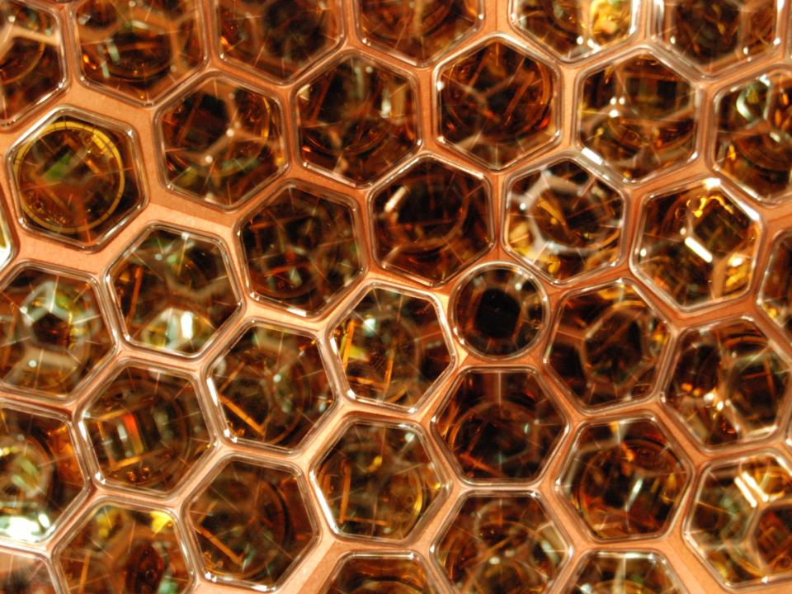
STATUS OF THE XMASS EXPERIMENT

Slide 34
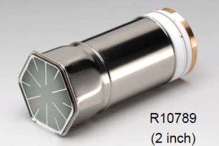
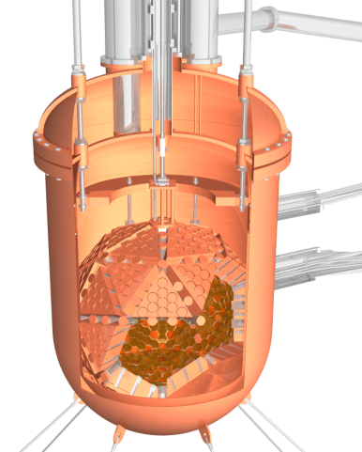
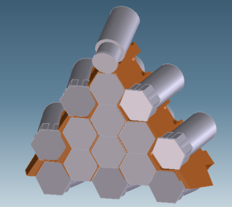
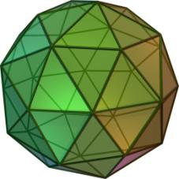
The phase-I XMASS detector
Detector
  Single phase (scintillation only) liquid Xenon detetor
  Operated at -100ºC and ∼0.065MPa
  100 kg fid. mass, [835 kg inner mass (0.8 mφ)]
  Pentakis dodecahedron
  ← 12 pentagonal pyramids: Each pyramid ← 5 triangle
  630 hex & 12 round PMTs with 28-39% Q.E.
  photocathode coverage: > 62% inner surface
1.2m diameter
Developed with Hamamatsu

Slide 35
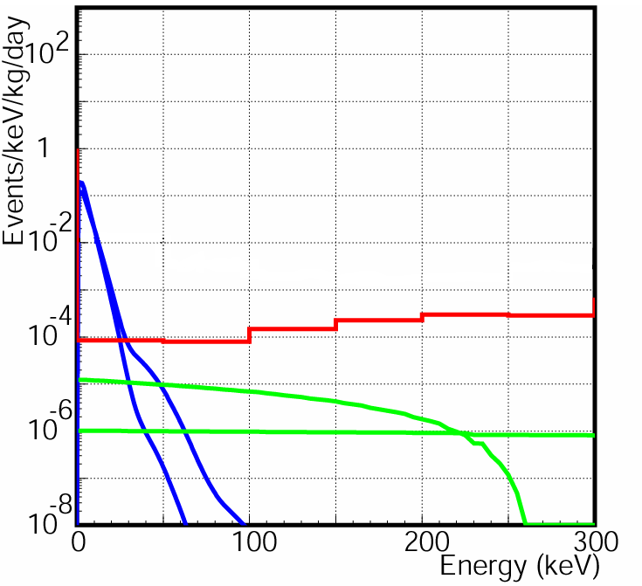

Characteristics and Aim
Low energy thresholed < 5keV_{ee} (∼25keV_{NR}) and good energy/vertex resolution
  ⬅ High light yields (∼NaI) and high photo-cathode coveragy
Possible low BG
  ⬅ Gas/liquid → purification during the running
Study Spin dependence (option)
  ⬅ Easier isotope separation (odd $ even)
Aim
  Backbround: 10⁻⁴ dru (ev/kg/keV/day)
  10⁻⁴⁵cm² SI for ∼100GeV WIMPs
Calculation
ββ-decay
Line for 10⁻⁴² cm² (50GeV / 100GeV)
Mostly Odd
Mostly Even
Background level
pp−solar ν
⁷Be solar ν
Challenge to reduce backgrounds

Slide 36
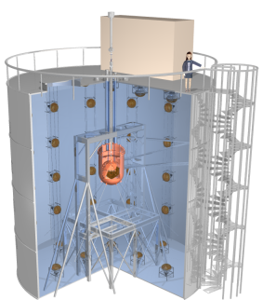
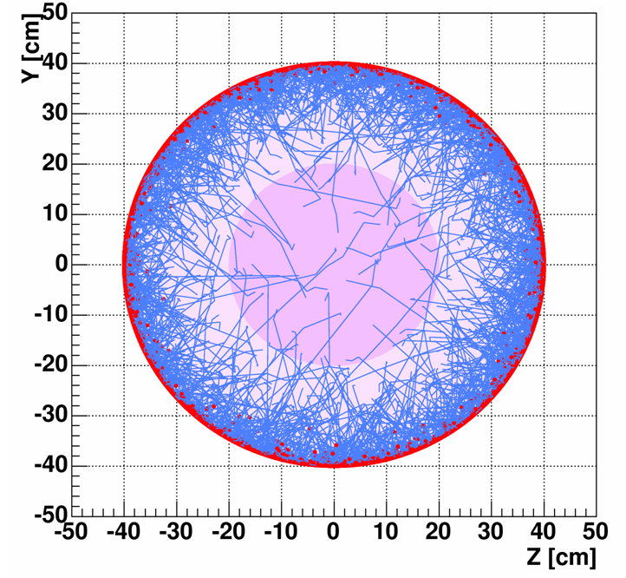
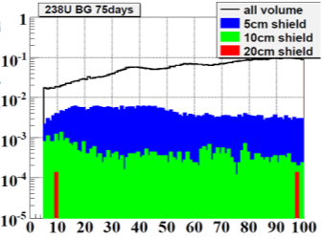
External backgrounds
γ, n from Rocks
  Water tank (active: 72 20” PMTs)
    > 4 m water shields
    γ: 10³ recuction by 2m
      smaller than PMT BG
    n << 10⁻⁴/d/kg (by 2m)
γ, n from PMT, detector parts
  Low BG PMT (∼1/100 of regular PMT)
  Material selection by HPGe detector
  Self-Shields
    < 10⁻⁴ /keV/day/kg
11 m
>4m
10 m
Self shielding effect
MC simulation
 | BG/PMT with base parts
U chain | 0.70 ± 0.28 mBq
Th chain | 1.5 ± 0.31 mBq
40K | < 5.1 mBq
60Co | 2.9 ± 0.16 mBq

Slide 37


Internal backgrounds
Off gas
Lower tmp
Kr (Q_{β} = 687 keV)
  Distillation: Kr has lower boiling point
  5 orders of magnitude reduction (test)
    0.1ppm➔1ppt with 4.7kg/hr
    K. Abe et al. for XMASS collab., Astropart. Phys. 31 (2009) 290
  Distillation: 10 days before filling into the detector (∼ 1 ton)
Rn
  target value
    ²²²Rn: target 1.0mBq for 835 kg inner volume
    ²²⁰Rn: target 0.43mBq for 835 kg inner volume
  Filtering by circulation
    liquid → gas (30litter-GXe/min) → liquid
      Charcoal
    liquid (a few litter-LXe/min)
      Understady
Higher tmp
Xe

Slide 38


Expected sensitivity
σ_{χp}>2x10⁻⁴⁵ cm²
for 50-100GeV WIMP, 90%C.L.
1yr exposure, 100kg FV,
BG: 1x10⁻⁴ /keV/d/kg
Scintillation efficiency: 0.2
Spin Independent
CDMS-II
Expected energy spectrum
XENON100
EDELWEISS-II
1 year exposure
σ_{χp}=10⁻⁴⁴ cm²
50GeV WIMP
- - - XMASS 5keVee th.(100d)
- - - XMASS 2keVee th.(100d)
Black:signal+BG
Red:BG

Slide 39



Detector Consturuction

Slide 40


Joining two halves

Slide 41

クリックしてタイトルを入力
クリックしてテキストを入力
P-01

Slide 42


Detector performance
Reconstruction
Reconstructed position
Real Data
Simulation
Reconstructed energy
distribution
122keV
~4% rms
real data
simulation
136keV
59.3keV of W
  Reconstruction:
  pe-distribution, hit pattern (and timing)
  energy, position (and particle id)
  High p.e. yield: 15.1±1.2 pe/keV
  Energy resolution for ⁵⁷Co (122keV, γ-rays)
    4% rms
Position Resolution for
⁵⁷Co (122keV γ rays)
1.4cm rms (0cm: center) 1cm rms (±20cm)

Slide 43



Internal BG (Rn)
²²²Rn: Identify ²¹⁴Bi → ²¹⁴Po → ²¹⁰Pb decays
  ²¹⁴ Po decays with 164 μs half life
  β and α coincidence
  8.2±0.5mBq in the inner volume
Fitting with
an expected
decay curve
1st event (²¹⁴Bi β)
2nd event (²¹⁴Po α)
Tail due to
saturation
100
500
1000
Time difference (μs)
²²⁰Rn: Identify ²²⁰Rn → ²¹⁶Po → ²¹²Pb decays
  ²¹⁶Po decays with 0.14sec half life
  two α’s with short coincidence
  Upper limit <0.28mBq (90%C.L.)

Slide 44

Summary for XMASS
XMASS is a single phase liquid Xenon detector
The XMASS 800kg detector is able to detect dark matter to the sensitivity 2x10⁻⁴⁵cm² (spin independent case).
Commissioning runs are on going to confirm the detector performance and background properties.
  Energy resolution and vertex resolution were as expected. ~1cm position resolution and ~4% energy resolution for 122keV γ.
  Radon background are close to the target values

Slide 45
Summary
Direct dark matter search experiments are in a very exciting and interesting stage: Some indications for low mass DM, but there are conflicting results.
People tried to reconcile those results: Many many papers.
  Inelastic DM, Isospin violating DM, Mirror DM, Composite DM, Resonant DM, SD inelastic DM, Complex Scalar DM, Astrophysical parameters, and so on….
But experimentally we need more studies on those data and understand backgrounds especially.
XMASS is now in commissioning stage and hope that we will show some results in a few months.

Slide 46
END

Slide 47


CDMS-II low threshold
2 keV threshold
Only 8 low BG Ge detectors
  Others: veto
241kg-days
Remaining event shape: similar to a WIMP signal, but,
Un-rejected electron events
  Zero-charge events (close to edge)
    Charge → by side wall, not readout electrode
    Phonon fiducialization does not work @LE ➔ remain as zero ch ev.
  Remaining surface events
  bulk events
  1.3 keV lines (L-shell EC)
2 10 100
Recoil Energy (keV)
total backgrounds
zero ch ev
1.3keV
bulk
surface
2 5 10 15 20
Recoil Energy (keV)
Recoil energy scale assumes that the ionization signal is consistent with a nuclear recoil

Slide 48

CDMS-II low threshold
2 keV threshold
Only 8 low BG Ge detectors
  Others: veto
241kg-days
Remaining event shape: similar to a WIMP signal, but,
Un-rejected electron events
  Zero-charge events (close to edge)
    Charge → by side wall, not readout electrode
    Phonon fiducialization does not work @LE ➔ remain as zero ch ev.
  Remaining surface events
  bulk events
  1.3 keV lines (L-shell EC)
XENON100-
10d (reduced)
CDMS-II
Shallow-LE
CDMS-II
DAMA
2 10 100
CoGeNT
Recoil Energy (keV)
total backgrounds
4 6 8 10 12
WIMP mass (GeV/c²)
XENON100-10d (Const)
CDMS-II-LE
zero ch ev
1.3keV
bulk
surface
2 5 10 15 20
Recoil Energy (keV)
Recoil energy scale assumes that the ionization signal is consistent with a nuclear recoil

Slide 49


Comparison between CDMS and CoGeNT
(Germanium detectors)
Acceptance corrected
CDMS selected as NR
CDMS: Consistent with backgrounds
  Surface, zero charge, EM bulk….
CoGeNT: no separation for NR and EM.
➔
If CoGeNT ‘signal’ is NR
  inconsistent with CDMS, and majority is backgrounds.
If CoGeNT ‘signal’ is EM
  CDMS cannot tell much.
CoGeNT data is corrected for quenching factor [D.Hooper et al. PRD,82,123509(10)].

