Slide 1
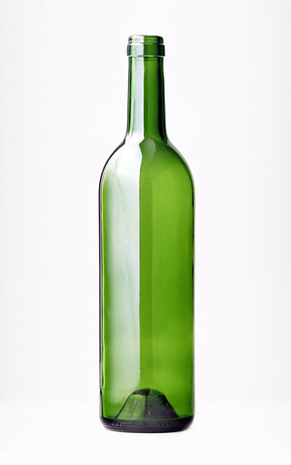
Old Wine in a New Wine Bottle----
Technidilaton as the 125 GeV Higgs
Technidilaton
125 GeV Higgs
http://ja.wikipedia.org/wiki/ワインボトル#mediaviewer/File:Bouteille.jpg

Slide 2


Old Wine in a New Wine Bottle----
Technidilaton as the 125 GeV Higgs
Koichi Yamawaki
KMI, Nagoya University
KMI Workshop on
Origin of Mass and Strong Coupling Gauge Theories
(SCGT 15)
In place of Volodya Miransky’s Talk
Sakata Memorial

Slide 3
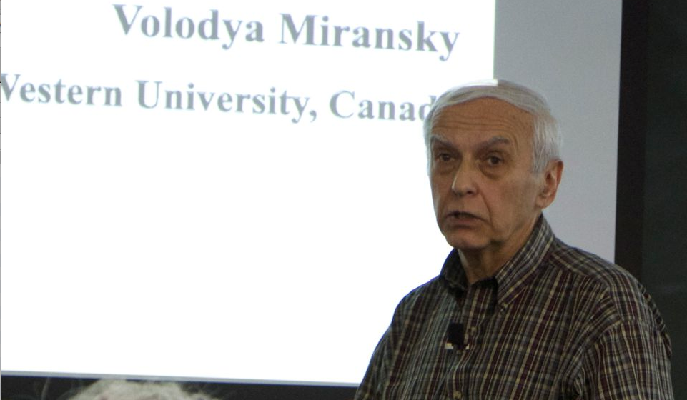
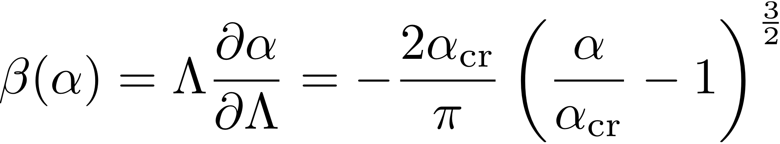
Volodya Miransky cancelled twice
the SCGT Workshops:
In SCGT 88 the first SCGT Workshop
in 1988 (delayed Visa for a Soviet citizen)
In SCGT15 the last SCGT Workshop
(his mother in bad health cond.)
Volodya invented a new renormalization for the formally conformal theory
(ladder SD equation) 1985
Miransky scaling or Berezinskii-Kosterlitz-Thouless transtion

Slide 4
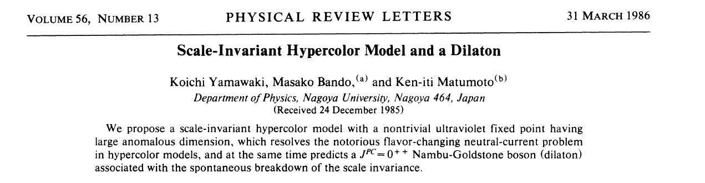
INSPIRE
%\cite{Yamawaki:1985zg}
\bibitem{Yamawaki:1985zg}
K.~Yamawaki, M.~Bando and K.~-i.~Matumoto,
%``Scale Invariant Technicolor Model and a Technidilaton,''
Phys.\ Rev.\ Lett.\ {\bf 56}, 1335 (1986).
%%CITATION = PRLTA,56,1335;%%

Slide 5
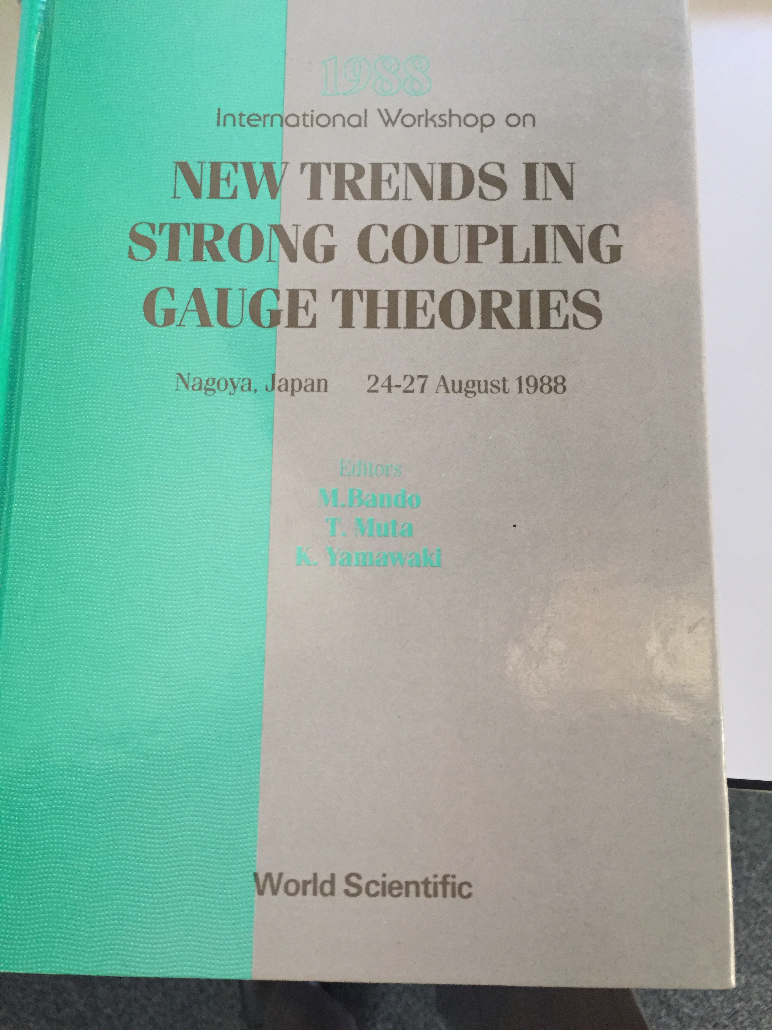
SCGT 88

Slide 6
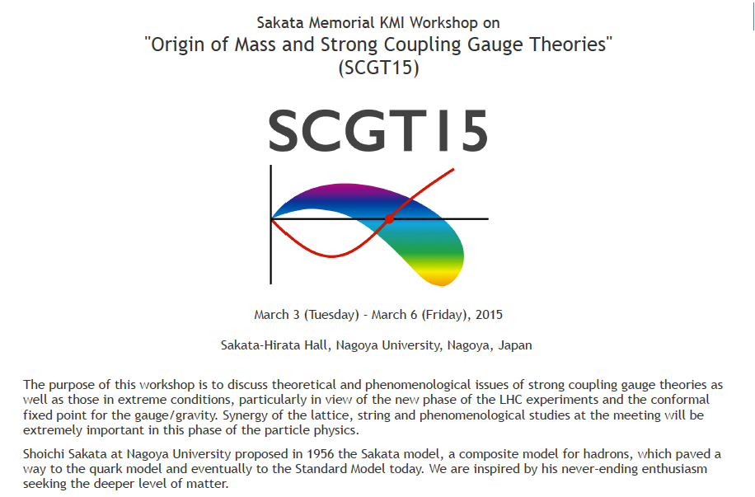

Slide 7

Composite Approach
Sakata Model (1956)
Quark Model (1964)
Shoichi Sakata （１９１１－１９７０）
In contrast to current view that the elementary particles are the ultimate
building stones of matter, we believe that nature as a whole has a structure of inexhaustible depth, and each of different kinds of atomistic conceptions, such as molecule, atom, nucleus, elementary particle, and so forth, stands for each of the qualitatively different levels of matter disclosed one after another by deeper studies. We should never expect to find out the deepest level of matter, because there are certainly more elements in it than we can possibly be aware of at any particular stage of scientific development……
(Supplement of Progress of Theoretical Physics, No.19, 1961)

Slide 9


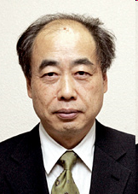
Composite Models
Gell-Mann, Zweig (1964)
S. Sakata (Nagoya Univ.)
Sakata (1956)
mixing
Maki-Nakagawa-Sakata (1962)
Kobayashi-Maskawa (1973)
Nagoya University

Slide 10


Slide 11
ORIGIN
of
MASS ?
LHC Higgs

Slide 12
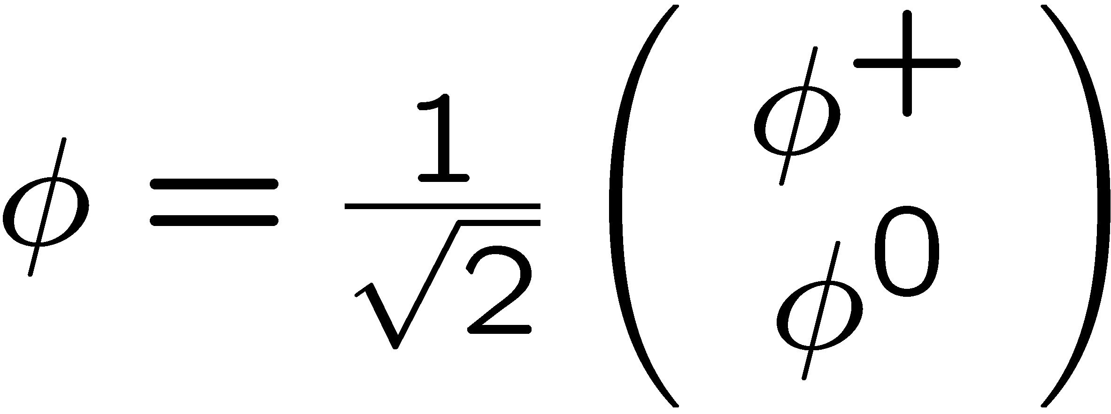
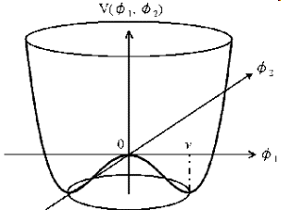
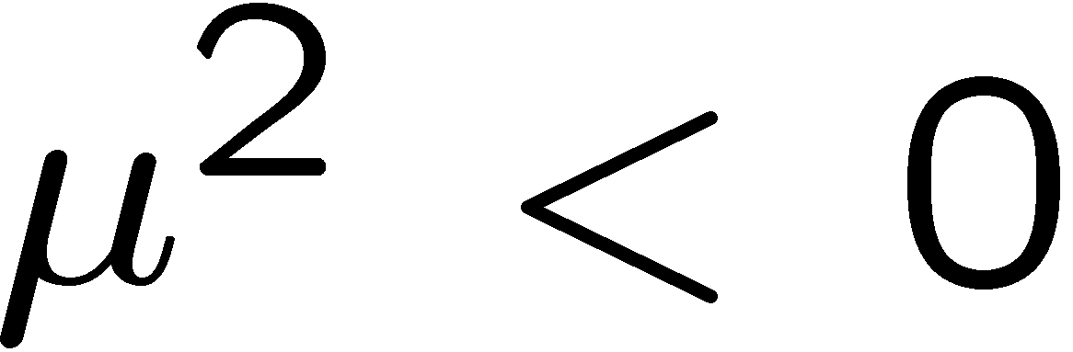


h
Ｔａｃｈｙｏｎ！？

Slide 13
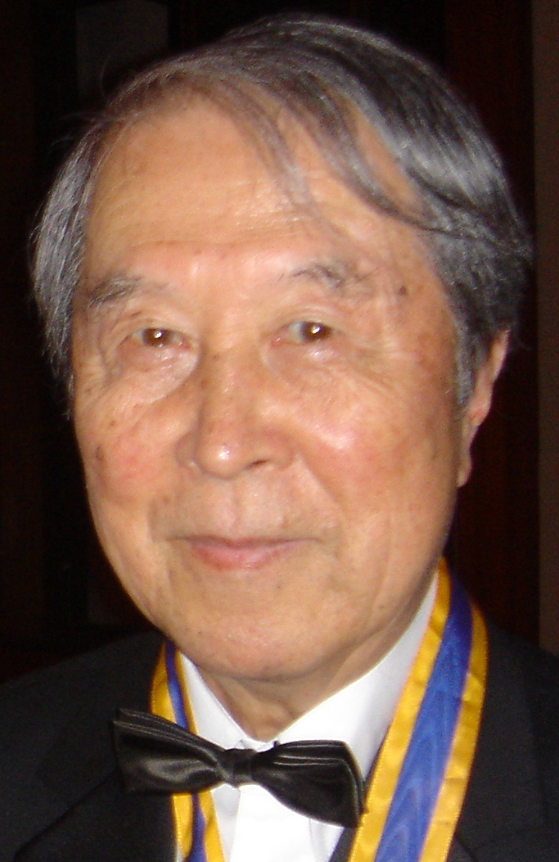
Spontaneous Symmetry Breaking
was born as
Dynamical Symmetry Breaking
BCS Analogue
Origin of Mass (Nucleon)
Tachyon Attractive Forces
(BCS instability)
Nambu-Jona-Lasinio (1960)

Slide 14


Slide 15
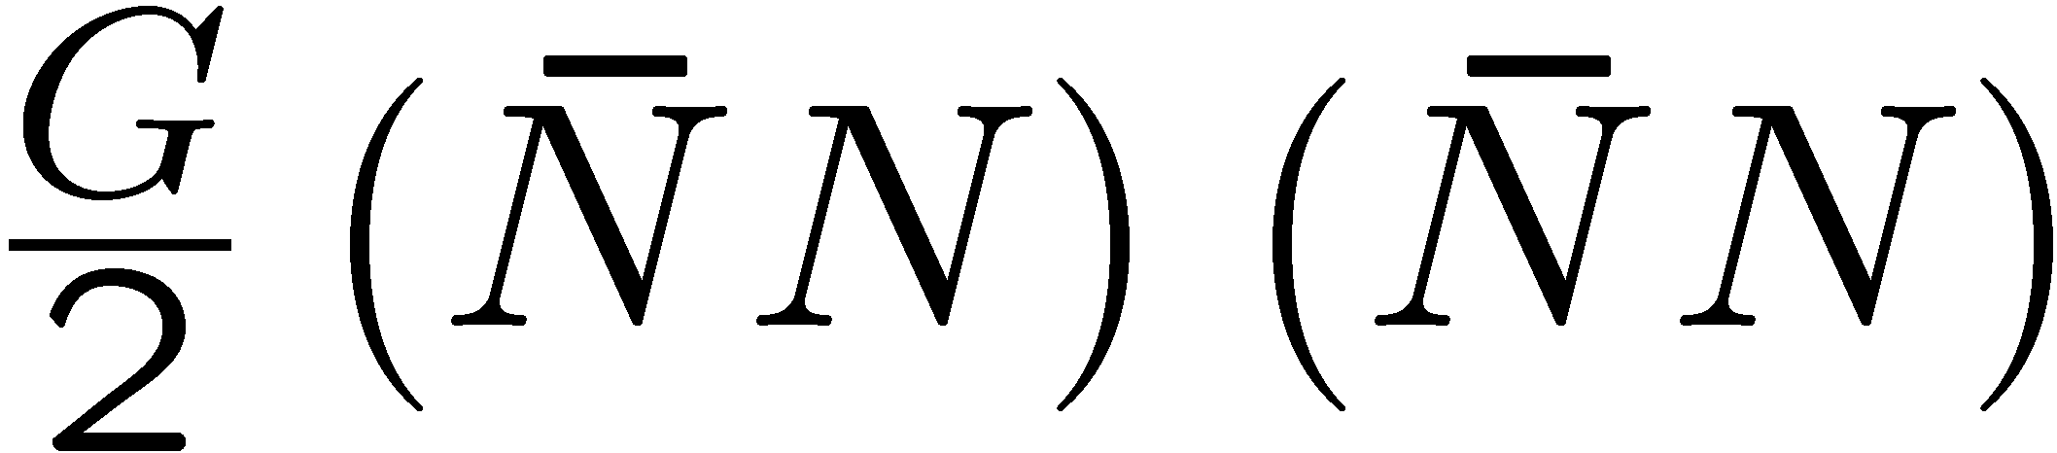





Gap eq.
(``Higgs’’)
Fermi-Yang Model (1948)
p
n
p
n
Λ
Sakata Model (1956)

Slide 16
Gap eq.
(``Higgs’’)
Fermi-Yang Model (1948)
p
n
p
n
Λ
Sakata Model (1956)

Slide 17

Composite Higgs I
Top Quark Condensate
(Top Mode Standard Model)
Miransky,Tanabashi and K.Y. (Dec. 1988) Nambu (Feb. 1989)
Bardeen, Hill and Lindner (July, 1989)

Slide 18
Z⁰
W±
(QCD effects)
(+ other effects)
Refinements:
Top seesaw
Technicolor-assisted Topcolor (TC²)
Top condensate in SM with extra
dimensions
Top-mode pseudo NG (Fukano’s talk)

Slide 19
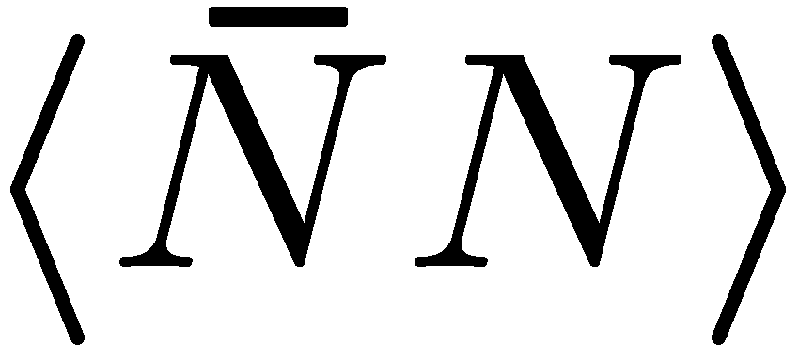
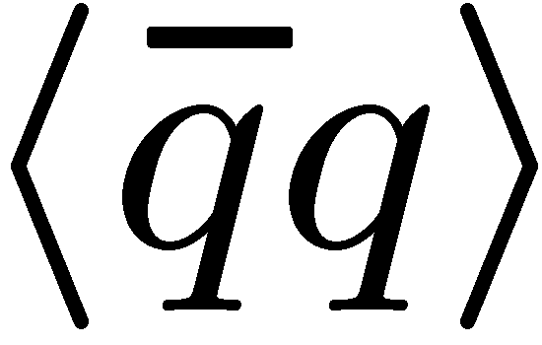

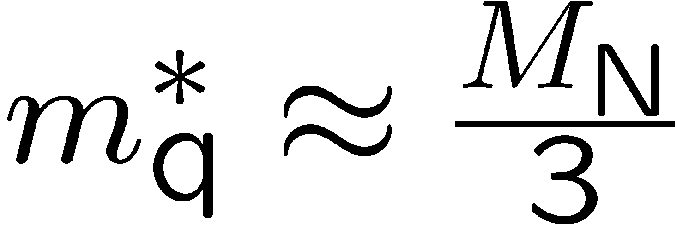


Essentially the same in QCD
Nucleon Quark
4-fermion int. Gauge int.
~
~
~
~
~
~
~
~
gluon

Slide 20
Origin of Mass (QCD)
: Scale-invariant (Classical)
Scale-anomaly (Quantum)
BCS-NJL

Slide 21
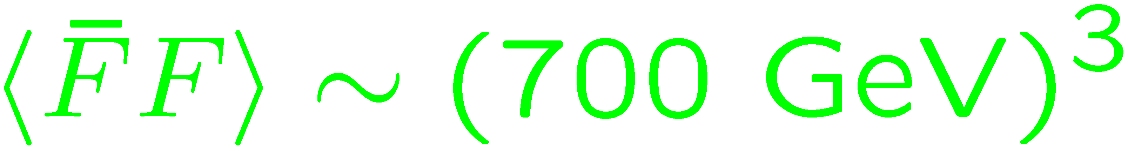


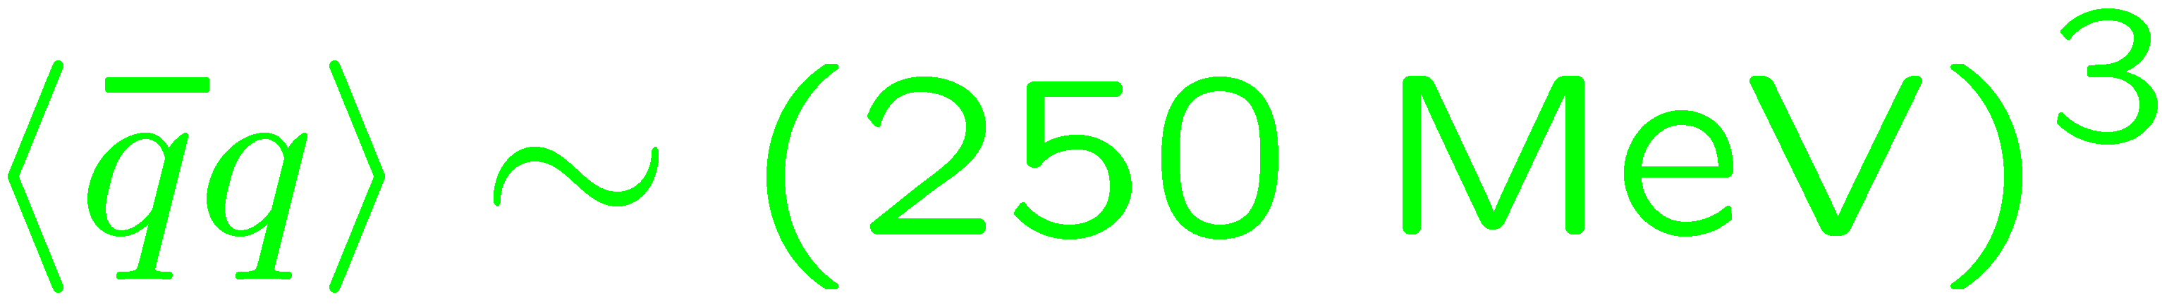
Composite Higgs II
Technicolor: a Scale-Up of QCD
S. Weinberg (1976)
L. Susskind (1979)
X 2600

Slide 22

Discovery of
125 GeV Higgs
New Wine Bottle

Slide 23
Standard Model is incomplete
No Dark matter candidates
Baryogenesis: KM CP violation not enough,
No 1st order phase transition
Strong CP Problem: neutron EDM
…
Naturalness Problem BSM on TeV
Origin of Mass

Slide 24
TC was killed 3 times
FCNC
S,T,U parameters
125 GeV Higgs
Walking TC
(Holographic)
Walking TC
[and/or ETC effects]
Walking TC
scale inv.

Slide 25
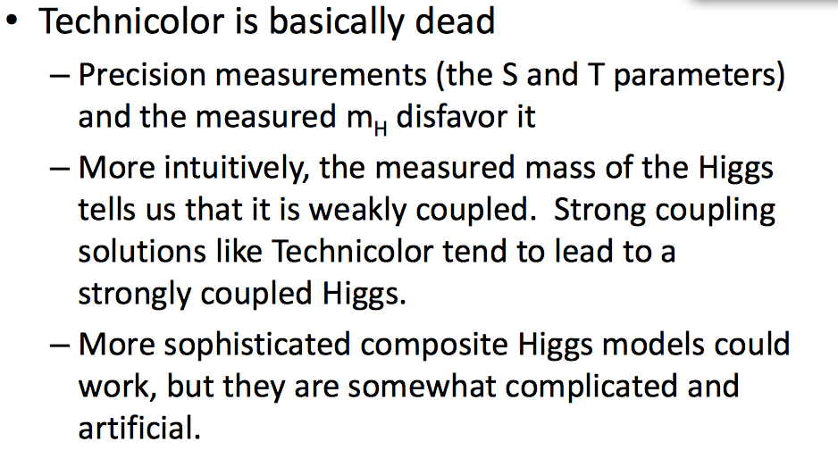
Weakly Coupled Light Scalar Composite
from
Strongly Coupled Dynamics?
Cf: N. Seiberg, Aspen 2013
Lightness
Yes !
Scale inv.
LHC confirmed
Weakness
Coupling to SM sector

Slide 26
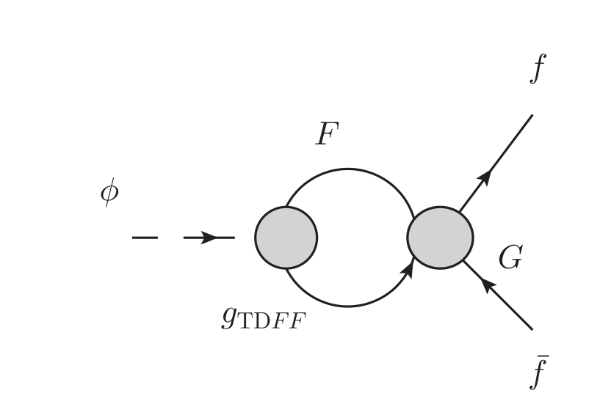
Not a linear sigma model !
TC sector
(Strongly coupled)
SM sector
Weak !
Even weaker than SM Higgs !!
-----------
Even needs enhancement !

Slide 27
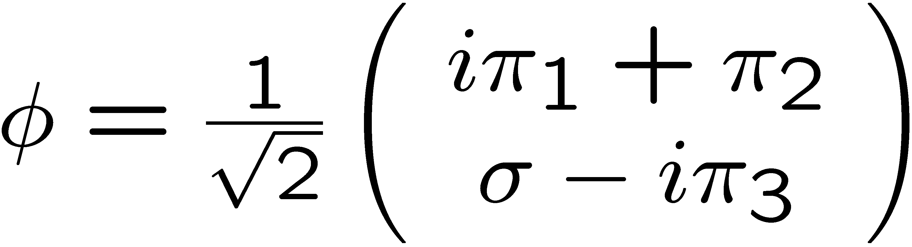
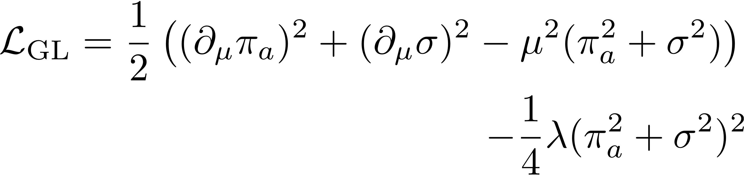
Naïve Arguments (base on LINEAR sigma model)

Slide 28
ChPT analyses
Gasser-Leutwyler (1984)
+ O(p^4)
WTC: Scale-Inv. (+anti-Veneziano limit)

Slide 29
Another Naiive Argument (based on Chiral Perturbation Theory: NDA)
Breaks down already in QCD
Light composite appears before ChPT breaks down !!
ChPT must be modified to include light spectrum
Actually, NDA itself should be modified
M. Soldate, R. Sundrum (1990)
R.S. Chivukla, M.J.Dugan, M.Soldate (1993)
M. Harada, KY (2003)
Scale inv. (PCDC)

Slide 30
Folklore:
Technicolor = Higgsless Model
S. Weinberg (1976)
L. Susskind (1979)
(No light scalar)
Walking Technicolor KY-Bando-Matumoto (1986)
= Composite Higgs Model
Approx. Scale Symmetry
Techni-dilaton
“Conformal Higgs”
125 GeV Composite Higgs

Slide 31
INSPIRE
%\cite{Yamawaki:1985zg}
\bibitem{Yamawaki:1985zg}
K.~Yamawaki, M.~Bando and K.~-i.~Matumoto,
%``Scale Invariant Technicolor Model and a Technidilaton,''
Phys.\ Rev.\ Lett.\ {\bf 56}, 1335 (1986).
%%CITATION = PRLTA,56,1335;%%

Slide 32
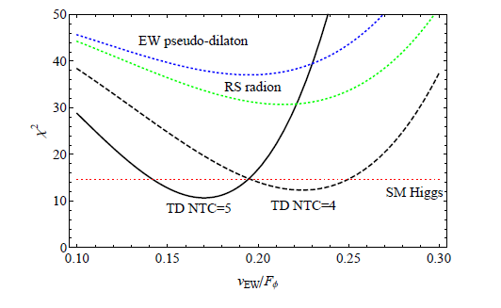

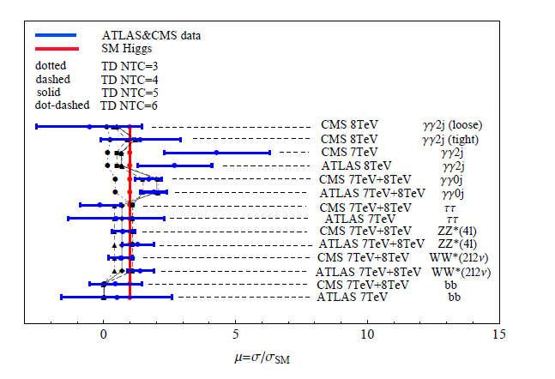
125 GeV Techni-dilaton(TD) at LHC
S.Matsuzaki and K. Y. ,
PLB719 (2013) 378
PRD86 (2012) 115004
TD (in 1FM) is favored by
the current data !!
* diphoton rate
enhaced by techni-fermions
(> W loop contribution)
* goodness-of-fit performed
for each search category
As of July 2012
Consistent with the updated after ICHEP 2014 (Matsuzaki’ talk)

Slide 33

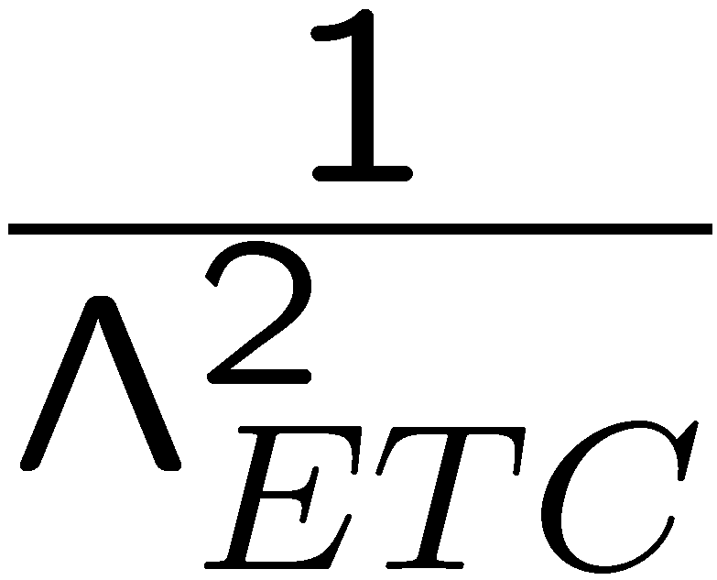
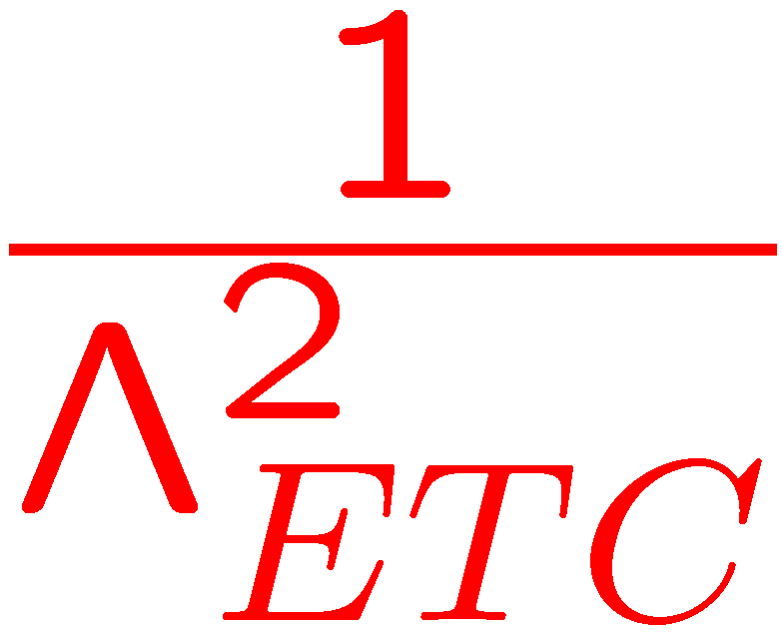


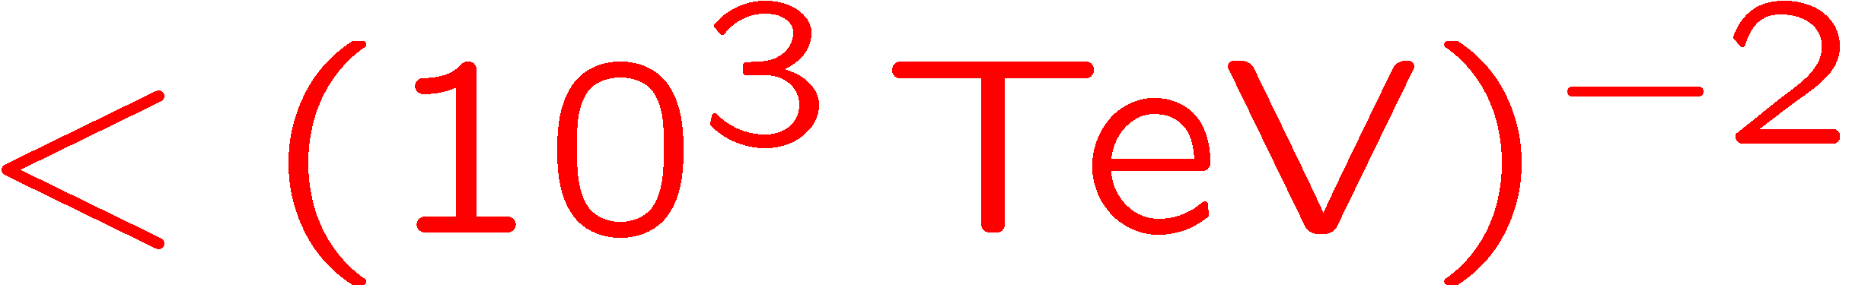
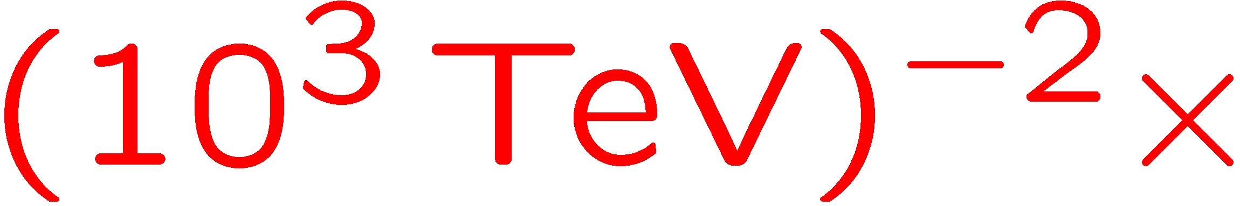

FCNC
FCNC Problems:
F_{L}
q_{R},l_{R}
ETC
q_{L},l_{L}
F_{R}
Mass of Quarks/Leptons
q_{R},l_{R}
F_{L}
X
q_{L},l_{L}
F_{R}
Needs 10³ enhancement

Slide 34
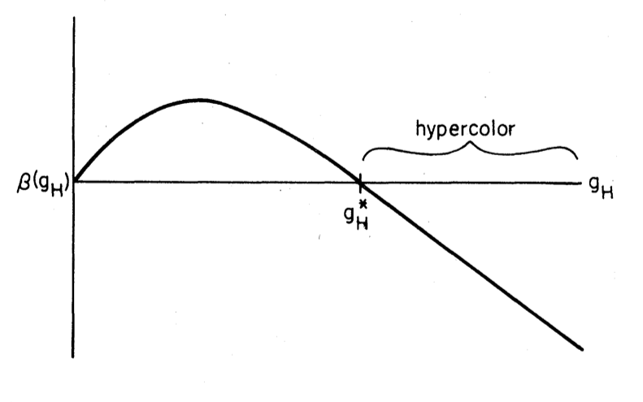
By Large Anomalous Dimension
Holdom (1981)
Pure Assumption of
Existence of Large
No Concrete Dynamics
No Concrete Value
If

Slide 35
Walking Technicolor
K.Y., Bando, Matumoto (Dec. 24, 1985)
Ladder Schwinger-Dyson Equation
Scale Invariance
FCNC Sol.
Techni-dilaton
Similar FCNC Sol. Without , Scale Invariance, Techni-dilaton:
Akiba, Yanagida (Jan. 3, 1986)
Appelquist, Karabali, Wijewardhana (June 2, 1986)
( Holdom (Oct. 12, 1984), pure numerical )

Slide 36
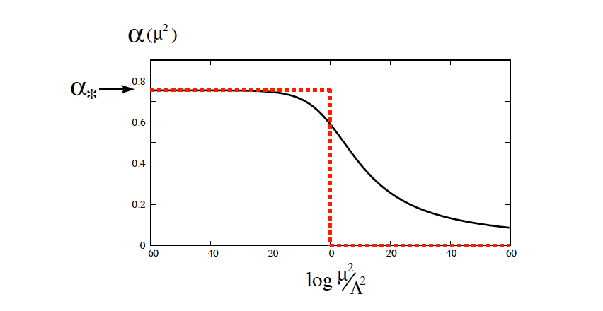
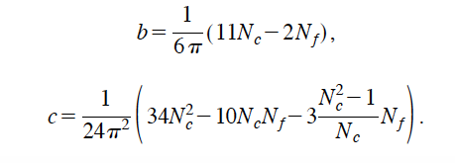
Ladder as an ideal limit of IRFP
( Large Nf QCD)
Caswell(1974)
Banks, Zaks(1982)
Two-loop beta function (scheme-independent)
two-loop coupling (Nf=12,Nc=3)
IRFP
Ladder coupling
IRFP
:
Almost continuous
“(anti-)Veneziano limit”

Slide 37
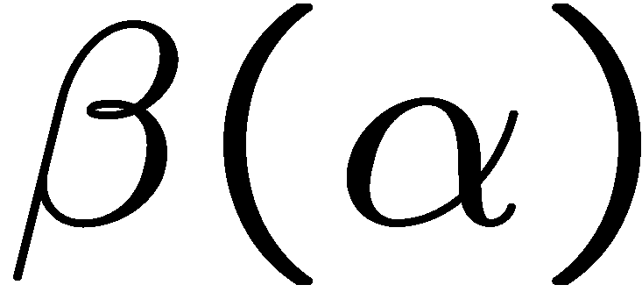
SSB
Appelquist,Terning,Wijewardhana (1996)
(ladder SD)
Miransky (1985)
IRFP
IRFP
UVFP
Scale sym
Nonperturbative beta fn.
IRFP
UVFP

Slide 38
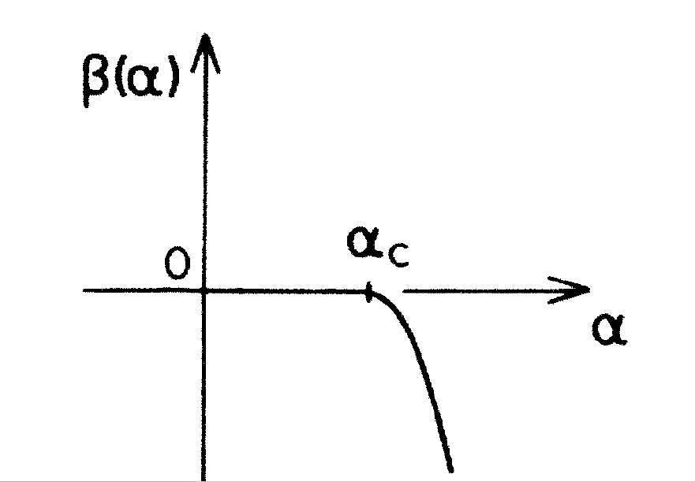
Not Taylor expandable
KY - M. Bando - K. Matumoto, PRL 56 (1986) 1335
Relevant to
Walking TC
ladder
UVFP
(Nonperturbative)
IRFP
(2-loop)

Slide 39
Conformal Phase Transition
V.A. Miransky, KY, PRD55 (1997) 5051
No
Bound
States
(Unparticle)
Light Bound States
ONLY due to dynamical mass
Scale Sym. SSB and ESB
Conformal Window
No
Bound
States
(Unparticle)
Light Bound States
ONLY due to explicit mass
Scale Sym. Only ESB

Slide 40
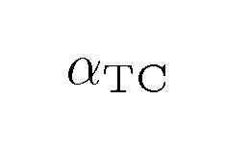
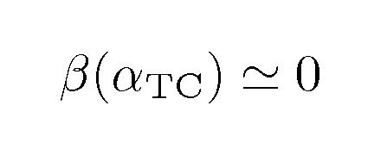

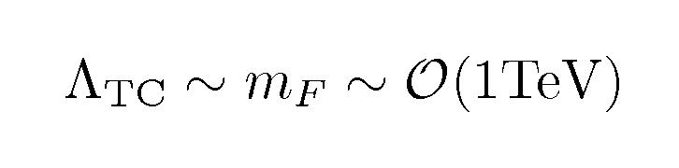
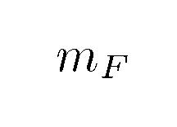
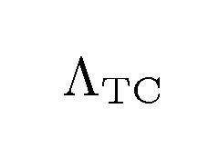
A schematic view of Walking TC
“walking”
QCD-like
QCD-like
(ETC~10^3TeV)
nonperturbative
trace anomaly
due to
Pseudo NG Boson: Techni-dilaton
Composite Higgs from technifermions having EW charges

Slide 41
Spontaneous breaking of
Electroweak & Scale symmetries due to Vacuum
Technipion
NG boson
Technidilaton
NG boson
SSB scale
Small Explicit breaking of Scale symmetry
(Nonperturbative Trace Anomaly)
PCDC

Slide 42
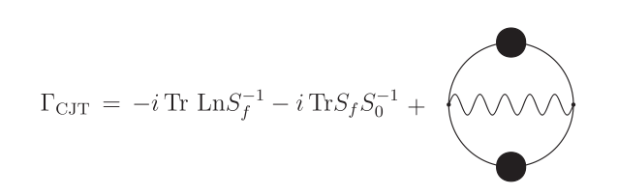

PCDC estimate of TD Mass &Decay const. (Ladder)
Bando-Matumoto-KY, PLB178 (1986) 308
Hashimoto-KY, PRD83 (2011) 015008
Kurachi-Matsuzaki-KY, PRD90 (2014) 095013; + R. Shrock, in preparation
Nonpertubative
Beta fn.
3 independent calculations
are consistent !!
Miransky-Gusynin (1989)
Pagels-Stokar

Slide 43
(anti-)Veneziano limit
= Walking
0
Light TD !
One-family model
Benchmark
Lightness = Weak Coupling
Consistent with LHC Higgs data !!

Slide 44
Origin of Mass (WTC)
: Scale-invariant (Classical)
Trace anomaly (Quantum)
Dim. transmutation
Non-perturbative Trace Anomaly
(Near Conformal SSB)
Dim. transmutation
``Scale Symmetry’’

Slide 45
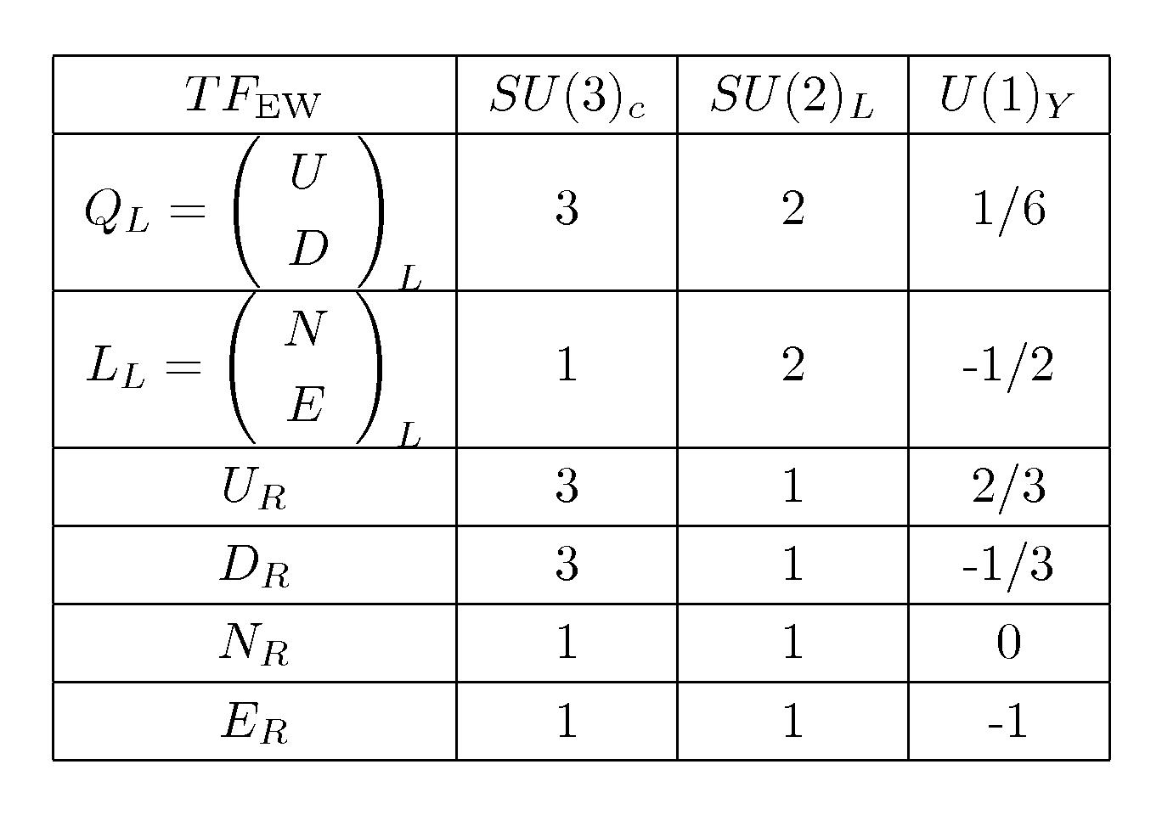
Discovering the Walking Technicolor on the LHC
125 GeV Higgs as a Technidilaton at LHC Run I
Testing Technidilaton at Run II
(Precise measurements)
2. Searching Technipions at LHC Run II
(Discovery)
3. Searching Techirho at LHC Run II
(Discovery)
Benchmark model: One family model

Slide 46






Technipions in One-family WTC
Chiral symmetry breaking: SU(8)L x SU(8)R → SU(8)V
3 “would-be” NGBs: eaten by W, Z
60 (pseudo) NGB = techni-pions (TPs)
All massive
: color-octet scalars (# 32)
: color-triplet scalars (“leptoquark”) (#24)
Expected masses :
(big enhancement !)
1 ～ 5 TeV
: color-singlet scalars (# 4)
J.Jia, S.Matsuzaki, K.Y.,
PRD87, 016006 (2012)
M. Kurachi, S. Matsuzaki, K.Y.
PRD90, 095013 (2014)
Explicit breakings:

Slide 47


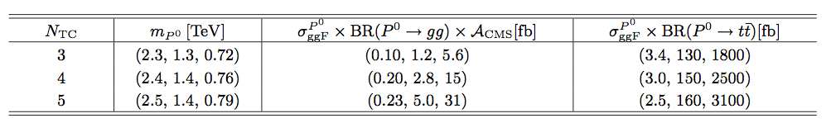
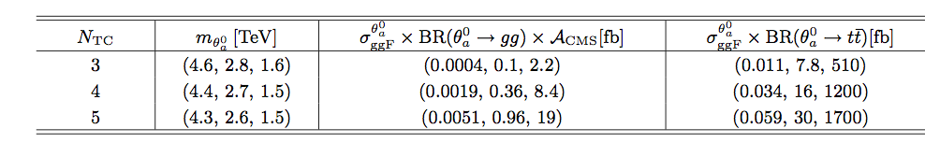
Techni-pions: Couplings to WW and ZZ highly suppressed
(NO NGB^3 vertex)
→ narrow resonances (tot.width ~ 10--50GeV)
Discovering isospin singlet TPs: and
J.Junji, S.Matsuzaki, K.Y.,
PRD87.016006. (2012)
M. Kurachi,S. Matsuzaki,K.Y.
PRD90, 095013 (2014)
* produced ONLY from ggF :
VBF, VH,
* Predominantly decaying to SM fermions
S=(0.1, 0.3, 1.0)
color-octet (θa) < 1.5—1.6 TeV
color-triplet (Tc) < 1.0 – 1.1 TeV
color-singlet (P) < 800 GeV
Heavy TP
Current LHC limits

Slide 48


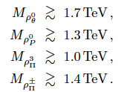


Expected masses :
1 ～ 4 TeV
consistent w/
EW precision tests
* Walking techni-rho (#63)
+ ω
: color-octet vectors (# 32)
S.Matsuzaki and K.Y.,
PRD86,115004 (2012)
: color-triplet vectors (# 24)
LHC constraints
: color-singlet vectors (# 4)
: color-singlet vectors (# 3)
[corresponding to vector states
for eaten NGBs]
Typical discovery channels: decays to WLWL (ZLZL)or TP and WL
q
W,Z,γ
ρ
WL, ZL
W,Z,γ
ρ
TP
q
WL,
ZL
WL, ZL
Novel discovery channel: decays to g, W(Z,γ) and TD!
(TP)
q
g,W,Z,γ
ρ
φ (TD)
No
q
g,W,Z,γ

Slide 49


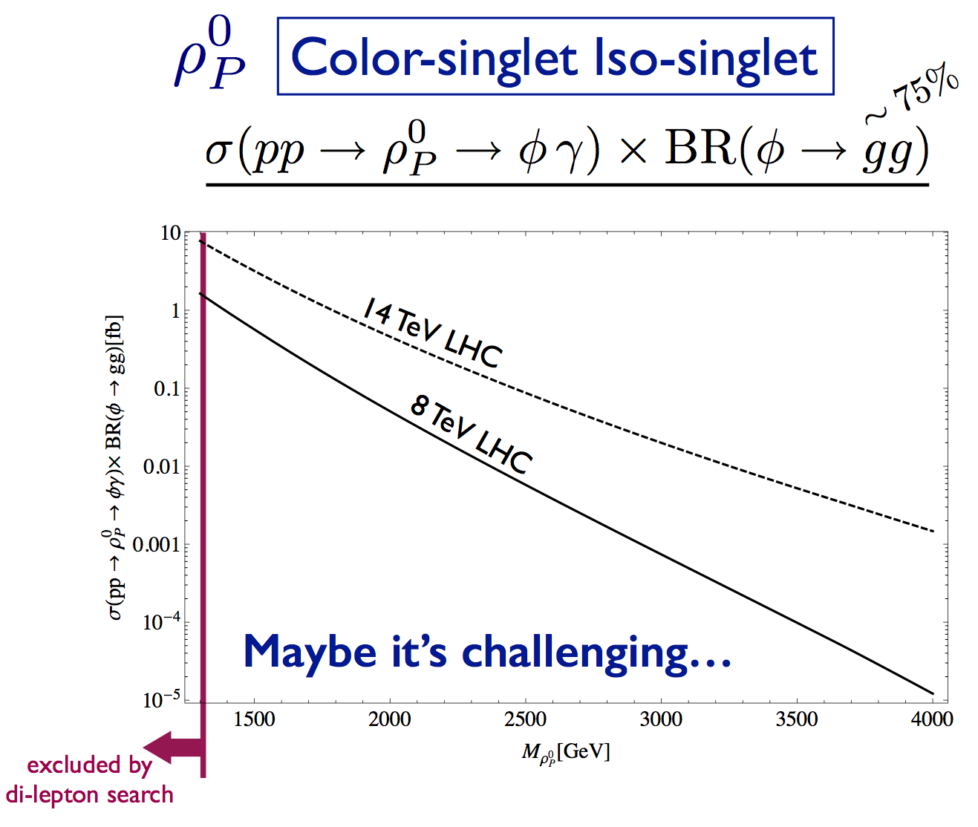
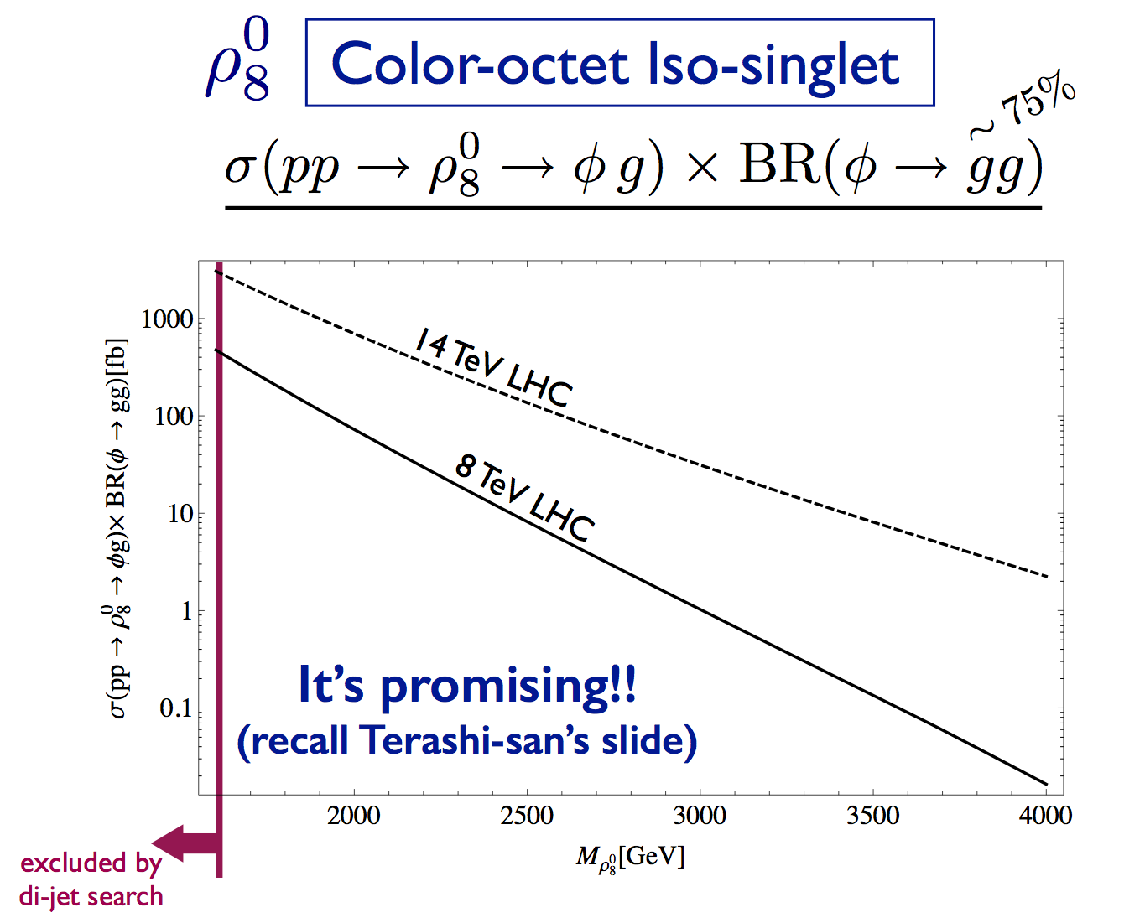
M. Kurachi, S.Matsuzaki and K.Y., PRD90,055028 (2014)
Scale-inv. HLS ChPT
Pararel to QCD rho
as HLS gauge boson
except scale-inv.
Bando-Kugo-Uehara-KY-Yanagida(1985)
Bando-Kugo-KY (1988)

Slide 50
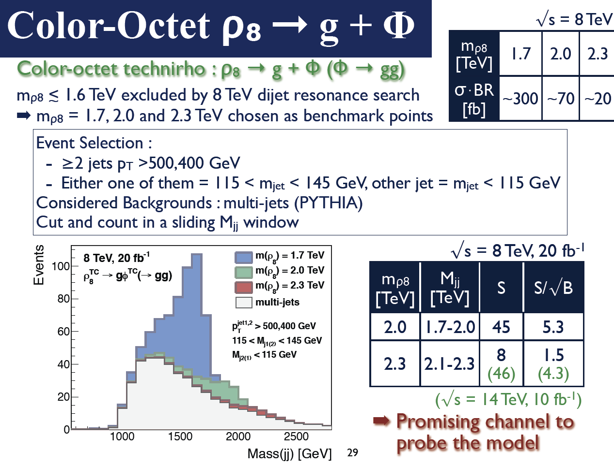
Slide from K.Terashi’s talk at SCGT14Mini, March 2014
M.Kurachi, S.M., K.Terashi & K.Yamawaki, in progress
Preliminary

Slide 51
Theoretical Issues
Walking Dynamics beyond Ladder/Holography ?
More Precise Quantitative Predictions?
Lattice !

Slide 52
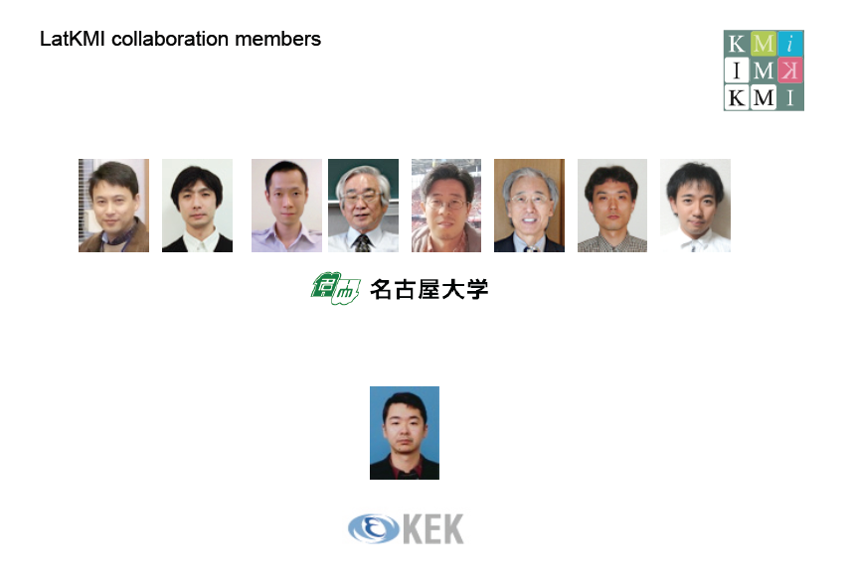






M. Kurachi
T. Maskawa
K. Nagai
K. Yamawaki
Y. Aoki
T. Aoyama
T. Yamazaki
H. Ohki
A. Shibata
Ed Bennett
E. Rinaldi
Lawrence Livermore National Laboratory

Slide 53
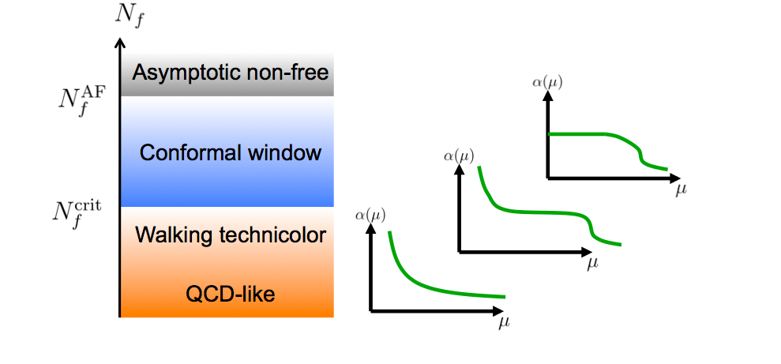
16.5
(would-be IRFP)

Slide 54
Walking candidate & Light Scalar
Nf=12 : Conformal
Nf=8: Walking
Light flavor-singlet scalar (& scalar glueball)
in Nf=12
Light flavor-singlet scalar
in Nf=8
LatKMI Collaboration, Phys. Rev. D86, 054506 (2012)
consistent with many other groups
LatKMI Collaboration,Phys. Rev. D 87, 094511 (2013) +update
confirmed by other groups (1405.4752; 1410.5886)
LatKMI Collaboration, Phys. Rev. Lett. 111 (2013) 162001
confirmed by other groups (1401.2176; 1411.3243)
LatKMI Collaboration, PoS LATTICE2013,070(arXiv:1309.0711),
Phys. Rev. D 89 (2014) 111502(R)
+ update (in preparation)

Slide 55
Conclusion
A light composite Higgs can be generated in the Walking Technicolor (Strongly coupled theory) as a Pseudo-NG boson of Scale Symmetry (Techni-dilaton), which is Weakly coupled to the SM particles.
Techni-dilaton is consistently identified with the 125 GeV Higgs
Predicts new resonances (technipions, technirhos) in TeV region
Lattice results of LatKMI Collaboration are consistent with
Nf=12 QCD: conformal behavior
Nf=8 QCD : walking behavior; chiral broken,
(approx.) conformal
Lattice results of LatKMI Collaboration observed
Nf=12: clean signal of a scalar lighter than pion
Nf=8: clean signal of a scalar comparable to pion
Both reflecting (near) conformality for a wide IR region below the
asymptotically free UV region
Hope to give the lattice answer to the theoretical issues
for 13/14 TeV LHC 2015-

Slide 56
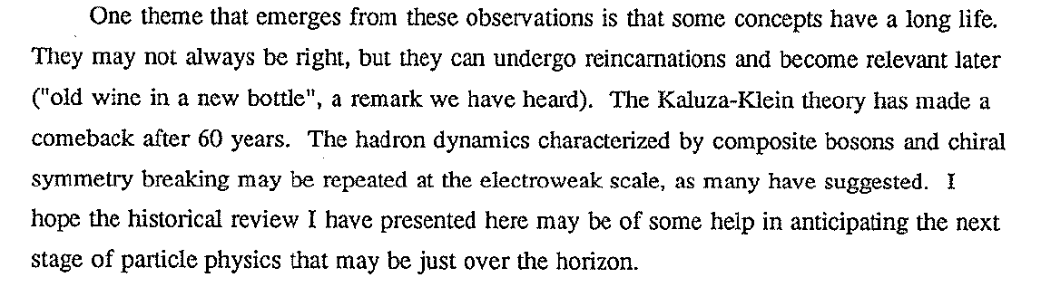
Concluding Remarks by
Y. Nambu @ SCGT 88
SCGT88

Slide 57
Concluding Remarks by
Y. Nambu @ SCGT 88

Slide 58

LHC and Lattice will tell us whether or not
we can have a toast with old wine in a new glass

