Slide 1
Weak Renormalization Group Approach for Dynamical Chiral Symmetry Breaking
SCGT15, Nagoya, 2015.03.04
Ken-Ichi Aoki (Kanazawa University)
Based on collaborative works with
Daisuke Sato and Shin-Ichiro Kumamoto
Particularly any questions should be redirected to
Dr. Kumamoto who will be presenting a poster tomorrow.
Prog. Theor. Exp. Phys. 2014, 043B05 (27 pages)
DOI: 10.1093/ptep/ptu039

Slide 2
SCGT and NPRG (me), A history

Slide 3
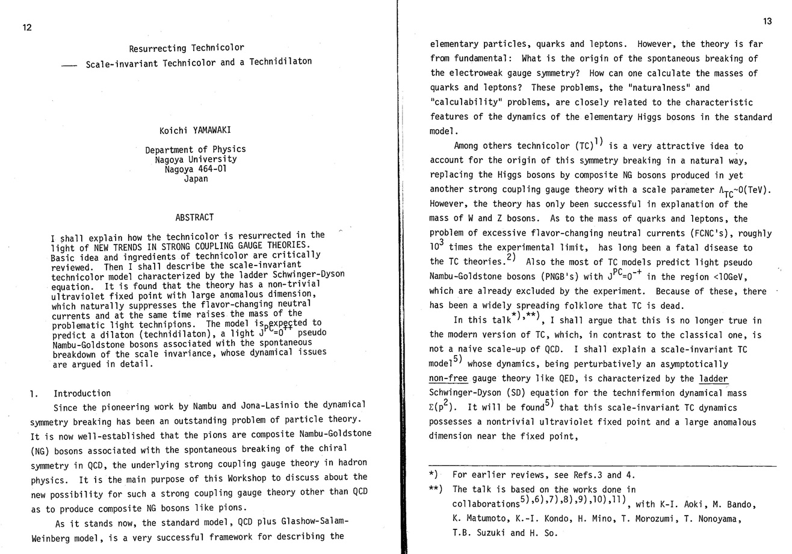

Slide 4
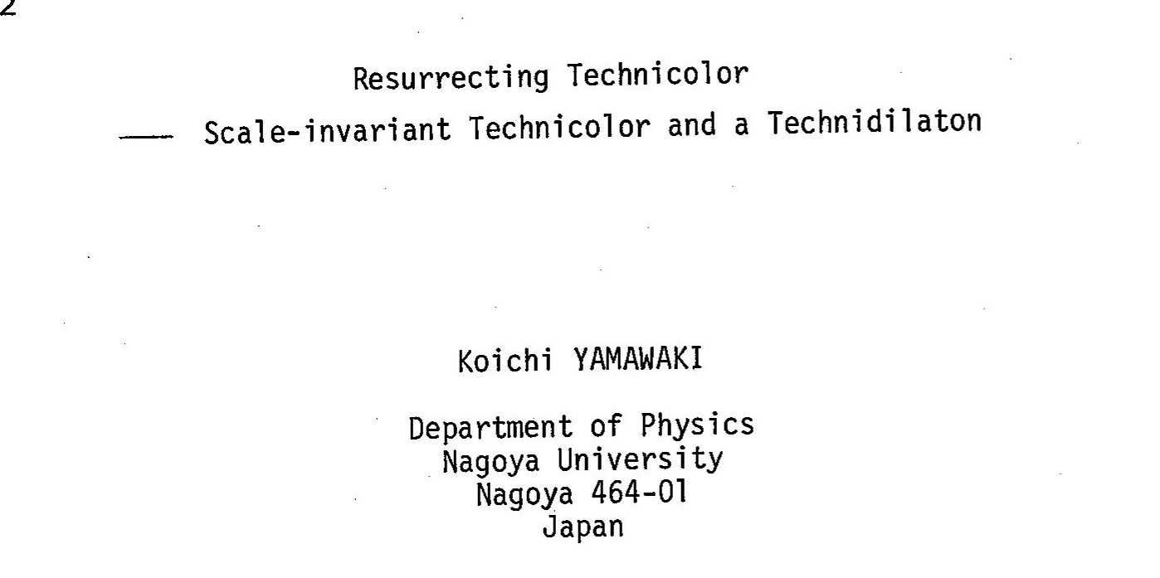

Slide 5
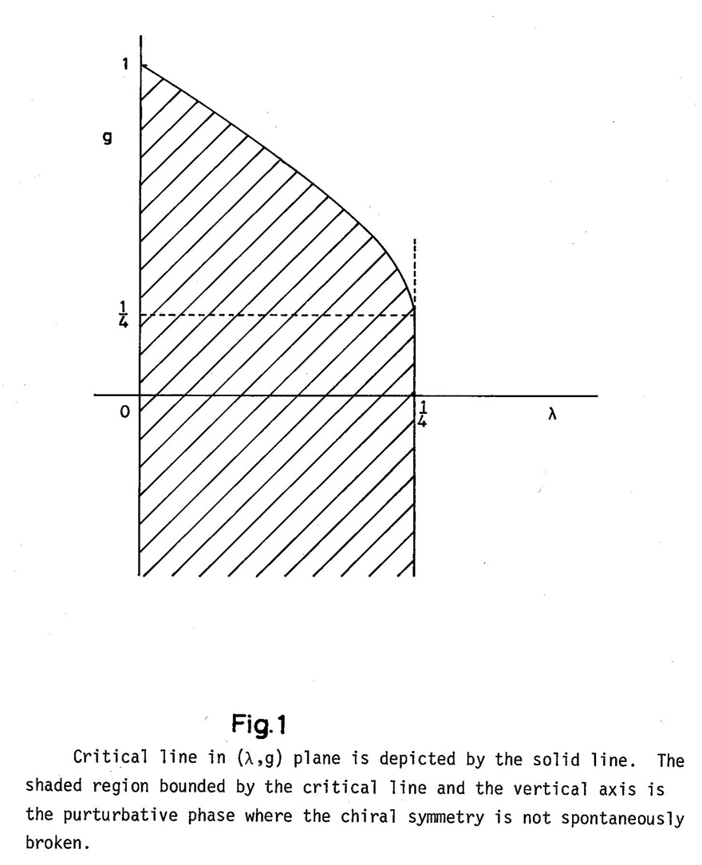
Obtained by coupled SD equation of
Gauge and 4-Fermi interactions.
Sometimes called gauged NJL model

Slide 6
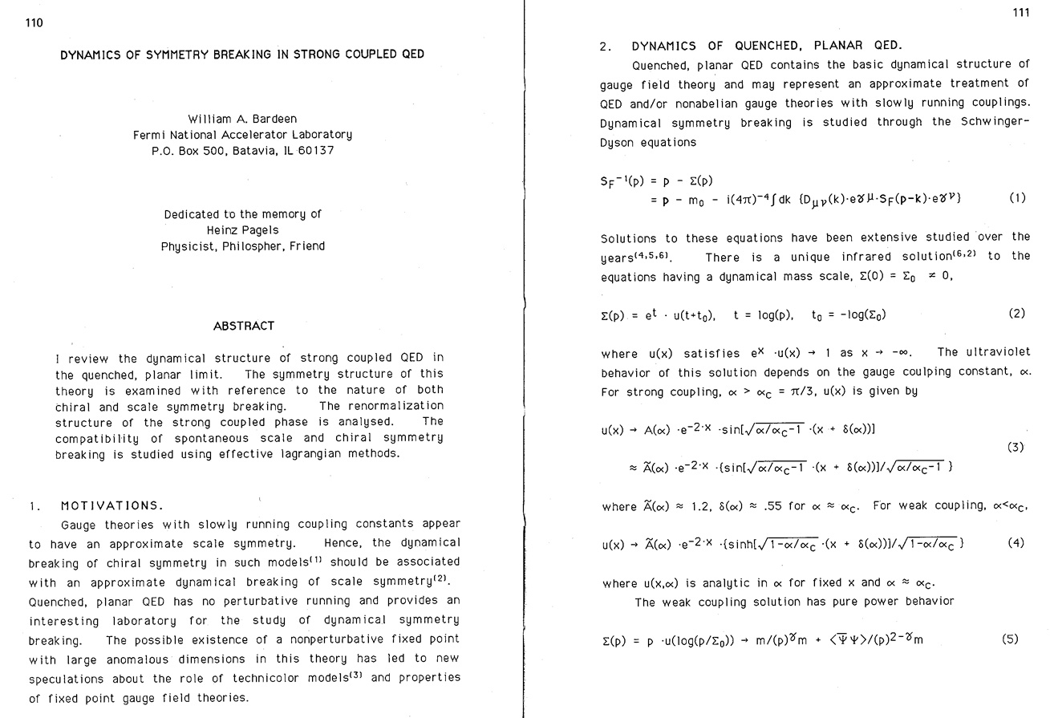

Slide 7
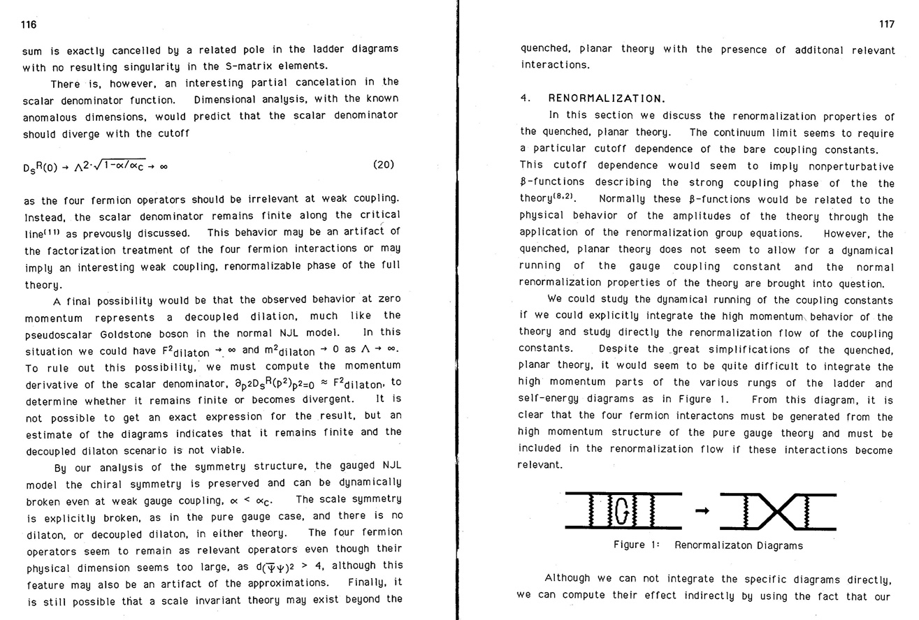
SCGT and NPRG (me), A history

Slide 9
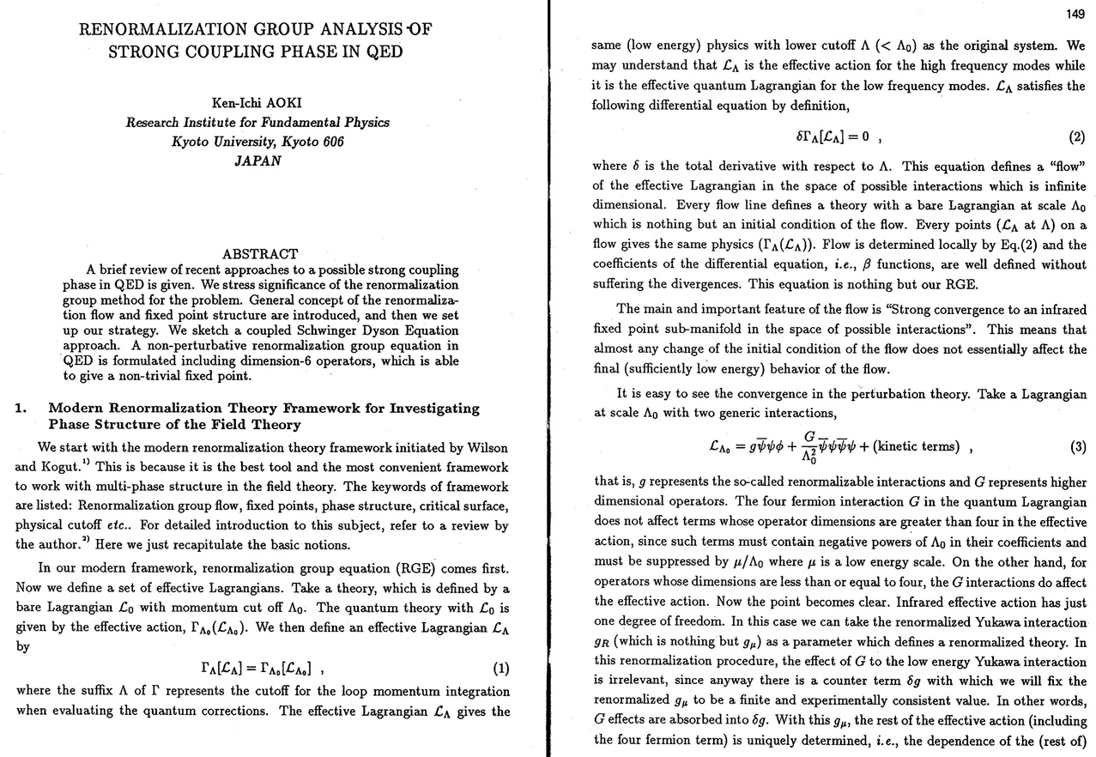

Slide 10
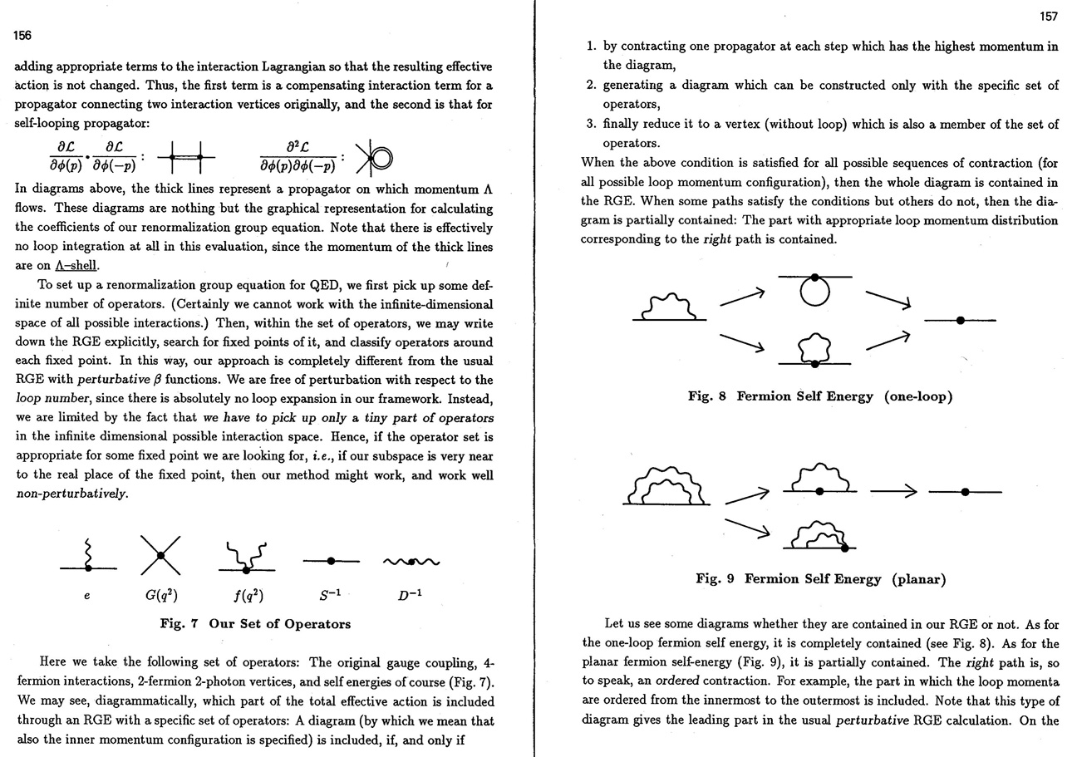
SCGT and NPRG (me), A history

Slide 12
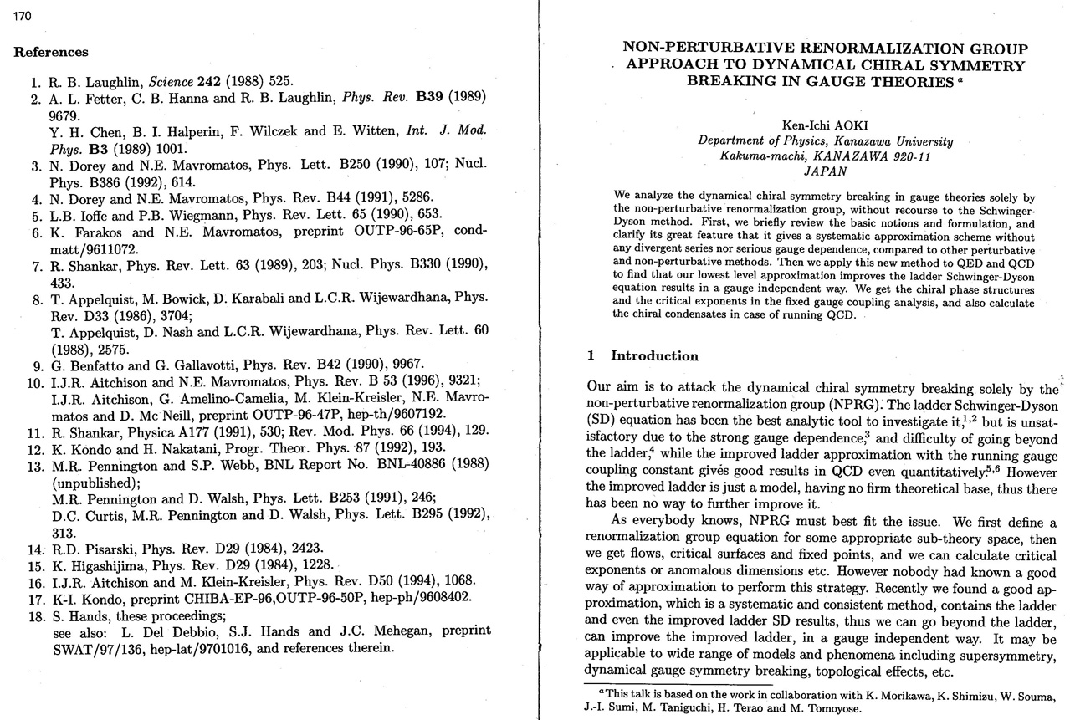

Slide 13
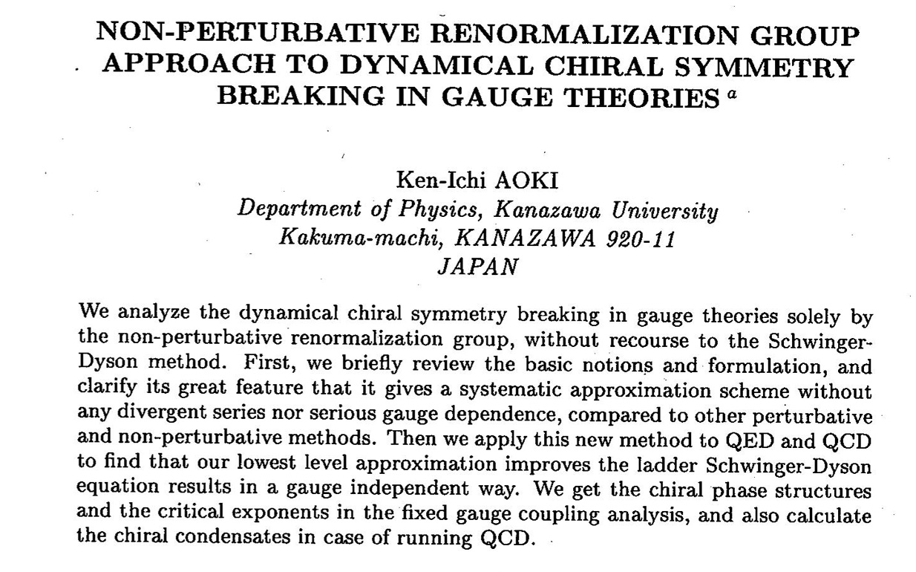

Slide 14
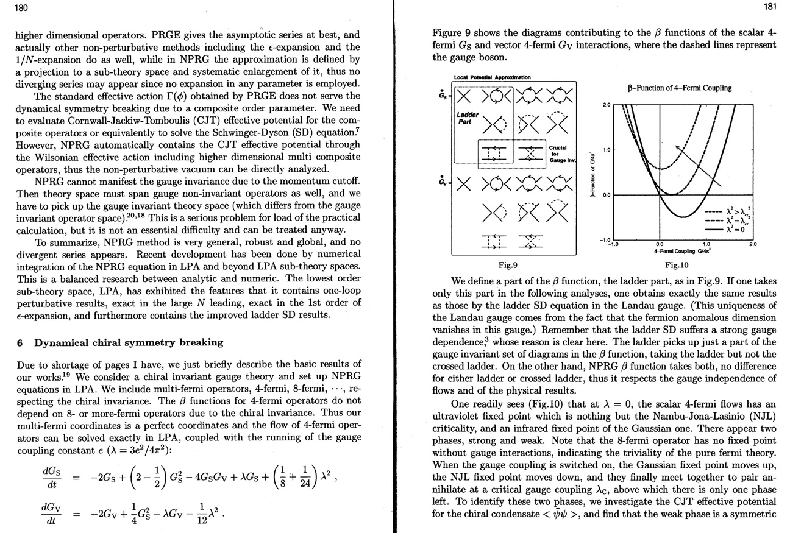

Slide 15
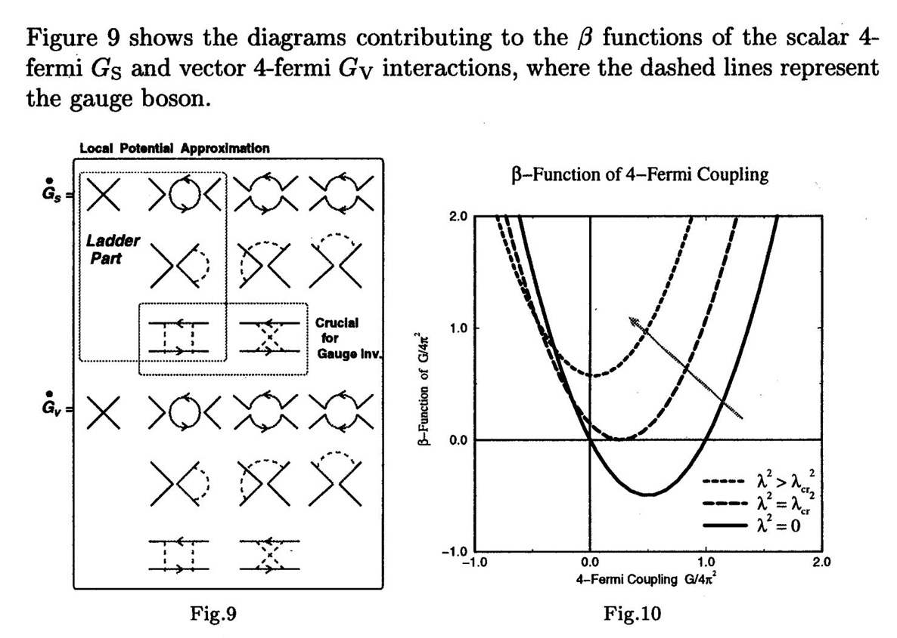
SCGT and NPRG (me), A history

Slide 16
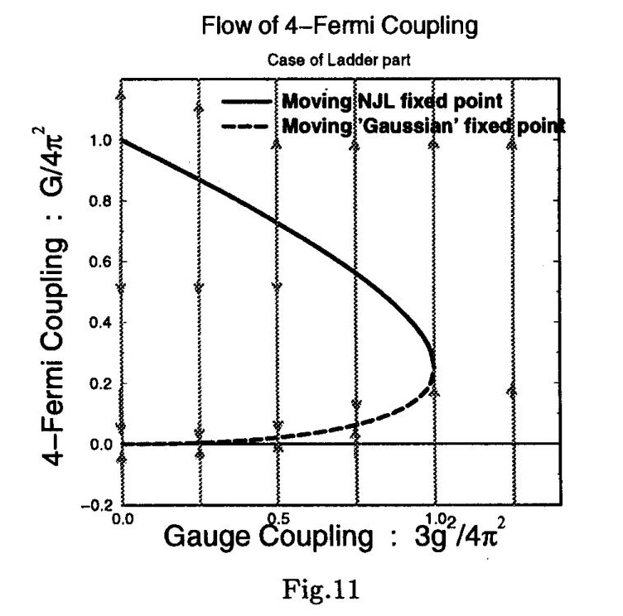

Slide 17
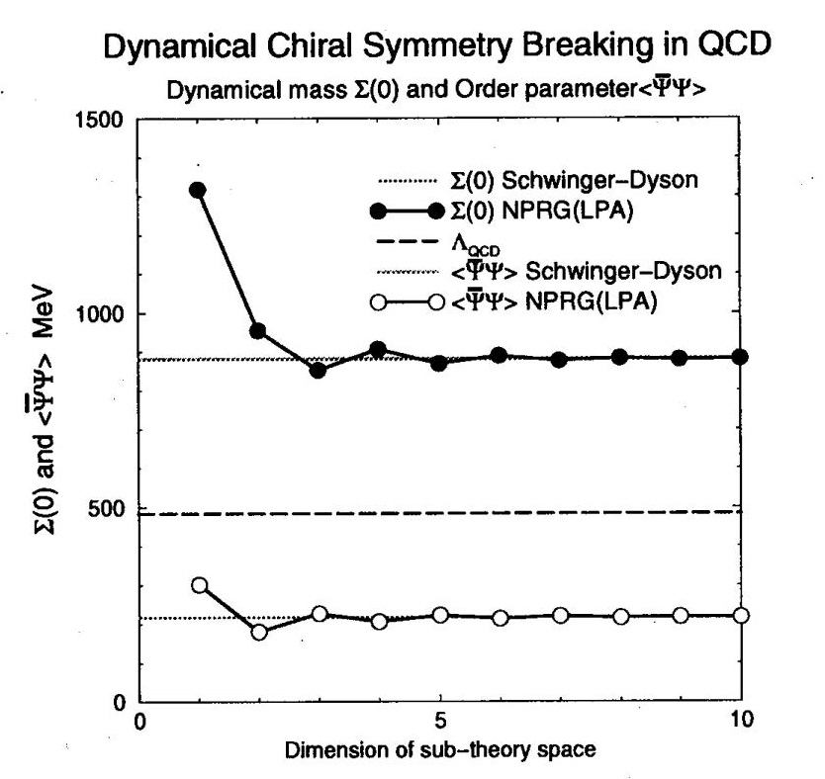

Slide 18
Non-perturbative Renormalization group
Newly generated effective interactions:
1-loop exact

Slide 19
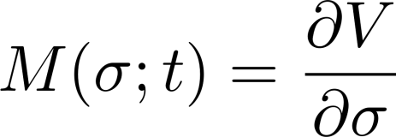
Sub-theory space
Fermion potential
Initial condition
Renormalized four-Fermi interactions
Renormalized (dynamical) mass
Mass function

Slide 20
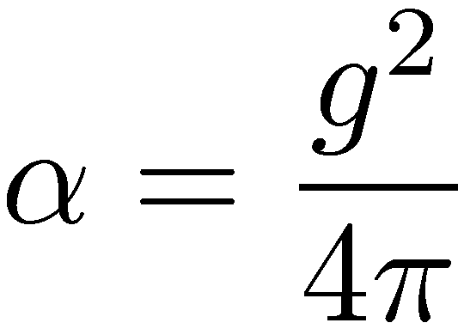
Four Fermi interactions
Non-pertubative renormalization of four Fermi interactions
Canonical scaling factor
Integrating NPRGE

Slide 21
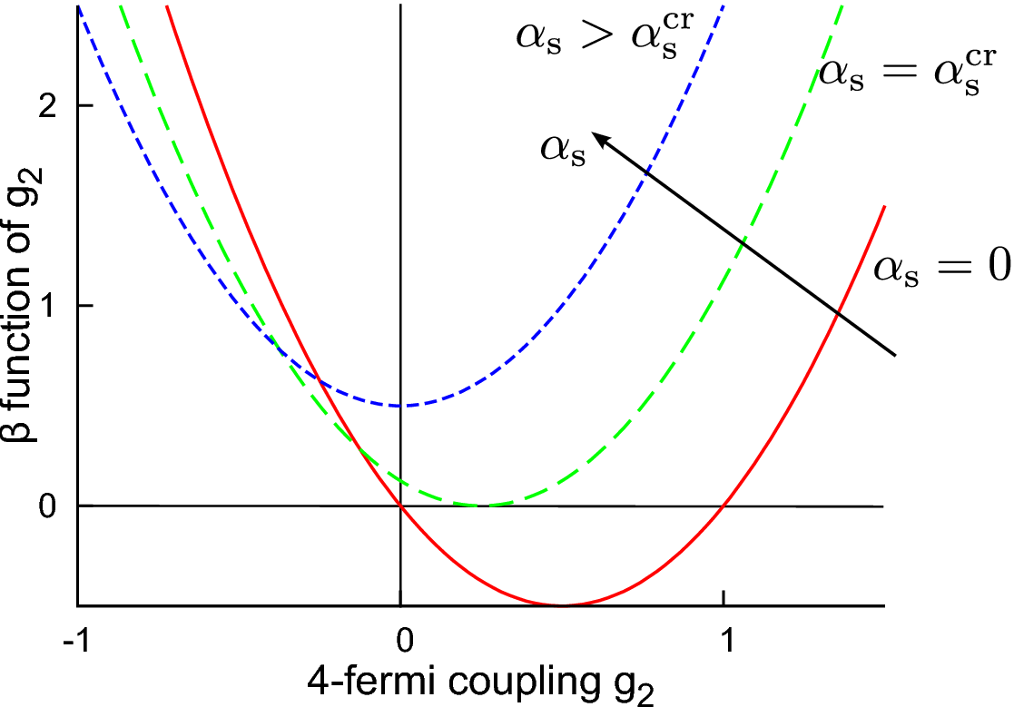
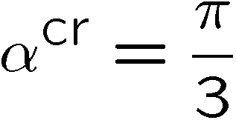
Fixed point structure
$β$function
IR fixed point
UV fixed point
K.-I. Aoki, K.-I. Morikawa, J.-I. Sumi,
H. Terao, M. Tomoyose (1997, 1999)

Slide 22
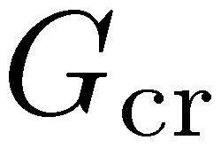
SCGT Phase Diagram given by NPRG
NJL
MN-FK

Slide 23
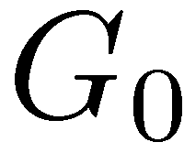
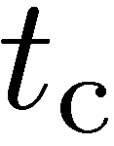
Blowup singularity
4-fermi interaction blows up at finite scale
RGE cannot go beyond this critical scale
0

Slide 24
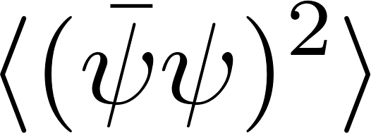
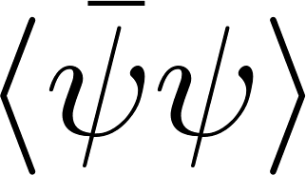
Explosion itself is correct, certainly
4-Fermi interactions is the chiral fluctuation
The fluctuation (susceptibility) must diverge at the phase transition point
This is renormalization scale dependence,
resembling to the temperature dependence
which may have singularities without problem.
macro
micro

Slide 25
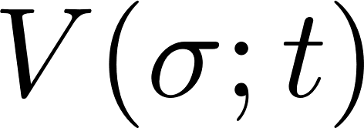
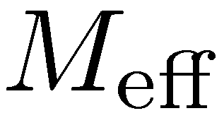
Back to our sub-theory space
NPRGE
2-dim. PDE
Effective Mass
・・・
Shell mode
Low mode
Integrating NPRGE
All the planar (bubble tree) diagrams are summed up
K.-I. Aoki, K.-I. Morikawa, J.-I. Sumi, H. Terao, M. Tomoyose (2000)

Slide 26
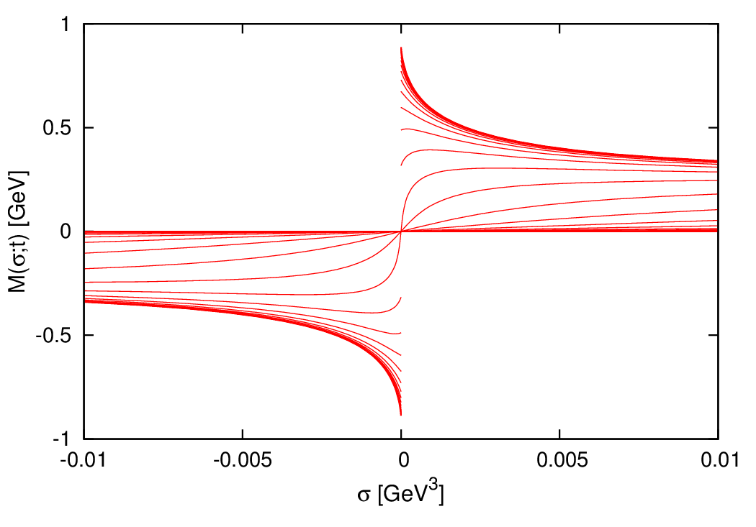
Mass function exhibiting dynamical mass generation
At finite scale,
the derivative of M at the origin diverges,
and then It becomes discontinuous there.
The fermion potential is not differentiable
at the origin after that.
Such function is not a solution of the PDE.
The NPRG solution must respect this spontaneous generation of singularity, as far as
The dynamical chiral symmetry breaking occurs due to quantum corrections.
This singularity generation is irrelevant to approximation.
We will modify the NPRG equation to allow such singular solution.

Slide 27
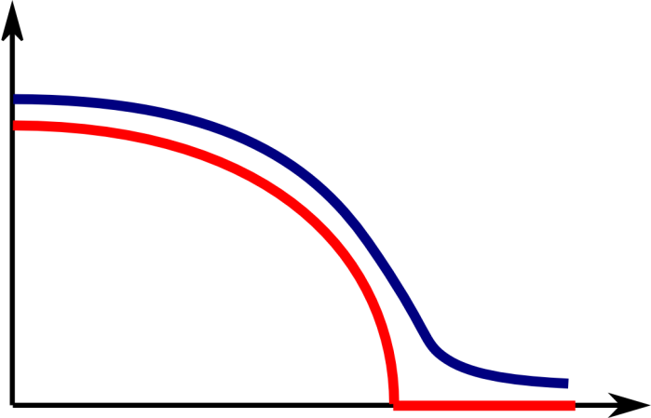
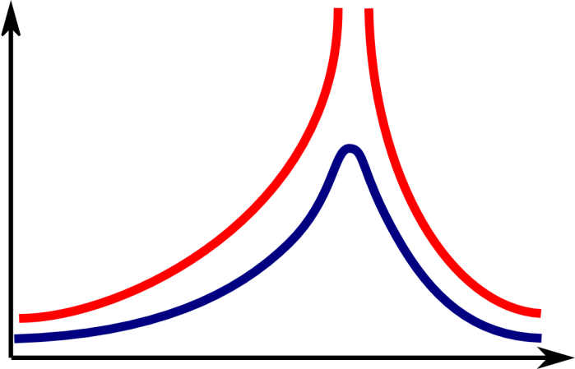
Bare mass does help, but little
It moderates the behavior of the dynamical mass,
and no divergence of susceptibility.
However, we can prove that the singularity of the fermion potential
is completely the same as vanishing bare mass case.
Only the position of the singularity moves off the origin,
which moderates the dynamical mass as above.

Slide 28
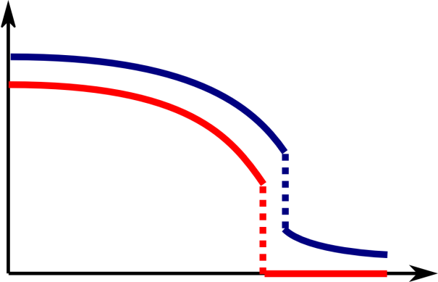
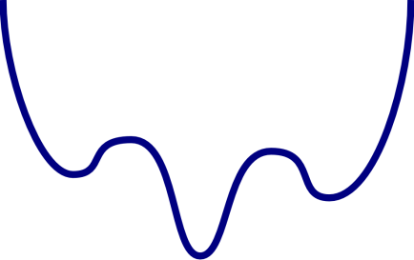
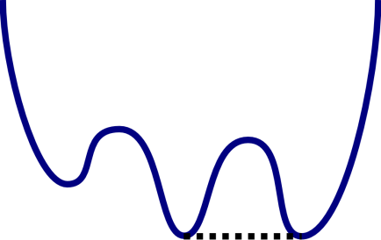
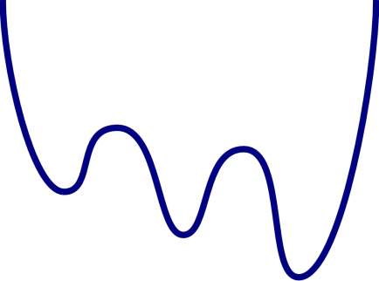
Bare mass helps nothing for 1st order transition
Bare mass does not
Moderate finite jump of m.
This finite jump with respect to the scale change
should be described by NPRG equation.

Slide 29
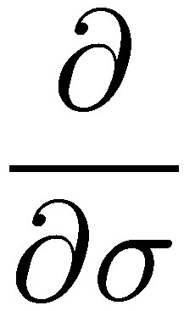
NPRG Eq.: 2-dimensional PDE
No σ dependence for NJL model

Slide 30
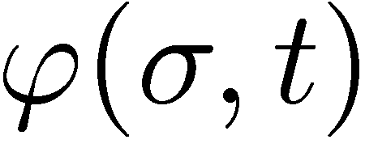
Weak Renormalization Group Equation
Strong Equation
: Smooth and bounded
test function
Weak equation
Weak solution: Satisfy weak equation for any test function.
Discontinuous function M can be a solution of weak equation.

Slide 31
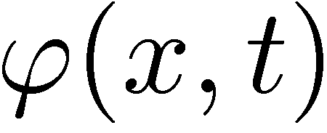
What is the weak solution?
Consider piecewise smooth function except for finite number of discontinuities.
The weak solution must satisfy strong equation except for discontinuities.
discontinuity

Slide 32
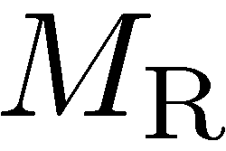
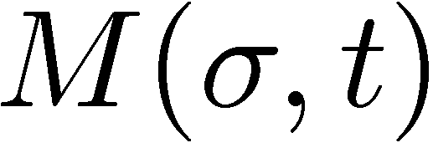
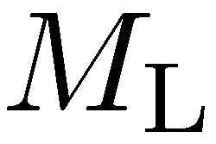
RH(Rankin-Hugoniot) condition
2. At the discontinuity,
the weak solution must satisfy the RH condition.
Equation of motion of the discontinuity

Slide 33
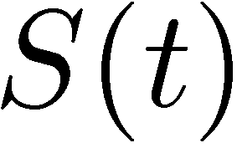
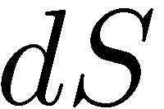
RH condition: proof for physicists
Conservation low: derivative form
Change of total charge:
Must be balanced
Current inflow - outflow:
RH condition = Conservation low: integral form

Slide 34
Construction method of weak solution
1. Prepare local strong solution.
Using characteristics, or string equation of motion
2. Local strong solution may have multi-leaves, multi-valued.
No global strong solution
3. Make a patchwork selecting a leaf to define global weak solution.
How to patchwork, is determined by RH condition

Slide 35
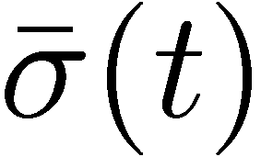
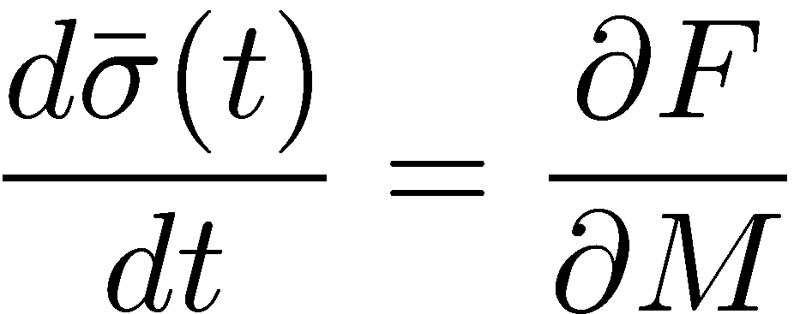
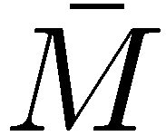
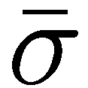
Method of characteristics
PDE
ODE
Initial condition：

Slide 36
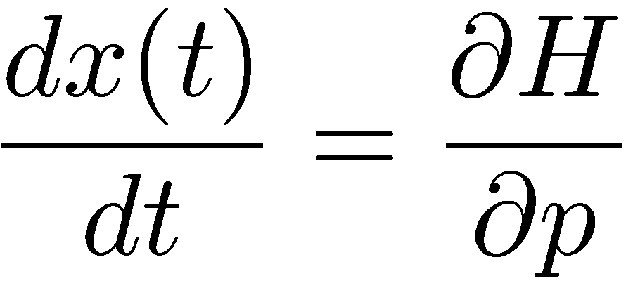
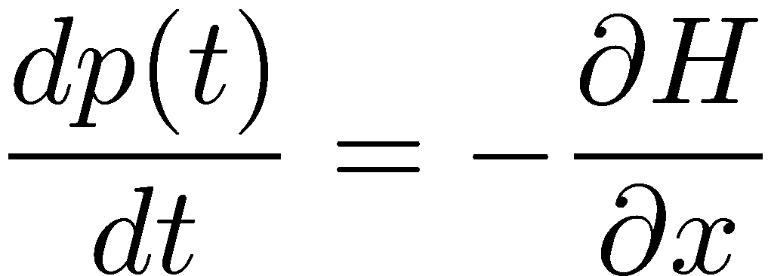
Exactly a Hamilton’s canonical system
NPRG equation
Hamilton-Jacobi Equation

Slide 37
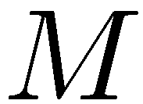
Phase space trajectory => String motion
Classical particle
Initial condition：
String does not cross itself
Set of particles
String motion

Slide 38
NJL model
Translational invariance: Free(?) motion
Initial condition：
String motion has no singularity globally.
After tc the string is self-folded and
Function M(σ) becomes multivalued.

Slide 39
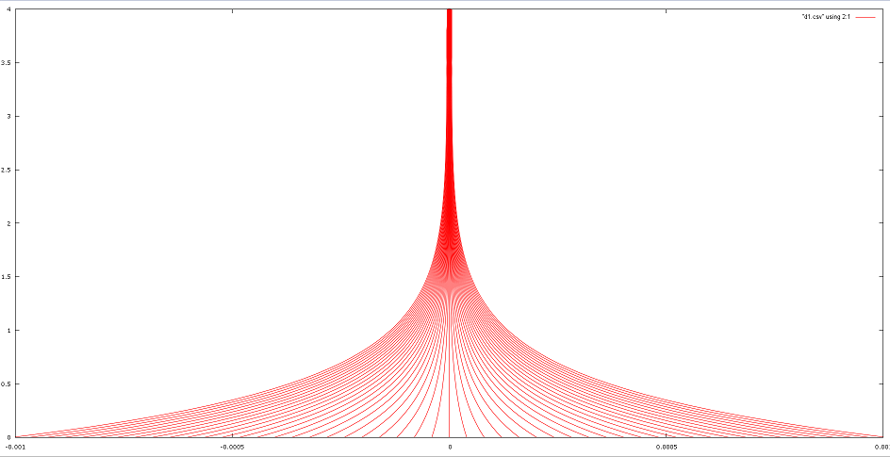
Characteristics or contour of M
4
0
0

Slide 40
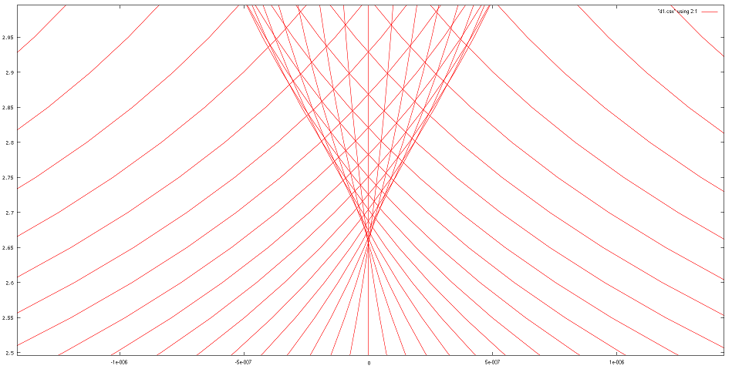
Characteristics starts crossing after
0

Slide 41
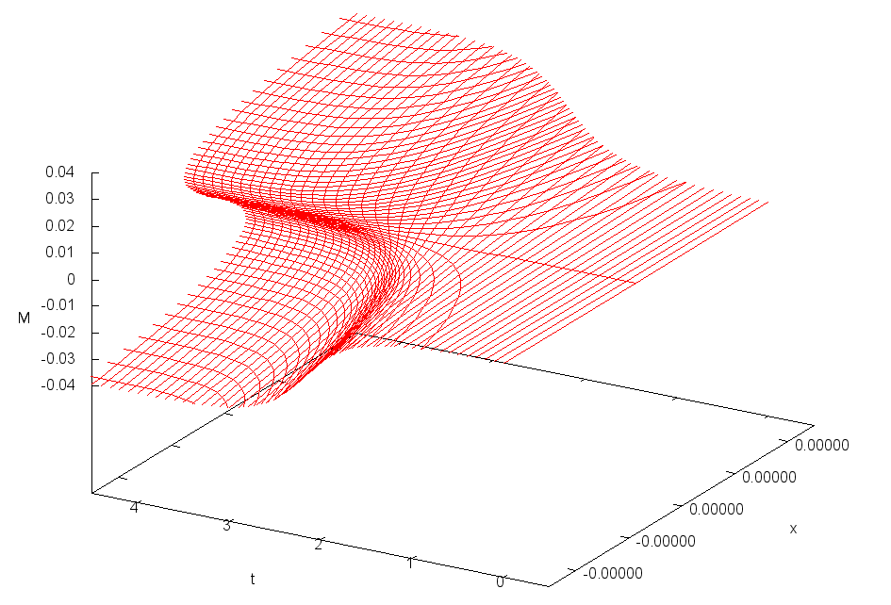
Motion of string: a world sheet

Slide 42
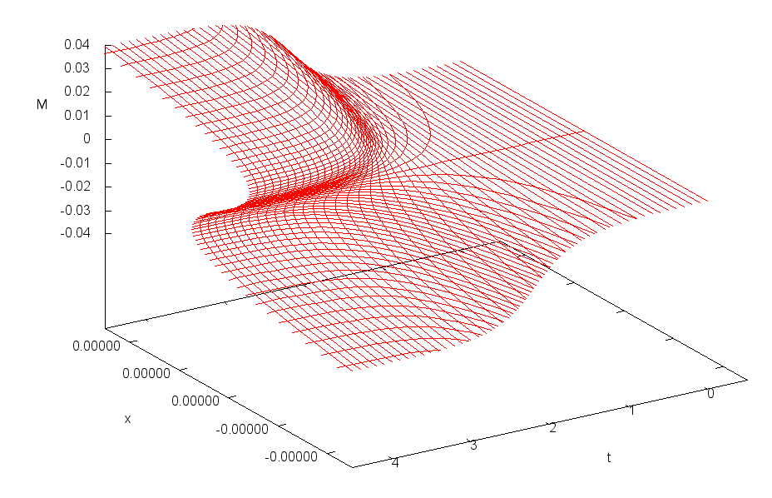
3-folding singularity emerges

Slide 43
RH condition => Continuity of $V(σ)$
Change of $V\left(σ;t\right)$ along $S\left(t\right)$ at $L$ and $R$:
RH condition
No singular point at the beginning
$V\left(σ;t\right)$ is continuous in the entire region.

Slide 44
Geometrical interpretation of RH condition
Areas surrounded by the local strong solution and the patch work jump:
R
1
2
Continuity of $V(σ;t)$
L
Equal (vanishing) area rule
cf. Maxwell equal area rule (liquid-gas coexistence)

Slide 45
Construction of Weak solution: Patchwork
RH Cond.
Equal area rule
The weak solution is uniquely obtained.

Slide 46
Fermion Potential
The origin is not differentiable below $t_{\text{c}}$.
0
The ``swallow tail’’ singularity

Slide 47
Near the origin: the non-linear wave Eq.
Free particle
with negative mass
rescale
Central engine breaking the chiral symmetry
shock
Non-linear (half) wave Eq.
Burger’s equation

Slide 48
Dynamical mass generation = spontaneous shock generation
Generation and expansion of shock

Slide 49
1st order transition is highly non-trivial
The weak solution seems trivial, since no other
Candidate due to the total symmetry.
2nd order phase transition:
Breaking convexity
Transition point
1st order phase transition:
Breaking
convexity
Meta-stability
Transition point

Slide 50
NPRG equation at finite density
PDE for mass function at finite density environment
:chemical potential
$θ(x)$: step function
Characteristics:
RG evolution stops when the energy $\sqrt{Λ^{2}+M^{2}}$ is smaller than the Fermi energy $μ$.

Slide 51
String motion of finite density NJL
Initial Conditions:

Slide 52
Effective potential constructed by weak solution
Effective potential by local strong solutions is non-convex, and has multi local minima as well as the mean field approximation.
Effective potential by WEAK solution is automatically “convexified”.
The minimum of the weak solution potential agrees with the global minimum of the local strong solutions. Uniqueness is achieved.
Non-convex
Convex
Weak solution choose the “true” stable state.
Notes:
In addition to constructing the weak solution of mass function, we will see the effective potential constructed by weak solution.
…
Questions arise.

Slide 53
Free energy
Introduce the external field $j$ for the chiral condensates $\left\langle \overline{ψ}ψ\right\rangle$:
Translational invariance of PDE with respect to $σ:$
Effects of the change of initial condition is absorbed:
$W(j;t)$ can be obtain from the $V\left(σ;t,j=0\right)$:

Slide 54
Legendre effective potential
Legendre transformation:
Equal area law
A
B
“Convexification” of $V_{L}(φ)$
Difference of the $W$s at A and B vanishes due to the continuity of $V$:
Envelope ( or
Common tangent)
B
A

Slide 55
Plausible transition 1
Breaking convexity
Meta stable state

Slide 56
Plausible transition 2
Transition point

Slide 57
Plausible transition 3

Slide 58
Lowering scale 1
Swallowtails
generated pairwise.
Notes:
Let’s the numerical result of the weak solution
…
We integrate the string of the mass function, and obtain the fermion potential, which has two crossing point.
The jump position is determined by the equal area law, and also by the crossing point of the fermion potential due to its continuity.

Slide 59
Lowering scale 2
59

Slide 60
Lowering scale 3
Swallowtail
in
swallowtail
60
60

Slide 61
Characteristics
The weak solution is uniquely
obtained.
The meeting time of
paired singularities
is the critical time.
There is no area where the characteristics do not exist.

Slide 62
Real jump at for the first order transition

Slide 64
Phase diagram of finite density NJL

Slide 65
Ladder QCD NPRG Equation
NPRG $β$ function is limited to ladder type
Theory space: ${σ^{n}=\left(\overline{ψ}ψ\right)}^{n}$
Multi-fermi interactions contribute to the effective mass
$ξ$: gauge fixing parameter
Notes:
So next we take into account of higher dimensional operator such as 6-fermi, 8-fermi and more.
For simplicity, we limit the NPRG eq. to ladder diagrams

Slide 66
QCD Characteristics

Slide 67
QCD Characteristics

Slide 68
QCD String motion
Due to masslessness of gluons,
Central engine does not stop.

Slide 69
QCD string motion

Slide 70
QCD Mass function by weak solution
D𝜒SB

Slide 71
Beyond the ladder QCD
ladder
Crossed ladder
Defining effective vertex adding crossed gluons

Slide 72
Beyond the ladder QCD NPRGE
Using the effective vertices,
K.-I. Aoki, K. Takagi, H. Terao and M. Tomoyose (2000)
Notes:
Then we can describe the NPRG eq. by the infinite number of ladder-form diagrams using corrected vertex.
And we can obtain the formulas of the diagrams with respect to any order of sigma, like this.
And we can resum the infinite number of the diagrams with respect to \sigma

Slide 73
Infinite series are summed up to give PDE
Beyond the ladder NPRGE
Weak solution method applicable
Ken-Ichi Aoki and Daisuke Sato (2013)
Ladder NPRGE
Notes:
Eventually, we can obtain the following partial differential equation equivalent to this beyond the ladder approximation.
We can compare the dependence on the gauge-fixing parameter \xi between NPRG eq. including non-ladder effect and Ladder-approximated one.
Non-ladder extended NPRG eq. seems to be improved better for gauge dependence than ladder-approximated one.
Finally, let’s see the numerical result.

Slide 74
Gauge dependence of physical quantity
Results obtained by the Weak solution
``Beyond the ladder’’ realizes
the gauge independence
Landau gauge ($ξ=0$) ladder coincides with the beyond the ladder, occasionally, or, (un)fortunately.

Slide 75
Finite density/temperature QCD
Beyond the Ladder QCD with massless 2-flavor quark:
$T$: Temperature
$μ$: Chemical potential of quark
Manageable by weak RGE method
2nd order
1st order

Slide 76
Chiral Phase Diagram

Slide 77
Chiral and color superconductivity
Multidimensional operator space
Weak solution can be applied to multi-variable case, either.
Free energy

Slide 78
Conclusions
NPRGE is able to directly provide a global solution uniquely, via its weak solution, even below the phase transition scale.
First successful example of using the notion of weak solution applied to RG equation.
The weak solution automatically describes the spontaneous generation of singularities, and even a jump of physical quantities through moving singularities.
The weak solution gives infrared macro physical quantities, mass, condensates, effective potentials.
The weak solution chooses correct physical vacuum by itself, even in case of the first order transition, through auto-convexifing the effective potential.
This method has been applied to beyond the ladder QCD which shows greatly small gauge dependence.
This method has been also applied to the finite density, finite temperature QCD/NJL, for simultaneous chiral and color condensates, giving phase diagrams.

Slide 79
What is Swallowtail (spinodal decomposition)
Now the dynamical chiral symmetry breaking joins the swallowtail club.
http://www.birdforum.net/opus/Barn_Swallow

Slide 82
R. Thom: Structural Stability and Morphogenesis, 1972
Fig. 5.6 Section of swallow tail
Fig. 7.7 Swallow tail

Slide 83
Arnold: Mathematical Methods in Classical Mechanics, (1968 Moscow)

Slide 85
C. Zeeman: On the unstable behavior of stock exchanges
Joel W. Robbin

Slide 86
The new Swallowtail Legend starts here!

Slide 87
Acknowledgement
We thank very much Professor Yamawaki for giving us interesting research subjects and opportunities to present our works and to discuss with world wide participants at SCGTs.
SCGTs must have been special workshops for me and for many other participants.
We miss SCGTs and strongly hope if someone might resurrect it in the future, which may be easier than resurrecting Technicolor.

Slide 88
Thank you

