Slide 1
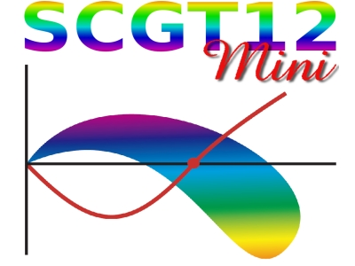
Techni-dilaton at LHC
Shinya Matsuzaki
Maskawa Institute for Science and Culture,
Kyoto Sangyo Univ.
@KMI, Nagoya Univ.
03/18/2012

Slide 2
Contents of this talk
Introduction & brief summary
Walking Technicolor and Techni-dilaton
Techni-dilaton couplings
Techni-dilaton signatures at LHC
Summary

Slide 3
Introduction & brief summary

Slide 4
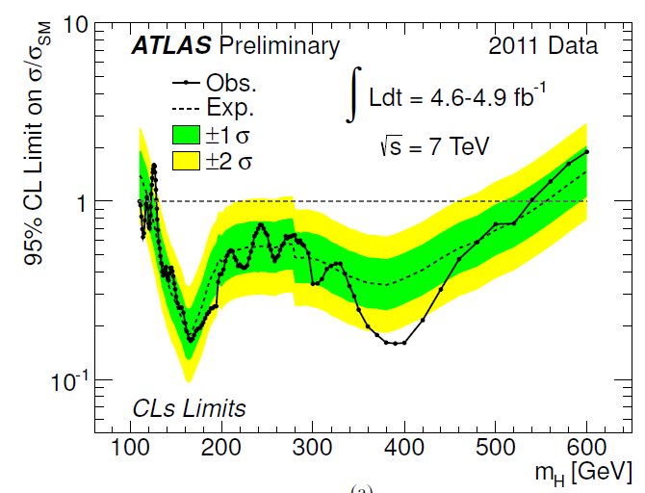
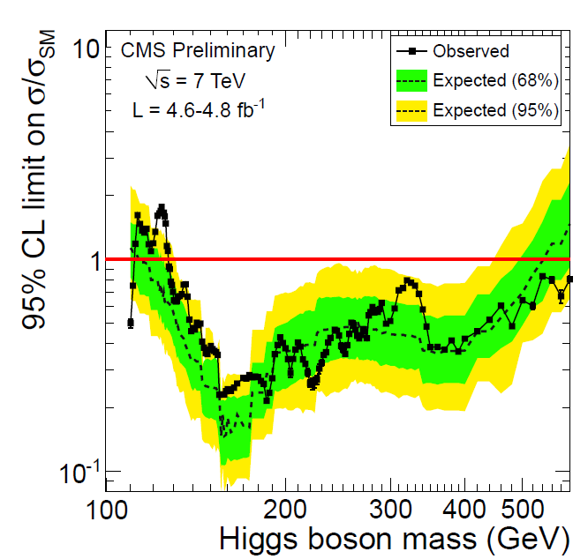
2011 LHC Higgs search
ATLAS-CONF-2012-019
CMS-PAS-HIG-12-008
SM Higgs: excluded in the most of mass range up to 600 GeV
--- implies:
the mass is unlikely to be as low as O(EW)?

Slide 5
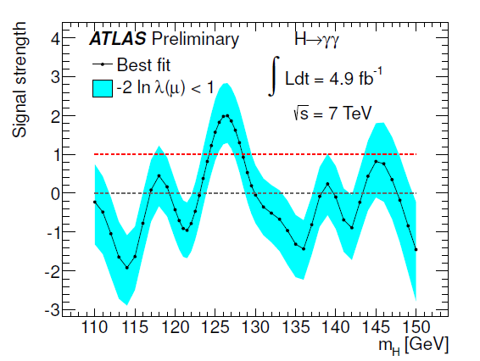
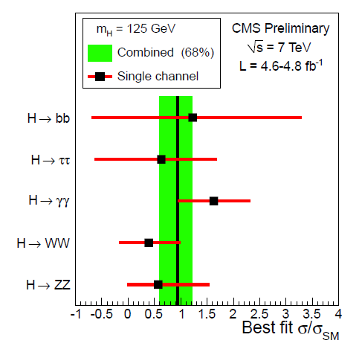
Even in low-mass range:
a hint from diphoton channel
ATLAS-CONF-2012-019
CMS-PAS-HIG-12-008
The best fit-signal strength σ/σSM|γγ～ 2
--- also implies a non-SM like Higgs object
at ～125 GeV?

Slide 6
This talk will tell us two non-SM like Higgs scenarios:
Techni-dilaton (TD):
a composite scalar, characteritic in walking technicolor (WTC)
light TD:
can explain the presently observed diphoton
excess at around 125 GeV
Yamawaki et al (1986); Bando et al (1986)
based on
S.M. and K. Yamawaki, arXiv: 1201.4722 [hep-ph];
arXiv: 1203.xxxx [hep-ph] (in preparation)
(somewhat) heavy TD :
can be seen in diphoton channel
as an excessive non-resonant signal
above 600 GeV
based on
S.M. and K.Yamawaki, Prog.Theor.Phys. 127 (2012);
arXiv: 1203.xxxx [hep-ph] (in preparation)

Slide 7
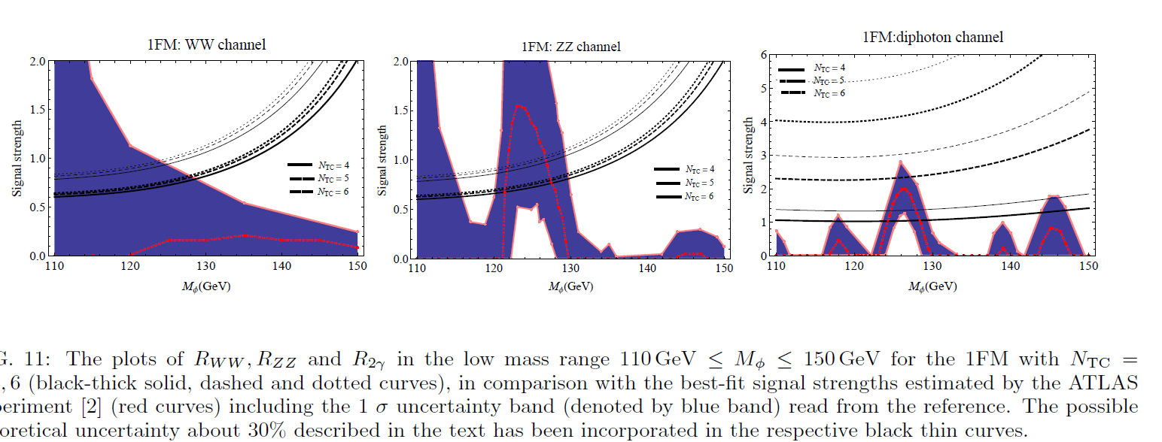
Quick view of main result on TD at ～125 GeV
S.M. and K. Yamawaki,
arXiv:1201.4722; 1203.xxxx.
WW*
ZZ*
γγ
* The signal strengths (γγ, WW*,ZZ*) are
in good agreement with the best-fit ones!!

Slide 8
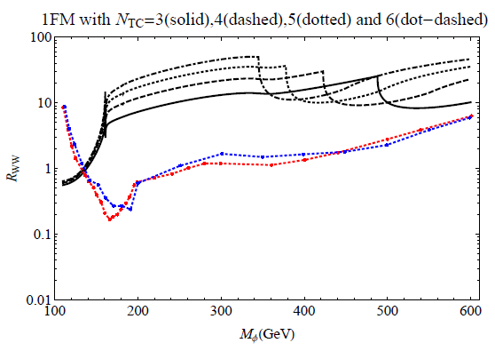
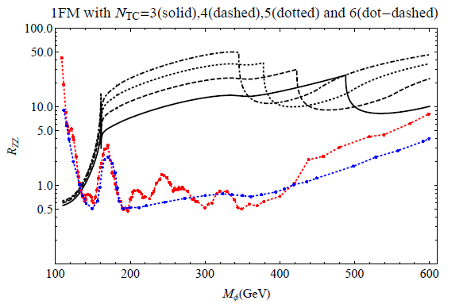
Quick view of main result on heavy TD
S.M. and K. Yamawaki,
PTP127 (2012). arXiv: 1203.xxxx.
WW
ZZ
ATLAS03/07/12
CMS03/07/12
* 140 GeV < M < 600 GeV excluded

Slide 9
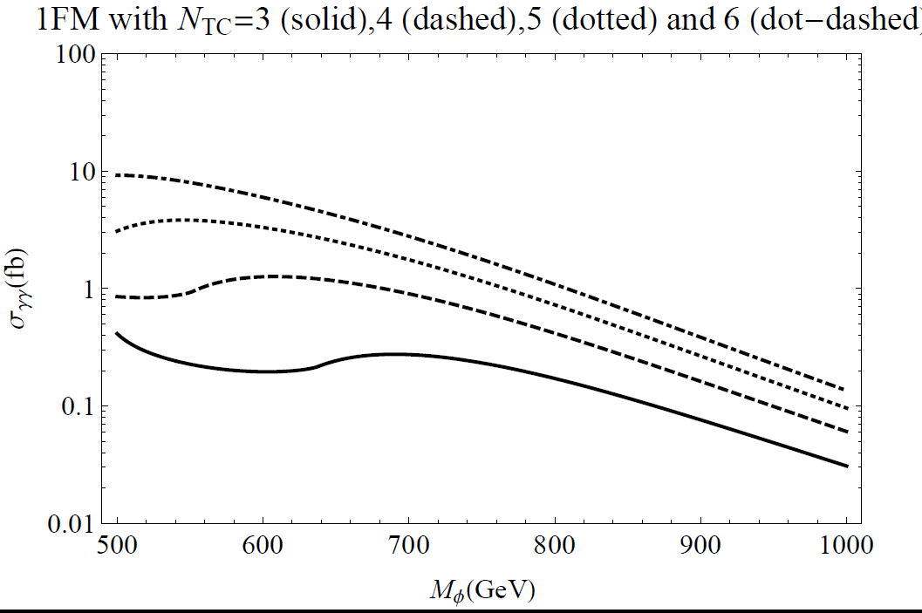
Above 600 GeV:
* huge total width > O(TeV) → non-resonant
* highly enhanced diphoton signal
w/ σ(pp->TD-> 2γ) ～ O(fb)

Slide 10
Walking Technicolor and Techni-dilaton

Slide 11
Technicolor (TC) → Walking TC
Weinberg (‘76), Susskind (‘79)
TC: origin of mass → dynamical explanation
for EWSB
techni-fermion condensation
like quarks in QCD
TC dynamics should be non QCD-like:
FCNC syndrome

Slide 12
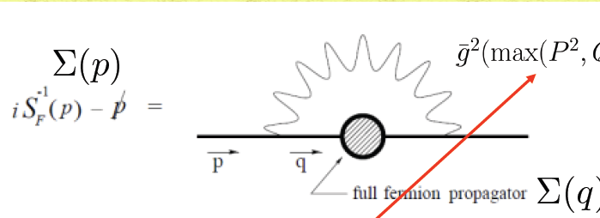
Be “Walking”
Holdom (1981);
Yamawaki et al (1986); Bando et al (1986);
Akiba et al (1986); Appelquist et al (1986); (1987)
To solve FCNC problem
The explicit proposal based on ladder SD eq analysis
Yamawaki et al (1986); Bando et al (1986)

Slide 13
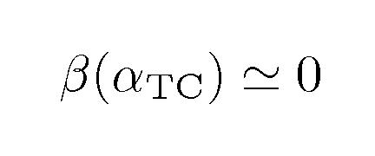
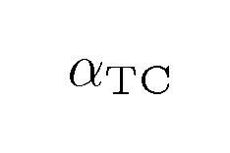
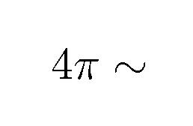
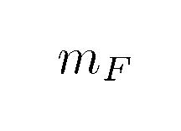
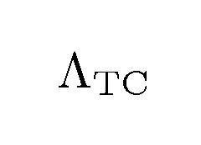
A schematic view of Walking TC
QCD-like
“walking”
replaced by
QCD-like
QCD-like
(~1TeV)
(ETC~10^3TeV)

Slide 14
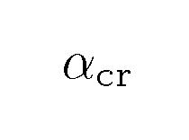
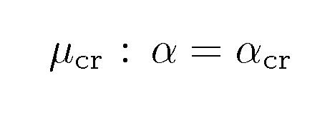
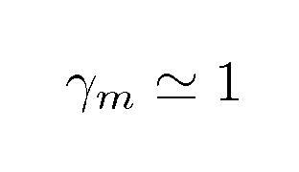
A schematic view of Walking TC
QCD-like
“walking”
replaced by
QCD-like
QCD-like
(~1TeV)
(ETC~10^3TeV)
*Dynamical TF mass generation by WTC @μcr
Miransky (1985)
“Miransky scaling”
(solve FCNC problem)
(naturalness)
(approx. scale invariance)

Slide 15
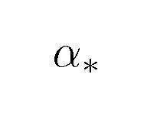
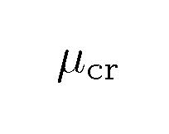
Large Nf QCD: a realistic dynamics for walking TC
Application to TC
“pseudo-FP”
set α* at a little outside of CW
*Conformal window (CW)
*criticality condition:
Appelquist et al (1996)
based on ladder SDeq analysis

Slide 16
Yamawaki et al (1986); Bando et al (1986)
WTC and techni-dilaton
(Approximate) scale-invariance in WTC
→ presence of (p)NGB for scale symm = “dilaton”.
walking regime

Slide 17
Yamawaki et al (1986); Bando et al (1986)
WTC and techni-dilaton
(Approximate) scale-invariance in WTC
walking regime
SSB by TF mass
generation @ mu_cr
(p)NGB for scale symm “dilaton” emerges

Slide 18
Yamawaki et al (1986); Bando et al (1986)
WTC and techni-dilaton
(Approximate) scale-invariance in WTC
walking regime
SSB by TF mass
generation @ mu_cr
(p)NGB for scale symm “dilaton” emerges
α starts “running”
(walking) up to mF
NP
nonperturbative
scale anomaly
NP
TC
makes dilaton massive: “techni-dilaton” (pNGB)
potentially light!

Slide 19
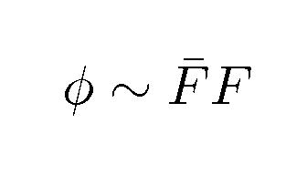
Cf: naive scale-up version of TC
Light composite scalar Higgs in naive scale-up version of QCD?
scale symmetry is badly broken at perturbative level (cf. QCD)
No reason to be ligher than
other TC hadrons
typical TC hadron mass scale

Slide 20
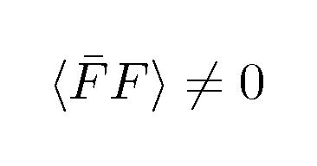
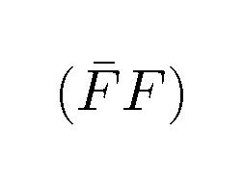
Techni-dilaton is chiral-singlet, FF bound state
TC
TC
TC sector
dilataion current = chiral singlet
TC
TC
TD: pNGB associated with SSB of scale symm.
w/ scale dim. of
Chiral singlet part
Chiral field
NOT “ σ ” as a chiral partner of π (c.f. composite Higgs)

Slide 21
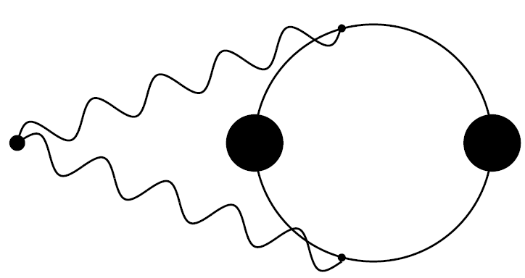
PCDC (partially conserved dilatation current)
* PCDC based on the Ward-Takahashi identity:
TC
TC
* TG condensation induced by TF condensation during walking
walking regime

Slide 22
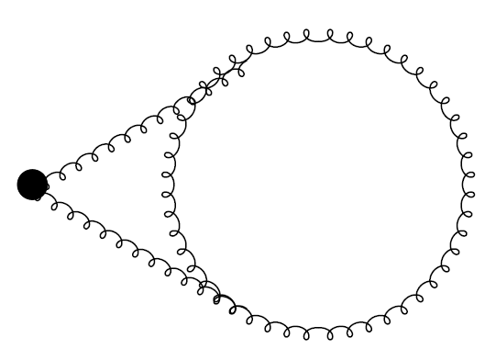
PCDC (partially conserved dilatation current)
* PCDC based on the Ward-Takahashi identity:
TC
TC
* TG condensation induced by TF condensation during walking
which has nothing to do w/ TG self-condensation
outside walking region (pert. running region)
walking regime

Slide 23
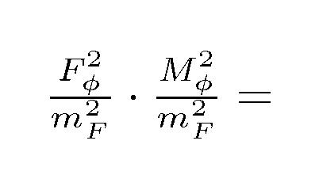
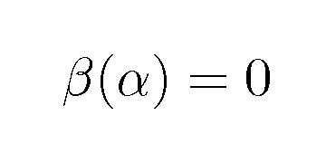
All the scale in the condensation should come from m_F
so it is expected to generically scale like
Straightforward non-pert. cals:
Miransky et al (1989): ladder approx. w/ constant coupling
Hashimoto et al (2011): improved ladder w/ two-loop beta func.
even at criticality limit
finite

Slide 24
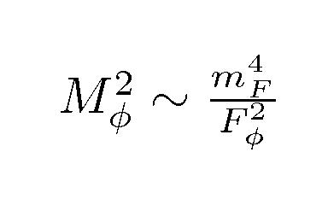
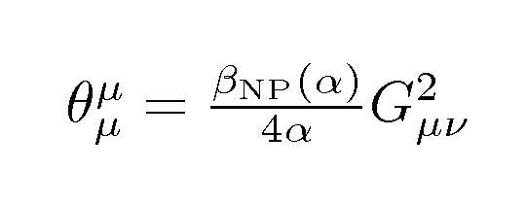
No exactly massless NGB limit for TD
PCDC
finite
implies:
TD cannot be massless unless Fφ → ∞: decoupled
No exactly massless NGB limit!
reflecting non-pert. scale anomaly (explicit breaking)
induced by mF generation itself

Slide 25
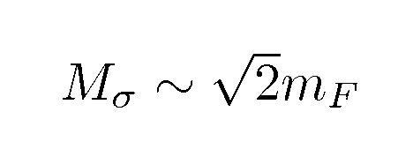
Straightforward calculation of TD mass?
* LSD + BS in large Nf QCD
chiral NON-singlet “σ” mass
Harada et al (1989);
Kurachi et al (2006)
* LSD via gauged NJL
Mσ ～500 – 600 GeV
for one-family model
Shuto et al (1990); Bardeen et al (1992);
Carena et al (1992) ; Hashimoto (1998)
But, Mσ may not be Mφ .... ?
No conclusive answer yet....
(theoretically unknown : Mφ as free/input parameter)

Slide 26
Techni-dilaton couplings
S.M. and K. Yamawaki,
PTP127 (2012). arXiv: 1203.xxxx.

Slide 27
TD coupling to techni-fermions
* Ward-Takahashi identity
TC
Full propagator^-1
mass func. in walking regime
w/

Slide 28
TD coupling to techni-fermions
* Ward-Takahashi identity
TC
TD pole
Full propagator^-1
mass func. in walking regime
w/
Yukawa vertex func.
c.f. GT relation for pion
coupling to nucleons in QCD

Slide 29
TD couplings to SM particles
* SM particles do not directly couple to TD:
TC
transform
Couplings are generated only through TF - loops

Slide 30
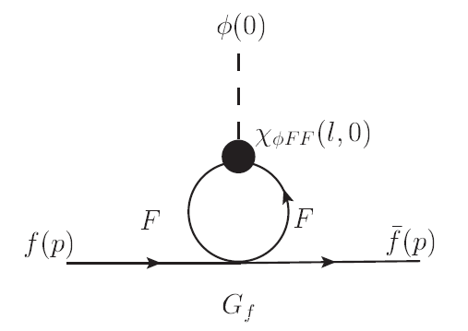
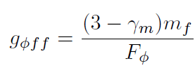
* TD coupling to SM fermions
TF condensation w/
ETC 4-fermi
Yukawa coupling to SM-fermion
SM f-fermion mass

Slide 31
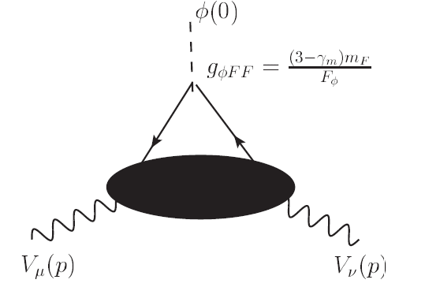
* TD couplings to SM gauge bosons
V-gauge boson self-energy func.
For weak bosons:
Note:
related to broken axialvector TF current
TD-WW coupling (mass coupling form):
with

Slide 32
In addition, higher-order WW coupling arises:
transverse part
one-loop approx.
SU(2) beta func. including
only TF-loop contributions
In TF decoupling limit: p^2/mF^2 → 0
with
TD-WW coupling (field strength form):
For couplings to diphoton and gluons
= similar field strength forms

Slide 33
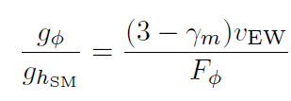
Thus, TD couplings to SM particles are
essentially the same as those for
the SM Higgs!
Just a simple scaling from the SM Higgs:
TD LHC study is doable!
(note: φ-gg, φ-γγ depending highly on particle contents of WTC models )
with

Slide 34
Estimate of TD coupling
* PCDC
criticality condition
* Pagels-Stokar formula
Appelequist et al (1996)
# of TFs
EW-doublets
``dummy”
* Recent LSD analysis (large Nf QCD)
Hashimoto et al (2011)

Slide 35
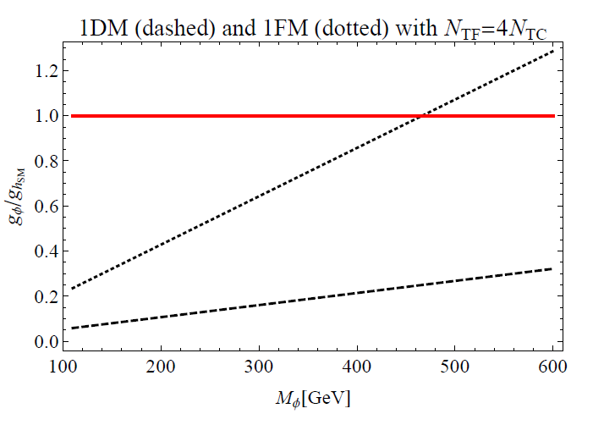
one-family model (1FM)
one-doublet model (1DM)
TD coupling is suppressed almost all over the mass range
110 GeV < M < 600 GeV! (non-SM Higgs like)

Slide 36
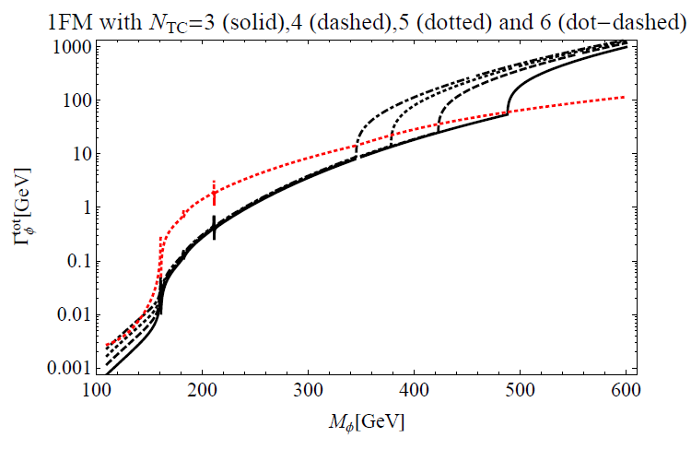
The total width (1FM) up to 600 GeV
SM Higgs
TD
Narrow
resonant
(gφ<ghiggs)
Broad
non-resonant
only two-body decays taken into account
SM –loop corrections incorporated

Slide 37
The total width (1FM) up to 600 GeV
SM Higgs
TD
Narrow
reasonant
(gφ<ghiggs)
Broad
non-reasonant
only two-body decays taken into account
SM –loop corrections incorporated
* decays to color-triplet techni-pions P3^+-00’ open to be dominant
Jia-Matsuzaki-Yamawaki,
in preparation

Slide 38
Techni-dilaton signatures at LHC
S.M. and K. Yamawaki,
PTP127 (2012);
arXiv:1201.4722;
arXiv: 1203.xxxx.

Slide 39
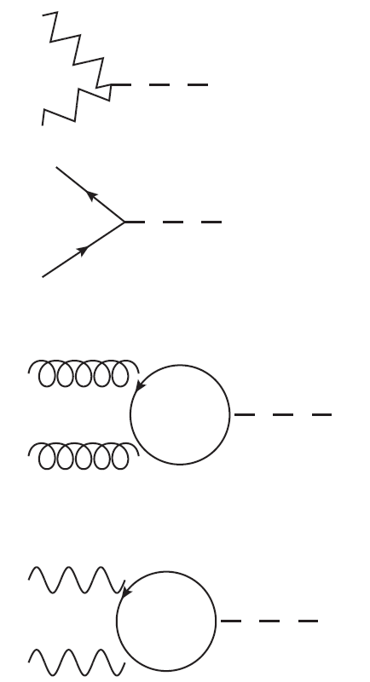
TD in 1FM @ LHC
W,Z
v.s SM Higgs
gφ
di-weak bosons
φ
suppressed
W,Z
q,l
gφ
quark, lepton pairs
φ
suppressed
q,l
Q,q
g
gφ
φ
enhanced
digluon
g
TQ contributions
F, f
γ
gφ
diphoton
φ
>> W -loops
enhanced
γ
EM-charged TF contributions

Slide 40
σ(pp → TD) x BR(TD → X ) at LHC
* Production: GF process >> VBF, others
* dominant decay channels:
110 GeV < Mφ < 2 Mw → gg mode
2 Mw < Mφ < 2 Mp3 → WW, ZZ modes
2 Mp3 < Mφ< 600 GeV → P3 (color-triplet TPs)
(～ 400 – 500 GeV)

Slide 41
LHC limits on TD
σ(pp → TD) x BR(TD → WW/ZZ )/σ(SMHiggs)
ATLAS03/07/12
CMS03/07/12
WW
ZZ
* large WW, ZZ signals enhanced by GF (TQ loops)
* 140 GeV < M < 600 GeV excluded

Slide 42
Above 600 GeV:
* large diphoton signal enhanced by large GF
σ > ～ O(fb)
*non-resonant signature (huge TD width)
* decays to WW,ZZ, ttbar suppressed (di-P3 dominant)

Slide 43
TD at around 125 GeV
WW*
ZZ*
γγ
* Only diphoton signal enhanced (depending on N_TC)
* The signal strengths (γγ, WW*,ZZ*) are in good
agreement with the best-fit ones!! (within 1 σ errors)
* If only diphoton excess will develop
→ may be discovery of 125 GeV TD

Slide 44
Summary
* TD is a characteristic light scalar in WTC.
* The couplings to the SM particles take essentially the same
forms as those for the SM Higgs, though the coupling
strengths depend on models of WTC .
* The salient (1FM) TD LHC signatures are seen only in
the diphoton channels either at ～125 GeV
or above 600 GeV, in sharp contrast to the SM Higgs,
to be tested soon this year!

Slide 45
Back up slides

Slide 46
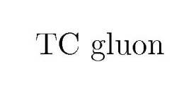
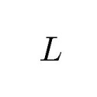
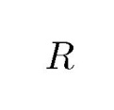
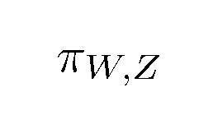
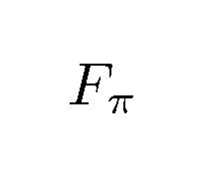
Technicolor
Weinberg (‘76), Susskind (‘79)
Dynamical EW(chiral) SB
Dynamical W,Z mass generation
W,Z
W,Z
Dynamical explanation of origin of mass

Slide 47
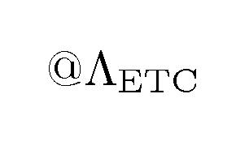
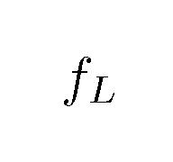
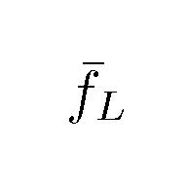
Technicolor should not be QCD-like at all
Extended TC: SM fermion mass generation
ETC
FCNC constraint
e.g.
ETC
associated w/ strange quark mass
Naive scale-up of QCD:
Needs enhancement by
Holdom (1981)

Slide 48
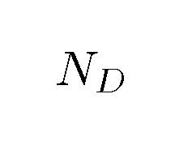
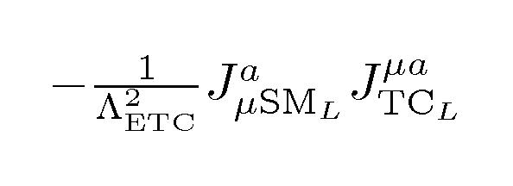
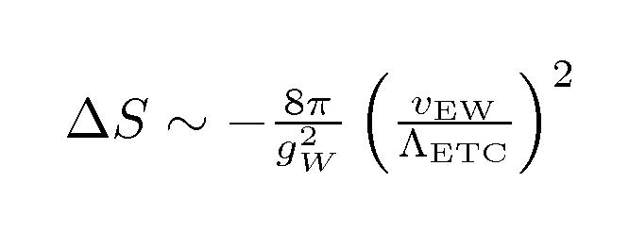
Other pheno. issues in TC scenarios
S parameter
: # EW doublets
too large!
Cf: S(exp) < 0.1 around T =0
One resolution: ETC-induced “delocalization” operator
Chivukula et al (2005)
vector channel
ETC
in low-energy
w/
modifies SM f-couplings to W, Z
contributes to S “negatively”

Slide 49
Top quark mass generation
ETC
ETC scale associated w/ top mass
too small!
One resolution: Strong ETC
Miransky et al (1989)
--- makes induced 4-fermi (tt UU) coupling large
enough to trigger chiral symm. breaking (almost by NJL dynamics)
boost-up
T parameter
(Strong) ETC generates large isospin breaking
→ highly model-dependent issue

Slide 50
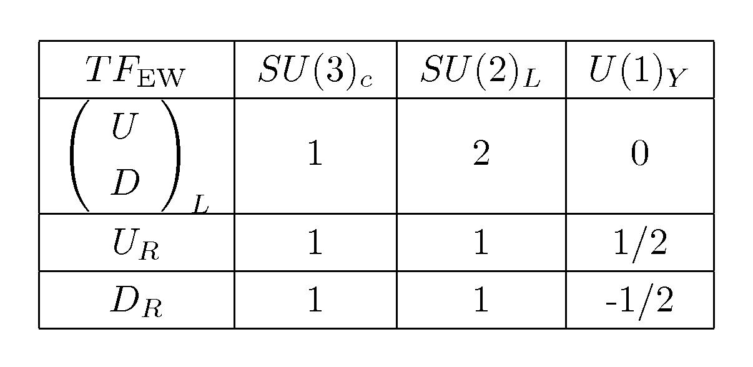
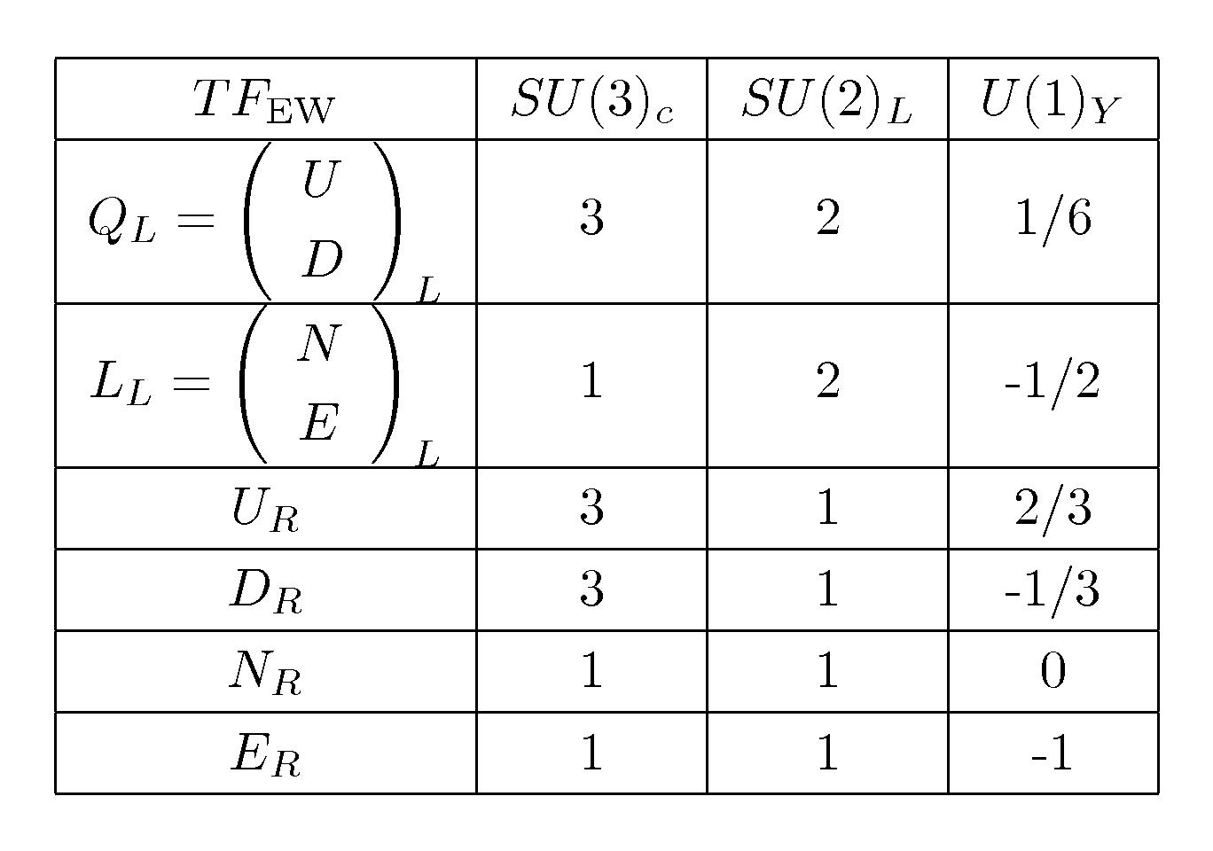
Farhi et al (1981)
One-doublet model (1DM)
Total # of techni-fermions
w/ critical # for mass generation
in WTC
One-family model (1FM)
Appelequist et al (1996)

Slide 51
The TD effective Lagrangian
* Nonlinear realization for both scale and chiral symmetries
TD field φ embedded in nonlinear base Χ for scale symmetry:
trans. linearly
w/ scale dim. 1
trans. nonlinearly
chiral pion field π (w/ scale dim. 0) embedded in usual chiral field U (w/ scale dim. 1):
* scale symm. broken spontaneously & explicitly by mF:
“Spurion field S”
introduced so as to
compensate scale-invariance

Slide 52
* TD arises from FF as
s.t. Χ coupling to operator w/ scale dim. Δ goes like
For Δ = 4
Compasate scale-invarinace
By spurion “S”
For Δ = 4

Slide 53
* Nonlinearly scale & chiral inv. Lagrangian w/ “S” included
w/
LET corresponding to
TD couplings are reproduced
* Potential term: reproduce the proper scale anomaly/PCDC

