Slide 1
Evidence for νμ→ντ oscillation by appearance mode from OPERA experiment
O.Sato (Nagoya University)
For OPERA Collaboration
@ KMI2013

Slide 2
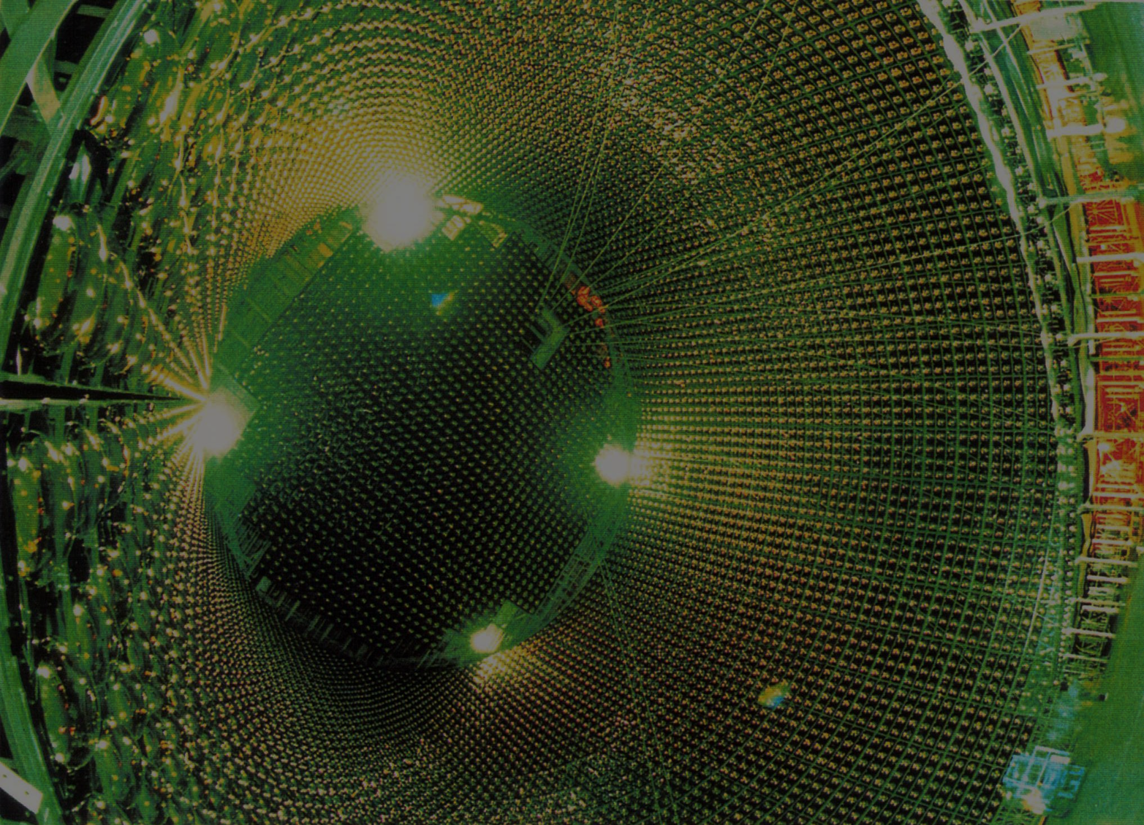
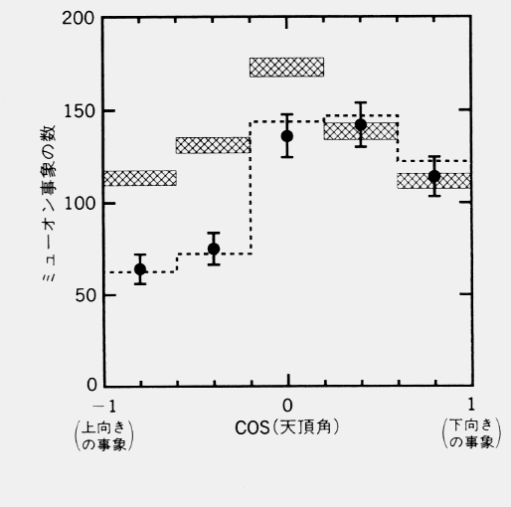
Trigger of OPERA
ｃｏｓθ＝１
ミューニュートリノ事象の天頂角分布
Cosmic ray
Zenith angle（θ）
ｃｏｓθ＝0
Earth
Up going
Down going
ν
νμ zenith angle distribution @NEUTRINO98
Atmosphere
π ◊μ＋ν_{μ}
Interpretation：
Disappearance of nm by oscillation νμ−>ντ
ｃｏｓθ＝－１
→ Really transit into ντ ?
Only detector with nuclear emulsion can check that .

Slide 3
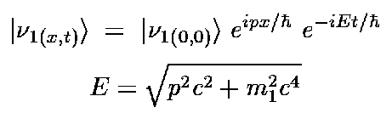
Neutrino oscillation
Neutrino flavor oscillation : Maki, Nakagawa, Sakata 1962
Weak int. Eigen states Mass Eigen states (m₁, m₂)
Mixing matrix
ν1
ν2
cosθ
ν_{μ}
ν_{τ}
sinθ
Propagating through mass Eigen states
If there is mass difference phase shifts between ν1 and ν2 after propagated
Notes:
3

Slide 4
Neutrino oscillation detection
Appearance method
Detection by the new flavor appearance after Oscillation.
→ No doubt for transit state.
Disappearance method
Detection of original flavor decrease after Oscillation.
→ No information for transit state.
Notes:
4

Slide 5
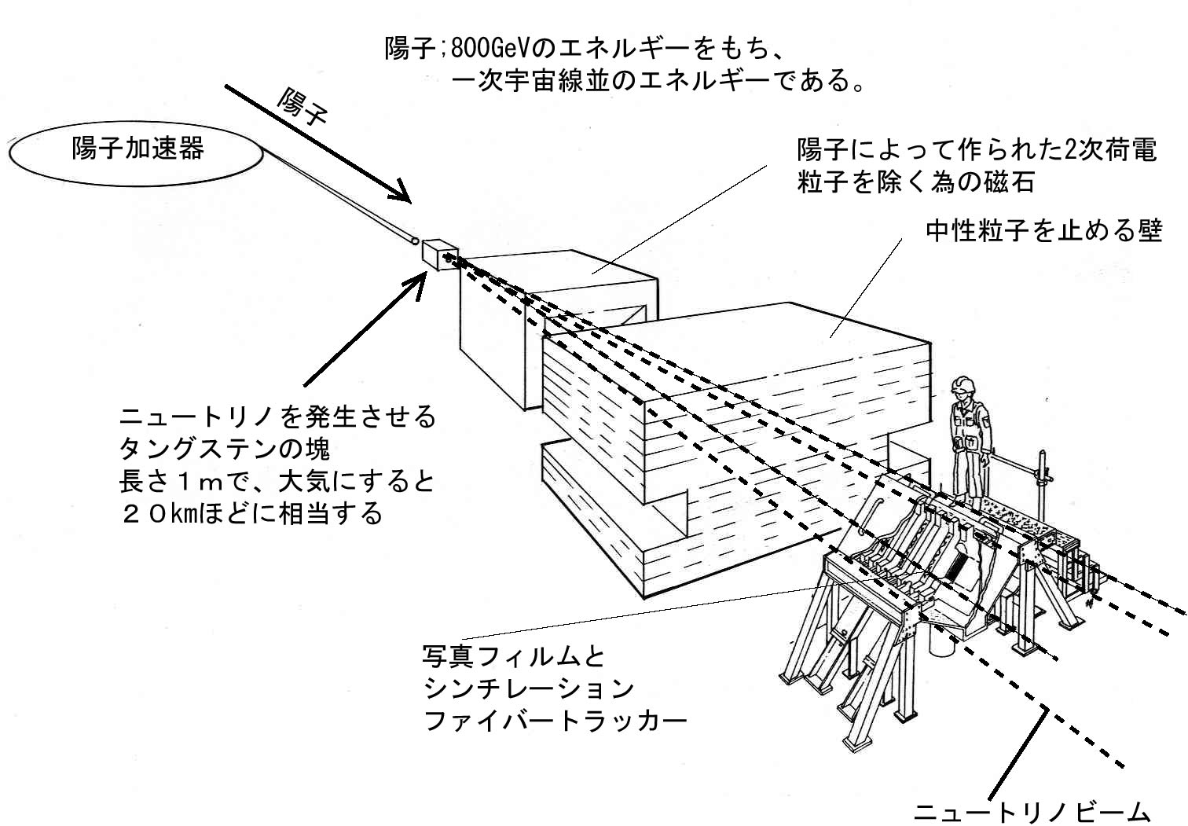
Observation of ντ @NEUTRINO98
(M.Nakamura)
800GeV Proton
Iron/Pb Shield
TEVATRON
Muon Sweeping Magnet
Tungsten Beam Dump
1m long
Emulsion- Scintillating Fiber Hybrid Target
DONUT
Prompt Neutrino Beam

Slide 6
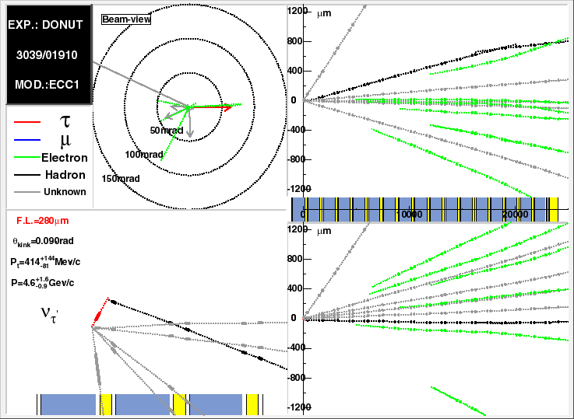
First observation of ντ @NEUTRINO98
(M.Nakamura)
3 Tau Neutrino Events until 1998 (Final 9 events)

Slide 7




OPERA experiment
Goal
The first detection of ντ interactions after neutrino oscillation.
Handling technique and Automated scanning system.
Proposed by K.Niwa (Nagoya University) et al in 1997.
European countries and Japan collaboration.
Construction of detector until 2008, Physics run start from 2008.
Belgium
ULB Brussels
Italy
Bari
Bologna
LNF Frascati
L’Aquila
LNGS
Naples
Padova
Rome
Salerno
Korea
Jinju
Croatia
IRB Zagreb
Russia
INR RAS Moscow
LPI RAS Moscow
ITEP Moscow
SINP MSU Moscow
JINR Dubna
France
LAPP Annecy
IPNL Lyon
IPHC Strasbourg
Japan
Aichi edu.
Kobe
Nagoya
Toho
Utsunomiya
Switzerland
Bern
ETH Zurich
Germany
Hamburg
Israel
Technion Haifa
Turkey
METU Ankara
（11 countries,30 Institutes~160 researchers）

Slide 8

OPERA Executive Chart
Spokesperson: G. De Lellis
Deputy-spokesperson : O.Sato
Deputy-spokesperson : Y.Gornushkin

Slide 9
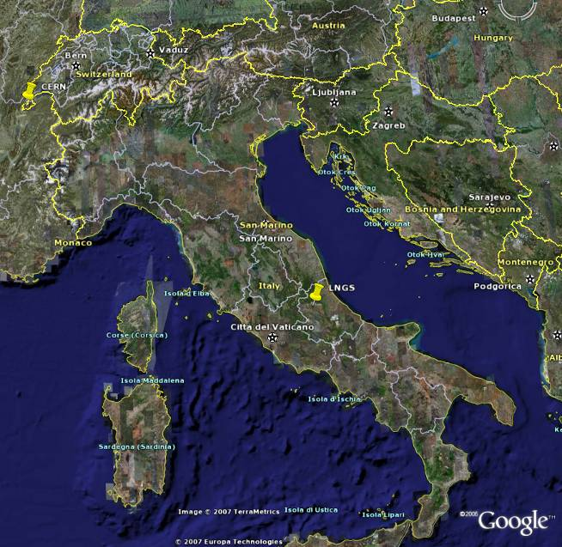
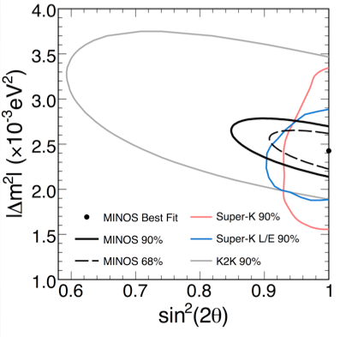
CNGS （Baseline 732 km、＜Eν＞17GeV）
Year | P.O.T.(10¹⁹)
2008 | 1.74
2009 | 3.53
2010 | 4.09
2011 | 4.75
2012 | 3.86
Total | 17.97
LNGS
* Interaction rate at LNGS
Covers the region indicated by Super-K, K2K & MINOS
< Eν > ( GeV ) 17
(ν_{e} + ν_{e}) / ν_{μ} 0.89, 0.06 %
ν_{μ} / ν_{μ} 2.1 %
ν_{τ} prompt Negligible
22.5x10¹⁹ POT (proposal) → Expected Events 7.6 Signal, 0.8 Background

Slide 10

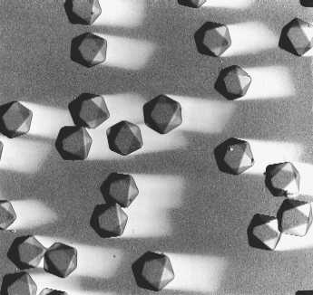
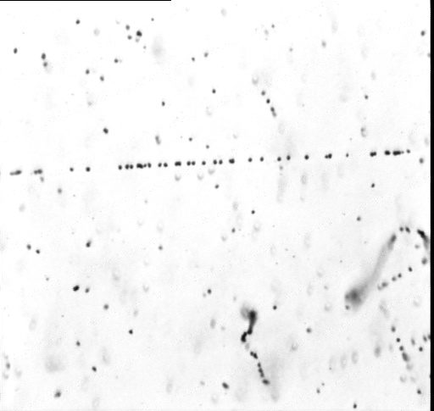
Nuclear emulsion (OPERA film, Fuji Film)
Nuclear emulsion (44 microns)
AgBr crystal,
radium 0.2 micron
Plastic base (205 microns)
Nuclear emulsion
sensitivity 15grains /44 um
Spatial resolution: 50 nm
No dead time
a MIP particle
electron ～100 keV
20 μm
10
10
Notes:
10
10

Slide 11
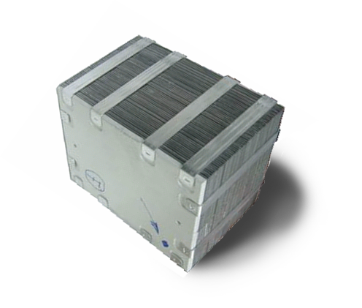
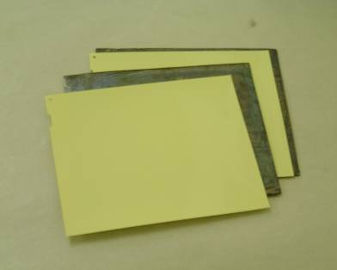
OPERA ECC : Camera for neutrino interactions
Pb(1mm) / emulsion (OPERA film) interleaved structure
A DONUT ν_{τ} event
Flight Length：280um
ν_{τ}
τ
1mm
Kink | τ → e | 18 ％
 | τ → μ | 17 ％
 | τ → h | 49 ％
Trident | τ → 3h | 15 ％
Emulsion
DONUT : Iron 1mm
OPERA : Lead 1mm
56 Pb plates + 57 emulsion plates , weight 8.3 kg
150,000 ECC 1250 ton target
9.3 million emulsion sheets
100mm
125mm

Slide 12
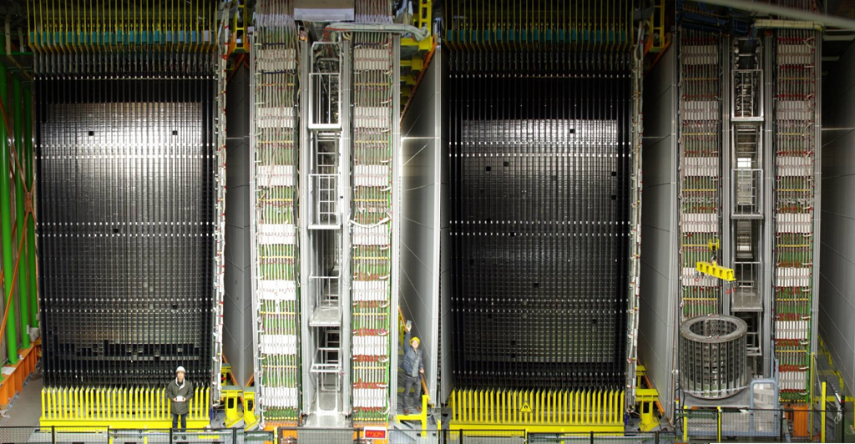
OPERA detector @ 1400m Underground Gran Sasso
150,000 ECC 1.25kt: exposed to the neutrino beam
ν

Slide 13
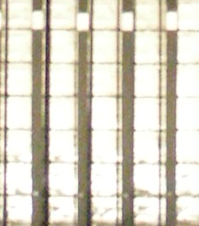
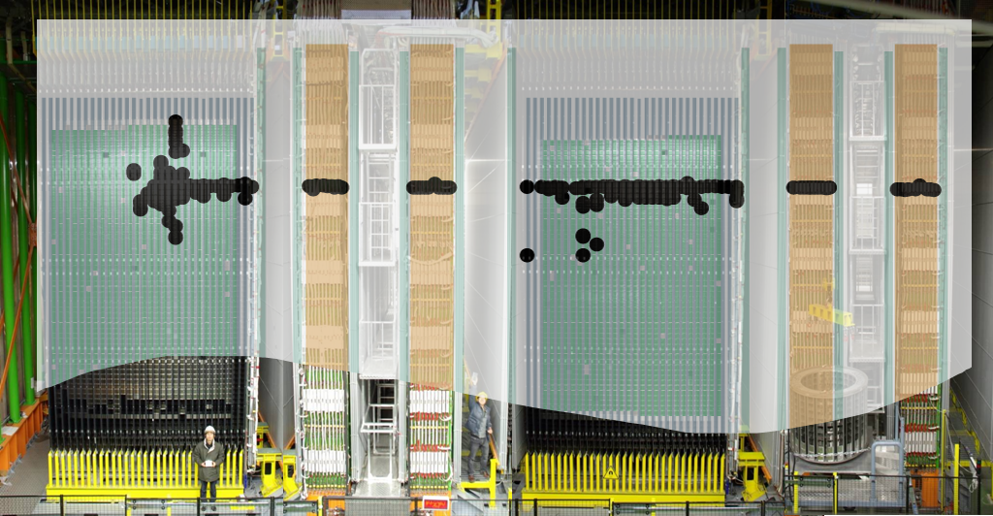
Super-imposed electronic detector information
X,Y scintilator strips : rough positioning prediction of target ECC
muon spectrometer : muon charge and momentum determination
ν

Slide 14
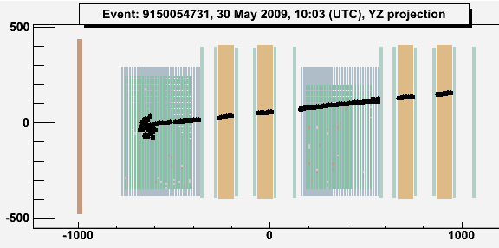
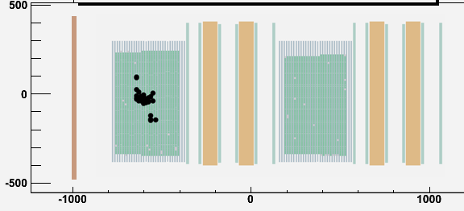
Detected Neutrino Interactions
With μ (1μ)
・ν_{μ} CC 70% of all
・ν_{τ} CC, τ→μ (17.4%)
ν
Without μ (0μ)
・ν NC 29% of all
・ν_{τ} CC, τ→e (17.8%)
・ν_{τ} CC, τ→h, 3h (64.8%)
ν
・ν_{e} CC 1% of all

Slide 15
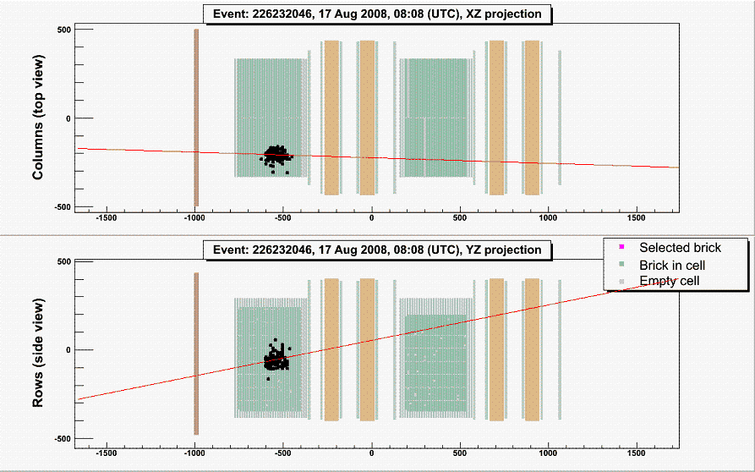
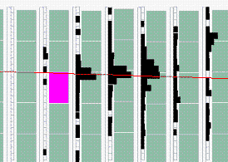
Typical ν_{μ}CC- and NC-like events
Extraction of a ECC
20 m

Slide 16
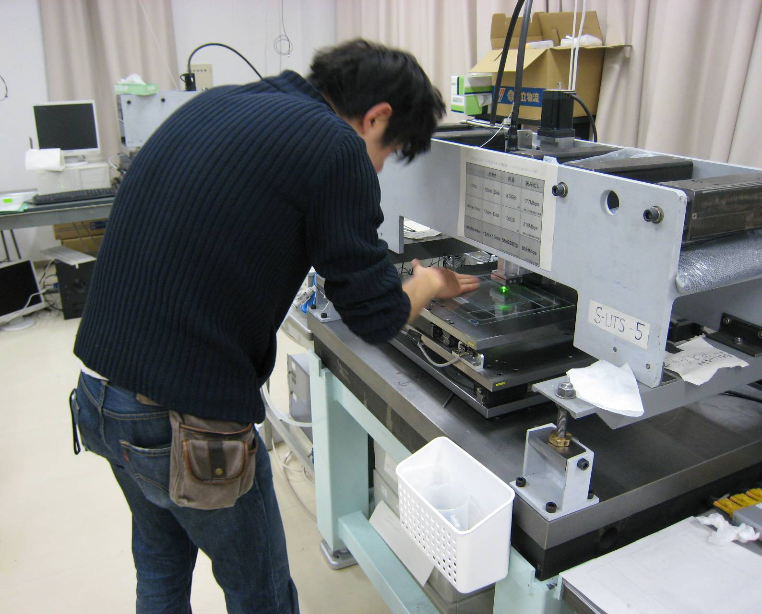
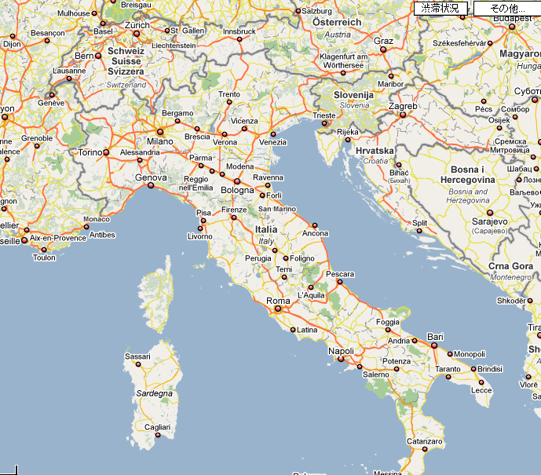
Data readout from emulsion
:: Automatic Scanning
SutsでCSすきゃん
To Dubna
Bern
Padova
Bologna
50%
4 hours
for extracting all track information
from a emulsion film（12cmx10cm）
SUTS
Fastest automatic microscope
Track segment reader
5 SUTS in Nagoya univ.
To Japan
Roma
LNGS
To Ankara
LNF
Bari
Napoli
Salerno

Slide 17
Event Location in the ECC
Changeable
Sheet
ECC
Large Area Scanning
~5cm x 5cm
ν
Lead
film
Lead
film
Lead
film
Lead
film
Lead
film
Lead
film
Lead
film
Lead
film
film
film
Notes:
17
17

Slide 18
Event Location in the ECC
Changeable
Sheet
ECC
Small area scan
~0.1mm*0.1mm
ν
Read-out films around the stopping point
Lead
film
Lead
film
Lead
film
Lead
film
Lead
film
Lead
film
Lead
film
Lead
film
film
film
Notes:
18
18

Slide 19
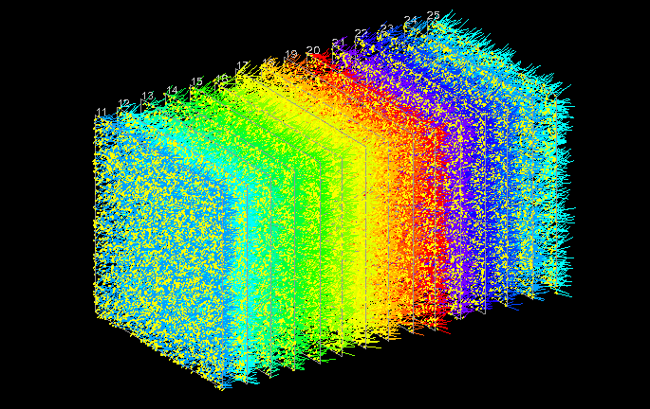
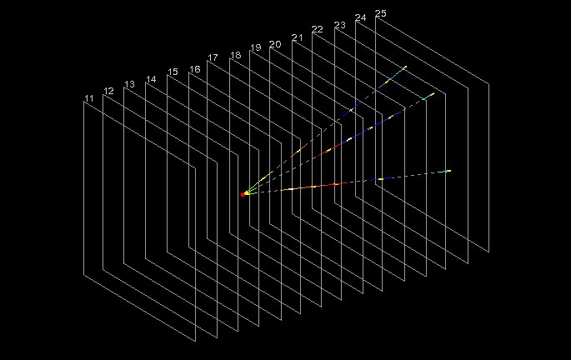
Neutrino interaction reconstruction
1 cm
1 cm
ν
Raw track segments
Connecting track originating from
the volume.

Slide 20
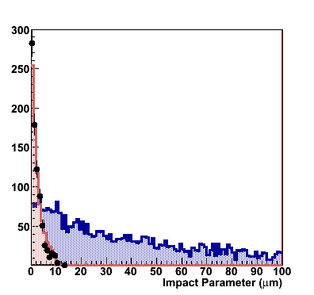
ν_{τ} CC Detection
Short flight decay
Impact Parameter distribution
ν_{τ}
Decay point
IP
τ
ν_{τ} events (MC)
NC+CC ν_{μ} events (MC)
NC+CC ν_{μ} events (Data)
Primary
vertex
(Mean 104.3 μm)
1mm Pb
Long flight decay
10 μm ↔ (cτ = 87μm)
Decay point
ν_{τ}
IP
τ
Primary
vertex
1mm Pb

Slide 21
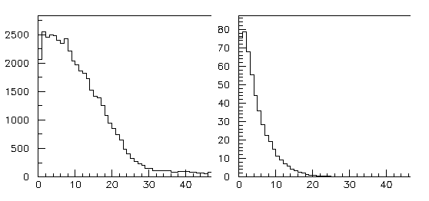
Analyzed sample
Year | P.O.T.(10¹⁹)
2008 | 1.74
2009 | 3.53
2010 | 4.09
2011 | 4.75
2012 | 3.86
Total | 17.97
Minimum bias analysis for 2008-2009 runs
- no kinematical pre-selection for analysis.
- up to 2 ECC extraction for each event analysis.
Kinematical cut for sample 2010-2012
- 1st ECC for 0mu events and 1mu with Pm<15GeV/c.
- 24 % reduction of 1mu sample
with keeping 98% tau→ mu signal
νμCC DIS μ momentum
ντCC DIS τ→μ momentum
background
Pμ>15 GeV/c
23.7%
signal
Pμ<=15GeV/c
97.7%
15GeV
15GeV

Slide 22
ν_{μ} → ν_{τ} oscillation search:
summary
Run Sample | Status | Analysed events | Expected ν_{τ} events | Expected BG | Observed ν_{τ} events
2008 -2009 | Finish | 2767 |  |  | 1
2010 - 2012 | 1st ECC | 2505 |  |  | 2
Current Total | ~70% of All | 5272 | 1.7 | 0.185 | 3

Slide 23
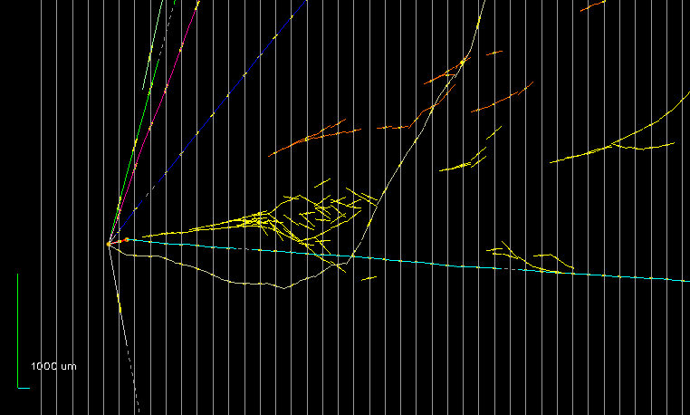
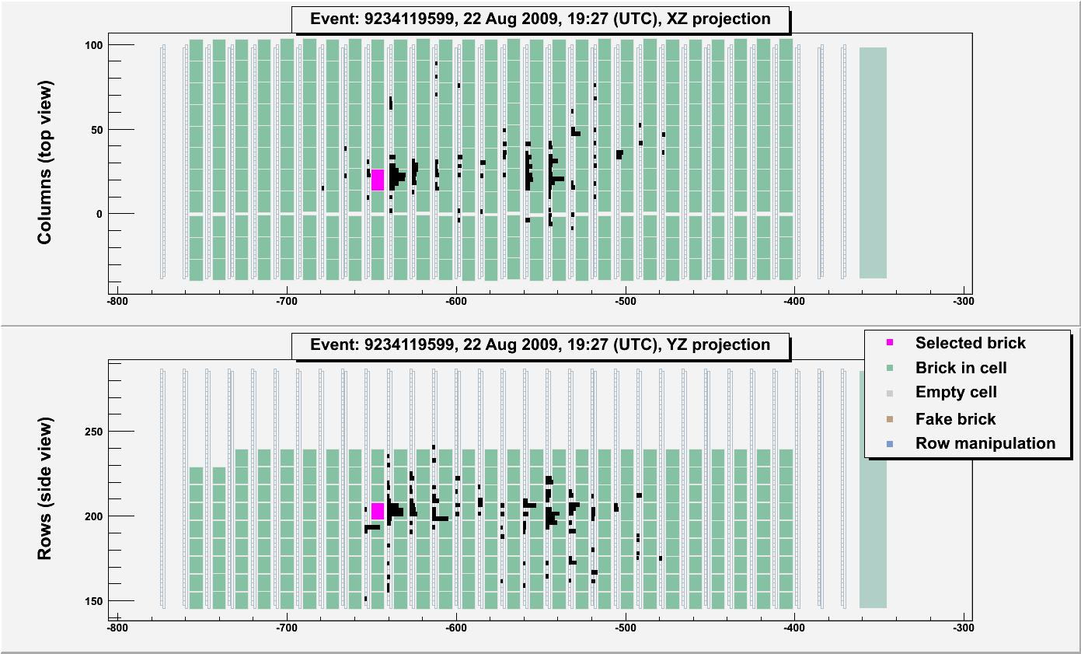
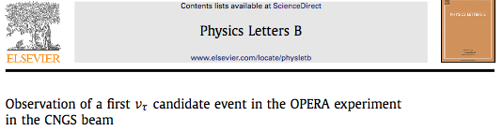
The first ν_{τ} event NEUTRINO2010 (O.Sato)
7
Side view
1
5
3
γ2
γ1
4
2
8 daughter
6
23

Slide 24
PL17
PL18
PL19
PL20
PL21
5
1
7
3
Primary vertex
γ1
kink point
4
8
careful visual inspection of the films behind/in front the secondary vertex:
no “black” or “evaporation” tracks. Support topological hypothesis of a particle decay
2
6
1mm lead
24
Notes:
24

Slide 25
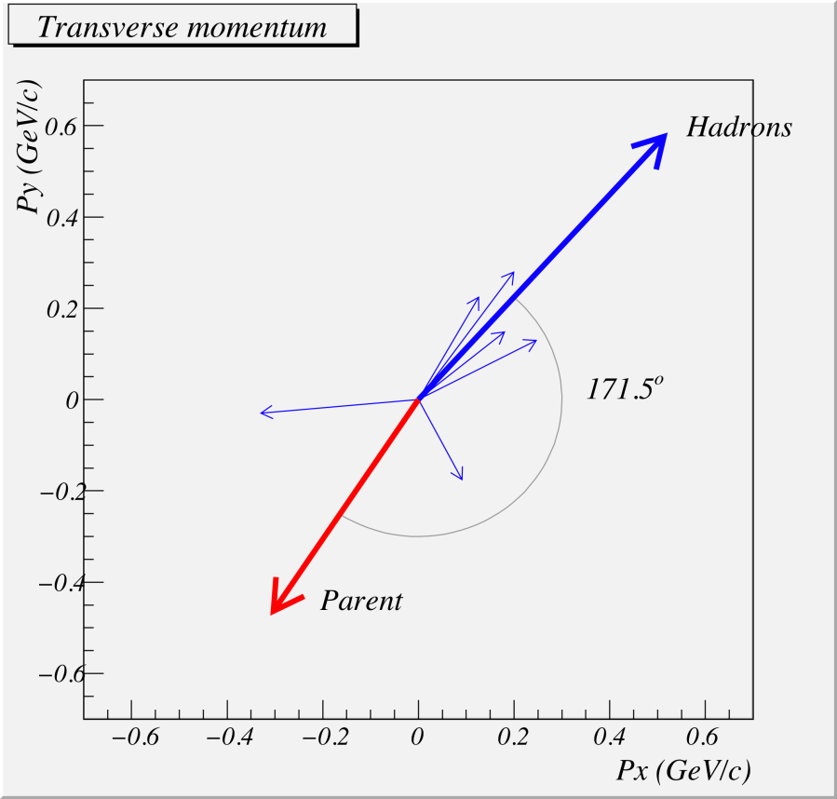
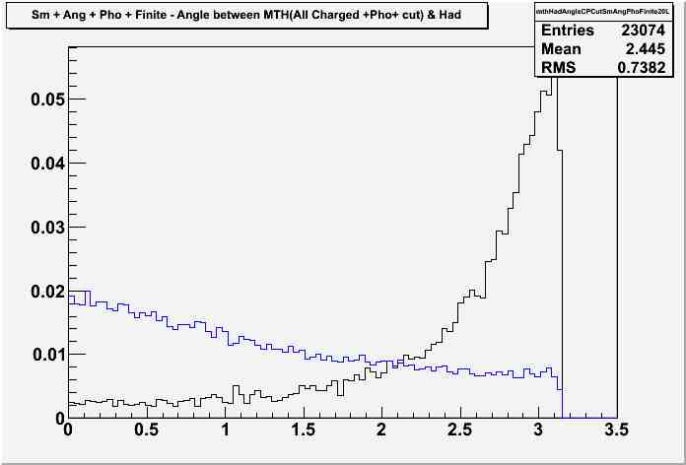
Φ : angle between
tau and hadron system
in plane perpendicular to beam
X (hadron shower)
Signal :
φ =180º
BG:
small φ
φ
kink
τ-decay
τ⁻
x
Signal
Tau and hadron system back to back.
Background
A track of the hadron system made a mimic kink
ν_{τ}
π⁻
φ
π⁻
π⁻
ν_{τ}N τ⁻X
ν_{μ}
ν_{μ}N ν_{μ}π⁻X
Blue: MC - NC
Black: MC - τ
cut
25
rad

Slide 26
Kinematical variables
Satisfying all selection criteria for hadronic kink ➔ first ν_{τ} candidate !
γ1 and γ2 are both assumed as attached to 2^{ry} vertex .
consistent as tau→ρ+ντ
VARIABLE | AVERAGE | Selection criteria
kink (mrad) | 41 ± 2 | >20
decay length (μm) | 1335 ± 35 | within 2 lead plates
P daughter (GeV/c) | 12 ⁺⁶₋₃ | >2
Pt (MeV/c) | 470 ⁺²³⁰₋₁₂₀ | >300 (γ attached)
missing Pt (MeV/c) | 570 ⁺³²⁰₋₁₇₀ | <1000
φ (deg) | 173 ± 2 | >90
26

Slide 27
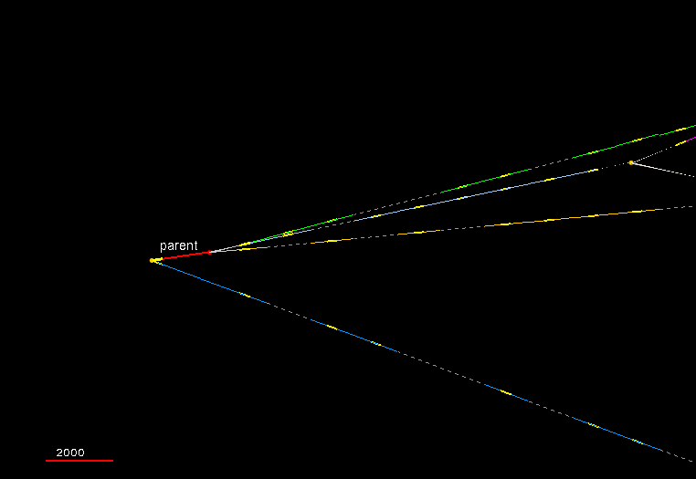
The 2nd ν_{τ} event NEUTRINO2012 (M.Nakamura) JHEP11 (2013)036
animation
2000 μm

Slide 28
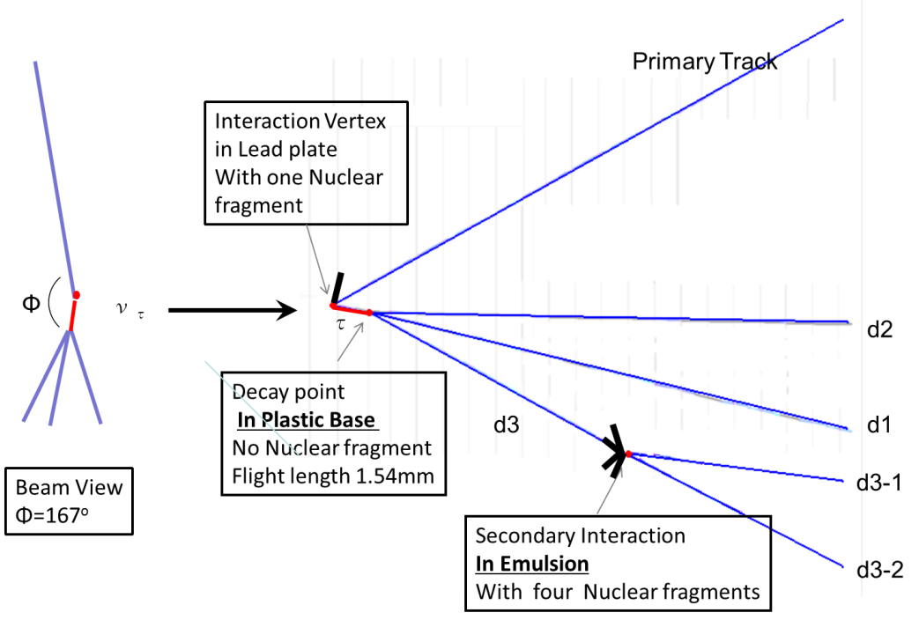
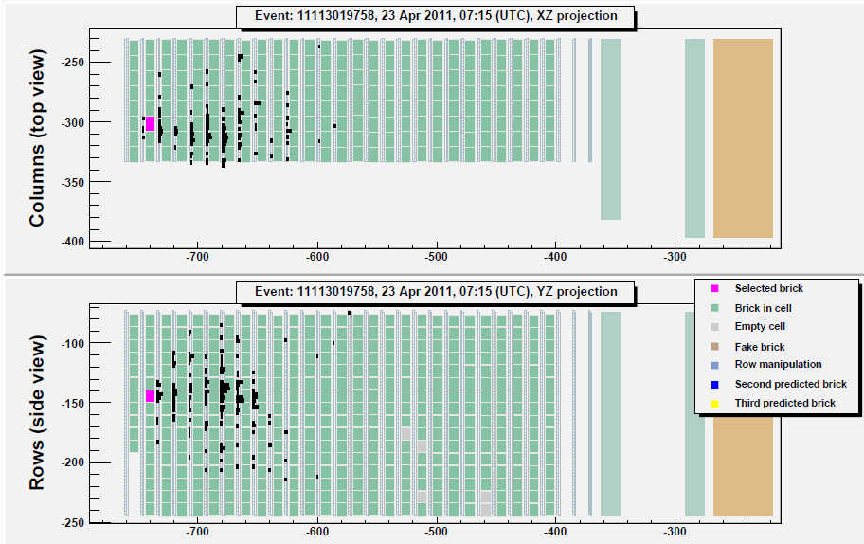
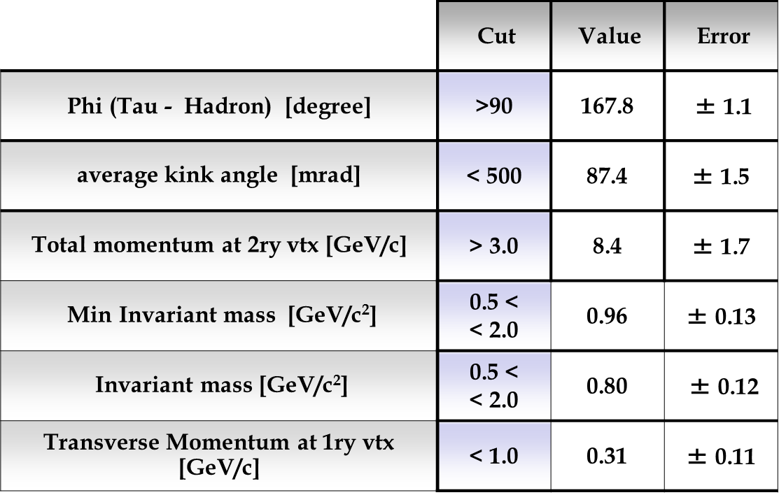
2nd ντ event
Event kinematics
2nd ν_{τ} candidate
All track were identified as hadron .
2 tracks : hadron interaction was located
2 tracks : range and momentum inconsistent

Slide 29
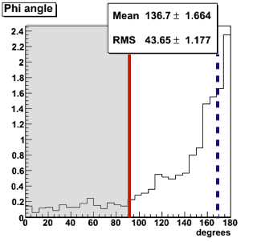
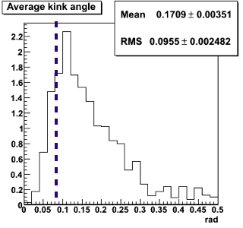
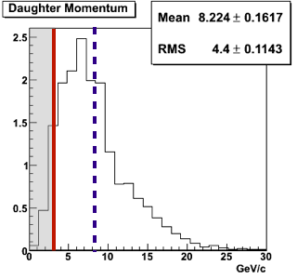
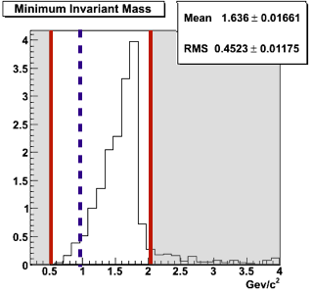
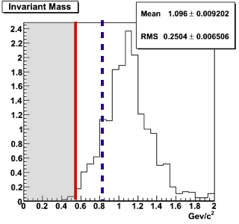
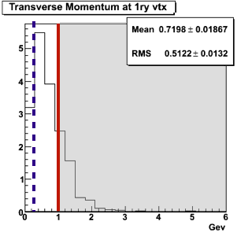
Kinematics of the New Candidate Event
candidate
cut

Slide 30

The 3rd ν_{τ} event 2013Mar
(Seminar CERN & JPS meeting)
Decay channel: τ → μ

Slide 31
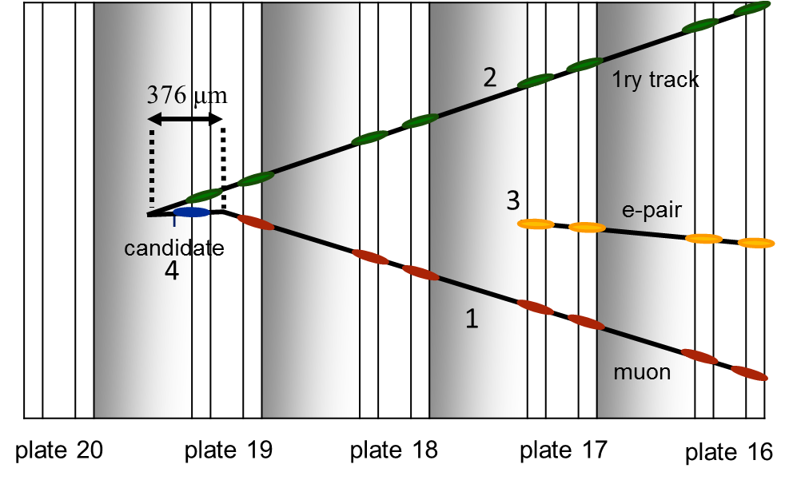
Pb
Pointing
1ry VTX
1ry Vertex : In Pb 225um from surface
tau with a 1ry hadron IP :0.4micron
Daughter muon IP=93.7micron to 1ry
Φ~154.5°
Tau decay vertex : in middle of plastics base
Decay at Lowest material in OPERA detector
tau and daughter muon IP:0.8 micron
decay angle : 0.245±0.005 rad
decay Pt : 690±50MeV/c
Hadron system

Slide 32
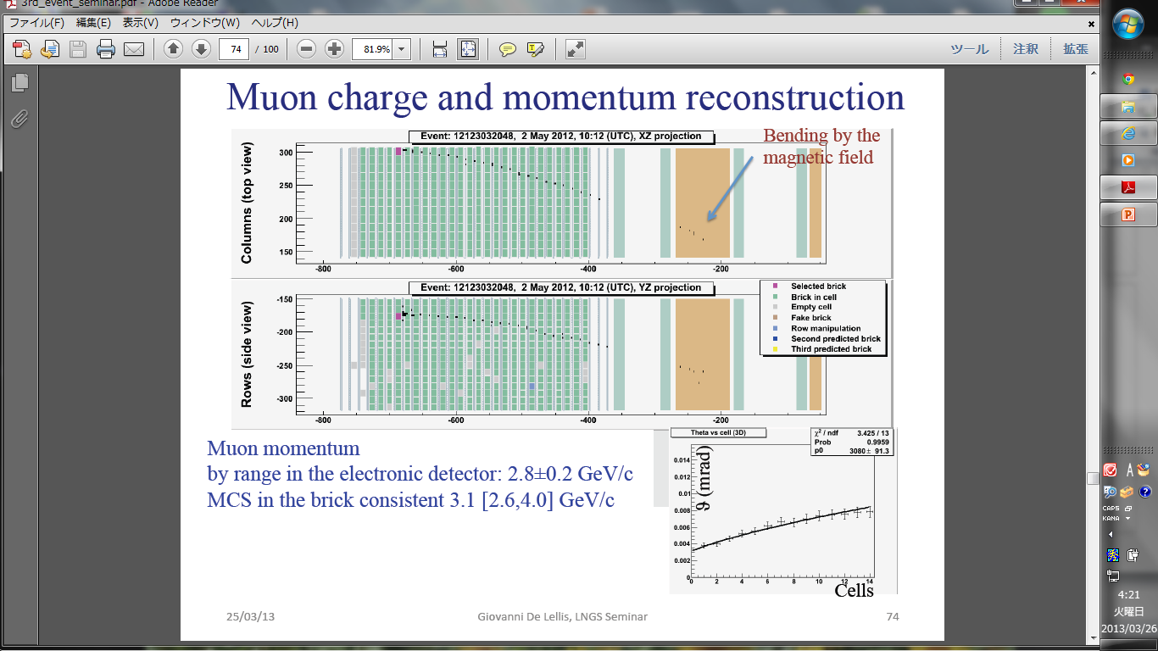
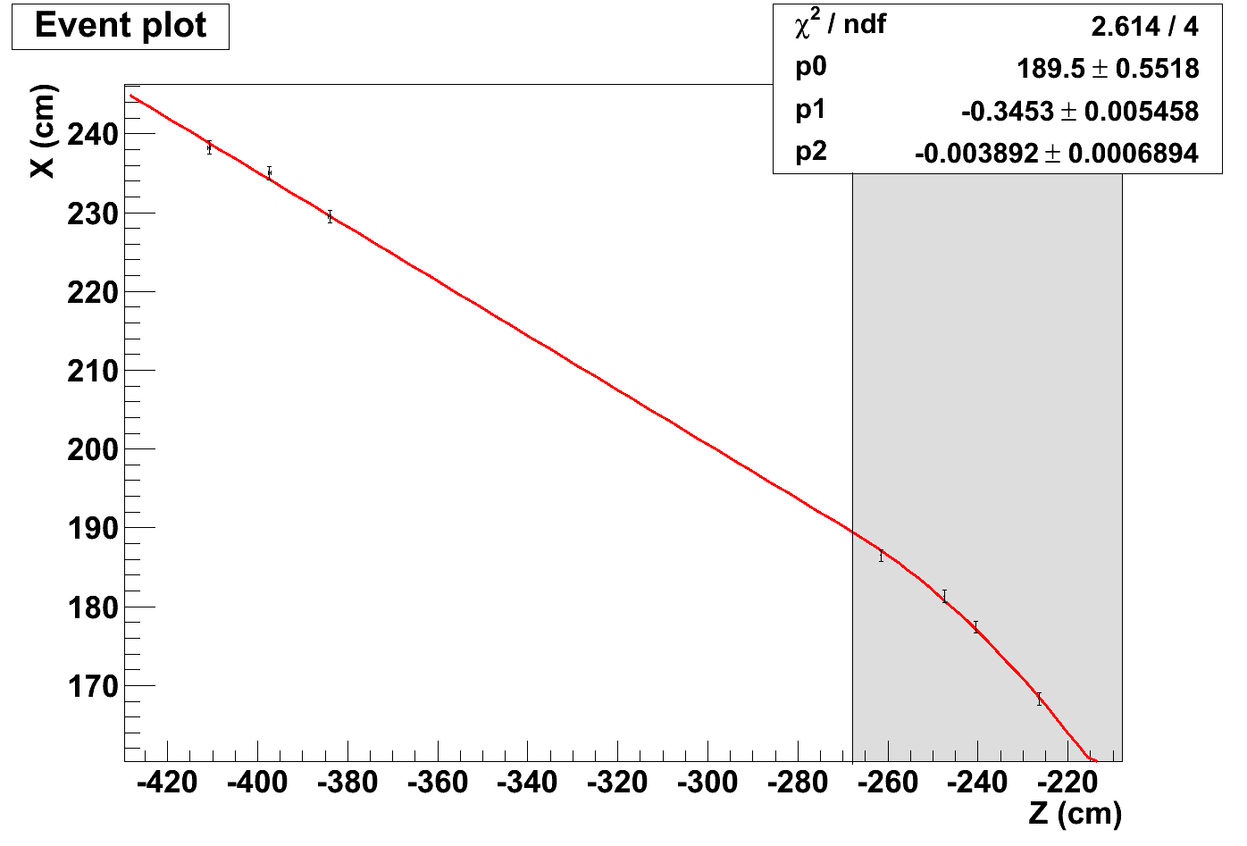
μ^{ｰ}
X
P2<0
→ negative charge
5.6 σ significance
R ~ 85 cm
Target Tracker hits
B
ν_{μ}→ν_{τ}
ν_{μ}→ν_{τ}
RPC hits
P-value = 0.063% (probability to reconstruct a μ⁺ stopping in the 7th iron layer with p2 < -0.00389 cm⁻¹)

Slide 33
Back ground expectation
preliminary
 | Signal | Back ground | Charm | Mu scattering | Hadrons
Tau→h | 0.31 | 0.027 | 0.011 | 0.000 | 0.016
Tau→3pi | 0.43 | 0.117 | 0.114 | 0.000 | 0.002
Tau→mu | 0.50 | 0.021 | 0.004 | 0.017 | 0.000
Tau→e | 0.46 | 0.020 | 0.020 | 0.000 | 0.000
total | 1.7 | 0.185 | 0.145 | 0.017 | 0.018
1
2
3
Main Background is charm associating events
with muon ID failed .
Total BG expectation is 0.185
Taking into account the difference of bg
in 4 decay channels
P_value of experiment = 2.9 x 10⁻⁴
Corresponding to 3.4 σ significance
c
ν_{μ}
Pb
film
μ

Slide 34
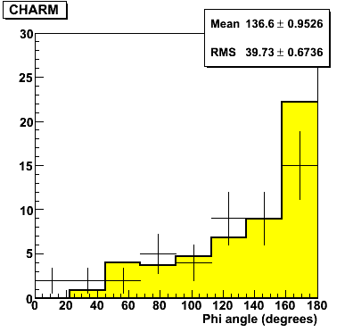
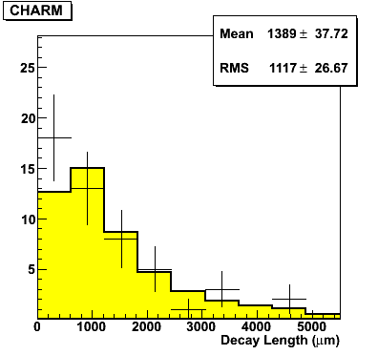
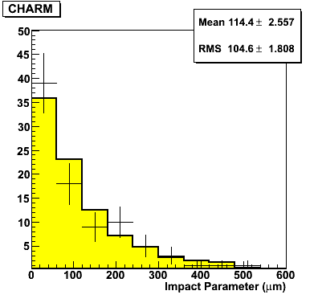
ν_{μ} → ν_{τ} oscillation search:
control sample
c
Charm’s life time is similar with tau.
➔ Tau detection efficiency validation sample
Expected events: 51 ± 7.5
Observed events: 49
ν_{μ}
Pb
film
μ
Charmed hadron – muon angle
in the plane transverse
to ν direction

Slide 35
Summary
OPERA complete 5 years neutrino exposure.
Accumulated POT is 80% of proposal value .
2008-09 sample analysis finished,
and the 1st ντ event was found in 2009 run.
1st ECC analysis of 2010-12 sample will be finished in a few months.
5272 events have been analyzed and summarized so far.
- 3 tau neutrino events found .
- 49 charm associating CC event validate the decay search efficiency.
Current significance of νμ→ντ signal observation is 3.4 σ from background fluctuation.
Increase of 30% statistics and further background reduction studies on going .
Together with polishing significance estimation method → 5 σ.

Slide 36
Back up

Slide 37
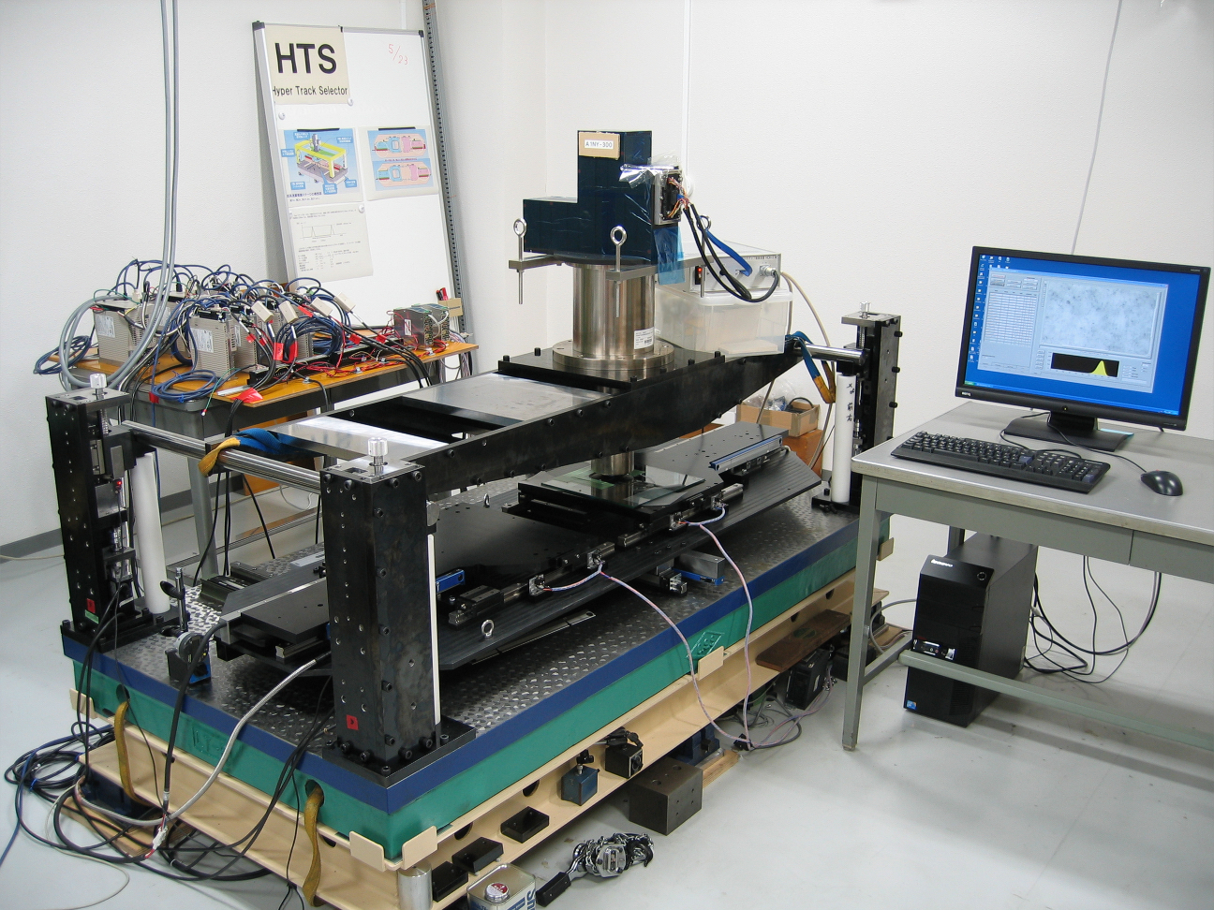
New weapon（ＨＴＳ）
100 times faster track reader
2.5 min for a emulsion film !
Currently took 4 hours
Launching soon, 2014 Jan
~2000m²/Year
10000
Speed in cm²/h
9000
~20m²/Year
1000
72
100
10
~0.02m²/Year
1
1
0.1
0.082
0.01
0.003
0.001
TS(TTL)
NTS(CPLD)
UTS(FPGA)
SUTS(FPGA)
HTS(GPGPU)
E653 CHORUS DONUT OPERA Future Exp.
1983 1994 1998 2006-
2013-

Slide 38
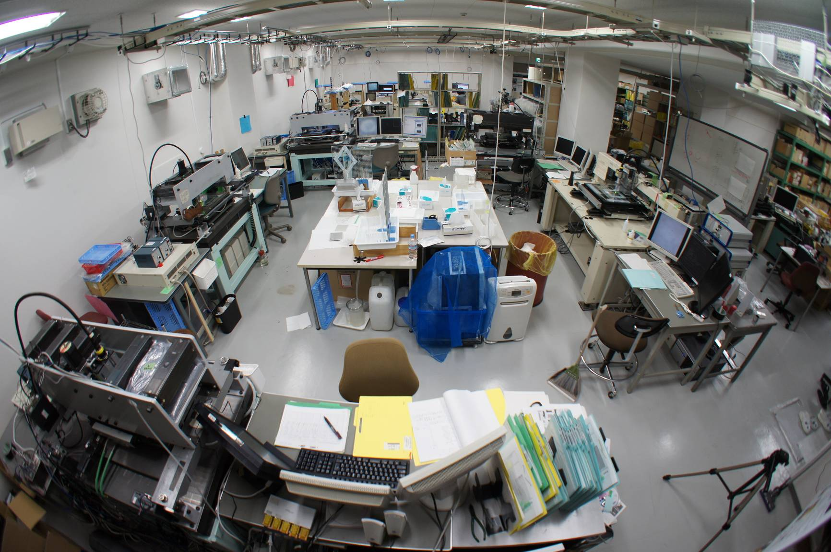
Scanning room at Nagoya University
5S-UTS

Slide 39
Summary for tau conference
The first observation of Lepton Flavor Violation
through detecting changed lepton flavor .
NOT Origin Flavor Disappeared nor Just Consistent .
But the Changed Lepton Flavor Identified !
1st tau neutrino event reported 2010 May. PLB 691 (2010) 138
2nd tau neutrino event reported 2012 Jun.
τ⁻
π⁺
ν_{μ}
ν_{τ}
N
μ⁺

