Slide 1
Tasks in Next 10 Years
- A personal view on future of searches for beyond the standard model -
Junji Hisano (Nagoya Univ.)
KMI International Symposium 2013
on ``Quest for the Origin of Particles and the Universe''
(KMI 2013)
December 11 (Wed.) - 13 (Fri.), 2013
Sakata-Hirata Hall

Slide 2

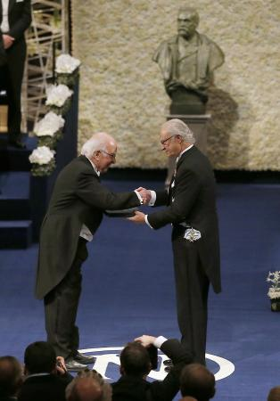
Victory of the standard model
- Discovery of Higgs boson -
Nobel week

Slide 3
Then, is particle physics over?

Slide 4
Five evidences for physics beyond SM
Non-baryonic dark matter
Neutrino mass
Dark energy
Apparently acausal density fluctuations
Baryon asymmetry
We don’t know their energy scales….

Slide 5
Urgency problems in particle physics
(my opinion)
Does deviation of muon (g-2) come from physics beyond the SM?
Is dark matter WIMPs?
Where is physics beyond the standard model? Around TeVs? Is discovered Higgs the SM one?

Slide 6
Three tools in particle physics
Energy Frontier
Beyond
the SM
Precision Frontier
Cosmic Frontier
Theoretical studies link three approaches

Slide 7
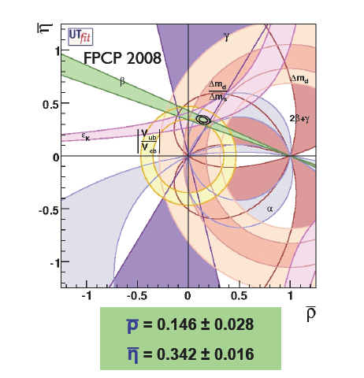
History of Kobayashi-Maskawa mechanism
Keywords: 3 generations
Unitarity of KM matrix
Barth of KM mechanism (73)
Discovery of tau (75) and bottom (77)
Discovery of mixing in neutral B meson system (81)
Discovery of direct CP violation (88) and its confirmation (99)
Discovery of top（99）
Discovery of CP violation in neutral B meson system (01)
The KM mechanism was established by conspiracy between energy and precision frontiers.

Slide 8
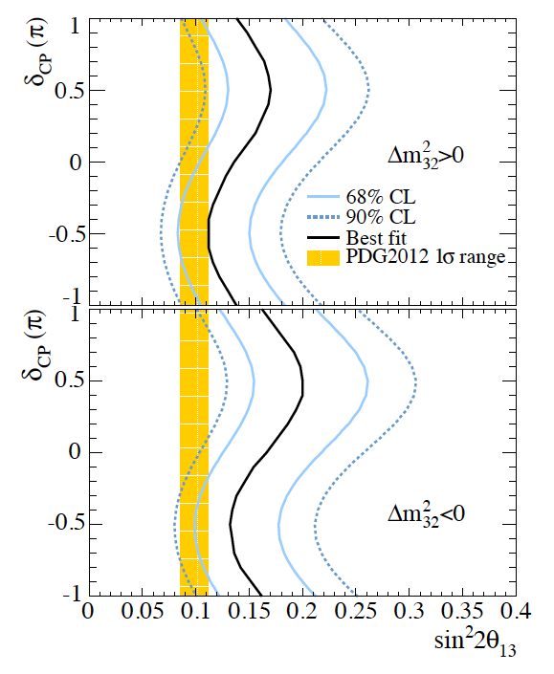
History of neutrino oscillation
Neutrino oscillation is being studied in cosmic and precision frontiers.
Atmospheric ν oscillation at SK (98)
Solar ν oscillation at SK and SNO (01)
Reactor ν at KamLAND (02)
Long baseline accelerator K2K experiment (04)
Tau ν appearance at OPERA (10)
U13 measurement (12)
Electron ν appearance at T2K (13)
(Latest T2K result)
Urgent problems (though I don’t cover in this talk)
Mass hierarchy (m_{ντ} >m_{νe/νμ} or m_{ντ} <m_{νe/νμ} )
CP violation
Majorana or Dirac

Slide 9
Urgency problems in particle physics
(my opinion)
Does deviation of muon (g-2) come from physics beyond the SM?
Is dark matter WIMPs?
Where is physics beyond the standard model? Around TeVs? Is discovered Higgs the SM one?

Slide 10
Does deviation of muon (g-2) come from physics beyond the SM?

Slide 11
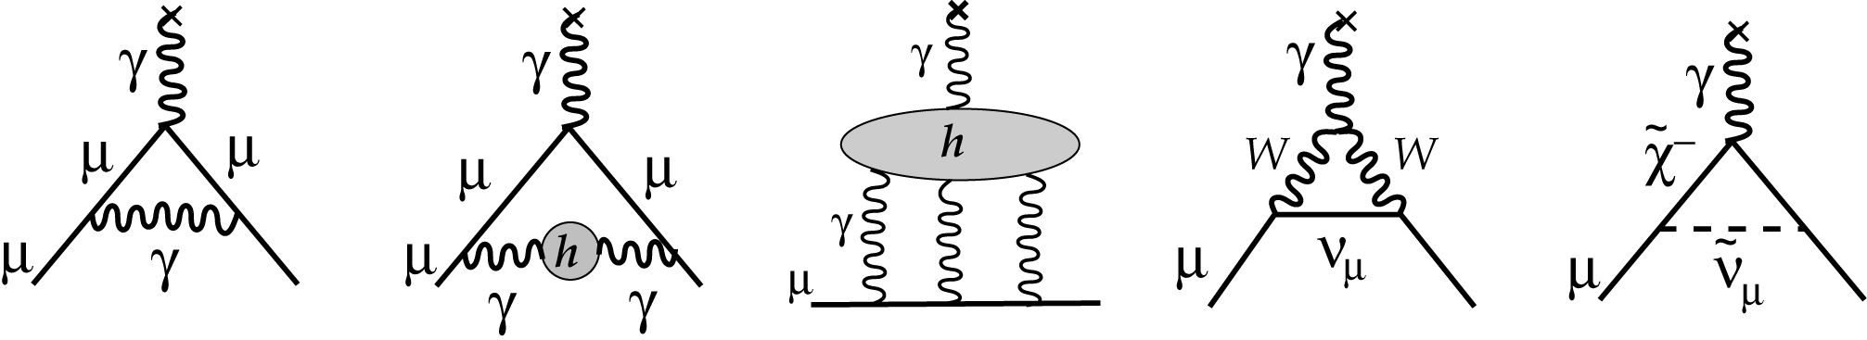
Muon (g-2)
Various contributions to muon (g-2):
QED
Up to 5-loop leading
Kinoshita et al
Hadronic vacuum
polarization (HVP)
Light-by-light
scattering
(LBL)
Electroweak
at two-loop
level
Beyond SM
Experimental value（BNK-E821）

Slide 12
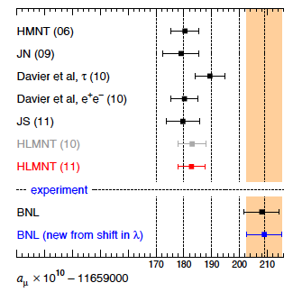
Muon (g-2)
Various contributions to muon (g-2):
QED
Up to 5-loop leading
Kinoshita et al
Hadronic vacuum
polarization (HVP)
Light-by-light
scattering
(LBL)
Electroweak
at two-loop
level
Beyond SM
Deviated from SM predictions with ~3 sigma level.
Experimental value（BNK-E821）
1, SM prediction may be still uncertain? Uncertainties in SM prediction come from HVP and LBL contributions.
2, Measurement is wrong? New experiments at Fermilab and Jparc.
3, New physics ?
(from Nomura-san’s paper)

Slide 13


Hadronic vacuum polarization （HVP)
HVP can be evaluated from R ratio using dispersion relation.
R ratio
Recent values of HVP (at leading order)：
(Hagiwara et al, 11)
(Davier al, 10)
(Jegerlehner and Szafran, 11)
→ SuperKEKB

Slide 14
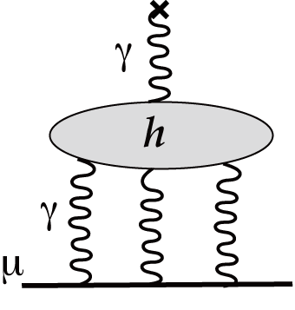
Light-by-light scattering（LBL)
No way to evaluate LBL from observables, no way to calculate it directly from QCD. We need to rely on “models”.
Glasgow consensus
Approach by Lattice QCD+QED is proposed by Hayakawa-san et al on 08, and the preliminary result for test of the calculation was done on 12.

Slide 15
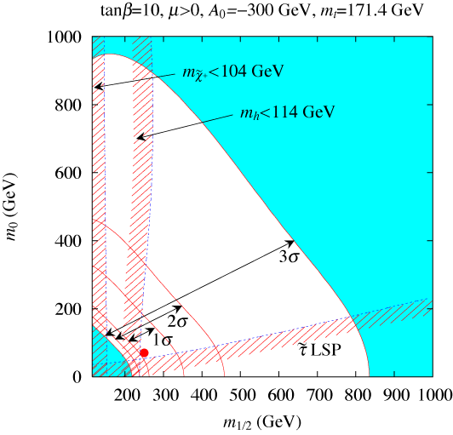
Muon g-2
Contribution from SUSY SM:
Since SUSY SM has two Higgs doublets, muon g-2 has a contribution proportional to .
CMSSM (Constrained MSSM) has been constrained by null results in SUSY searches at LHC. If we give up the GUT relation, we may get light EW SUSY particles, while squarks and gluino are heavy enough.
M_{sq}<2TeV
M_{sq}<1TeV
(Hagiwara et al, 06)

Slide 16
Is dark matter WIMPs?

Slide 17
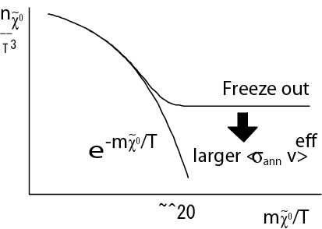
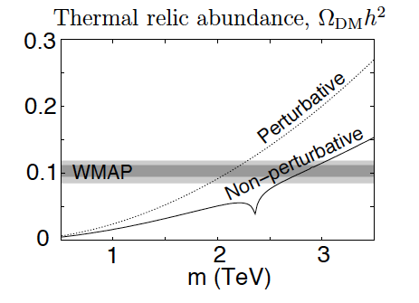
WIMPs
Weakly-Interacting Massive Particles (WIMPs): Candidates of DM
Thermal DM production hypothesis：
Decoupling temperature 〜ｍ/20.
“WIMP Miracle !”
ElecroWeak-interacting Massive particles (E-WIMPs)
Under thermal DM production hypothesis, WIMP mass is larger than O(1)TeV.
(SU(2) triplet and doublet, called as Wino and Higgsino in SUSY SM, have masses about 3 and 1 TeV, respectively.)
SU(2) triplet “wino”

Slide 18
WIMP searches
Direct production at LHC
Direct detection on the earth
Searches for signature of WIMP annihilation in cosmic rays (gamma rays, anti-particles, neutrinos) , CMB and so on.

Slide 19
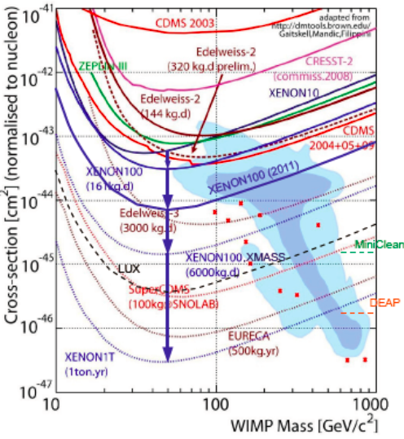
Direct detection on the earth
Experiments detect recoiled nuclei with keV kinetic energy. Ton-scale next-generation detectors will cover σv~ 10⁻⁽⁴⁶⁻⁴⁷⁾cm^{2.}
Talk by Overlack (2011)
M=60GeV

Slide 20
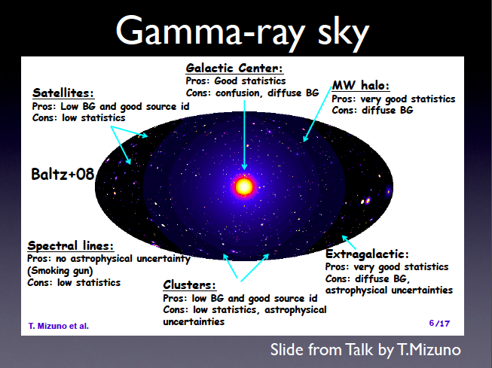
Gamma rays

Slide 21
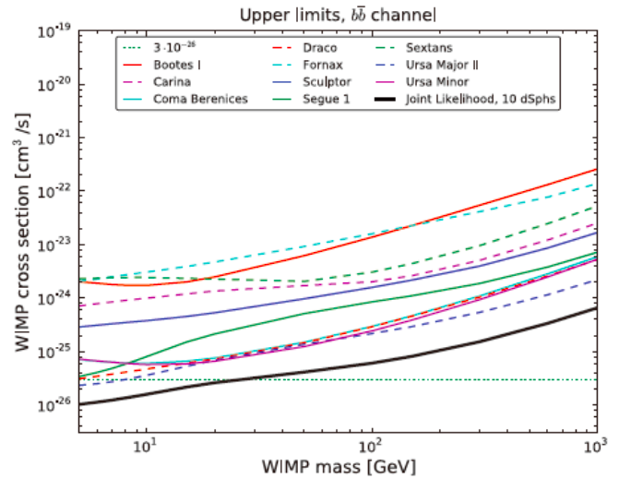
Gamma rays from Dwarf Spheroidals
Combined upperbound
on cross section.
Thermal DM production

Slide 22

Line gamma rays (smoking gun)
Line gamma rays are smaking gun of WIMPs.
The Gamma rays comes from loop diagrams, and then the annihilation cross section is suppressed compared with tree level processes.

Slide 23
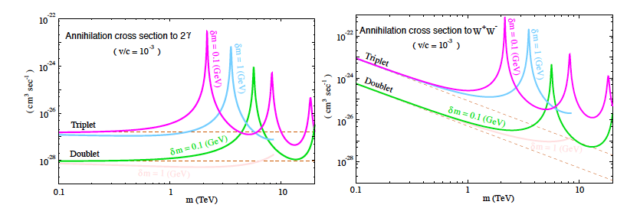
Line gamma rays (smoking gun)
When E-WIMP mass is larger than O(1) TeV, pair annihilation of E-WIMPs is enhanced by non-perturbative Sommerfeld effect since they have SU(2) gauge interaction.
Cross section to line gamma rays becomes comparable to those of tree-level processes (such as annihilation to WW).
(JH, Nojiri, and Matsumoto)

Slide 24
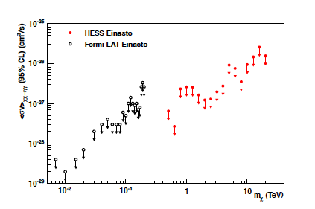
Line gamma rays from GC
HESS and FERMI give constraints on flux of line gamma rays from galactic center. Even heavier WIMPs than O(1) TeV can be constrained.
FERMI
HESS

Slide 25
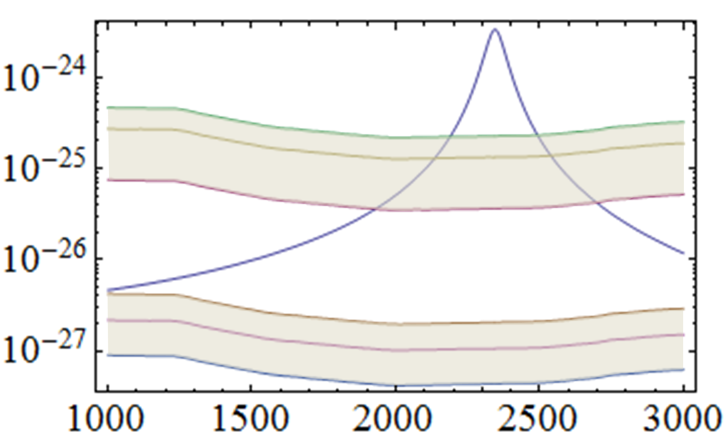
Line gamma rays from GC
SU(2) triplet fermion, wino, is constrained from line gamma rays from GC with even too heavy mass to be access at LHC. The constraint depends on DM density profile at GC.
Sensitivities will be improved at CTA.
Thermal DM
Production
Hypothesis regon
<σv>(2 γs) (cm³/s)
Scaled upperbound (Burkert DM profile)
HESS Upperbound (NFW DM profile)
Wino mass (GeV)
(Figure from Matsumoto-san)

Slide 26
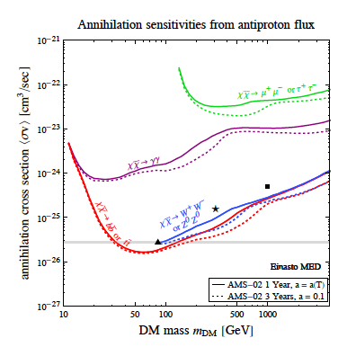
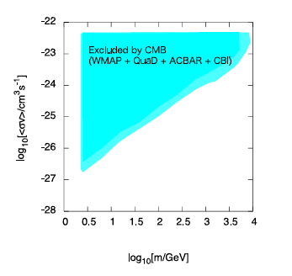
Other bounds
CMB anisotropy with DM annihilation effect
(Cirelli and Giesen)
)
(Kanzaki, Nakayama, Kawasaki)

Slide 27
Where is physics beyond the standard model? Around TeVs? Is discovered Higgs the SM one?

Slide 28
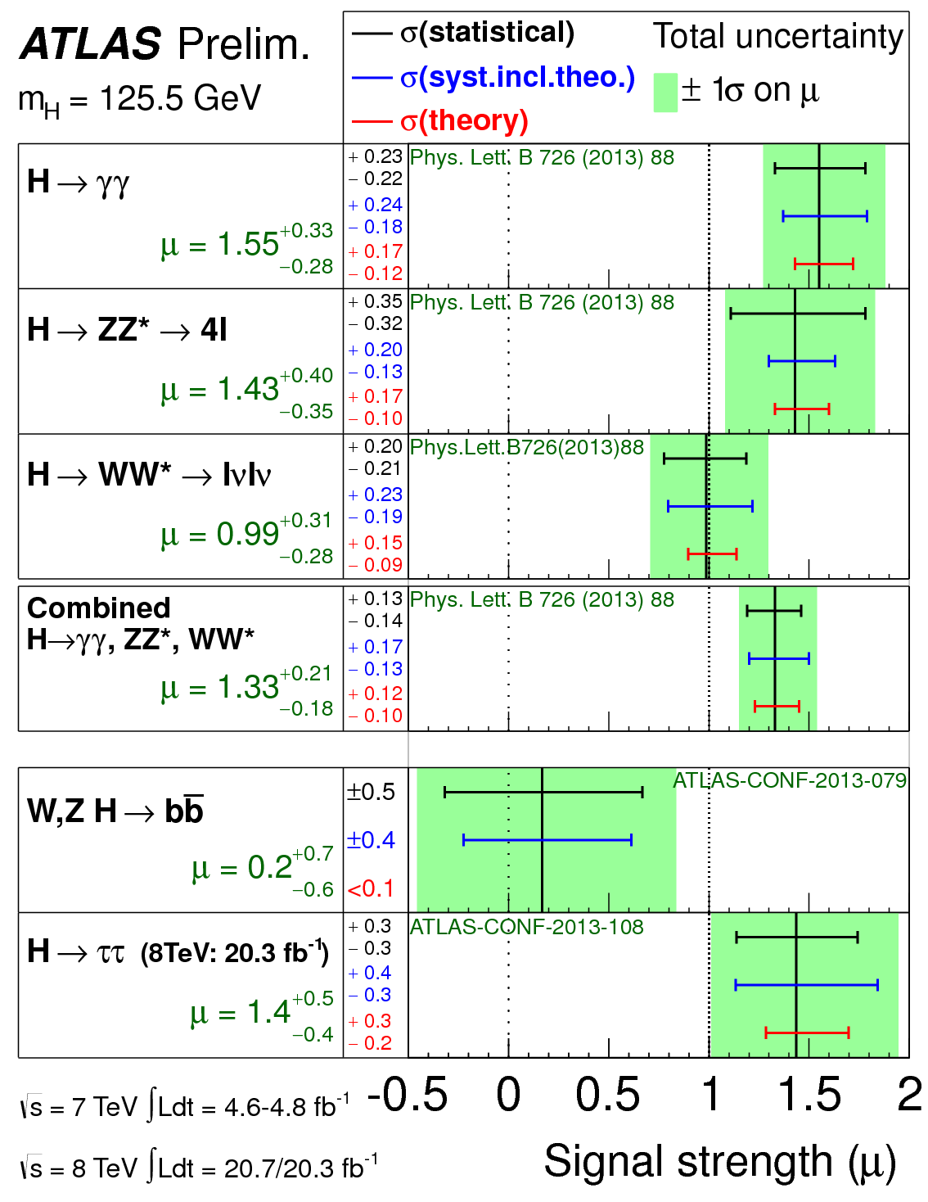
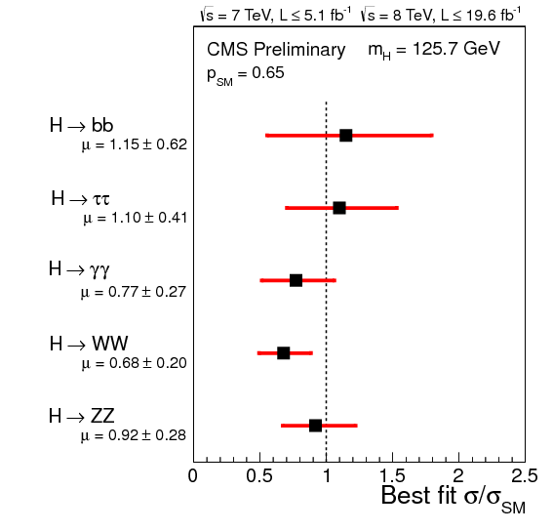
Is discovered Higgs boson the SM one?
Higgs boson is a new window to BSM.

Slide 29
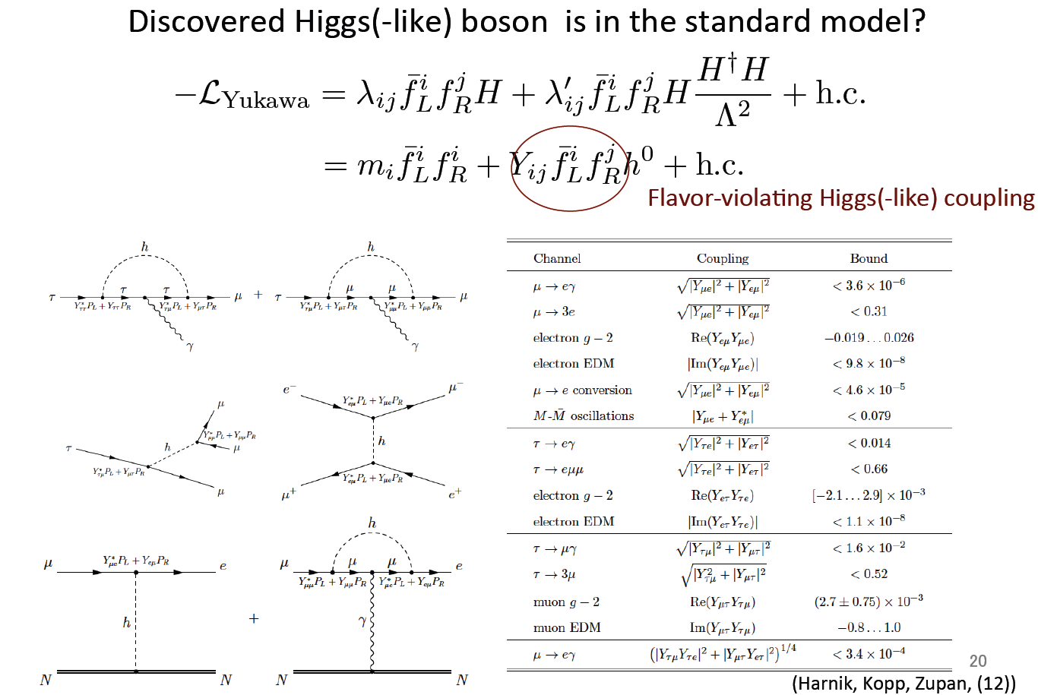
Does Higgs boson have lepton-flavor-violating coupling?

Slide 30
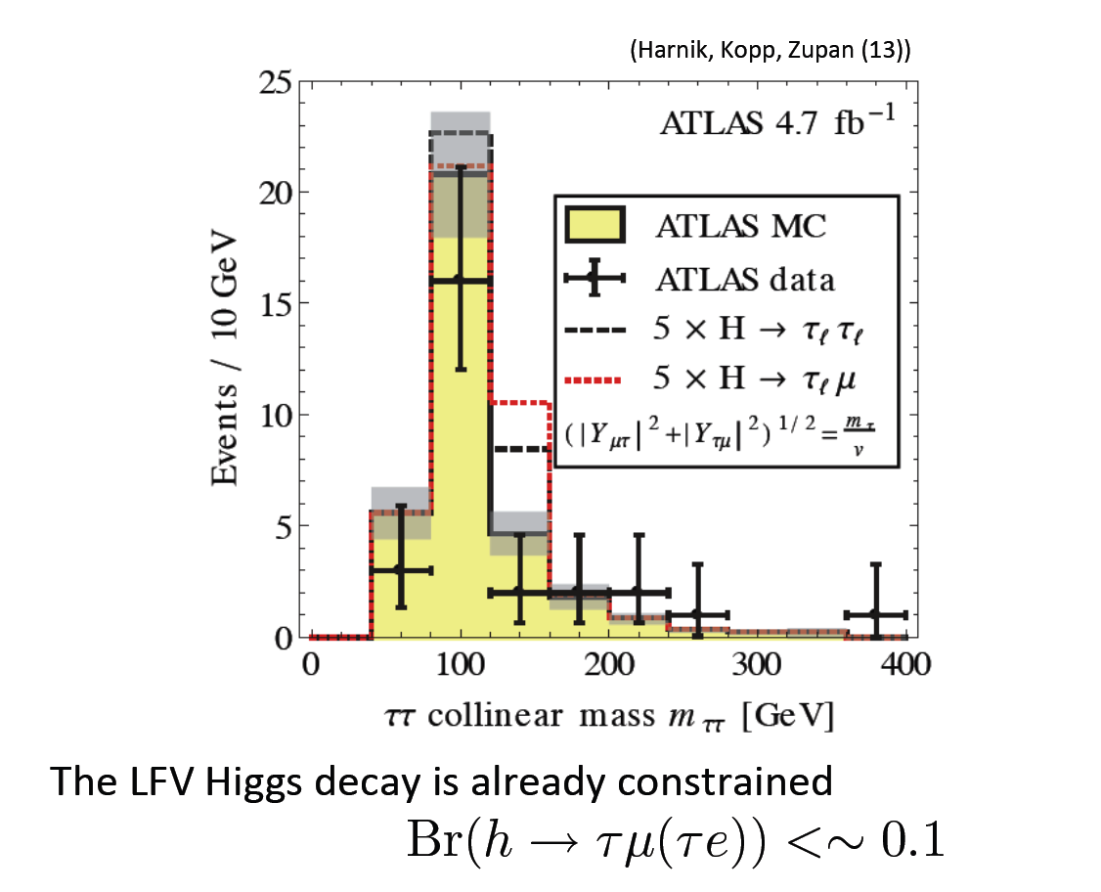
Does Higgs boson have
lepton-flavor-violating coupling?

Slide 31
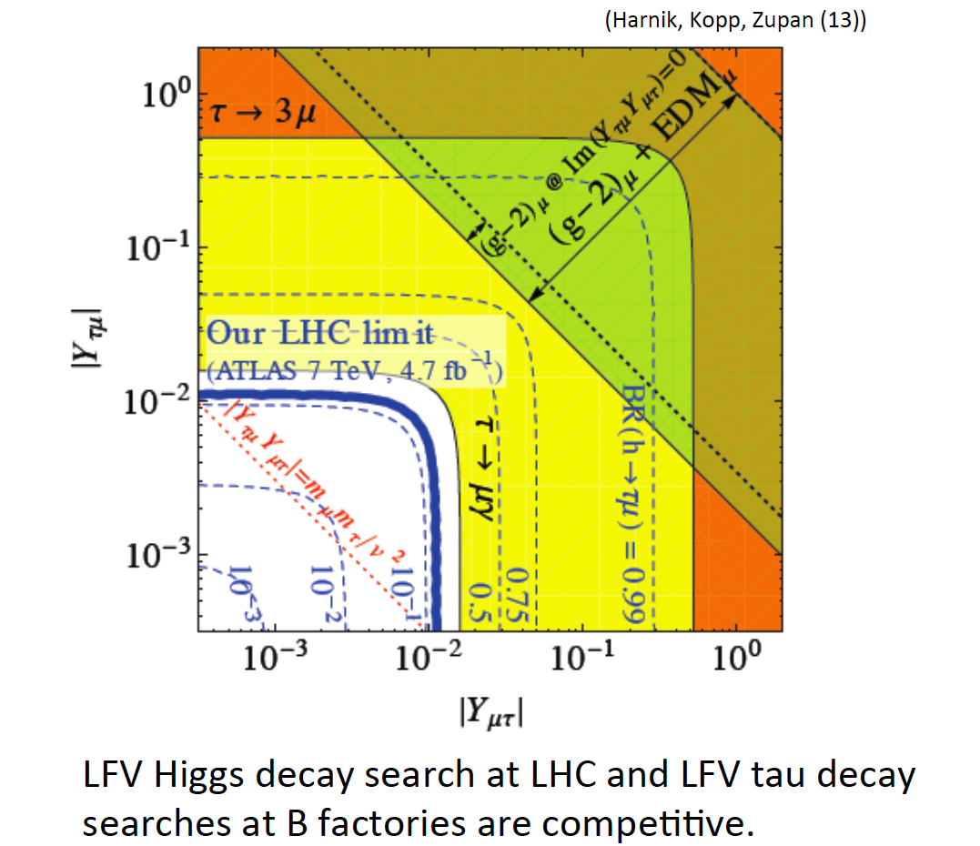
Does Higgs boson have
lepton-flavor-violating coupling?

Slide 32
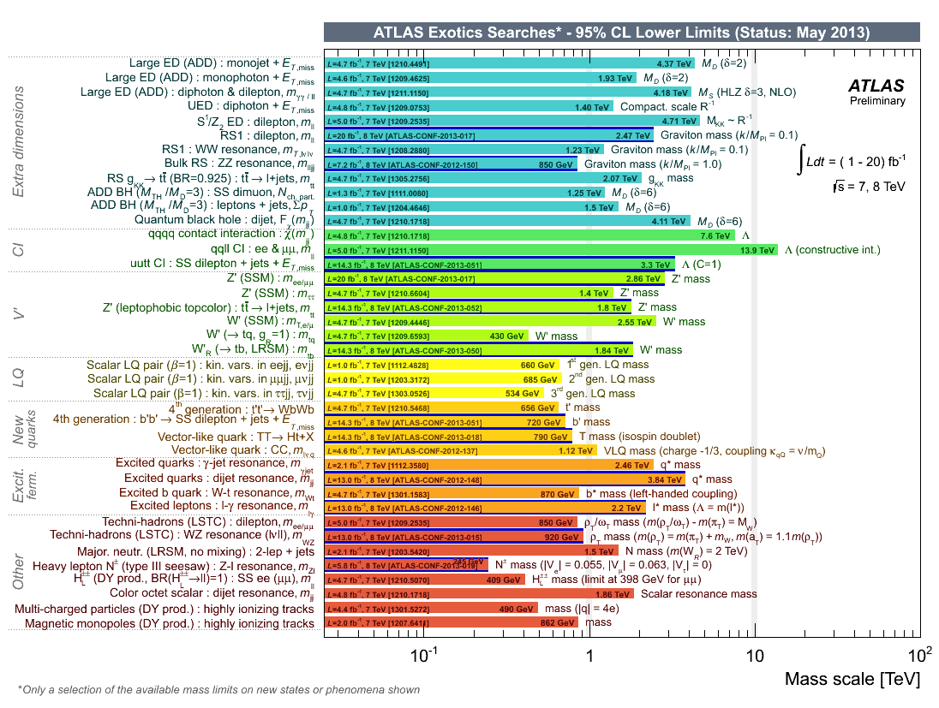
LHC may discover BSM below a few TeV....
Precision frontier physics sensitive to higher scale is complimentary to energy frontier.

Slide 33
Electric Dipole Moments (EDMs)
Upper bounds on electron and neutron EDMs:
|d_{e}|<1.4×10⁻²⁷ e cm (→8.7×10⁻²⁹ e cm, ACME(13))
|d_{n}|<3.3×10⁻²⁶ e cm
Dimensional analysis for fermionic EDM:
(In renormalization theories, EDMs are suppressed by loop factors (~O(10⁻⁽²⁻⁴⁾)). )
EDMs have a great potential to search for physics beyond the SM.

Slide 34
EDMs from BSM
Assuming maximal CP phase, one-loop diagrams for EDMs give strong constraint to new-physics below the TeV scale, and even two-loop diagrams can also constrain new physics around O(100-1000) GeV scale.

Slide 35
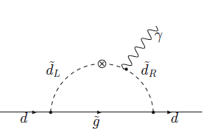
Supersymmetric standard model
SUSY SM is a leading candidate for BSM. Many SUSY breaking parameters introduced there are complex so that EDMs are predicted. One-loop diagrams of SUSY particles generate EDMs. Assuming maximal CP violation,

Slide 36
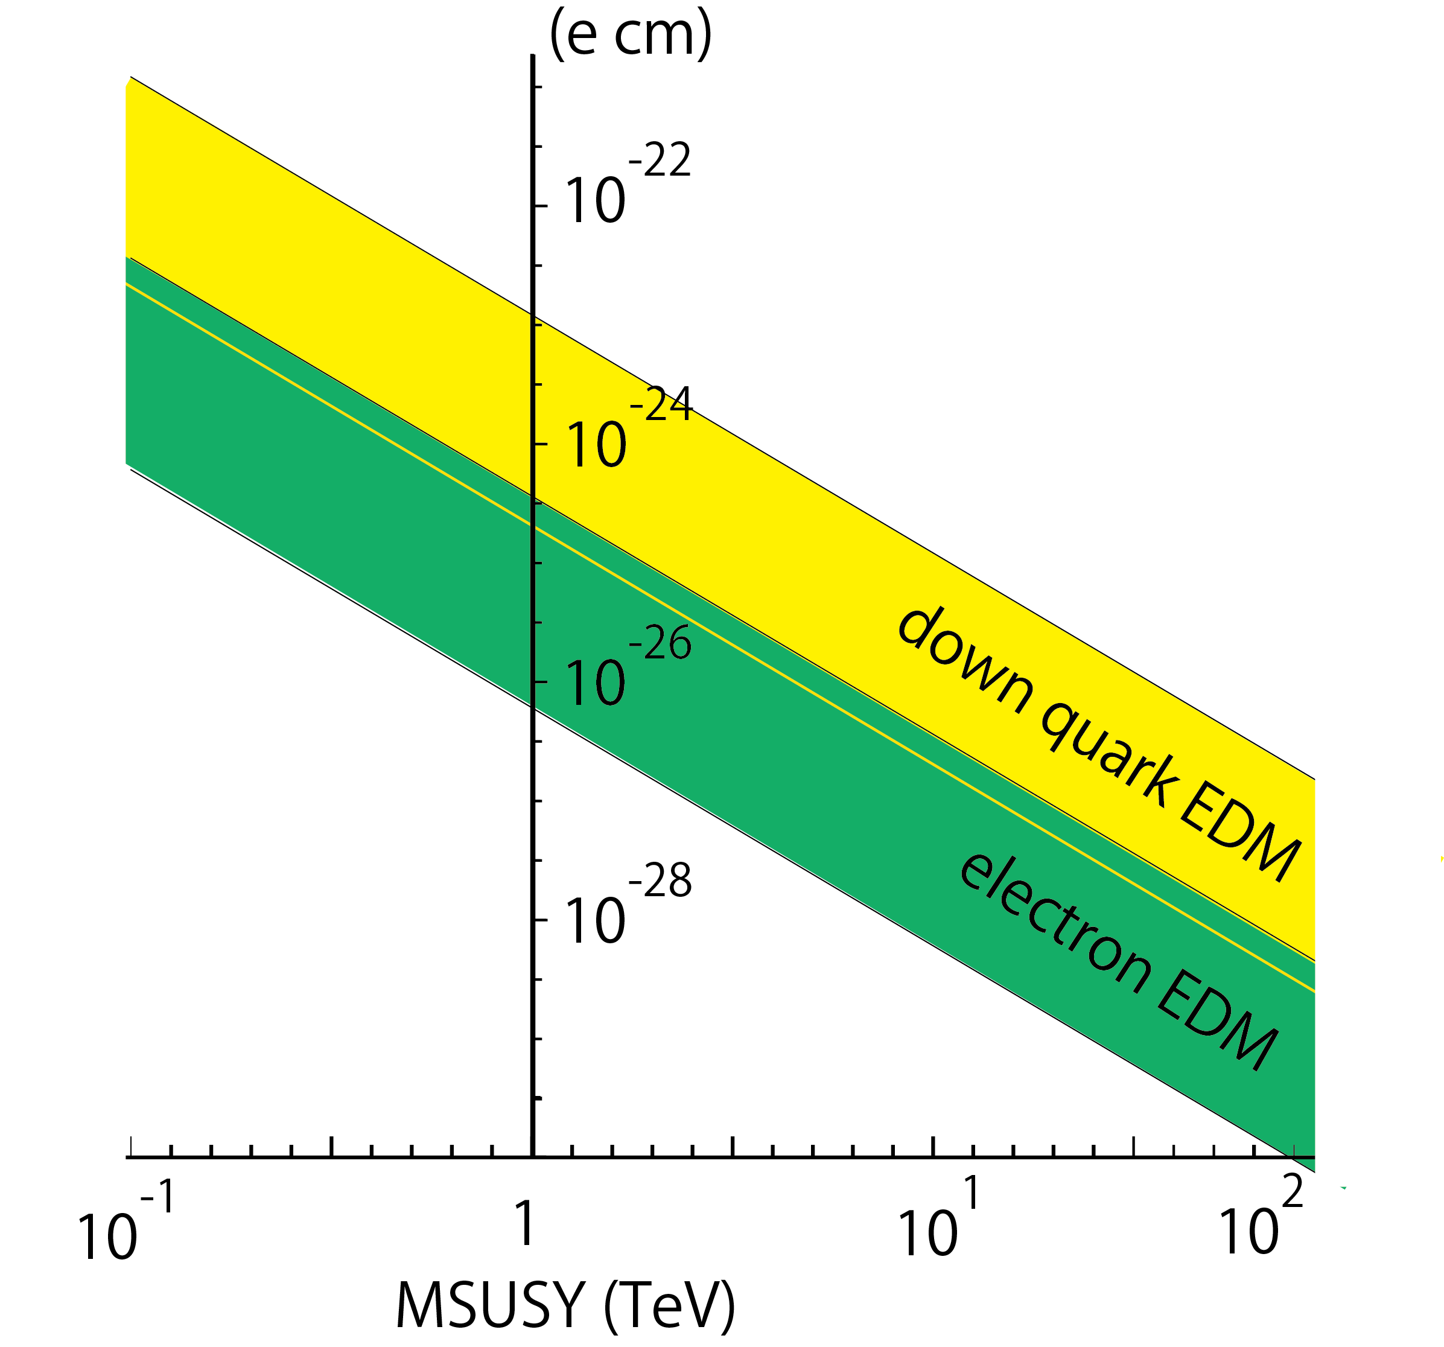
Supersymmetric standard model
SUSY SM is a leading candidate for BSM. Many SUSY breaking parameters introduced there are complex so that EDMs are predicted. One-loop diagrams of SUSY particles generate (C)EDMs. Assuming maximal CP violation,
Neutron EDM
Electron EDM

Slide 37
Supersymmetric standard model with flavor violation
When both left-handed and right-handed squarks/sleptons have flavor violation, the relative phase contribute to EDMs. EDMs are enhanced by heavier fermion mass.
(Fuyuto, JH, Nagata,
Tsumura.)

Slide 38
Higgs-mediated Barr-Zee diagrams to EDMs
new
particles
t, b, τ
Higgs
Higgs
Higgs
When Higgs boson has CP-violating coupling with SM particles or new particles, the Barr-Zee diagrams at two-loop level generate EDMs for quarks and leptons.
We may get a clue for questions,” Higgs boson is CP even ?”, “Higgs boson is only one ?”, ”Higgs boson has coupling with new particles ?”.

Slide 39
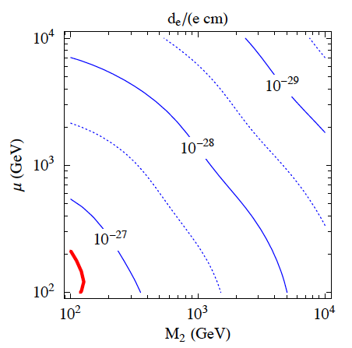
New physics contribution to EDMs via Higgs
SU(2) triplet and doublet fermions coupled with Higgs
(dark matter particles in Split SUSY model)
doublet fermion mass
|d_{e}|<8.7×10⁻²⁹ e cm (ACME)
Triplet fermion mass
New charged fermions coupled with higgs contriute to h→γγ, deviation of Br(h→γγ） from SM should be small if CP phase is O(1) there.

Slide 40

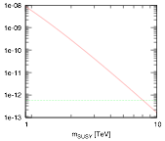









Precision tests in FCNC processes
Lepton-flavor-violating muon decay
Latest MEG experiment bound:
SUSY contributions
current bound
μ→eγ is sensitive to slepton ~ 10 TeV.
(Figures from Shimizu-san)

Slide 41
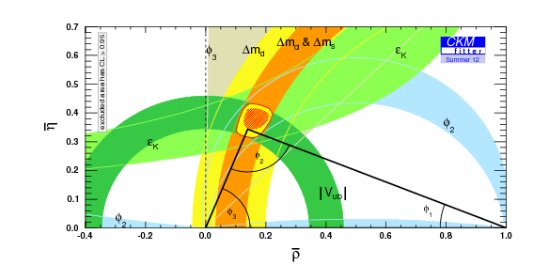
Precision tests in FCNC processes
Unitarity of the CKM matrix
It seems that no room for SUSY contributions.

Slide 42
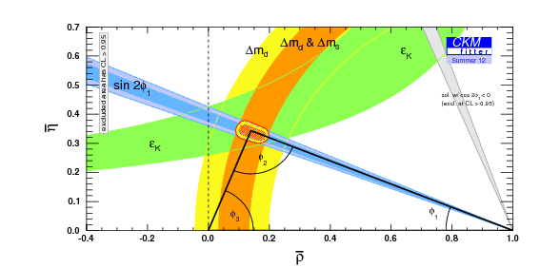

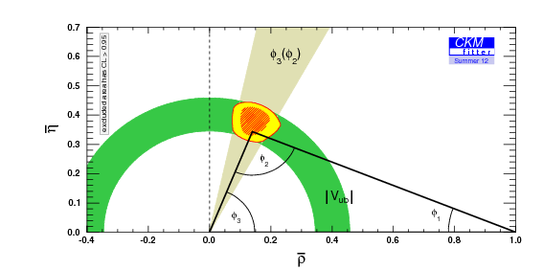

Precision tests in FCNC processes
UT from the loop processes
New physics contributions may be sizable.
UT from the tree processes
New physics contributions may be
negligible.

Slide 43
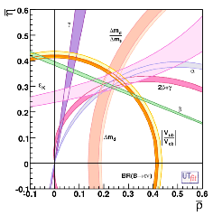
Precision tests in FCNC processes
Expectation in Super B factory experiments
tree
Hadronic uncertainties are assumed to be O(1)% by the future lattice calculations.
loop
Tree and loop favored regions may not have overlap at future experiment.

Slide 44
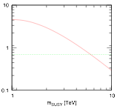

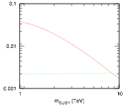


SUSY SM at 10 TeV may give sizable contribution to B, K mixings.
experimental value
experimental value
(Figures from Shimizu-san)

Slide 45
Summary of talk
We have to derive answer for muon (g-2) and WIMP DM, BSM around TeVs, and we need to study them from various directions in energy, precision, and cosmic frontiers.
Energy Frontier
Direct search for new particles
Measurement of Higgs boson
Beyond
the SM
Precision Frontier
Cosmic Frontier
Muon g-2
hadron and lepton FCNCs
EDMs
Direct and indirect
WIMP searches.

Slide 47
backup

Slide 48
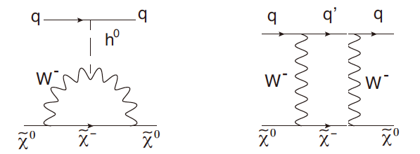
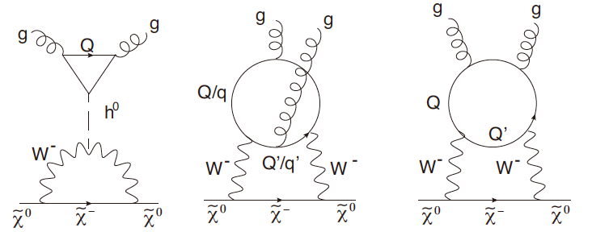
Direct detection of E-WIMPs
While scattering of E-WIMP with nucleon is a loop process, the cross section is not suppressed by the E-WIMP mass, and σv~ 10⁻⁽⁴⁶⁻⁴⁷⁾cm².
(JH, Ishiwata, Nagata)

Slide 49
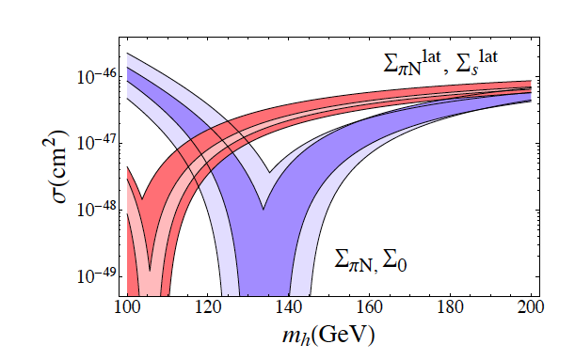
Wino direct detection
125 GeV
Higgs mass
(QCD lattice)
(chiral langrangian)
(Solon and Hill)
More reliable evaluation of matrix element and also higher order correction are required.

Slide 50
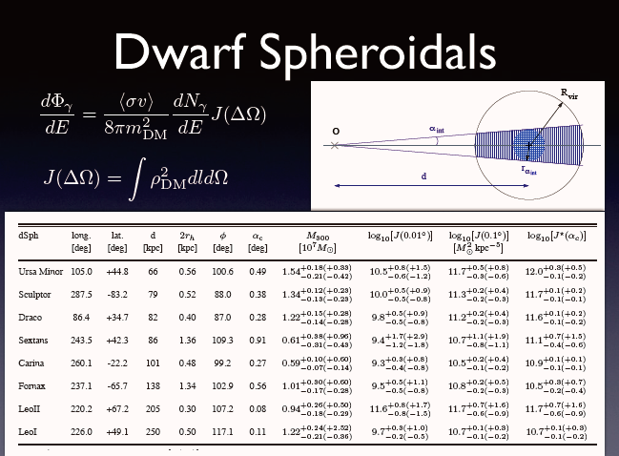

Slide 51
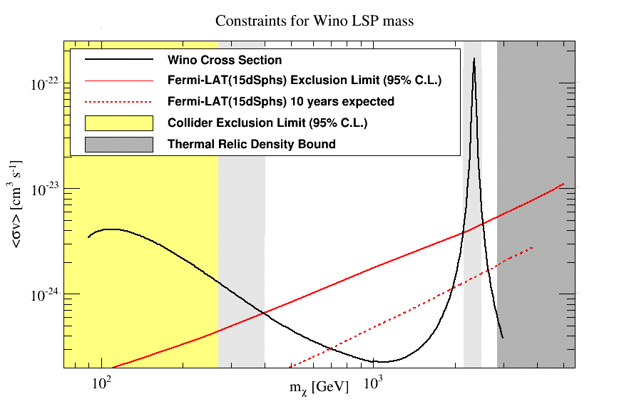
Constraints on wino from FERMI
(figure from Matsumoto-san)

Slide 52
The standard model in particle physics
Building blocks
SU(3)×SU(2)×U(1)
gauge theories
3 generations
of quarks and leptons
Higgs mechanism
for orgin of mass

Slide 53
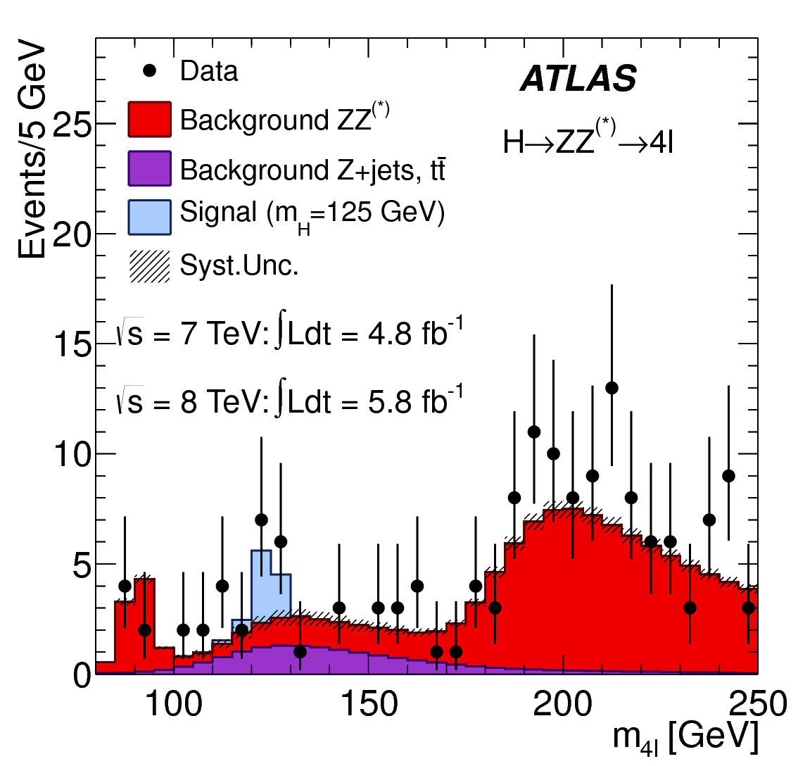
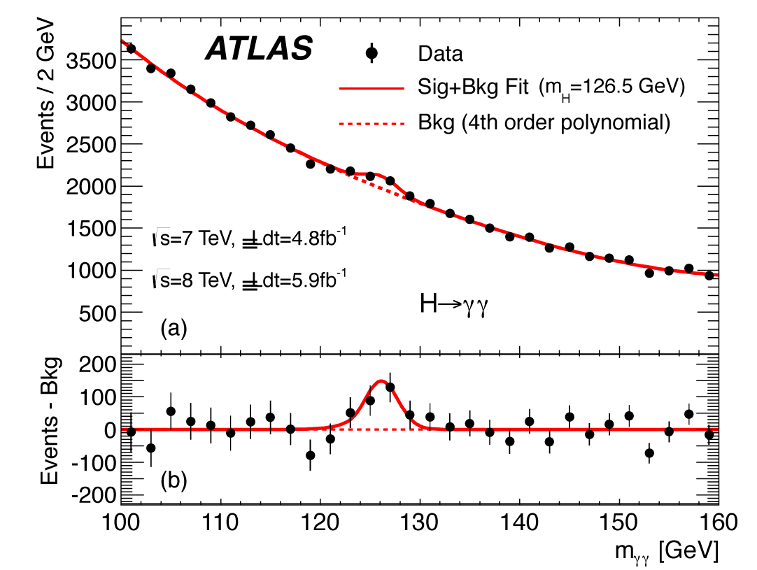
Victory of the standard model
- Discovery of Higgs boson -
On Junly 4th 2012, the Higgs boson with mass 125-126 GeV was discovered at ATLAS and CMS experiments.

