Slide 1


Formation and Evolution of Black Holes in Cosmic Backgrounds
Günther Hasinger
Institute for Astronomy
University of Hawaii
KMI2013 International Symposium
KMI Institute, Nagoya University
December 12, 2013

Slide 2
Resolving the X-ray Background

Slide 3
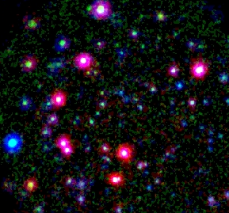
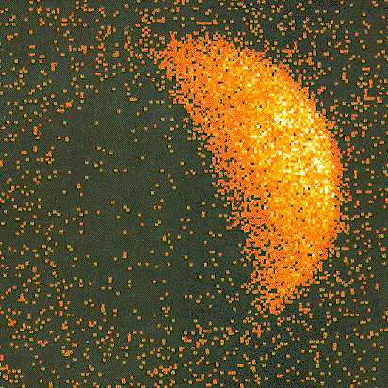
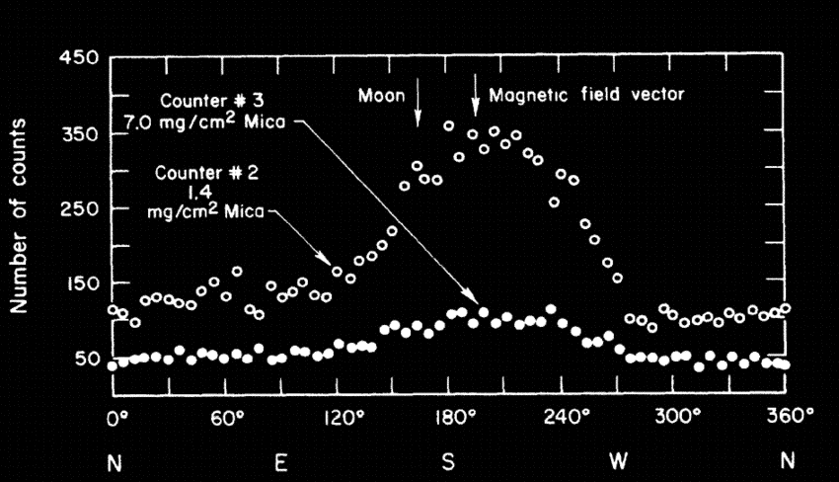
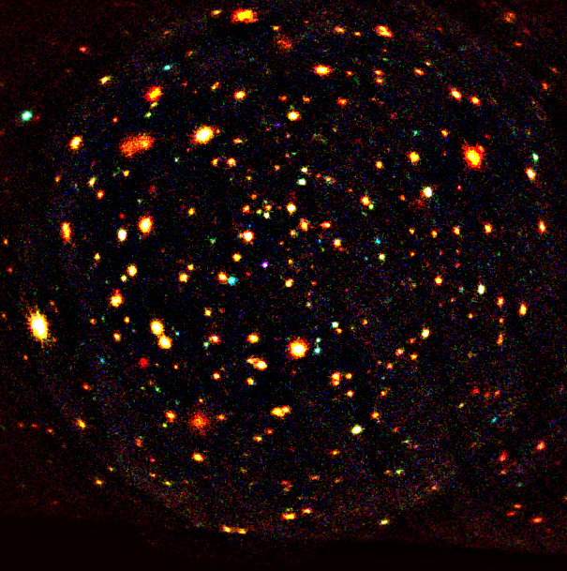
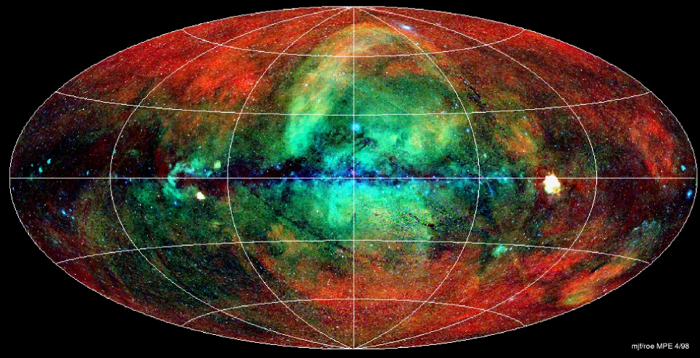
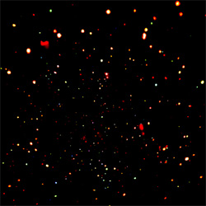
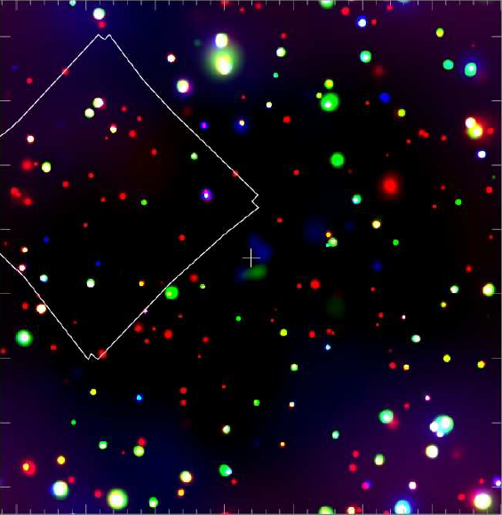
The X-ray background
ROSAT 1998
ROSAT 1991
Giacconi 1962
XMM-Newton 2001
ROSAT 1998
The background is resolved as the echo of the formation and growth of supermassive black holes over the whole cosmic history.
Chandra 2011
Chandra 2003

Slide 4
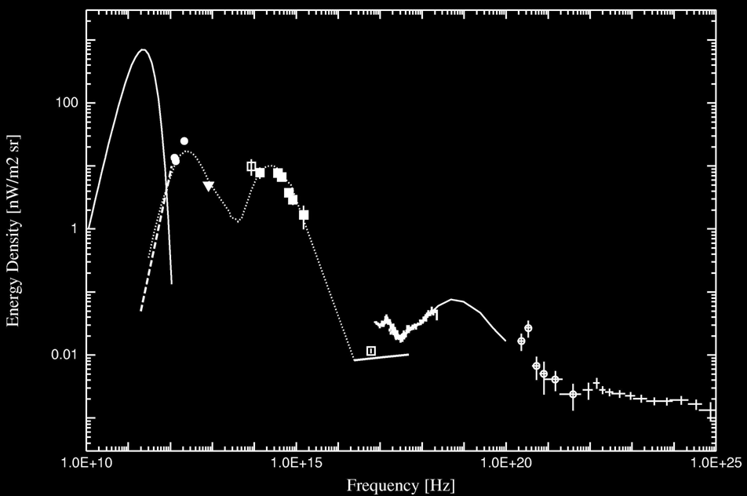
AGN and the Extragalactic Background Light
AGN make about 10% of the CIB
90% of the XRB
▲
▲
▲
▲
▲
▲
▲
H.E.S.S. upper limits
▲
▲
▲
▲
▲
▲
▲
▲
▲
▲
Intensity [nW m⁻² sr⁻¹]
Spitzer / HST
▲
ROSAT Galactic/WHIM
Galactic
Gamma bkg
Spitzer AGN
Treister et al.06
New EGRET bkg
(Strong et al., 04)
ROSAT/XMM/
Chandra
(Worsley et al.)
Sy2 SED
(Sturm et al. 06)
▲
RXTE
(Revnivtsev et al.)
Frequency [Hz]
EGRET resolved

Slide 5
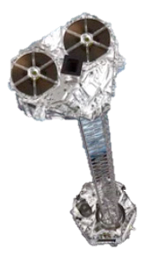
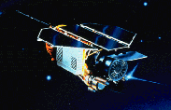
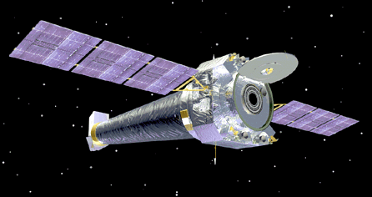
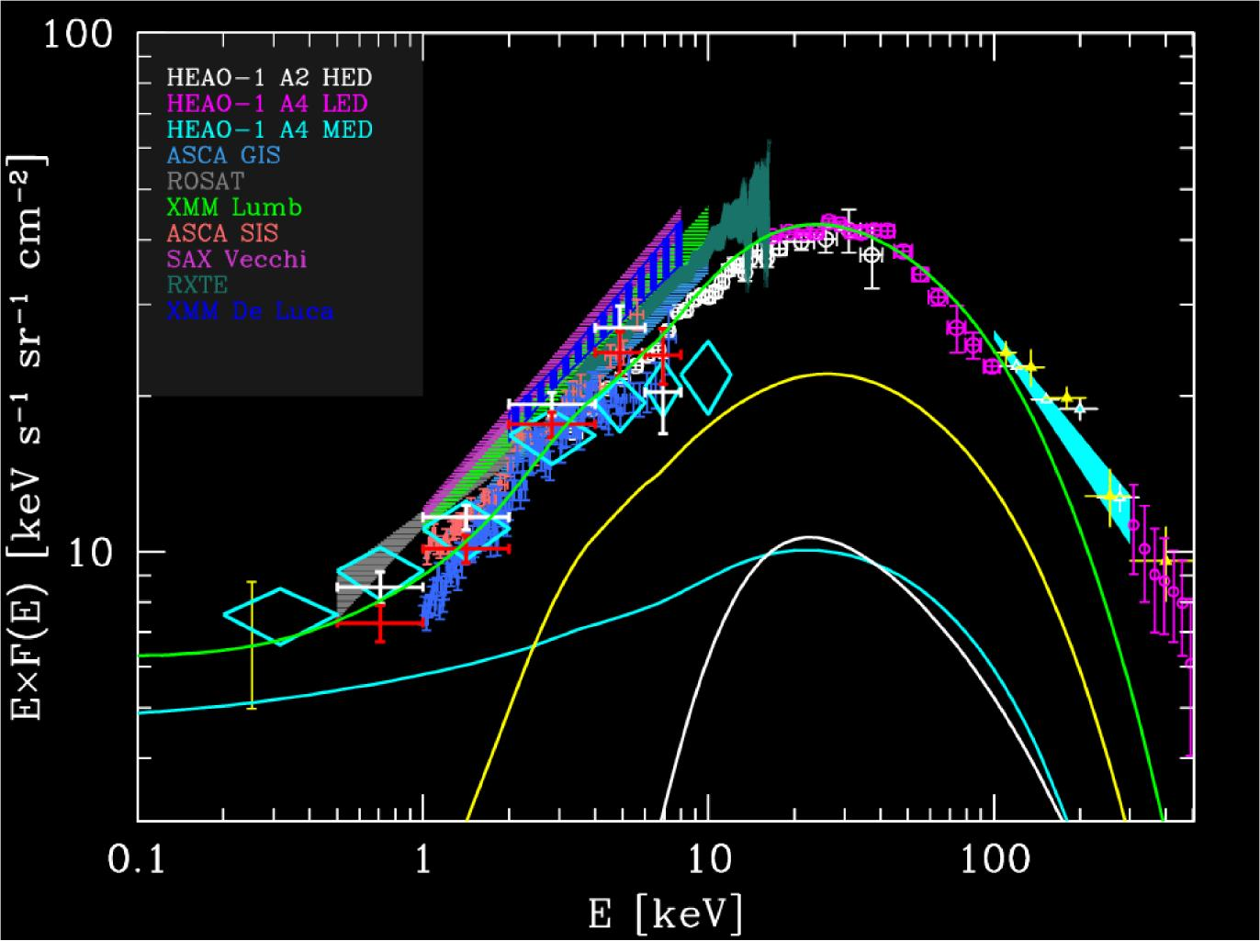


AGNs and the cosmic X-ray background
XMM-Newton
Chandra
Nustar
Astro-H
ROSAT
total
BAT Ajello
obscured
C-thick
obscured
C-thin
unobscured
Gilli, Comastri & G.H., 2007

Slide 6
Cosmic Evolution of AGN

Slide 7
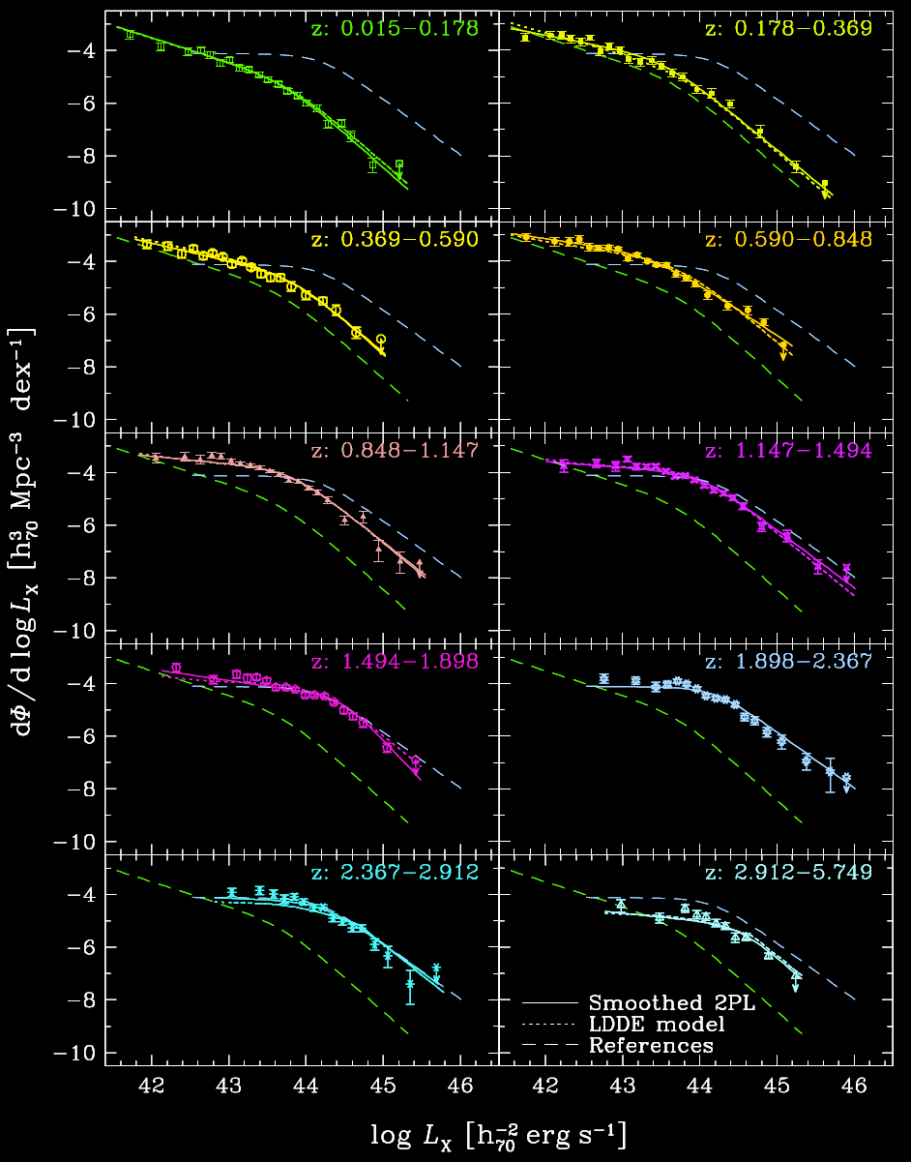
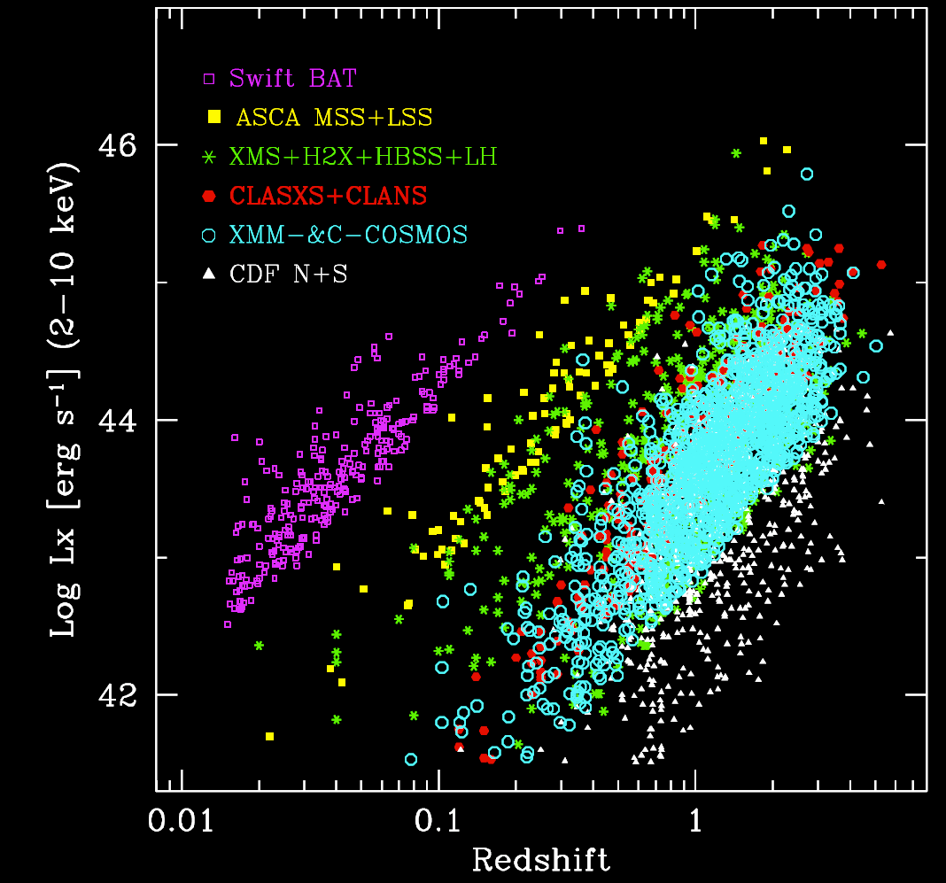
AGN X-ray Luminosity Function
4000 AGN with redshifts from many different samples. Fit with Luminosity-dependent density evolution (LDDE) model
Miyaji et al., 2013

Slide 8
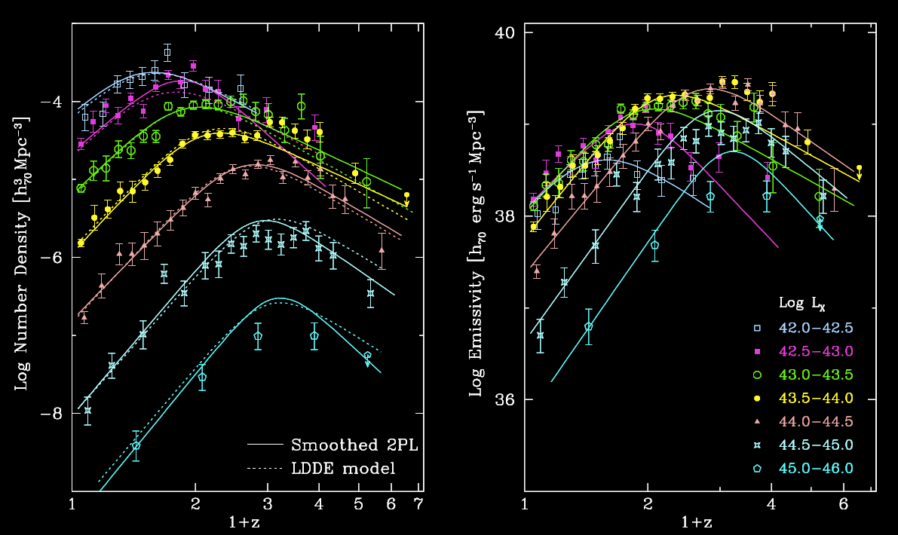
AGN Space density vs. redshift
Space Density Luminosity Density
Ueda et al., 2013
Total
Bouwens et al., 2011
Star Formation Rate
AGN Downsizing similar to galaxy downsizing!
BH growth similar to star formation history
Miyaji et al., 2013

Slide 9
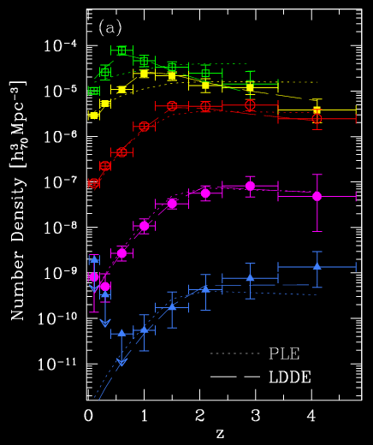
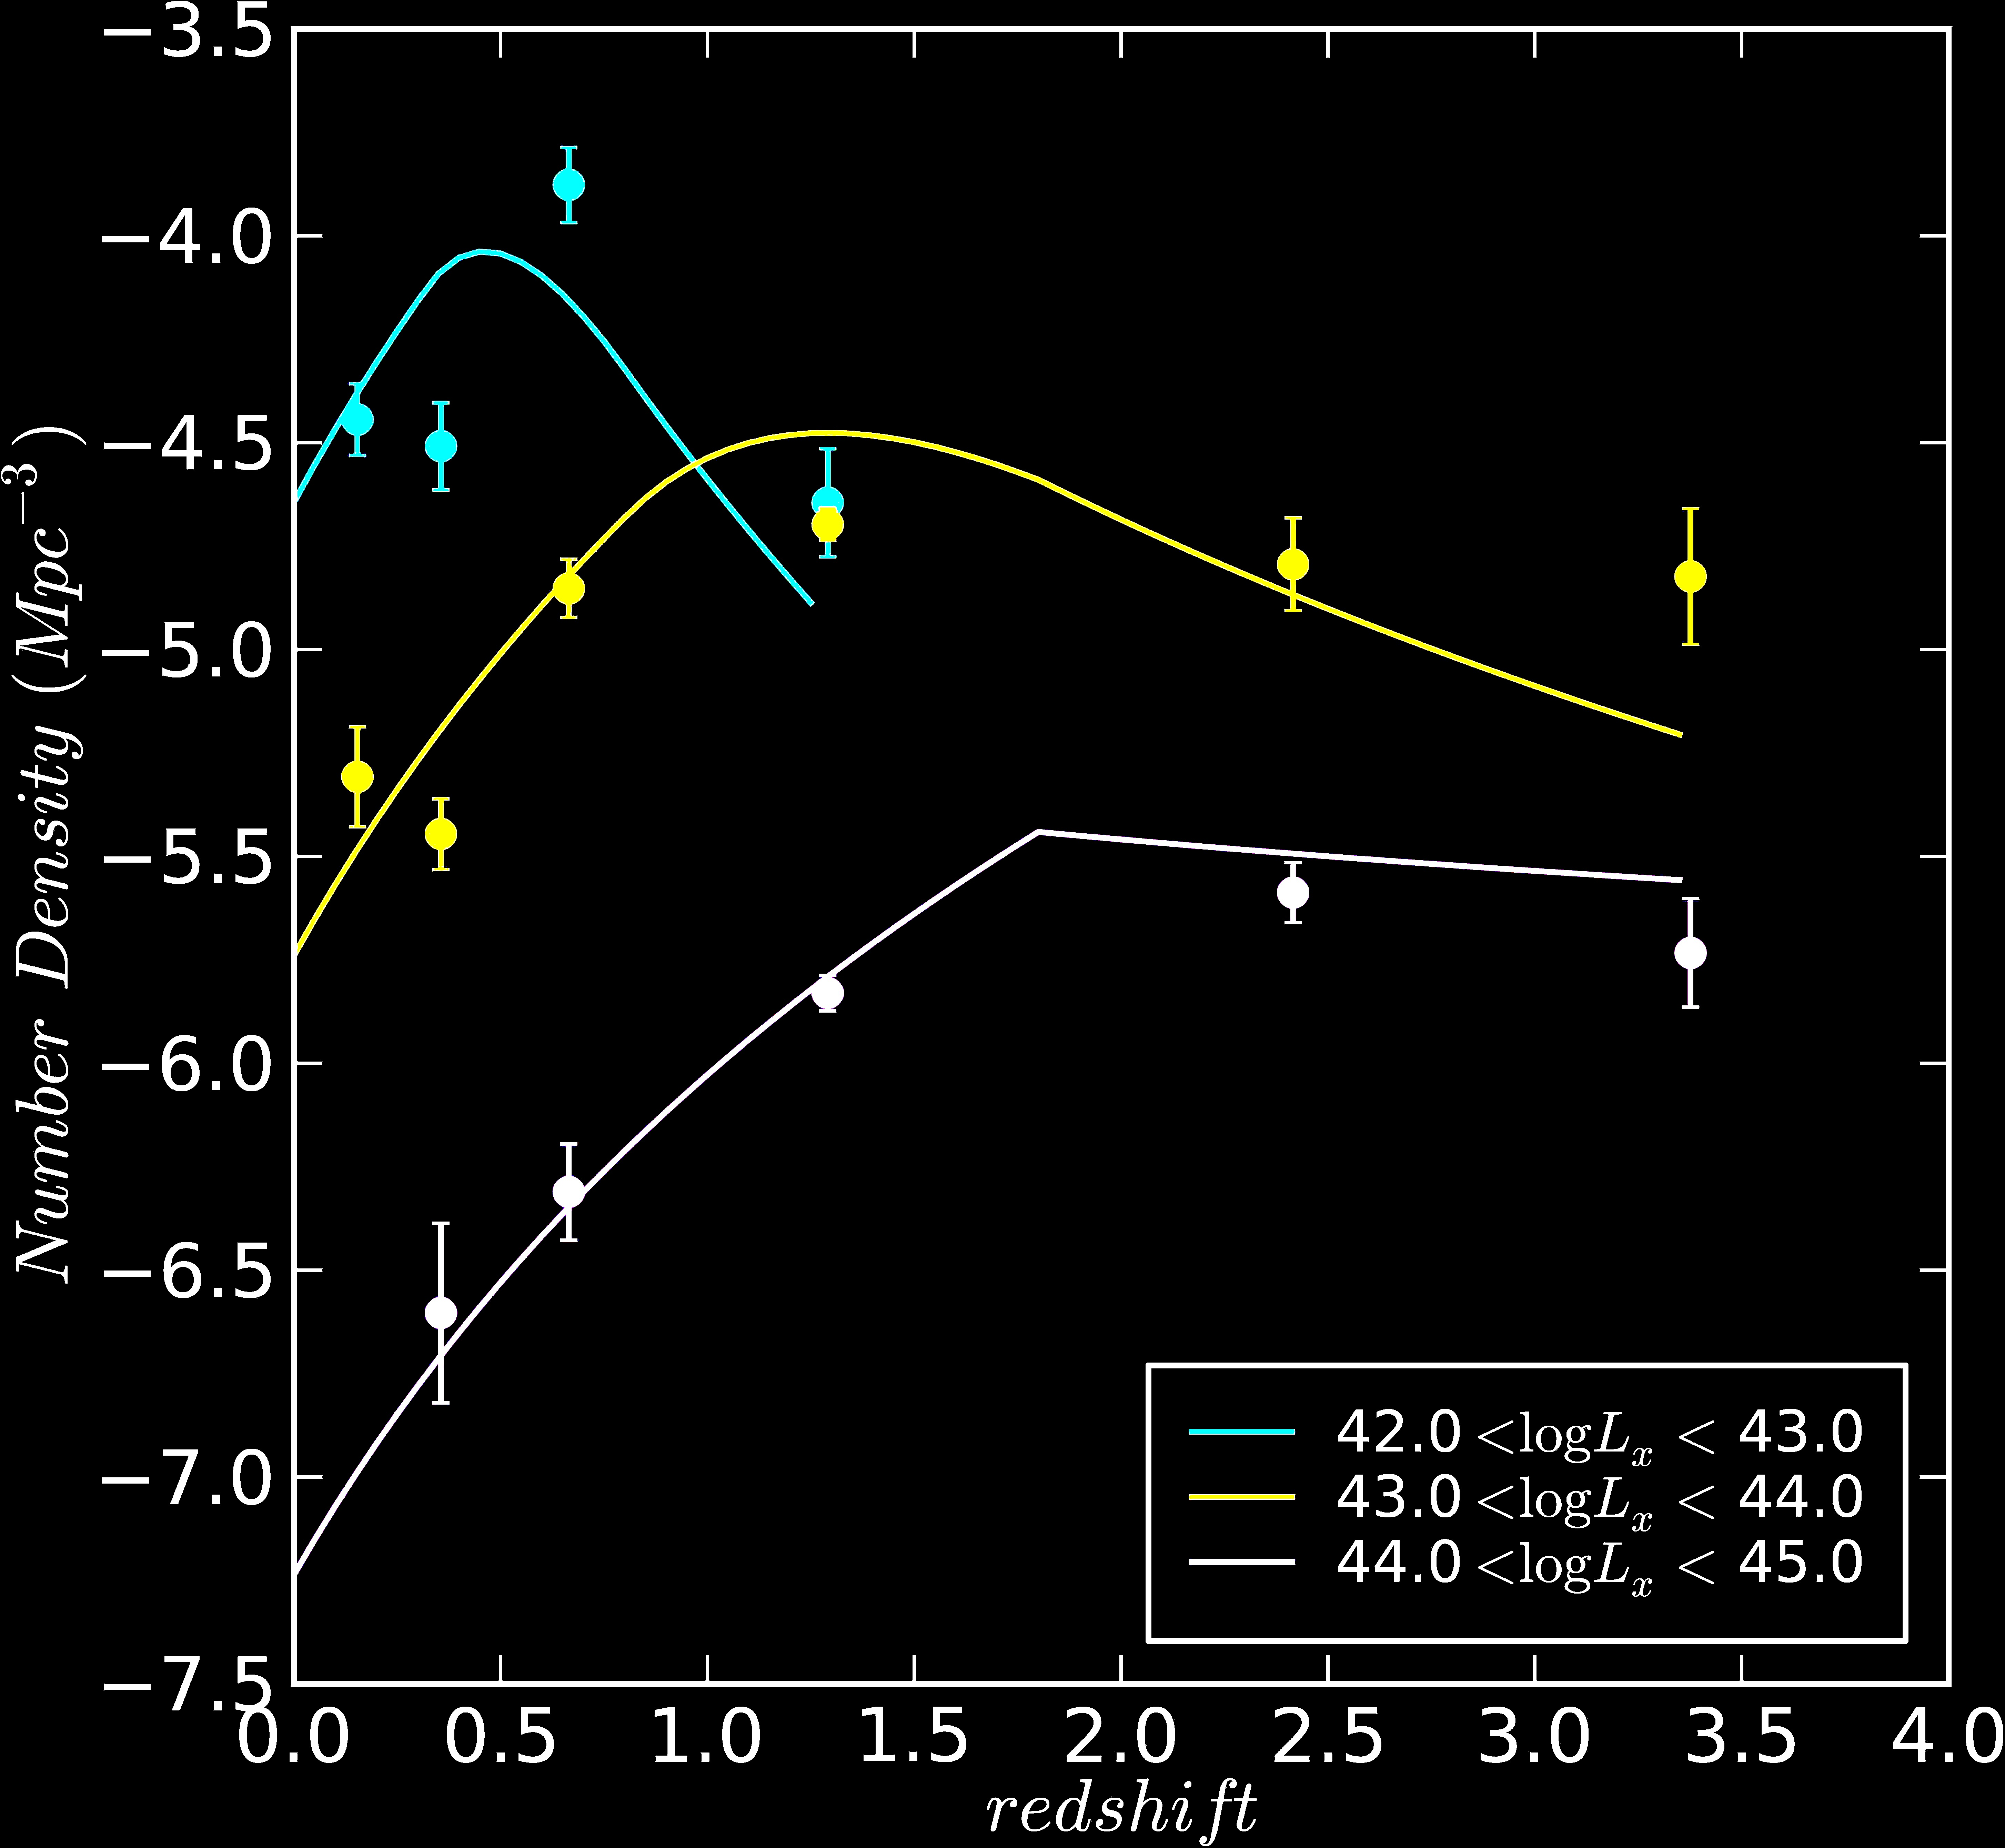
AGN Downsizing Evolution
0.5-2 keV 2-10 keV 5-10 keV
G.H., Miyaji, Schmidt 2005 Miyaji et al., 2013 Fotoupolou et al., 2011
Same “anti-hierarchical” downsizing evolution found in all bands,
also in the optical, MIR and radio bands

Slide 10
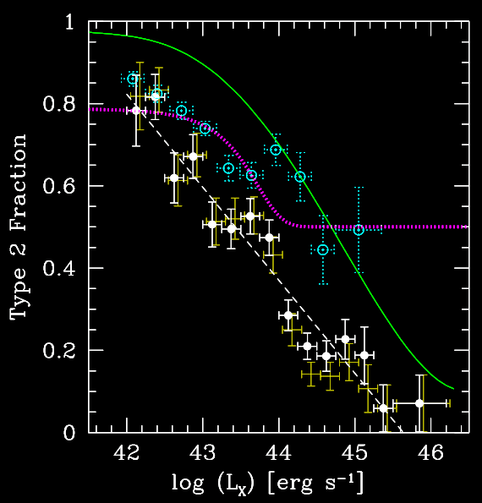
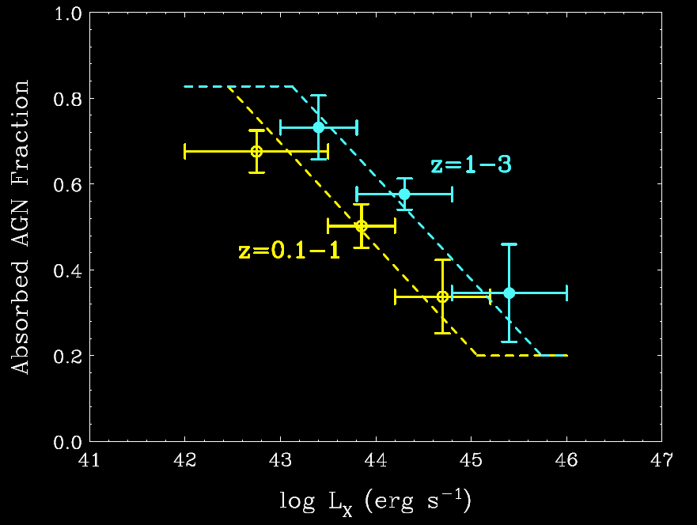
X-ray Absorption vs. Luminosity
Hasinger 2008
Ueda et al. 2013
Absorption is strongly dependent on luminosity!
Strong Unified AGN Model ruled out; likely evolutionary effect
Luminous QSOs can “clean out” their environment.

Slide 11
Dark Matter Host Halos of AGN

Slide 12
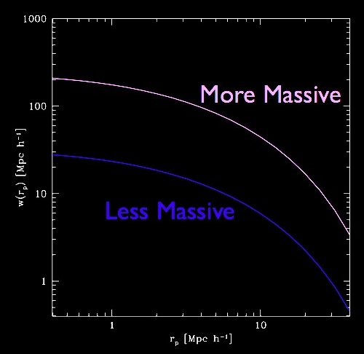
DM Halo Mass from correlation function
Bias of a source class ⬅➔ M_{Halo}

Slide 13
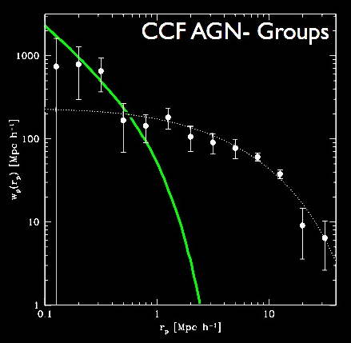
AGN Crosscorrelation Analysis
1-Halo Term
Non-linear scales:
<NAGN> vs Mh
Fraction of AGN in satellite or central galaxies
2-Halo Term
Linear scales:
AGN bias factor
Typical DM halo mass
Allevato et al., 2011

Slide 14
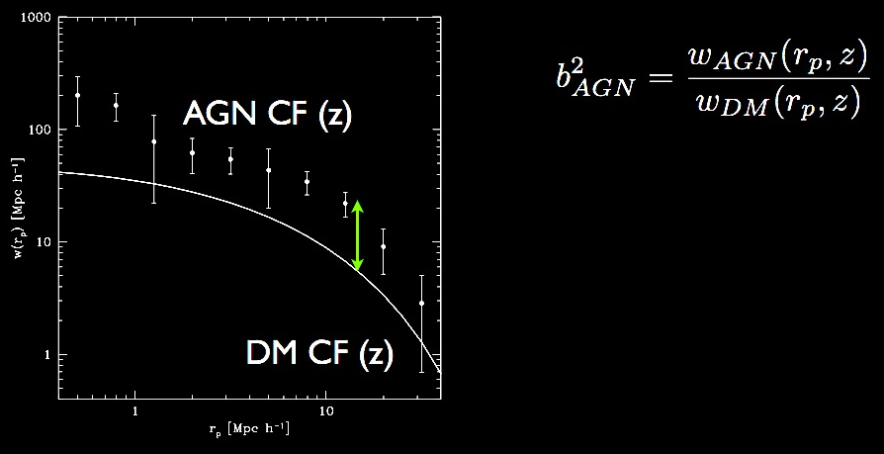
COSMOS AGN ACF
AGN bias is an indicator of the typical mass of the AGN hosting halos
2-Halo Term
Allevato et al., 2011

Slide 15
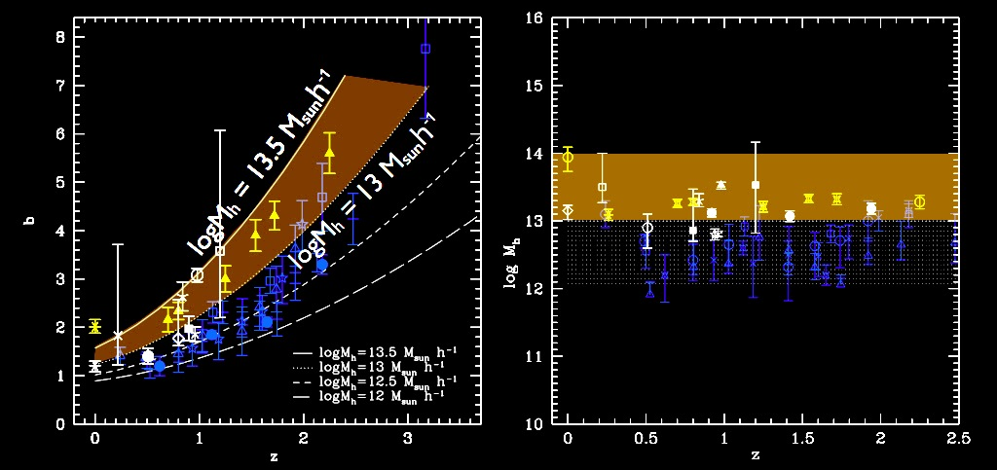
Moderate AGN versus QSOs
Moderate luminosity X-ray selected AGN (XMM-COSMOS)
•
•
Luminous, optically selected quasars (SDSS, 2dF)
Moderate luminosity AGN reside in more massive DM halos (10^{13.3} M) than luminous quasars (10^{12.5} M). No halo growth. Mass 10^{13.3} M selects out the group scale at z<2.2.
At z>2 strong growth of AGN host halos: mergers at QSO peak?
Allevato et al. 2013
Allevato et al. 2011; Cappelluti et al. 2012

Slide 16
Black Hole Masses and Eddington Ratios

Slide 17
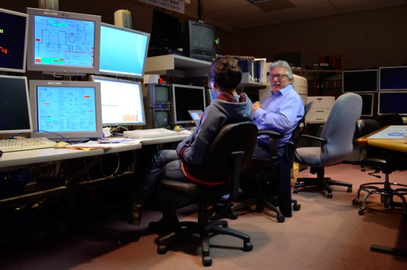
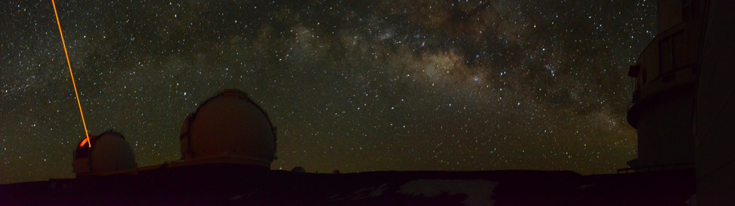
More clues:
Subaru FMOS spectroscopy
3/12-11/13
Hyewon Suh

Slide 18
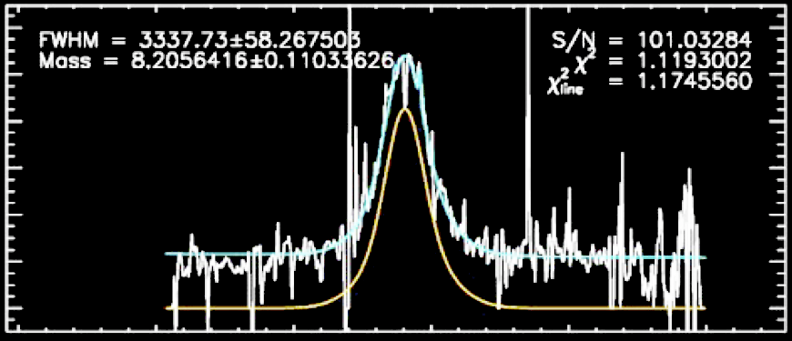
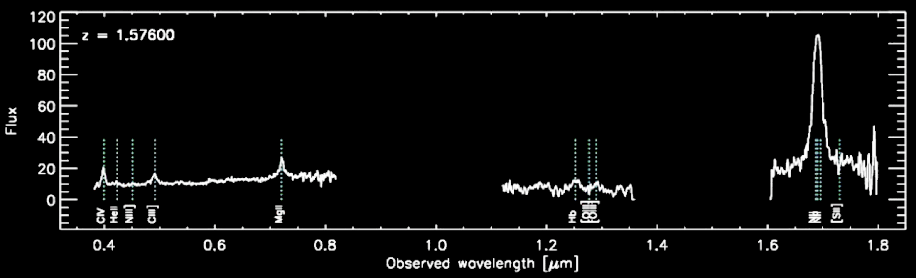
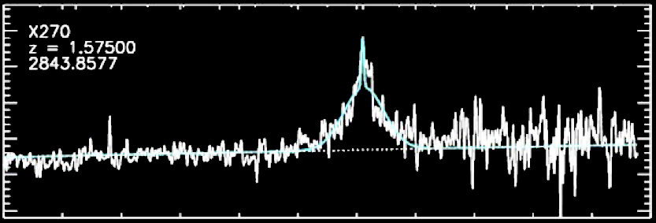
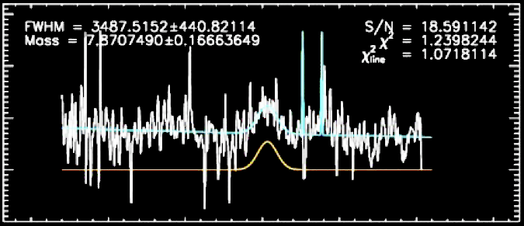
Quantitative Line Fits
Hα
To determine Black Hole masses from broad lines
Hα
Keck DEIMOS Subaru FMOS
MgII
Hβ
MgII
Hβ

Slide 19
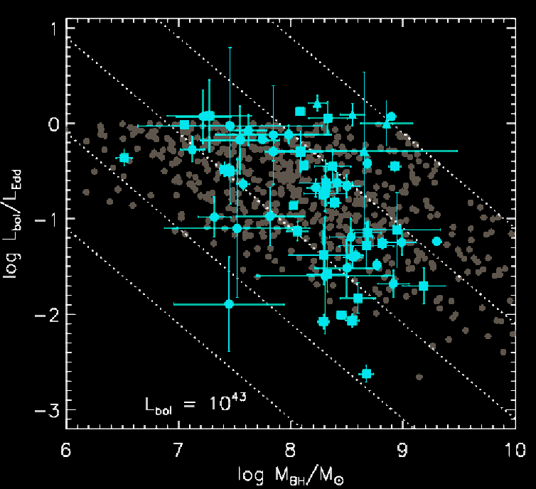
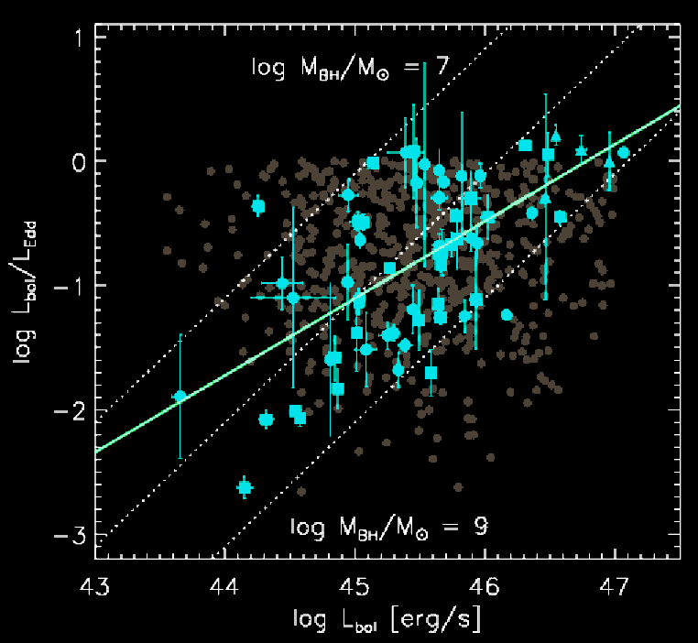
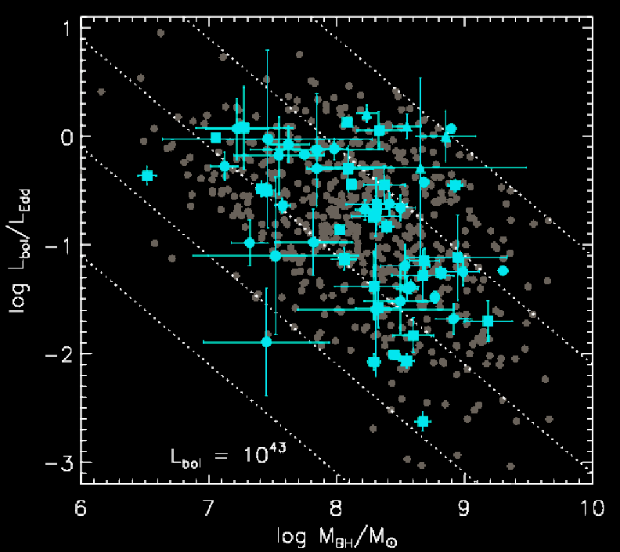
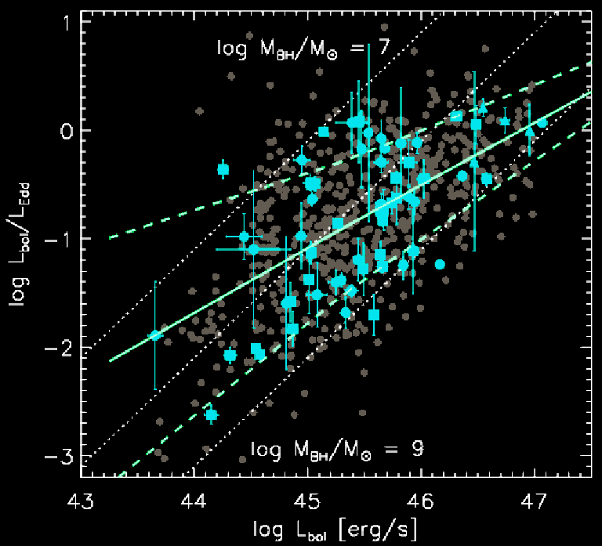
Eddington Ratio vs. Luminosity
Clear correlation of the Eddington ratio with luminosity and mass, i.e. lower-luminosity and higher-mass objects accrete at lower Eddington ratios, confirming AGN downsizing.
Hyewon Suh et al., PhD thesis

Slide 20
Putting it all together
Anti-hierarchical evolution (downsizing) corresponds to two different accretion modes:
a fast, likely merger-driven mode at higher z
  with high Eddington ratios
  onto lower-mass black holes
  in smaller, growing Dark Matter Halos
a slow, secular accretion mode at lower z
  with lower Eddington ratios
  onto higher-mass black holes
  in larger, group-size Dark Matter Halos

Slide 21
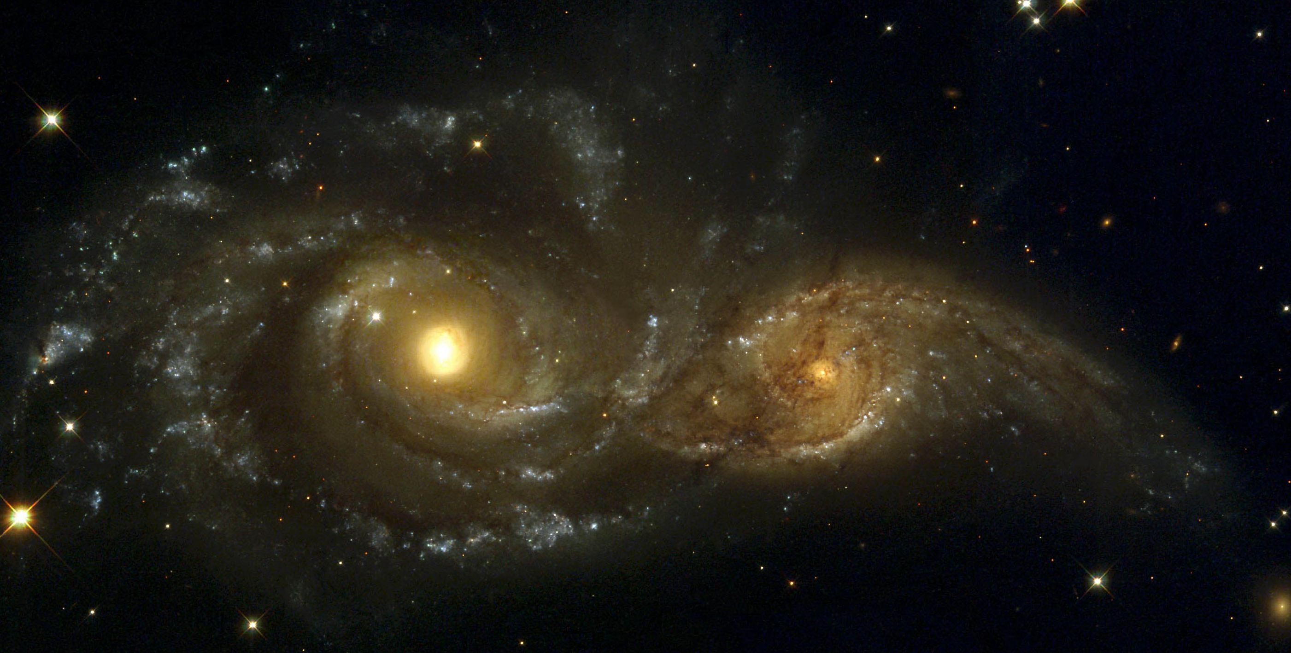
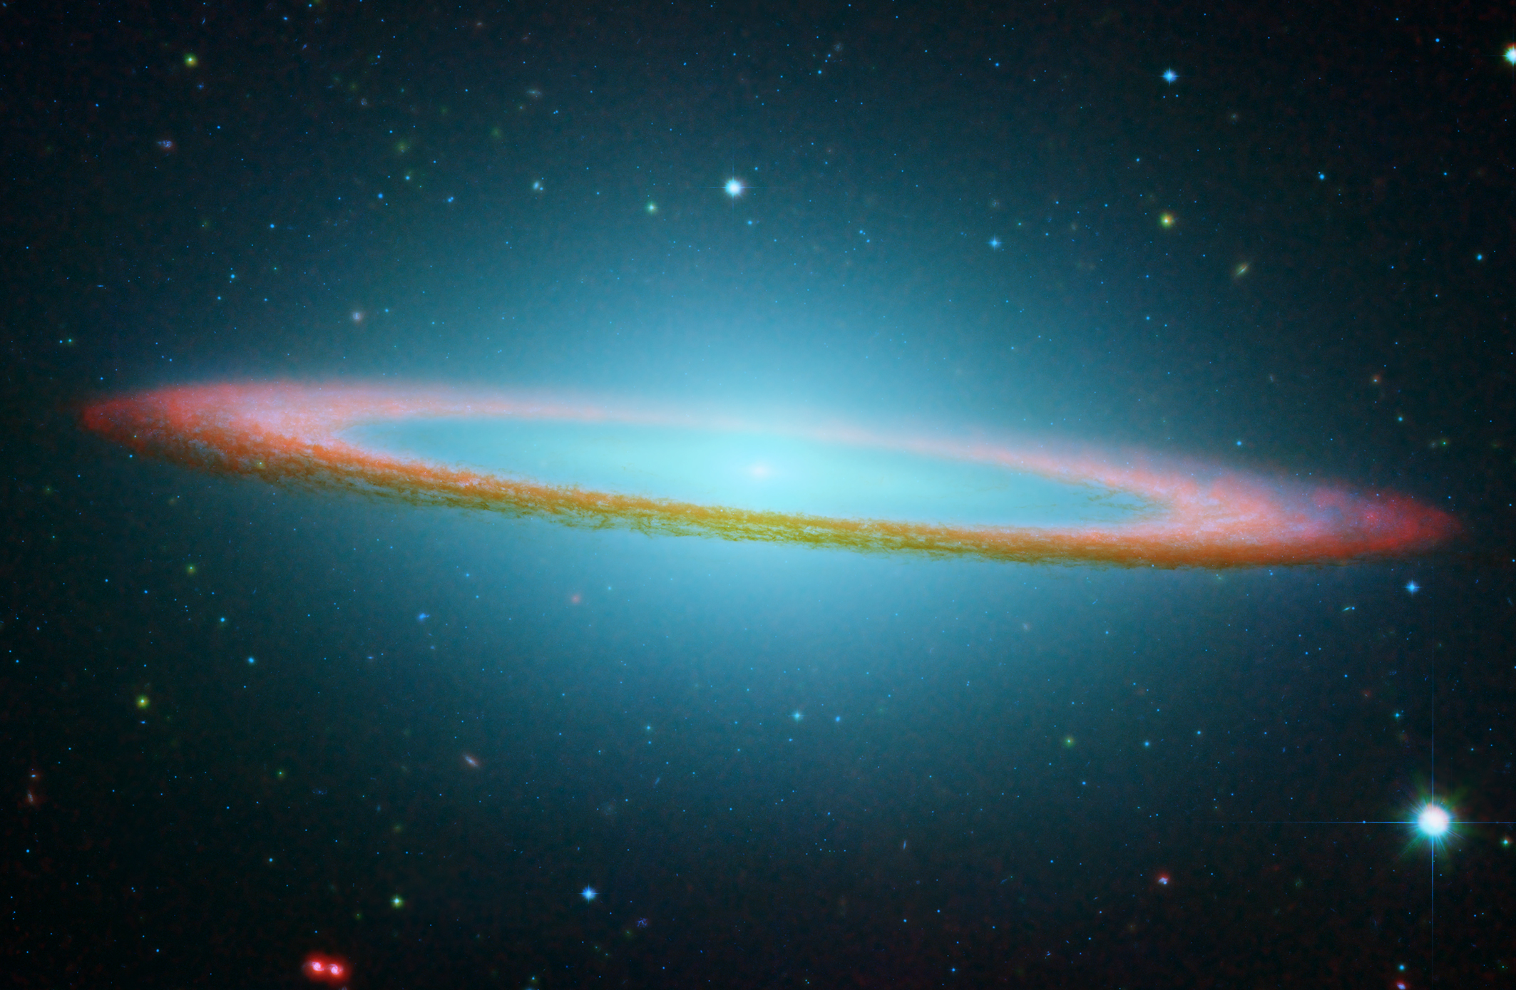
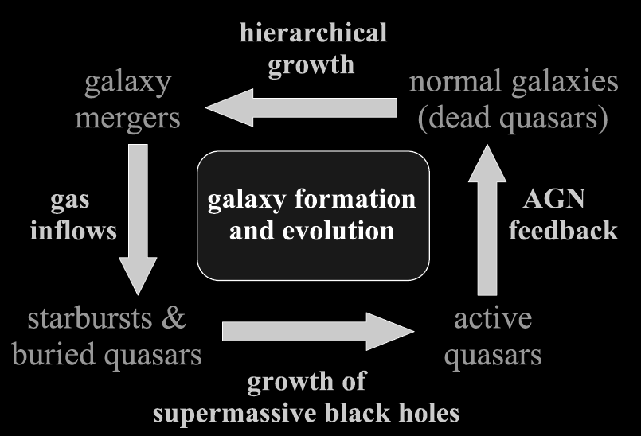
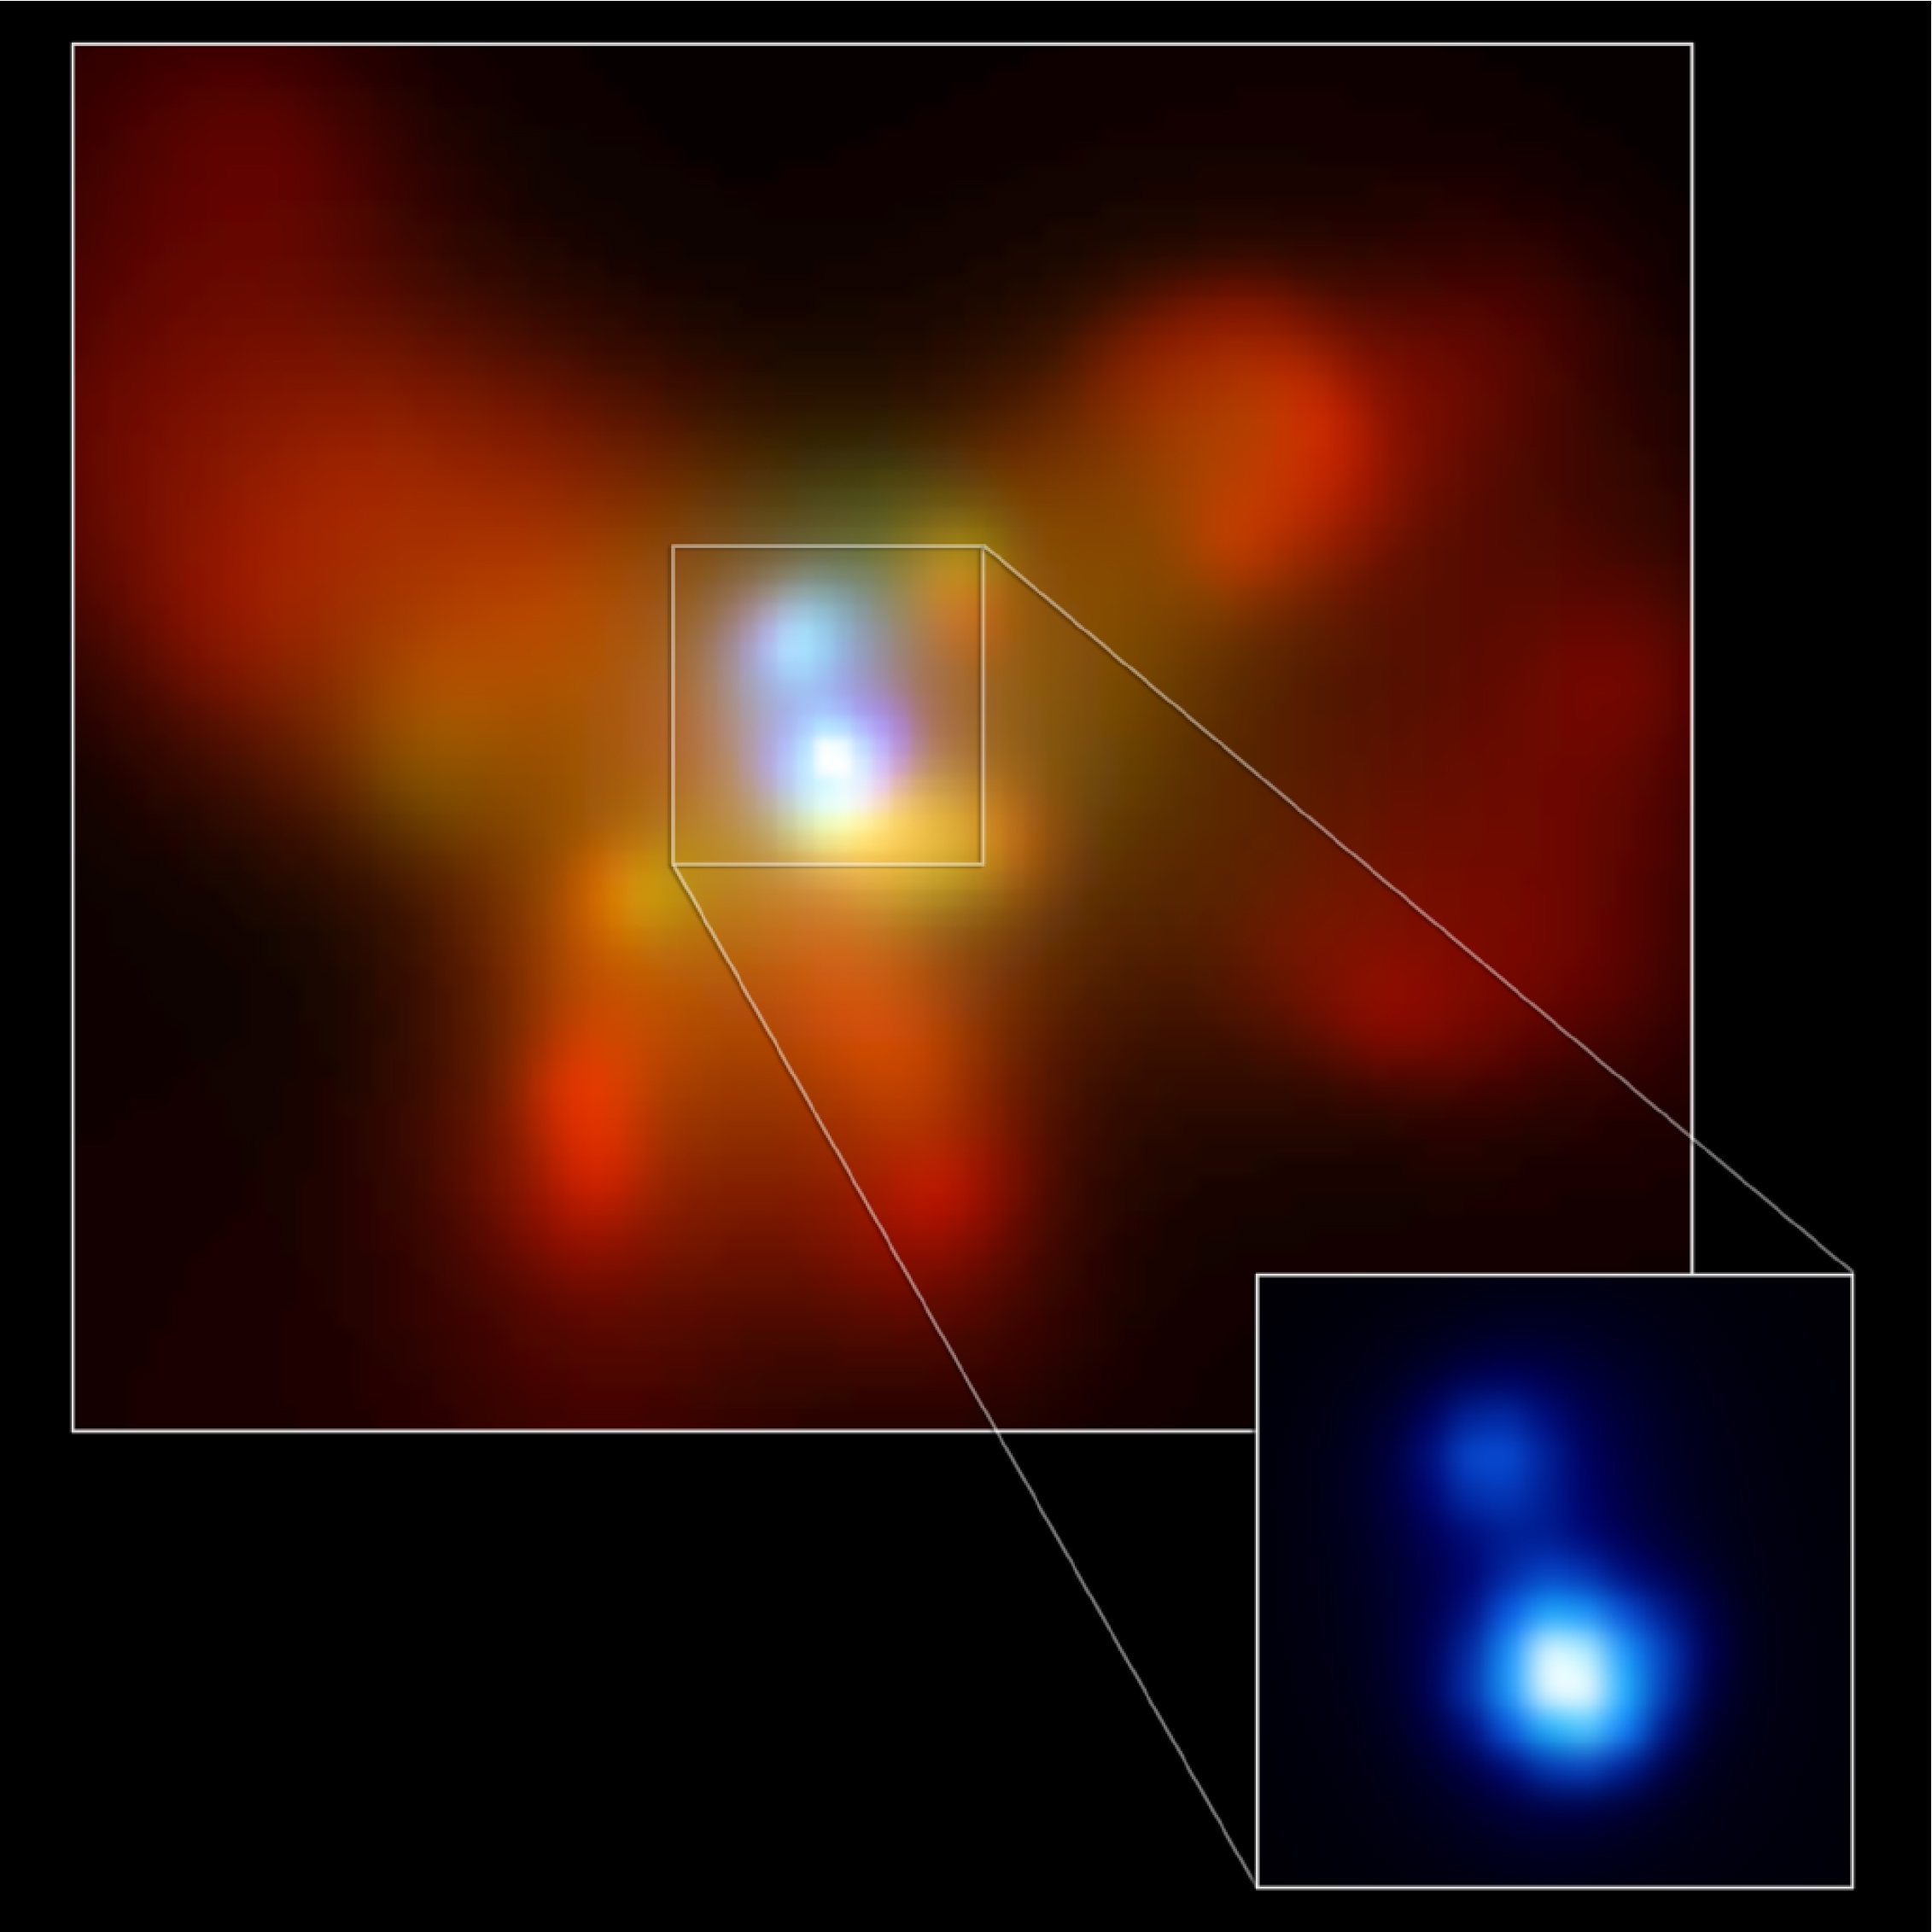
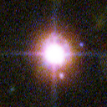
Merger & Accretion Evolution
SLOW/AGN: low L/L_{Edd}
FAST/QSO:
high L/L_{Edd}
Hopkins et al., 2005

Slide 22
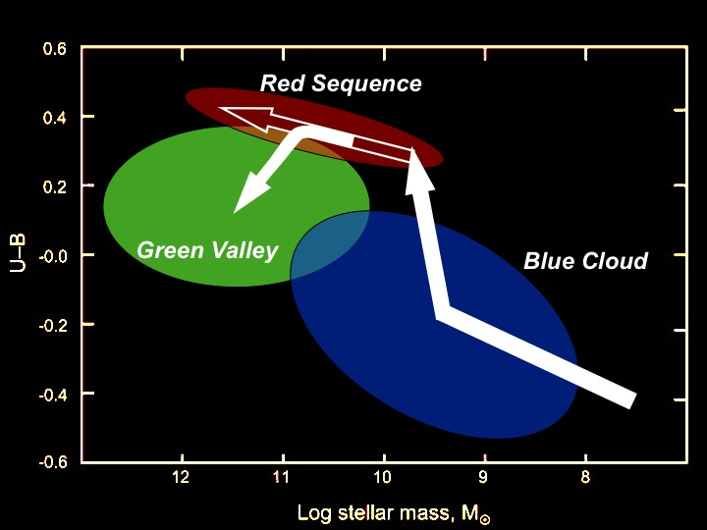
“Anti-hierarchical” Puzzle Resolved
AGN
QSO
QSO are triggered in mergers of relatively low-mass halos.
Moderate luminosity AGN occur in pre-fabricated higher mass black holes, which are re-juvenated by cold gas accretion & rebuilding disks.
Hasinger 2008

Slide 23
The Highest-redshift Frontier: Fingerprints of First Objects?

Slide 24
Resolving the 0.5-2 keV X-ray background
Chandra 4Ms Image
75-80% ROSAT sources
z~1-3
Hasinger, Schmidt et al. 1993 & 1998
Luo et al. 2010
Cowie et al. 2012
Cappelluti et al 2013
~90% Chandra/XMM sources
z~0.5-1.5
Few % Stacking Galaxies
z~3-5
1% Correlation with CIB
z~7-10?

Slide 25
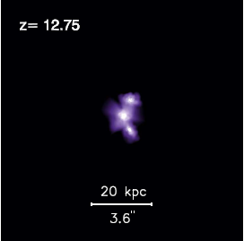
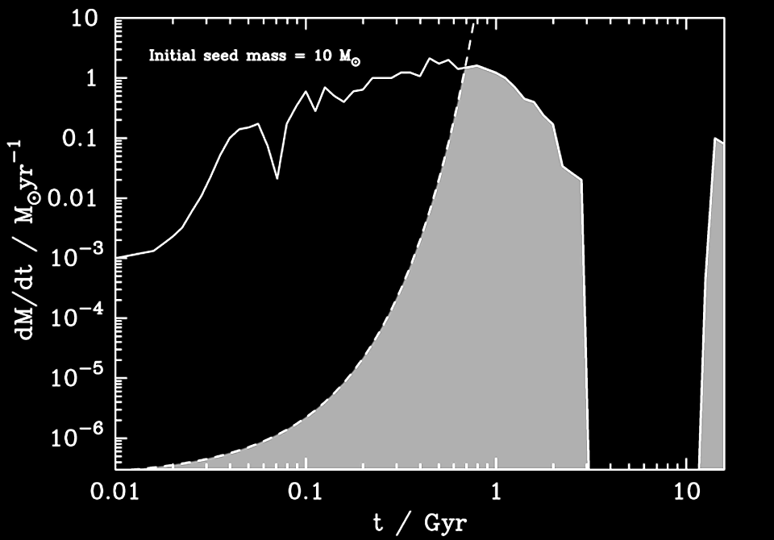
First proto-quasars
z=12.75
10⁹ M
_{known QSO}
z=7.1
20 kpc
Li, Hernquist, et al. 2007
z=9.17
Protogalaxy
10⁵ M
_{Seed BH}
z=6.54
Black Hole
z=15-20
100 M
_{Gamma Burst}
Archibald et al., 2001

Slide 26
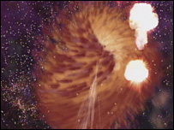
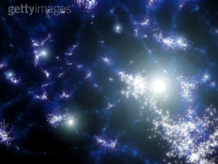
How do SMBH form?
Directly Collapsing BH (Quasistars)
MBH=10⁴-10⁵M☉
(Begelman+08)
Massive Progenitors
We need to explain how to make
a 10⁹ M☉ SMBH @z~7
POP-III, Metal free
massive stars
(HMXB?)
MBH=10²-10³M☉
(Abel+03)
These sources should leave their signature in the anisotropies of Cosmic backgrounds
(Kashlinsky+05,07,12)

Slide 27
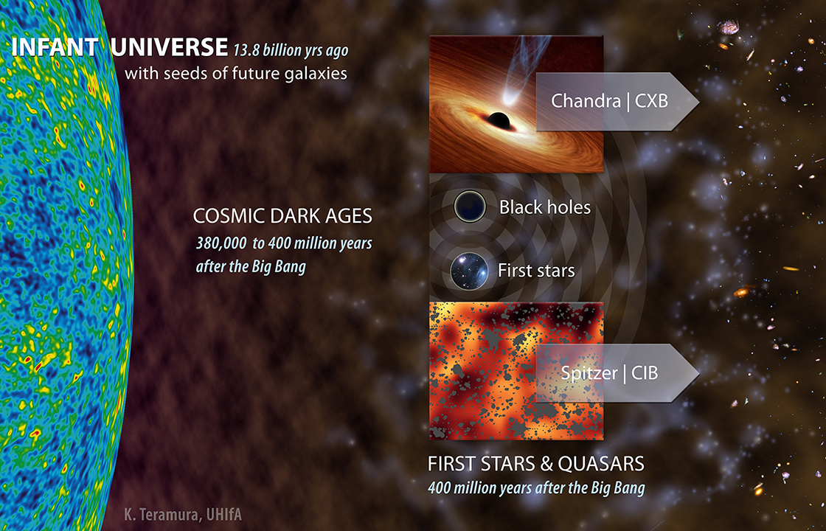
Hints from unresolved backgrounds
NASA Press Release June 5th, 2013

Slide 28
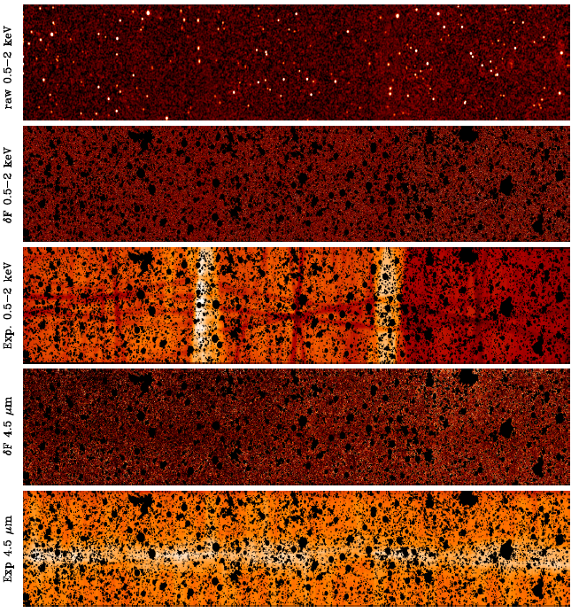
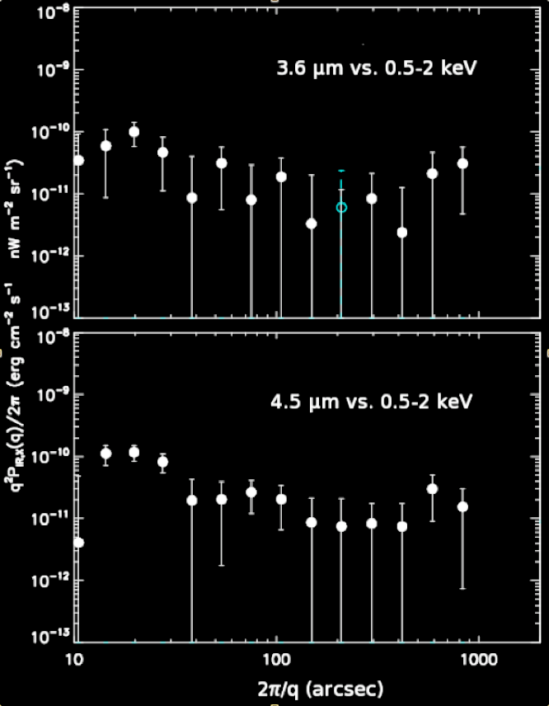
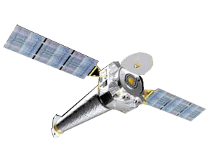
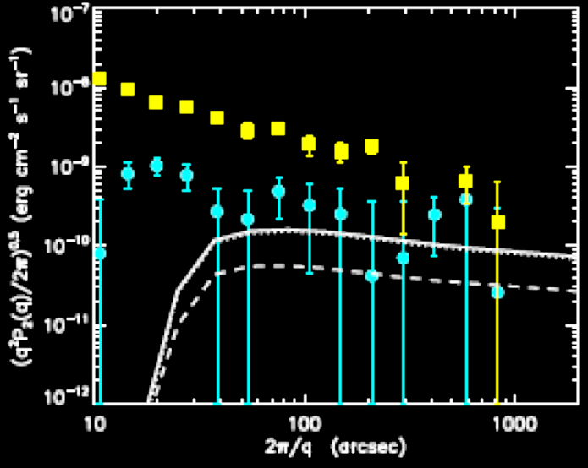
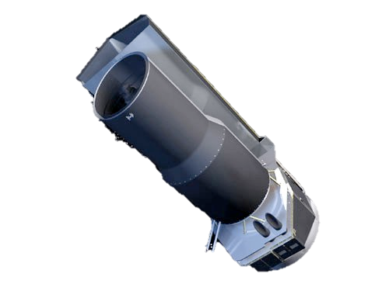
Fingerprint of the first Black Holes?
CIB x CXB Cross-Power
Chandra 0.5-2 keV
Raw Image
Chandra 0.5-2 keV
Background Image
Exposure
CIB
Spitzer 4.5 μ
Background image
CXB
Exposure
Cappelluti et al. 2013

Slide 29
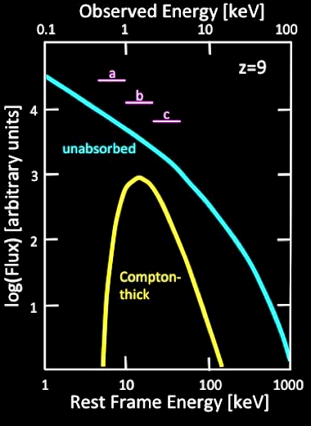

CXB: Expected Angular and Energy Distribution
μQSO
(HMXB)
miniQSO
(Quasistars)
Characteristic peak at the horizon scale at matter-radiation equality

Slide 30
The new Frontier of the X-ray Background is at z~7-10 !
Analysis of Spitzer/Chandra data in the COSMOS field
Try to bring XMM-Newton into the picture
New wide/deep Spitzer & Chandra/XMM fields
eROSITA !
Euclid: part of the LIBRAE consortium
JWST
…
Ultimately we need a new X-ray observatory, which can resolve the first black hole population

Slide 31
Summary / Conclusions
90% of the X-ray Background is resolved into BHs
X-ray background spectrum due to absorption, which is strongly luminosity-dependent
AGN across all wave-bands follow an “anti-hierarchical” downsizing evolution
DM Host Halo and BH masses (as well as host galaxy morphologies not discussed here) show that this is due to different accretion modes, mergers at high z and secular accretion at low z
Fingerprints of the first black hole population at z~7-10 found?

Slide 32

Mahalo

